Slide 1
Revised Estimate for Bent Crystal Installed at RR62
D. Still
Jan 3, 2012

Slide 2
Plan from Dec 16, 2011 Meeting
Short term plan: For the short term there is an opportunity to use the Recycler for beam studies up to ~ Feb. However, work to prepare and install a gonoimeter in the RR62 SS and conduct studies is going to be difficult but all decided this should be the first direction. In order to have any chance the following will have to be done ASAP. The plan will be to install only the vertical goniometer and use whatever else the RR currently has. 1) Tues Dec 20 go into RR and look, measure, take pictures & access cables & instrumentation for installing the goniometer only. 2) Cons will need to provide lattice and beam parameters to Nikolai for Sasha and the 2 Yuri's. 3) Dean will need to ask Rob Rielly about build stand to house the vertical goniometer. 4) Dean will need to provide layout of experiment at RR62 SS. 5) Vladimir will need to impression on division plans which my impact ANU schedule. 6) Possibility move vertical collimator and install vacuum isolation valves. Long term plan: For the long term there should be more details presentation of plans and simulation. The idea is to create a location that is easily accessible to for these studies. 1) Maybe moving experiment from RR62 to RR52 to use for extraction might be beneficial. 2) Define the components that would allow for horizontal use of extraction. 3) will need specific prepared crystals and possible other hardware.

Slide 3
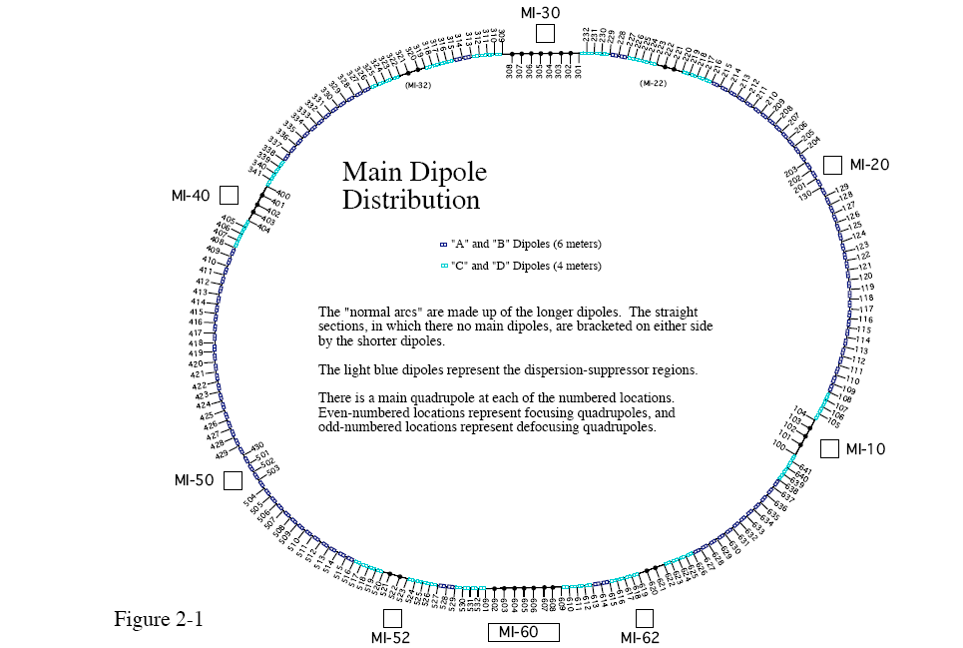
Possible location RR62 SS

Slide 4
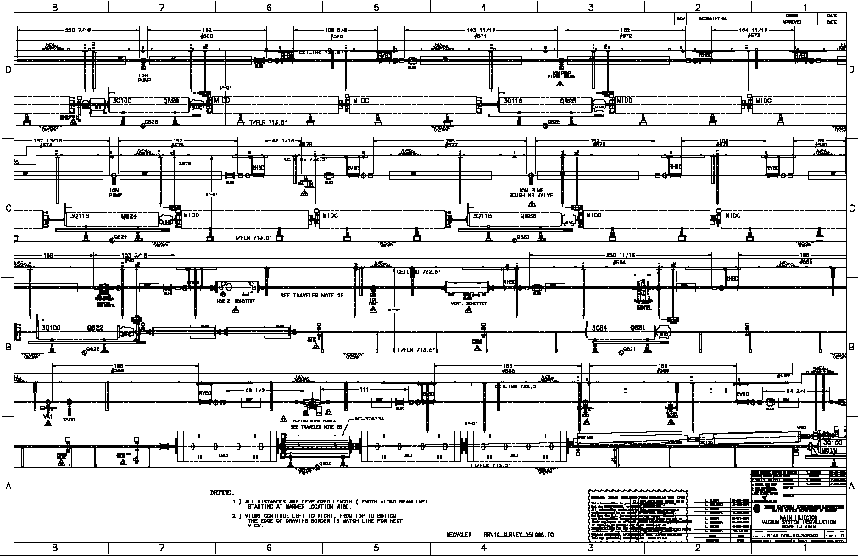
RR62 Straight Section – Possible installation
Vertical Collimator
Hor collimator
Quadrapole??
Proton beam
Install vertical goniometer
Here

Slide 5
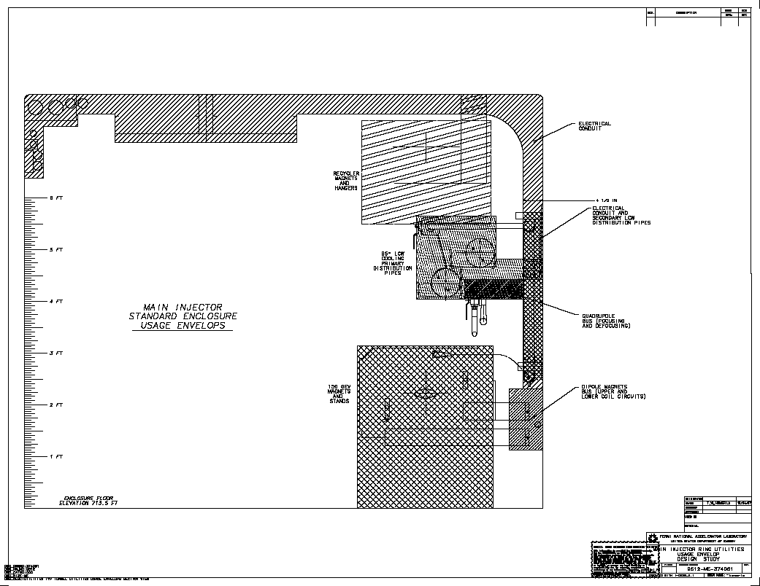
There is 2’ from
Beam center to ceiling
10”
2.7’
Get the vertical
Goniometer in there
8 ft off the floor – upside
down

Slide 6
Draft of RR62 Installation

Slide 7
RR62 Rough Layout
Goniometer to collimator ~ 10.7m NOT 15.2m
Goniometer has to be flipped from tevatron orientation
VR direction is down.
There is a quadruple between Goniometer & collimator
VR angle @ 8.9Gev ~ 64urad(1/sqt(8.9/980)) = 671urad
Displacement @ collimator ~ 7.2mm
Collimator is 2 vertical sides like lhc

Slide 8
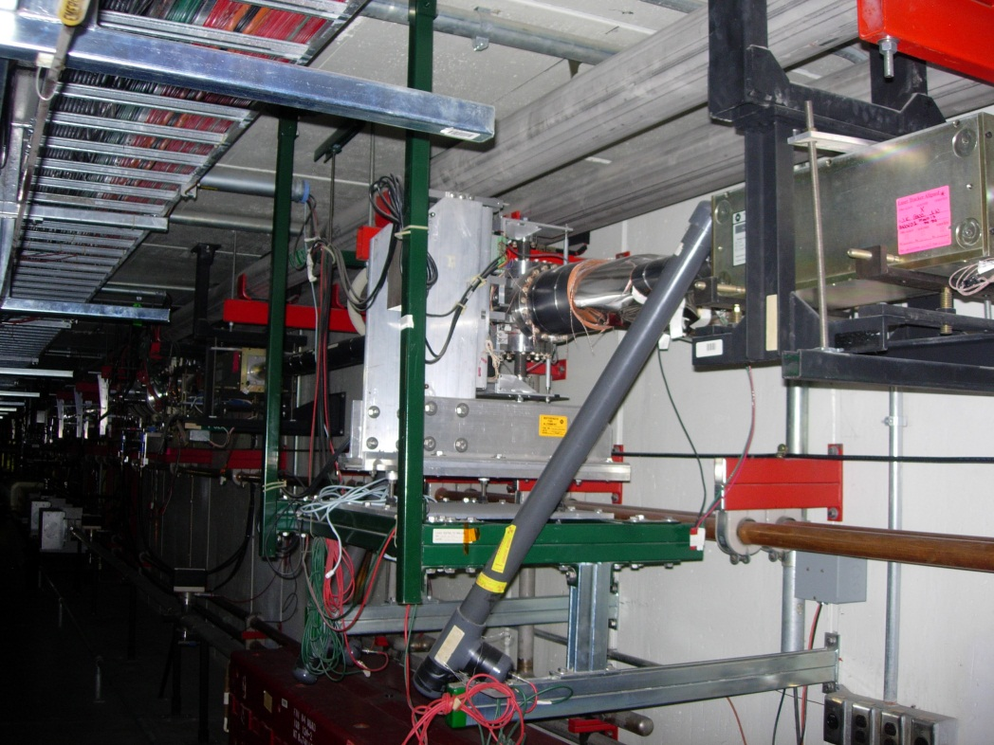
RR62
Beam
RR62 vertical Collimator and
Upstream quad.
RR62 proposed Crystal location.

Slide 9
RR52
RR52 proposed Crystal location.

Slide 10
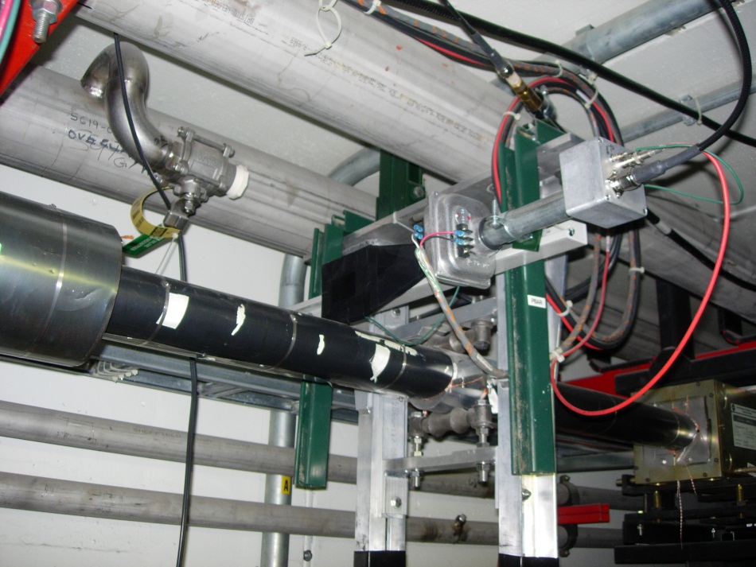
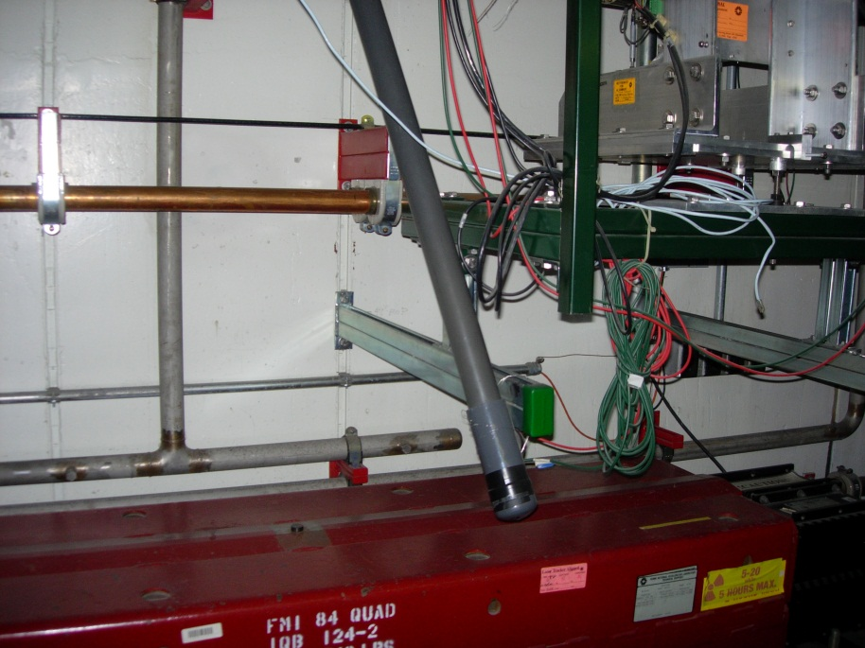
Possible Instrumentation(RR62)

Slide 11
Schedule as of 1/3/2012
Topic | Rough date | time
Remove T980 hardware | Jan 2
Prep T980 hardware to RR install | Feb - Oct
Build Stands and support | March - Oct
Simulations and Beam Plan | Feb - May
Install tunnel components: 1 goniometer,pixel?,septum?,counters, Cables?? $$ | March - Oct
Install upstairs hardware: Motion controls, BLM hardware, | Feb - Oct
build 2 new crystals deliver install | Feb – June June- Aug Aug – Oct
LOI and Collaboration | Jan - March

