Slide 1
MCenter Tuning Study June 20 ,2021 NOvA/AD MCenter Beam Meeting
Buse Naz Temizel
Illinois Institute of Technology
September 8 , 2021

Slide 2
Settings
Op = Operational Tune
Op Pol = Operational Polarity New tune (CJJ)
Halfway = (Op + Op Pol)/2

Slide 3
Settings

Slide 4
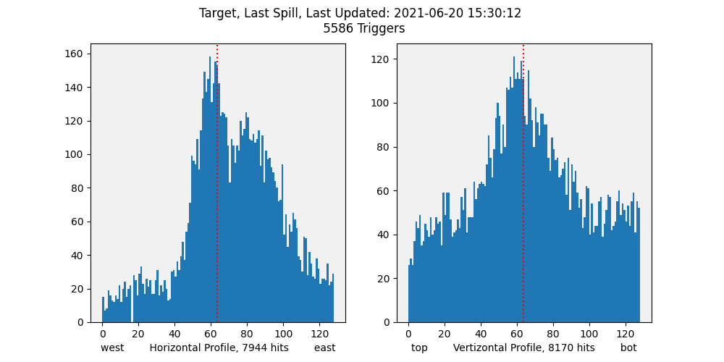
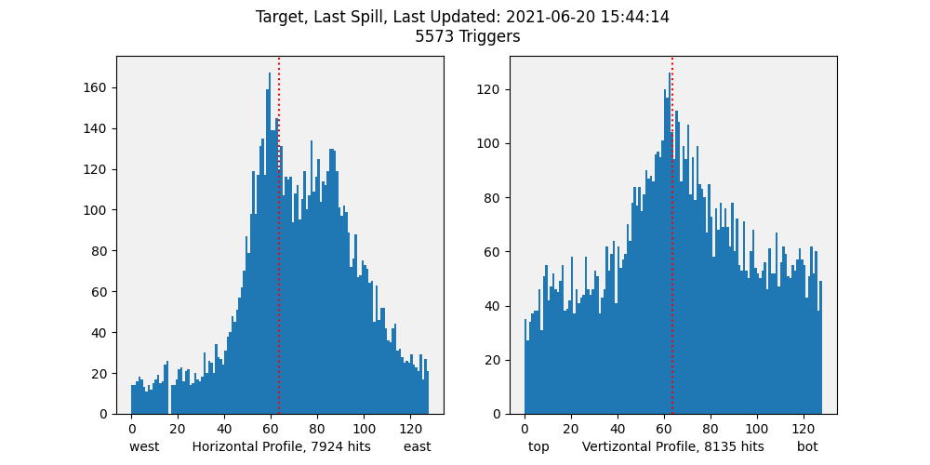
Fig 2. Spill 9030
START
All profiles in this presentation are at the NOvA target
This talk includes some part of the data
Before trying different settings we got a few spills
Fig 1. Spill 9016
MC6Q1I | 19.38 | Operational
MC6Q2I | - 649.5
MC6Q3I | 37.23
MC6Q4I | - 49.93 | Operational
MC6Q5I | 577.2
MC6Q6I | - 30.19
MC6CV | 10.2

Slide 5
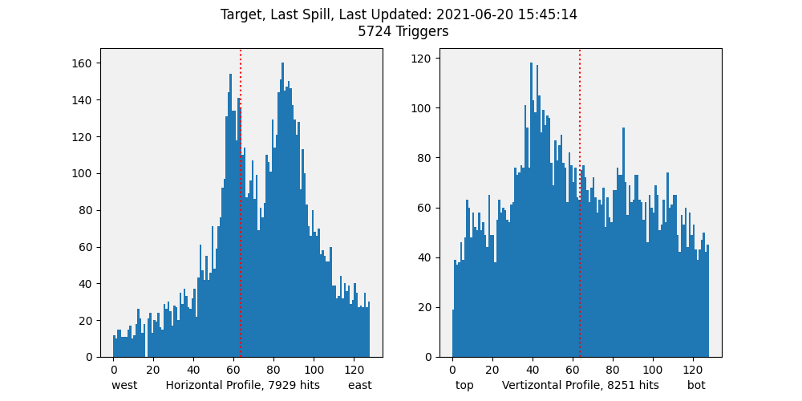
MC6Q1I | 19.38 | Operational
MC6Q2I | -649.5
MC6Q3I | 37.23
MC6Q4I | -70.5 | Operational Operational Polarity
MC6Q5I | 730.7
MC6Q6I | -42.7
MC6CV | 10.2
1
DS quad settings changed from Operational Tune to Operational polarity Tune
More pronounced double peak in horizontal
Vertical peak shifted to the left (up)
20 mm above the center
Fig 3 Spill 9030
Fig 4 Spill 9031

Slide 6
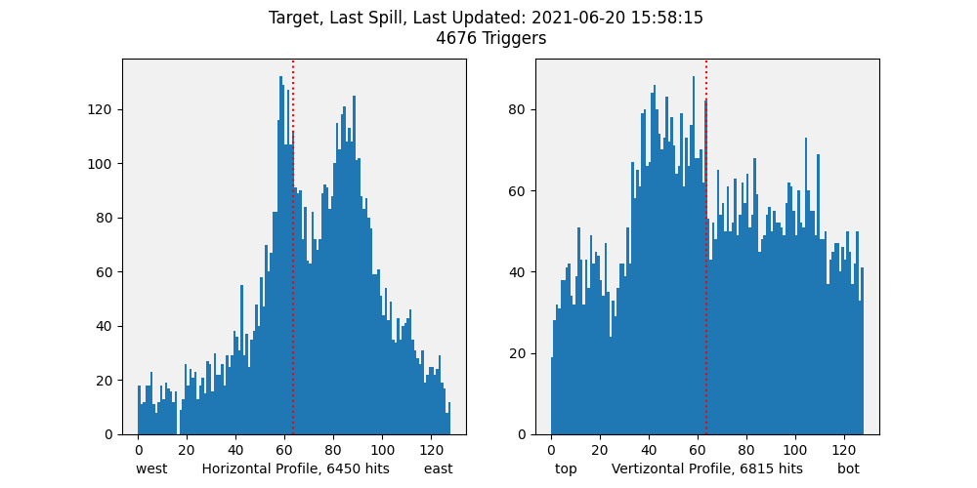
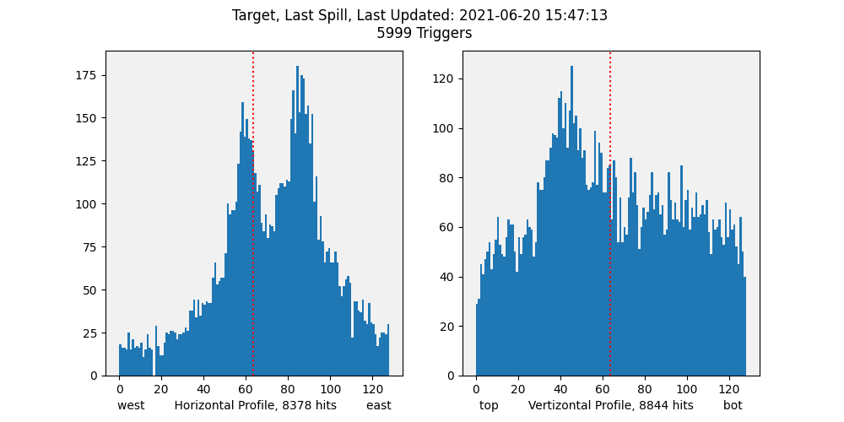
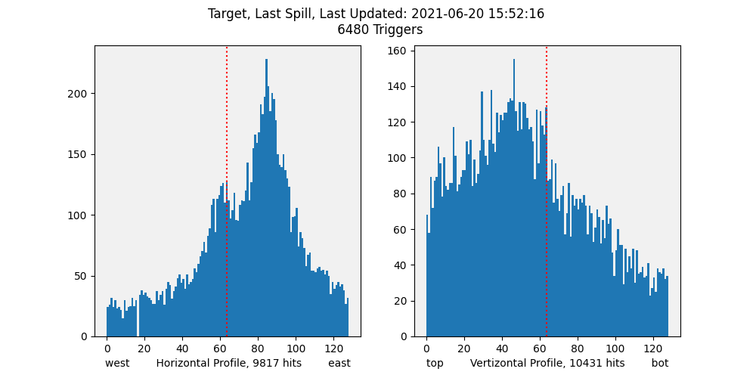
Collimator Scan
Fig 5. Spill 9044
MC6CV | Spill
6.0 | 9044
10.2 | 9032
20.2 | 9038
Fig 6. Spill 9032
Fig 7. Spill 9038

Slide 7
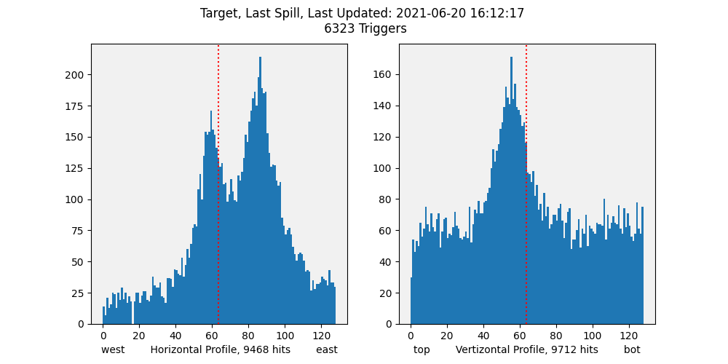
2
MC6Q1I | 19.38 | Operational
MC6Q2I | -649.5
MC6Q3I | 37.23
MC6Q4I | -60.2 | Operational Halfway Polarity
MC6Q5I | 654
MC6Q6I | -36.5
MC6CV | 20.3
DS Quads changed from Op Pol to Halfway
Vertical peak shifted to the right (down) with a better shape
8mm above the center
For Spill 9057 and 9058
MC6V1 is 10
MC6V2 is 54.95
Fig 8. Spill 9057
Fig 9. Spill 9058
Notes:
MC6V2 is 54.95 and MC6CV is 20.3 for Spill 9057 and 9058

Slide 8
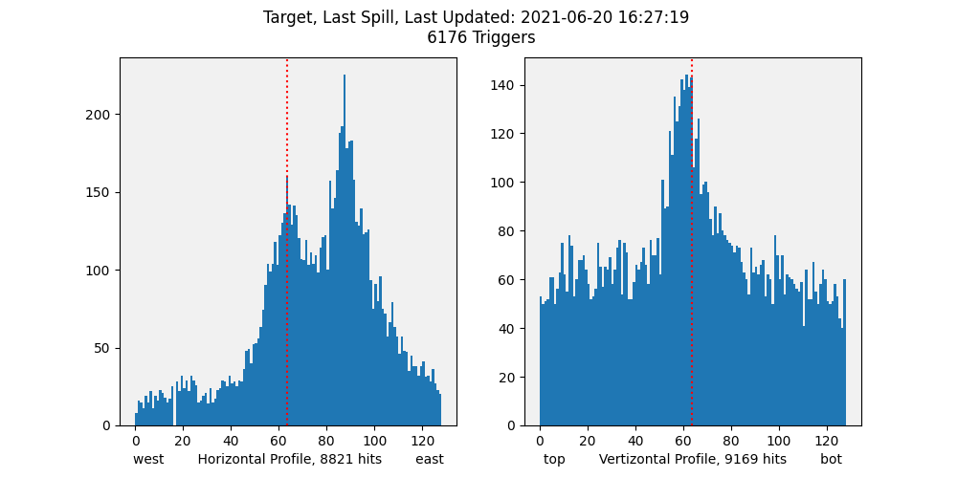
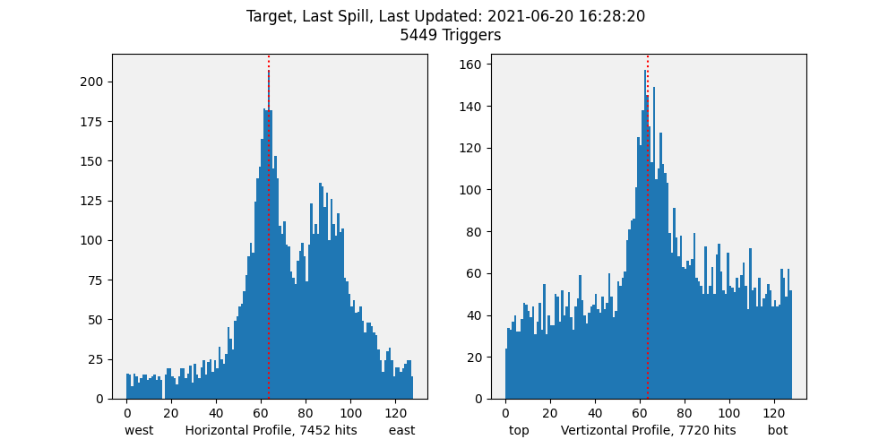
Collimator Scan
When we closed the collimator, the background fuzz went down
Fig 10. Spill 9072
MC6CV | Spill
20.3 | 9072
10.5 | 9074
Fig 11. Spill 9074

Slide 9
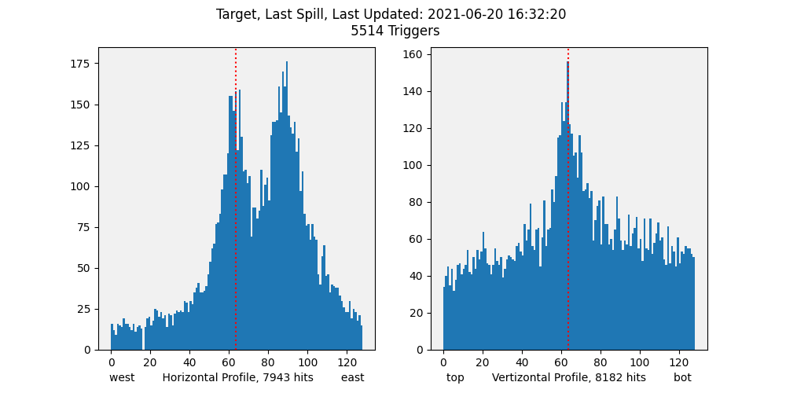
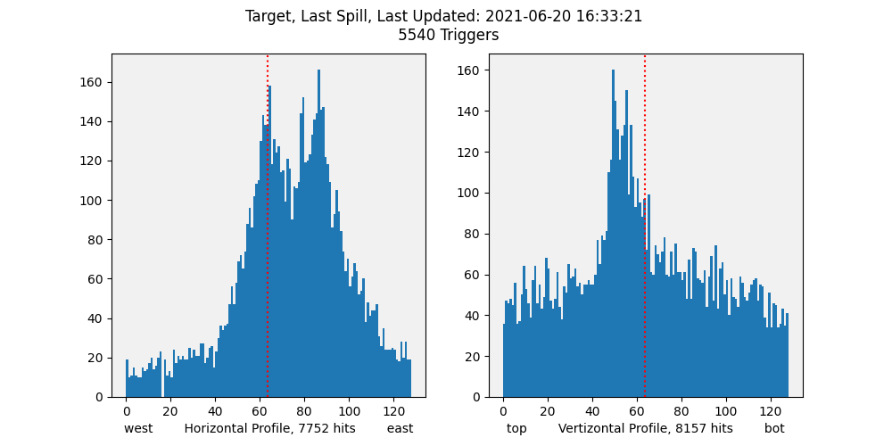
3
MC6Q1I | 31.9 | Operational Halfway
MC6Q2I | -721.4
MC6Q3I | 56.8
MC6Q4I | -60.2 | Halfway
MC6Q5I | 654
MC6Q6I | -36.5
MC6CV | 10.5
US quad settings changed from operational to halfway
Vert peak shifted to the left (up)
16 mm above the center
For Spill 9078 and 9079
MC6V1 is 10
MC6V2 is 15
Fig 12. Spill 9078
Fig 13. Spill 9079

Slide 10
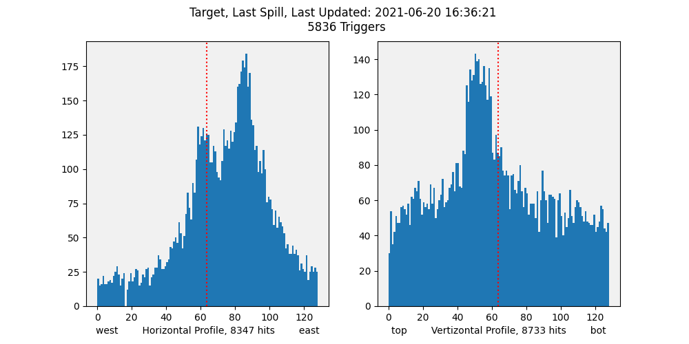
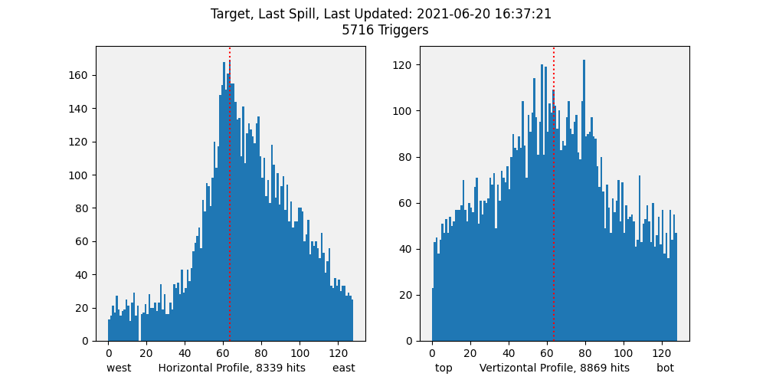
4
MC6Q1I | 31.9 | Halfway
MC6Q2I | -721.4
MC6Q3I | 56.8
MC6Q4I | - 49.93 | Halfway Operational
MC6Q5I | 577.2
MC6Q6I | - 30.19
MC6CV | 19.9
DS quad settings changed from halfway to Operational tune
No double peak in horizontal
Vertical peak shifted to the right (down)
Centered
Wider peak
For Spill 9082 and 9083
MC6V1 is 10
MC6V2 is 15
Fig 14. Spill 9082
Fig 15. Spill 9083

Slide 11
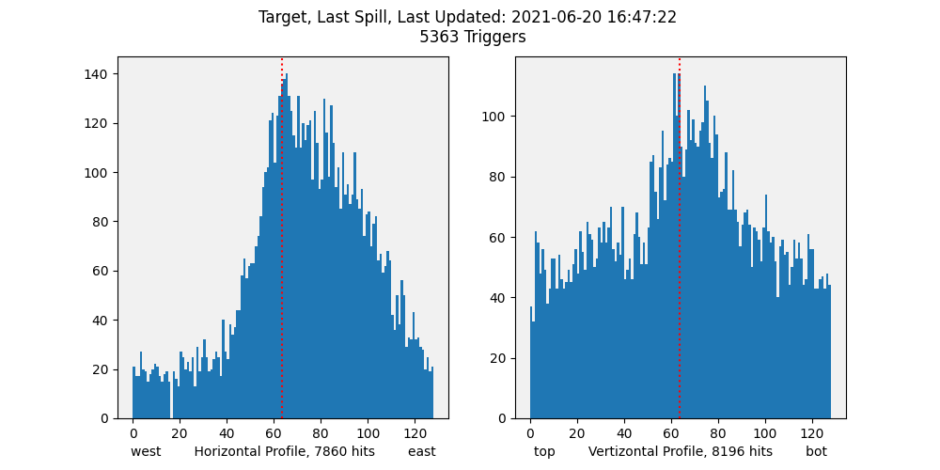
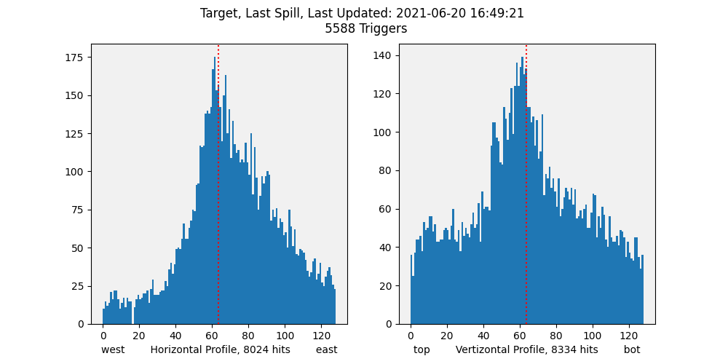
5
MC6Q1I | 44.47 | Halfway Operational Polarity
MC6Q2I | -793.3
MC6Q3I | 76.4
MC6Q4I | - 49.93 | Operational
MC6Q5I | 577.2
MC6Q6I | - 30.19
MC6CV | 10.1
US quad settings changed from Halfway to Operational Polarity
Better peak in horizontal
Vertical peak shifted to the left (up)
6mm above the center
For Spill 9093 and 9094
MC6V1 is 10
MC6V2 is 15
Fig 16. Spill 9093
Fig 17. Spill 9094

Slide 12
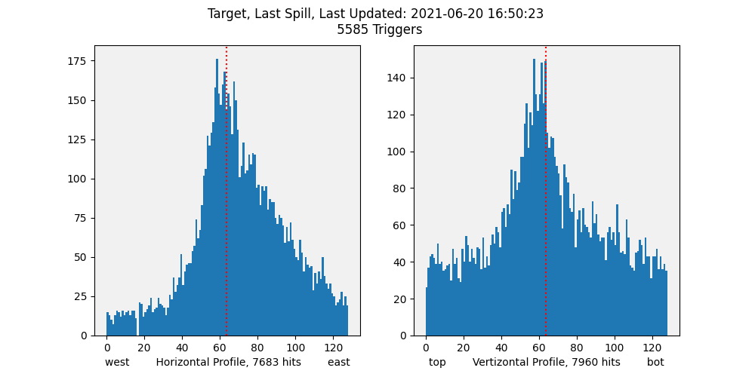
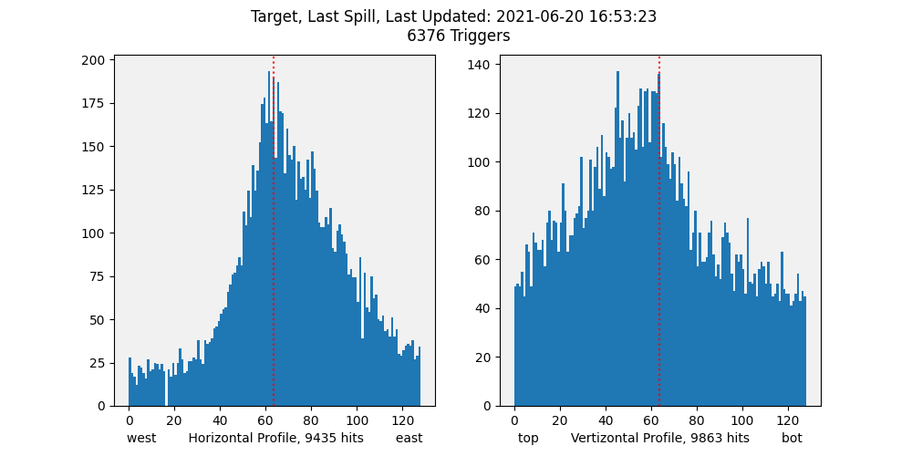
Collimator Scan
Fig 18. Spill 9096
MC6CV | Spill
10.1 | 9096
20.0 | 9099
Fig 19. Spill 9099

Slide 13
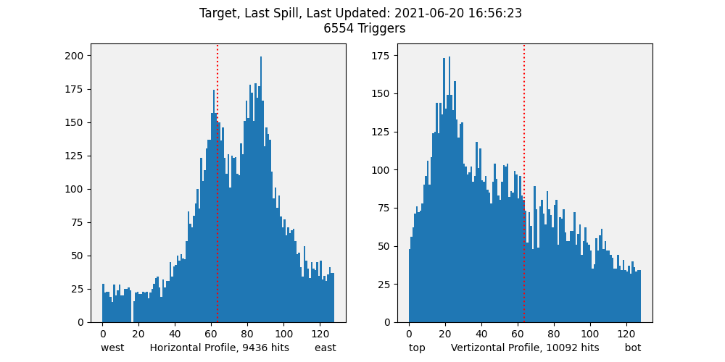
6
MC6Q1I | 44.47 | Operational Polarity
MC6Q2I | -793.3
MC6Q3I | 76.4
MC6Q4I | -70.5 | Operational Operational Polarity
MC6Q5I | 730.7
MC6Q6I | -42.7
MC6CV | 20.0
DS quads changed from Operational tune to Operational Polarity tune
Double peak came back in horizontal
Vertical peak shifted to the left (up)
46 mm above the center
For Spill 9100 and 9102
MC6V1 is 10
MC6V2 is 15
Fig 20. Spill 9100
Fig 21. Spill 9102

Slide 14
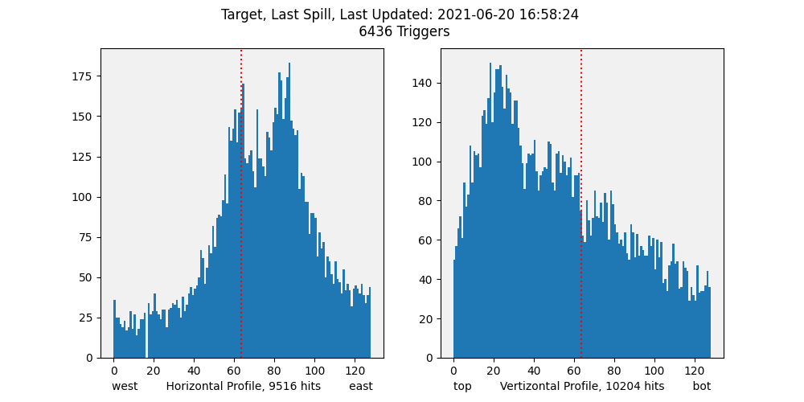
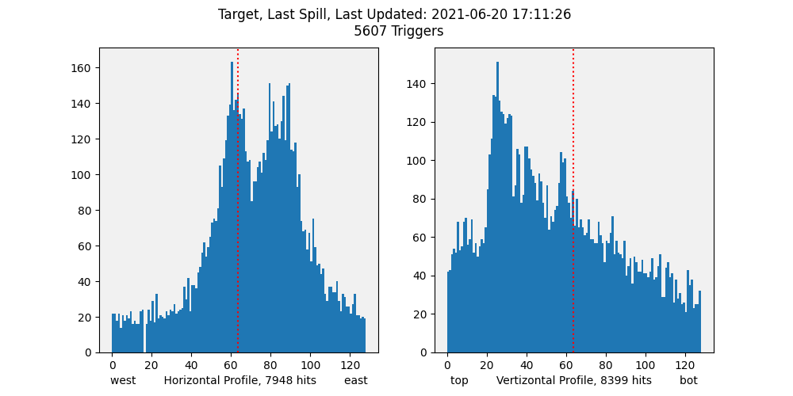
Collimator Scan
MC6CV | Spill
20.0 | 9104
10.2 | 9117
Fig 22. Spill 9104
Fig 23. Spill 9117

Slide 15
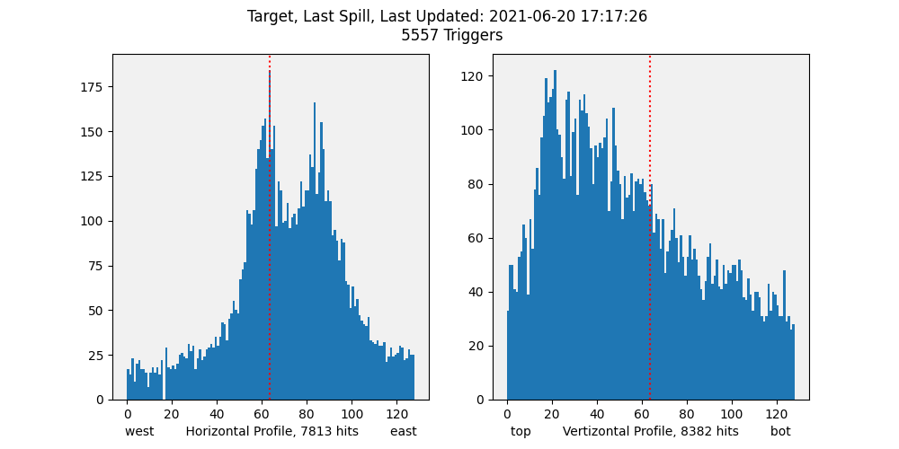
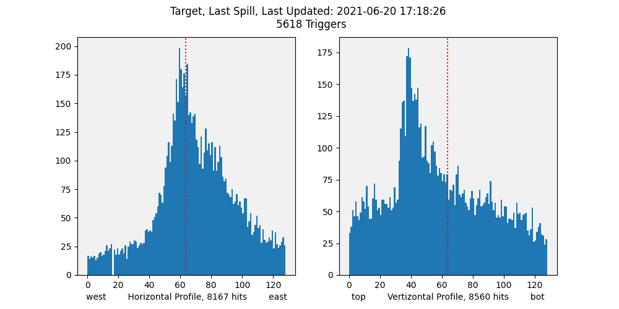
7 Half Magic
MC6Q1I | 44.47 | Operational Polarity
MC6Q2I | -793.3
MC6Q3I | 76.4
MC6Q4I | -60.2 | Operational Halfway Polarity
MC6Q5I | 654
MC6Q6I | -36.5
MC6CV | 10.2
DS quad settings changed from Operational Polarity to Halfway
Double peak disappeared
Better profiles in both horizontal and vertical
Vertical peak shifted to the right
22 mm above the center
For Spill 9123 and 9124
MC6V1 is 10
MC6V2 is 15
Fig 24. Spill 9123
Fig 25. Spill 9124

Slide 16
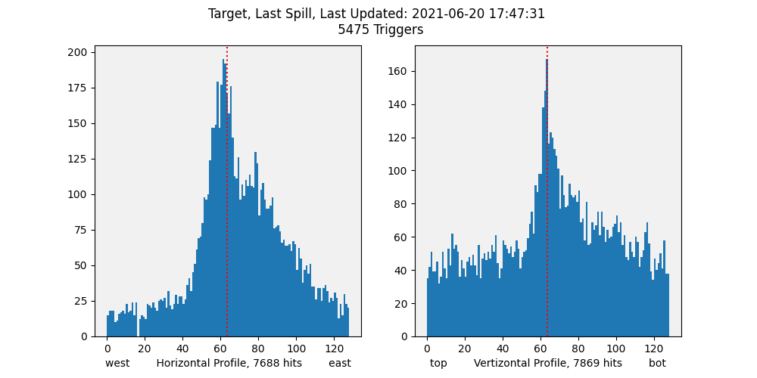
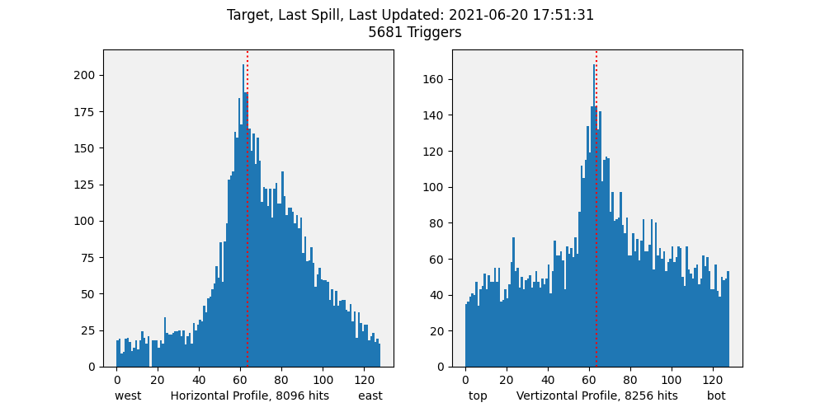
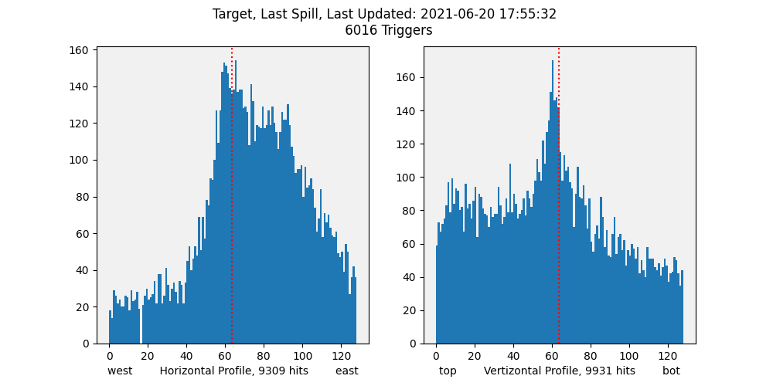
Collimator Scan
Fig 26. Spill 9153
Fig 27. Spill 9157
MC6CV | Spill
10.3 | 9153
14.2 | 9157
20.0 | 9161
Fig 28. Spill 9161
Notes:
10 to 14 not much change from 14 to 20 vertical changes to the left(above) the center

Slide 17
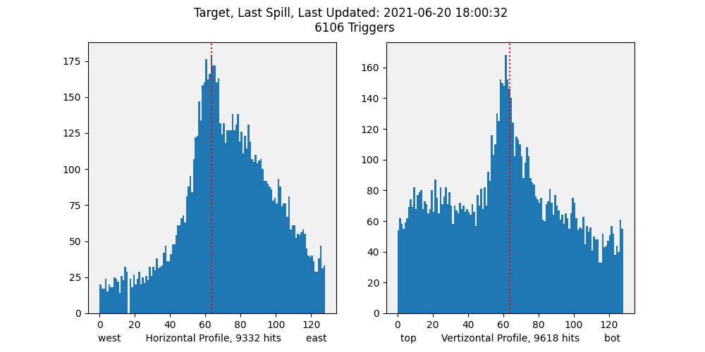
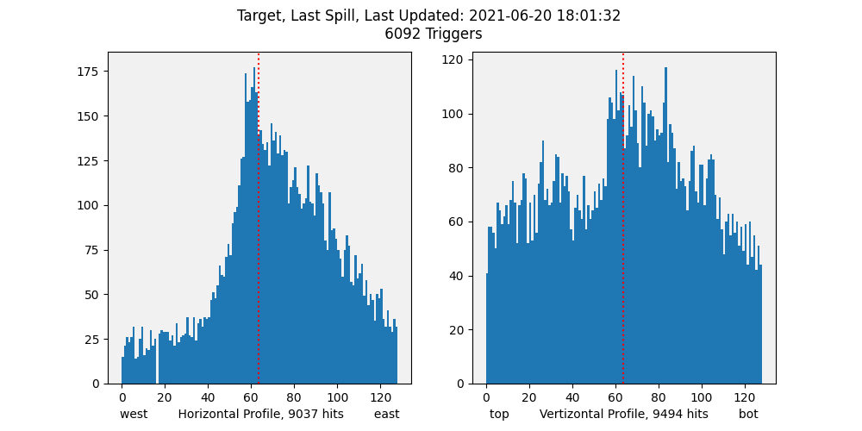
8
MC6Q1I | 44.47 | Operational Polarity
MC6Q2I | -793.3
MC6Q3I | 76.4
MC6Q4I | -55.1 | Halfway 1/4
MC6Q5I | 615.6
MC6Q6I | -33.3
MC6CV | 20.1
Ds quad settings changed from halfway to ¼
No change in horizontal
Background went up in vertical profile
For Spill 9166 and 9167
MC6V1 is 80
MC6V2 is 80
Fig 29. Spill 9166
Fig 30. Spill 9167

Slide 18
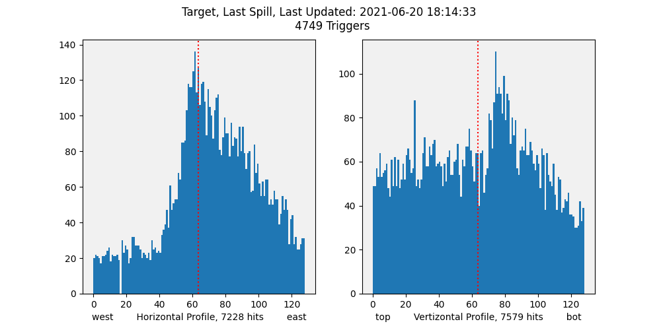
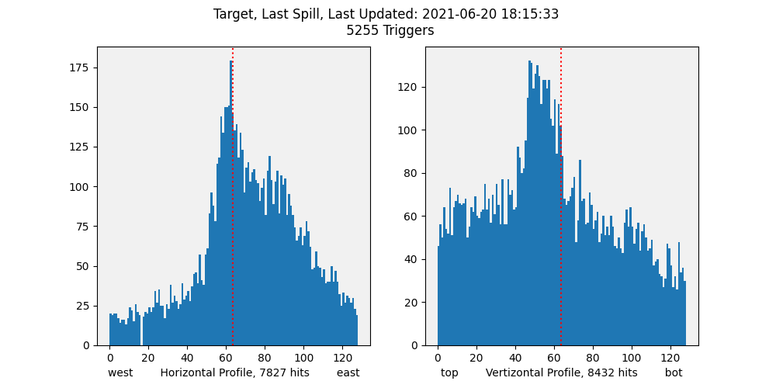
9
MC6Q1I | 44.47 | Operational Polarity
MC6Q2I | -793.3
MC6Q3I | 76.4
MC6Q4I | -65.4 | ¼ ¾
MC6Q5I | 692.3
MC6Q6I | -39.6
MC6CV | 9.9
DS quad settings changed from 1/4 to 3/4
Vertical peak shifted to the left (up)
Better profile in vertical
For Spill 9180 and 9181
MC6V1 is 80
MC6V2 is 80
Fig 31. Spill 9180
Fig 32. Spill 9181

Slide 19
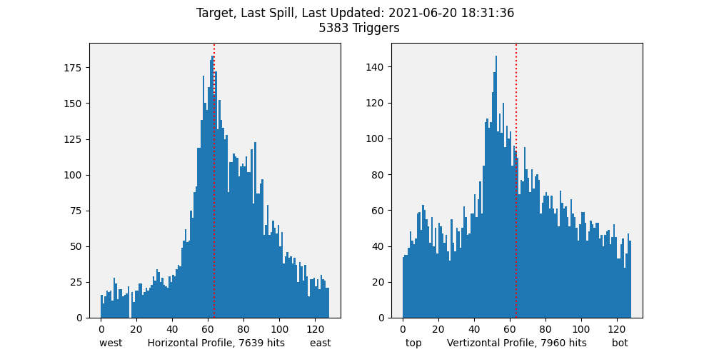
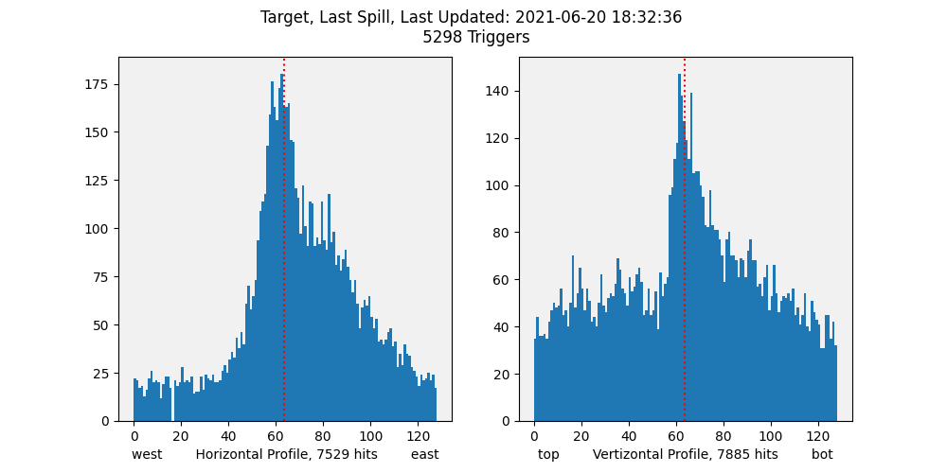
10
MC6Q1I | 44.47 | Operational Polarity
MC6Q2I | -793.3
MC6Q3I | 76.4
MC6Q4I | -60.2 | 3/4 1/2
MC6Q5I | 654
MC6Q6I | -36.5
MC6CV | 10.3
DS quad settings changed from 3/4 to halfway
Vertical peak shifted to the right
For Spill 9197 and 9198
MC6V1 is 80
MC6V2 is 80
Fig 33. Spill 9197
Fig 34. Spill 9198

Slide 20
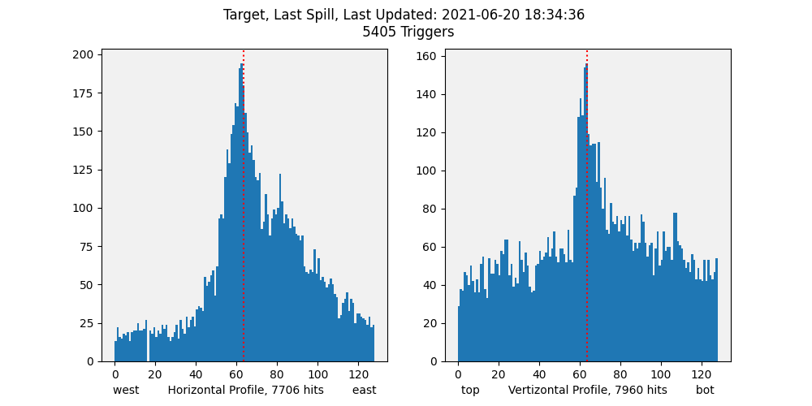
First and Last Profiles
MC6Q1I | 19.38 | Operational
MC6Q2I | - 649.5
MC6Q3I | 37.23
MC6Q4I | - 49.93 | Operational
MC6Q5I | 577.2
MC6Q6I | - 30.19
MC6CV | 10.2
Fig 35. Spill 9016
MC6Q1I | 44.47 | Operational Polarity
MC6Q2I | -793.3
MC6Q3I | 76.4
MC6Q4I | -60.2 | Halfway
MC6Q5I | 654
MC6Q6I | -36.5
MC6CV | 10.3
Fig 36. Spill 9200

Slide 21
Summary
We ran the beam study with different quadrupole and collimator settings and ended up with a nice profile
When we closed down the collimator, background underneath the vertical peak started lowering
We kept the Half Magic tune for the rest of the run

Slide 22
Beam Studies
April 19: Found magic settings during transition between operational tune and new(operational polarity) tune
Much better profiles on the Nova target
But beam fell off the top of the target
June 20: interpolated between operational and (new) operational polarity tune in search of the "magic" settings from last study; ended up with the new "half-magic" operating point
June 26 (morning): scans around the new operating point to explore the response
June 26 (evening): study the double peak in horizontal profiles observed in earlier scans

