Slide 1
The Developing $μ4ν$ Initiative
NuSTEC Workshop on Charged Lepton Scattering
by Josh Barrow, MIT-TAU, Zuckerman Postdoctoral Scholar

Slide 2
QE-like $ν_{μ}Ar→1μ1p$
Definitive energy transfer knowledge limited
$$p$$
$$μ$$
$$ν_{μ}$$
$\sim$Unknown incoming neutrino energy

Slide 3
QE-like $μAr→1μ1p$
$$μ$$
Energy transfer knowledge not limited to only
final state particles
$$p$$
$$μ$$

Slide 4
QE-like $μAr→1μ1p$
$$μ$$
Energy transfer knowledge not limited to only
final state particles
More information about kinematics given initial track leg
$$p$$
$$μ$$
Multiple Coulomb scattering
Notes:
14 CMs!!!!

Slide 5
In Situ $μ+Ar$
Cosmic muon tracks deposit energy in ~understood ways
Incoming $ℓ^{±}$ energy can be reconstructed
Find energy just before $ℓ^{±}$ interaction
Multiple Coulomb scattering (MCS)
Fast timing from veto systems (in principle)
Use “normal” $ν_{ℓ}$ methods to assess final state
Can similarly constrain outgoing $ℓ^{±}$ with MCS
Chief goals for $μ4ν$ via cosmics:
Determine bias in $E_{ν_{μ}}$ (mis)reconstruction

Slide 6
Courtesy of A. Furmanski
Multiprong (4) QE-like candidate
Reconstructing cosmic muon scatter events in MicroBooNE

Slide 7
Courtesy of A. Furmanski
Current focus of my own studies
$$p$$
Multiprong (3) QE-like candidate
Reconstructing cosmic muon scatter events in MicroBooNE

Slide 8
Expected QE-like Data Rates
QE-like proton ($μ+Ar→p+μ+X$) candidates
Estimate from CORSIKA flux and $σ_{eAr}^{QE,EM}$:
$\sim 4000$ cosmic $μ$ per second
$≳1Hz$ true QE-like interactions above threshold
Full analysis for estimation underway
Utilize MicroBooNE EXT unbiased data
Courtesy of A. Ashkenazi and W. Van De Pontseele

Slide 9
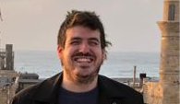
Measuring $p_{μ}$ Using MCS in LArTPCs
Muons traverse a medium, are scattered off nuclei
$$θ_{1}$$
$$θ_{2}$$
$$14 cm$$
$$θ_{3}$$
Tracks divided into segments
Scattering angles between consecutive segments measured
Particle momentum calculated from likelihood method
Amir Gruber

Slide 10
MCS momentum resolution is $\sim 15\%$ for $p_{μ}<2GeV/c$ in MC
MCS permits knowledge of approximate incoming $μ$ energies
$$μ$$
Energy transfer knowledge not limited to only
final state particles
$$p$$
MCS improvements being codeveloped
$$μ$$
Amir Gruber
Multiple Coulomb scattering
Notes:
14 CMs!!!!

Slide 11
A Simplified View of LArTPC
A single plane can be studied as a facsimile
ADC time (up page)
Increasing channel number

Slide 12
Trigger Primitives Access Waveforms Directly
$$μ$$
ADC time (up page)
$$p$$
$$μ$$
Increasing channel number

Slide 13
Trigger Primitives Access Waveforms Directly
$$μ$$
ADC time (up page)
$$p$$
$$μ$$
Increasing channel number

Slide 14
Trigger Primitives Access Waveforms Directly
$$μ$$
ADC time (up page)
“Hits”
$$p$$
$$μ$$
Increasing channel number

Slide 15
$$p$$
Hits
$$μ$$
$$μ$$

Slide 16
Multiprong Trigger Design
Considers “hits” of trigger primitives
Locations in time and wire number
Effectively a “cartesian” plane
Treat every hit as a potential vertex
Consider surrounding hits only to try and find “tracks”
Outer box/“radius” of activity
Transform: semi-cylindrical coordinates
Use $θ$ to differentiate “tracks” from one another from

Slide 17
Consider some multiprong topology to be reconstructed hits on our wires
$$p$$
Hits
$$μ$$
$$μ$$

Slide 18
$$p$$
We want to be able to identify the multiprong topology’s vertex
Hits
Vertex found!
Truth Track
$$μ$$
$$μ$$

Slide 19
$$p$$
Hits
Truth Track
$$μ$$
Extra hits from wire noise or background tracks make this picture more complicated
$$μ$$

Slide 20
Treat all hits as potential vertices

Slide 21
Treat all hits as potential vertices

Slide 22
But only $\sim 1$ true vertex hit!
Treat all hits as potential vertices

Slide 23
False vertex
How to test this?
Measure angles to all other hits!

Slide 24
False vertices lead to many potential angles, mostly outside some angular tolerance

Slide 25
$$\sim 5°$$
$$\sim 5°$$
Require certain number of hits to be within some angular tolerance, take an average
$$\sim 5°$$

Slide 26
Most will have large enough angular differences to be outside angular tolerance

Slide 27
This greatly limits the number of possible tracks of particular angles which can be triggered on
$$→Require≥3 for multiprong!$$

Slide 28
True vertex

Slide 30
$$\sim 5°$$
$$\sim 5°$$
$$\sim 5°$$

Slide 32
Original idea developed in conversation with A. Ashkenazi
Vertex found!
This greatly limits the number of possible tracks of particular angles which can be triggered on
$$→Require≥3 for multiprong!$$

Slide 33
$$p$$
Including high ADC requirements makes this selection more pure
$$μ$$
$$μ$$

Slide 34
$μ4ν$ Summary
Cosmic QE-like EM events ($μ+Ar→μ+Np+X$)
Offer powerful facsimile to $ν_{μ}$ CC events
More information from incoming lepton
Final state can be studies as if from $ν_{μ}$ interaction
Deliverables in $μ4ν$ via cosmics:
Select $1μ1p$ via trigger algorithm on data
Determine bias in $E_{ν_{μ}}$ (mis)reconstruction
Improve MCS for uncontained tracks
Apply as calibrations to $ν_{μ}$ CC interactions

Slide 35
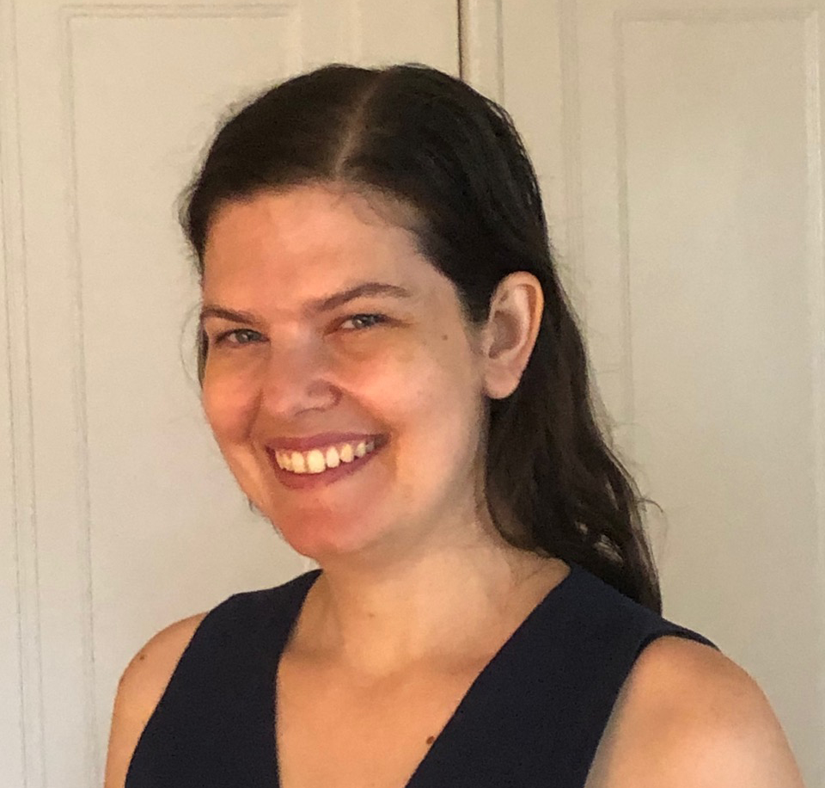
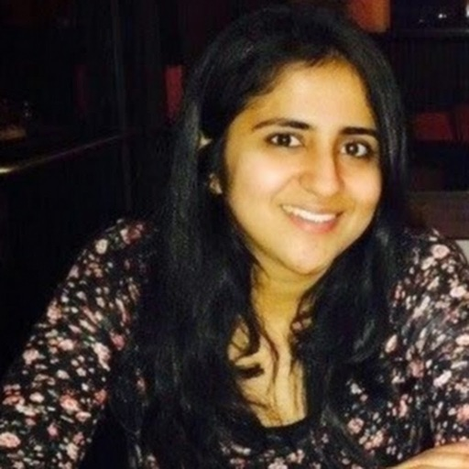
Thanks
to the
team!
Clockwise from top left: G. Karagiorgi (Columbia), W. Ketchum (FNAL), A. Ashkenazi (TAU), D. Kalra (Columbia), M. Bhattacharya (FNAL), A. Gruber (TAU), M. Kirby (FNAL)

