Slide 1
MICE RF System Overview
Derun Li
Center for Beam Physics
Lawrence Berkeley National Laboratory
MAP Winter Meeting at SLAC
March 6, 2012

Slide 2
MICE RF System Overview
Hardware
Two RFCC modules: two pairs of four 201-MHz RF cavities with 16 coaxial loop RF couplers and ceramic RF windows (two per cavity) - LBNL
Amplifiers and power distribution systems - DL
Vacuum and water cooling systems - RAL
Diagnostics and control systems
Software
LLRF firmware and cavity tuning control
MICE data analysis
Controls and correlation between detectors and RF amplitude/phase
RF system design review held in December 2011

Slide 3
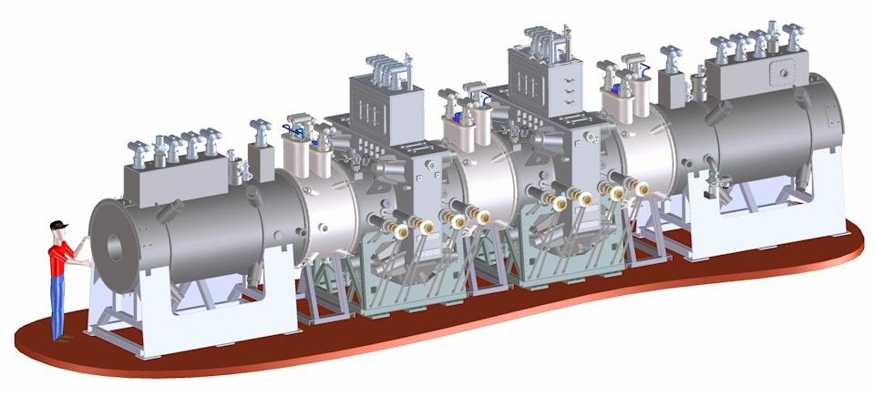
2 RFCC Modules in MICE Channel
RFCC Module #1
RFCC Module #2

Slide 4
RFCC Module Overview
The MICE RF and Coupling Coil Module has been designed by LBNL and our collaborators
The MICE cooling channel incorporates two RFCC modules to be provided by LBNL
Each module consists of a single superconducting Coupling Coil integrated with four tunable 201 MHz normal conducting RF cavities and a vacuum vessel
The Coupling Coil design was developed by the Harbin Institute of Technology (HIT) in China (a MICE collaborator), in collaboration with LBNL
A third Coupling Coil (first delivered) for MuCool will be sited in the MTA at Fermilab
The 201 MHz cavity design is based on the prototype cavity developed by LBNL and J-Lab and has been operated in the MTA

Slide 5
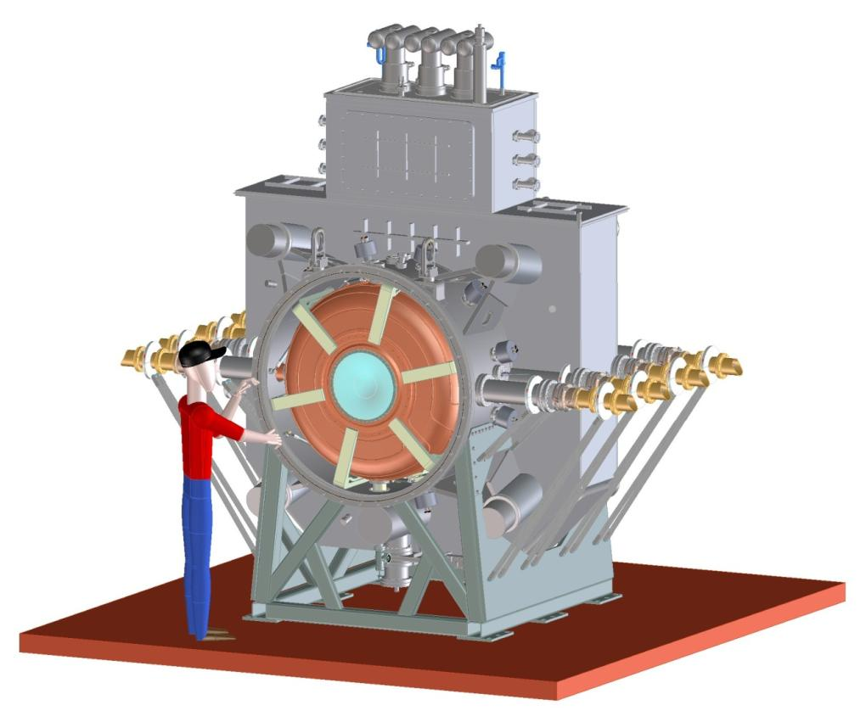
RFCC Module Overview
Coupling Coil
RF Cavities
Tuner arms
Couplers

Slide 6
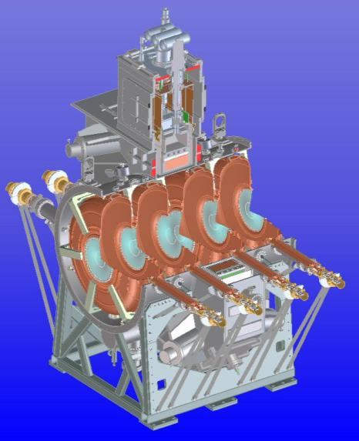
Status of RF Cavities
Ten RF cavities (two spares) at LBNL now;
All 11 beryllium windows received at LBNL;
Ten ceramic RF windows;
Six tuner flexures are being fabricated at
Fermilab;
Components for 6 actuators are being
fabricated;
RF loop coupler design has been updated to
eliminate the gap between the outer coax and the RF loop;
EP preparation in progress at LBNL:
Fabrication of fixturing complete;
ES &H approval for EP in progress at LBNL;
Preparation of the cavity surface: mechanical smoothing;
EP to start after the ES & H approval.
Measurements of the remaining six cavities to start after EP;
Each cavity will be tuned to a center frequency after EP.

Slide 7
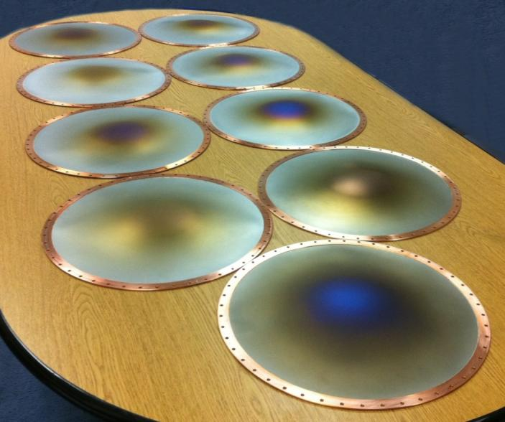
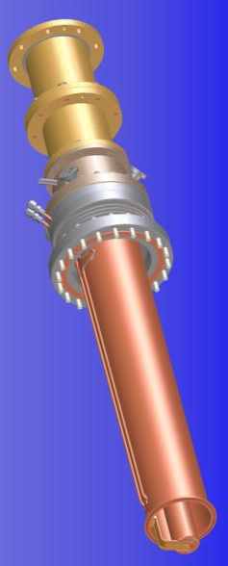
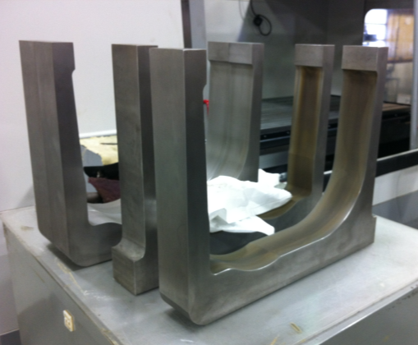
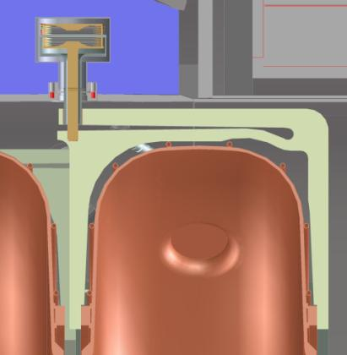
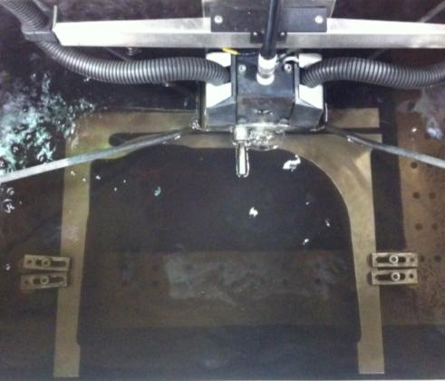
Coupler
design
EP setup at LBNL
Be windows at LBNL
Tuner arms fabricated at FNAL
Tuner design
Wire EDM at FNAL

Slide 8
RF Power System Components
Master Oscillator
Controls etc
DL Test System
At present
Not found
Auxiliary Systems
300 kW Amplifier
300 kW Amplifier
300 kW Amplifier
300 kW Amplifier
Auxiliary Systems
HT Supplies
2 MW Amplifier
2 MW Amplifier
2 MW Amplifier
2 MW Amplifier
HT Supplies
Daresbury
LBNL
CERN
201 MHz Cavity Module
201 MHz Cavity Module

Slide 9
RF Amplifier Status
Refurbishment of LBNL and CERN RF components:
First medium power (250 kW) amplifier and power supply system tested 2008
Refurbishment and rebuild of first high power (2 MW) amplifier complete October 2009
Power supplies for first 2 MW amp operational
Two further 300 kW amplifiers awaiting repair
Two refurbished 2 MW CERN amplifiers partly tested, awaiting assembly and high power test
Need to build 3 more sets of power supplies
One more 300kW amplifier to buy/acquire

Slide 10
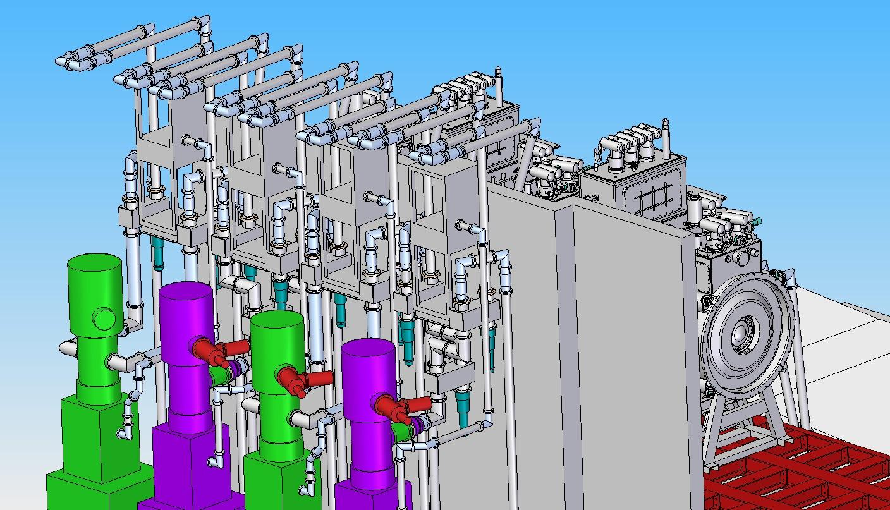
RF Power Distribution
Trombone phase shifter
Outputs to cavity
RF load
Hybrid power splitter

Slide 11
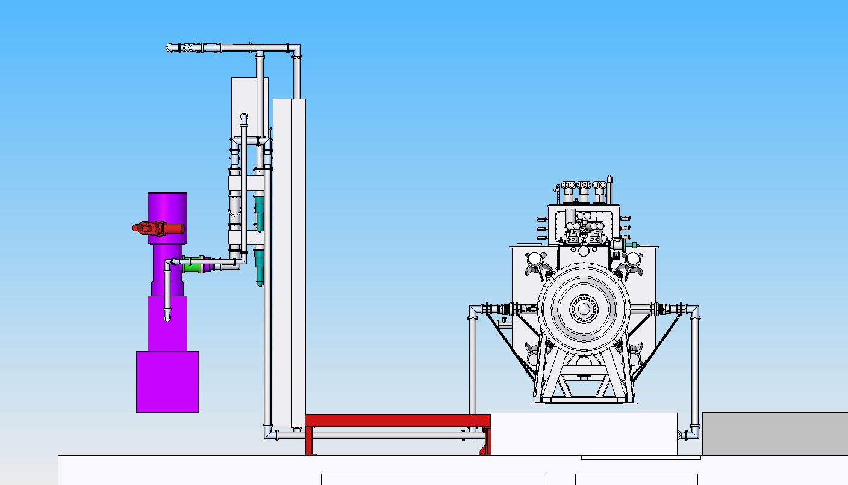
RF Power Distribution

Slide 12
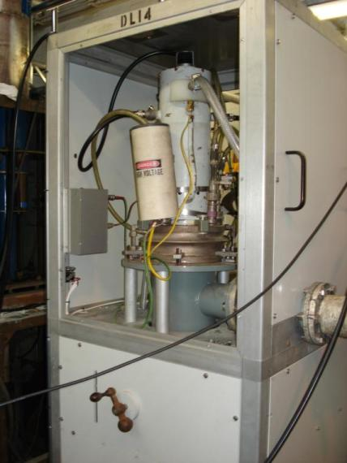
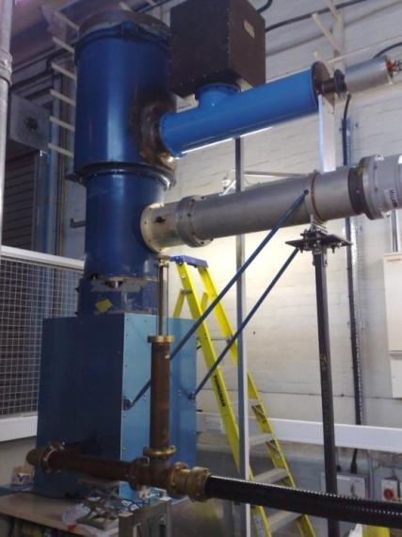
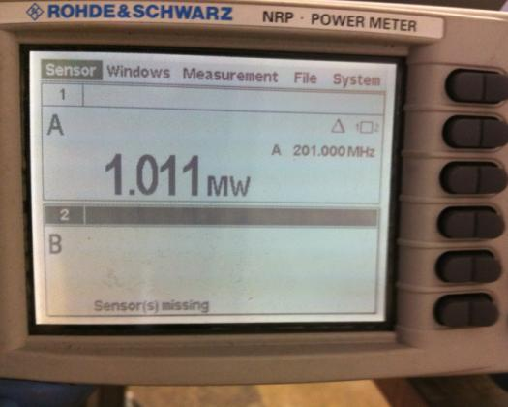
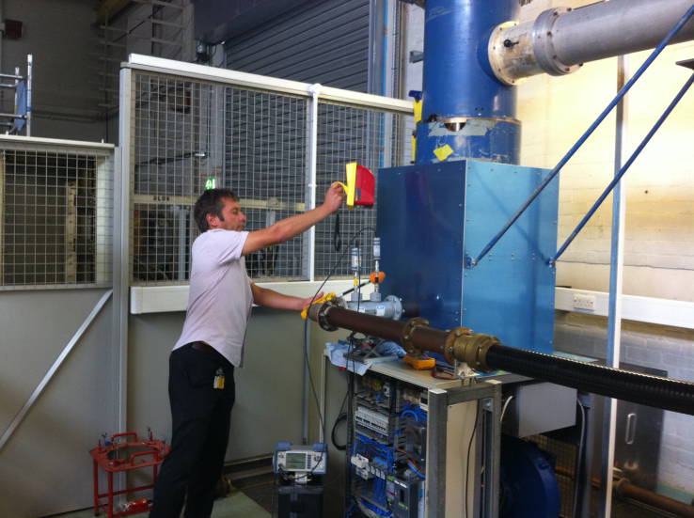
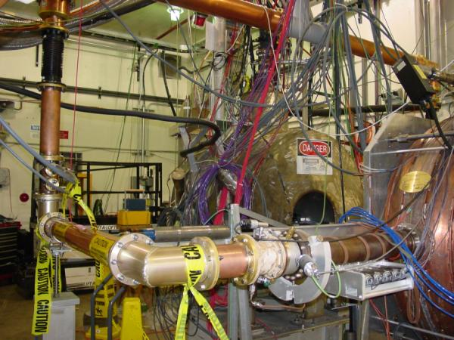
High Power Amplifier
Reached 1 MW RF power
4616 Medium Power Amplifier
MTA RF setup
Andrew Moss working at Daresbury Laboratory

Slide 13
MICE RF Power 1 MW/cavity

Slide 14
20 kV Power Supply for 4616
HV Power Supply 20 kV
4616 Circuit
Enclosure
Auxiliary Rack
RF Signal Generator
(201 MHz)
Control Crate
Resistor bank
RF cable
4616 Tube
PLC Crate
RF output (co-ax)
Capacitor Charger
20 kV+
Screen cable
Heater Controller
Grid cable
Water cooling
circuits (4)
RF solid state amplifier
Earth Switch
Crowbar (Ignitron)
Compressed air
cooling
Grid PSU
(300 Vdc)
HV cable
Screen Pulser
(2000 Vdc)
Dump Relay
0.95V
500A
Capacitor
29 uF
Screen PSU (600 Vdc)
Heater Transformer

Slide 15
38 kV Power Supply for TH116
HV Power Supply 38 kV
TH116 Circuit
Enclosure
Auxiliary Rack
Control Crate
HV cable
Resistor bank
TH116 Tube
RF output (co-ax)
PLC Crate
RF input from
4616 (co-ax)
Capacitor Charger
40 kV+
Heater Controller
Water cooling circuit
Trigger pulse
Cathode Modulator
450V DC Bias PSU
Earth Switch
Crowbar (Thyratron)
Compressed air
cooling
Dump Relay
Cooling Fans
20V
500A
Capacitor
140 uF
Heater Transformer

Slide 16
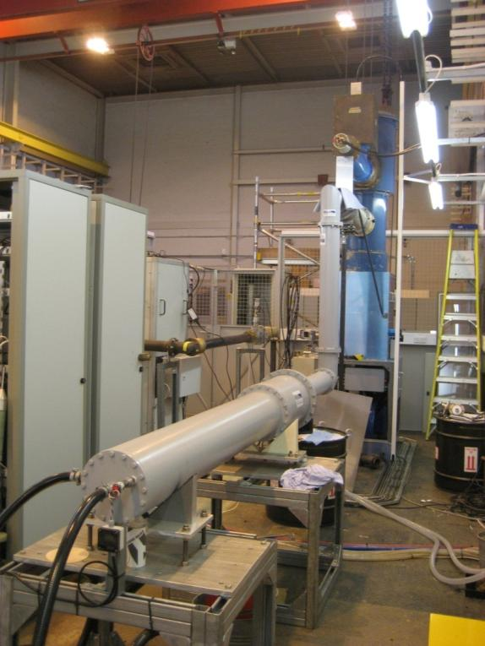
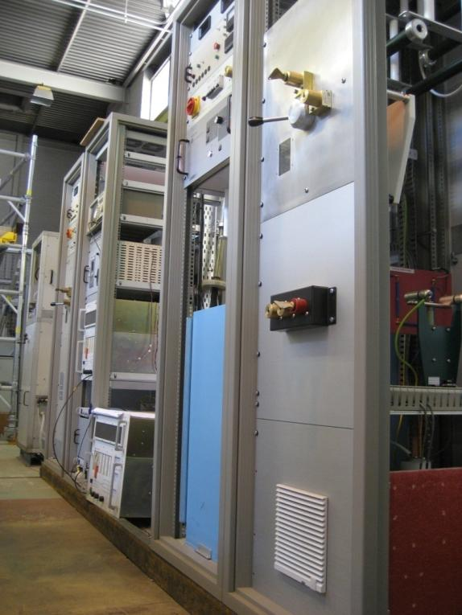
RF Test Area at DL

Slide 17
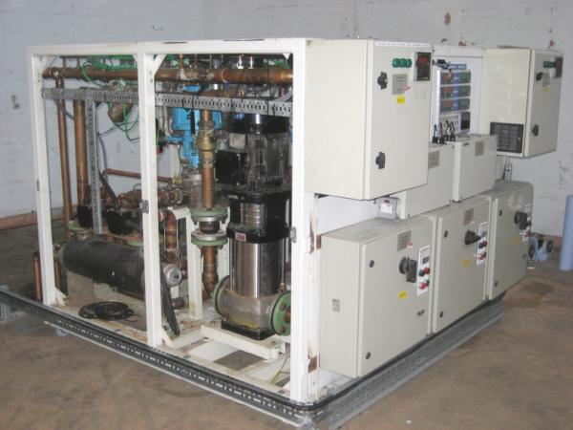
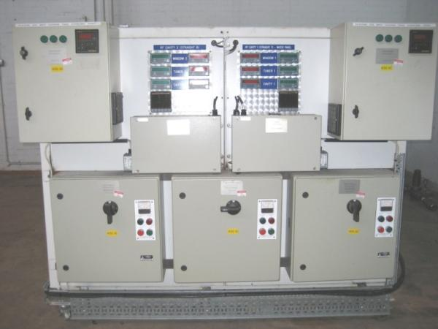
Water Cooling System at DL
DL site cooling system decommissioned
Ex-SRS twin-circuit chiller installed
Demin for amplifiers
Glycol for load
Now fully operational

Slide 18
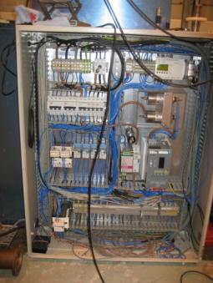
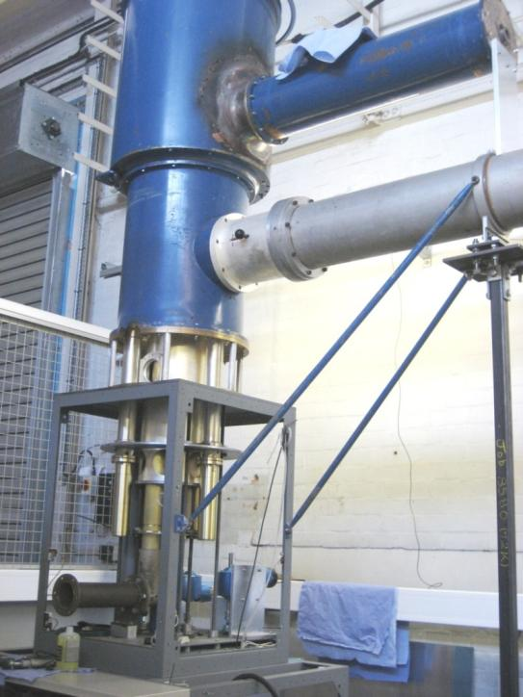
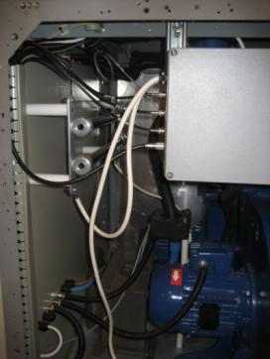
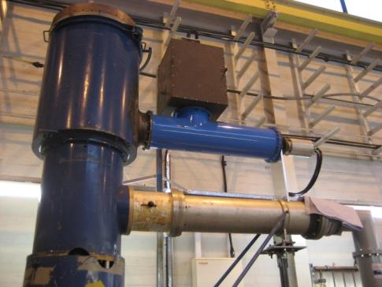
TH116 Circuit #1
Mechanically complete
New fans fitted
Cathode modulator built
Motorised tuners
Electrical control panel
Heater controller
Safety interlocks
Tested to 1 MW RF output

Slide 19
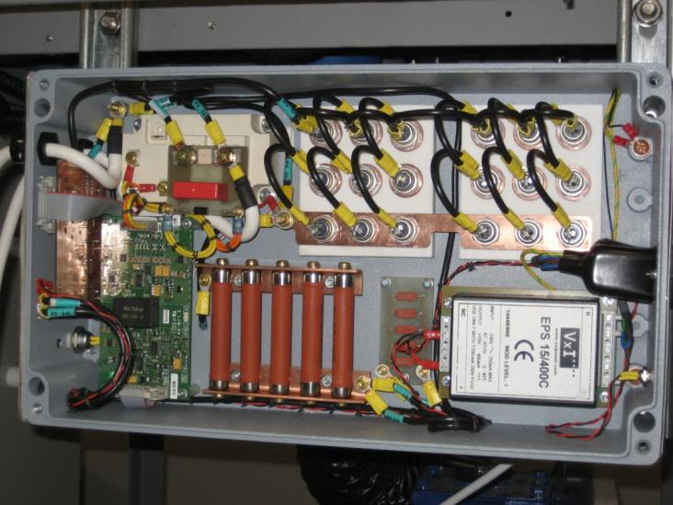
Cathode Modulator
IGBT switch
IGBT control board
Potential divider
Zener diode array
TH116
38 kV
TH116 CATHODE MODULATOR CIRCUIT
From 4616
2R7
33R
15k
IGBT
450Vdc
Fully operational
Second unit now complete
Trigger

Slide 20
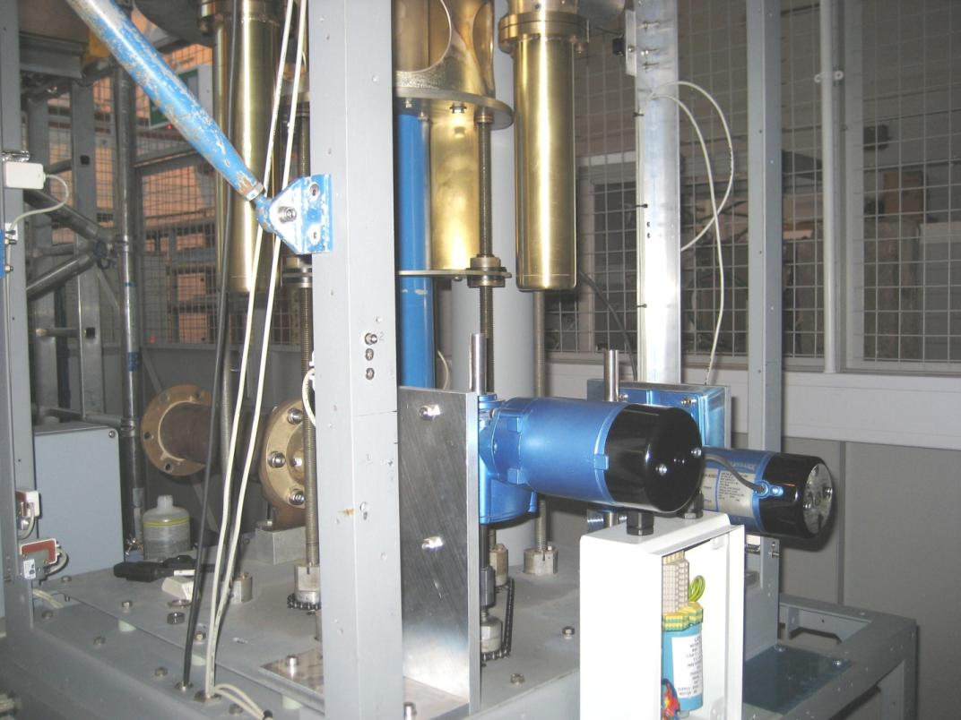
Circuit Tuning Motors

Slide 21
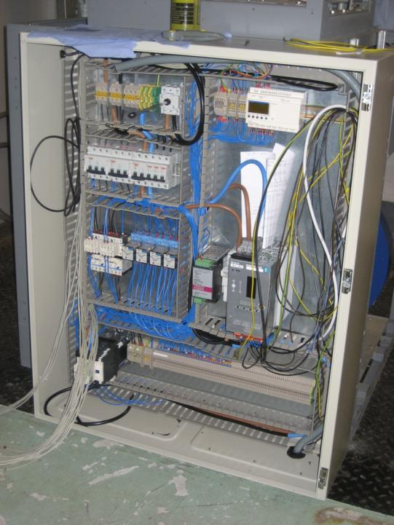
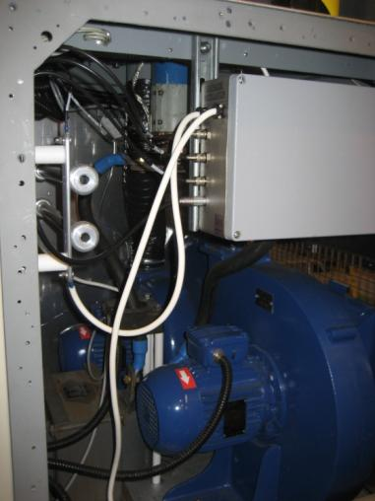
TH116 Electrical Control Panel
Fan control-gear
Heater controller (thyristor)
Circuit-breakers
Tuning control relays

Slide 22
RF Control and Monitor System
EPICS Server
4616 & TH116
Aux. Racks
Network/ Controls Rack
VME Crate
Canbus modules
DAC/ADC modules
Typical I/L
Digital signals/serial link
PLC Crate (TH116)
Interlocks
Compressed air pressure
Digital signals/serial link
PLC Crate (4616)
Interlocks
Water flow
Enable
Panel switches
Analog signals
Grid PSU (4616)
Analog signals
Screen PSU (4616)
Enable
Analog & digital signals
Heater Controller (4616)
Enable
Heater V and I
Analog & digital signals
Heater Controller (TH116)
Enable
Heater V and I
Analog & digital signals
450V DC Bias PSU
Enable
Interlocks

Slide 23
RF Power Supplies – MICE Hall Layout
RF Amplifiers
RF Power Supply Racks
Air Conditioning Units
RF Network/Control Racks
Layout of North Mezzanine

Slide 24
Current Status/Plan of RF Power Sys.
Amplifier test system tested to 1 MW with power supplies;
Coax system designed to phase match RF into each cavity, all coax lines are the same length and have the same number of elbows;
Hybrids will be used to split RF power and give good isolation, reject load can be small as balanced reflected; power will be directed back to triode, this should not present an issue;
Cavity phasing can be done using a combination of LLRF and limited range high power phase shifters;
Nitrogen gas pressure will be used to extend the peak voltage stand off of the coax guides.

Slide 25
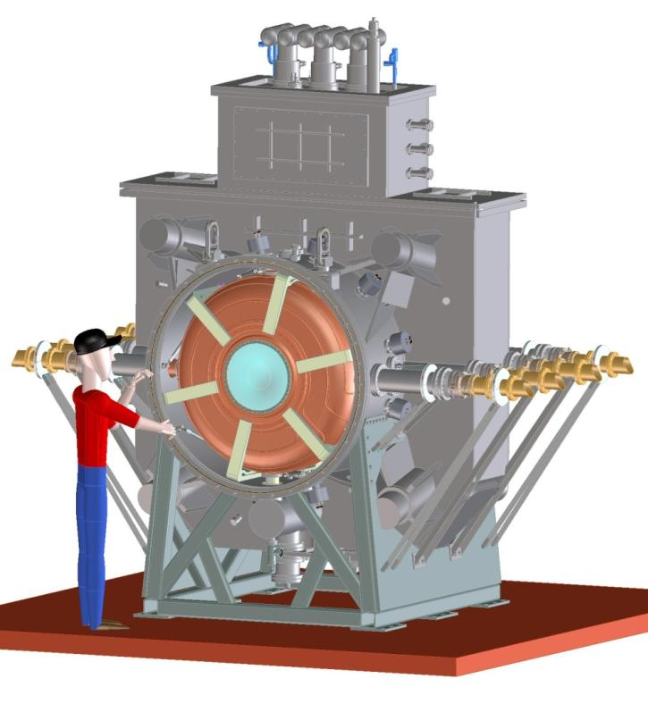
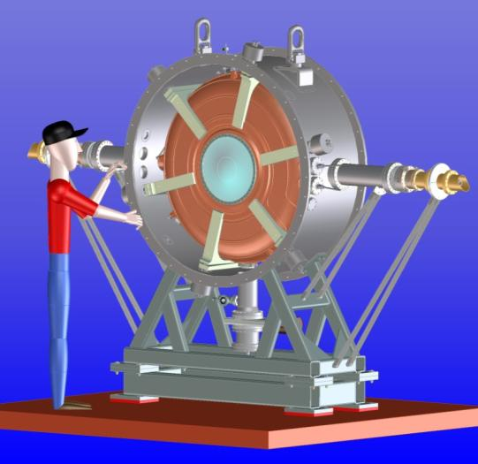
Single Cavity Vacuum Vessel
The design kept as much as possible of
the same dimensions and features of
the RFCC module
One vessel to accommodate two types
of MICE cavities (left and right)
Possible for future LN operation
RFCC module

Slide 26
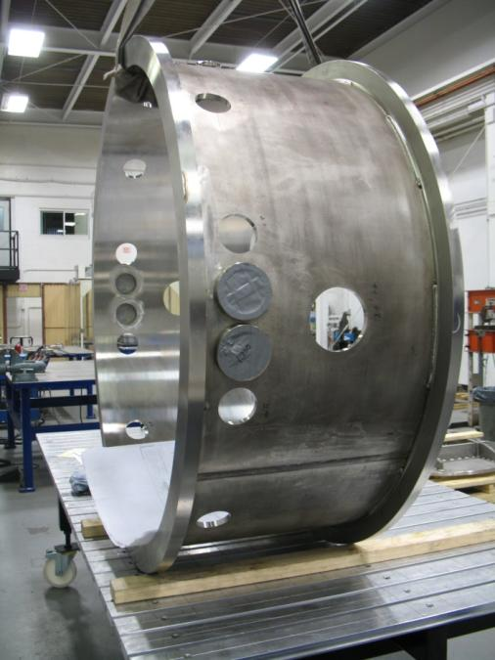
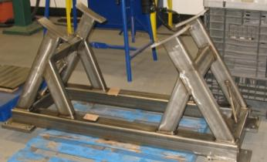
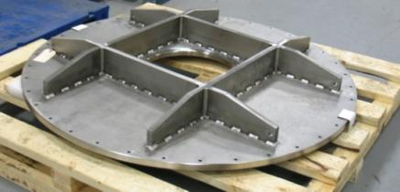
Single Cavity Vacuum Vessel Status
Design was completed in mid-2011 at LBNL
Fabrication is complete at Keller Technology
in Buffalo New York
The vessel should arrive Fermilab this week

Slide 27
Testing of the Single Cavity Vessel
Check engineering and mechanical design
Fully define the fabrication process
Incorporate any design changes into the RFCC vacuum vessel design
Test of the RF tuning system with 6 tuners and actuators on a cavity and verify the frequency tuning range
Obtain hands-on experience on assembly and procedures
Cavity installation
Develop fixturing for inserting the cavities into the vacuum vessel
Beryllium windows
RF couplers and connections
Water cooling pipe connections

Slide 28
Testing of the Single Cavity Vessel
Vacuum port and connections
Tuners and actuator circuit
Mounting and alignment of the tuners onto the cavity is critical to alignment of the cavity in the vacuum vessel
Alignment of actuator (through the vacuum vessel wall) to the tuner is important
Aligning cavity with hexapod support struts
Test developed MathCAD alignment software program
Vacuum vessel support and handling
Verify operation of the getter vacuum system
RF processing MICE cavities
RF power system and future LN operation

Slide 29
Summary and Tasks
Progress in MICE RF hardware development;
Progress of RF system and control;
Specification/Interface between RF power system and RFCC modules;
Plan/development for diagnostics and controls, in particular with detector/analysis group:
Communications/meetings started recently at LBNL, but need a real plan;
A LLRF/DAQ Workshop will be held April 16-17 in DL, UK
Testing plan of using the single cavity vessel at the MTA, Fermilab
Waiting for cavity EP at LBNL, fabrication of other accessory components;
Assembly and integration;
MICE cavity tuning and control;
Experimental study of high magnetic field at RF coupler region;
Welcome RF testing proposals from MAP collaborators.

