Slide 1
Backgrounds in the Muon Collider Experiments
Adam Para, Fermilab
MAP Collaboration Meeting,
SLAC, March 8, 2012

Slide 2
The (Frequently Asked) Question
Can the experiment at the Muon Collider ‘work’ in the beam-induced background environment?
Will it melt/blacken? Will it be radiation damaged? NO! The radiation environment at the MC is comparable to/no worse than at the LHC.
Will the data be ‘analyse-able’? Or will the combinatorics kill the tracking? Or jets be lost in the sea of fluctuating noise? Probably not. May require smart detector design: granularity, excellent timing, redundancy..
Muon Collider experiments will be the precision experiments: Will the background suppression and/or rejection techniques compromise the precision of the measurements?

Slide 3
Possible Strategies for the Evaluation
Simulate physics process with proper addition of the simulated backgrounds and evaluate the degradation (or lack of it) of the physics capabilities as a function of the background levels. Very difficult strategy: exceedingly computing and manpower intensive and requires a representative set of physics benchmarks relevant to the MC era.
Simplified approach? Any new physics will be accesible via combination of ‘partons’: leptons, jets, missing (transverse) energy and W/Z’s of typical energies of ~100-500 GeV. Study the detection efficiency and measurement accuracy of the parton direction/energy measurement as a function of the background levels. Study single and multi-partons combinations. Declare 5%(?) contribution to the energy resolution as an acceptable limit.

Slide 4
Another Frequently Asked Questions: Fluctuations?
The overall amount of energy deposited in the detector volume exceeds that deposited by the physics events of interest by more than 2 orders of magnitude. It exceeds the energy of ‘objects of interest’ by more than a factor of 1000. What are the residual fluctuations (after all of the background reduction) and how do we know that they do not kill the precision of the measurement? Two kinds of fluctuations:
From bunch crossing to bunch crossing
Over the detector volume (~million(?) channels)
Frequently given answers: ‘with 10⁸ background particles produced by 10⁸ muons decays the statistical fluctuations are very small’ is not very convincing, even if true.

Slide 5
Simulating the Fluctuations?
Ideally one would like to simulate the background created in a large number (1000?) beam crossings and study the resulting fluctuations. This is not feasible.
Alternative: background consists of contributions from independent muon decays. Create a large sample (10-50 beam crossing equivalent) of muon decays, simulate their signals in the detector and overlay a randomly selected subsample of backgrorund ‘events’ onto the physics event. Ideally, GEANT-like events (i.e. a complete list of background particles) would be the most straightforward to use. Weighted events require more thought/work.

Slide 6
Background Files, Vintage 2011
Nikolai Mokhov and Sergei Striganov: careful optimization of the shielding using MARS
Major development of simulation techniques to attain the accuracy of the background predictions
Detailed analysis of background levels, composition, etc.. Many talks over the past year..
We need to understand how to use these files to simulate background and its fluctuations in a detector volume.
This talk is a ‘progress report’ along these lines.

Slide 7
Topology of the Background Data Files
At Z=ZDEC (coordinate along the beam line) a beam muon decays. Decay electron showers in the material surrounding the beam pipe.
At XORIG,YRIG,ZORIG - shower particle of type IORIG, with energy EORIG, produces a particle of type JJ
This particle (JJ) arrives at the interface surface at the point X,Y,Z at TOFF = time with respect to bunch crossing
With momentum PX,PY,PZ (GeV/c)
This particle has a weight W (it ‘represents’ W
particles entering the detector volume),
KORIG - type of process in which particle JJ was created
Note: for most of the decays N=0
‘Readme’ file with detailed information
N

Slide 8
Probability that a Decaying Muon will Produce at least one Background Particle
Most of the background is produced by beam muons decaying within ~25 meter from the IP (probability per muon ~0.1 – 0.5)
Bethe-Heitler muons produced as far as ~150-200 meters from the IP contribute to the background, with probabilities <10⁻⁴.
Two different approaches: ‘inclusive’ – far decays and ‘full event’ – near decays.

Slide 9
 |  | 25 – 189 m | 0 – 25 m | Total |  | Mokhov/Striganov
neutron | Energy (GeV) Number | 44.3 55.1 | 170.9x10³ 40.7x10⁶ | 171.0x10³ 40.7x10⁶ | 171.0x10³ 40.7x10⁶ | 172x10³ 41.x10⁶
proton | Energy (GeV) Number | 15.8 14.0 | 5.8x10³ 31.1x10³ | 5.8x10³ 31.1x10³ | 11.9x10³ 46.8x10³ | 12x10³ 48x10³
pi+ | Energy (GeV) Number | 4.9 3.4 | 3.0x10³ 7.1x10³ | 3.0x10³ 7.1x10³
pi- | Energy (GeV) Number | 4.0 3.5 | 2.9x10³ 8.1x10³ | 2.9x10³ 8.1x10³
K+ | Energy (GeV) Number | 0.35 0.18 | 204.7 462.9 | 205.0 463.1
K- | Energy (GeV) Number | 0.56 0.33 | 46.9 69.4 | 47.5 69.7
mu+ | Energy (GeV) Number | 77.6x10³ 2.7x10³ | 15.0x10³ 1.2x10³ | 92.0x10³ 3.9x10³ | 92.0x10³ 3.9x10³ | 92x10³ 3.9x10³
mu- | Energy (GeV) Number | 78.4x10³ 2.7x10³ | 13.8x10³ 1.4x10³ | 92.2x10³ 4.1x10³ | 92.2x10³ 4.1x10³ | 92x10³ 4.1x10³
gamma | Energy (GeV) Number | 37.2 27.0 | 157.3x10³ 16.7x10⁶ | 157.3x10³ 16.7x10⁶ | 157.3x10³ 16.7x10⁶ | 164x10³ 18x10⁶
e- | Energy (GeV) Number | 29.6 22.1 | 3.3x10³ 807.0x10³ | 3.3x10³ 807.0x10³ | 5.8x10³ 989.0x10³ | 5.8x10³ 1000x10³
e+ | Energy (GeV) Number | 7.8 7.5 | 2.5x10³ 182.0x10³ | 2.5x10³ 182.0x10³

Slide 10
Test: reproduce results of Mokhov/Striganov
OK.
180 TeV of muons (~ 30 GeV on average), mostly from ‘far’ decays
170 TeV of neutrons (4 x 10⁷)
160 TeV of photons (1.7 x 10⁷⁾
12 TeV of charged hadrons
6 TeV of electrons

Slide 11
Bethe-Heitler Muons

Slide 12
BH muons: arrival time and energy spectrum
muons arrive within 10-20 ns from the beam crossing.
Some arrive before the beam crossing
some ~10 muons decay in flight within the detector volume

Slide 13
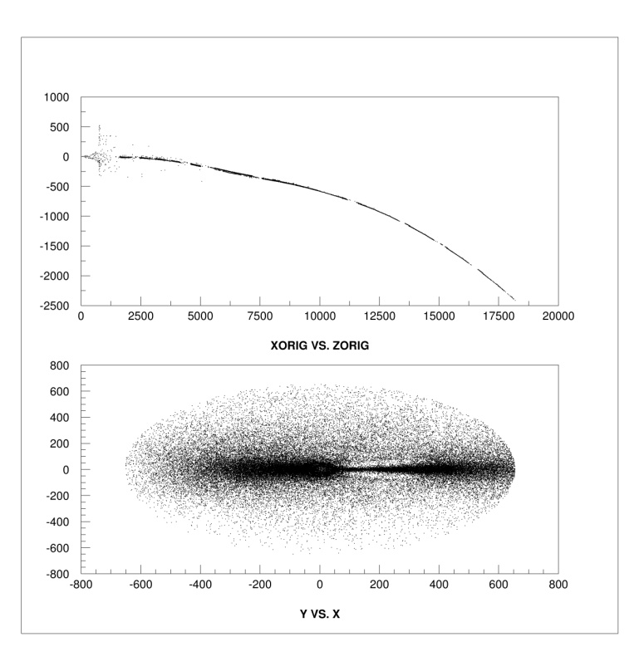
BH muons: Production point and entry point into the detector
Muons are produced along the beam pipe. Some can travel along shorter path – hence they arrive early
Muons enter the detector within the plane of the machine
Muons are ‘sign separated’

Slide 14
BH muons: entrance to the detector volume; sign separated

Slide 15
Weights of Bethe-Heitler Muons
weight of muons varies by a big factor.
A significant contribution of muons with very large weights

Slide 16
Weights of Bethe-Heitler muons are not uniform along the orbit
High weigths muons. There is a ‘hot spot’: a source of very high weights muons at 60 m from the IP
Low weigths muons

Slide 17
BH muons weights at different decay points
25 – 50 m 50 – 100 m
100 – 150 m 150 – 189 m

Slide 18
BH (far) muons
Significant work is necessary to develop statistically correct procedure for random sampling of the muon sample to overlay with the physics events.

Slide 19
Near, Exclusive sample
The simulated sample of decays corresponds to ~ 4% of one beam crossing, hence a overall weight factor of ~26 must be applied.

Slide 20
Weights of Secondaries
Weights have relatively narrow distribution (giving a hope for pretty much weight 1 files once more decays are simulated)
but muons have weight ~1: different simualtion procedure for muons?
need to investigate the origin of very large weights tails

Slide 21
Multiplicity of particles from a single muon decay
Contribution of different muon decays varies very much: from few background particles to more than 10,000 background particles from a decay

Slide 22
Dispersion of weights and arrival times from a single muon decay
background particles form a single muon decay have large dispersion of weights
and they have large dispersion of arrival times
it is rather difficult to develop a statistically sound procedure for using weighted events

Slide 23
Origin of Low Energy Photons and Neutrons
Vast majority of background particles are photons and neutrons.
They are produced in the tungsten cones intercepting the decay electrons: a point or rather a ring source.
May lead to spatial correlations between the induced signals.
beam

Slide 24
Timing of Low Energy Photons and Neutrons
Most of photons and neutrons are very soft, below 1 MeV.
Photons are relatively ‘in time’ (within 20 nsec), whereas neutrons tend to come much later (after 100 nsec)

Slide 25
Neutrons and Photons Spectra
Simulated photon spectrum is cut off at 200 KeV, neutrons are cut at 100 KeV.
The total number of background particles is underestimated by some factor (depending on the cutoff appropriate)
For neutrons it has no implication for the detector (they are late!), lack of photons leads to underestimate of rates in the tracker. It is probably of no significance for calorimetry (missing contribution is very soft).

Slide 26
Fluctuations in Background Energy
Energy contributed by a single muon decays fluctuates a lot
~75% of the background energy is produced by ~ 1% of the decays

Slide 27
Ffluctuations in Number of Background Particles?
Number of background particles produced in a single muon decay varies significantly
About half of all the background particles is produced in 7% of the decays.

Slide 28
Work in Progress
It will take some more time and work to develop statistically sound procedure for overlaying the background on the physics events and address the issue of a contributions of background fluctuations to the resolution of the measurement.
Calorimetry is likely to be more difficult case than tracking.

