Slide 1
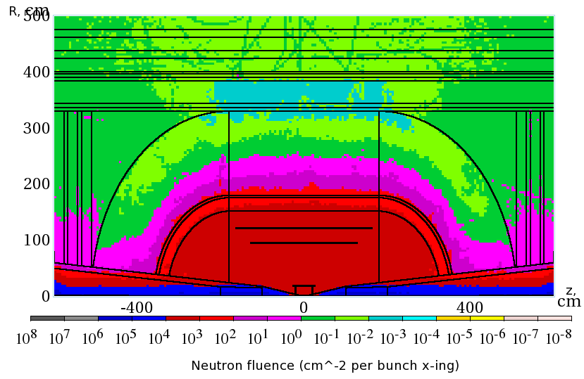
Detector Prospects for the Muon Collider
Tracking
Ronald Lipton - Fermilab
Can we perform experiments in the harsh background environment of the Muon Collider?
What are the challenges?
What are the physics tradeoffs?
What R&D is needed
We have learned quite a bit in the last year. I will try to explore some of the issues related to tracking
Fluence similar to LHC

Slide 2
Background Characteristics
Much of the background is from soft photons and low momentum neutrons.
Muon background has a different character, coming from upstream interactions
164 TeV
5.8 TeV
92 TeV
92 TeV
172 TeV
12 TeV
Striganov

Slide 3
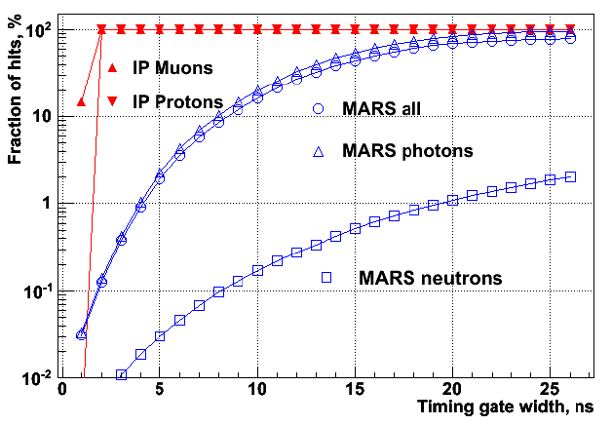
Timing
Much of the track background is out of time – this is a consistent theme in discussing background rejection
(Terentev)

Slide 4
Let’s look more carefully at the
characteristics of background energy deposits. (LCSIM detector model from H Wenzel)
Assume SiD-like tracker with 300 micron thick silicon tracking layers. Look at:
Time
De/dx
Path length in detector
Drphi (exit-entrance position)
Following plots are only for barrel

Slide 5
Look carefully at charge deposits in the tracker. RΔφ measures local momentum and can reduce background
RΔφ
300 μ

Slide 6
Path length of parent track within silicon detector
Detector thickness
Angled tracks
Time of energy deposit with respect to TOF from IP

Slide 7
Background de/dx distribution
MIP

Slide 8
Detector thickness
Angled tracks
MIP
Path length in detector vs de/dx

Slide 9
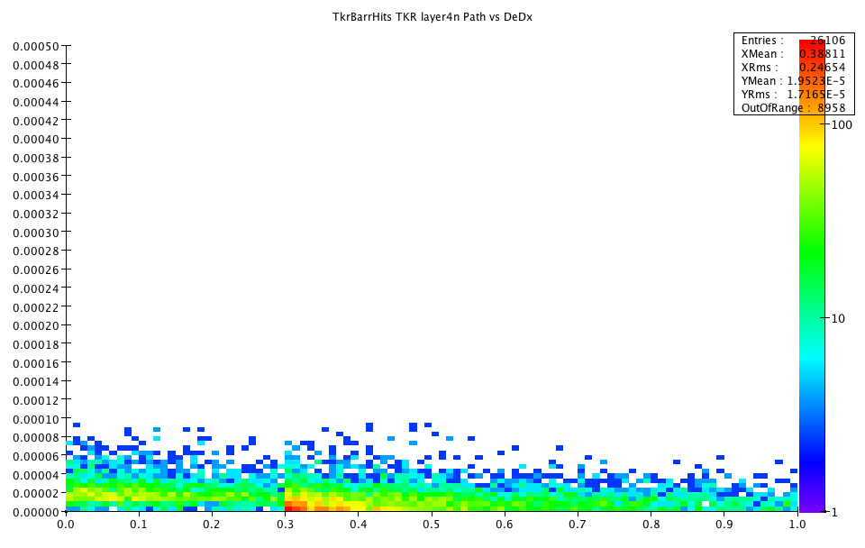
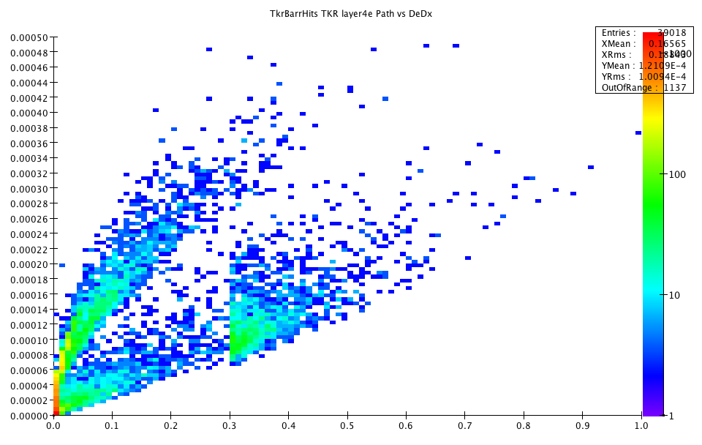
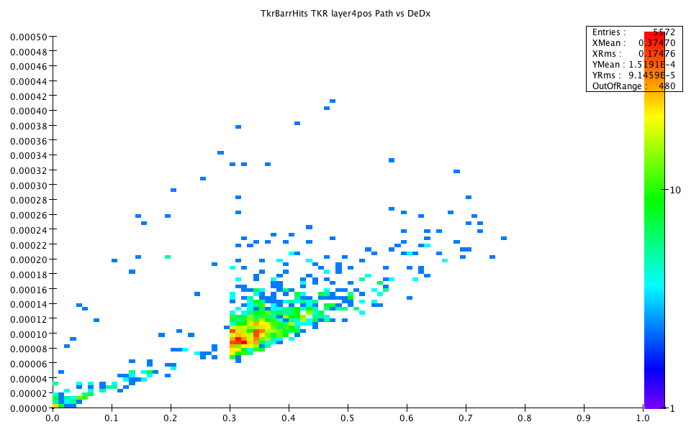
Neutrons
electrons
positrons
Compton
High energy
conversions
soft
conversions

Slide 10
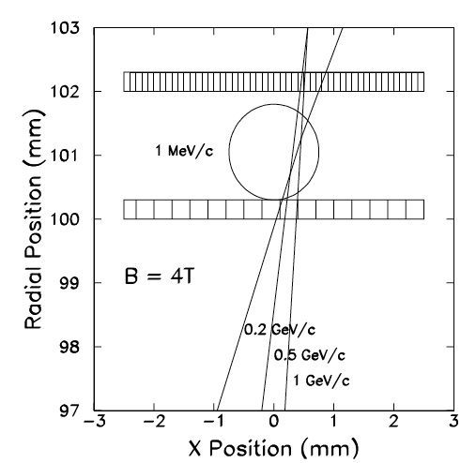
Effects of Cuts on Tracker
Background Hit rejection
Radius | DT Cut | DT&rphi | DT& rphi&dedx
20 | 0.0012 | 0.0012 | 0.0009
46.2 | 0.0008 | 0.0008 | 0.0006
71.7 | 0.0011 | 0.0010 | 0.0007
97.3 | 0.0006 | 0.0006 | 0.0004
122.9 | 0.0009 | 0.0008 | 0.0006
Timing is the most important
  Reduce backgrounds by
  3 orders of magnitude
Curvature cut (rφ) has a
small effect – we have already
gotten rid of much of the soft stuff
  This implies that a “double layer” design will not be very helpful
De/dx also is also important
  We need this anyway since our timing accuracy will depend on signal/noise

Slide 11
Electronics for Fast Tracking
We clearly would like fast (ns level) time stamping or gating. We also need fine segmentation, low mass, and good resolution. The electronics and sensors also have to be radiation hard
We will have to pay… but how much?
The price is power which implies mass
We also have increased mass for cooling in radiation environment
ILC had very aggressive mass goals – but what is really needed for the physics at Muon collider/CLIC energies?

Slide 12
How to build a fast silicon tracker
Minimize collection time
  Collect electrons (μ_{e}=1350 cm/V*sec, μ_{h}=1350 cm/V*sec)
Fast amplifier
  T_{r}~ 0.35/f_{u}, f_{u}~g_{m}/(2πC_{gs}), High transistor g_{m}
Good signal/noise
  σ_{t} ~ T_{r}/(S/N)
Low noise, high signal
  (S/N)² ~ Q_{s}²(1/(4kTΔf) (g_{m}/C_{d}²), thick detector, short strips
  Noise² ~ 1/g_{m} ~ 1/I_{d} – direct power penalty
Minimize detector thickness for short collection time
Maximize detector thickness for low C_{d}, high Q_{s}

Slide 13
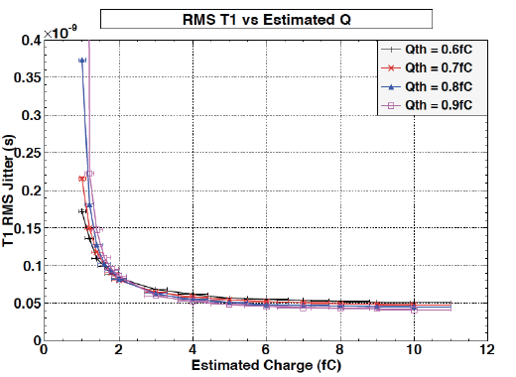
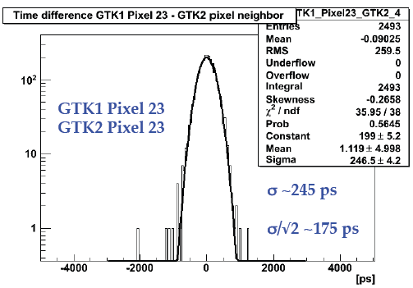
Example – NA62 Gigatracker
Designed for K_{L}-> πνν decay in flight.
800 MHz DC beam
<200 ps hit timing resolution
40 μA front end transistor bias
200 micron silicon
200 ff detector capacitance
We can scale our models to the NA62 design, changing I_{d}, C_{d}, to match pixel size and transistor currents to estimate what we need for nanosecond level resolution

Slide 14
power

Slide 15
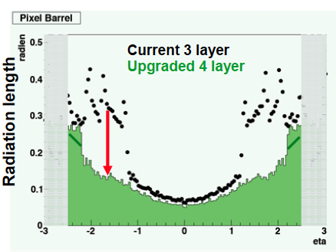
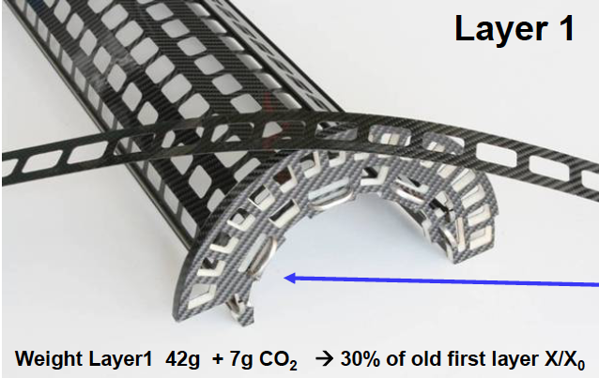
Power and Mass
Radiation length reduction in CMS
  Switch to CO₂ cooling
  Ultra light mechanics
  DC-DC conversion
Next generation cooling will
cost less in mass
Still – the Muon Collider detector will look more like an
LHC than an ILC detector
  ~ 2% RL/layer

Slide 16
Issues to consider
What is the strip/pixel size?
  Low energy hits form a kind of background – if this background is significant it can ruin our timing resolution.
    Keeping pixels small reduces this effect and lowers load capacitance. Luckily most background is late …
Radiation damage – similar to LHC
  We would like large signal (thick detector) to maximize S/N but heavily irradiated detectors lose charge collection – the detector looks thinner, but has the same mass
  Detectors need to be cooled to ~-10 deg C to minimize “reverse annealing” – more mass
Vertex design – need a thicker (>50 micron ILC design) detector for de/dz and time measurement – probably at leatst
Forward tracker – somewhat different mix of particles

Slide 17
It may not feel like it, but we are in the mainstream.
LHC is developing radiation hard sensors and electronics
HL-LHC needs to have small pixels to limit occupancy
Intensity frontier experiments will need high speed electronics
Forward detectors at LHC need ~100 ps resolution
CLIC will also need electronics with ns-level resolution for bunch identification
Many folks inside and outside of HEP are looking at high speed systems for particle ID , PET scanning, …

Slide 18
Discussion
The environment continues to shift. Everyone knows budgets are grim
2013 President’s Budget has ILC zeroed out.
  Formally this is only the accelerator work, but the detector R&D program also ends and will not be extended
There continues to be support from Japan for a “Higgs factory” ILC (assuming LHC/Tevatron hints are correct)
  If this progresses reaction would presumably be based on government-government contacts
No hints of new physics from LHC
  Energy scale of new physics going up
  ILC almost out of the game, CLIC limited in power budget

Slide 19
Discussion II
There will be a Snowmass meeting in 2013 with impact on the direction of the field
What do we need to present from Muon Collider?
  Feasibility of experiments
    Background studies
    Detector performance in background environment
  Ability to address new physics
    A discovery will focus our minds – if LHC finds something what can MuC do?
  Physics tradeoffs vs CLIC
  Detector R&D directions

Slide 20
Funding, Manpower, and Organization
We are hoping to integrate the physics and detector effort into the MAP organization
  Separation of accelerator and detector work was a weakness of the ILC
  Funding will remain separate
SLAC is submitting a proposal to support continued LCSIM development for lepton colliders
Fermilab will continue some support for simulation infrastructure
There are few prospects for an increase in scientific manpower at the laboratories
University contributions can make a significant difference
Infrastructure to exploit the manpower is in place
A new framework is needed to replace ALCPG (ILC) group with a broader mandate

