Slide 1
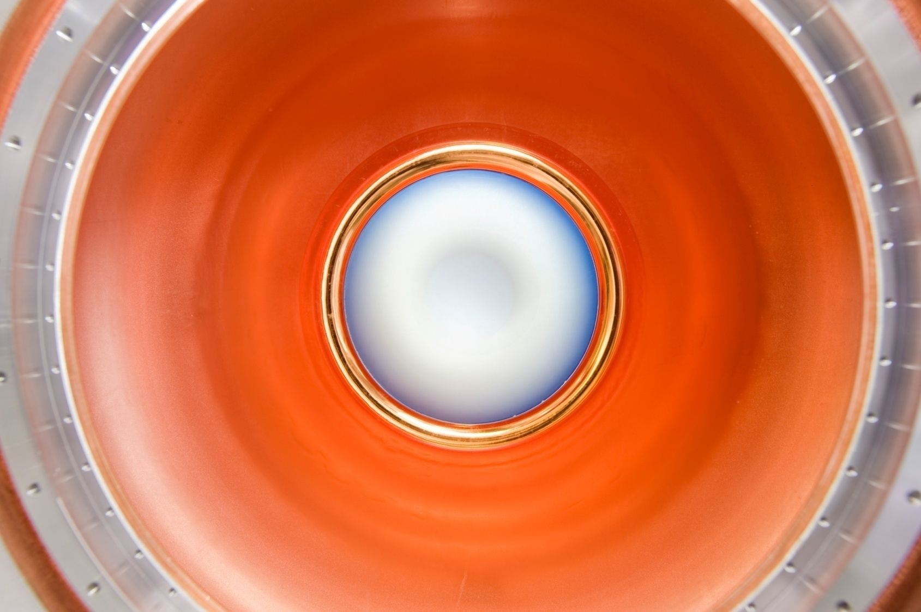
Component Development

Slide 2
Outline
Program Overview
Progress & goals
Plans
Summary

Slide 3
Component Development L2 Organization
Normal Conducting RF
Derun Li, LBNL, RF scientist for the MuCool program
Superconducting RF
Don Hartill, Professor Cornell University
Magnets
John Tompkins, Deputy Head Fermilab (TD) Magnet Systems Department
Targets and Absorbers
Kirk McDonald, Princeton University & co-spokesperson of the MERIT experiment
MuCool Test Area Coordinator
Yagmur Torun, Professor Illinois Institute of Technology

Slide 4
Primary Goals
Establish the viability of the concepts and components that will be used in the design reports
Neutrino Factory Reference Design Report (NF-RDR)
Muon Collider Design Feasibility Study Report (MC-DFSR)
Establish the engineering performance parameters to be assumed in the design studies
Provide a good basis for cost estimates.

Slide 5
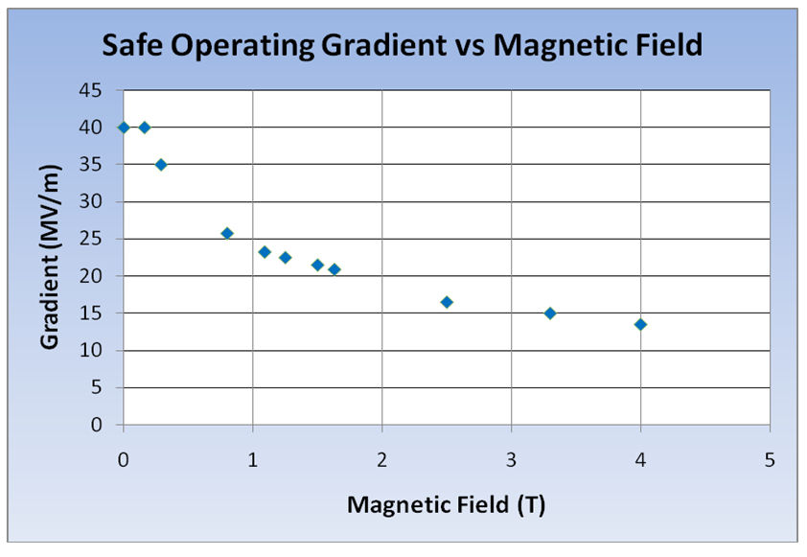
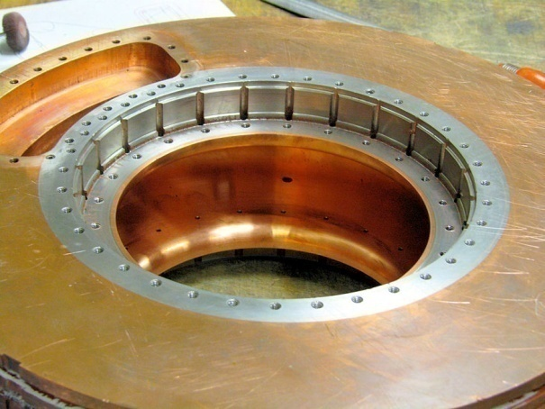
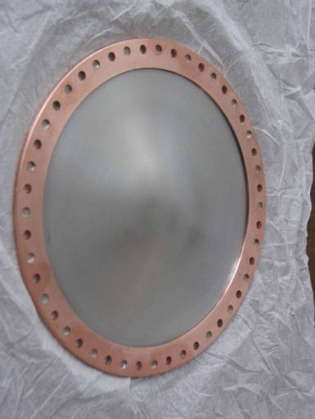
NCRF
Significant degradation in maximum stable operating gradient with applied B field
805 MHz RF Pillbox data
Curved Be windows
E parallel B
Electron current/arcs focused by B
Degradation also observed with 201 MHz cavity
Qualitatively, quite different
Details will be presented in RF parallel

Slide 6
NCRF Program R&D Strategy
Technology Assessment (continuation of existing multi-pronged program)
Surface Processing
Reduce (eliminate?) surface field enhancements, field emission
SCRF processing techniques
Electro-polishing (smooth by removing) + HP H₂O rinse
More advanced techniques (Atomic-Layer-Deposition (ALD))
Smooth by adding to surface (conformal coating @ molecular level)
Materials studies: Use base materials that are more robust to the focusing effects of the magnetic field
Cavity bodies made from Be or possibly Mo
Magnetic Insulation
Inhibit focusing due to applied B
High-Pressure Gas-filled (H₂) cavities
Vacuum

Slide 7
Phase I RF Program (2+ year)
Complete tests on Magnetic Insulation
Tests completed - concept dropped (DnS’d)
Materials tests: Be
Button cavity test (Y. Torun)
Be wall cavity (D. Li)
Beam tests of HP H₂ filled cavity (Yonehara)
All-Seasons Cavity tests (AB)
Future
MICE 201 MHz production cavity test
New 805 MHz pillbox (Z. Li)
201 MHz tests in higher B field
Need new SC magnet - FY2014

Slide 8
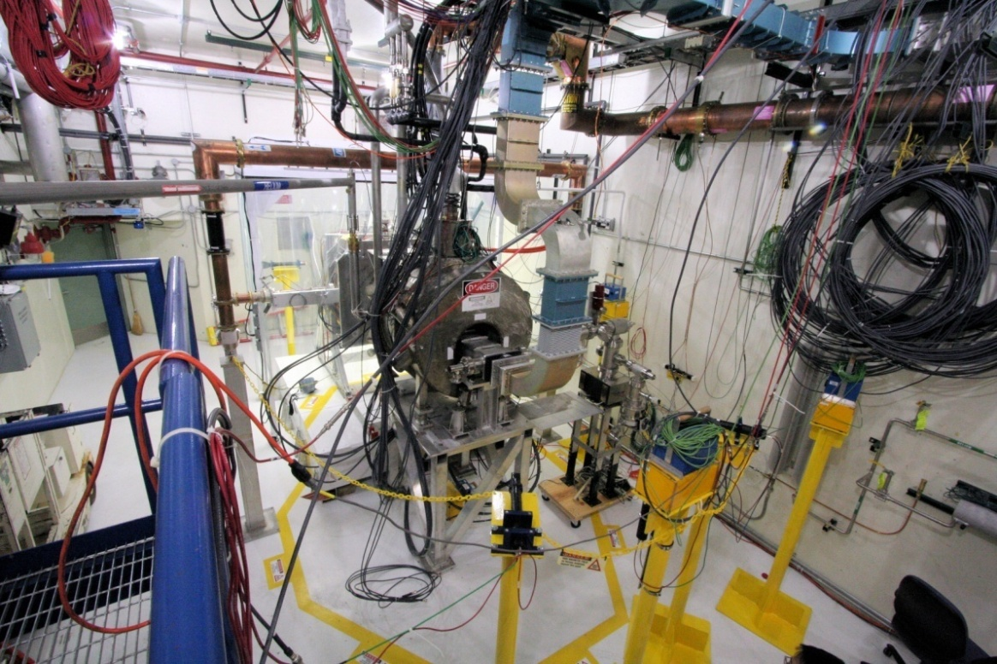
RF Test Facility
MuCool Test Area
RF Power
201 MHz (5MW)
805 MHz (12 MW)
Class 100 clean room
Instrumentation
Ion counters, scintillation counters, optical signal, spectrophotometer
4T SC Solenoid
250W LHe cryo-plant
400 MeV p beam line

Slide 9
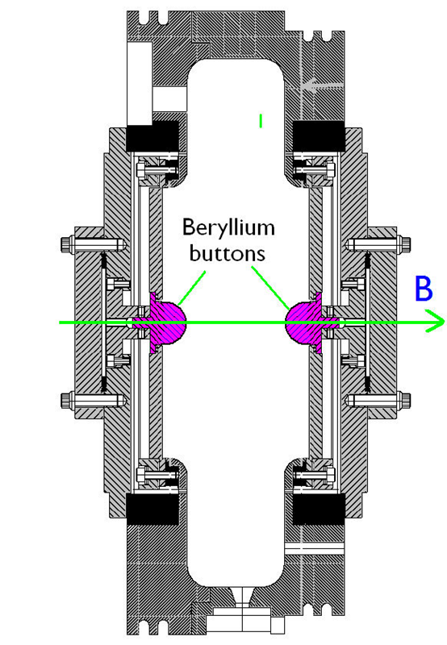
Be Button Tests
Copper
buttons
vs.
Yagmur Torun

Slide 10
Be-Wall Cavity
Derun Li

Slide 11
New 805 MHz Pillbox
Zhenghai Li

Slide 12
High-Pressure H₂ filled Cavity
Katsuya Yonehara

Slide 13
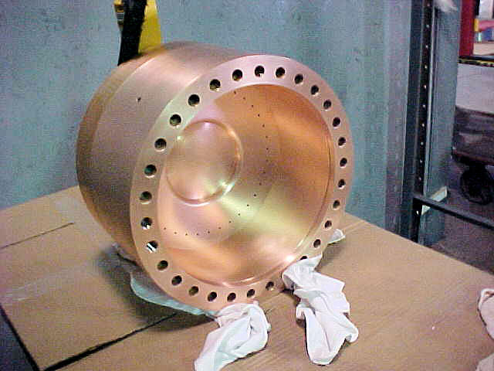
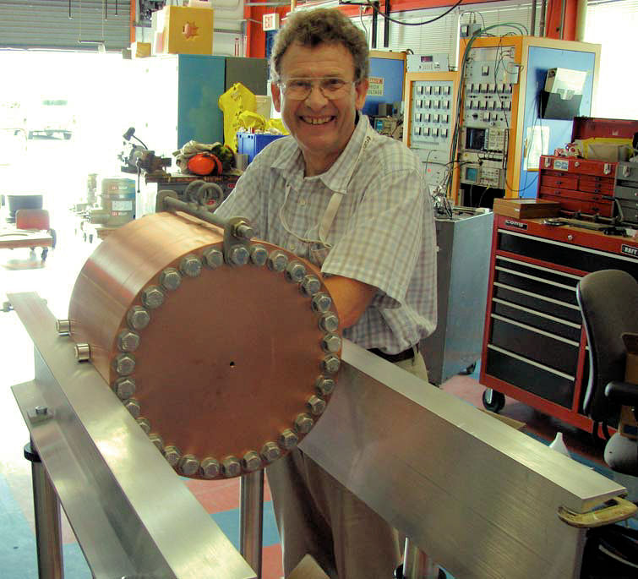
All-Seasons Cavity
Tested at B=0 & B=3T
Two cycles: B₀, B₃, B₀ & B₃
No difference in Max Stable Op. Gradient
RF pickup did not work
Gradient ≈ 25 MV/m ± 5%
Paradigm shift for vacuum RF in B?

Slide 14
MICE 201 MHz Production Cavity Test
Ready for final assembly
in May 2012

Slide 15
MICE RFCC_{lite} Test in MTA

Slide 16
Magnet R&D - Overview
Neutrino Factory and Muon Collider accelerator complexes require magnets with quite challenging parameters
HTS solenoid R&D to assess the parameters that are likely to be achieved
What is the highest practical achievable solenoid field & what is the R&D required before these solenoids can be built?
Magnet design R&D for collider ring and IR magnets that have to deal with the expected high level of energy deposition from μ decay electrons
What is the optimal design for the collider ring magnets that will enable them to operate in the presence of the decay electrons? Paper studies only (with D&S group)
Fast Ramping Magnets utilized in rapid-cycling synchrotron for final acceleration for the MC

Slide 17
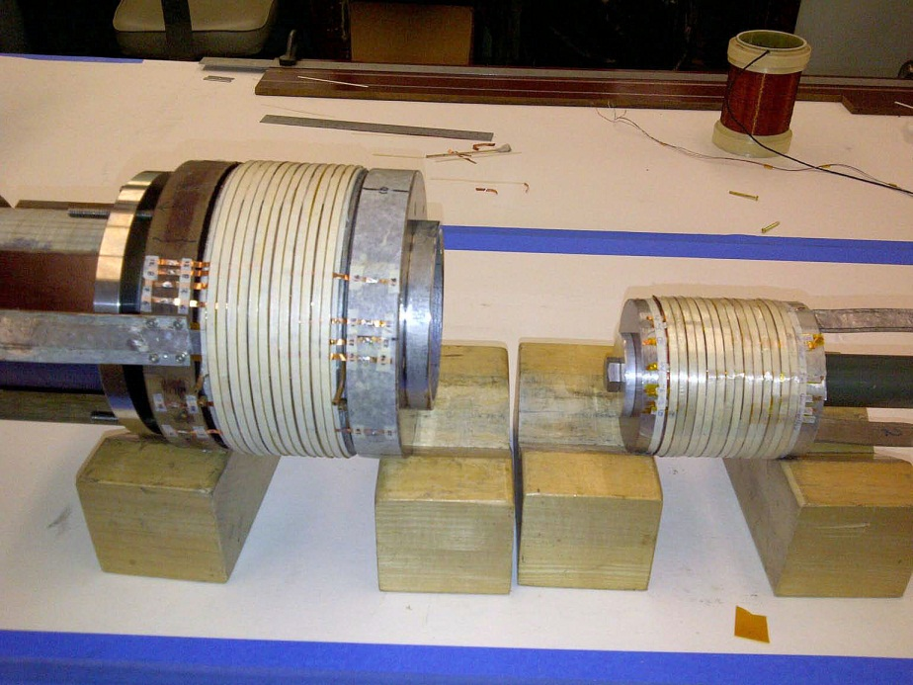
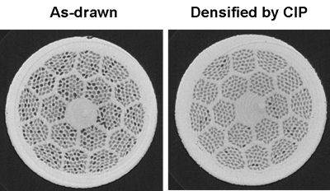
Magnet R&D – HTS
HTS Solenoid
Develop functional specifications for the high field solenoid & perform tests
HTS conductor cable R&D
Tengming Shen
HTS pancake magnet tests
Ramesh Gupta

Slide 18
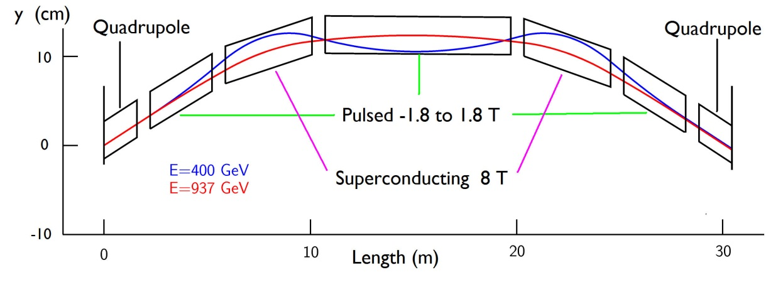
Magnet R&D μCollider Ring & Acceleration
Collider Ring Magnets (A. Zlobin)
Produce effective conceptual designs for
IR quads & dipoles
Collider ring dipoles and quads
Fast Ramping Magnets (400 Hz) (D. Summers)
Building prototypes with goal to produce 30 cm test magnets

Slide 19
400 Hz prototype

Slide 20
Targetry
This year has been primarily limited to paper studies
Nozzel & jet (Y. Zhan)
MHD Simulations (R. Samulyak)
Particle production (X. Ding)
Energy management (N. Souchlas)
Magnet configurations (R. Weggel)

Slide 21
Component Development RF Plans/Milestones
 | MILESTONE | DELIVERABLE | INSTITUTION
RF / MTA
RF-1 | Complete Be button test | MAP note; Q2 | FNAL
RF-2 | Complete 2nd HPRF cavity beam test | Draft Journal paper; Q4 | FNAL
RF-3 | Prepare MTA for MICE production cavity test | Inspection; Q3 | FNAL
RF-4 | Upgrade CAMAC DAQ system | Inspection; Q2 | IIT
RF-5 | Analyze pillbox cavity Be button data | MAP Note; Q2 | IIT
RF-6 | Analyze box cavity data | MAP Note; Q1 | IIT
RF-7 | Analyze 2nd HPRF beam test data | MAP Note; Q4 | IIT
RF-8 | Analyze MTA magnet map data | MAP Note; Q1 | IIT
RF-9 | Finish MTA environmental monitoring setup | Inspection; Q1 | IIT
RF-10 | Test acoustic sensors on RF cavity | Presentation; Q3 | IIT
RF-11 | Support MTA RF R&D | Inspection; ongoing | JLab
RF-12 | Complete Be-wall cavity design | Engineering note; Q3 | LBNL
RF-13 | Support MTA RF R&D | Inspection; ongoing | LBNL
RF-14 | Support MTA RF R&D | Inspection; ongoing | ANL
RF-15 | Complete RF cavity & coupler waveguide design | Design review; Q2 | SLAC
RF-16 | Complete cavity drawing package | Engineering note; Q3 | SLAC
RF-17 | Cavity assembly & cold test, and assist in high power test at MTA | MAP note; Q4 | SLAC

Slide 22
Component Development Magnet Plans/Milestones
MAGNETS
MAG-1 | Wind, react, and test small-scale Bi-2212 coil which has all the key elements of a 30T insert | MAP Note; Q4 | FNAL
MAG-2 | Document 400Hz, 1.8T dipole results | Conf. paper; Q2 | U. Miss
MAG-3 | Develop BH curves for grain oriented steel with Epstein frame | MAP note; Q3 | U. Miss
MAG-4 | Produce OPERA-2D map for rap. cycling dipole | MAP note; Q3 | U. Miss
MAG-5 | Develop code to handle grain oriented steel | MAP note; Q3 | U. Miss
MAG-6 | Complete 2nd round magnet measurements | MAP note; Q2 | U. Miss
MAG-7 | Make 2nd rap. cycling dipole prototype | Inspection; Q4 | U. Miss

Slide 23
Component Development Targetry Plans/Milestones
TARGET
T-1 | Design integrated coil/shielding config. for target | IPAC12 paper; Q3 | BNL
T-2 | Continue target area design studies | MAP note; Q3 | Princeton
T-3 | Contribute to IDS-NF target design | Report; Q4 | Princeton
T-4 | Develop Hg target system concepts for IDS-NF | IPAC paper; Q3 | ORNL

Slide 24
Summary
The RF program continues a multi-pronged attack on the technology
The MTA is now a smoothly running facility that is unique in the world
Magnetic Insulation (voted off the island)
Materials studies
SCRF processing
Cavity materials (Be)
High-pressure H₂ filled RF exposed to p beam
Continuing 201 MHz program
MICE production single-cavity test system
Future studies @ higher B field

Slide 25
Summary II
Magnet program is primarily addressing cooling issues
Final cooling via very-high-field HTS solenoids
But also addresses the other critical magnet issues for the MC complex
Ring magnets
Open-plane dipoles, quads, etc
Acceleration
Fast-ramping magnets
Targetry has mostly been limited to paper studies due funding limitations.

Slide 26
END
Now lets gone on to the“Meat”
Well, coffee first

