Slide 1
Low Surface Field 805-MHz Pillbox Cavity
Zenghai Li, Lixin Ge, Chris Adolphsen, and David W. Martin, SLAC
Derun Li and Daniel L. Bowring, LBNL
MAP Workshop, SLAC, March 4-8, 2012

Slide 2
Outline
New low surface field 805-MHz cavity design
Multipacting comparison
Field emission dark current analysis
Summary and outlook

Slide 3
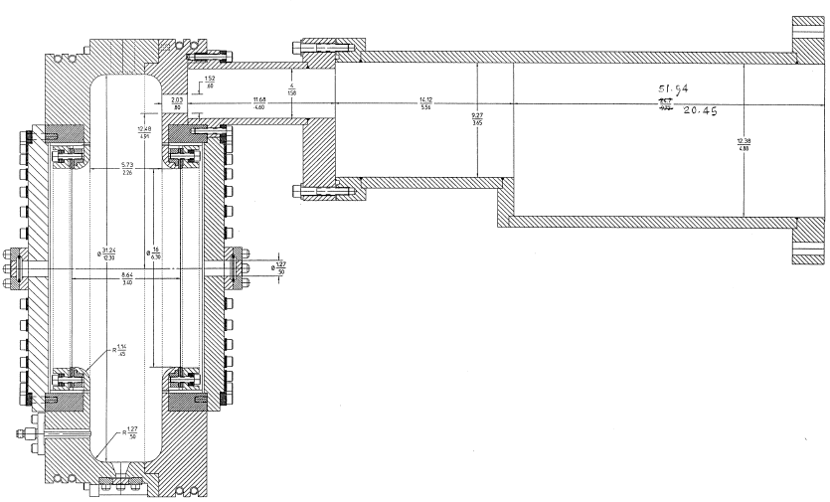
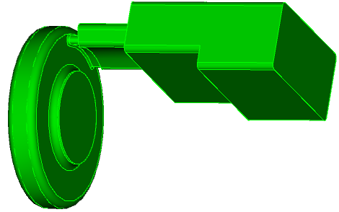
805-MHz Cavity
(Derun Li)
Original Design
B field

Slide 4
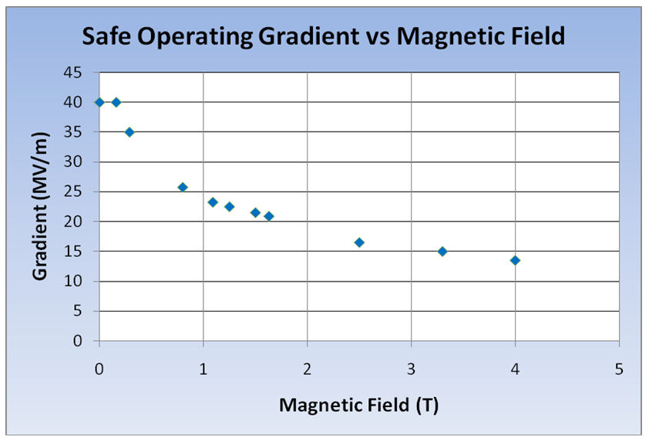
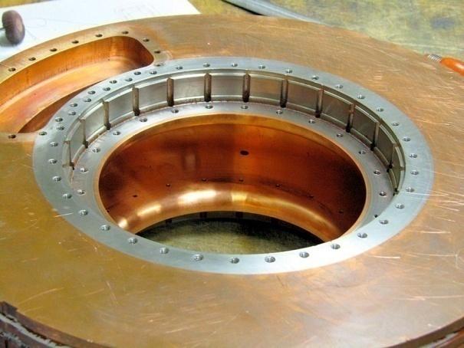
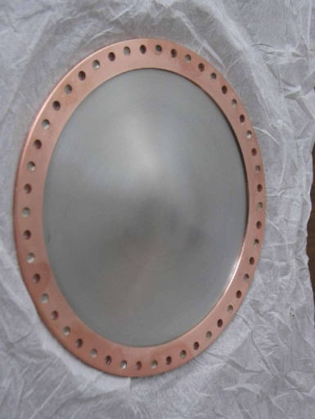
“Our” RF Challenge
Significant degradation in maximum stable operating gradient with applied B field
805 MHz RF Pillbox data
  Curved Be windows
  E parallel B
  Electron current/arcs focused by B
Degradation also observed with 201 MHz cavity
  Qualitatively, quite different

Slide 5
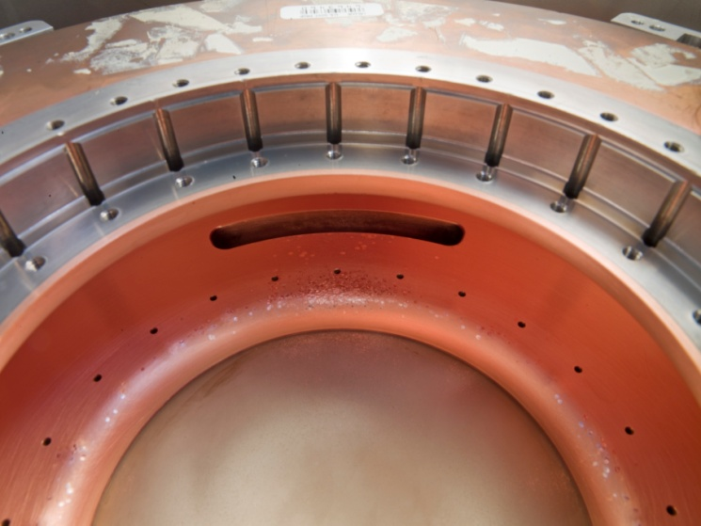
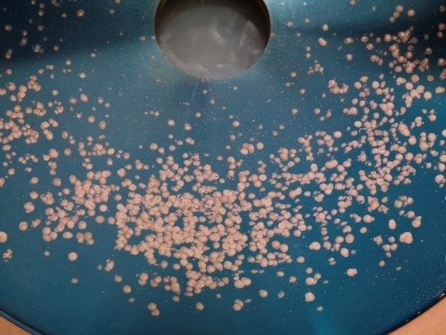
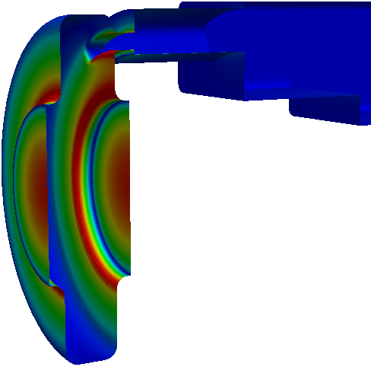
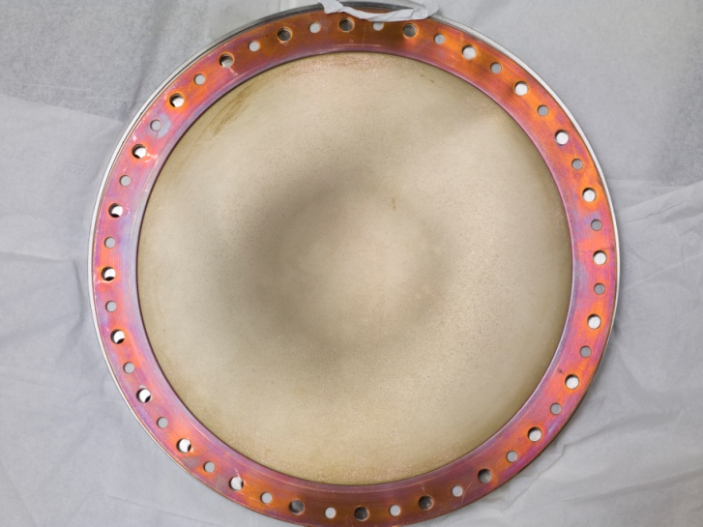
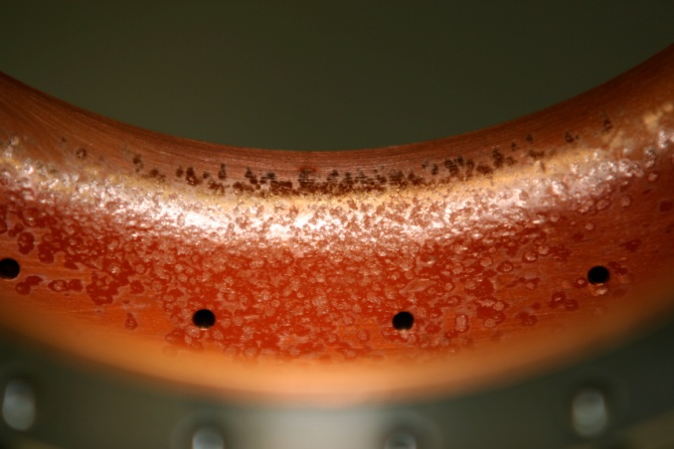
805 Pillbox
Post-Mortem
Significant damage observed
  Iris
  RF coupler
  Button holder
However
  No damage to Be window
E field

Slide 6
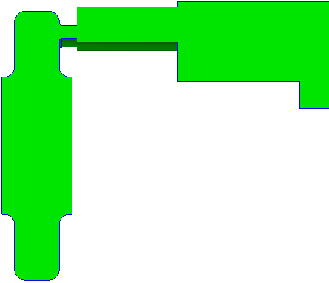
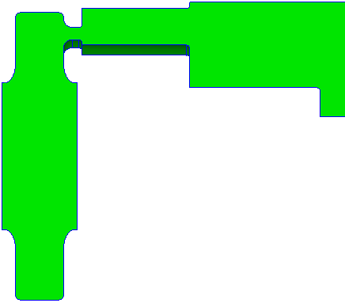

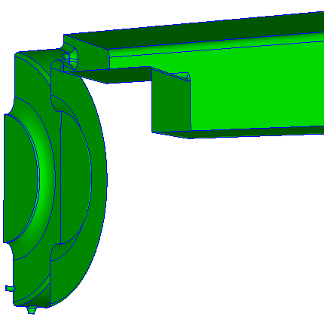
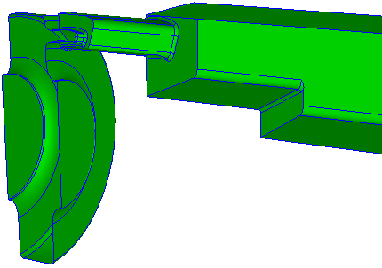
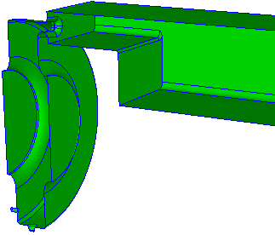
New Design with Improved Surface Field
Original
New low field design
Larger rounding around coupling slot
Elliptical disk profile
40% surface field reduction
Replaced cutoff wg with propagating wg
Coupling at cavity outer radius
Smaller opening – lower field
Significant surface field reduction – Max E field on window surface

Slide 7
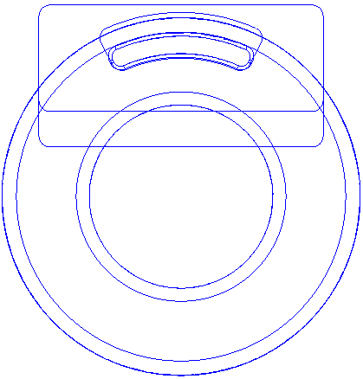
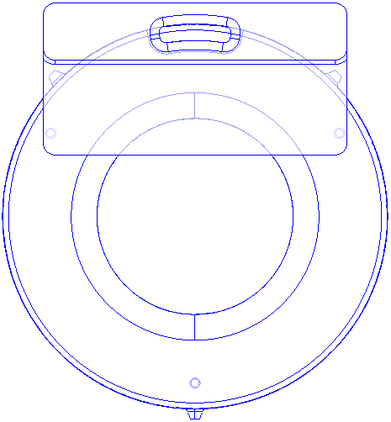
Coupler Design Comparison
Original
New

Slide 8
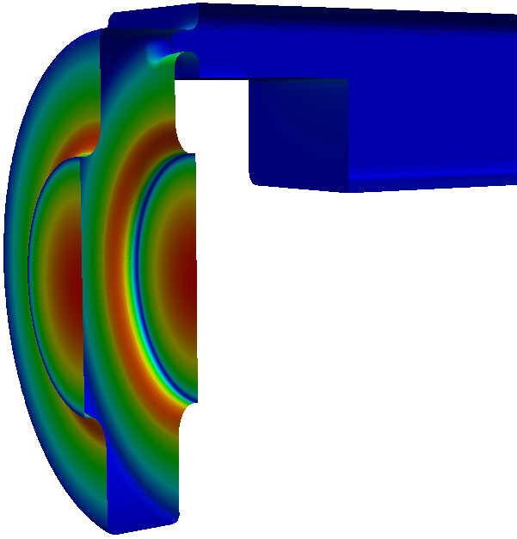
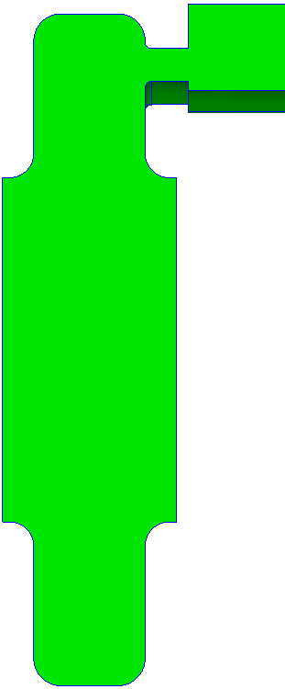
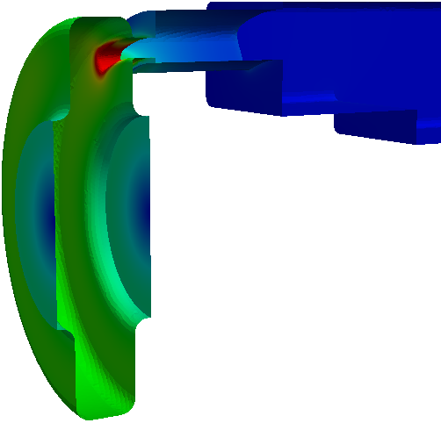
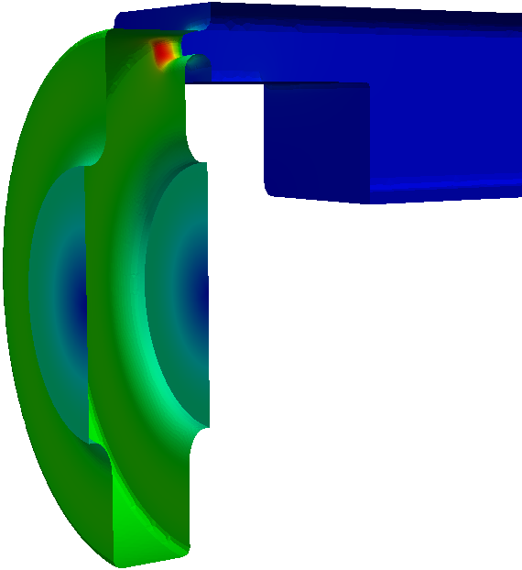
New Design With Low Surface Field
Original
New low field design
slot 2
slot 1
E
E
anose
end bp
B
B

Slide 9
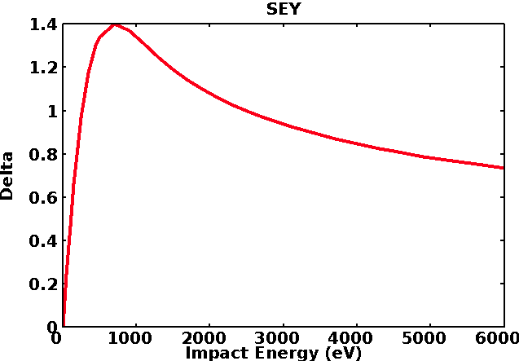
Multipacting Simulation Using Track3P
Part of ACE3P (Omega3P, S3P, T3P, Track3P, etc)
3D parallel particle tracking in high-order finite-element mesh
Analyze resonant trajectories
Use impact energy and SEY to estimate MP strength
Copper SEY peak around 800eV impact energy

Slide 10
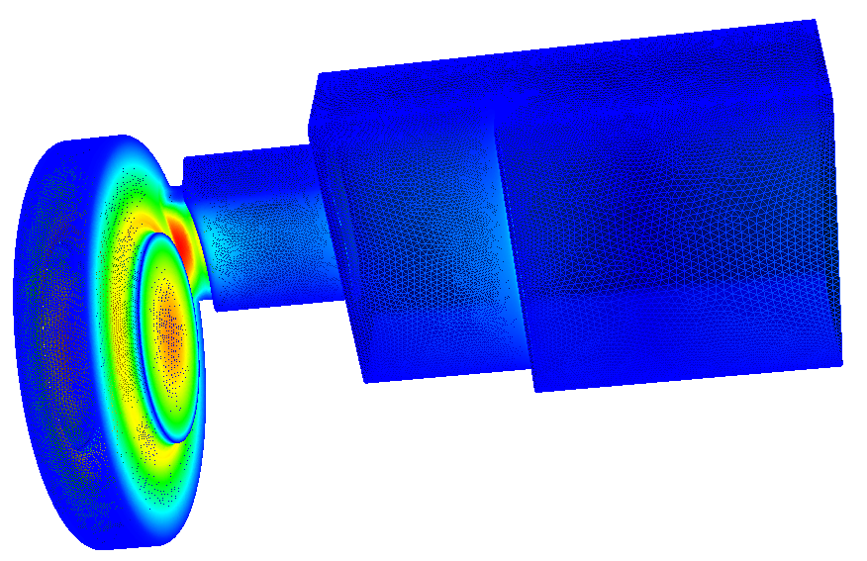
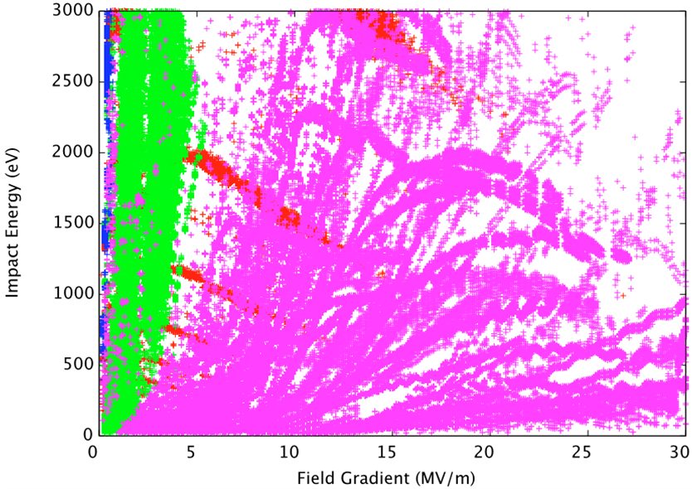
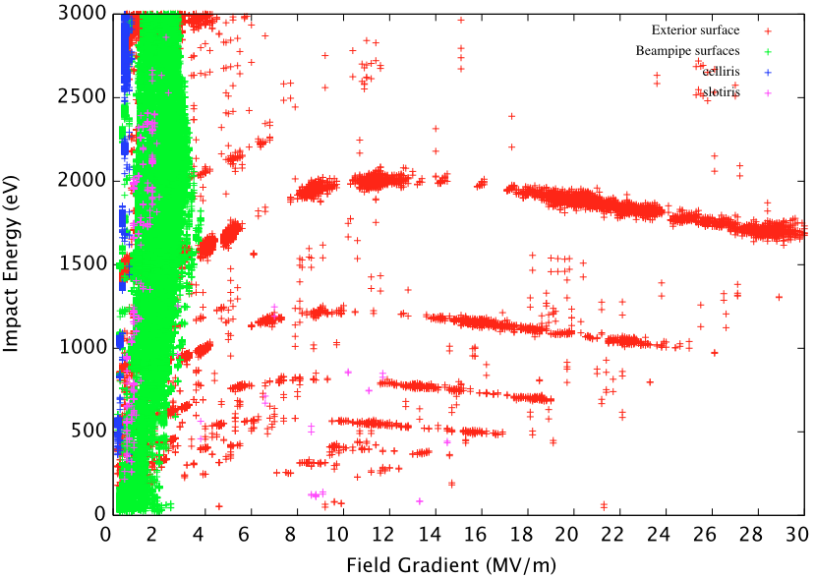
Multipacting Analysis
Field level scan: 0.1MV/m – 30MV/m, interval 0.1MV/m
Initial Particles distributed on all exterior surface
Each field level ran 50 RF cycles
3 Tesla
Original Design
New Design
Window
Disk rounding
Coupling iris
Other

Slide 11
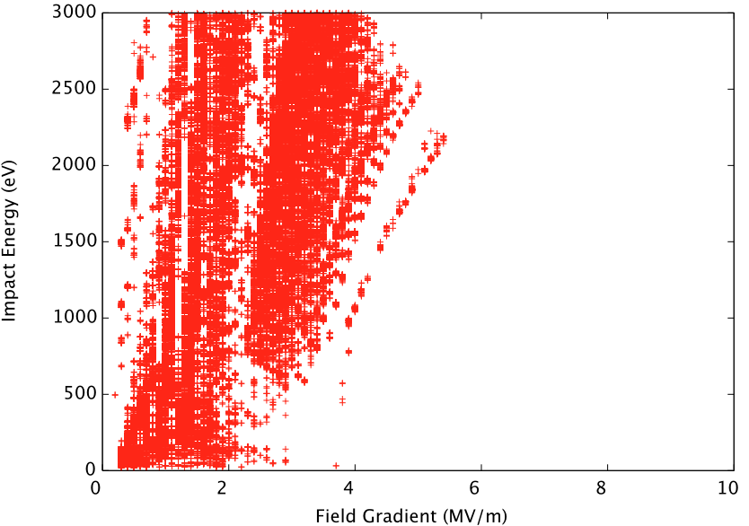
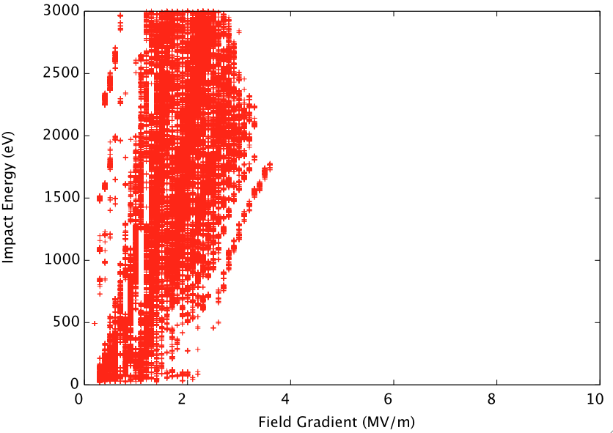
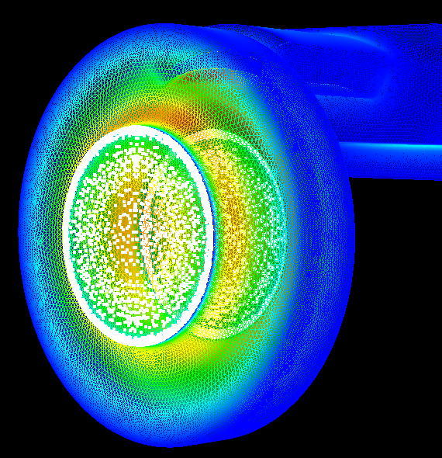
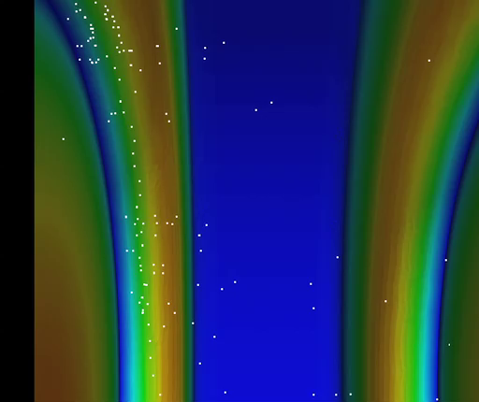
Multipacting on Window Surface
Original Design New Design

Slide 12
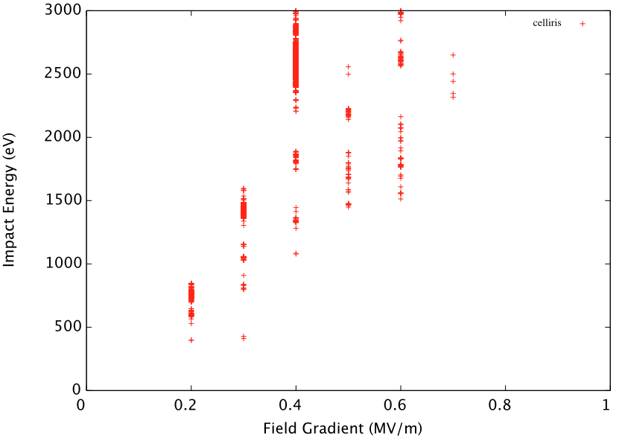
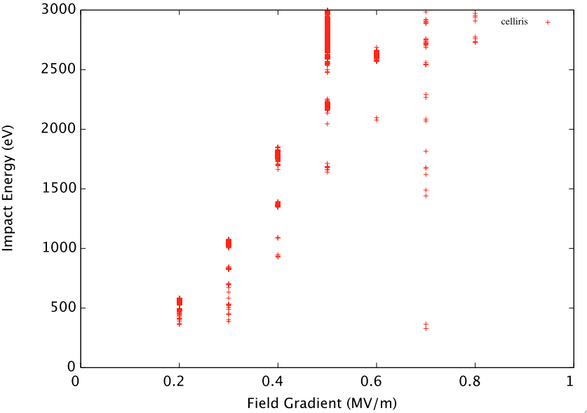
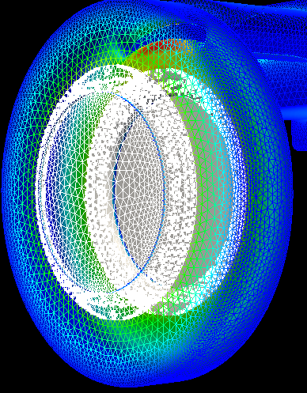
Multipacting on Disk Rounding
Original Design New Design

Slide 13
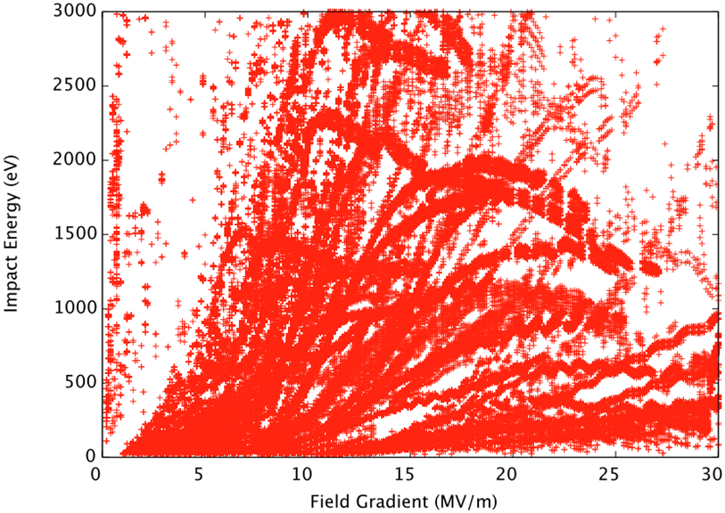
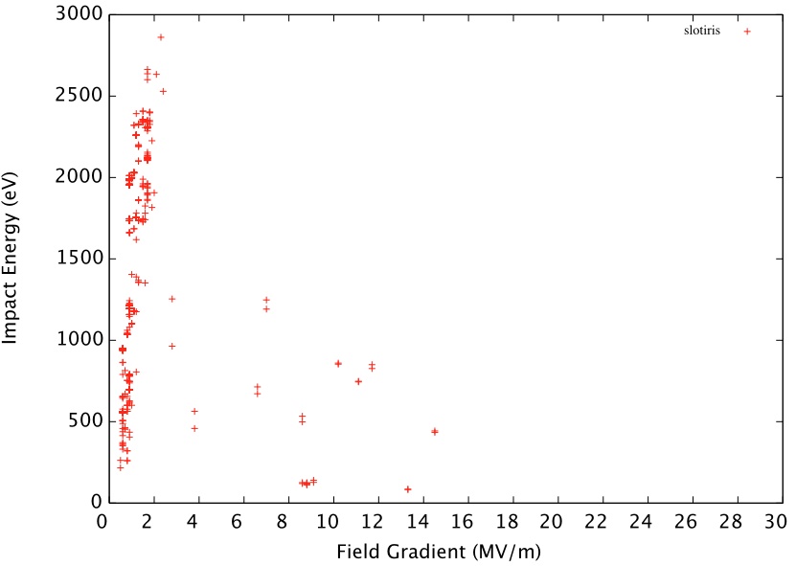
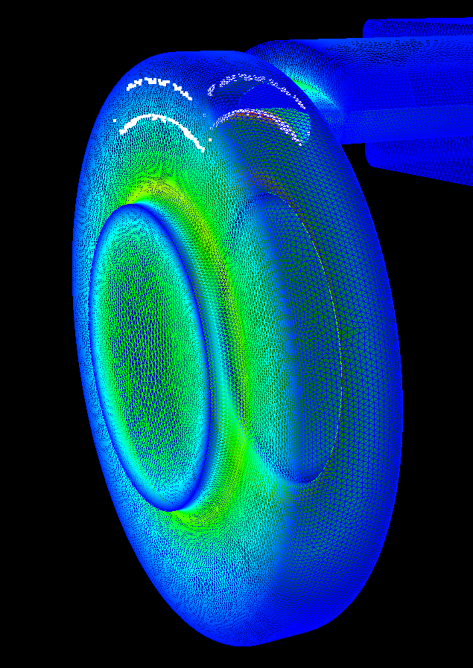
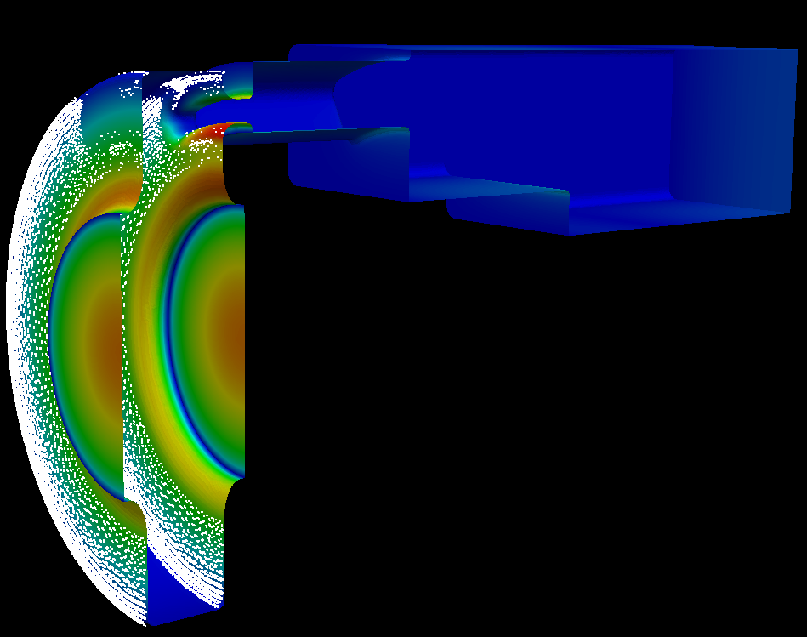
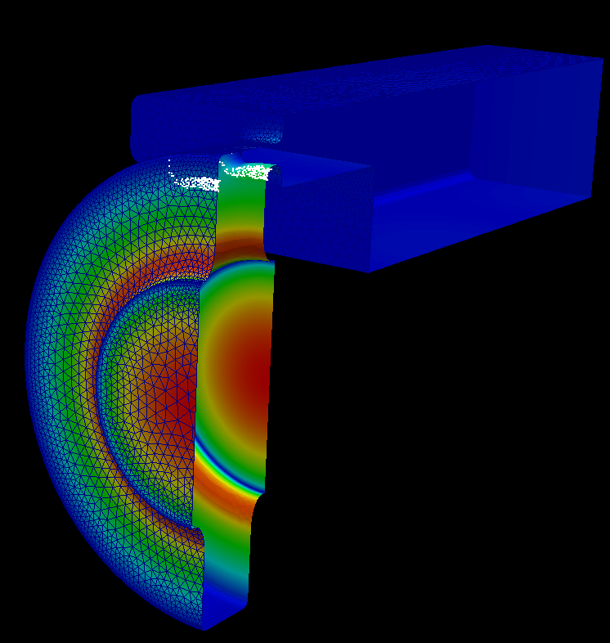
Multipacting on Coupling Iris
Original Design New Design
1st & 2nd order

Slide 14
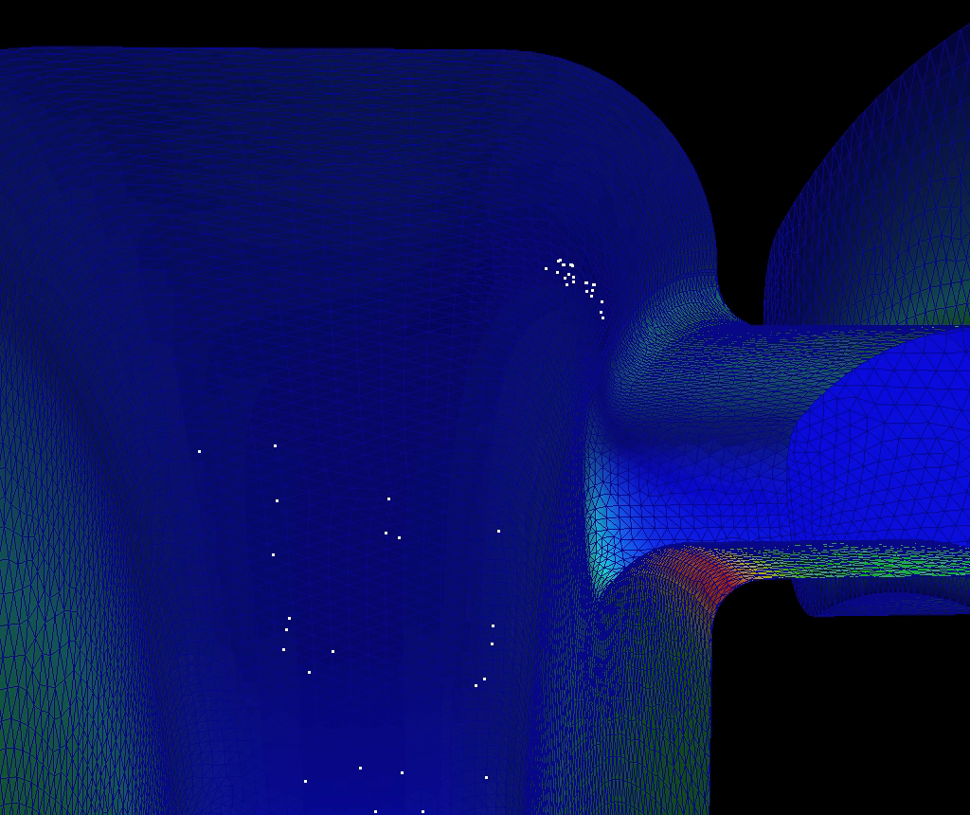
Sample MP Trajectories Around Coupling Iris
- Original Design

Slide 15
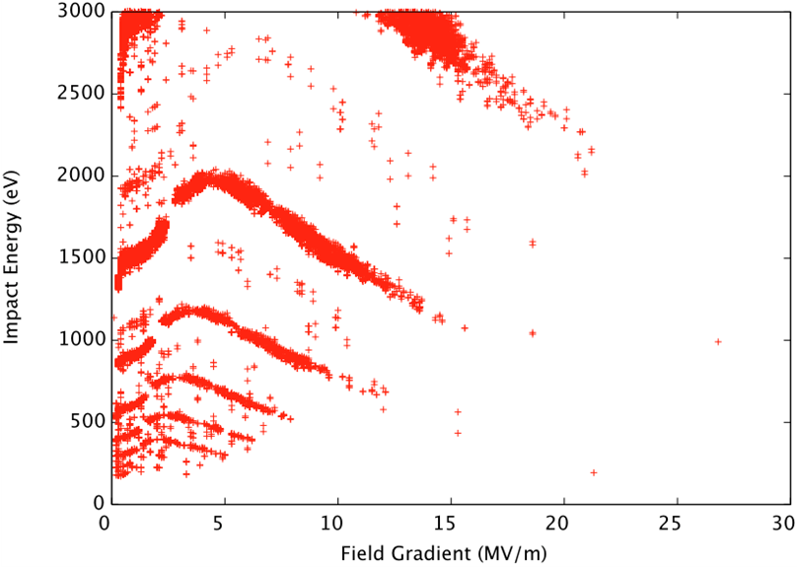
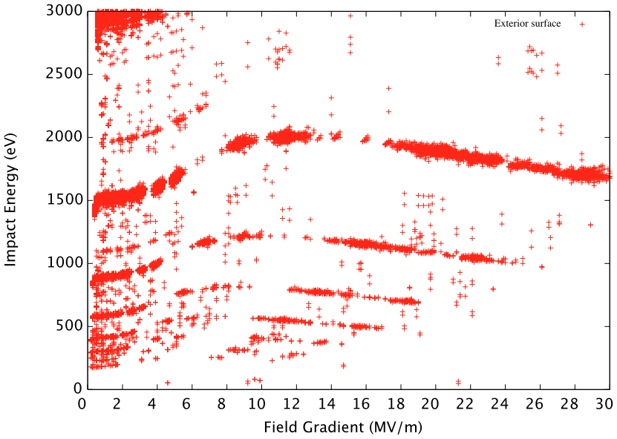
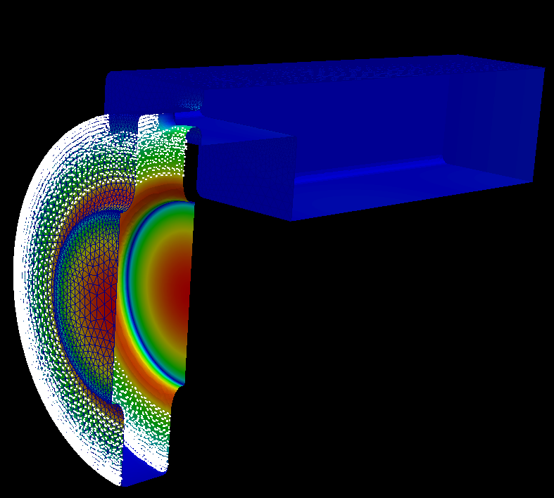
Multipacting other exterior surface
Original Design New Design
4th
6th
8th
10th

Slide 16
Field Emission Simulation
Gradient: 25 MV/m
Beta = 150 (normally use 50 for copper)
Emitted all the surface based on Fowler-Nordheim field emission
No secondary
Quantity of interest (as function of rf phase)
  Impact Energy of field emitted current
  Current (relative quantity, depend on actual beta)
  Distribution

Slide 17
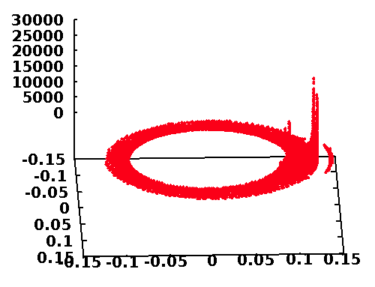
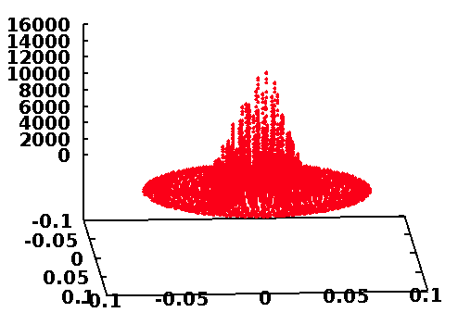
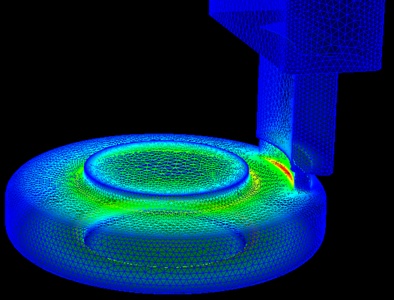
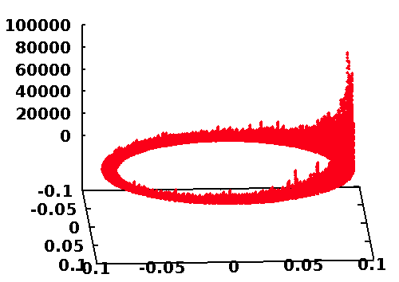
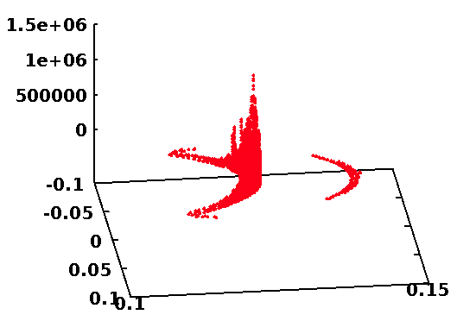
Dark Current Distribution – (original design)
Other surfaces
Window
Disk rounding
Coupling iris
Field emission current corresponding to surface E field

Slide 18
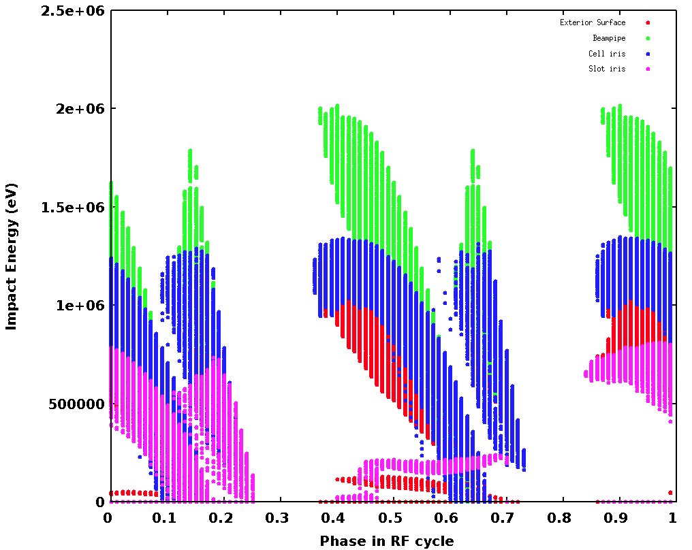
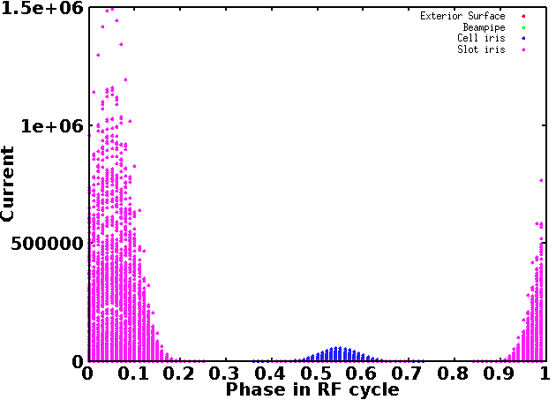
Dark Current Energy and Current (“a.u.”)
Energy v.s. Phase
Window
Disk rounding
Coupling iris
Other surfaces
(New design only has field emission on window and disk rounding)
Current v.s. Phase
High “E*I” may result in “significant damage”
(relative rf phase between original and new arbitrary)

Slide 19
Summary and Outlook
New design significantly reduced field enhancement around the coupling slot. New high field region is on the window.
Multipacting simulation indicated significant improvement in the coupling slot region.
Field emission DC reduced as a result of low surface field.
Engineering design in progress.
Will compare with measurement data to help understand high power processing of the 805-MHz cavity
Would like to contribute to other RF cavity/system studies

