Slide 1
Accelerator R&D at SLAC: Finding answers to questions we know and those we don’t
N. Holtkamp
SLAC National Accelerator Laboratory
DESY
Nov 15, 2011

Slide 2
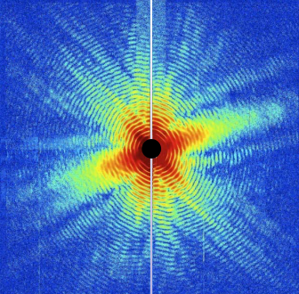
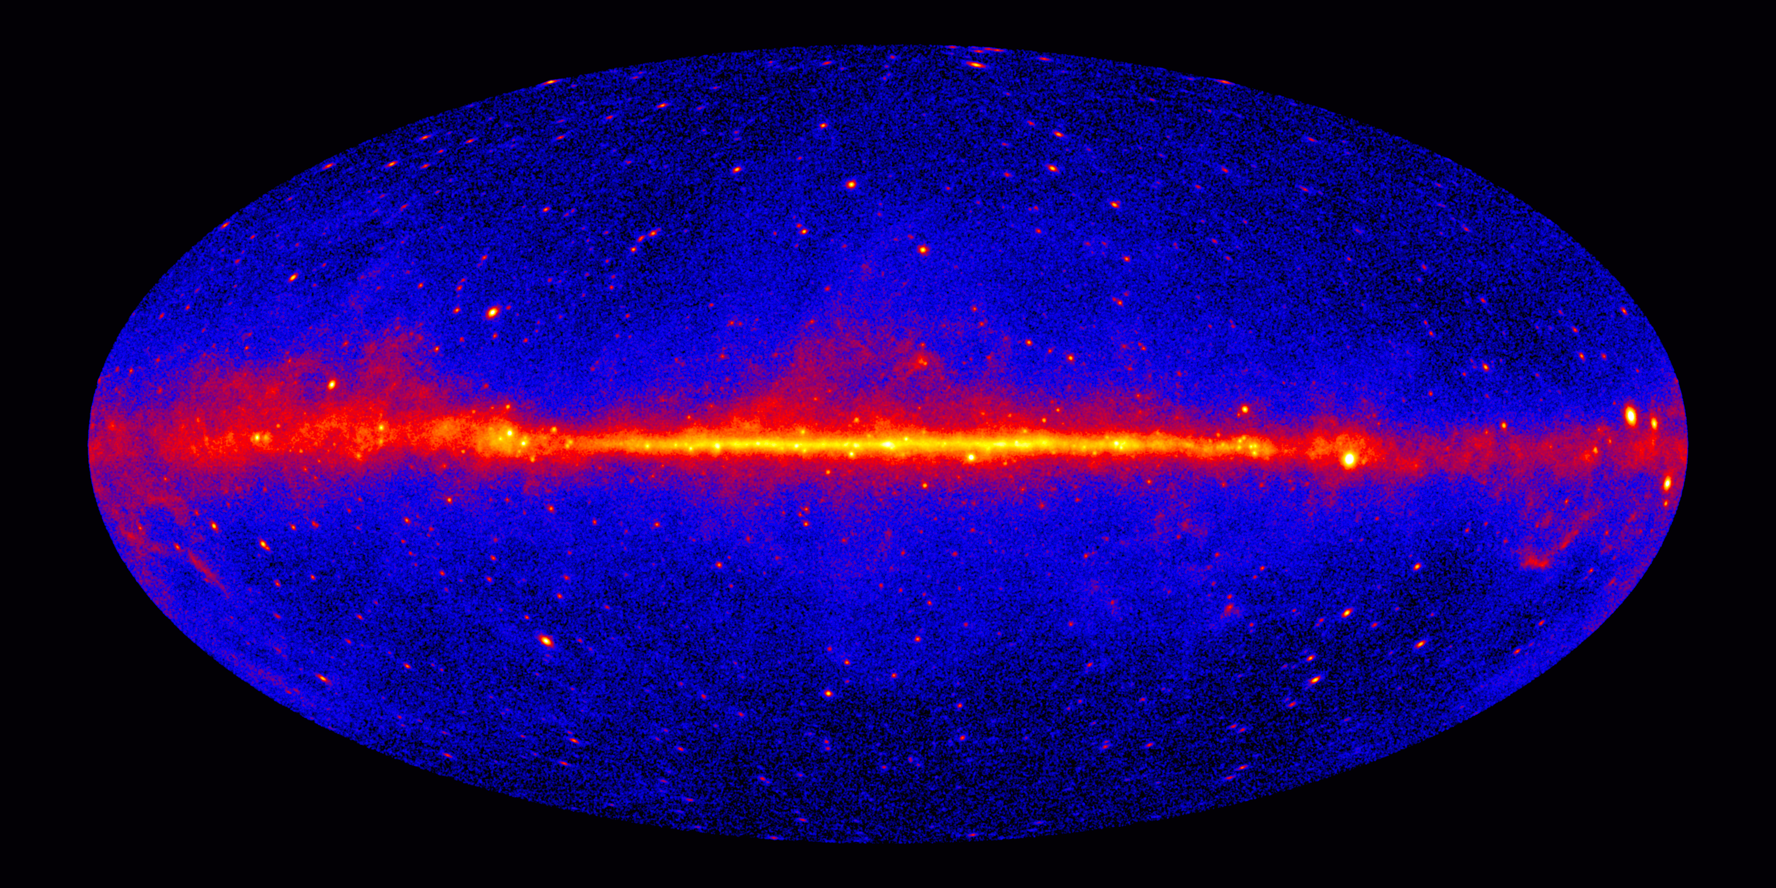
Mission of SLAC
Grow into the premier Photon Science Laboratory
  Build and operate world leading facilities
  Perform world leading science at these facilities
Maintain our position as the premier accelerator laboratory
Pursue strategic programs in particle physics, particle astrophysics and cosmology

Slide 3
Lab-at-a-Glance
Total FY2011: $351M
Recovery Act Obligated from DOE: $92.7M
  Location: Menlo Park, CA
  Type: Multi-program Laboratory
  Contract Operator:
  Stanford University
  Human Capital:
    Employees: 1,579 FTE
    205 Postdocs, Undergrad + Grad Students
    3,142 Facility Users & Visiting Scientists

Slide 4
Over last 5 years, SLAC has shifted its focus away from particle physics

Slide 5
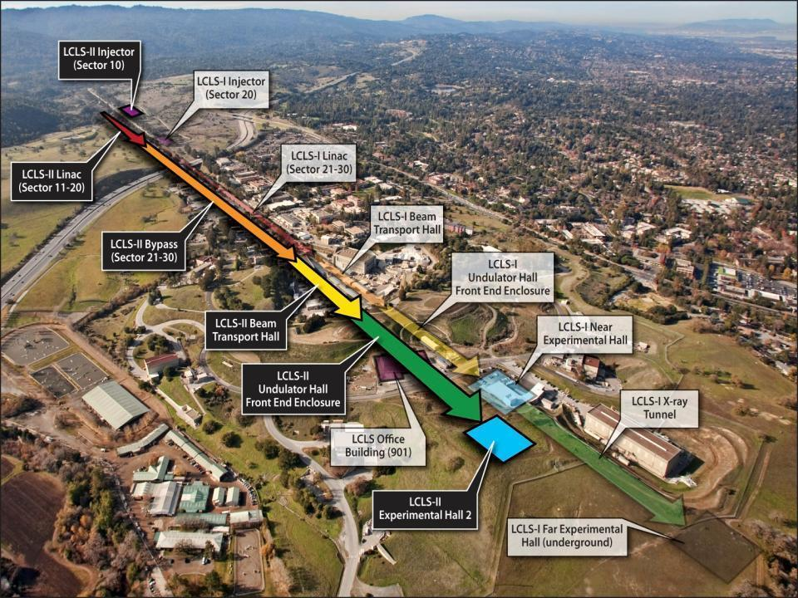
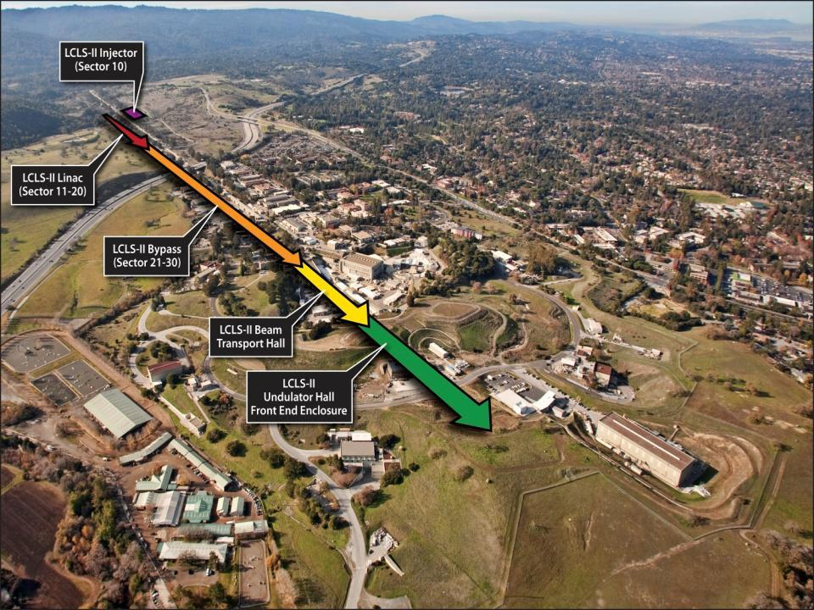
…Here is where we accomplish the Mission?
FACET National User Facility
ASTA
SSRL
ESTB
NLCTA
(Acc. R&D)
Notes:
Message: investing at SLAC is the cheapest way for DOE to stay at the forefront. Since we don’t see growing budgets for new project, we give DOE the solution.

Slide 6
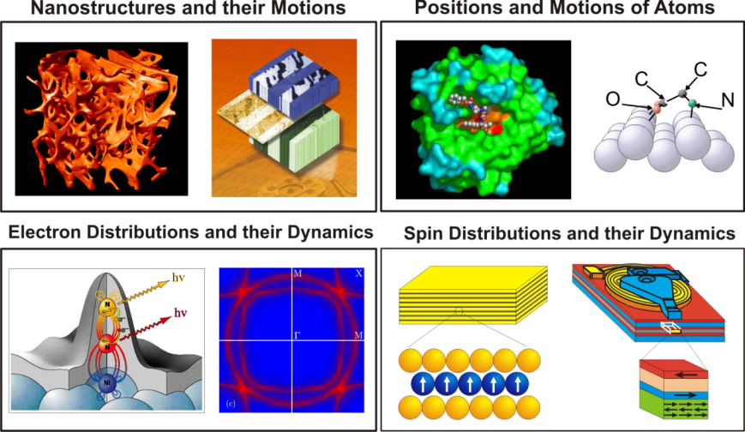
X-Rays - seeing the Invisible

Slide 7
Beyond HEP: The SLAC Multi-Program Environment
PPA
AD
LCLS,SSRL & Photon Science
Detector R&D
Computing
Data acquisition & management
Beam Dynamics
Technology infrastructure
Test Facilities
Research on future colliders
Computation
LCLS Operations
LCLS Experiments
  Data acquisition
  Data storage
High brightness beams
Low Emittance Beam Acceleration
New light source concepts
…and back

Slide 8
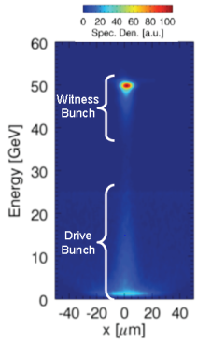
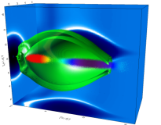
Objective: Maintain our status as the Premier Accelerator Laboratory
SLAC accelerator research key to our future
  World leaders in FEL R&D
  World leader in Advanced Accelerator R&D. Provide facilities but also perform science
  World leader in High Power RF and NC Linac Design and construction
Goal to provide accelerator technology to SLAC and the nation
FACET

Slide 9
Targeted Programs in Accelerator R&D relevant to Particle physics

Slide 10
What is needed for the Energy Frontier?
New acceleration mechanisms
New power sources
New particle sources
Ring Design, Beam dynamics, feedback systems
Controlling nanometer beams
Controlling beam trains & feedback
A factor of 10 or more is needed in many directions…..
High gradient rf;
Direct laser acceleration;
Plasma wakefield acc.
Higher energy
Higher gradients
Higher luminosity
Smaller emittance
More beam control
RFARE
Division and
ESB testing
Science needs
TeV energies &10³⁴ luminosity
MPS design;
Fast kickers;
High power dumps
Polarized
guns and
rf guns
Final focus systems;
Nonlinear dynamics;
Vibration stabilization
Ring design
GHz feedback
Notes:
Message: SLAC still contributes in the Energy Frontier research. Existing infrastructure and talent supports HEP mission at the Energy frontier, especially but not only in the Lepton front. In several cases HEP and BES infrastructure are common.

Slide 11
The Importance of “high gradient”
Many paths towards high gradients
  RF source driven superconducting structures
  RF source driven metallic structures
  Beam-driven metallic structures
  Laser-driven dielectric structures
  Beam-driven dielectric structures
  Laser-driven plasmas
  Beam-driven plasmas
FNAL/JLAB
~50 MV/m
NLCTA
~100 MV/m
CERN
E-163
~1 GV/m
FACET
BELLA
~10 GV/m
FACET

Slide 12
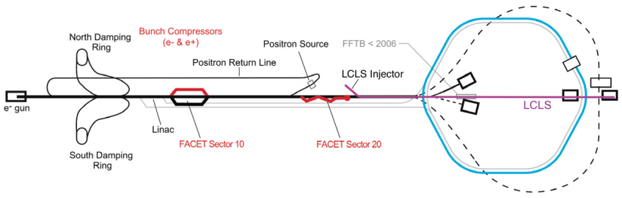
Facility for Advanced Accelerator Tests a National User Facility
FACET uses the first two-thirds of the SLAC Linac
Electron and positron beams
Energy 20 to 23 GeV
Charge 3.2 nC (=2*10¹⁰ particles)
Sigma x = 14 μm
Sigma y = 6 μm
Sigma z = 14 μm minimum (20 μm typical)
@ IP

Slide 13
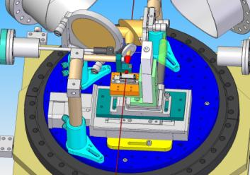
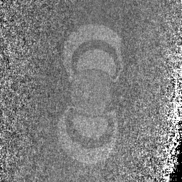

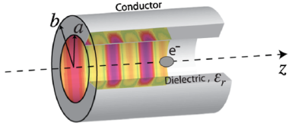
FACET Science: E-201 and E-205 Wakefield Acceleration in Dielectric Structures & E-202 Ultrafast Magnetic Switching
The FACET beam is sent through prototype dielectric wakefield acceleration structures
Investigation of magnetic switching processes by exposing samples to electron bunches then image with spin-sensitive scanning electron microscope
a = 100um to 800um
MAP 2012 Winter Meeting
CoFe/MgO, σ_{t}=230fs
Fe/W(110)

Slide 14

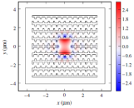
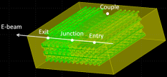
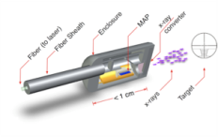
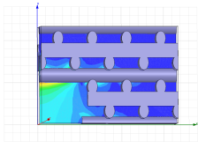
Other Areas: Direct LASER Acceleration
Working with optical wavelengths necessarily means that components built to confine fields in this range achieve nanometer and attosecond scale performance.
Further applications of DLA
  Optical undulators (T. Plettner, KLA-Tencor)
  Optical BPMs (Z. Wu, K. Soong, SLAC),
  Optical Structure Based beam focusing (B. Cowan, Tech-X)
  Optical kickers and steering elements (K. Soong, C. McGuinness, Stanford)
  Attosecond-scale timing diagnostics
  Internal-Beam Radiotherapy (G. Travish, R. Yoder, UCLA)
  Optical BPMs (L. Schächter, IIT-Technion)
  THz sources (Z. Wu, SLAC)
Grating-based optical undulator– T. Plettner, PRST-AB, 11, 030704 (2008).
Not today
Woodpile structure designed with focusing field—B. Cowan, PRST-AB, 11, 011301, (2008).
Woodpile structure simulations as a BPM—Z. Wu
MAP structure for IBRT. -- G. Travish, R. Yoder, UCLA.
Woodpile structure designed to support deflecting mode—C. McGuinness

Slide 15
Leader in FEL Operation and FEL R&D for LCLS, LCLS II and FELs for the next generation

Slide 16
Accelerator R&D for the future of FELs
Brighter e- beams
fsec diagnostics
Seeding
Multi bunches
Polarization control
Fast x-ray switching
Push a factor of 10 or more in many directions…..
Cathode Test Facility
Microbunching beam
physics; rf gun LDRD
More photons in <5fsec
More photons per phase space
More photons per ΔE/E
More photons per pulse
More photon control
T-Cavities
fs-timing
CCT
Science Needs:
# of γ’s
Short pulses
Rep Rate
Detector & X Ray
R&D
Echo
HXRSS
SXRSS
ITF
APPLE undulator
RF undulators
SLAC and LBNL working together to optimize an R&D program for LCLS-II and future FELs …..
360 Hz ops
Bunch trains; fast kickers
Notes:
Message: SLAC has the capability, the infrastructure and the manpower to lead the FEL field for a decade to come if we can successfully pull off even half of the elements in the program. The program is complete and if we do it right we will do it first.-Give two key examples to introduce message of the next slide. :Namely: a) HXRSS we can do at LCLS-ECHO 7 /15 we can do now ECHO 100 needs new facility. Need ITF.
NOT NLCTA

Slide 17
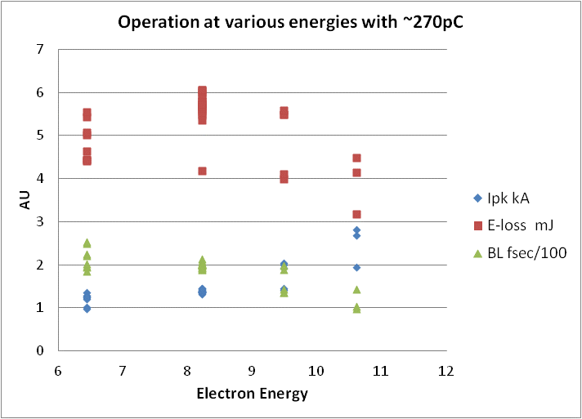
LCLS Peak Performance and new records during Run IV
 | LCLS baseline | Current performance
Photon energy range | 800 to 8000 eV | 0.4 to >9.0 keV (16keV)
FEL pulse length | 230 fs | <10 - 500 fs
FEL pulse energy | up to 2 mJ | up to 4 mJ-> 6mJ
fs
eV
mJ
Most significant event:
  Achievement of new photon pulse energy record (Aug. 24^{th,} 2011, 00:01 h)
  > 6 mJ at 3 keV

Slide 18

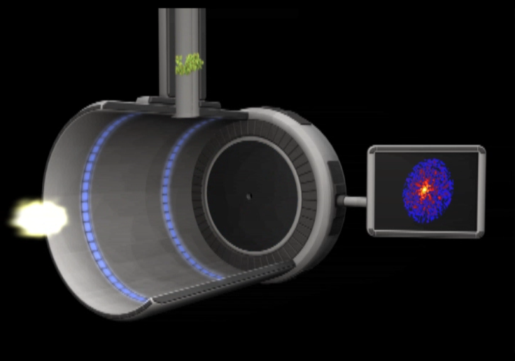
An Example: Atomic-Resolution Imaging of Nano-structured Periodic and Non-Periodic Objects
V=10-100 m/sec = 10-100 nm/nsec
⇒ ~1 diam /10 nsec
Hit rate: 5%– 30% ⇒ use multi bunch mode 10-100nsec
separation

Slide 19
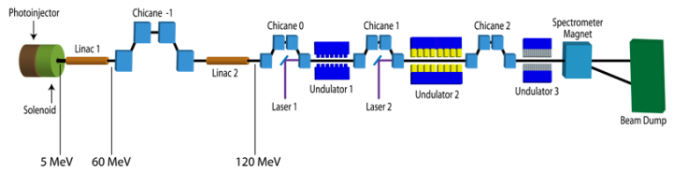
Seeding R&D outside of LCLS
Echo-7 @ NLCTA
  During the past months we
    upgraded the beam spectrometer
    installed a new high resolution in vacuum spectrometer
    Installed 2 transverse deflecting cavities
      to increase the slice energy spread in order to reduce HGHG
      to measure longitudinal phase space, laser energy modulation and slice parameters
T11
T27
In Vacuum Spectrometer

Slide 20
Maintain our position as a premier Accelerator Laboratory - but how?
Working in a multi-program environment

Slide 21
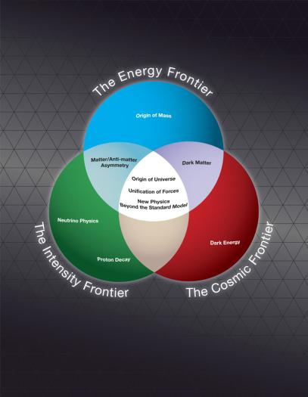
It all goes together, but something has to drive…
Maintain to be a world leader in Accelerartor
R&D
Provide unique infra-structure
Lead in NC linac and RF technology, Adv Accel Technology +Beam Dynamics
Where is Accel. R & D ?
Notes:
[Wait to activate animation until finished talking.]

Slide 22
Conceive, Design, Build, Test, & Operate RF Sources, Pulsed Power Systems, and Accelerators
  The leader in NC linear accelerator design (any frequency) and the development of high power systems:
    Lifecycle stewardship of RF sources, accelerators, and systems, that power the SLAC facilities from 0.2 to 90 GHz
    World’s only integrated capability to conceive, design, build, test, and operate high power rf systems
    Backup capability for other Laboratories in the DOE Complex!!!!
  Support the design of accelerators for application (MaRIE, MEGA RAY, etc…)
  Support the component development necessary for other accelerators
Notes:
Crisis response, machine upgrades, detailed knowledge of operating characteristics, quality, and risk and their impact on accelerator performance.
That define the state of the art
No commercial facilities for testing high power sources (high power modulators).

Slide 23



Why do we want to do it?
Strengthen SLAC by providing a broader base for the laboratory
An expectation from society, from congress and from DOE to help strengthen the economy
Maintain our strength and our infrastructure beyond what we could afford otherwise
It’s a lot of fun !!

Slide 24
Exploiting existing experience and broadening the agenda - Particle Physics and Detectors D. macfarlane

Slide 25
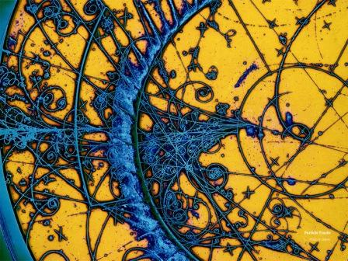
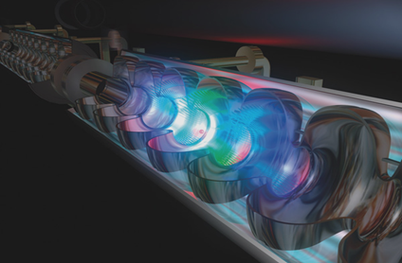

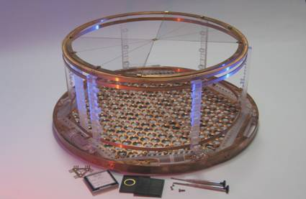
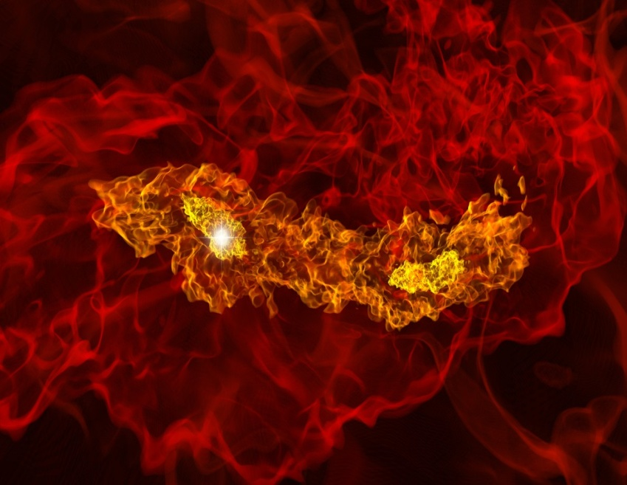
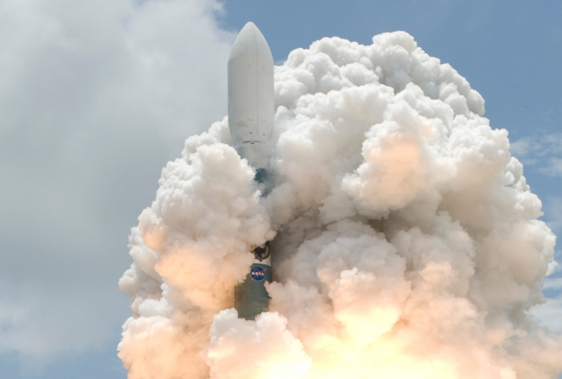
Particle Physics & Astrophysics
Accelerator research:
LHC, ILC, high-gradient,
plasma-wakefield, laser
Particle Physics Theory
Accelerator-based
particle physics:
ATLAS & BABAR
Underground physics:
EXO-200, CDMS
Particle Astrophysics & Cosmology Theory
Astrophysics &
Cosmology:
Fermi GST, DES, LSST, CTA

Slide 26
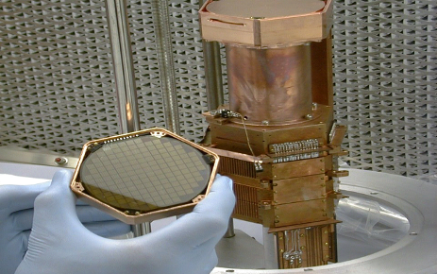
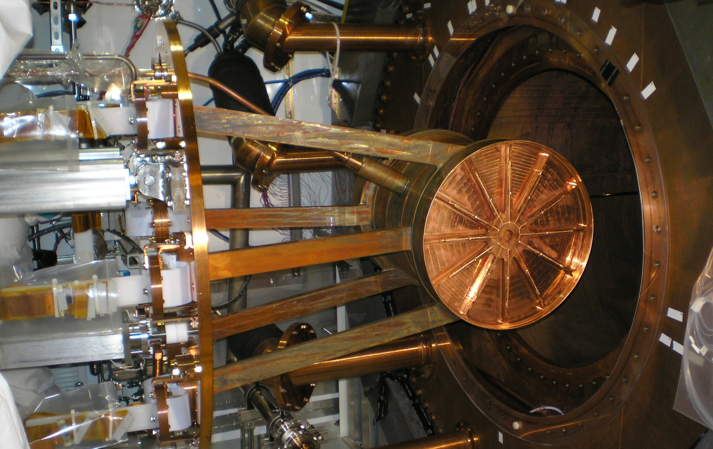
Pursuing Frontiers of Scientific Discovery
Discovery at the energy frontier
  Searching for physics beyond the Standard Model with ATLAS
  Positioning community for future Lepton Collider
Discovery at cosmology frontier
  Nature of dark energy with DES and LSST
  Discovery of dark matter with CDMS, Fermi GST, CTA
  Nature of inflation with CMB R&D
Discovery at intensity frontier
  Nature of the neutrino with EXO & LBNE

Slide 27
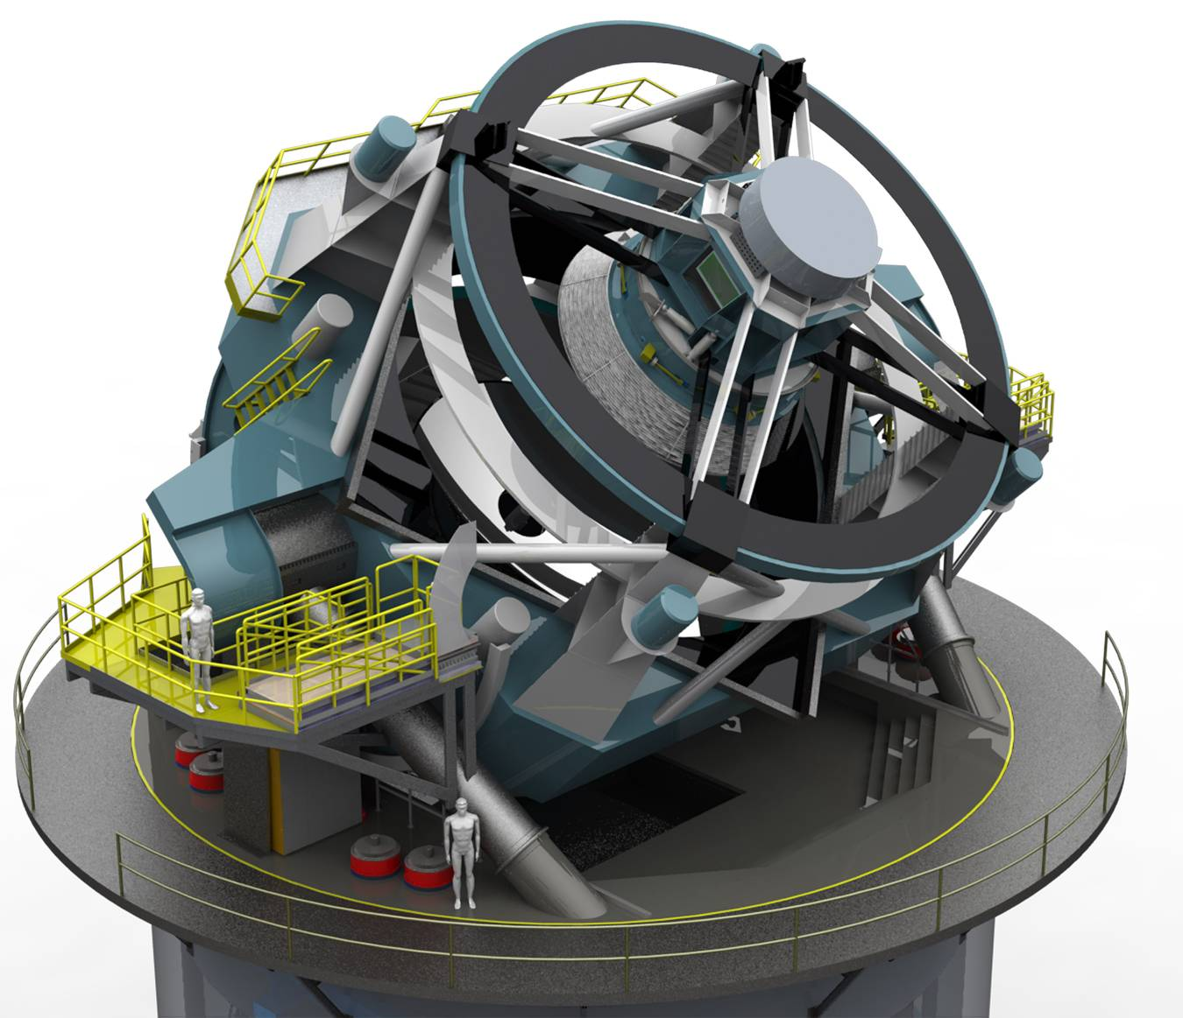
Seeking to understand Dark Energy
Provide a sensitive survey of the entire sky at visible wavelengths every few nights
  Tight constraints on cosmic expansion history, and thus on the nature of Dark Energy
Envisioned as a collaborative NSF and DOE-HEP project
  NSF: Telescope & data system
  DOE: 3.2 Gigapixel camera
SLAC role
  Lead-lab for DOE project, principally the consortium to design and construct the camera
Large Synoptic Survey Telescope (LSST)

Slide 28
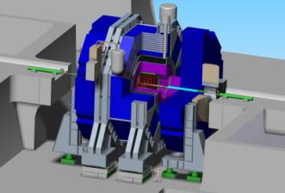
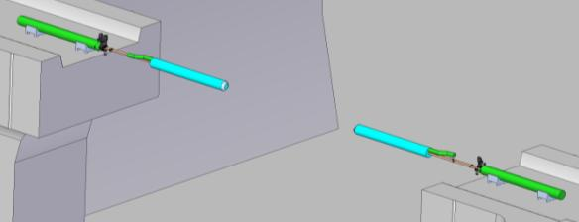


Lepton Collider detector work at SLAC
Silicon Detector (SiD):
  High performance, cost-optimized detector concept matched to ILC precision physics requirements
  Concept documented in the SiD LOI and reviewed by IDAG
    Detailed detector description, status of critical R&D, benchmarked with full GEANT4 simulation, cost optimized
  Next step is completion of critical R&D and production of the detector Detailed Baseline Document (DBD) due at end of 2012
Work underway:
FEA analysis
Cost vs stability
Metrology concepts
QD0
QD0

Slide 29
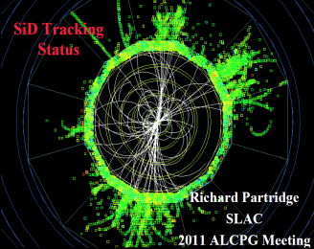

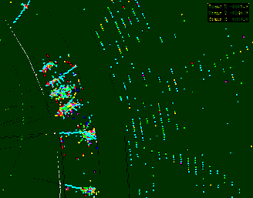
Simulation & particle flow calorimetry
Simulation/Reconstruction (slic and LCSim)
  Revise & improve tracking & PFA to handle greater realism & higher energies
  Support SiD detector variant for CLIC
  Preparations for SiD DBD
PFA calorimetry promises superb jet energy resolution
  Tracker measures charged energy
  Calorimeters measure neutral energy after
  excluding energy from charged tracks
  High segmentation required!
Assessing PFAs requires
  Realistic calorimeter & tracker designs
  Full GEANT4 simulation & optimized algorithms

Slide 30
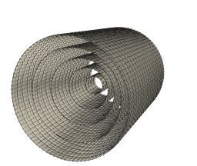
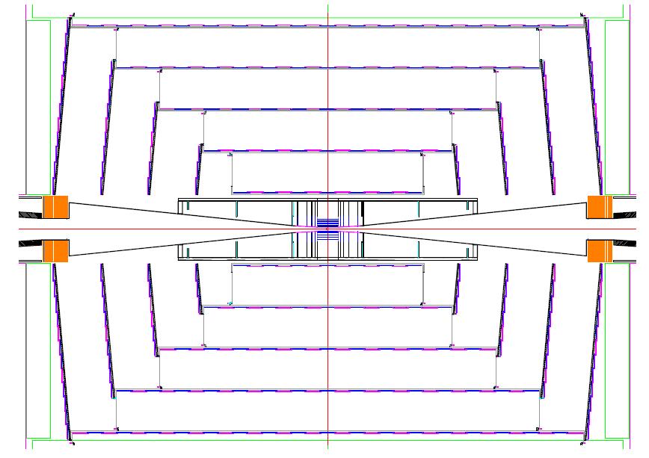
Low mass silicon tracker concept
Sensor Modules tile tracker
cylinders and endcaps
Kapton cables route signals
and power
Material <1/6 LHC trackers
Precision >3X LHC trackers
CF + Rohrcell Cylinders
Sensor Module
Nested Endcaps
Design FNAL/SLAC

Slide 31
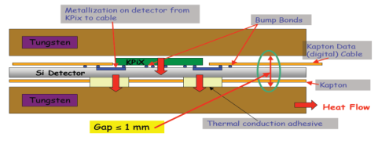
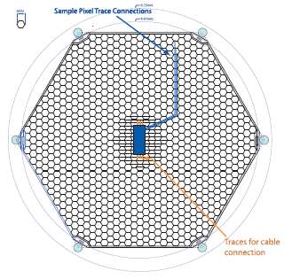
SiD calorimeter related R&D
Detector R&D in collaboration with University community
  Readout ASIC KPiX 512 and 1024 built and under test
  R&D for bump bonding KPiX to sensors continues
  Rad Hard Beamcal sensors being developed (UCSC)
  Power pulsing being developed (Yale)
  64 ch full pulse train beamcal readout chip prototyped
  Si/W Ecal prototype being developed (Oregon)
KPiX bonded to Ecal Sensor
Ecal W-Si-W sandwich with KPiX

Slide 32
Unique capabilities and in Accelerator Physics – High gradients, Collider Rings and MDI expertise

Slide 33
Theoretical and Simulation Expertise for Studying RF Breakdown Phenomena at SLAC
SLAC has a long history for simulating the multi-physics breakdown phenomena in a self consistent manner, in particular:
  A Joint MAP & High Gradient RF Collaboration Workshop was held in November 1-4th, 2011 at Lawrence Berkeley National Laboratory
  Phenomena related to the breakdown events, the effect of the breakdown current on the electromagnetic field distribution and the energy deposited on the cavity walls.
Measurements of a breakdown event in a waveguide
3D PIC simulation of the breakdown event

Slide 34
Collider Ring Design
Design a lattice for the higher energy option
  Adequate dynamic aperture with machine errors and beam-beam effects
Integrate with MDI study & IR magnet specification
(R. Palmer, 2008, P5)
Notes:
The current lattice for high-energy is not quite adequate.
Stronger focusing in the interaction region (indicated by 3 mm bunch length and higher luminosity) along with higher energy make the IR quadrupoles extremely difficult.
We are working on a similar problem for the HiLum LHC through LARP. So there is expertise and synergy.
IR magnet will be a part of LBNL effort.

Slide 35
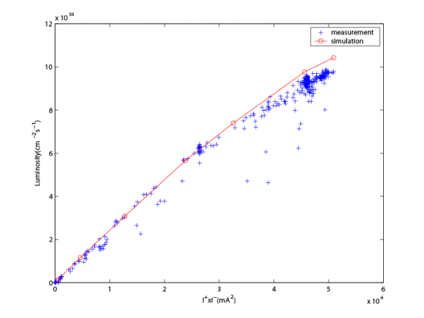
Beam-Beam Simulation Peak Luminosity and MDI Designs: Example (PEP-II)
(I⁺=2940mA, I⁻=1733mA, n_{b}=1732)
beam-beam
parameters:
The self-consistent simulations were carried out on a parallel computer cluster.
The code can be used for muon collision.
Notes:
1) This is a strong-strong simulation. The equilibrium beam sizes of the colliding beams, including radiation damping and beam-beam force, are part of the part of the simulation. Our code is well benchmarked against experiments.

Slide 36
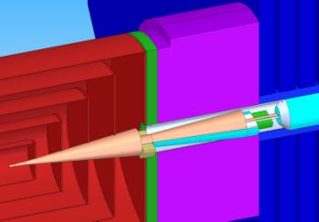
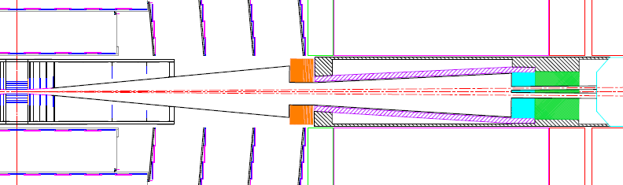
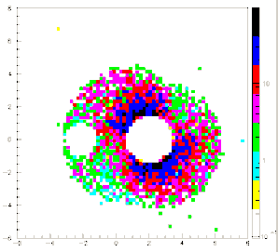
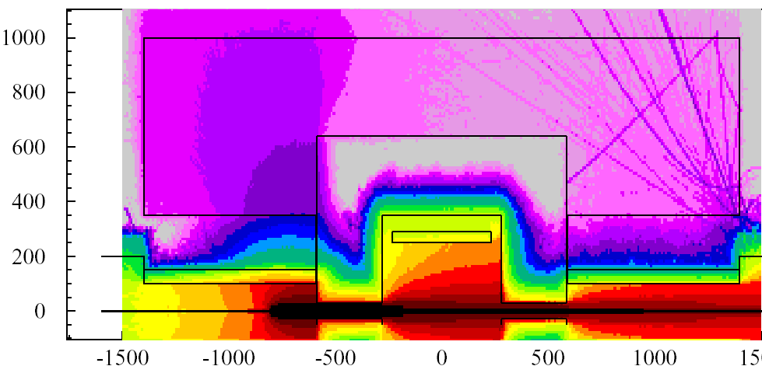
Machine Detector Interface
Integrated Optics, Engineering, Background Calculations, Radiation Effects, Detector Performance

Slide 37
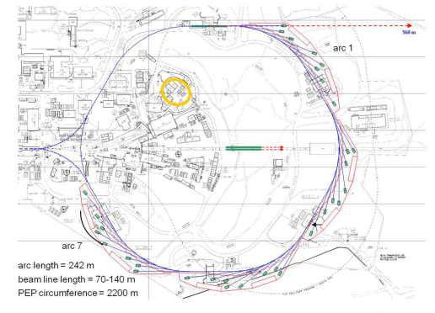
Storage Ring Design
PEP-X: Baseline (2008)
PEP-X: an ultimate storage ring
PEP-X: USR (2011)
Energy, GeV 4.5
Circumference, km 2.2
Beam current, mA 200
Emittance at 200 mA, x/y, pm 12 / 12
Touschek lifetime, hour 10
Dynamic aperture , mm Storage Ring Design 10
Notes:
It is extremely hard to achieve 12 pm-rad emittance and 10 mm dynamic aperture.
We have a strong design team, looking for new challenges.
3) Tune scan of dynamic aperture (two plots) is in unit of sigma of the equilibrium beam size. The key of the improvement is the cancellation of 3rd and 4th order resonances in the 2011 design

Slide 38
Summary
SLAC is on its way to become a fully integrated Multi purpose laboratory
HEP is an important piece of SLACs mission
Accelerator Science and Technology is fundamental to the laboratory
The laboratory has core technologies that are unique and mission critical to Science Community, other laboratories and the DOE complex
SLAC would very much like to be part of MAP and make a unique contribution

