Slide 1
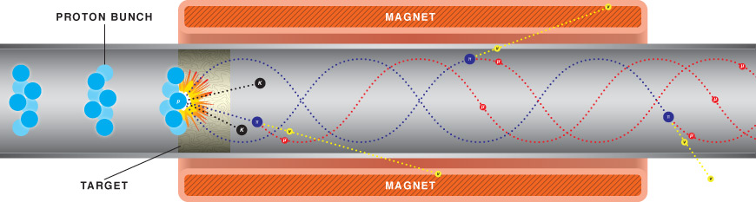

HTS for high field coils:
Current status and Needed R&D
David Larbalestier*
National High Magnetic Field Laboratory
Florida State University
SLAC, March 4-8, 2012

Slide 2
Viewpoint – REBCO and 2212
A local NHMFL one
  HTS R&D effort – key players Eric Hellstrom (Bi-2212 conductor), Jan Jaroszynski and Dima Abraimov (REBCO conductor), HTS cables (Huub Weijers), Bi-2212 and REBCO test coils (Ulf Trociewitz and Huub Weijers)
  32 T user magnet project (Denis Markiewicz and Huub Weijers)
A broader HEP-driven Bi-2212 collaboration (VHFSMC, now BSCCo)
  led by Alvin Tollestrup and DCL with main players now Shen and Cooley (FNAL), Ghosh (BNL), Godeke (LBNL) and Hellstrom, Jiang, Kametani, Trociewitz and DCL (NHMFL)
Strong industrial collaborations
  Superpower for REBCO, Oxford Superconducting Technology for 2212 and now Advanced cable Technology for REBCO cables

Slide 3
REBCO Coil demonstrations
REBCO - NHMFL in collaboration with SP (pancakes and layer wound)
  7 T in 19 T(2007), 3T in 31T T (2009) with pancakes of ~50m, 35.4 T (31T background) with 120m in layer wind
REBCO – BNL/PBL in collaboration with SP (pancakes)
  15 T self field (2012)
REBCO – NIMS/RIKEN in collaboration with Fujikura (layer wound)
  24 T all superconducting (HTS – 7T)

Slide 4
Bi-2212 coil demonstrations
20 + 5 = 25T NHMFL/OST pancake and layer wound tapes (2003)
  Impressive coil for its time but conductor not ready for wide deployment (Weijers et al. SuST 2003)
Started test coils again in 2007 in 20T and 31T resistive magnets to evaluate new OST conductors in high field and high stress conditions
OI/OST coil – 2010 - 22.5T all superconducting coil – 2.5T in 20T LTS background

Slide 5
What do we need for a secure HTS magnet technology?
Conductors in length with assured, uniform and predictable performance
Cabled versions of the conductor
Working insulations
Resistance to Lorentz and other coil forces
Quench protection
Affordability
Reliable performance under plausible service conditions

Slide 6
What’s the magnet community’s mission for HTS?
NHMFL – COHMAG (NRC 2004) goals
  30T plus user magnets
  30T NMR
  60T hybrid
US-HEP – Muon Accelerator
  Many complex magnets, 30-50T solenoids
CERN – LHC upgrade
  20T Nb-Ti/Nb₃Sn/HTS dipoles
Industry
  30T NMR
  Cryogen-free MRI
  MagLev trains
Electric utilities worldwide
  FCL, Wind turbine, transformer, cables
SciMag – meets in March – what goals for it now?

Slide 7
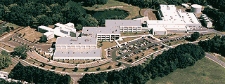
National Magnet Lab User Facility
Provides the world’s highest DC magnetic fields
  45T in hybrid, 32 mm warm bore
  Purely resistive magnets: 36T in 32 mm warm bore, 31 T in 50 mm bore and 20T in 195 mm warm bore
20 MW resistive magnets cost ~$2000/hr at full power
  Long-time, full-field experiments are very expensive
  Quantum oscillation, quantum Hall effect, low noise, large signal averaging experiments could run 7 days a week………

Slide 8
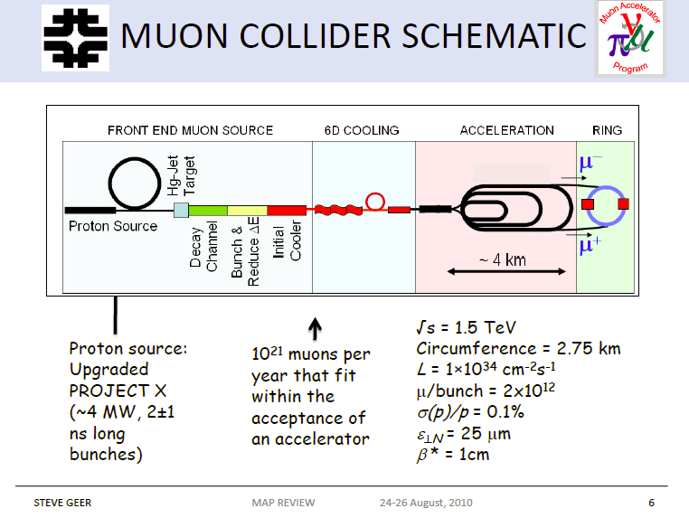
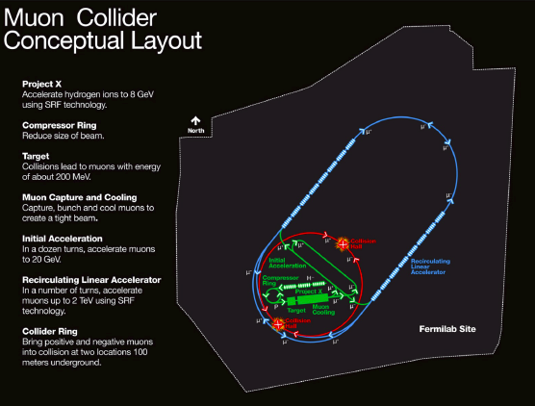
Muon Collider
2010 review slide – still valid?
HTS conductors key to several coils for MC
  30-50T solenoid cooling magnets

Slide 9
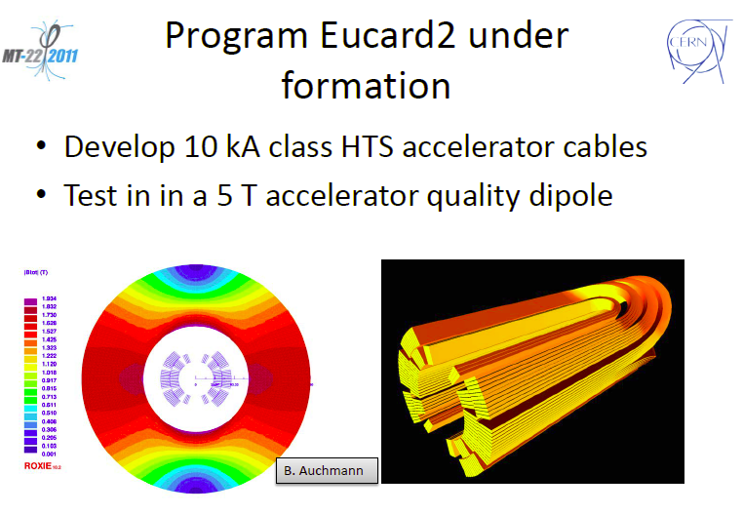
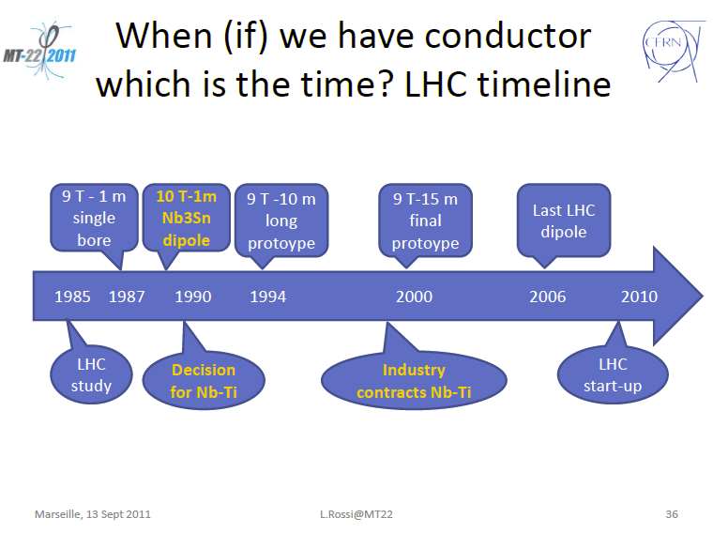
LHC Energy Upgrade
CERN intends to focus on REBCO Roebel cable relying on BSCCo to develop 2212 cable technology
LHC took 20 years even with Nb-Ti
The next 5 years are key for HTS for magnets
EUCARD proposal submitted to EU 10/11

Slide 10
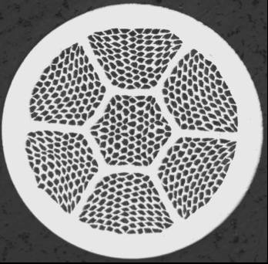




The HTS conductor choices
Bi-2223 multifilament tapes
Bi-2212 round wire ~ 1mm dia.
Bi-2223 tapes exhaustively studied for power applications 30-77K: Now mature – lower Je than 2212 and YBCO
REBCO coated conductor tapes
2 μm Ag
1 μm HTS
~ 30 nm LMO
~ 30 nm Homo-epi MgO
20μm Cu
~ 10 nm IBAD MgO
< 0.1 mm
50μm Hastelloy substrate
20μm Cu

Slide 11
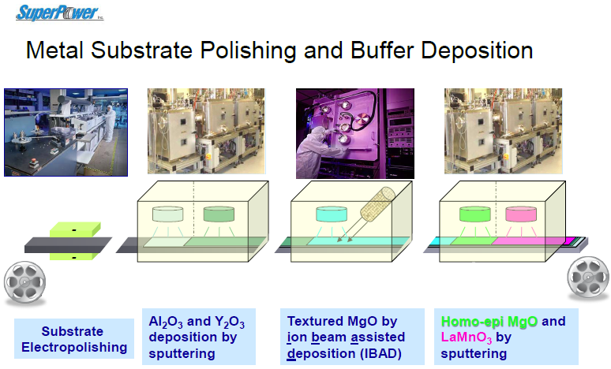
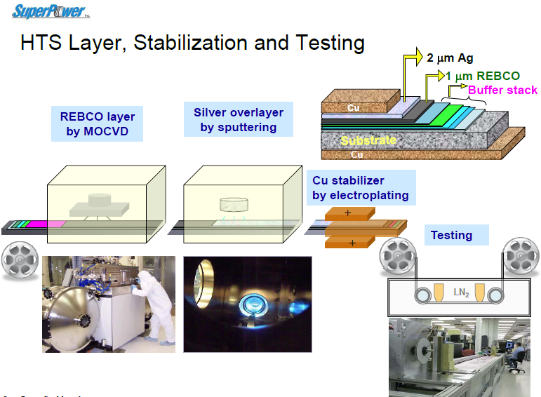
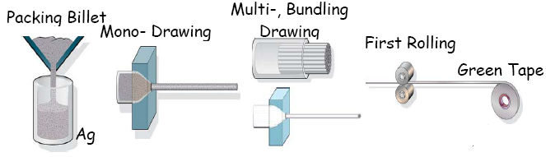
Manufacturing processes are quite different
IBAD-YBCO
Powder in tube:
2212 and 2223

Slide 12
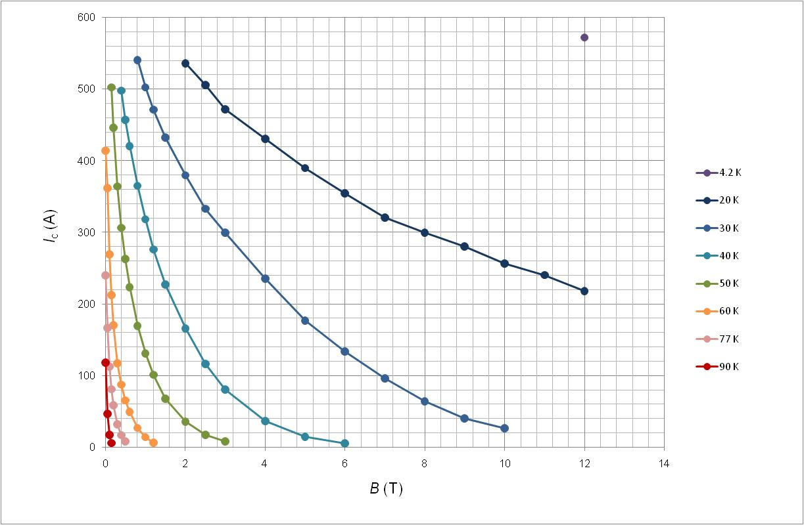
Bi-2223 tape – Gen I or DI-2223
0.23mmx4.28mm, 40% Bi-2223
240 A, self field, 77K, 580 A (12T, 4.2K)
Courtesy Ken-Ichi Sato SEI)

Slide 13
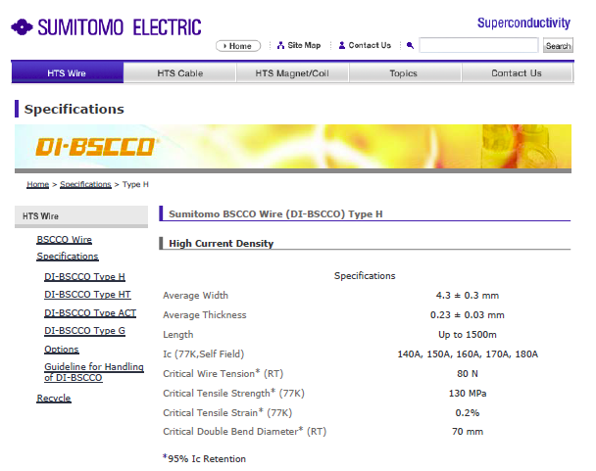
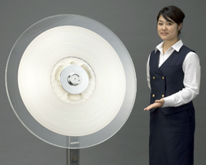

The most mature HTS conductor
Available
  200-240A (77K, SF)
  Untwisted or twisted
  Laminated for strength
  Ag-Au sheath for current leads
  Several hundred m
Not easy to cable except for power cables with large diameter mandrel

Slide 14
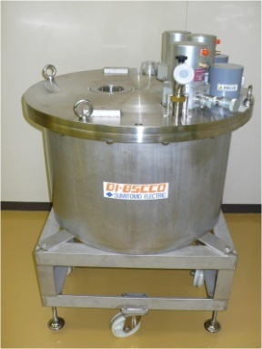
B-H Curve Tracer Magnet
14
B-H Curve Tracer for NIHON DENJI SOKKI CO.
5T-φ100mm
20K Refrigerator
Evaluations of permanent magnets used for automotive motors etc.
<Conventional Magnet>
Measurable up to 10mm in dia.
・DC Magnets(+/- 2T)
・Pulse Magnets(+/- 12T)
<HTS Magnet>
・DC Magnet(+/- 5T)
Measurable up to 40-mm-square
・0T → + 5T → - 5T → 0T / 2min.
Faster change in magnetic field
0.9m-width
1.2m-height
Improvements of rare-earth magnets (NdFeB)
Large size (influence of eddy-current)
Coercive Force enhancement
Features
● Cost/Merit of 10 times faster ramp rate (1T/6sec) of DI-BSCCO vs NbTi (1T/60sec)
● Similar applications in PM industries

Slide 15

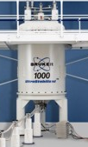
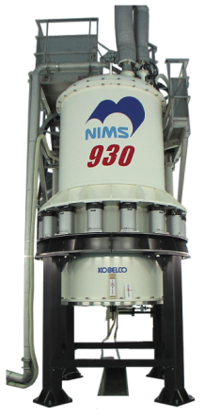
Progress in High-Resolution NMR Magnets
HTS/LTS NMR
HTS
WM
+HTS
1.03 GHz HTS/LTS Magnet
limit of LTS NMR
SM
LTS
NMR
930 MHz NMR Magnet
Kyoshi et al., IEEE TAS 21, 2110 (2011)

Slide 16
Coated conductors of REBCO – Generation II
Bi-2223 J_{c} and J_{e} have been limited by the difficulty of texturing the grains
  An approximately uniaxial texture FWHM 12-15° FWHM
  Voids and cracks controlled effectively by Overpressure process (CTOP)
  40% of cross-section Bi-2223, 60% Ag
  ~$150/kA.m using 77K,SF metric
By contrast raw material costs of YBCO much less (2-3%Ag)
  Big investments world-wide in coated conductors based on biaxially (FWHM as low as 2-3°) textured REBCO

Slide 17


GB obstruction forced development of coated conductors of YBCO: “single crystals by the mile”
2 μm Ag
Invention by Fujikura
The IBAD approach – ion-beam-assisted deposition of the textured template
1 μm HTS
~ 30 nm LMO
~ 30 nm Homo-epi MgO
20μm Cu
~ 10 nm IBAD MgO
Copper Stabilizer
50-75 μm
< 0.1 mm
50μm Hastelloy substrate
Ag (<1 μm)
20μm Cu
The RABiTS approach – Rolling-Assisted, Biaxially Textured Substrate
Production 500-1 km lengths, delivery 50-150 m
CeO₂ (~75 nm)
YSZ (~75 nm)
Y₂O₃ (~75 nm)
Ni-W alloy
(50-75 μm)
Invention by ORNL

Slide 18
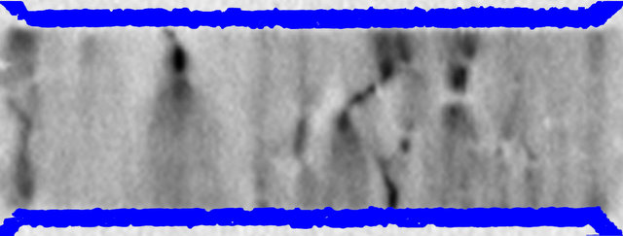
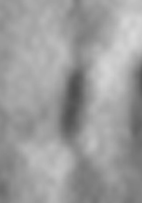
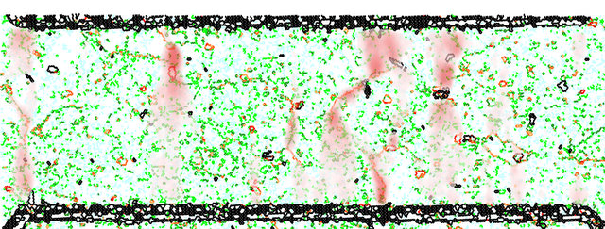
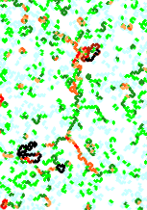
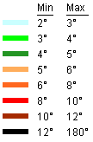
8-10º GBs force current to flow through lower angle GBs
0.42 μV
Electric field map
0.8 T, 77K
-0.04 μV
J
Misorientation + E map
OIM, E field map
50 μV
GB dissipation visualized by LT laser imaging
J
Abraimov (NHMFL) on AMSC RABiTS

Slide 19
Continuously higher field REBCO Test Coils
A
A
A
A
A
A
A
2011: 35.4T with single layer-wound coil
Early coils with SuperPower and subsequent ones built at NHMFL
SuperPower I.
NHMFL I.
Hazelton IEEE TAS 19, 22129 (2009)
2008: 33.8T with pancake coil
14.65 avg. turns/layer, 80 layers, 96 m of 4 mm wide tape = 35.5T total
4.3 T in 31.2 T background at 196 A and peak hoop stress of >340 MPa
Trociewitz, et al APL 99, 202506 (2011)
SuperPower II.
NHMFL II.
Weijers IEEE TAS 20 576 (2010)

Slide 20
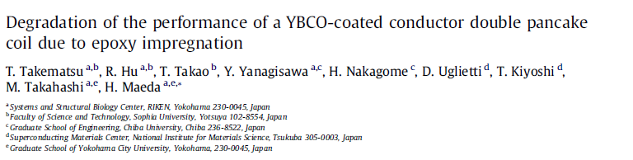
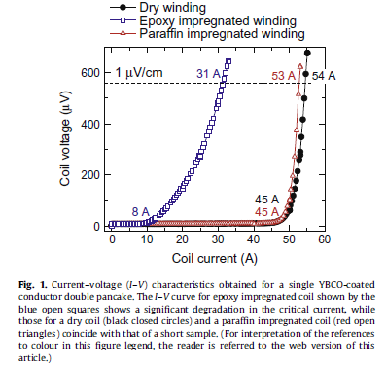
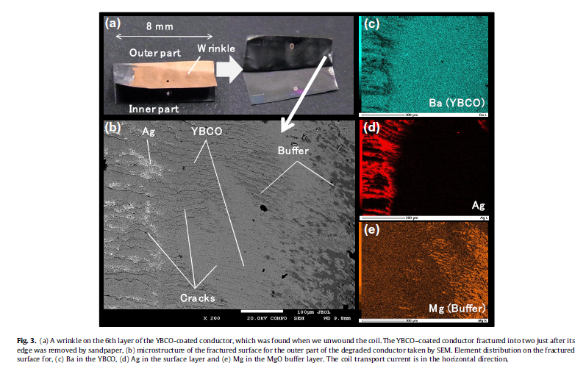
Perpendicular, not just axial strength is important
Physica C 470, 674-677 (2010)

Slide 21
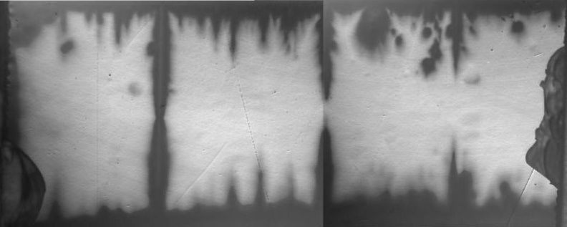
Extensive suite of capabilities
Magneto optical image of line defects in CC
Position counted from start of Ic(x) as in measurements
500 A at 31T
J. Jaroszynski
T = 75 K B= 0.5 T
B||c
No HTS conductor is without defect
Impact of defects needs to be understood
B||ab
θ = 72 deg
J. Yates Coulter Ic(x)
System under construction at LANL – Yates Coulter

Slide 22
Whether BZO doped or not, YBCO CC have similar Jc(θ, B) - No c-axis maximum
cusp-like ab-plane maximum
ab
ab
Xu et al. SuST 23 014003 (2010) and Braccini et al. SuST 24, 035001 2011

Slide 23
32 T Superconducting user magnet: REBCO coated conductor
Goal:
  32 T, 4.2 K, 32 mm bore, 500 ppm in 10 mm DSV, 1 hour ramp, fitted with dilution refrigerator giving <20 mK
  On line late 2013
Funding:
  $2M grant from NSF for LTS coils, cryostat, YBCO tape & other components of magnet system
  Core grant for technology development
  dilution fridge not yet funded
Key Personnel
  Huub Weijers, NHMFL, Project lead
  Denis Markiewicz, NHMFL: Magnet Design
  David Larbalestier, NHMFL: co-PI, SC Materials
  Stephen Julian, Univ. of Toronto: co-PI, Science
Minimum Ic Condition
B = 16.6 T Θ = 16.7°
B = 23.2 T
Θ = 9.7°
B_{max} = 32.1 T
B_{max} = 21.2 T
Markiewicz et al (MT22 paper) to appear IEEE TAS 2012
Current = 172 A, Inductance = 619 H, Stored Energy = 9.15 MJ

Slide 24
Poor correlation: Ic @ 77 K SF and 4.2 K 14 T||c
However, samples >100 A @77 K are better than 140A @ LHe @ 14 T B||c

Slide 25
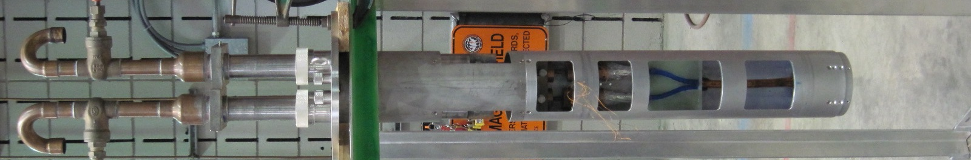
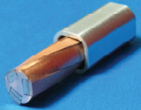
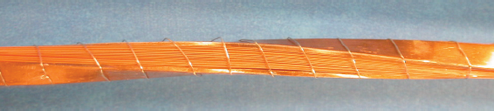
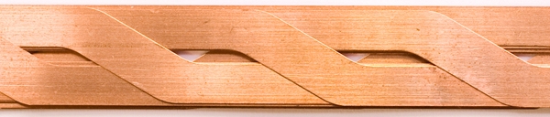
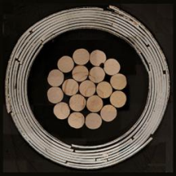

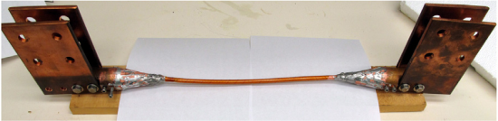
Cable variants of REBCO HTS
Twisted stack, 32 tapes, 4 mm wide, 200 mm pitch
Makoto Takayasu (MIT)
Three twisted stacks in Cu core with conduit
ROEBEL
~5- 12 mm
Long (IRL) and Goldacker (KIT)
CORCC 6-80 tapes demonstrated)
6⁺ mm
Existing test setup for 20 T
Large Bore Resistive Magnet (LBRM)
LBRM being used to test these and 2212 cables
Van der Laan (NIST/UC/ACT)
R&D test effort led by Huub Weijers in collaboration with cable makers

Slide 26
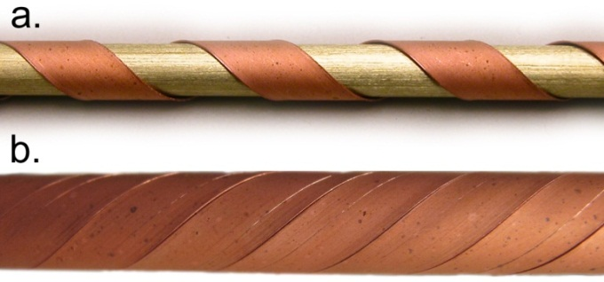
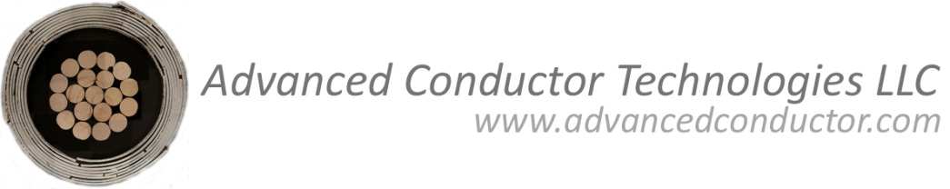
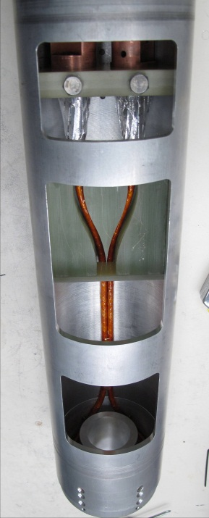
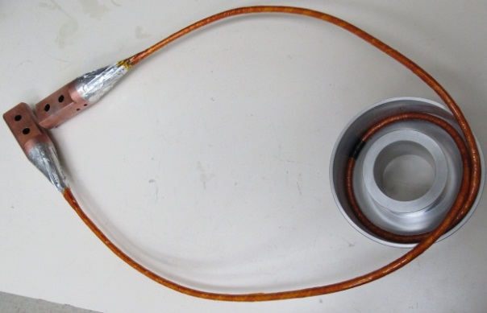


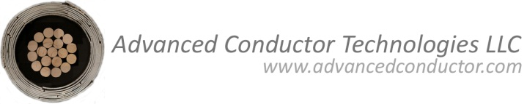
CORCC: Conductor on Round Core Cable
Winding many YBCO coated conductors in many layers
in a helical fashion on a round former:
Danko van der Laan 720-933-5674
Cables tested at the NHMFL in 19.8 T background field:
Danko van der Laan, Huub Weijers, Patrick Noyes, George Miller and Gerard Willering
Cable: 4 layers, 12 YBCO coated conductors:
I_{c} = 875 A @ 4.2 K, 19.8 T
J_{e} = 26 A/mm²

Slide 27
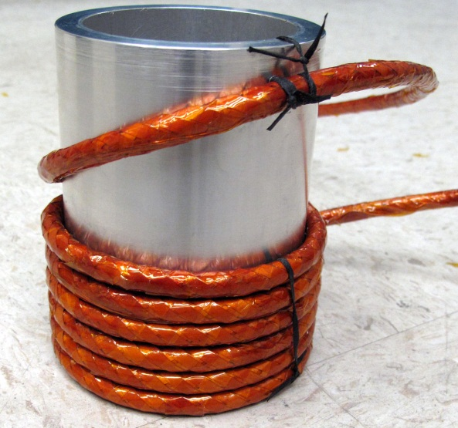
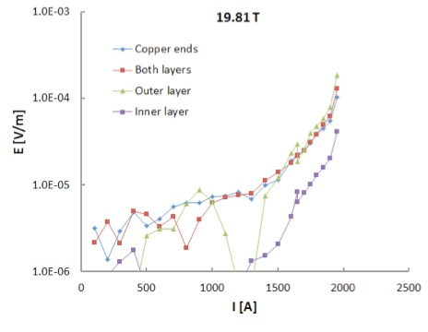
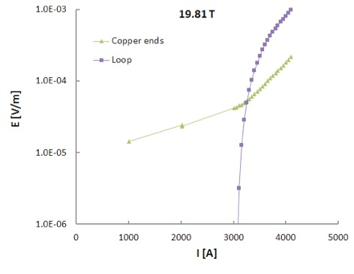
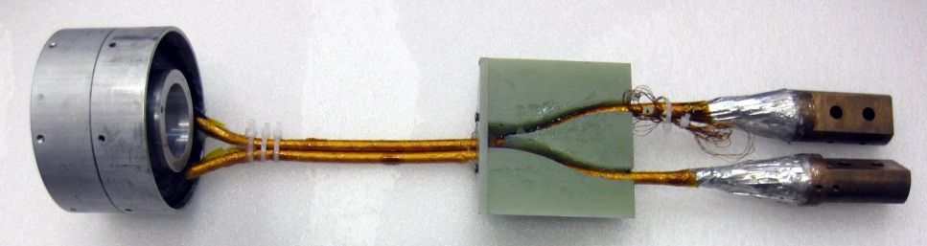
CORC-Cable tests at 4.2 K, 20 T
Magnet: 2 layers, 12 turns with a cable of 20 YBCO tapes in 6 layers:
I.D. 9 cm
I_{c} = 1950 A @ 4.2 K, 20 T
J_{e} = 50 A/mm²
Cable: 13 layers, 40 YBCO coated conductors:
I_{quench} = 4101 A @ 4.2 K, 19.8 T
J_{e} = 93 A/mm²

Slide 28
YBCO CC for magnets
Works very well at 4 K
  Perhaps can work well for 5-15T at 40-60K?
Strong in axial tension (weak in perpendicular tension), high H_{irr} and high J_{c}
Coils have now made 35.5T (15T in self field), more than 50% higher than Nb₃Sn limit
But………….
  Tape architecture is constraining
  Cabled variants in early stages still
  Concern about risk of local Ic disruptions…
Manufacture is complex, specific and capital intensive
Round wires and multifilament would be so much better!

Slide 29
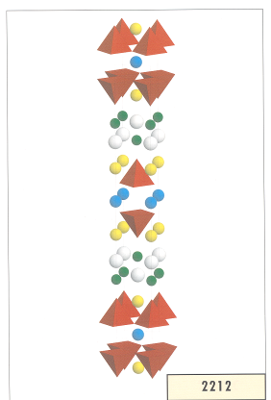
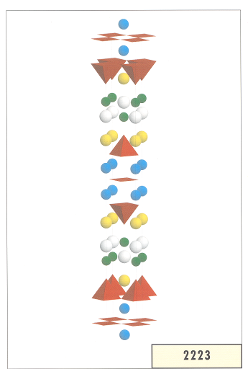
But a round wire BSCCO-2212 technology may be feasible too
Bi-2212 works as an untextured round wire – perhaps because grain boundaries can be overdoped?
RW - 2212
Charge reservoir layer
Charge reservoir layer
Charge reservoir layer
Charge reservoir layer
Tape 2223

Slide 30

HT for high Jc is complex
Melt region – Why does J_{c} vary with T_{max}?
2212 formation region – How to form more and better connected 2212?
Annealing step – Needed to increase J_{c}, but do not know what occurs.
T
Cooling to RT – Overdope 2212 with oxygen to increase pinning and J_{c}.
t
New understanding on these steps obtained in VHFSMC

Slide 31
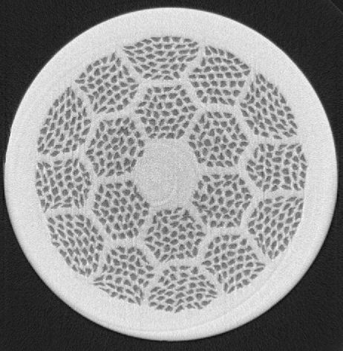
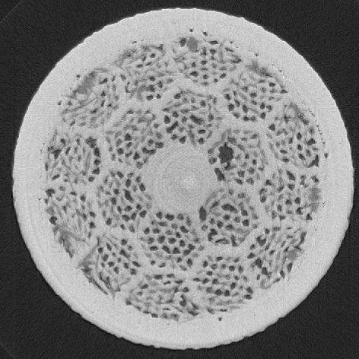
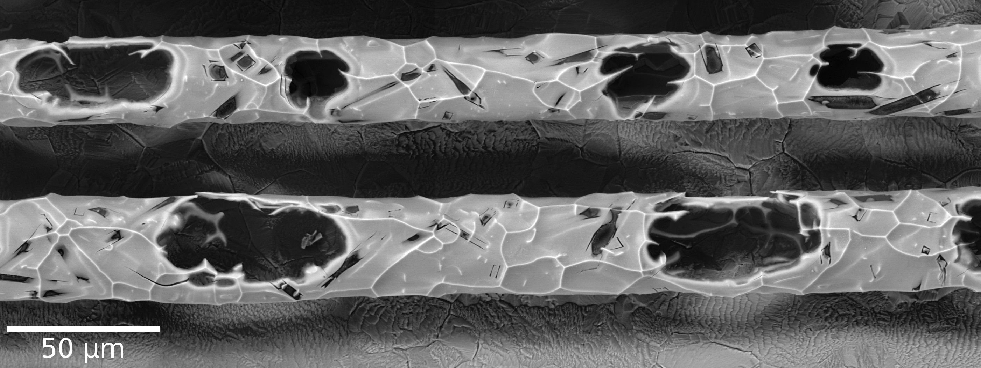
Processing Bi-2212 has many aspects
Tmax/0.2h
10°C/h
Tmax-10°C
50°C/h
836°C /48h
As drawn – distributed porosity
2.5°C/h
After reaction – inhomogeneous bubbles
160°C/h
825°C/2h
80°C/h
Tomography movies by Scheuerlein et al, SuST 24, 115004 (2011).
RT
Quench
RT
Tomography at ESRF by Christian Scheuerlein (CERN) using NHMFL samples

Slide 32
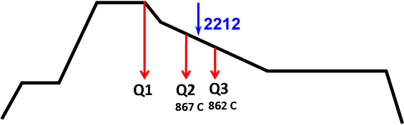
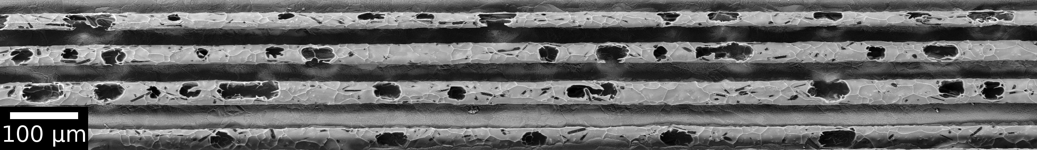

Quench1: Large bubbles form on melting and holding at T_{max}
Malagoli et al, SuST, 24, 075016 (2011), Kametani et al, SuST 24, 075009 (2011), Jiang et al. SuST 24 082001 (2011), Scheuerlein eta al, SuST 24, 115004 (2011)..
Notes:
32

Slide 33
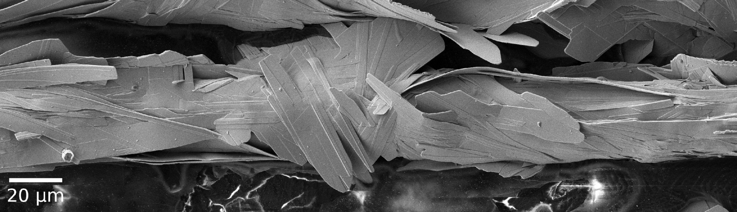
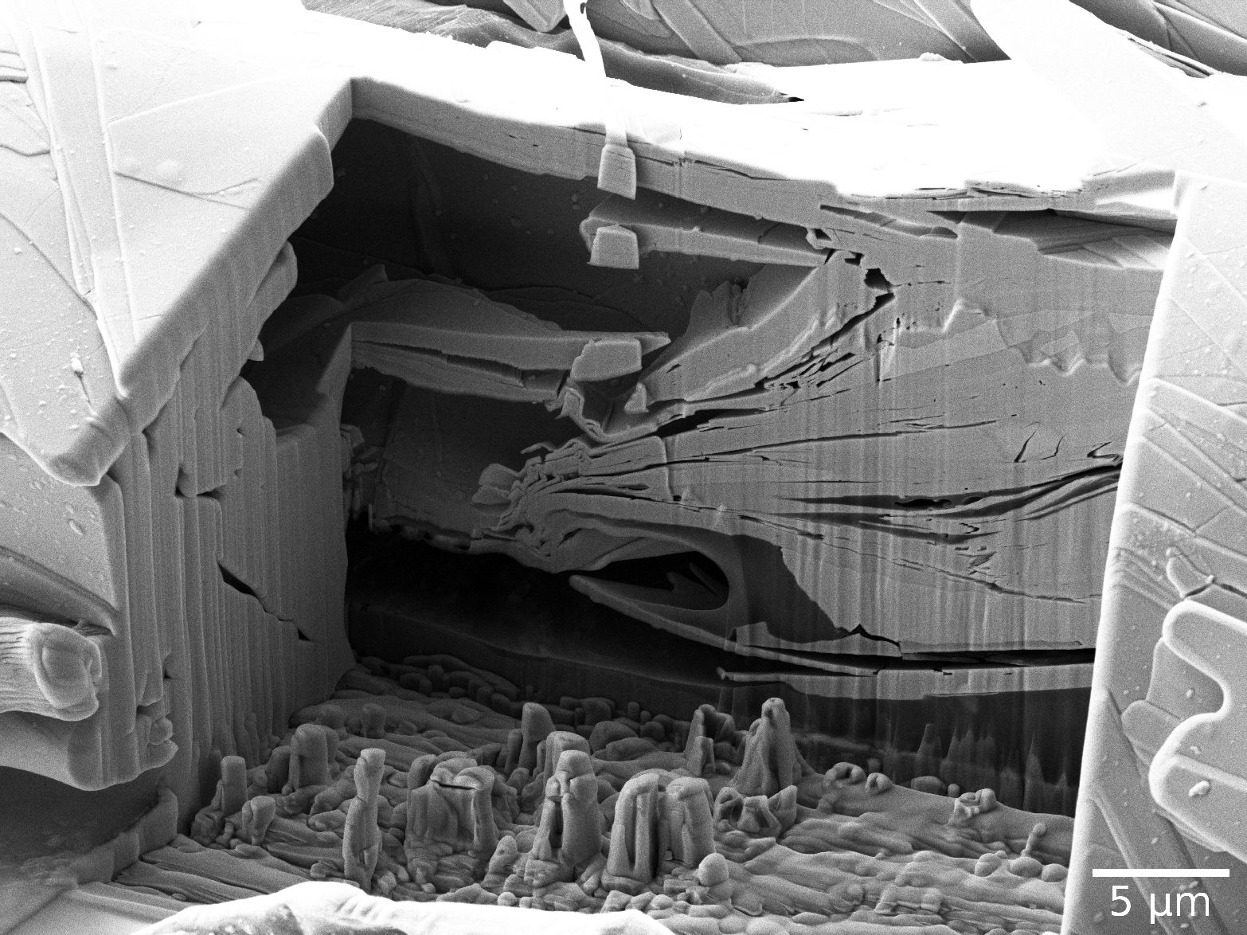
Large voids in filaments block current in fully-processed wire
FIB-cut
Bubbles can be partially filled on resolidification and 2212 reformation – but many voids remain
Variation of void density is a major part of the wire Jc variation
Void
Void
Kametani et al, SuST 24, 075009 (2011).
Notes:
33

Slide 34
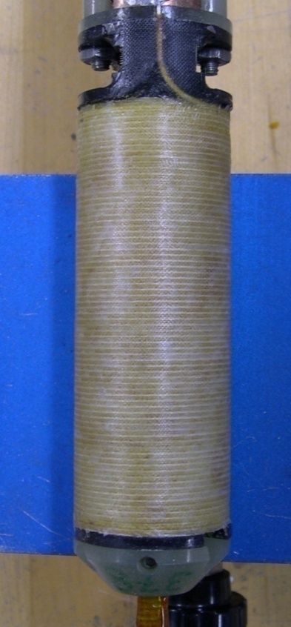




Bi-2212 Test Coils are advancing (even with bubbles)
High Field Test coil:
10 layers/750 turns, L ~ 3 mH
ID = 15 mm, OD = 38 mm
height = 100 mm
conductor length ~66 m
ΔB = 1.1 T at 31 T
first HTS wire-wound coil to go beyond 30 T (32.1 T in 31 T background)
180 mm
Bore-tube-free Test Coils:
Minimize chemical interactions with conductor
High Field Test coil
“7 T inner shell”:
10 layers/135 turns, L = 14.9 mH
ID = 32.4 mm, OD = 57.4 mm
height = 180 mm
conductor length ~220 m
ΔB = 1.2 T at 20 T
Large OD σ_{hoop} test coil:
ID = 92.5 mm
OD = 118.5 mm
10 layers, 10 turns
Bore tube less
epoxy impregnated
ΔB ~ 0.2 T at 20 T
Trociewitz, Myers, Dalban

Slide 35


Cored 2212 cable work at FNAL going well
Transport measurements showed that FNAL cable attains 105% J_{c} of that of the single-strand – Tengming Shen 3/4/12 MC workshop
Good Rutherford cables have been demonstrated in racetrack coils at LBNL by Godeke

Slide 36
Summary - 2212
We have a much better working understanding of the HT process
  We now see that a dominant current-limiting factor is the agglomeration of porosity in the melt step into large bubbles
  Reduction of bubbles by CIPping can double Ic
  The cause of bubbles (C, H₂O?) must be verified and controlled)
Coils show much less leakage now and we are ready to go for a 25-27 T solenoid in a background of:
  20 T resistive magnet or 20 T Nb-Ti/Nb₃Sn 78 mm bore coil (NHMFL has just commissioned an OI 20T/4.2K 78mm bore magnet that has a removable inner Nb₃Sn magnet which allows 17.5T at 112 mm bore)

Slide 37
Can we make a decision between REBCO and 2212?
Property | 2223 reacted tape (multifilament) | REBCO coated conductor (single “filament”) | Unreacted round wire (multifilament)
Production maturity | Stable and mature | Late pilot plant stage | Mature but boutique mfr.
Capital and staff requirements | Large | Large | Much smaller
High Jc for magnets? | No – little sign that it will be | Yes | Yes in short lengths – long length is present focus
Piece lengths | ~ 1km | 50-150 m | 300 but scale up straightforward
Path to 5 kA magnet cables? | No | Difficult but progress being made | Straightforward
Each has advantages and disadvantages – best of all would be RW REBCO

Slide 38
What now?
The old funding patterns have broken down:
  DOE-OEDR/EERE for utility applications – GONE
  DOE-HEP AARD – present emphasis is on Nb₃Sn for LHC use
  ARRA-supported VHFSMC Bi-2212 has ended
  BSCCo (BNL-FNAL-LBNL-NHMFL) – continuation is an orphan
  BNL/PBL program is banking on SBIR support
Collectively regroup and argue for base HTS conductor and test coil support

Slide 39

Major macro issue: the DOE budget request to Congress January 2010
YBCO is commercial and DOE ended support in favor of search for RT superconductors!

Slide 40
Conductor and Test Coil technologies are intimately linked
Coils, R&D
Test Beds
27T with SuperPower
35.5 T REBCO NHMFL
15T BNL/PBL
Conductors
YBCO
2212
CDP support
HTS Magnet
Systems
32 T, 30 T NMR, SMES
Muon Colliders, LHC energy upgrade.
EUCARD2
The SBIR and CDP (Conductor Development Program within HEP have maintained a strong industrial component to the effort

Slide 41


HTS can now enable a new generation of magnets - > 30 Tesla
J_{E} floor for practicality
Plot maintained by Peter Lee at: http://magnet.fsu.edu/~lee/plot/plot.htm

Slide 42
Summary
The long incubation period of HTS is over…………
  1990 – the first 2212 and 2223 conductors
  ~2005 – the first REBCO conductors
  2011 – round wire 2212 emerging in strength
  Viable cable strategies for REBCO and 2212
Demonstration coils of REBCO (35T and 15T) and 2212 (32T) show capability
Projects and people (NHMFL user facilities, SMES, MAP and EUCARD2) that will push HTS into significant magnets are at hand
Budgets are uncertain!

