Slide 1
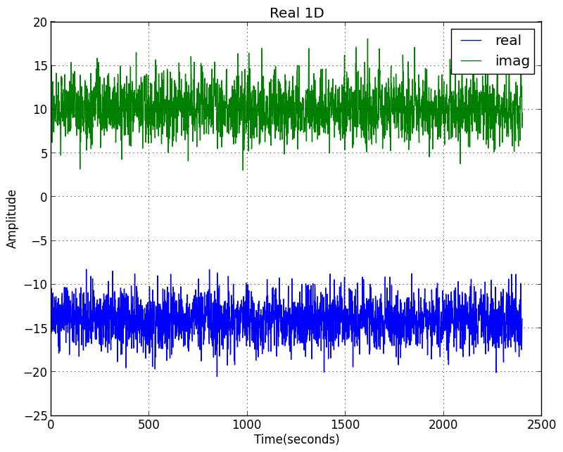
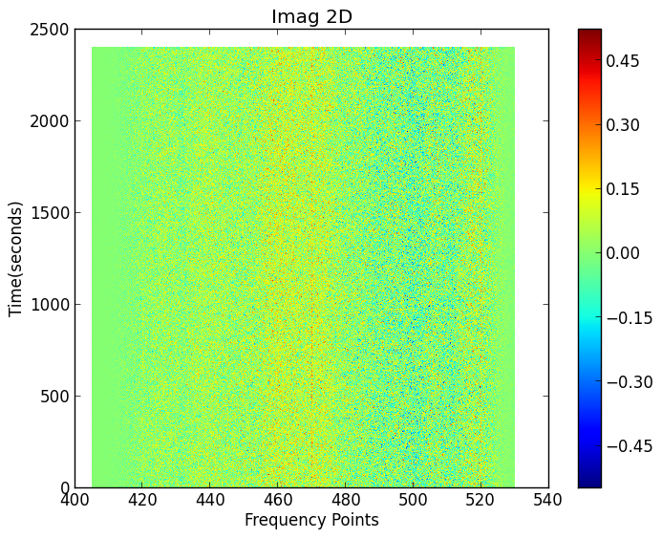
2 independent noise generators
Directly input to
Dish correlator: ch1 and ch3

Slide 2
