Slide 1
VM Technologies (and others) for Site and Service Resiliency
Shawn McKee/University of Michigan
OSG AHM - Lincoln, Nebraska
March 19th, 2012

Slide 2
Service and Site Resiliency Motivations
I’m sure every site providing any service is concerned with resiliency: they want their services to remain useable
For AGLT2 we have a large distributed LHC Tier-2 for ATLAS that spans two locations: UM/Ann Arbor and MSU/East Lansing with roughly 50% of the storage and compute at each site (Total ~4500 job slots and 2.2 PB of dCache)
However almost all of the critical site services are at the UM location! What happens if the UM site is down?
We are very interested in overall resiliency of the Tier-2 and would like to continue operations even if one of our sites is down/offline for an extended period of time. (Either one of our two sites represents a significant amount of resources)
First GOAL: Allow AGLT2 to continue to run with one site up

Slide 3
Virtualization of Service Nodes
Our current USATLAS grid infrastructure requires a number of services to operate:
Grid gatekeepers and authentication/authorization services
Job scheduler
Grid storage and distributed file-systems
Various meta-data services
These services need to be robust and highly-available
Can Virtualization technologies be used to support some of these services?
Depending upon the virtualization system this can help:
Backing up critical services
Increasing availability, reliability via enterprise features
Easing management

Slide 4
Virtualization Technology
In the last two years, we have tested and deployed virtualization technologies for our services
AGLT2 uses VMware Enterprise V5.0 Plus which runs:
LFC, 4 Squid servers, USATLAS Gatekeeper, OSG Gatekeeper, Condor headnode, ROCKS headnodes (dev/prod), Kerb/AFS nodes, central syslog-ng host, muon calibration splitter, Oracle DB, all our AFS file servers (storage in iSCSI), dCache headnode
“HA” mode can ensure services run even if a physical server fails. Backup is easy as well.
Can “live-migrate” VMs between 3 servers or migrate VM storage to alternate back-end iSCSI storage servers.
Downside is initial/on-going costs for VMware.

Slide 5
Virtualization Installation at MSU
MSU interim virtualization purchase (final delivery today):
Two Dell R710s, 192GB, 2 X5675 processors, 2 X520 dual 10GE
MD3220 (8 x 6Gbps ports, SSD 150G, 23 x 300G 15K SAS; 7TB)
MD1220 (24 x 900G 10K SAS disks; 21.6 TB raw)
VMware Ent Plus licenses with Production support via Merit
Sized to hold all needed services from UM site (has 33% more memory, disks selected to provide IOPS and space)
Limitation: SAS-connected disks are not visible from UM site
MSU VMware nodes can copy from UM. Plan to setup replication process for needed VMs from UM to MSU

Slide 6
Virtualization Considerations
Before deploying any VM technology you should plan out the underlying hardware layer to ensure a robust basis for whatever gets installed
Multiple VM “servers” (to run VM images) are important for redundancy and load balancing
Multiple, shared back-end storage is important to provide VM storage options to support advanced features
iSCSI or clustered filesystems recommended
Scale hardware to planned deployment
Sufficient CPU/memory to allow failover (N-1 svrs)
Sufficient storage for range of services (IOPS+space)
Sufficient physical network interfaces for # of VMs
Design for no-single point-of-failure to the extent possible

Slide 7
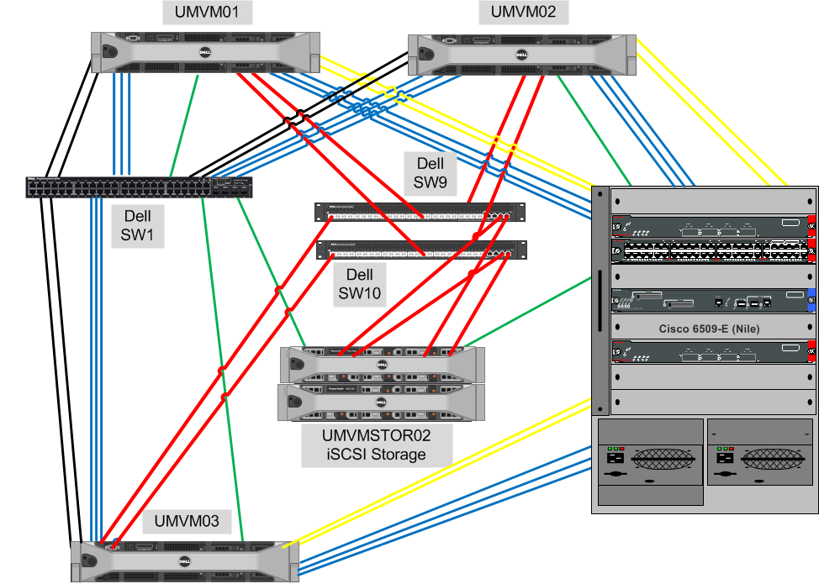
Example: AGLT2_UM VMware Hardware
Mgmt
10GE
VLANS

Slide 8
iSCSI for VM Storage
iSCSI has been around for a while. Lots of nice features
Relative to fiber channel it can be inexpensive
Allows multi-host access to the same storage
Typically supports features like snap-shots and cloning for LUNs. Easy to migrate via LAN/WAN
With 10GE and hardware iSCSI offloading, performance can exceed fiber channel
Roll-your-own with Open-iSCSI or Openfiler
Allows advanced features (like “Storage vMotion” in VMware)

Slide 9
iSCSI Hardware Options
Can buy iSCSI appliances. ..lots of choices
Dell offers MD32xxi/ D36xxi. Relatively inexpensive via LHC matrix. Can configure 12 disks up to 3TB each or 24 disks up to 1TB each. Can add MD12xx shelves (up to 4).
Oracle(Sun) 74xx (Amber Road) systems provide higher-end capabilities and nice interface and multiple access options.
Very nice systems with higher-end features from other vendors ($$$) (Isilon, HP, EMC VNX5300)
Can build your own direct attached storage and enable iSCSI (e.g., OpenFiler)
Must balance features vs cost as usual

Slide 10
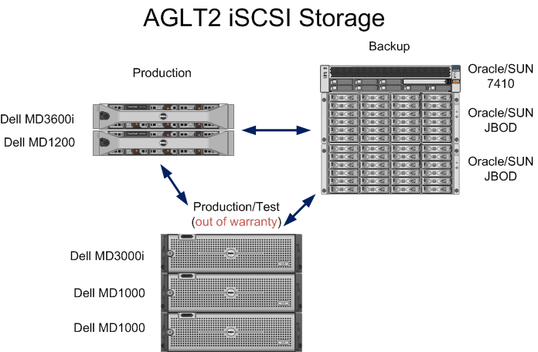
iSCSI for “backend” Live Storage Migration
This set of equipment + VMware allows us to distribute the I/O load as needed to provide the
level of service the VMs need
We can also move VMs “live” between storage for maintenance or repair reasons
Interim purchase as MSU will only allow MSU nodes to replicate VM images from UM site. This is OK for our primary goal as long as we maintain a timely replica

Slide 11
Service Multi-Site Resiliency Options
What about site level resiliency? Various options by service:
DB can use “internal” replication methods: Postgresql – streaming/hot-standby, Oracle – Streams/Clustering, MySQL – Replication
Already using Oracle Streams to CERN and Postgresql 9.0 hot-standby for dCache DBs at AGLT2_UM. Must extend to include MSU once up.
Services without state: AFS, Kerberos, LFC, ROCKs head nodes, web servers, etc. use virtualization features like HA which makes sure an instance is always running
AFS is a special case: need both DB/auth and file-server components
Plan to add AFS VM nodes at MSU and leverage AFS volume replication
Grid services with state: Condor, Gatekeepers: still looking for a good solution. Currently both virtualized at AGLT2. Plan: replication of VM image to keep “cold” copy at remote site. Startup requires network changes to instantiate at secondary site. Host-cert issues…

Slide 12
Multi-Site Virtualization Challenges
VMware (or other virtualization technologies) can provide high availability and ease management but require that the same networks are present at two sites for transparent operations
If the networks available at each site differ, we need some additional work:
Readdress VMs before bringing up at the remote site
“Move” the network from the down site to the up site
Use network aliases and DNS to allow different back-end addresses to serve the same DNS name (LVS is one example)
Share a “service” subnet between two sites (allows hot-migration)
VMware has “Site Recovery Manager” which automates some of this and we intend to test it out

Slide 13
Grid Storage Considerations
In addition to services, we need to worry about storage.
AGLT2 uses dCache to host its 2.2 Petabytes of storage.
Storage is split between UM and MSU. We cannot afford to replicate this volume of data. How can the site continue to operate with 50% of its storage offline?
New files can continue to be written to the remaining online nodes
Files already written may be either offline or online
AGLT2 uses a site-caching configuration which ends up replicating “hot” (in use) files at each site (see next slide)
Federated Xrootd configuration might be able to augment this by transparently getting any missing files from other sites in the federation (might even use dCache “cache” to store them)

Slide 14
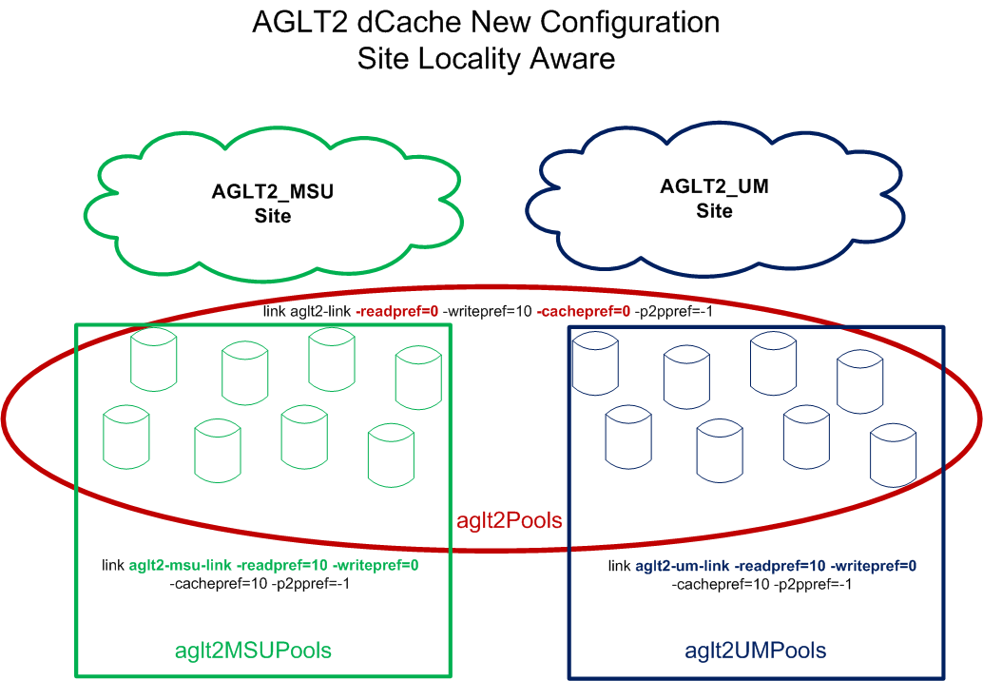
dCache Inter-site Caching
All reads MUST come from a local pool
Missing files staged in from remote site
Staged files marked as replica. Files transparently overwritten (LRU)

Slide 15
A little more on Federated Xrootd Use
The previous slide shows how dCache can be made to transparently cache popular files by forcing a site to only “read” from local dCache pools.
Missing files are retrieved from the remote site via pool-to-pool copying (remote site is treated just like a tape system)
When the remote-site pools are offline we would like to fall-back to retrieve missing files via our Xrootd Federation.
The plan is to patch dCache’s pool-to-pool copy process to allow it to use xrdcp from the federation to get missing files when dCache pools containing the file are offline.
Xrootd files end up cached at the site just as if they came from the other sites dCache pool during normal operation

Slide 16
Future Considerations
Our primary goal is to allow AGLT2 to continue to function if one of the two physical sites is down for an extended period.
Would like to have the ability to hot-migrate services between sites: requires robust replication and network changes.
Some services will need to be replicated to be running at both sites: DB replication, DNS aliases with LVS, etc.
Will need well-documented procedures to promote secondary to primary for each such setup
Software solutions may not be sufficiently robust or may have too large of a latency to meet our desired service level but we plan to try them out
We think iSCSI hardware may be able to provide needed replication and storage services for site resiliency. Cost is an issue.

Slide 17
Summary
Most of our focus has been on “Service Virtualization”
Reliability (multiple hosts and storage systems support live migration)
Ease of management
Easy to backup/clone/update
Maintenance do-able without downtime for VMs (most cases)
Works well within one site
Goal is “site resiliency” allowing AGLT2 to function with either UM or MSU site being down
Currently recovering from loss of UM site would take weeks; our goal is to reduce that to hours.
dCache and Federated Xrootd may allow storage to support single site operations
Hardware and plans in place to meet this goal soon

Slide 18
Questions / Discussion?

Slide 19
Additional Resiliency Considerations

Slide 20
Storage Connectivity
Increase robustness for storage by providing resiliency at various levels:
Network: Bonding (e.g. 802.3ad)
Raid/SCSI redundant cabling, multipathing
iSCSI (with redundant connections)
Disk choices: SATA, SAS, SSD ?
Single-Host resiliency: redundant power, mirrored memory, RAID OS disks, multipath controllers
Clustered/failover storage servers
Multiple copies, multiple write locations

Slide 21
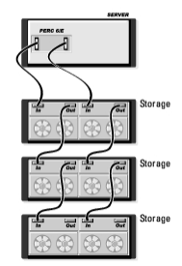
Redundant Cabling Using Dell MD1200s
Firmware for Dell RAID controllers allows redundant cabling of MD1200s
MD1200 can have two EMMs, each capable of accessing all disks
An H800 has two SAS channels
Can now cable each channel to an EMM on a shelf. Connection shows one logical link (similar to “bond” in networking): Performance and Reliability

Slide 22
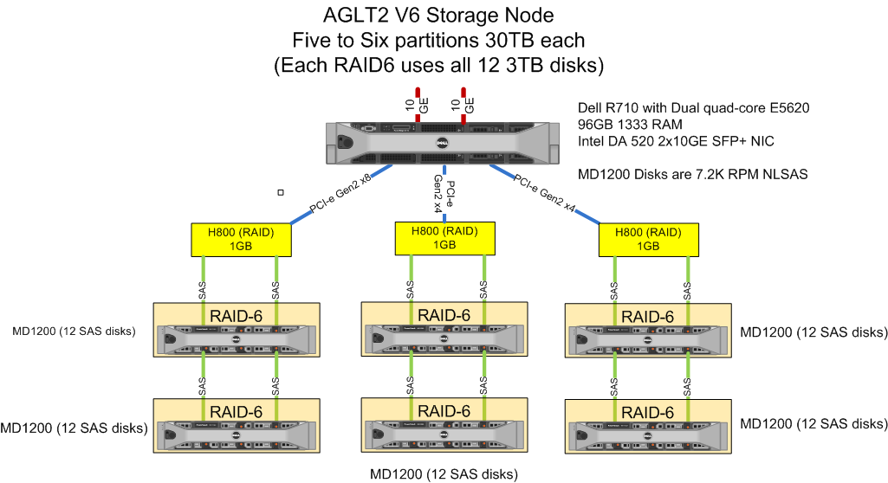
Storage Example: Inexpensive, Robust and Powerful
Dell has special LHC pricing available. US ATLAS Tier-2s have found the following configuration both powerful and inexpensive
Individual storage nodes have exceeded 750MB/sec on the WAN

Slide 23
Site Disk Choices
Currently a number of disks choices:
SATA – Inexpensive, varying RPMs, good BW
SAS - Higher quality, faster interface, more $
SSDs – Expensive, great IOPs, interface varies
Reliability can be very good for most choices. NL-SAS (SATA/SAS hybrid) very robust. Range of throughputs and IOPS.
SSDs have IOPS in the 10K+ region versus fast SAS disks at ~200. SSD I/O bandwidths usually x2-3 rotating disk

Slide 24
SSDs for Targeted Apps
SSDs make good sense if IOPS are critical.
DB applications are a prime example
Server hot-spots (NFS locations, other)
Example: Intel SSDs at AGLT2 decreased some operation times from 4 hours to 45 minutes
New SSDs very robust compared to previous generations…capable of 8+ Petabytes of writes; 5 year lifetimes (check endurance figures)
Lower power; bandwidths to 550 MB/sec
Choice of interface: SATA, SAS, bus-attached. Seagate/Hitachi/Toshiba/OCZ have 6 Gbps/SAS
See https://hep.pa.msu.edu/twiki/bin/view/AGLT2/TestingSSD

Slide 25
Power Issues
Power issues can frequently be the cause of service loss in our infrastructure
Redundant power-supplies connected to independent circuits can minimize loss due to circuit or supply failure (Verify one circuit can support the required load!!)
UPS systems can bridge brown-outs or short-duration loses and protect equipment from power fluctuations
Generators provide longer-term bridging

Slide 26
General Considerations (1/2)
Lots of things can impact both reliability and performance
At the hardware level:
Check for driver updates
Examine firmware/bios versions (newer isn’t always better BTW)
Software versions…fixes for problems?
Test changes – Do they do what you thought? What else did they break? ☺

Slide 27
General Considerations (2/2)
Sometimes the additional complexity to add “resiliency” actually decreases availability compared to doing nothing!
Having test equipment to experiment with is critical for trying new options
Often you need to trade-off cost vs performance vs reliability (pick 2 ☺ )
Documentation, issue tracking and version control systems are your friends!

Slide 28
“Robustness” Summary
There are many components and complex interactions possible in our sites.
We need to understand our options (frequently site specific) to help create robust, high-performing infrastructures
Hardware choices can give resiliency and performance. Need to tweak for each site.
Reminder: test changes to make sure they actually do what you want (and not something you don’t want!)

Slide 29
Questions / Discussion?

