Slide 1
Emerging Campus Infrastructure at Virginia Tech
OSG All Hands Meeting 2012
Bill Marmagas
zorba@vbi.vt.edu

Slide 2
Virginia Bioinformatics Institute
ACDIL Division
Modeling and simulation of interaction-based, co-evolving technical, biological, and social networks in support of national policy
Infrastructure, immunology and disease, public health epidemiology, and national security
Research Niches
Advancing the math & science of these simulations
Integrating social and behavioral modeling
Developing computational tools that leverage HPC

Slide 3
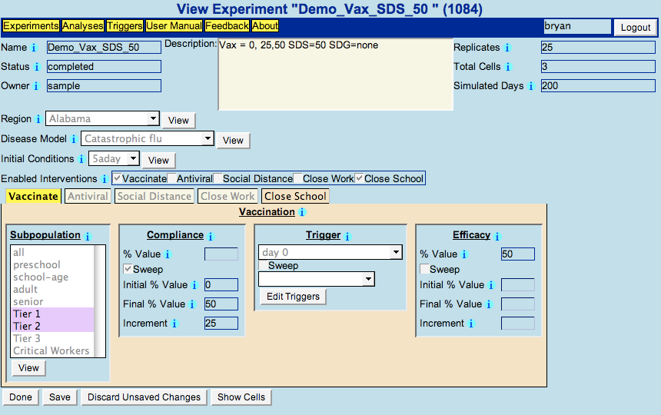
Example: DIDACTIC / EpiFast
Web-based epidemic modeling using HPC

Slide 4
Major Funders

Slide 5
Campus Infrastructure Pieces
OSG Submit Host
Campus Factory

Slide 6
OSG Submit Host
Flocks HTPC Jobs to OSG Via Engage
RENCI Configured Host DN on engage-submit3
OSG Factory Also Configured to Allow Access
Host Certificate
This Host Can Be A Shared, Multi-User Resource
Submit Host Firewall: Condor Config.
HIGHPORT = 65535
LOWPORT = 44536

Slide 7
Submit File Example: EpiFast
universe = vanilla
executable = runepifast.sh
Requirements = (CAN_RUN_WHOLE_MACHINE =?= TRUE)
+RequiresWholeMachine = True
# Put a process run on Hold if it has been running for four hours:
periodic_hold = JobStatus == 2 && (CurrentTime - EnteredCurrentStatus > 14400)
ShouldTransferFiles = YES
when_to_transfer_output = ON_EXIT
output = submit.htpc.Vac-0.05_Alloc.out.$(Cluster).$(Process)
error = submit.htpc.Vac-0.05_Alloc.err.$(Cluster).$(Process)
log = submit.htpc.Vac-0.05_Alloc.log.$(Cluster).$(Process)
#Process Run: 0
transfer_input_files = ../../../bin/EpiFast, ../../../bin/mpiexec, ../../../areas/SeattleData.tgz, ../Vac-0.05_Alloc-0.0-0.0-0.0-0.0-1.0.tgz
arguments = 8 Vac-0.05_Alloc-0.0-0.0-0.0-0.0-1.0
queue

Slide 8
Campus Factory
Enables Flocking to Local HPC Clusters
Jobs Glide In To Compute Nodes
Can Also Be An HTPC Resource
echo "#PBS -lnodes=1:ppn=8”
(/usr/libexec/condor/glite/bin/pbs_local_submit_attributes.sh)
Moab NODEACCESSPOLICY=SINGLEJOB does same
Same EpiFast Jobs Run Here

Slide 9
Latest Campus Factory 0.4.3
Prevents “Walltime Rogues”
SHUTDOWN_GRACEFUL_TIMEOUT = 72000
MAXJOBRETIREMENTTIME = 34800
72000 sec. + 34800 sec. = 29 hours 40 minutes
./glideinExec/glidein_startup -dyn -f -r 1200
1200 min. = 20 hours run time for condor_master
echo "#PBS -lwalltime=30:00:00”
30 Hour Walltime is a bit more than SHUTDOWN_GRACEFUL_TIMEOUT + MAXJOBRETIREMENTTIME

Slide 10
Future Work
Infrastructure
Add Second Campus Factory Cluster
Integrate Campus Factories Into Submit Host
Web Interface Plug-In to Submit Host
More Applications
Computational Social Science Example
Biochemical Network Simulation Example

Slide 11
Discrete Dynamical Systems
Application: Model group dynamics and how a population may or may not reach a majority view.
75879-node Epinions Network = 10⁷⁵⁸⁷⁹ Config’s
We can look at a smaller, statistically significant set
Perhaps: 100 Config’s X 50 Simulation Time Steps
Clusters of Muticore (Worker and Slave) Jobs
Ideology
0
1
2
3
4
view 1 or opinion 1
5
6
7
8
9
view 2 or opinion 2
increasing levels of conviction

Slide 12
COPASI
A software application for simulation and analysis of biochemical networks and their dynamics.
A collaboration between VBI, the University of Heidelberg, and the University of Manchester
Condor-COPASI is a web-based interface for integrating COPASI with Condor
Potential good fit to flock to a dedicated Campus Factory to submit to their cluster queue

Slide 13
References
TWiki: CampusGrids/InstallCondorFlockSubmit
TWiki: Documentation/CampusFactoryInstall
Bill Marmagas
Senior Systems Engineer
Network Dynamics and Simulation Science Laboratory
Virginia Bioinformatics Institute
zorba@vbi.vt.edu

