Slide 1
FermiCloud Infrastructure as a Service (IaaS) Cloud Computing In Support of the Fermilab Scientific Program OSG All Hands Meeting 2012
Steven Timm timm@fnal.gov
Fermilab Grid & Cloud Computing Dept.
For FermiCloud team: K. Chadwick, D. Yocum, F. Lowe,
G. Garzoglio, T. Levshina, P. Mhashilkar, H. Kim
Work supported by the U.S. Department of Energy under contract No. DE-AC02-07CH11359

Slide 2
FermiCloud Introduction
As part of the FY2010 activities, the (then) Grid Facilities Department established a project to implement an initial “FermiCloud” capability.
GOAL: Deliver production-capable Infrastucture-as-a-service to support Fermilab Scientific Program
Reuse what we learned from Grid
High Availability, Authentication/Authorization, Virtualization
FermiCloud Phase I—Completed Nov. 2010:
Specify, acquire and deploy the FermiCloud hardware,
Establish initial FermiCloud requirements and select the “best” open source cloud computing framework that best met these requirements (OpenNebula).
Deploy capabilities to meet the needs of the stakeholders (JDEM analysis development, Grid Developers and Integration test stands, Storage/dCache Developers, LQCD testbed).
Replaced six old racks of integration/test nodes with one rack.

Slide 3
FermiCloud – Current Activities
FermiCloud Phase II:
Implement x509 based authentication (patches contributed back to OpenNebula project and are generally available in OpenNebula V3.2), perform secure contexualization of virtual machines at launch.
Implement monitoring and accounting,
Target “small” low-cpu-load servers such as Grid gatekeepers, forwarding nodes, small databases, monitoring, etc.
Begin the hardware deployment of a distributed SAN,
FermiCloud Phase III:
Select and deploy a true multi-user filesystem on top of a distributed & replicated SAN,
Deploy 24x7 production services
Live migration becomes important for this phase.

Slide 4
FermiCloud – Hardware Specifications
Currently 23 systems split across FCC-3 and GCC-B:
2 x 2.67 GHz Intel “Westmere” 4 core CPU
Total 8 physical cores, potentially 16 cores with Hyper Threading (HT),
24 GBytes of memory (we are considering an upgrade to 48),
2 x 1GBit Ethernet interface (1 public, 1 private),
8 port Raid Controller,
2 x 300 GBytes of high speed local disk (15K RPM SAS),
6 x 2 TBytes = 12 TB raw of RAID SATA disk = ~10 TB formatted,
InfiniBand SysConnect II DDR HBA,
Brocade FibreChannel HBA (added in Fall 2011),
2U SuperMicro chassis with redundant power supplies

Slide 5
FermiCloud—Software Stack
Current production
Scientific Linux 5.7 host, SLF5 and SLF6 guest
KVM hypervisor (Xen available on request).
OpenNebula 2.0 with command-line launch
Virtual machines distributed via SCP
Coming soon
Scientific Linux 6.1, SLF5 and SLF6 guests
KVM hypervisor
OpenNebula 3.2 with X.509 authentication
Command line, SunStone Web UI, EC2 emulation, OCCI interface, Condor-G
Persistent virtual machines stored on SAN (GFS).
All Open Source

Slide 6
FermiCloud Typical VM Specifications
Unit:
1 Virtual CPU [2.67 GHz “core” with Hyper Threading (HT)],
2 GBytes of memory,
10-20 GBytes of of SAN based “VM Image” storage,
Additional ~20-50 GBytes of “transient” local storage.
Additional CPU “cores”, memory and storage are available for “purchase”:
Based on the (Draft) FermiCloud Economic Model,
Raw VM costs are competitive with Amazon EC2,
FermiCloud VMs can be custom configured per “client”,
Access to Fermilab science datasets is much better than Amazon EC2.

Slide 7
FermiCloud – Monitoring
Temporary FermiCloud Usage Monitor:
http://www-fermicloud.fnal.gov/fermicloud-usage-data.html
Data collection dynamically “ping-pongs” across systems deployed in FCC and GCC to offer redundancy,
See plot on next page.
FermiCloud Redundant Ganglia Servers:
http://fcl301k1.fnal.gov/ganglia/
http://fcl002k1.fnal.gov/ganglia/
Preliminary RSV based monitoring pilot:
http://fermicloudrsv.fnal.gov/rsv

Slide 8
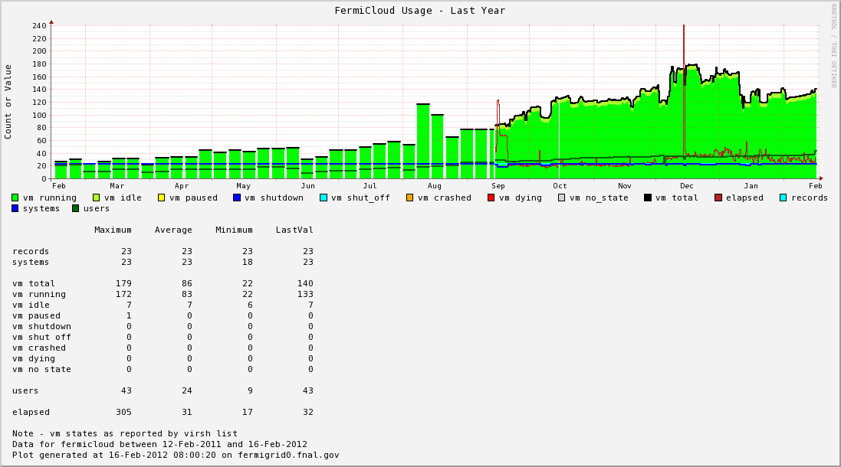
Note – FermiGrid Production Services are operated at 100% to 200% “oversubscription”
VM states as reported by “virsh list”
FermiCloud Capacity | # of Units
Nominal (1 physical core = 1 VM) | 184
50% over subscription | 276
100% over subscription (1 HT core = 1 VM) | 368
200% over subscription | 552
FermiCloud Target

Slide 9
Description of Virtual Machine States Reported by “virsh list” Command
State | Description
running | The domain is currently running on a CPU. Note – KVM based VMs show up in this state even when they are “idle”.
idle | The domain is idle, and not running or runnable. This can be caused because the domain is waiting on I/O (a traditional wait state) or has gone to sleep because there was nothing else for it to do. Note – Xen based VMs typically show up in this state even when they are “running”.
paused | The domain has been paused, usually occurring through the administrator running virsh suspend. When in a paused state the domain will still consume allocated resources like memory, but will not be eligible for scheduling by the hypervisor.
shutdown | The domain is in the process of shutting down, i.e. the guest operating system has been notified and should be in the process of stopping its operations gracefully.
shut off | The domain has been shut down. When in a shut off state the domain does not consume resources.
crashed | The domain has crashed. Usually this state can only occur if the domain has been configured not to restart on crash.
dying | The domain is in process of dying, but hasn't completely shutdown or crashed.

Slide 10
FermiCloud – Monitoring Requirements & Goals
Need to monitor to assure that:
All hardware is available (both in FCC3 and GCC-B),
All necessary and required OpenNebula services are running,
All Virtual Machine hosts are healthy
All “24x7” & “9x5” virtual machines (VMs) are running,
If a building is “lost”, then automatically relaunch “24x7” VMs on surviving infrastructure, then relaunch “9x5” VMs if there is sufficient remaining capacity,
Perform notification (via Service-Now) when exceptions are detected.
We plan to replace the temporary monitoring with an infrastructure based on either Nagios or Zabbix during CY2012.
Possibly utilizing the OSG Resource Service Validation (RSV) scripts.
This work will likely be performed in collaboration with KISTI.
Goal is to identify really idle virtual machines and suspend if necessary.
Can’t trust hypervisor VM state output on this—Need rule-based definition
In times of resource need, we want the ability to suspend or “shelve” the really idle VMs in order to free up resources for higher priority usage.
Shelving of “9x5” and “opportunistic” VMs will allow us to use FermiCloud resources for Grid worker node VMs during nights and weekends (this is part of the draft economic model).

Slide 11
FermiCloud - Accounting
Currently have two “probes” based on the Gratia accounting framework used by Fermilab and the Open Science Grid
Standard Process Accounting (“psacct”) Probe:
Installed and runs within the virtual machine image,
Reports to standard gratia-fermi-psacct.fnal.gov.
Open Nebula Gratia Accounting Probe:
Runs on the OpenNebula management node and collects data from ONE logs, emits standard Gratia usage records,
Reports to the “virtualization” Gratia collector,
The “virtualization” Gratia collector runs existing standard Gratia collector software (no development was required),
The development of the Open Nebula Gratia accounting probe was performed by Tanya Levshina and Parag Mhashilkar.
Additional Gratia accounting probes could be developed:
Commercial – OracleVM, VMware, ---
Open Source – Nimbus, Eucalyptus, OpenStack, …

Slide 12
Open Nebula Gratia Accounting Probe
Fermilab Gratia Collector/Reporter
onevm_query
ONE
API
ONE DB
Collector
Collector
gratia-fermi-itb
gr11x4
gratia-fermi-itb
gr10x4
Collector
Collector
gratia-fermi-transfer
gr11x3
gratia-fermi-transfer
gr10x3
Collector
Collector
gratia-fermi-qcd
gr11x2
gratia-fermi-qcd
gr10x2
Collector
Collector
gratia-fermi-psacct
gr11x1
gratia-fermi-psacct
gr10x1
Reporter
Collector
gratia-fermi-osg
gr11x0
gratia-fermi-osg
gr10x0
onevm
data
Probe
Config
Standard
Usage
Records
MySQL Database
MySQL Database
gratia_onevm
Gratia
API
osg
user
map
New Code

Slide 13
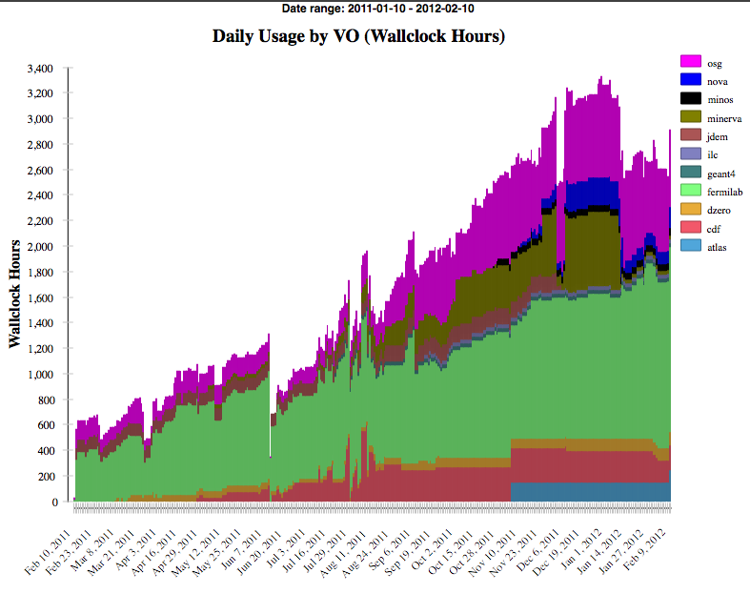
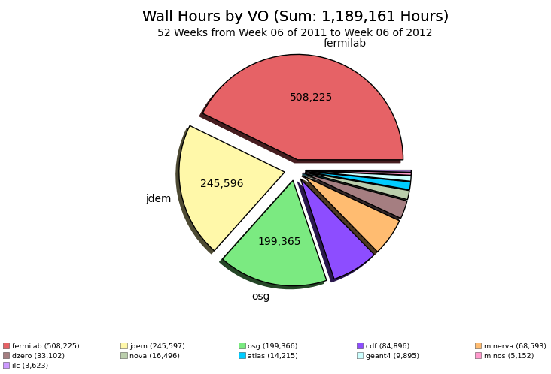
FermiCloud – Gratia Accounting Reports
Here are the preliminary results of “replaying” the previous year of the OpenNebula “OneVM” data into the new accounting probe:

Slide 14
vCluster
Deployable on demand virtual cluster using hybrid cloud computing resources.
Head nodes launched on virtual machines within the FermiCloud private cloud.
Worker nodes launched on virtual machines within the Amazon EC2 public cloud and on FermiCloud
Work done by Dr. Seo-Young Noh, KISTI-GSDC visitor at Fermilab, summer 2011
Look ahead at Condor queue to see what kind of virtual machines are needed and submit as needed.

Slide 15
MPI on FermiCloud (Note 1)
Configuration | #Host Systems | #VM/host | #CPU | Total Physical CPU | HPL Benchmark (Gflops)
Bare Metal without pinning | 2 | -- | 8 | 16 | 13.9
Bare Metal with pinning (Note 2) | 2 | -- | 8 | 16 | 24.5
VM without pinning (Notes 2,3) | 2 | 8 | 1 vCPU | 16 | 8.2
VM with pinning (Notes 2,3) | 2 | 8 | 1 vCPU | 16 | 17.5
VM+SRIOV with pinning (Notes 2,4) | 2 | 7 | 2 vCPU | 14 | 23.6
Notes: (1) Work performed by Dr. Hyunwoo Kim of KISTI in collaboration with Dr. Steven Timm of Fermilab.
(2) Process/Virtual Machine “pinned” to CPU and associated NUMA memory via use of numactl.
(3) Software Bridged Virtual Network using IP over IB (seen by Virtual Machine as a virtual Ethernet).
(4) SRIOV driver presents native InfiniBand to virtual machine(s), 2nd virtual CPU is required to start SRIOV, but is only a virtual CPU, not an actual physical CPU.

Slide 16
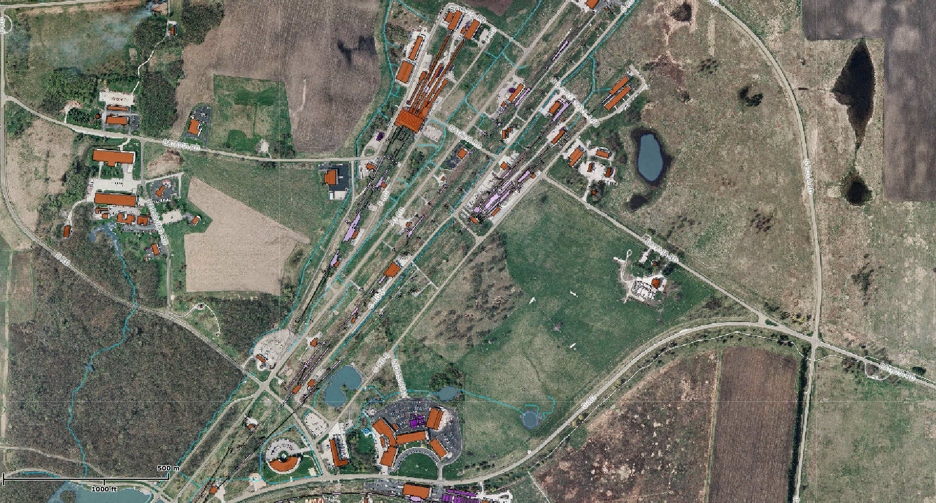
FermiCloud Facilities
GCC
The FCC and GCC buildings are separated by approximately 1 mile (1.6 km).
FCC has UPS and Generator.
GCC has UPS.
FCC

Slide 17
FermiCloud – Network & SAN “Today”
FCC-3
FCC-2
GCC-A
GCC-B
Nexus
7010
Nexus
7010
fcl316
To
fcl323
fcl001
To
fcl015
Nexus
7010
Nexus
7010
FCC-3
GCC-B
Private Ethernet
over dedicated fiber
Brocade
Brocade
Satabeast
Fibre Channel
Satabeast
Brocade
Brocade
FY2011 / FY2012
Note – Dashed Lines = Waiting for Equipment or Fiber

Slide 18
FermiCloud – Network & SAN (Possible Future – FY2013/2014)
FCC-2
GCC-A
Brocade
Brocade
Brocade
Brocade
fcl0yy
To
fcl0zz
fcl0xx
To
fcl0yy
FCC-2
GCC-A
Nexus
7010
Nexus
7010
FCC-3
GCC-B
fcl316
To
fcl330
fcl001
To
fcl015
Nexus
7010
Nexus
7010
FCC-3
GCC-B
Fibre Channel
Brocade
Brocade
Satabeast
Fibre Channel
Satabeast
Brocade
Brocade

Slide 19
FermiCloud – Support for Science (direct and indirect)
Grid middleware developers and integrators as well as CDF, D0 and the Cosmic and Intensity Frontiers.
Detailed analysis of filesystem performance for Grid applications
(Lustre vs. Hadoop vs. OrangeFS vs. Bluearc).
Tuning and stress tests of GUMS-XACML and SAZ-XACML
dCache NFS v4.1 interface
Fabric testbeds—IPv6 for Grid and Cloud applications
OSG Software Team integration and testing of OSG 3.0 RPMS
Scientific control and communication system tests for JDEM and NOVA
Production services have been deployed on FermiCloud, including:
Specialized GridFTP virtual machines for the Intensity Frontier experiments,
NFS Administration virtual machines to allow Intensity Frontier experiments to perform file ownership management of their BlueArc volumes.
SAMGrid forwarding nodes to send D0 jobs to WLCG sites via GlideinWMS

Slide 20
Recent FermiCloud Uses
Application/Project | Stakeholder
JDEM Demo Data Processing System | LSST
OSG Software Team build and test | OSG
GEANT4 validation server | CET
GlobusOnline test work (CEDPS) | OSG & CEDPS
CVMFS testing | IF
Test GUMS and SAZ servers | FermiGrid
Extenci Lustre-over-WAN | OSG
Vcluster demo (grid cluster in the cloud) | GCC & KISTI
Expt-specific gridftp servers (MINOS, NOVA) | IF
SAMGrid forwarding nodes | D0
dCache NFS4.1 testing | REX & DMS
Scientist survey | Directorate
MCAS | GCC
OSG-XSEDE interoperability | OSG, XSEDE

Slide 21
FermiCloud Conclusions
The existing (temporary) FermiCloud usage monitoring shows that the peak FermiCloud usage is ~100% of the nominal capacity and ~50% of the expected oversubscription capacity.
The FermiCloud collaboration with KISTI has leveraged the resources and expertise of both institutions to achieve significant benefits.
FermiCloud has plans to implement both monitoring and accounting by extension of existing tools in CY2012.
Using SRIOV drivers on FermiCloud virtual machines, MPI performance has been demonstrated to be >96% of the native “bare metal” performance.
Note that this HPL benchmark performance measurement was accomplished using 2 fewer physical CPUs than the corresponding “bare metal” performance measurement!
FermiCloud personnel are working to implement a SAN storage deployment that will offer a true multi-user filesystem on top of a distributed & replicated SAN.
Science is directly and indirectly benefiting from FermiCloud.

Slide 22
Summary
FermiCloud operates at the forefront of delivering cloud computing capabilities to support physics research:
By starting small, developing a list of requirements, building on existing Grid knowledge and infrastructure to address those requirements, FermiCloud has managed to deliver an Infrastructure as a Service cloud computing capability that supports science at Fermilab.
The Open Science Grid software team is using FermiCloud resources to support their RPM “refactoring”.
Thanks to:
Open Source collaborators—OpenNebula and Scientific Linux
Fermilab Networking and Facilities team
Collaborators from KISTI-GSDC
We welcome collaborators and visitors!
Keep an eye on Fermilab’s employment website for opening (hopefully) coming soon.

Slide 23
Extra Slides

Slide 24
FermiCloud vs. Magellan
FermiCloud | Magellan
Bottom up requirements and design. | Top down requirements and mission.
Funded out of existing budget ($230K+$128K). | Funded via ARRA ($32M).
Multi phase project, with each phase building on knowledge gained during previous phases. | Fixed term project without ongoing funding.
Evaluated available open source cloud computing frameworks (Eucalyptus, Nimbus, OpenNebula) against requirements and selected OpenNebula. We plan to “circle back” and evaluate OpenStack this year. | Spent a lot of time trying to get the open source version of Eucalyptus to work at scale, eventually switched to a combination of Nimbus and OpenStack late in the project.
Approached cloud computing from a Grid and high throughput computing (HTC) perspective. | Approached cloud computing from a high performance computing (HPC) perspective.
Significant prior experience delivering production Grid services via open source virtualization (Xen and KVM). | Unclear.
Have SRIOV drivers for InfiniBand. | Did not have SRIOV drivers for InfiniBand before the end of the project.
Actively sought collaboration (OpenNebula, KISTI). | Project was sited at NERSC and Argonne.

