Slide 1
Enzyme Design on the OSG
Florian Richter
Baker Group, Dept. of Biochemistry
University of Washington, Seattle

Slide 2
Overview
Introduction to Proteins
Protein Structure
Computational modeling of proteins
Introduction to Enzymes
Redesigning an enzyme for live-cell imaging on OSG
Some general thoughts on Protein modeling on OSG

Slide 3
Overview
Introduction to Proteins
Protein Structure
Computational modeling of proteins
Introduction to Enzymes
Redesigning an enzyme for live-cell imaging on OSG
Some general thoughts on Protein modeling on OSG

Slide 4
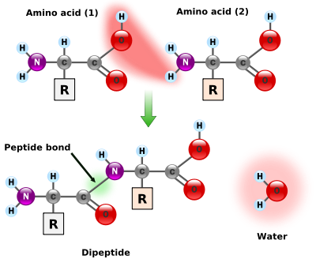
1a. Introduction to Protein Structure
Proteins are linear chains of amino acids
20 amino acids in nature
Amino acid sequence determines a proteins 3D-structure and funtion
Distinction between the protein backbone and the side-chains
Notes:
Talk about different properties of amino acids in R groups
Charged
polar
Hydrophobic
Point out backbone vs sidechains, backbone is the same for every amino acid, side chain is what’s different

Slide 5
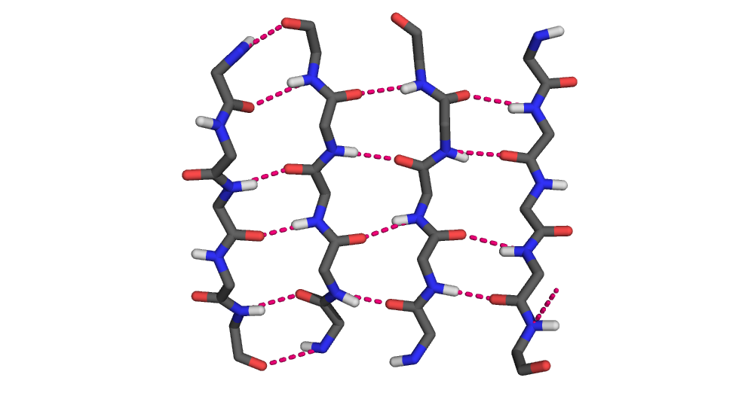
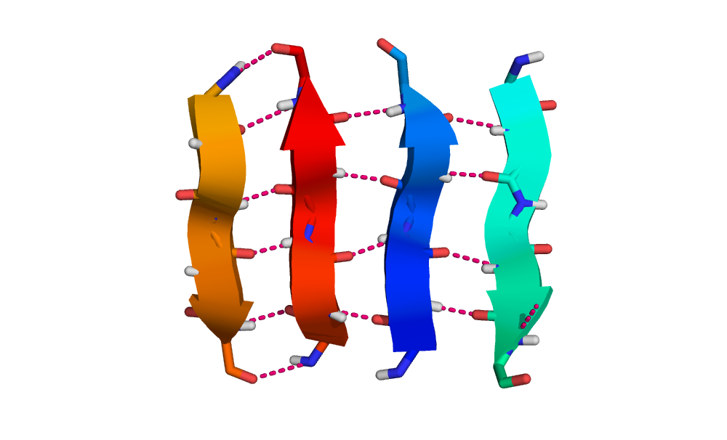
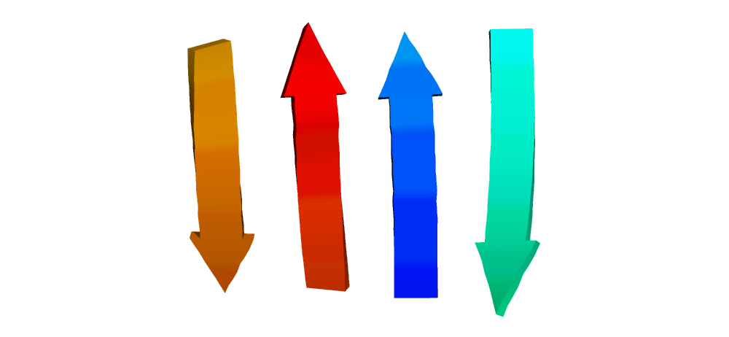
1a. Introduction to Protein Structure
Proteins spontaneously fold into three-dimensional structure
Interactions between amino acids (e.g. electrostatic, hydrogen bonds) determine structure
Backbone can fold into three types of 2° structure
β Strands/Sheet
α Helix
Notes:
Mention hydrogen bonds between backbone NH and oxygens

Slide 6
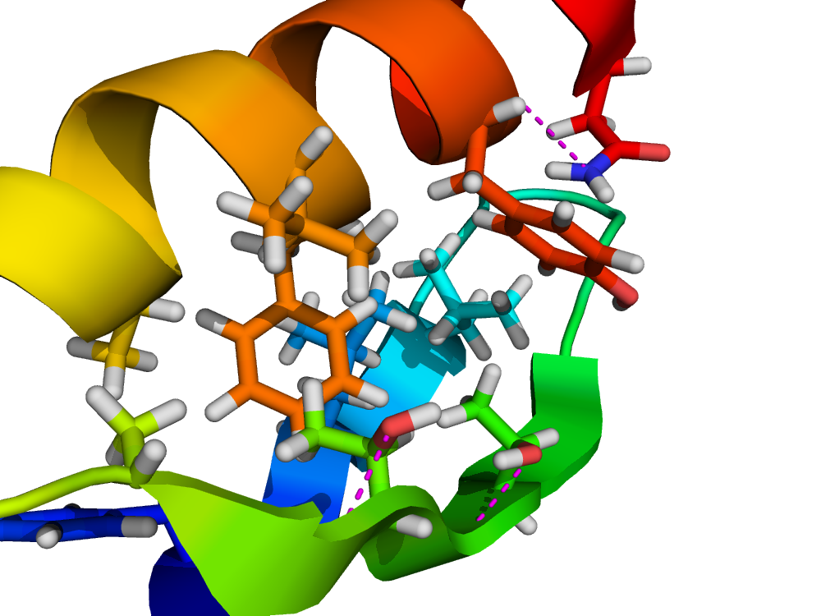
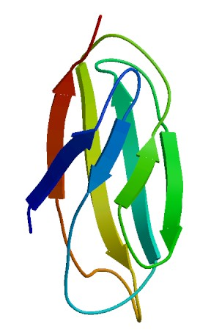
1a. Introduction to Protein Structure
2° structure elements fold up to form 3° structure, guided by side-chain interactions (“packing”)
Global structure of protein determines function
about 70000 protein structures have been elucidated so far, deposited in “Protein Data Bank” (PDB), www.rcsb.org
An example of sidechain packing
Some exemplary protein structures
Notes:
Describe packing observed in with phenylalanine
Mention that sidechains are omitted in three images
Elucidation is tedious process

Slide 7
1b. Computational modeling of proteins
Why do we want to model proteins?
Structure prediction from amino acid sequence
Design of proteins with new functions
Protein modeling algorithm needs: 1) An energy function to score a certain proposed conformation
2) sampling method to generate conformations
Goal is to find a conformation with as low energy / score as possible
Notes:
Mention that any modeling algorithm needs score function / sampling method

Slide 8
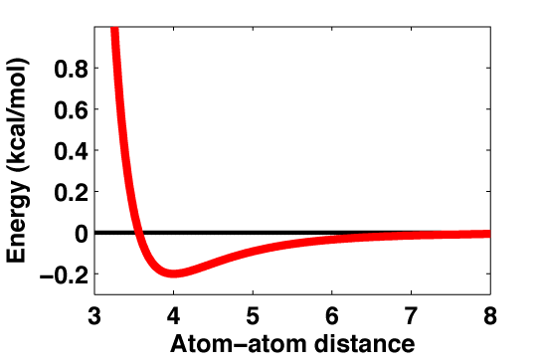
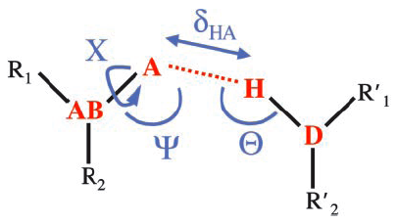
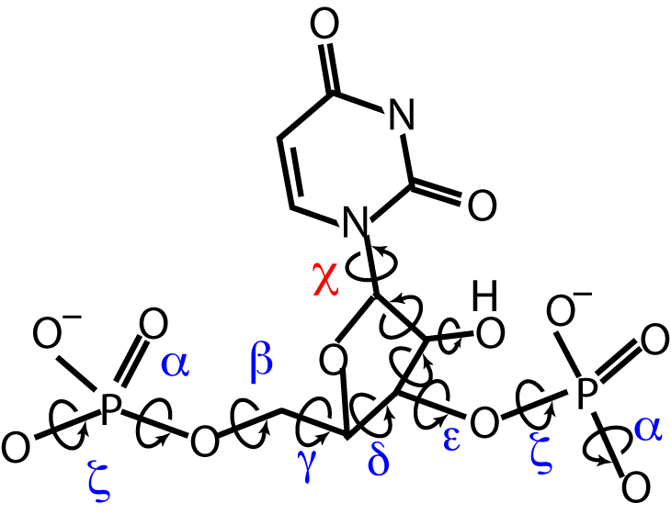
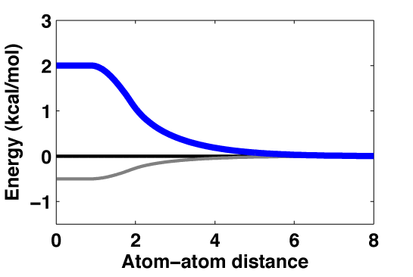
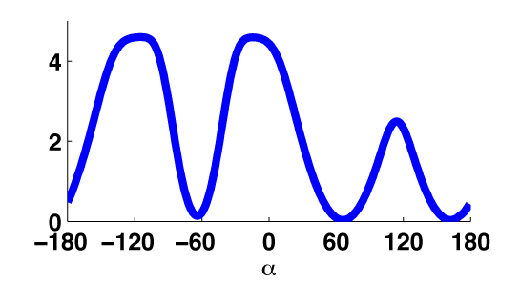
1b. Computational modeling of proteins 1) Energy function makeup
Proteins are usually modeled using a classical physics representation (“ball and stick model”)
Energy function contains several “terms”
Atom-Atom Force Fields
Hydrogen Bond Potentials
D
Solvation Potential
Torsional Potentials
The cost of desolvation
Polar atoms
Non-polar atoms
The hydrophobic effect
Notes:
Describe each term a bit
The total score is the sum over the terms

Slide 9
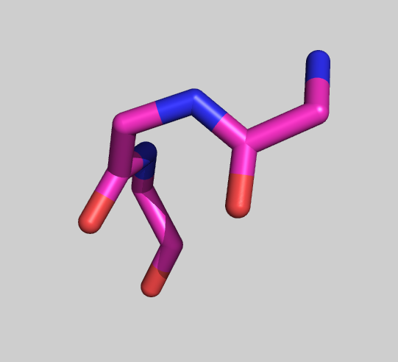
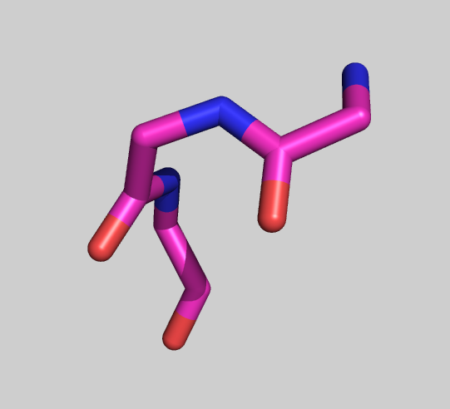
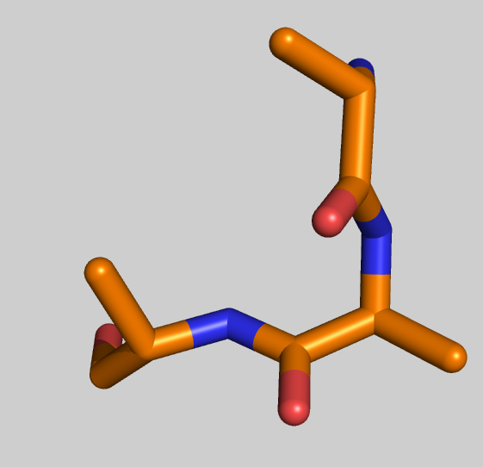
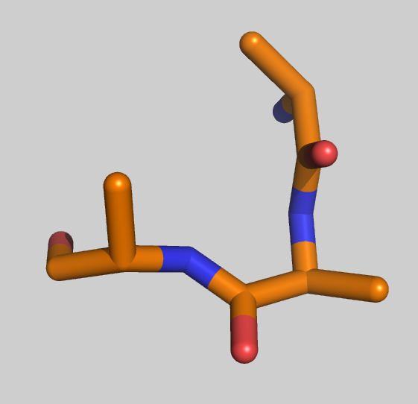
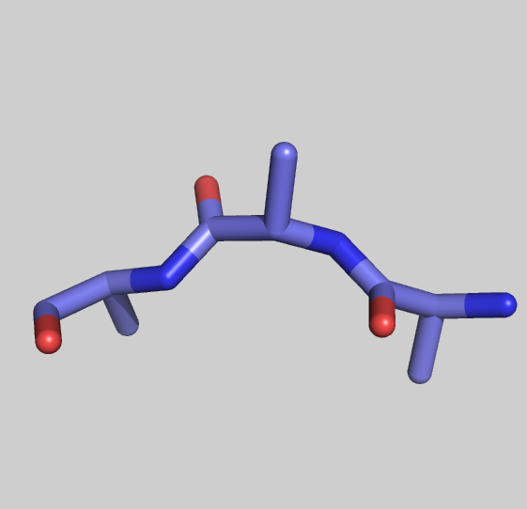
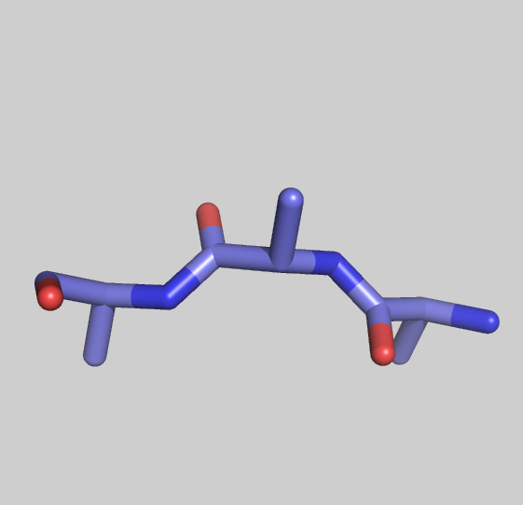
1b. Computational modeling of proteins 2) an exemplary backbone sampling algorithm
“Fragments” are selected from PDB
Fragment = e.g. a 3 amino-acid stretch of backbone
Random fragment is inserted into model, resulting conformation scored w/ E. func.
The conformational change is accepted if it passes the Metropolis criterion
Step is repeated several 10000 times to obtain an alternative low-energy conformation
Fragment list
HHH
HHH
LLE
LLE
EEE
EEE

Slide 10
1b. Computational modeling of proteins
Protein structure prediction 1) find a low energy conformation for the backbone
Monte –Carlo algorithm used
(stochastic)
Several 10K steps shown
Usually a large number of independent trajectories

Slide 11
1b. Computational modeling of proteins
Protein structure prediction 2) determine structures for the side chains
Packing algorithm similar to backbone algorithm
make library of side chain conformations seen in crystal structures
Monte-Carlo algorithm to determine optimal combination of side chain conformation

Slide 12
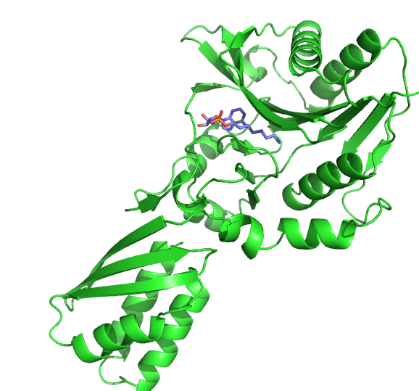
1c. Introduction to enzymes
Enzymes are proteins that catalyze chemical reactions
Universally important (e.g. metabolism, cell development, etc etc)
The catalytic activity is mediated by the ‘active site’
Enzyme
“substrate”
products
Structure of an exemplary enzyme
Schematic diagram of an enzymatic reaction
Notes:
Catalyze = accelerate
Mention food breakdown, muscle activity
Mention that catalyst doesn’t get used up, most enzymes can turn over thousands of times
Point out active site, mention that it is relatively small

Slide 13
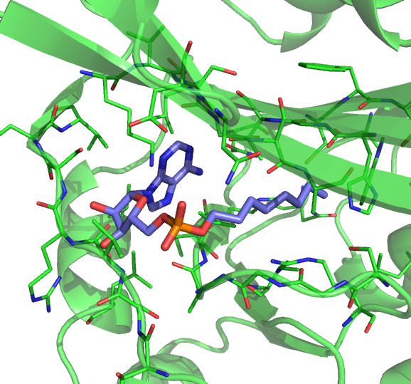
1c. Introduction to enzymes
Enzyme example: Ligase
Attaches a small molecule to other proteins
These other proteins need the attachment to perform their functions
Targets a small ~12 amino-acid recognition sequence
Close-up of the ligase active site
Notes:
Enzyme needs to bind to both substrates to performs its function
Mention that in picture, structure with small molecule is shown
Point out recognition sequence
Talk about biological role,
Some functions can’t be carried out by the 20 amino acids
prepares enzymes used in fatty acid metabolism for their function
Mention that other proteins can be made targets of ligase by adding the target sequence

Slide 14
Overview
Introduction to Proteins
Protein Structure
Computational modeling of proteins
Introduction to Enzymes
Redesigning an enzyme for live-cell imaging on OSG
Some general thoughts on Protein modeling on OSG

Slide 15
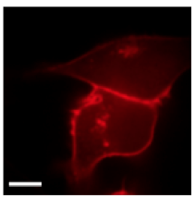
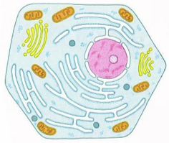
2. Redesigning an enzyme for live-cell imaging on OSG
What is live-cell imaging?
Cells are compartmentalized
Different proteins are located in different compartments
To study localization of a protein of interest, a fluorescent tag can be attached to it
Schematic diagram of a cell
A fluorophore-tagged protein localised in nucleus
Notes:
Briefly mention compartments and what they to
Nucleus contains dna
Mitochondria provide energy
Endoplasmic reticulum prepares proteins for secretion

Slide 16
2. Redesigning an enzyme for live-cell imaging on OSG
Several strategies for labeling proteins in cells exist, none are perfect
Idea: redesigning ligase to transfer a fluorophore instead of its natural substrate
A fluorogenic substrate very similar to the natural substrate exists
Natural ligase reaction
Redesigned ligase reaction
Notes:
Mention that existing strategies have advantages and disadvantages, but don’t go in detail
Mention advantage of ligase, short target sequence
Active site needs to be redesigned

Slide 17
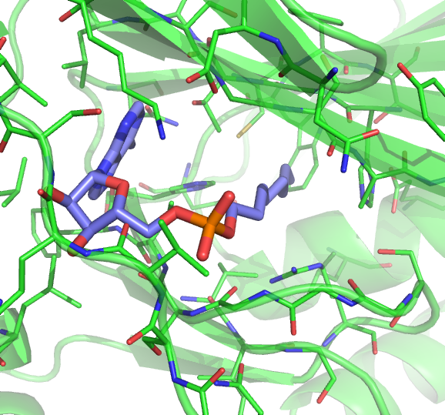
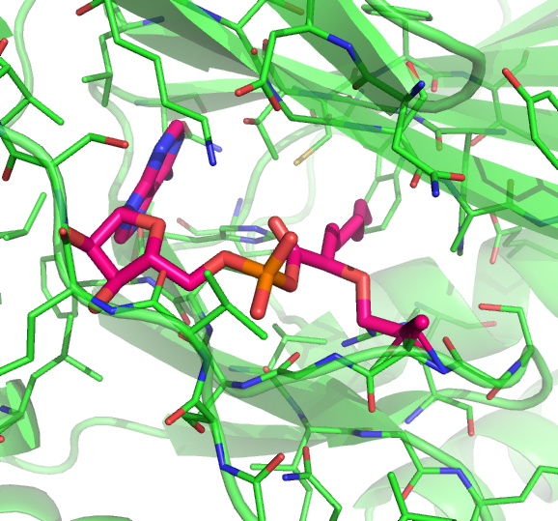
2. Redesigning an enzyme for live-cell imaging on OSG
Task: use computational design to create a variant of ligase that transfers a fluorophore to its targets
A model of the fluorophore was created and superimposed on the natural substrate
Problem: fluorophore part ‘clashes’ with backbone of ligase
vs.
Notes:
Point out part that ‘glows’

Slide 18
2. Redesigning an enzyme for live-cell imaging on OSG
Computational algorithm:
Find new conformation for clashing loop (backbone modeling)
Design new sequence for alternative conformations (side chain modeling)
If Score is comparable to score of natural conformation, write model
Repeat several 10K times in parallel
Notes:
Mention that backbone modelling is done with fragments,
Point out moving substrate, modeling done at same time as protein side chains

Slide 19
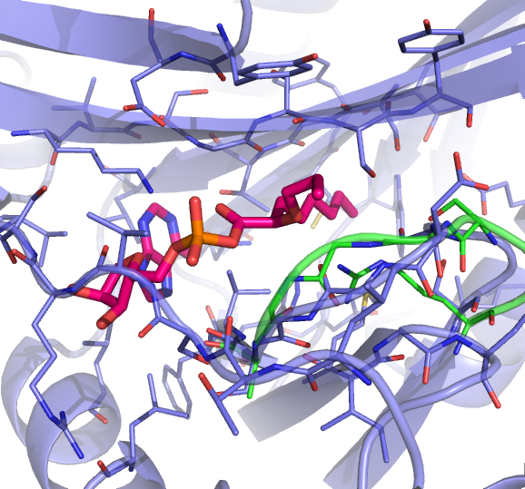
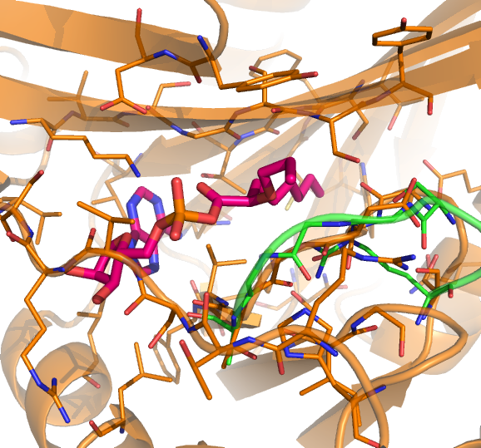
2. Redesigning an enzyme for live-cell imaging on OSG
A total of ~250K trajectories were started (~52K CPU hours)
493 decent models generated (as judged by score )
After filtering and visual inspection, 10 selected for experimental characterization
Experimental characterization has begun, but no results yet

Slide 20
Overview
Introduction to Proteins
Protein Structure
Computational modeling of proteins
Introduction to Enzymes
Redesigning an enzyme for live-cell imaging on OSG
Some general thoughts on Protein modeling on OSG

Slide 21
3. Some general thoughts on Protein modeling on OSG
Generally working great! (~10⁶ cpu hours in ~7 months)
Current computational resources in the Baker Group
480 node cluster for interactive jobs
~1600 node cluster w/ condor system
BOINC / Rosetta@Home, ~300K active hosts
OSG fits in well, between 1600 node cluster and R@H
Notes:
Mention that 1600 cluster is a little old

Slide 22
3. Some general thoughts on Protein modeling on OSG
Our software / community
Rosetta 3.x, developed since 2006, all C++ codebase, >10⁶ lines by now
Semi open source, free academic license
About ~100 developers (10-20 active ones)
www.rosettacommons.org
Most types of calculations use stochastic algorithms
-> embarrassingly parallel, well suited for current osg setup
Some MPI-protocols are being developed, but not widely used yet
Maybe switch to GPUs at some point in the distant future
Notes:
Mention that 1600 cluster is a little old

Slide 23
3. Some general thoughts on Protein modeling on OSG
Computational needs for typical Rosetta3.x protocols / jobs
Category | Resources needed
CPU cycles | lots
memory | normal
storage | little - normal
Network transfer | Input: ~400MB in total, i.e. ~50MB static executable + ~300MB general input files + <20MB job-specific input files Output: <20MB
Notes:
Explain meaning of normal for memory use -> can run most protocols on laptops
Storage: calculate number of output per cpu hours

Slide 24
Acknowledgements
OSG
Zachary Miller
Mats Rynge
Miron Livny
David Swanson
Ruth Pordes
Baker Lab
Keith Laidig
Darwin Alonso
David Baker
Ting Lab @ MIT
Dan Liu
Wenjing Wang
Alice Ting
More questions? floric@uw.edu

