Slide 1
DC offset test (continued)
Jixia Li
NAOC

Slide 2
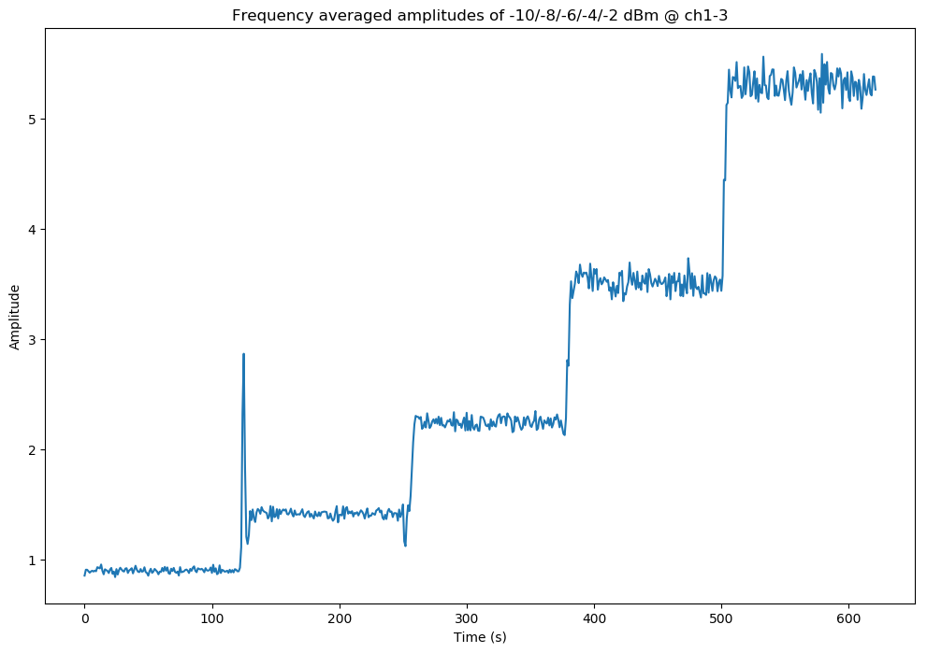
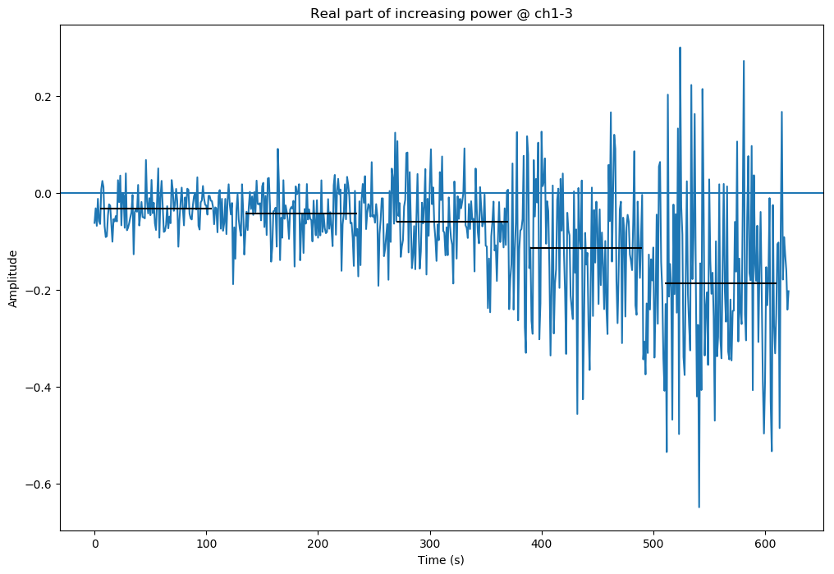
Noise signals directly input to ADC (very short cable this time).

Slide 3
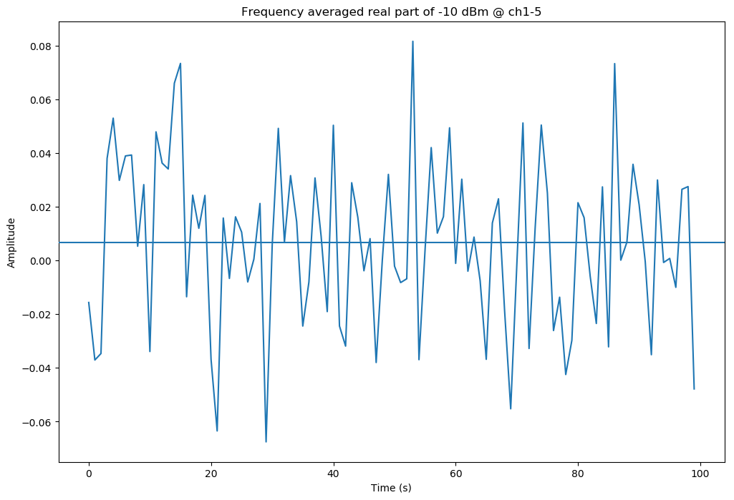
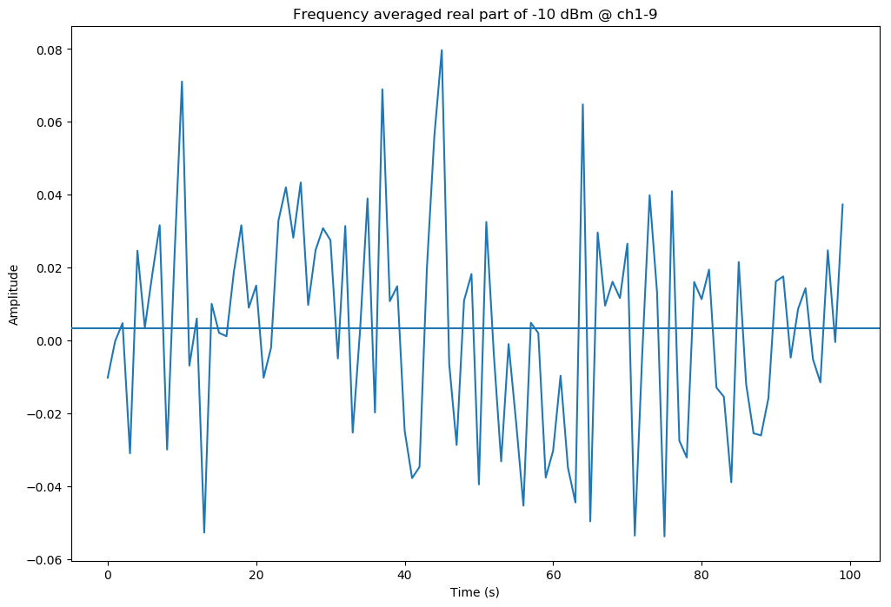
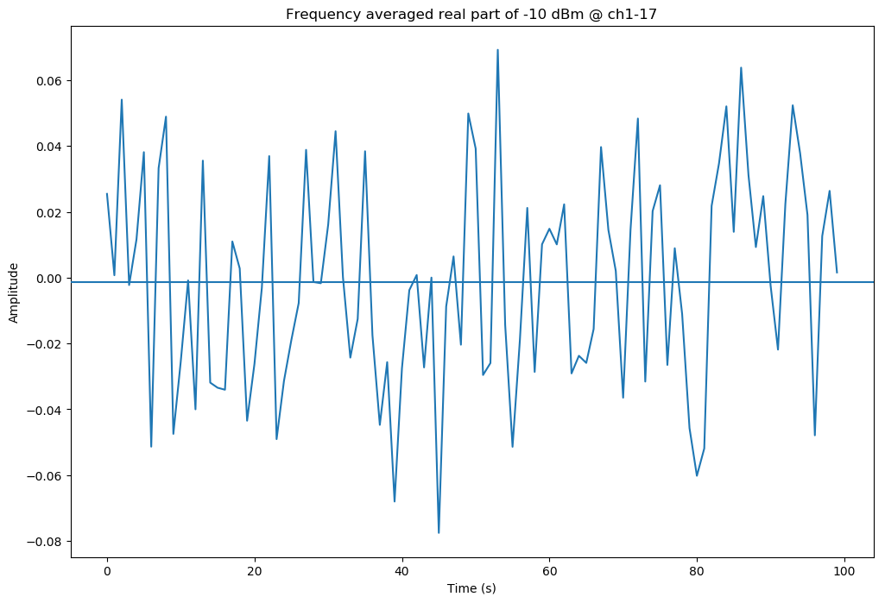
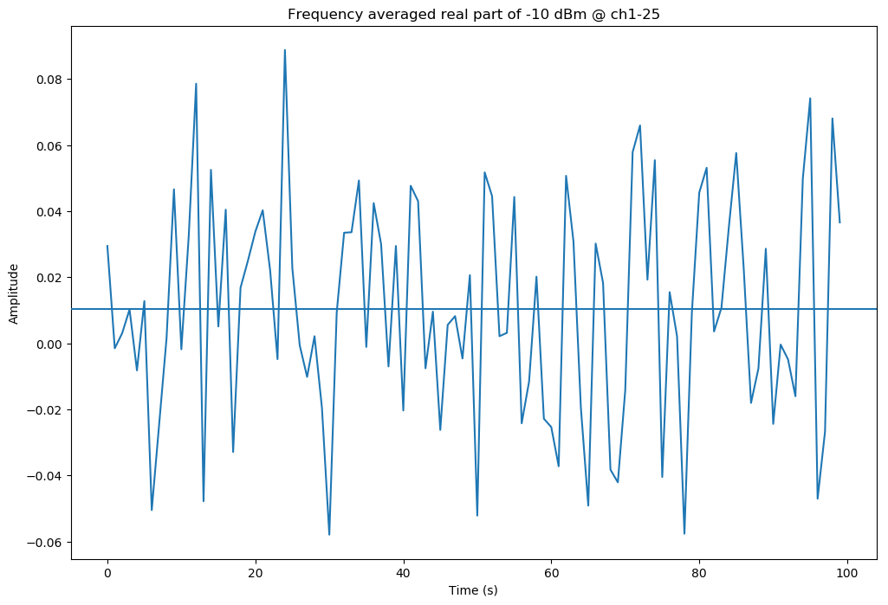

Slide 4
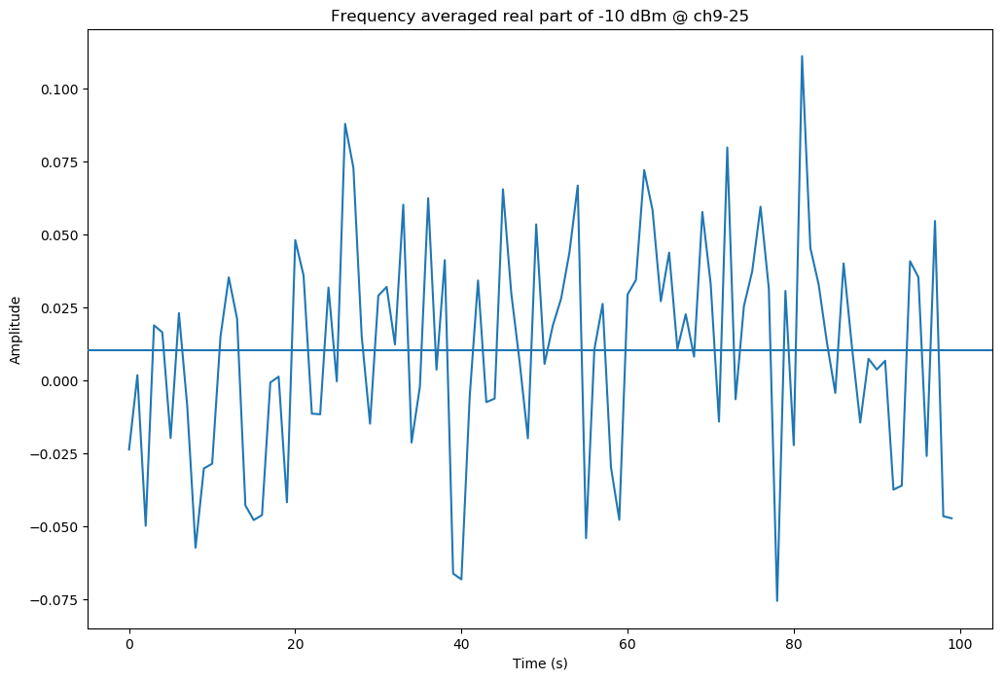
Channels | Board1 | Board2
ADC1 | Ch1,2,3…8 | Ch17,18,19…24
ADC2 | Ch9,10,11…16 | Ch25,28,29…32

