Slide 1
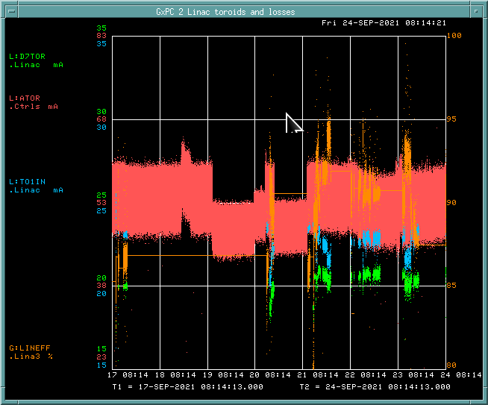
PREACC/LINAC Weekly Performance September 17– September 24, 2021)
ATOR: 52.6 mA
TO1IN: 22.6 mA
D7TOR: 20.4 mA
LRF1 cavity skid
PS beam studies
LINAC efficiency:
~ 90%

Slide 2
Issues
Leaser notch is off → will replace water pump this morning
MEBT quads stop tracking setting current → K. Martin is working on it
Inst. (Aisha) has been calibrating toroid.
RFQ lost heartbeat a few times → B. Hendricks is working on it
KRFD klixon temp → the interlock was for Tank oil level
KRF3 waveguide pressure had been increasing → MS drained water from the filter

