Slide 1
Muon Collider Meeting
Mayuri Kawale
University of Oklahoma (OU)
August 19th, 2021

Slide 2

Overview
These are truth level plots normalized using the cross-sections (in pb units) and assuming luminosity=1 ${pb}^{−1}$
These graphs are corresponding to signal with T1 strength parameter whose value is set to 1e-12 and all background samples at 6TeV.

Slide 3
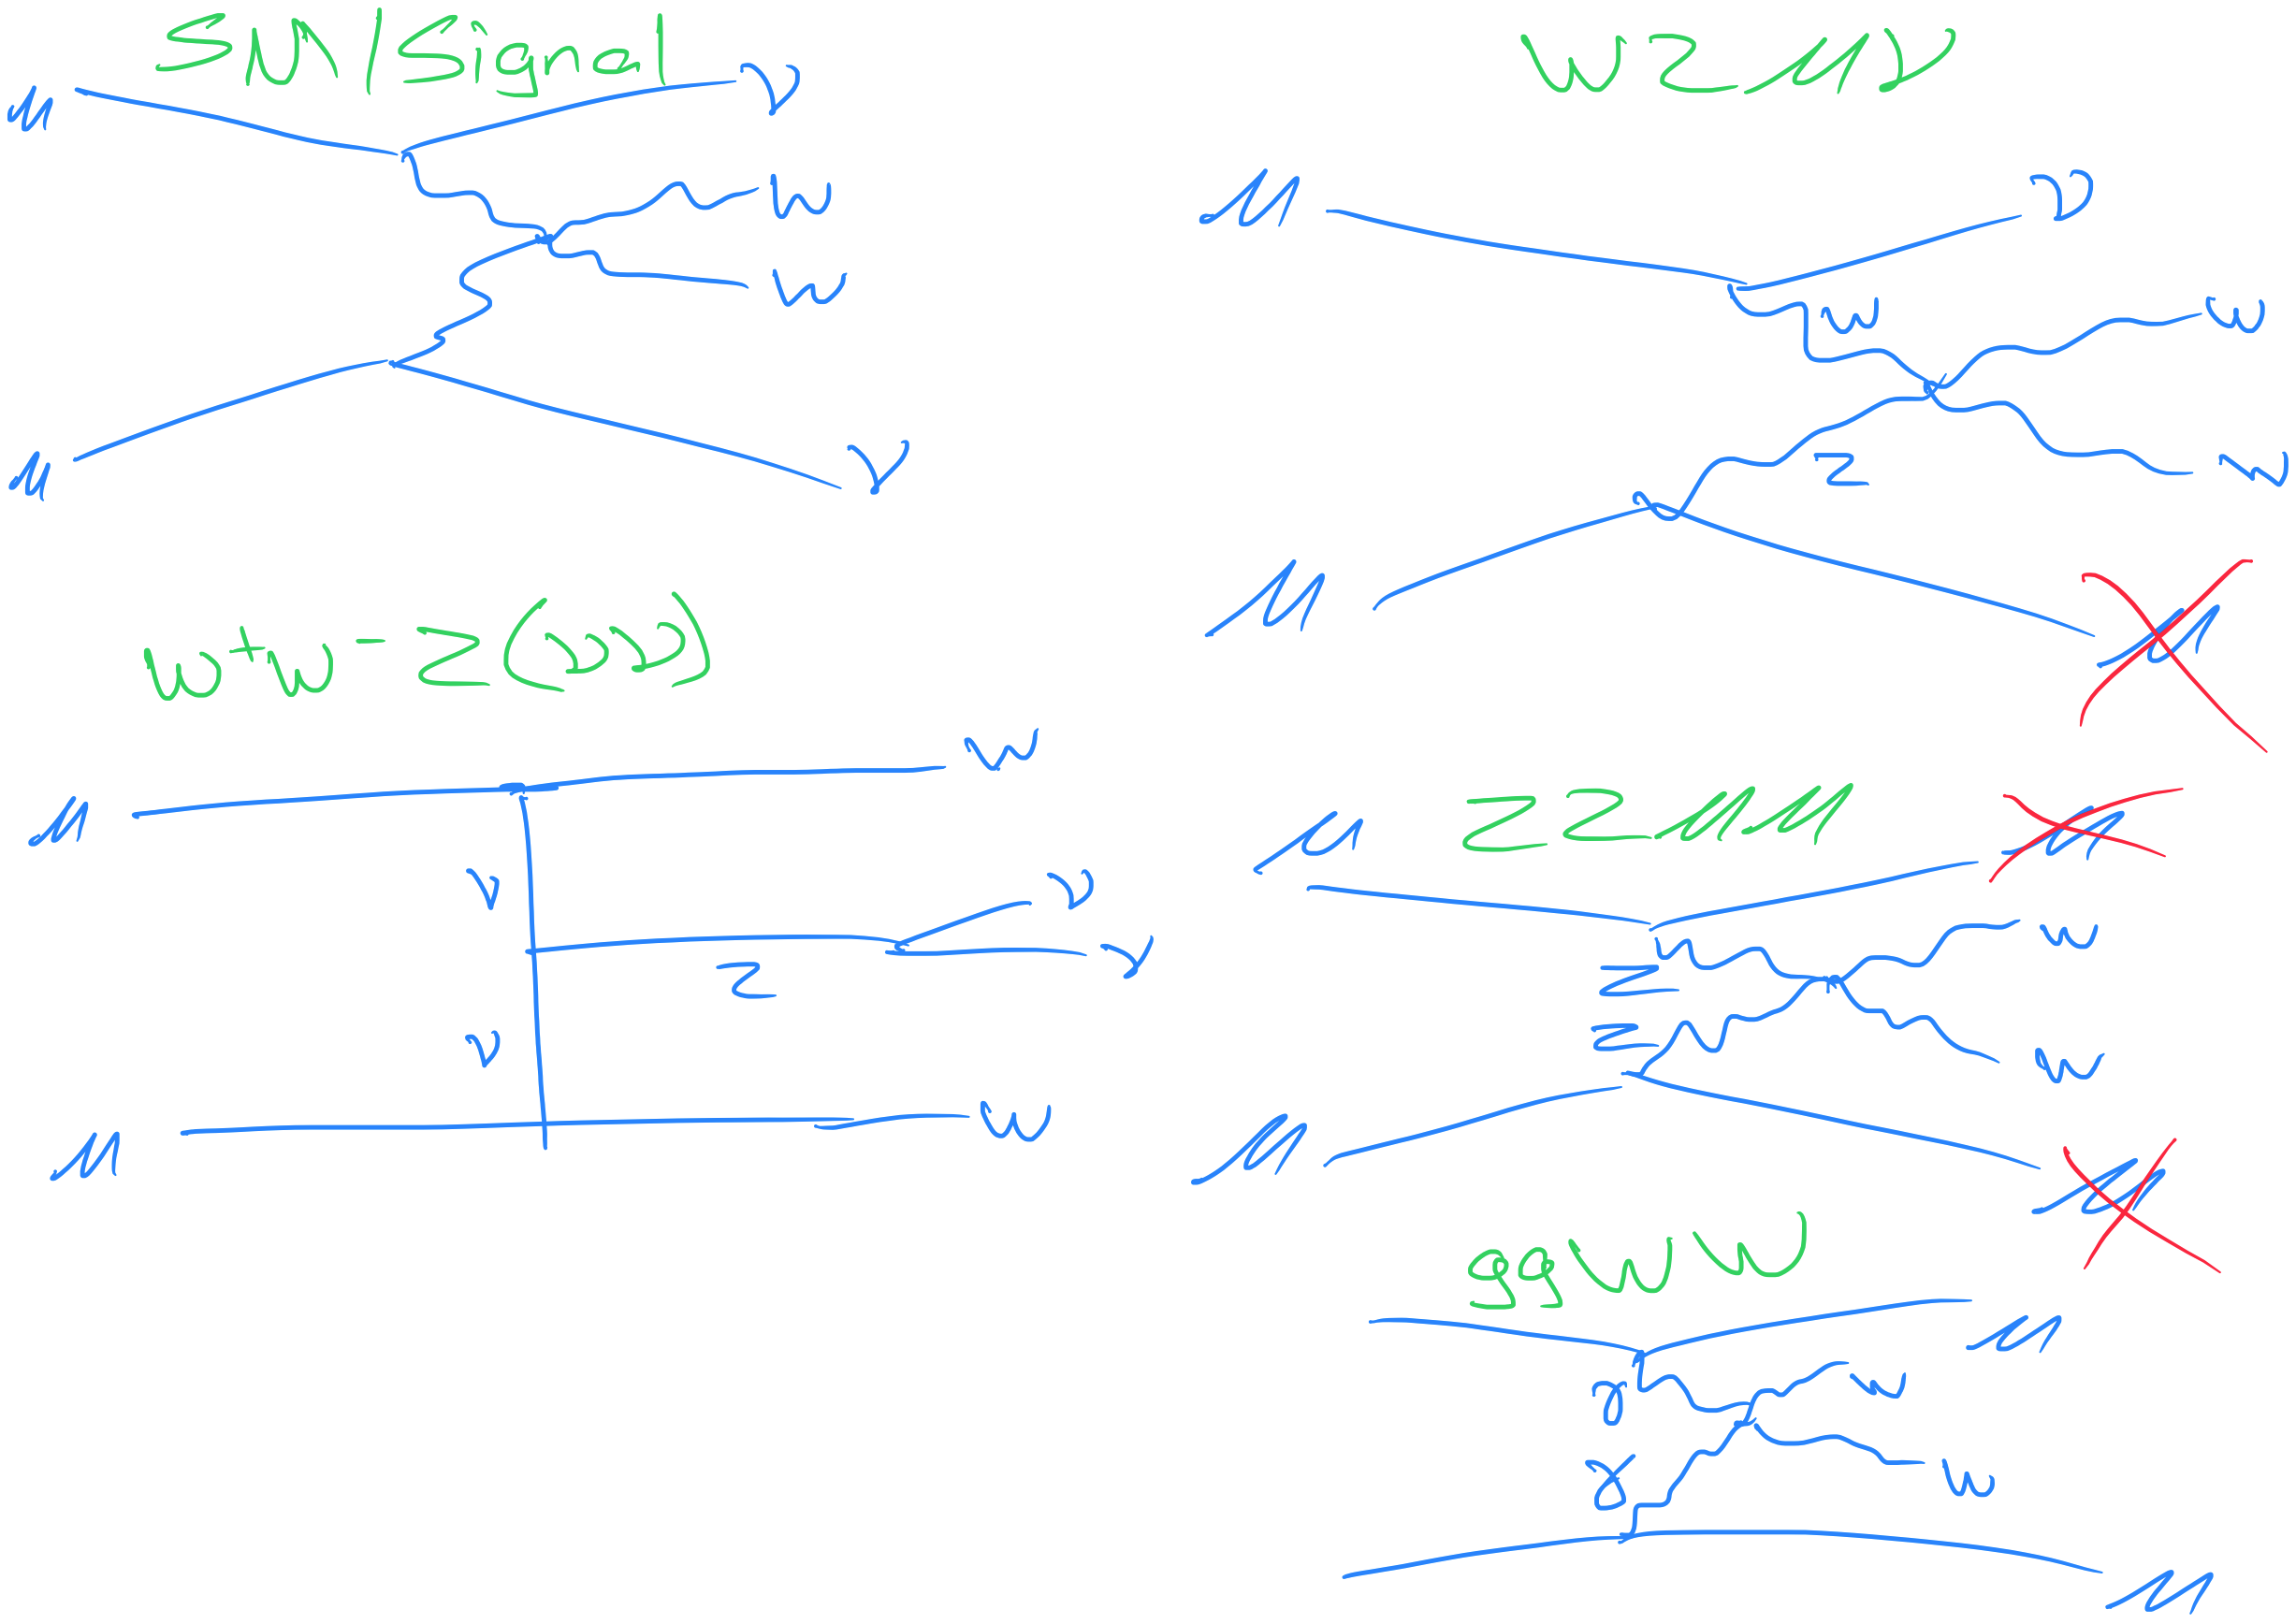
Background samples

Slide 4
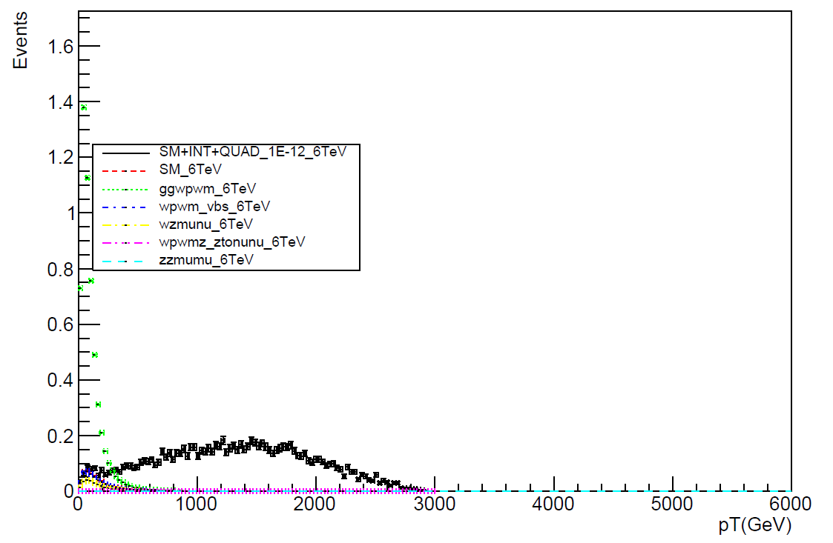
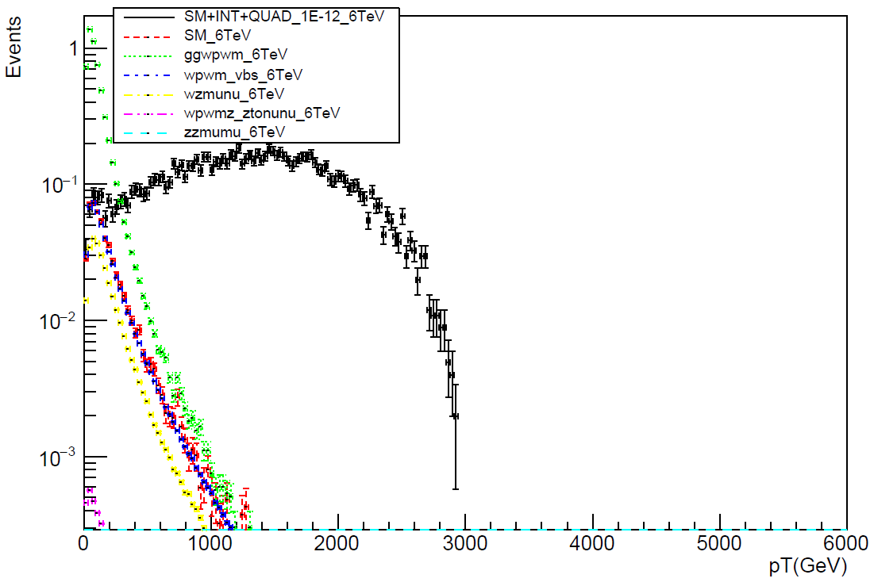
Truth level pT plots
W boson

Slide 5
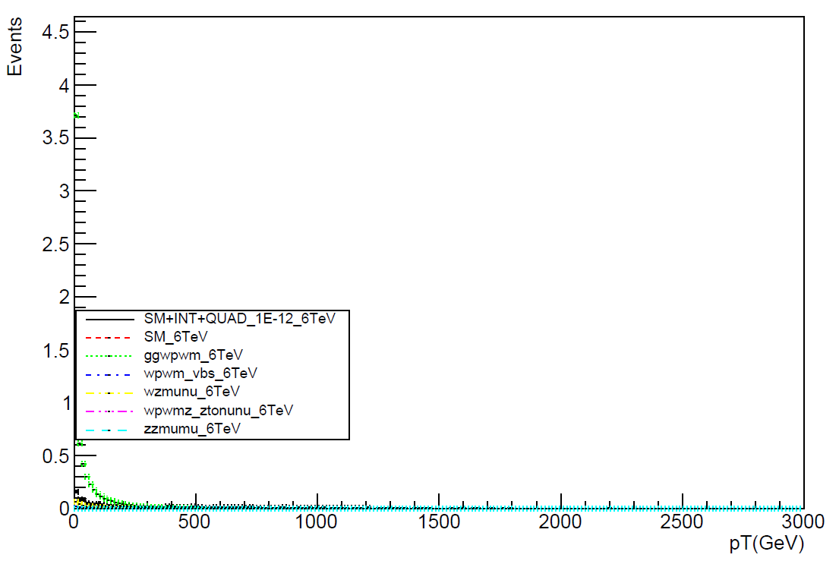
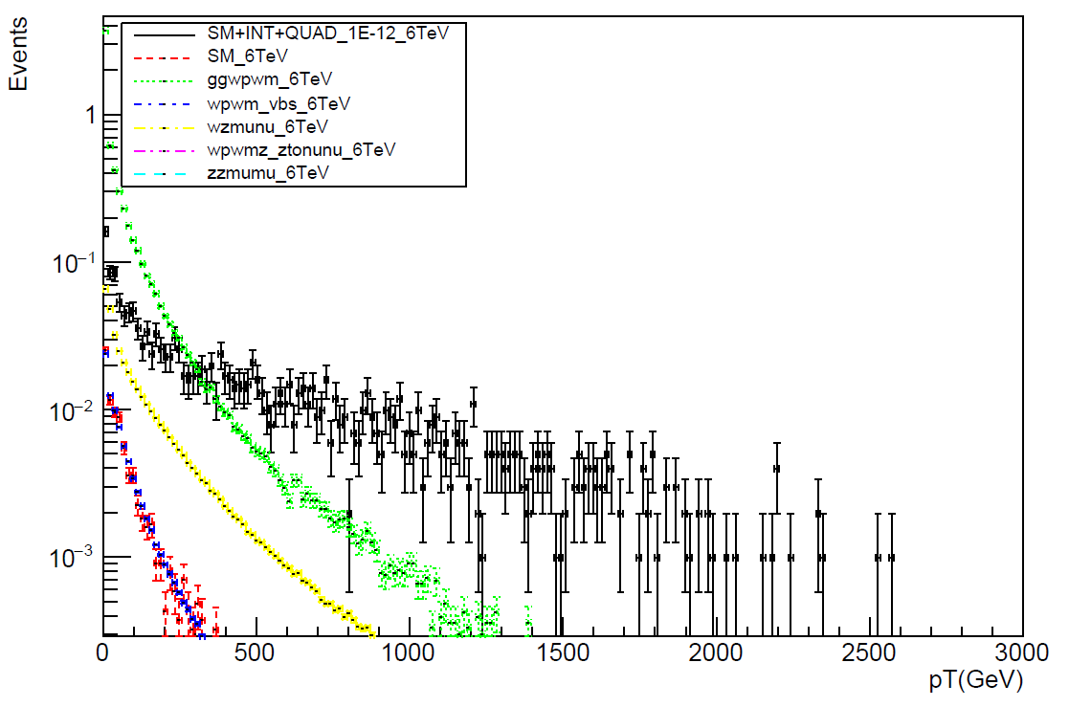
Truth level pT plots
Muon

Slide 6
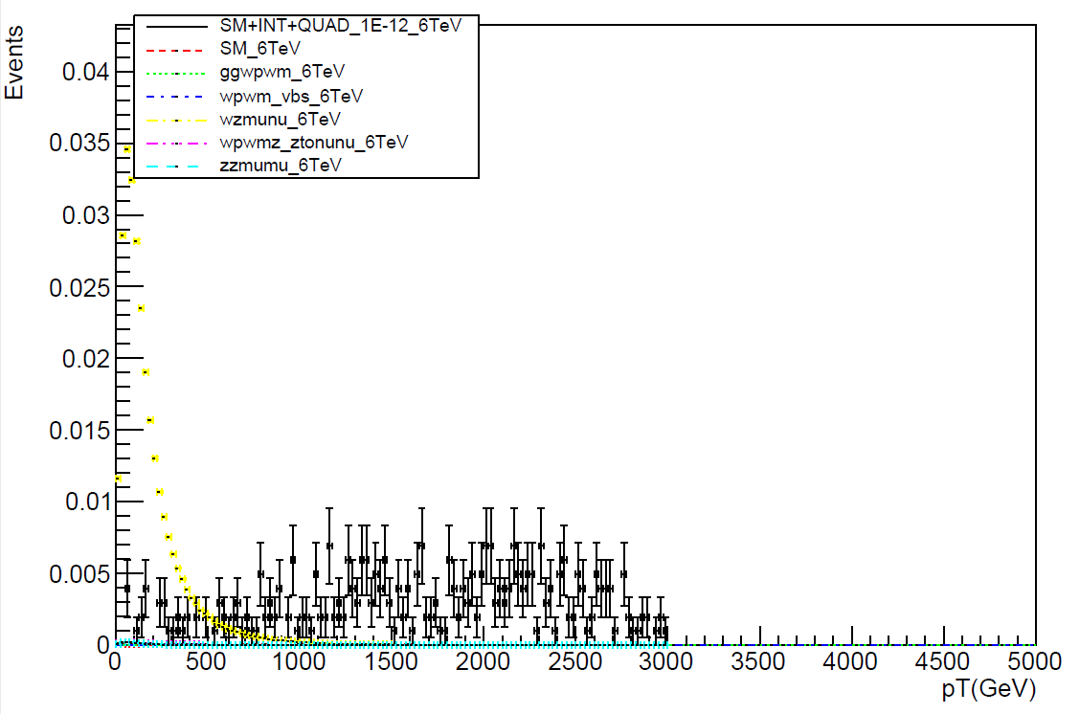
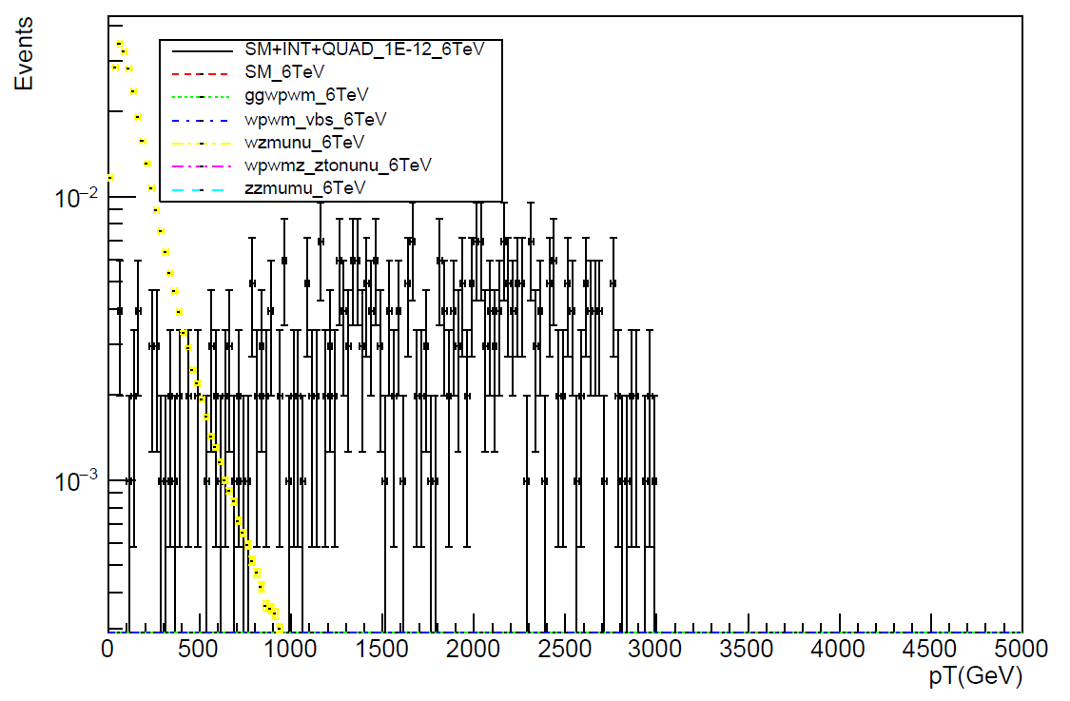
Truth level pT plots
Z boson

Slide 7
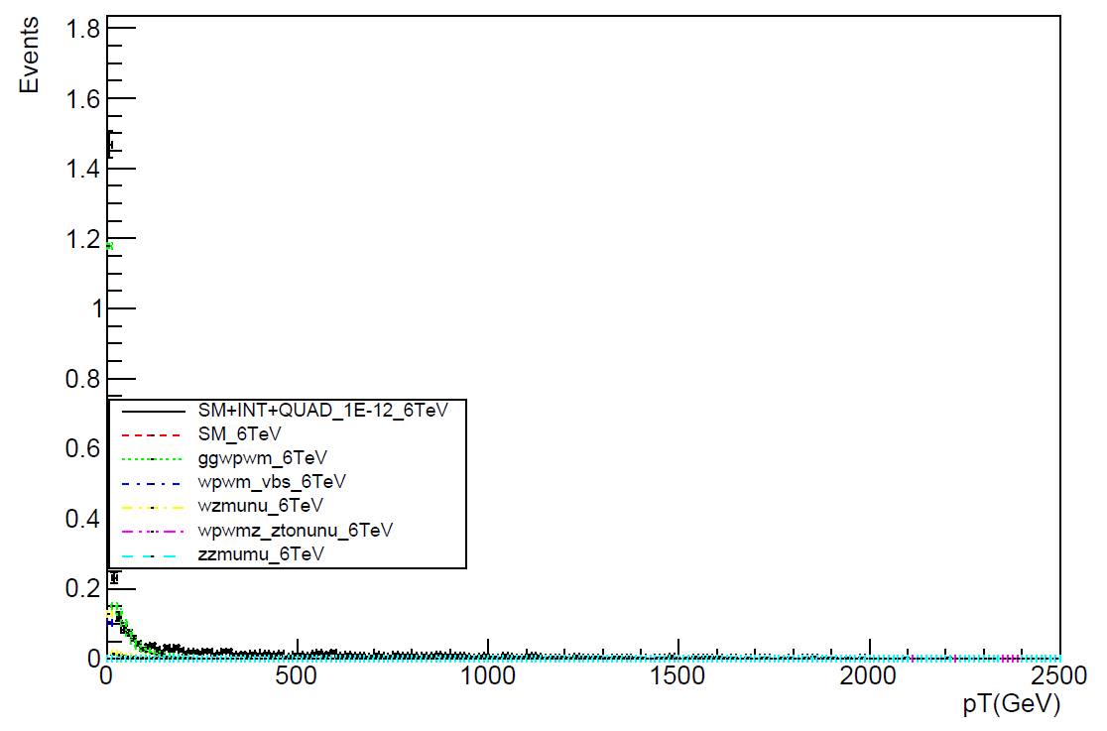
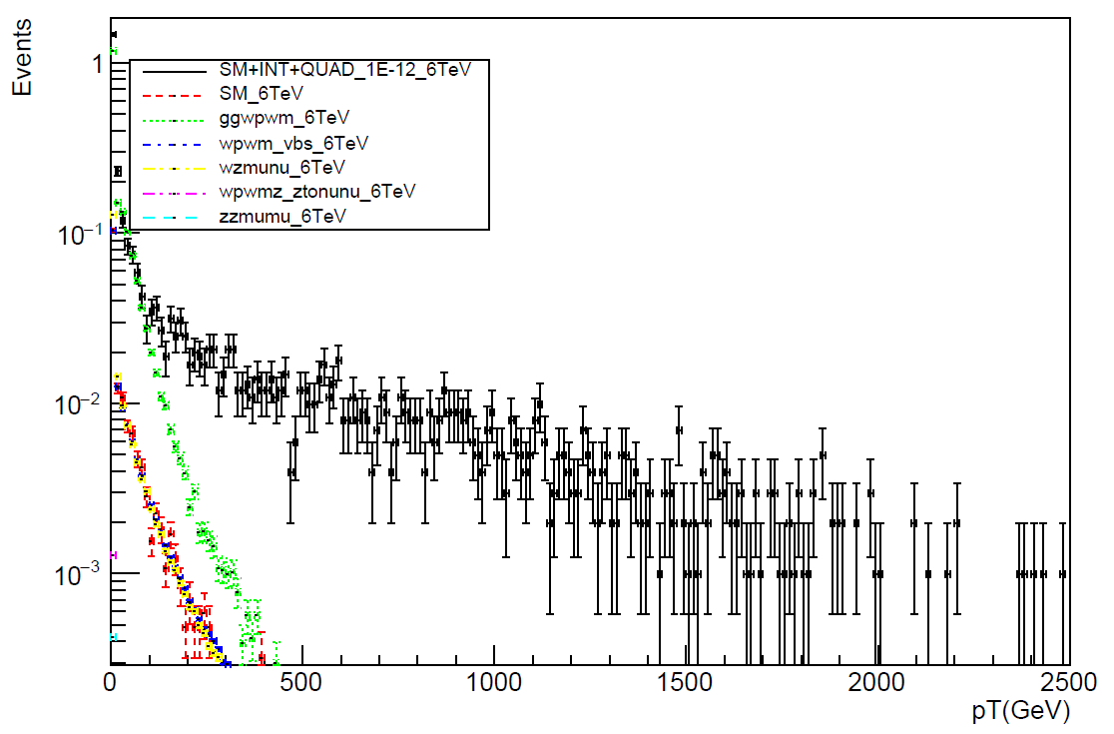
Truth level pT plots
Electron

Slide 8
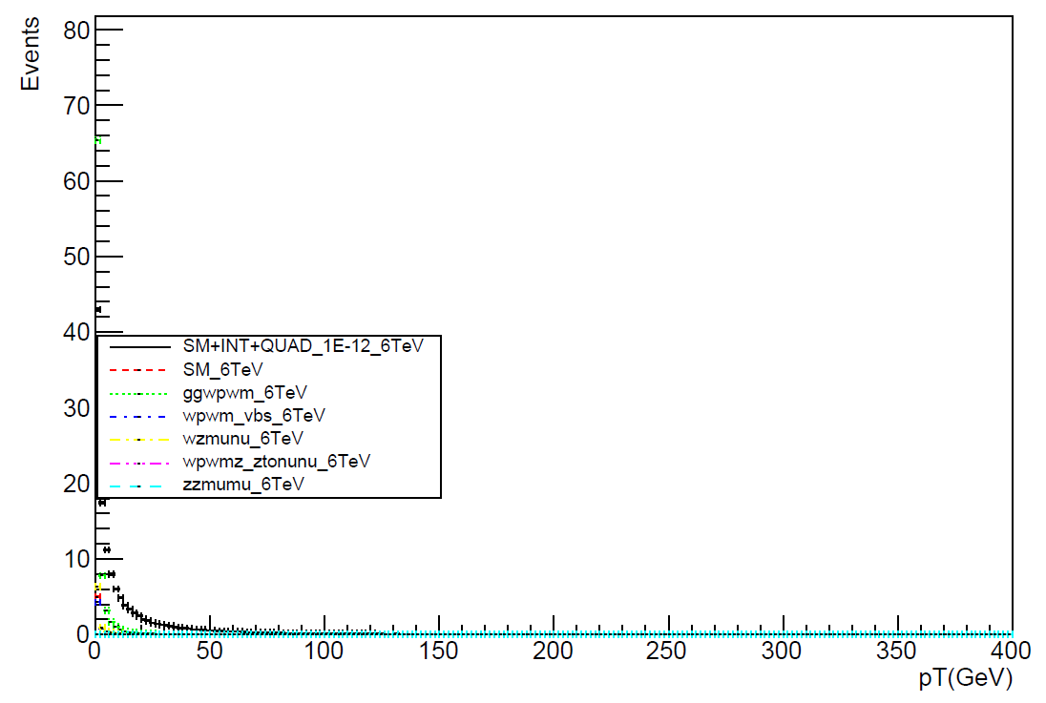
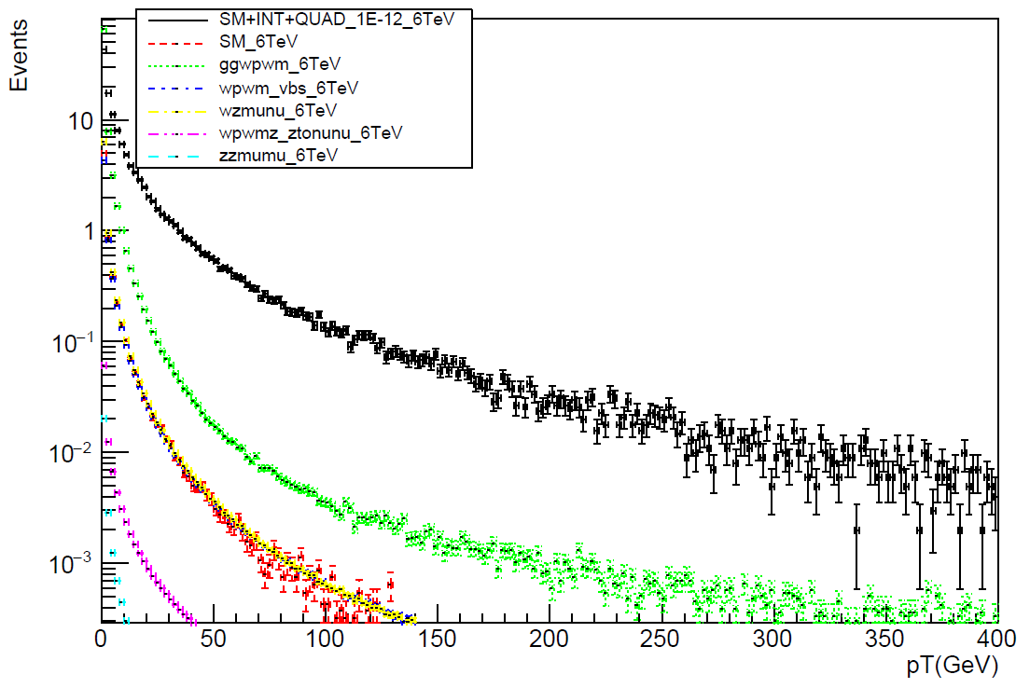
Truth level pT plots
Photon

Slide 9
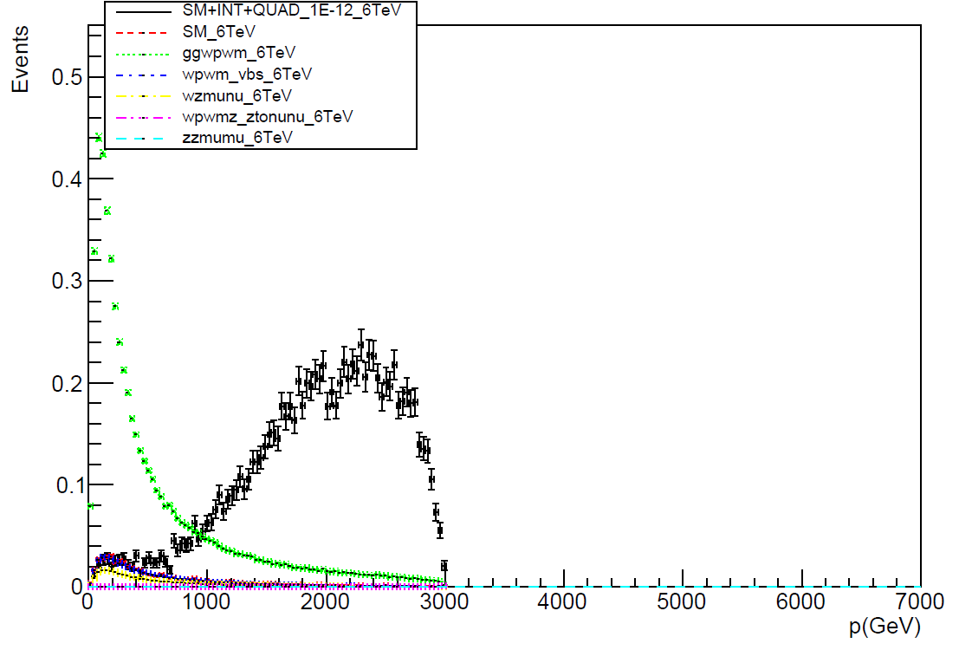
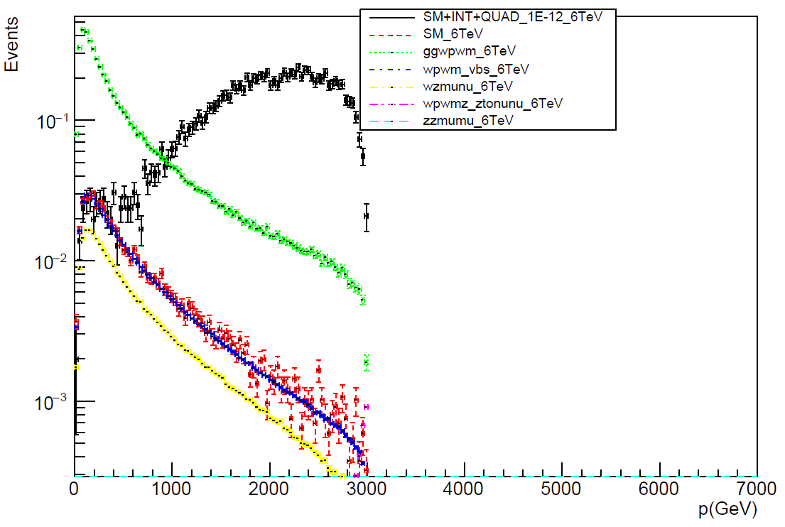
Truth level momentum plots
W boson

Slide 10
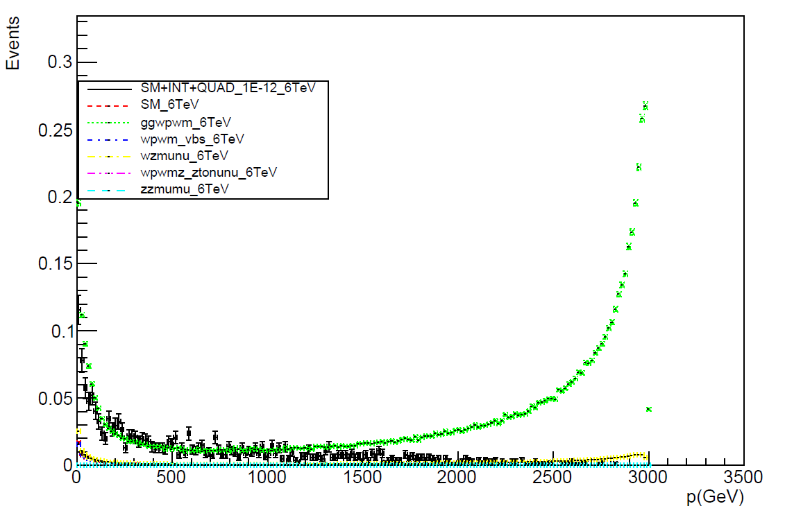
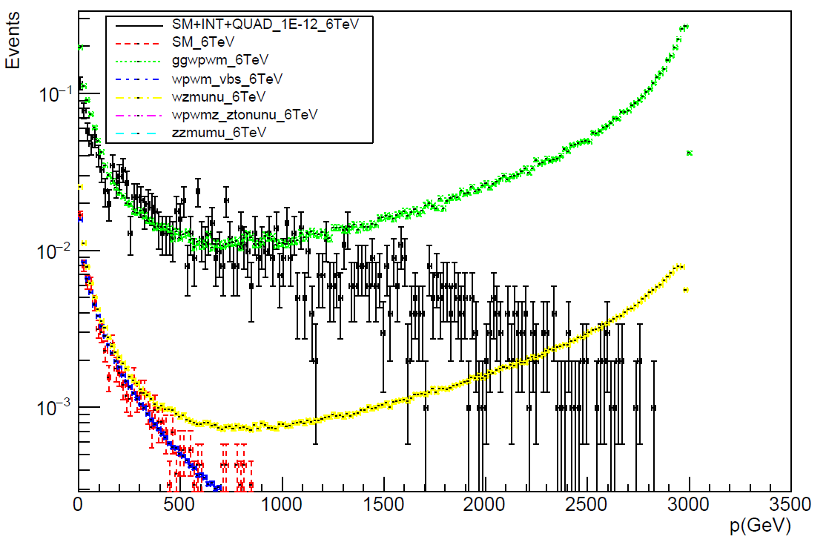
Truth level momentum plots
Muon

Slide 11
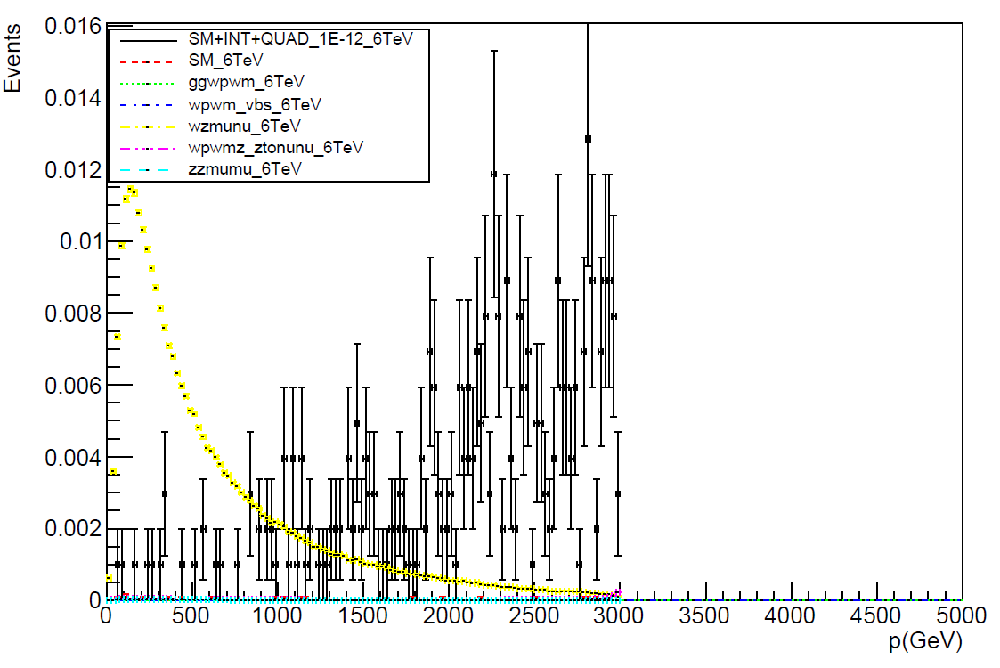
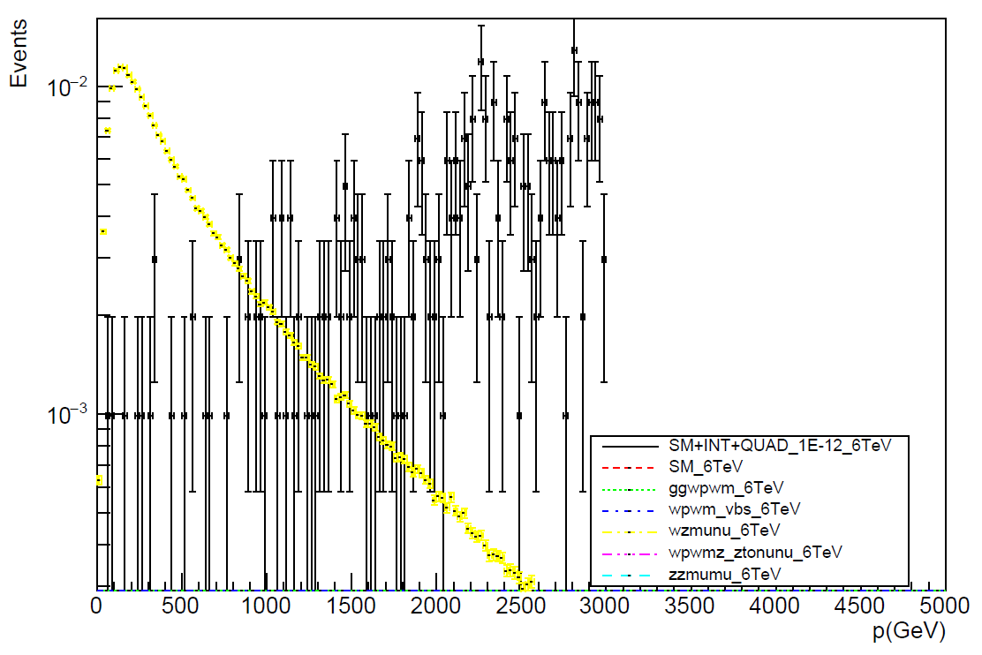
Truth level momentum plots
Z boson

Slide 12
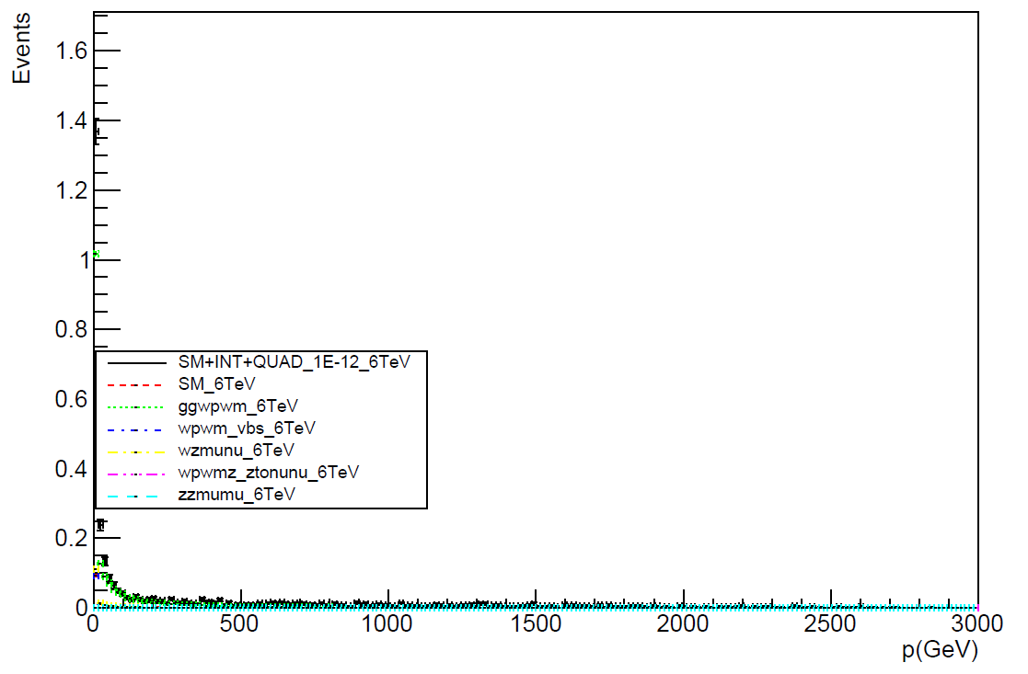
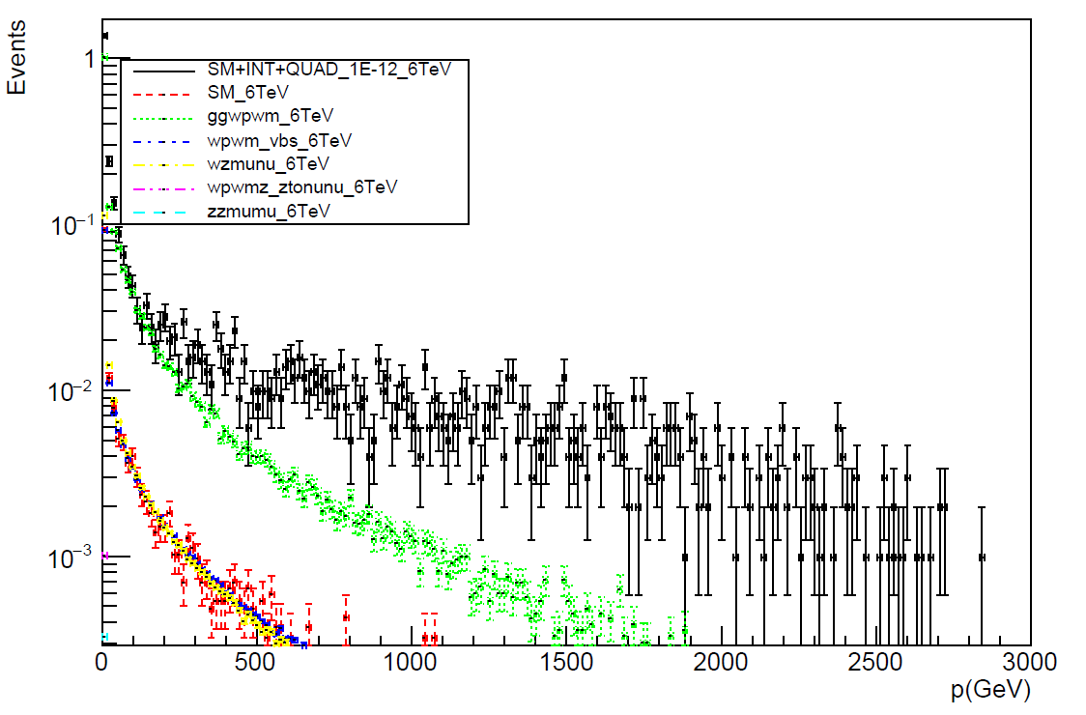
Truth level momentum plots
Electron

Slide 13
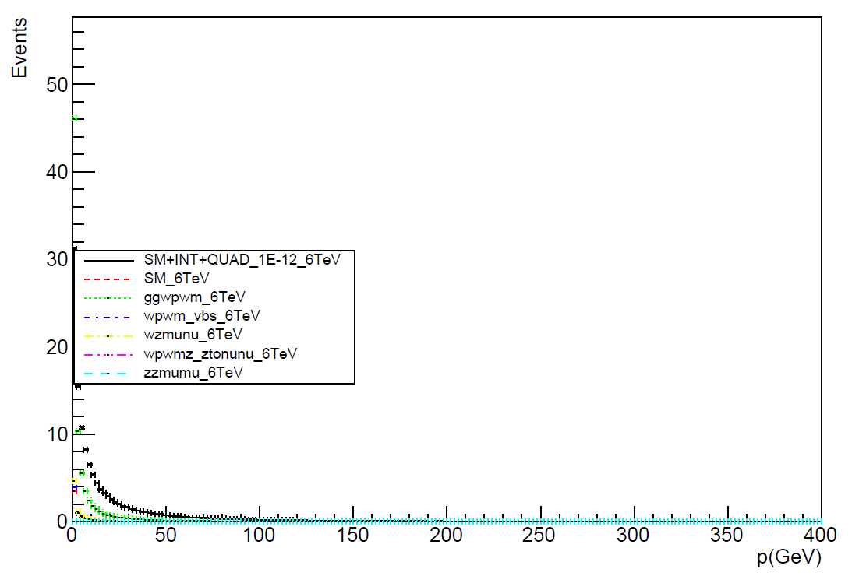
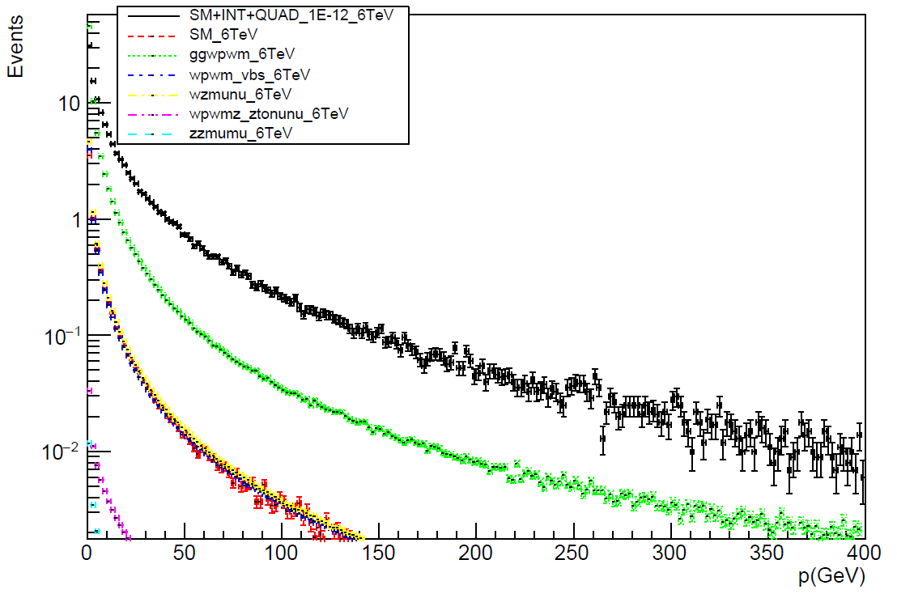
Truth level momentum plots
Photon

Slide 14
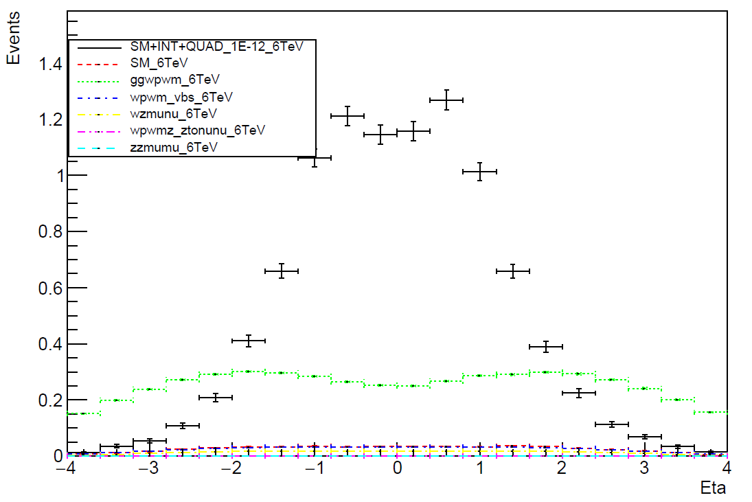
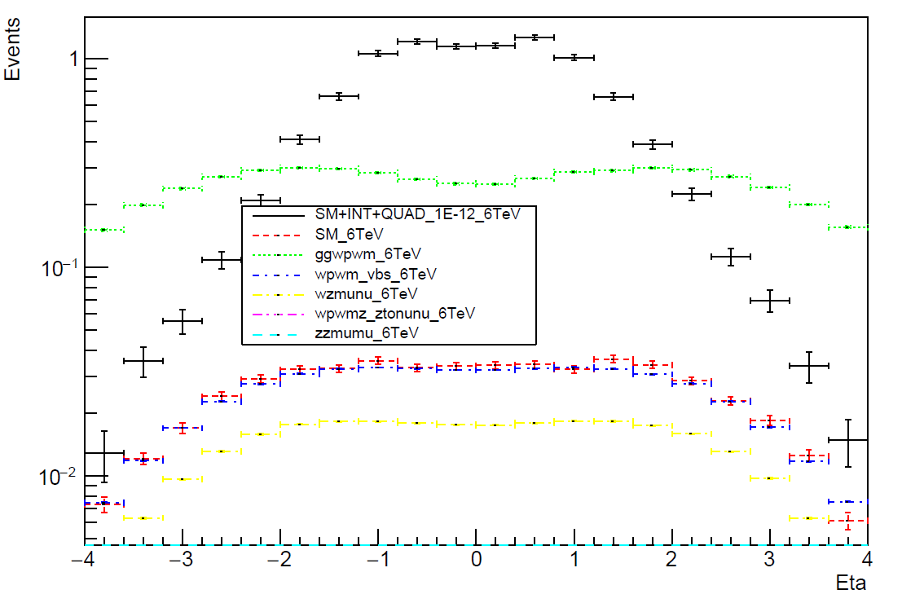
Truth level eta plots
W boson

Slide 15
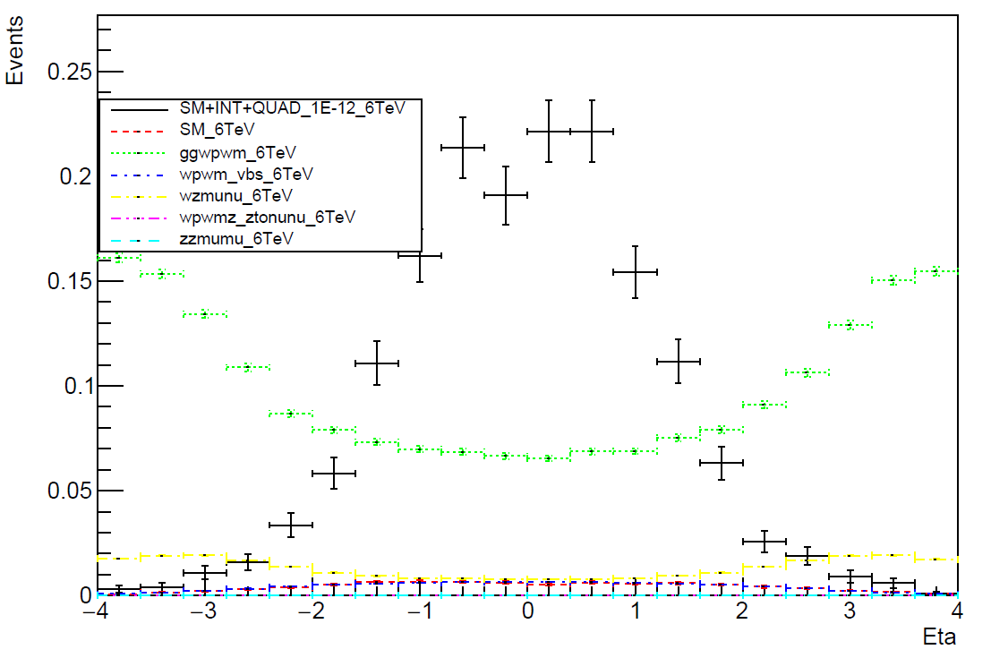
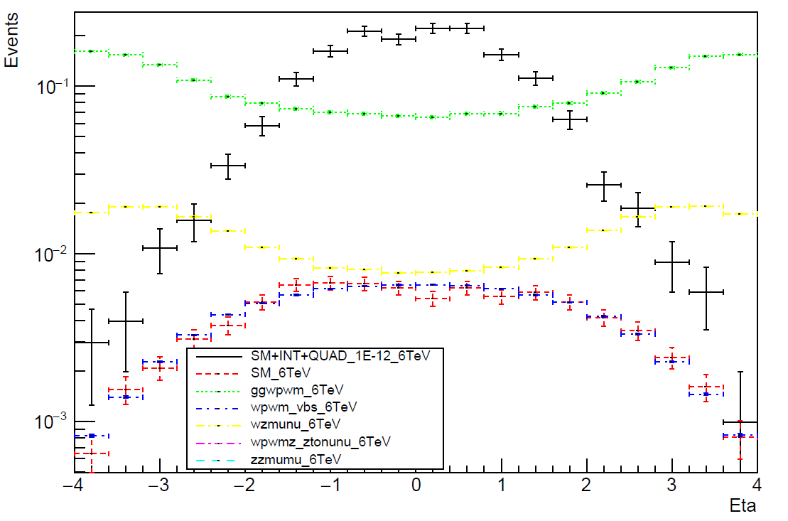
Truth level eta plots
Muon

Slide 16
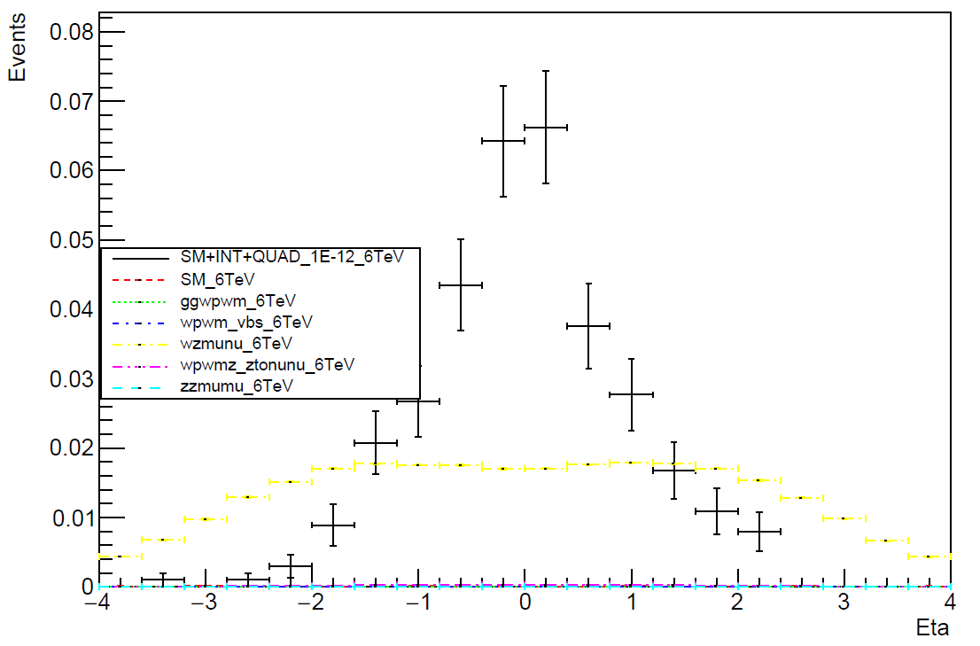
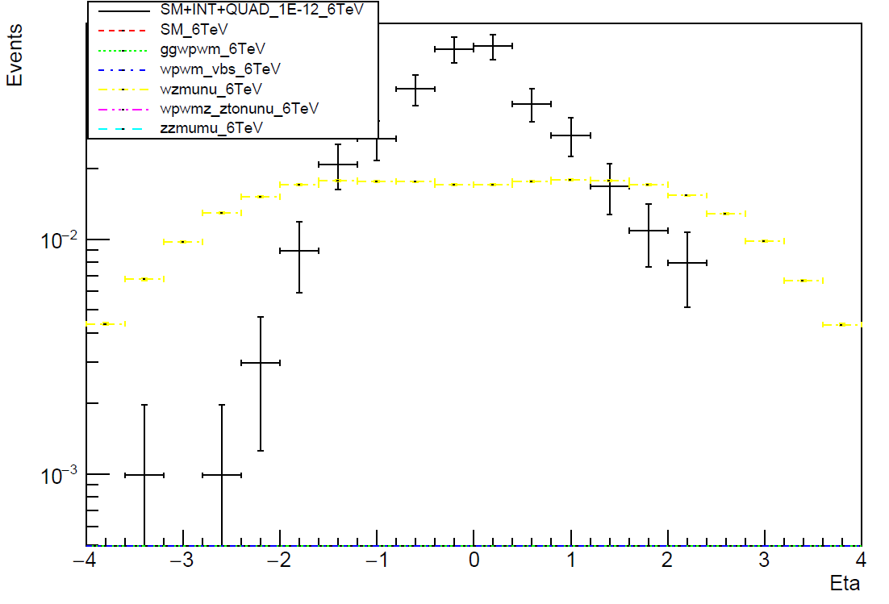
Truth level eta plots
Z boson

Slide 17
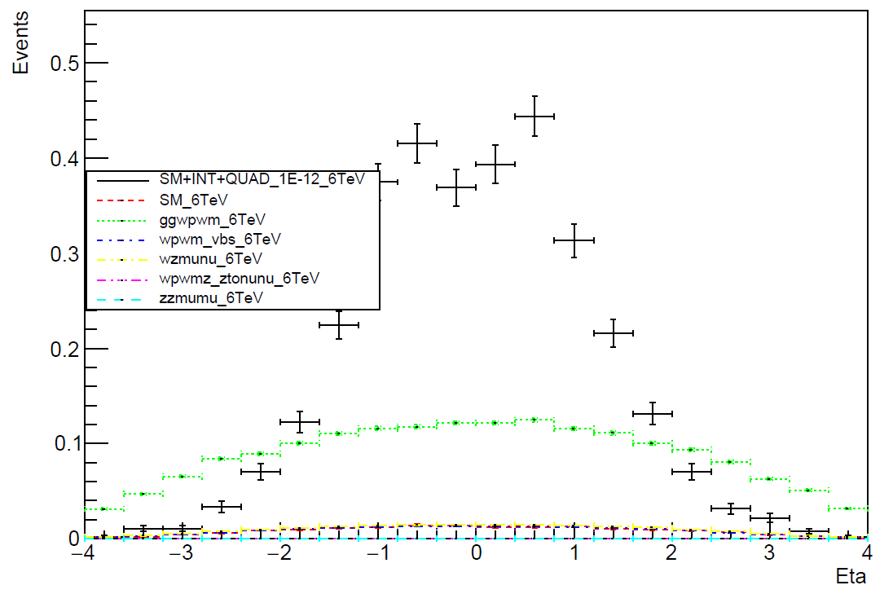
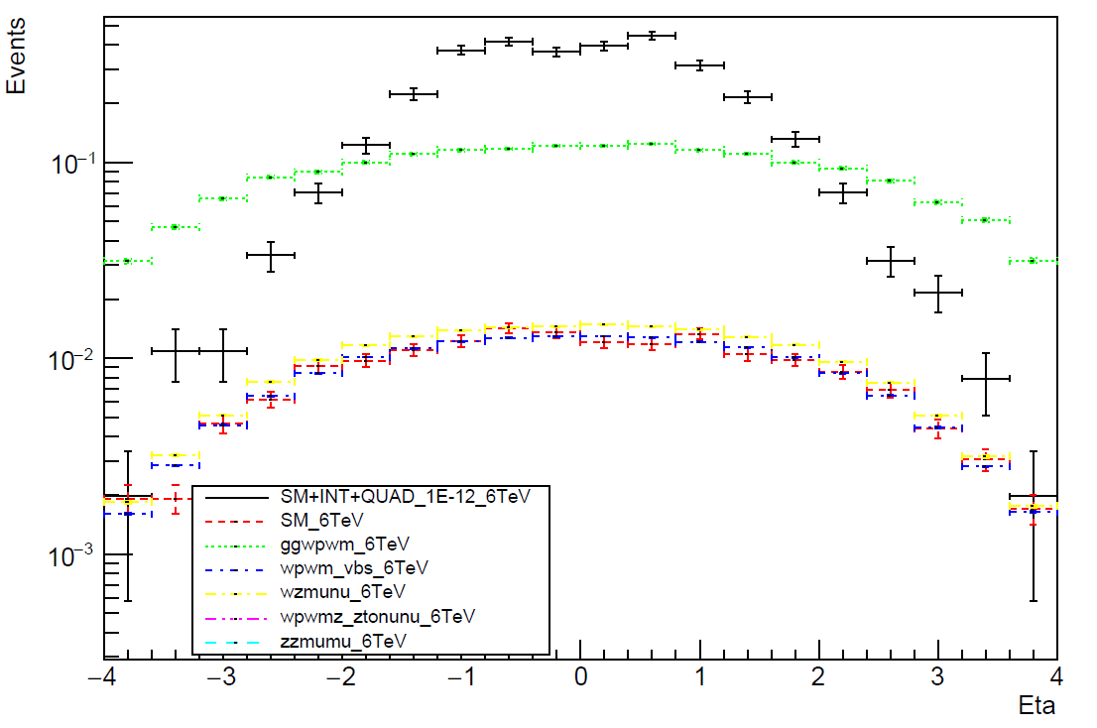
Truth level eta plots
Electron

Slide 18
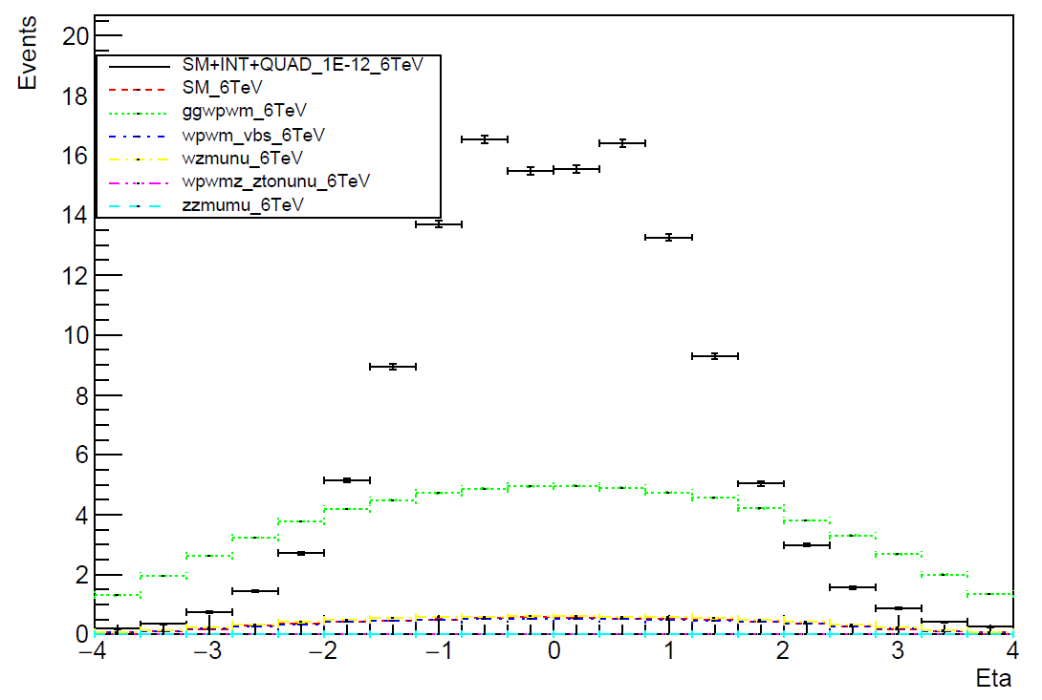
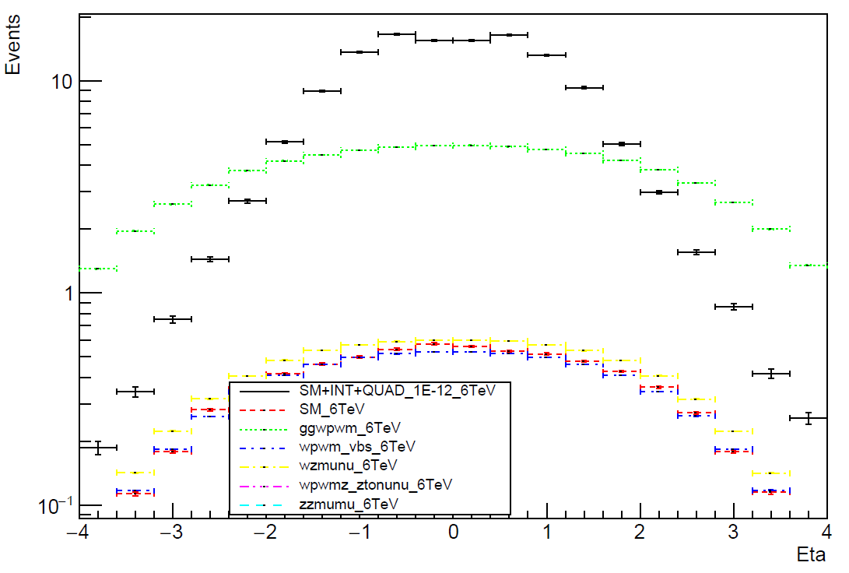
Truth level eta plots
Photon

Slide 19
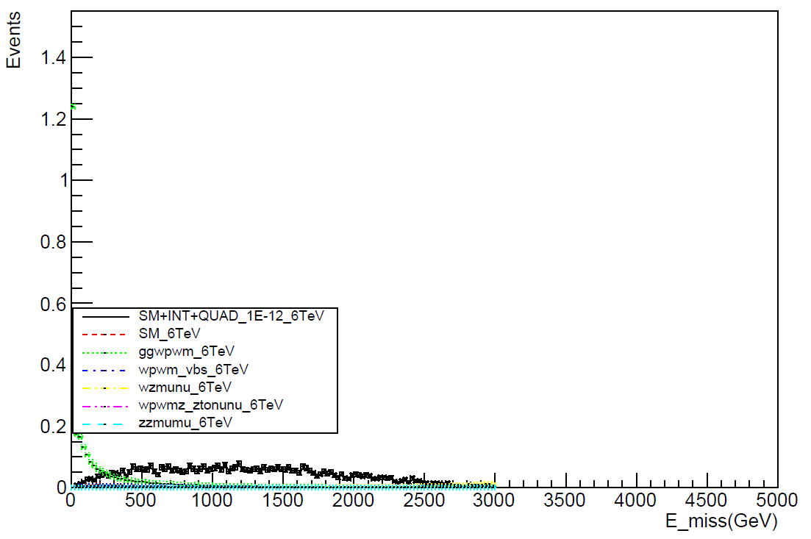
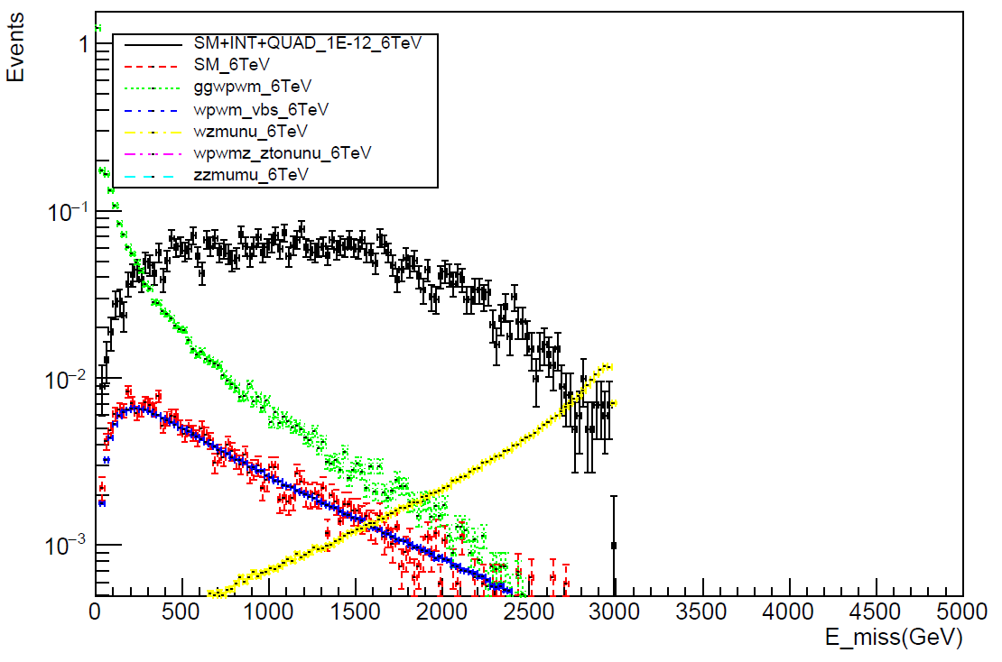
Truth level plots
Missing E

Slide 20
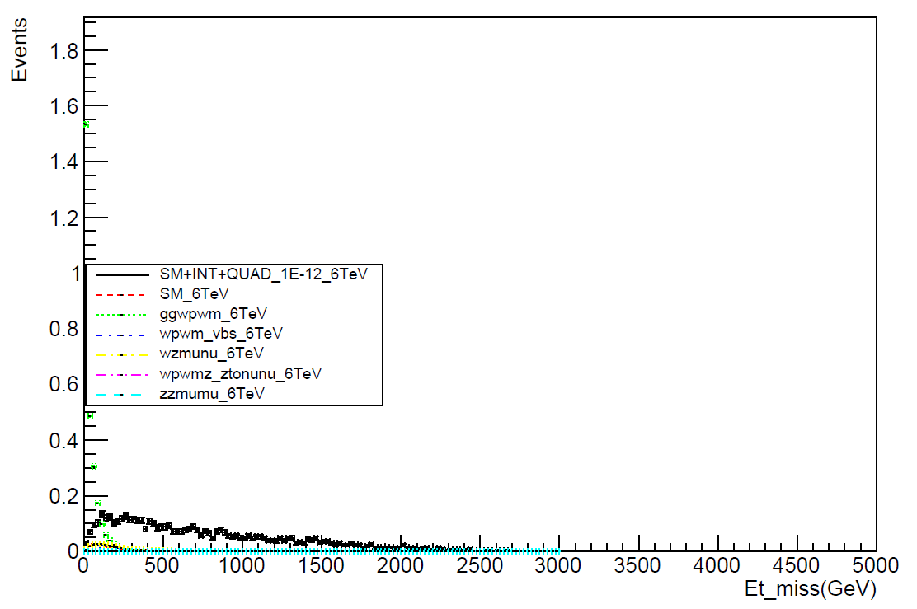
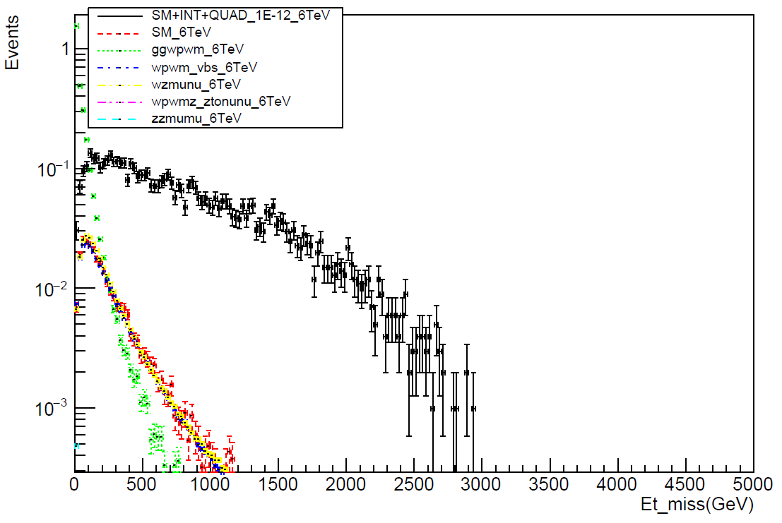
Truth level plots
Missing Et

Slide 21
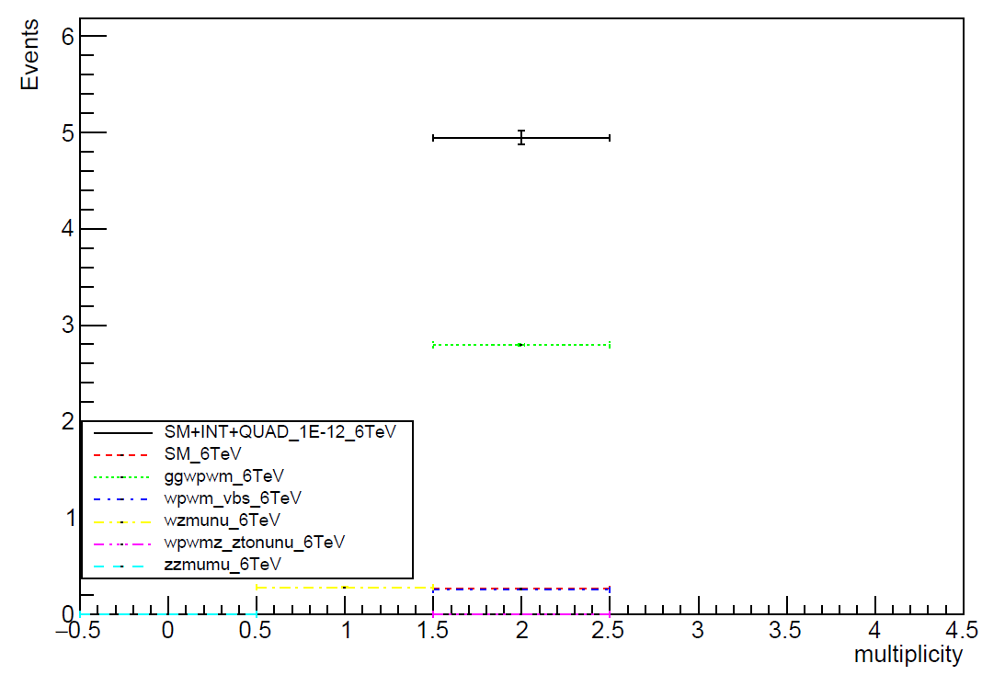
Truth level multiplicity plots
W boson

Slide 22
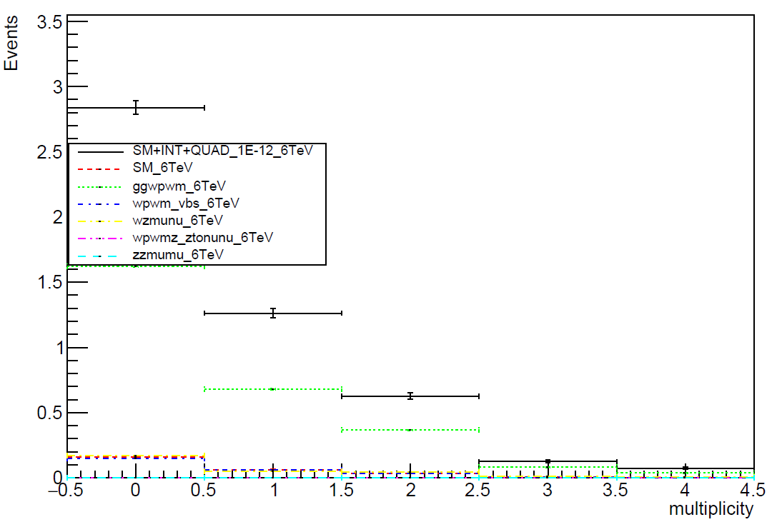
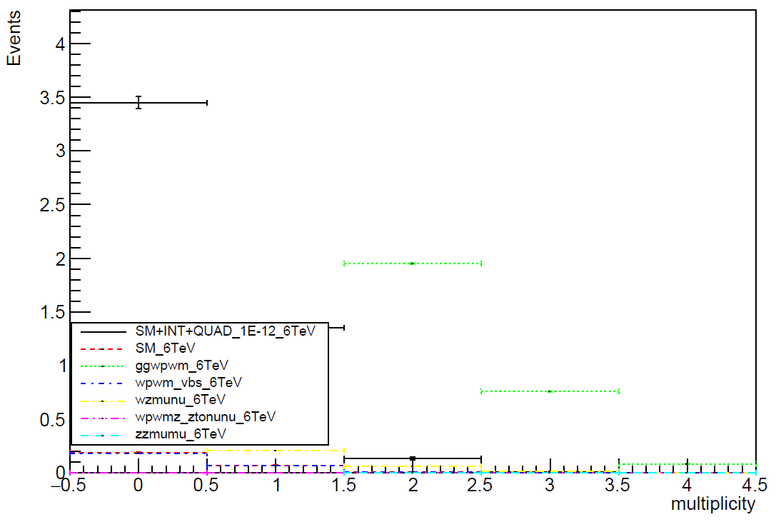
Truth level multiplicity plots
Electron
Muon

Slide 23
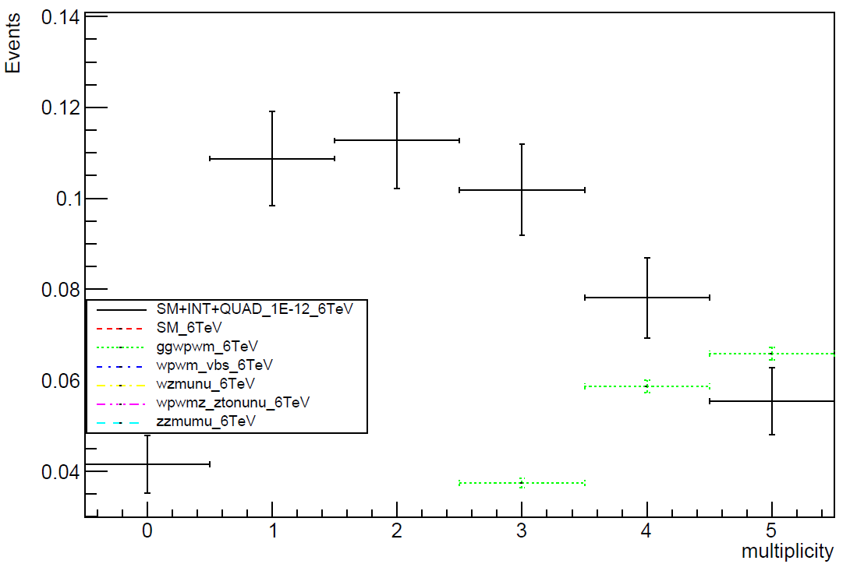
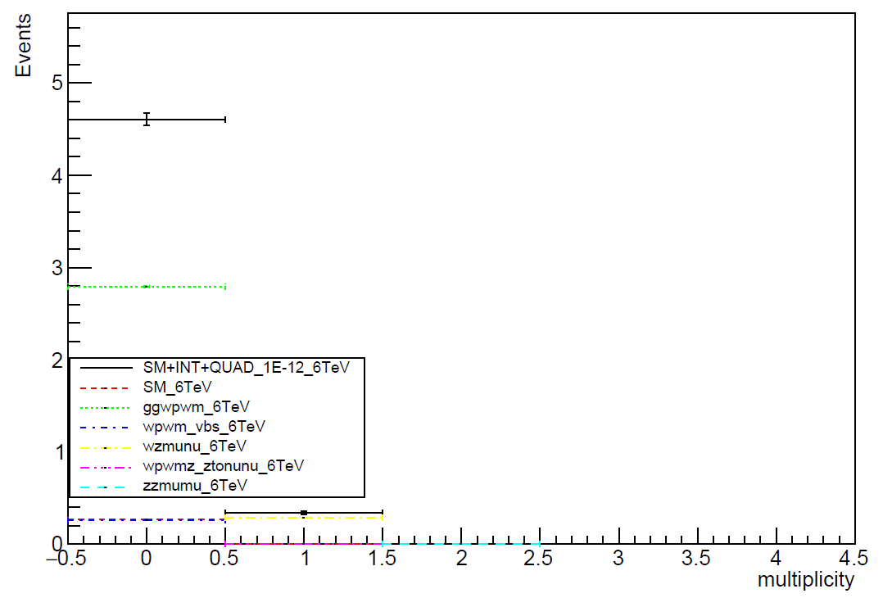
Truth level multiplicity plots
Photon
Z boson

Slide 24
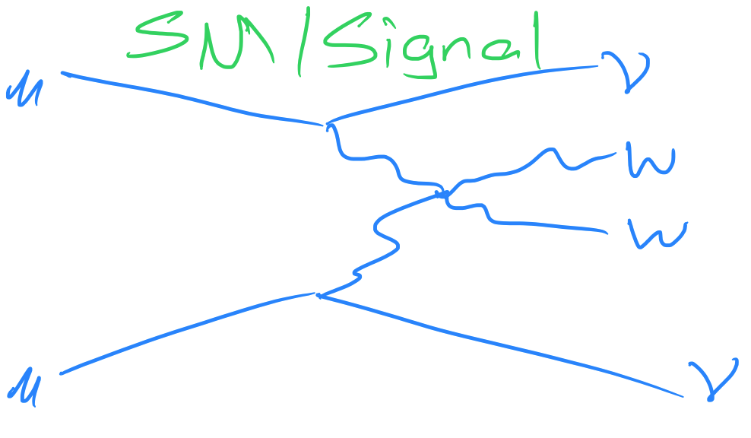
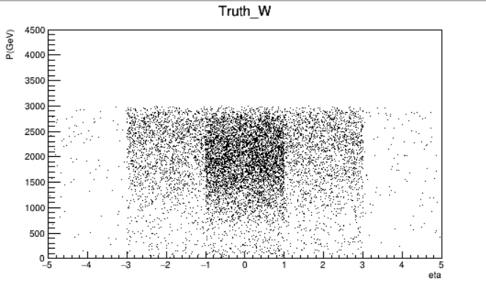
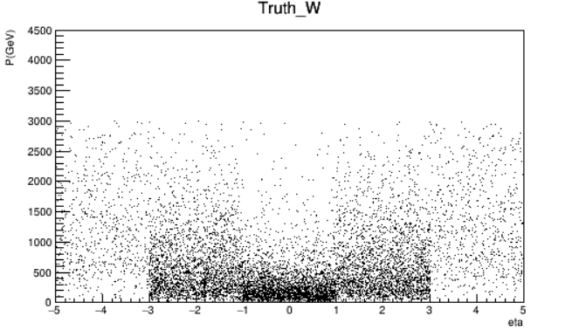
P vs eta
FULL_1E-12
FULL_1E-14

Slide 25
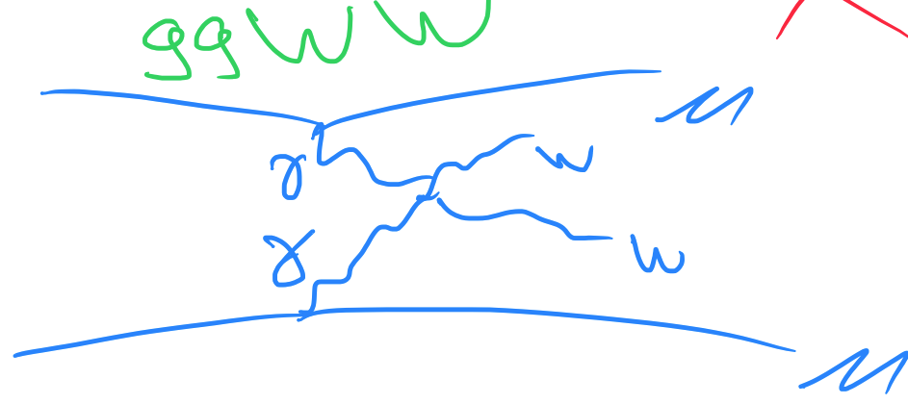
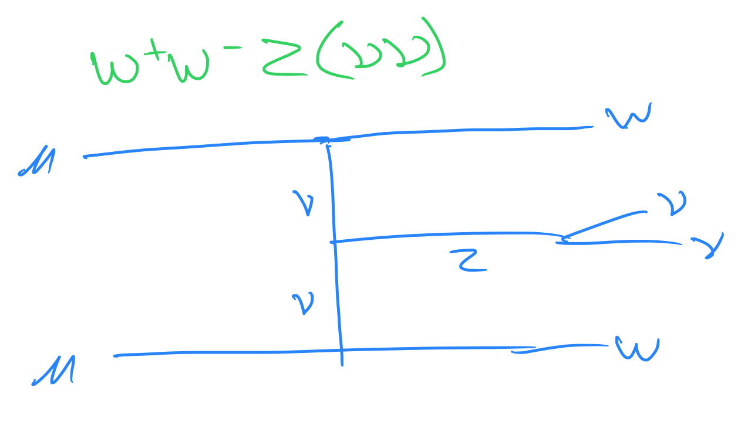
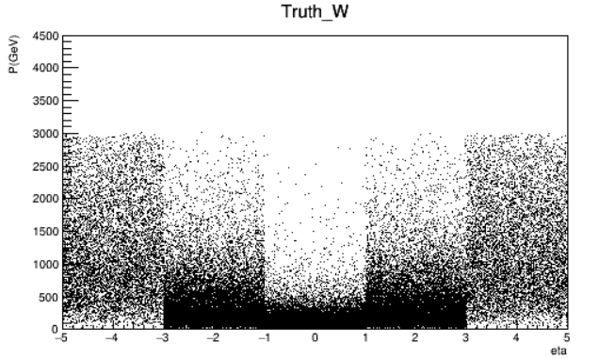
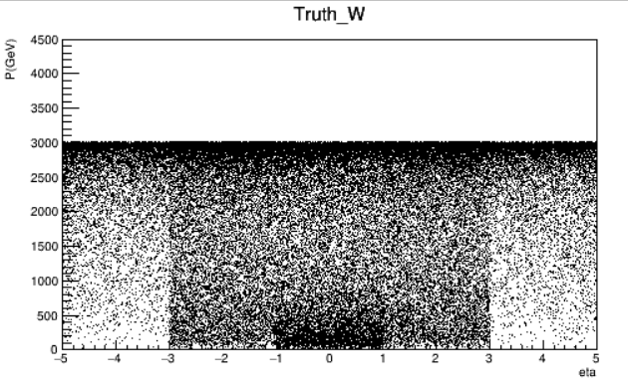
P vs eta
ggwpwm
wpwmz_ztonunu

Slide 26
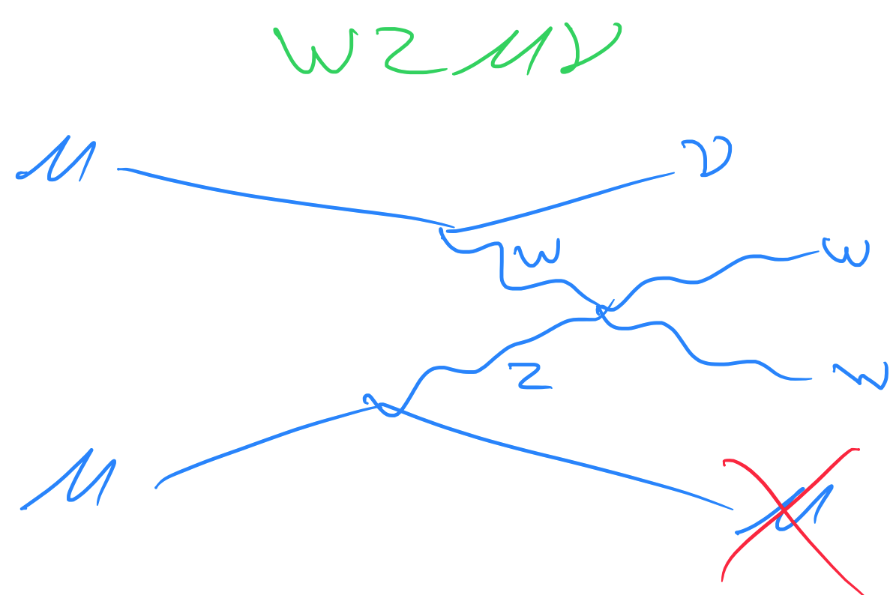
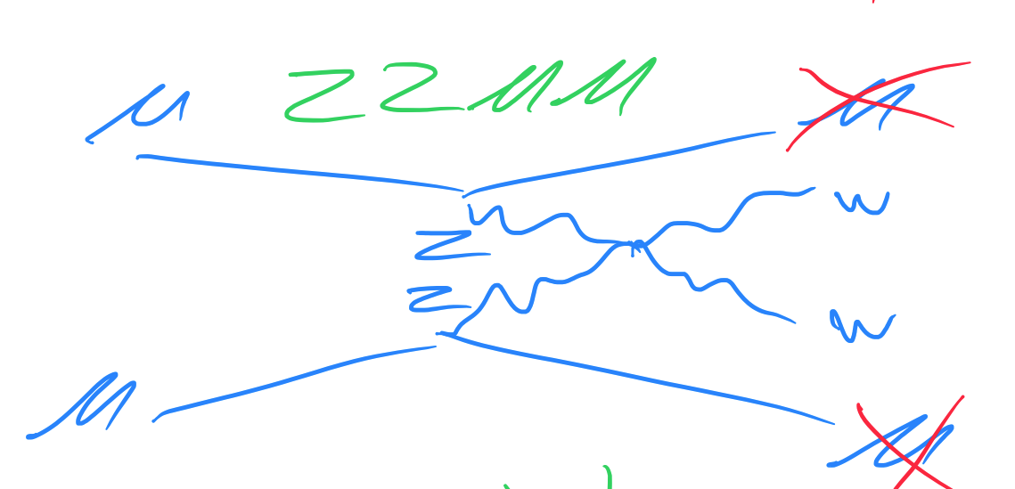


P vs eta
wzmunu
zzmumu

Slide 28


pT vs eta
FULL_1E-12
FULL_1E-14

Slide 29


pT vs eta
ggwpwm
wpwmz_ztonunu

Slide 30


pT vs eta
wzmunu
zzmumu

Slide 32


P vs eta
FULL_1E-12
FULL_1E-14

Slide 33


P vs eta
ggwpwm
wpwmz_ztonunu

Slide 34


P vs eta
wzmunu
zzmumu

Slide 36


pT vs eta
FULL_1E-12
FULL_1E-14

Slide 37


pT vs eta
ggwpwm
wpwmz_ztonunu

Slide 38


pT vs eta
wzmunu
zzmumu

