Slide 1
Muon Collider Meeting
Mayuri Kawale
University of Oklahoma (OU)
September 14th, 2021

Slide 2
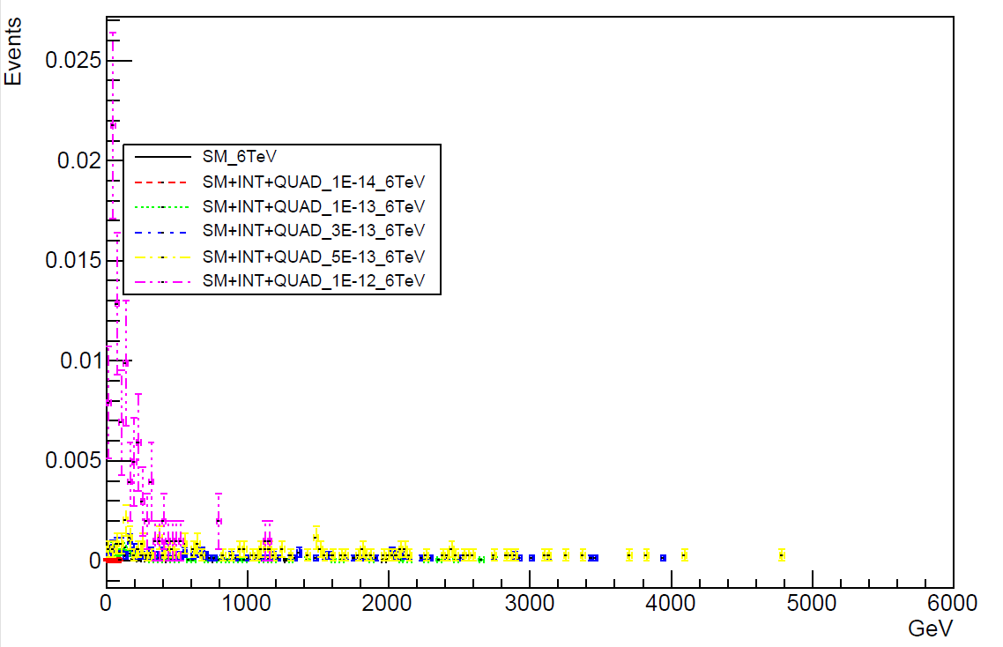
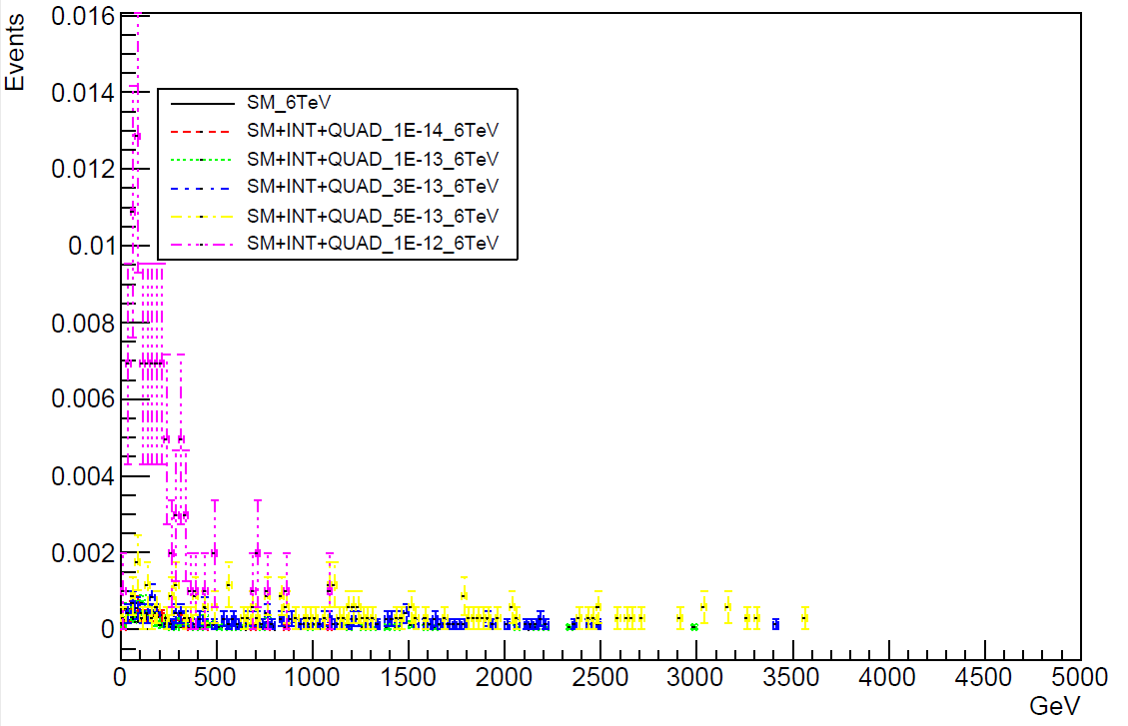
Reco level plots
Opposite sign leptons
emu_mass
emu_pT

Slide 3
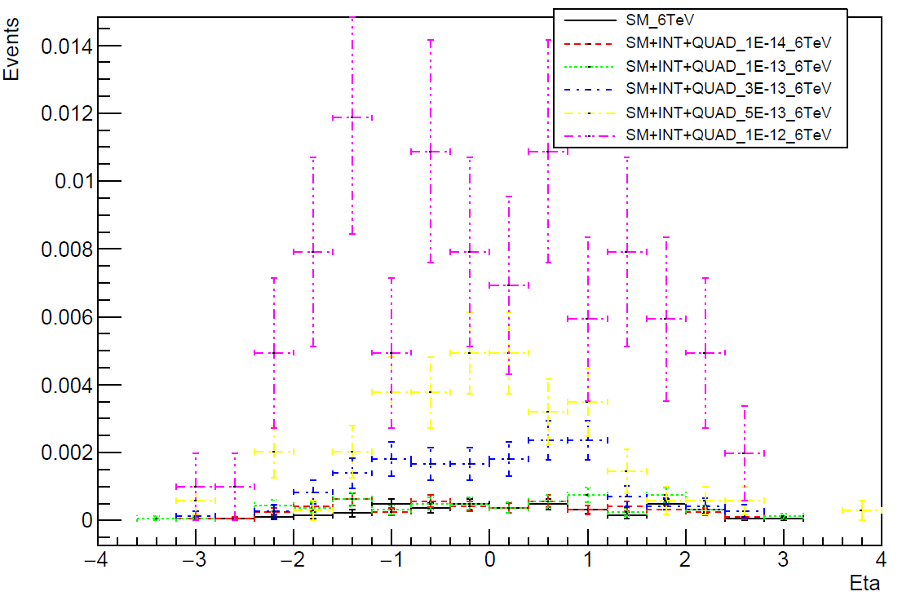
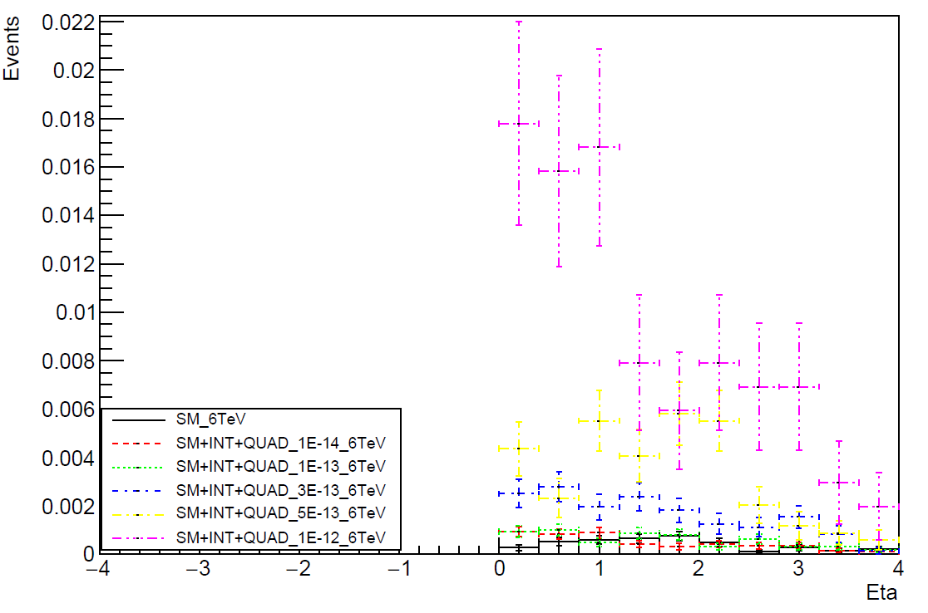
Reco level plots
Opposite sign leptons
emu_Eta
emu_deltaEta

Slide 4
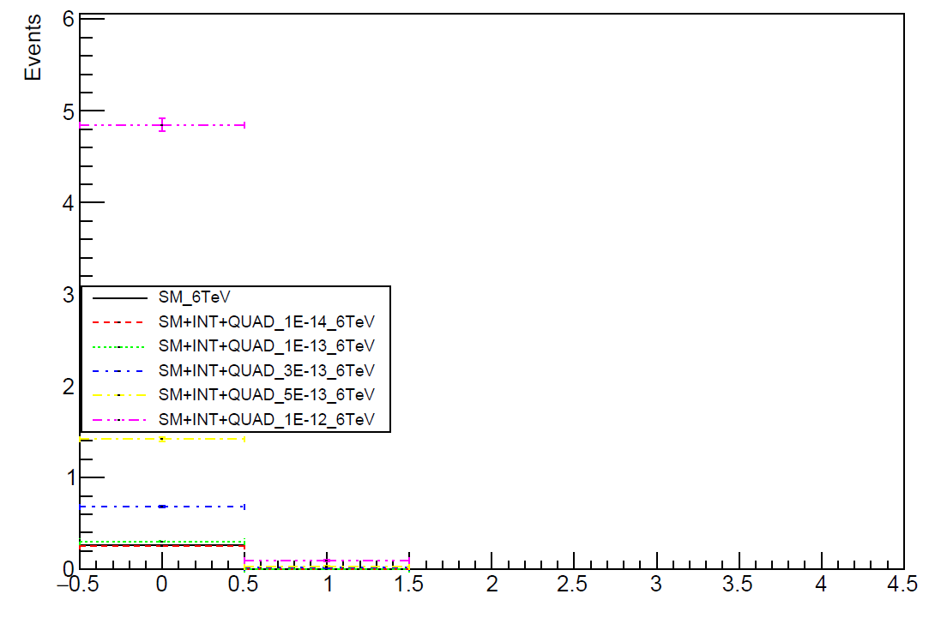
Reco level plots
Opposite sign leptons
emu_multiplicity

Slide 5
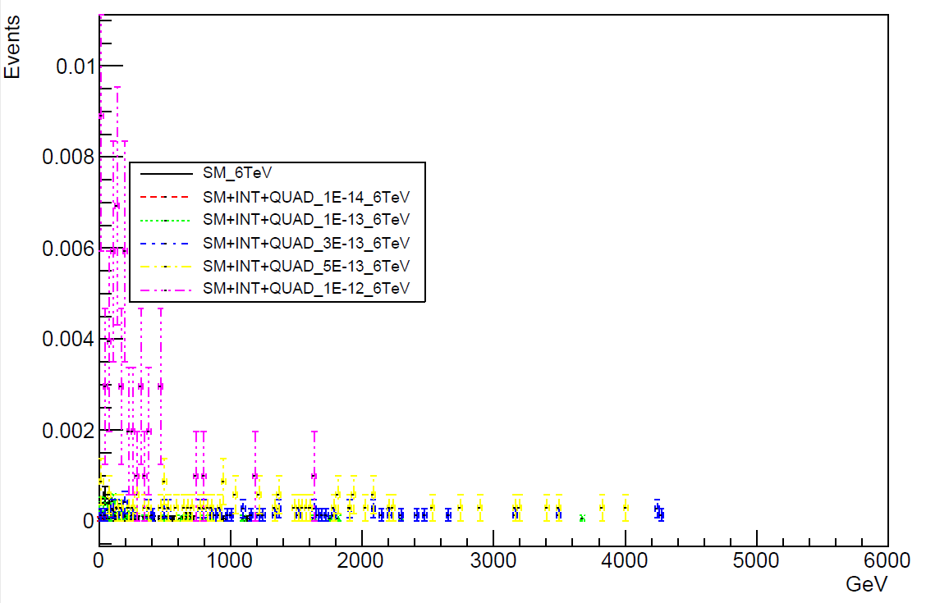
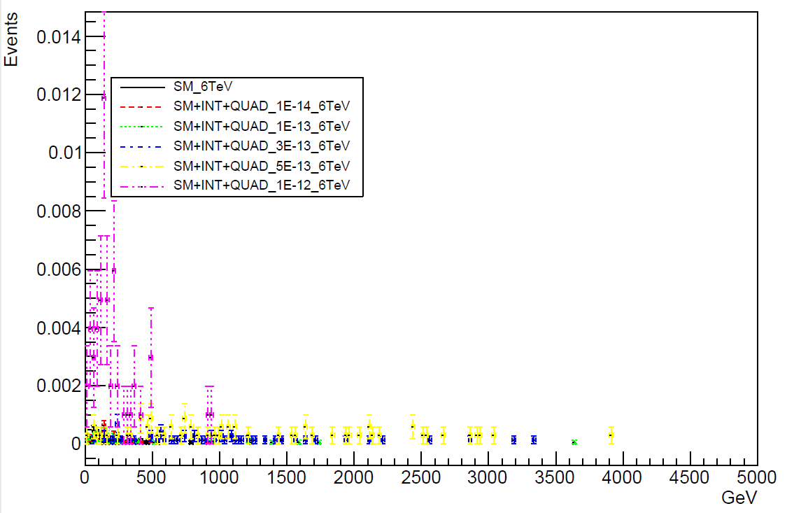
Reco level plots
Opposite sign leptons
mumu_mass
mumu_pT

Slide 6
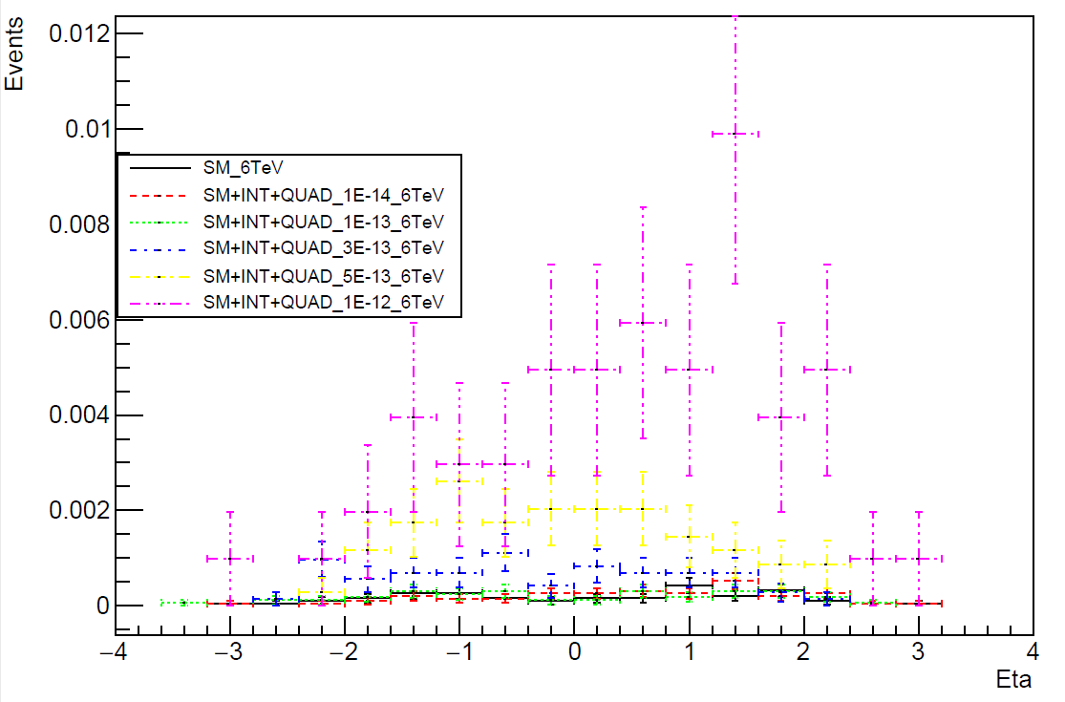
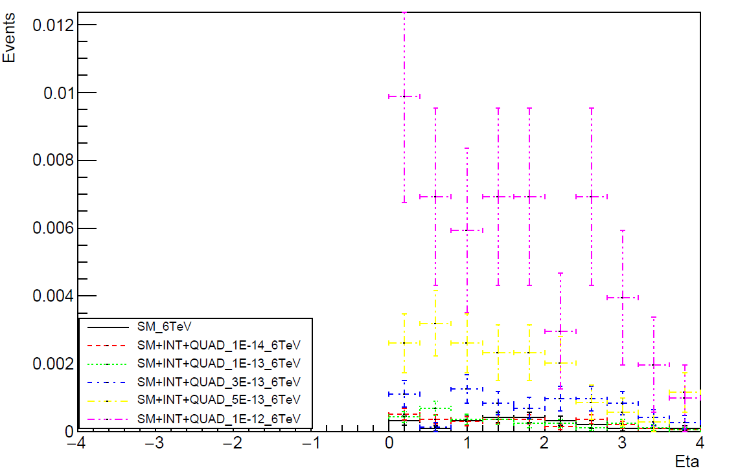
Reco level plots
Opposite sign leptons
mumu_Eta
mumu_deltaEta

Slide 7
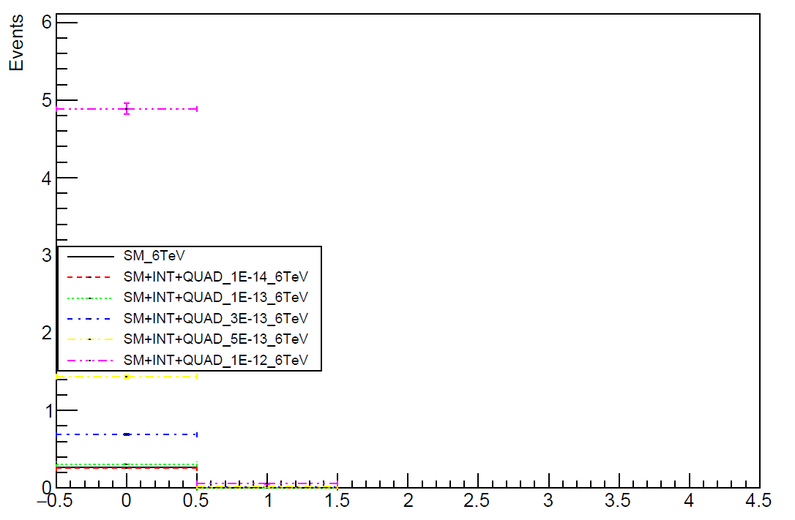
Reco level plots
Opposite sign leptons
mumu_multiplicity

Slide 8
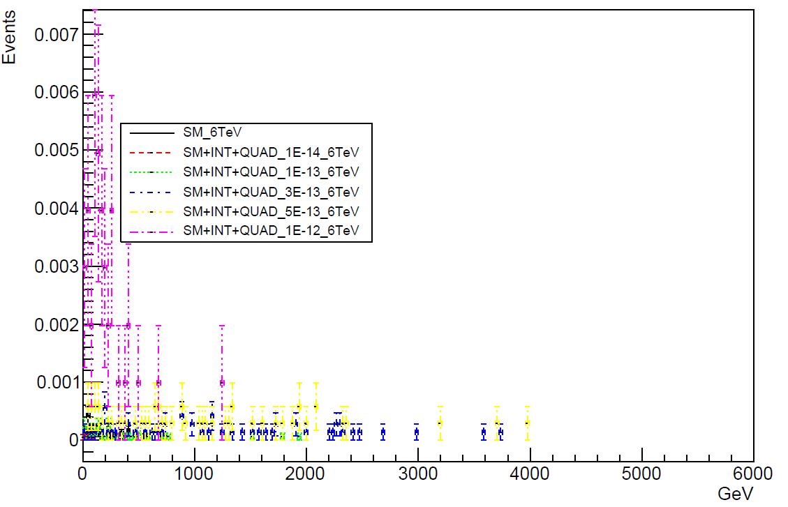
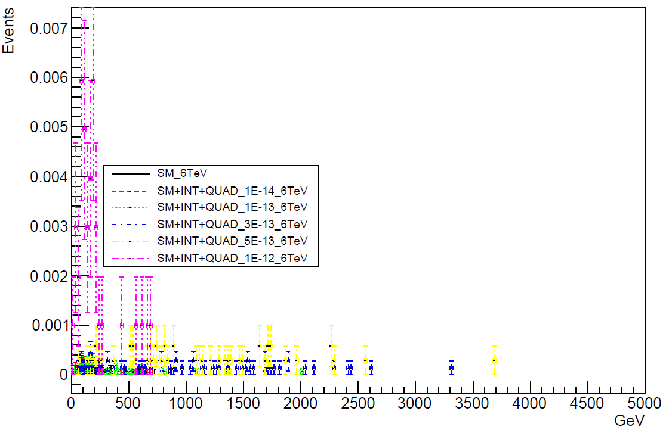
Reco level plots
Opposite sign leptons
ee_mass
ee_pT

Slide 9
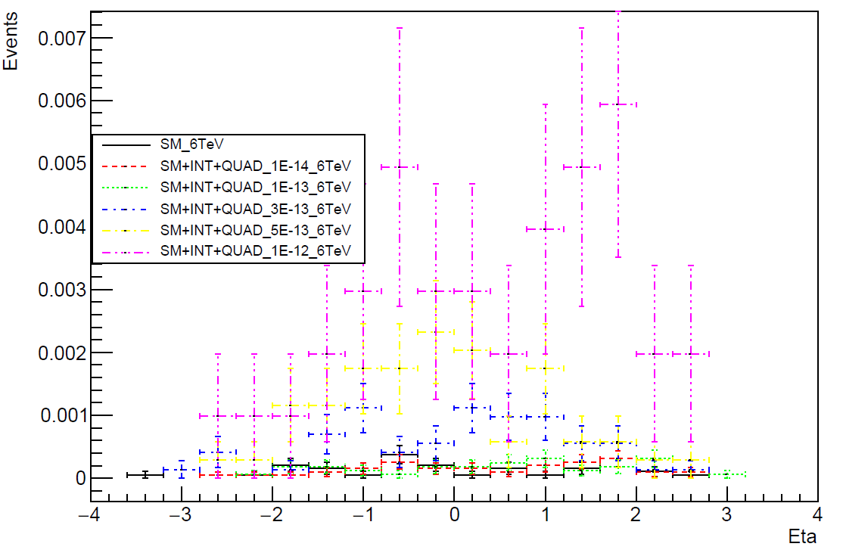
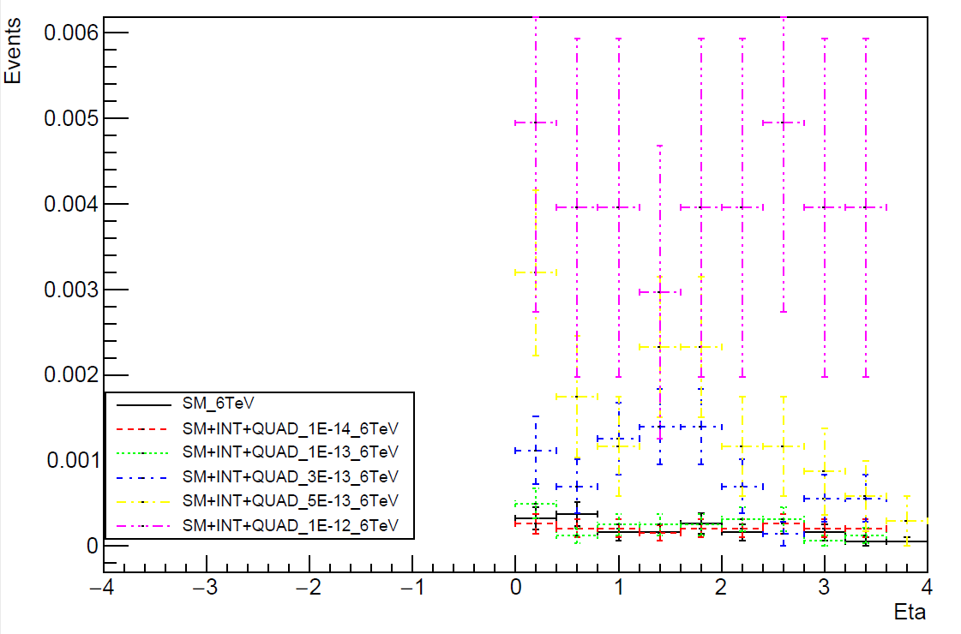
Reco level plots
Opposite sign leptons
ee_Eta
ee_deltaEta

Slide 10
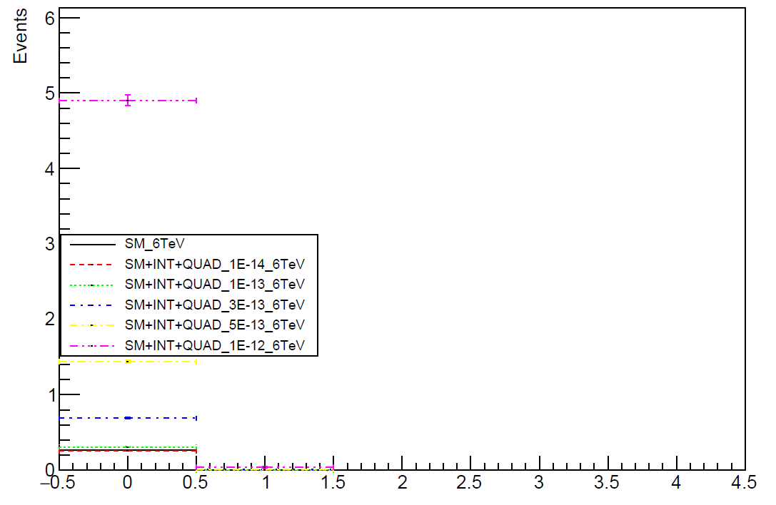
Reco level plots
Opposite sign leptons
ee_multiplicity

Slide 11
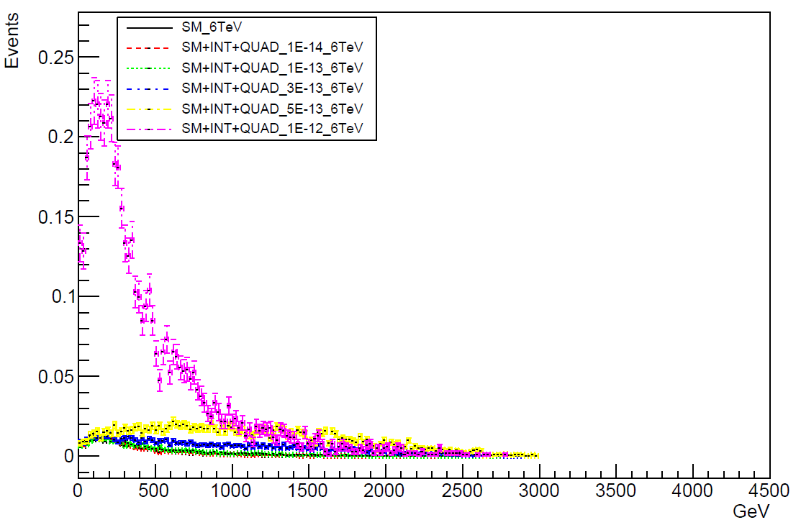
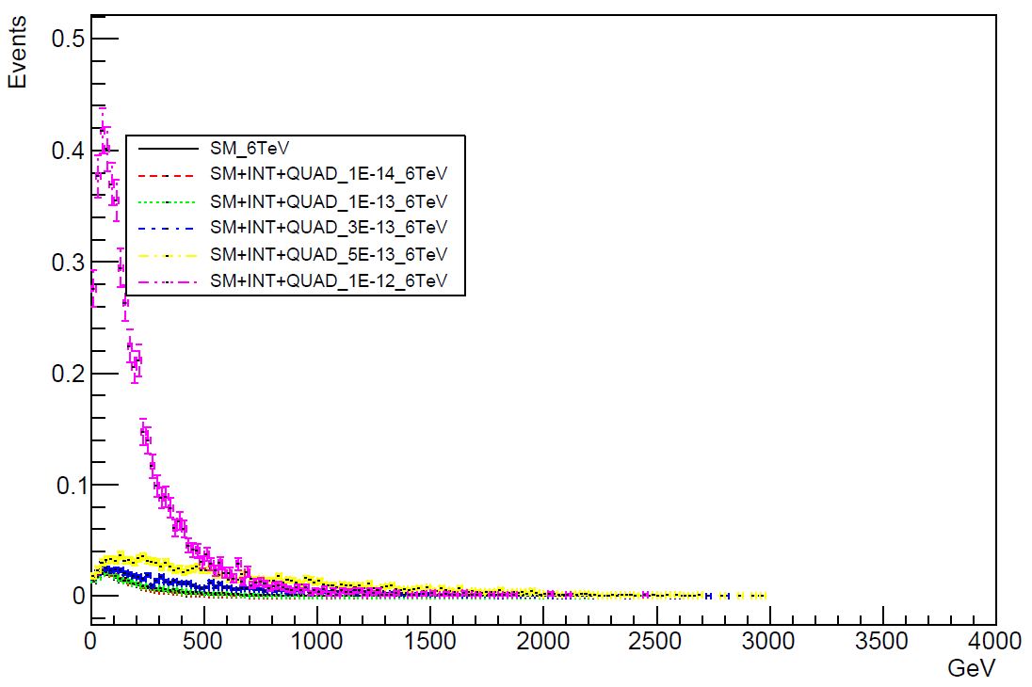
Reco level plots
MissingE
MissingEt

Slide 12
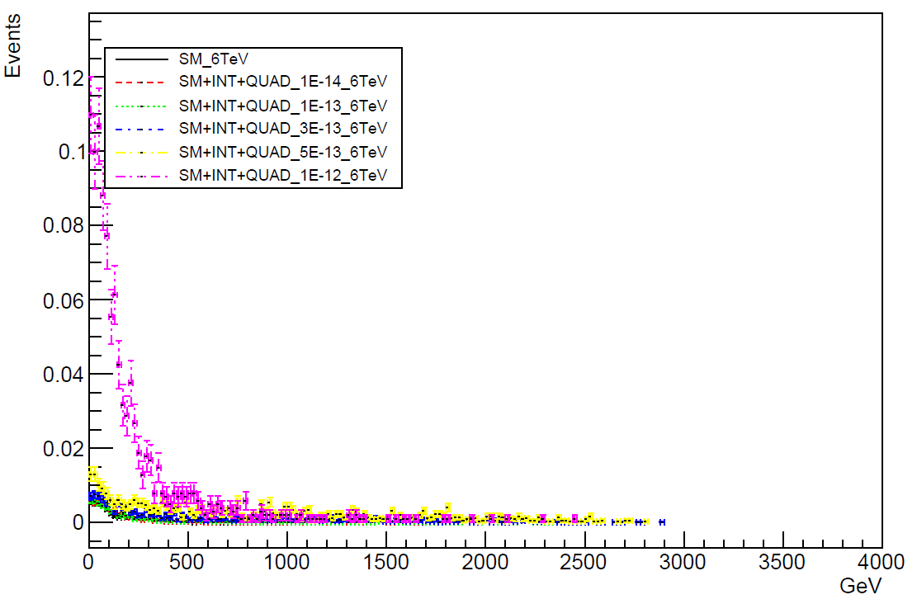
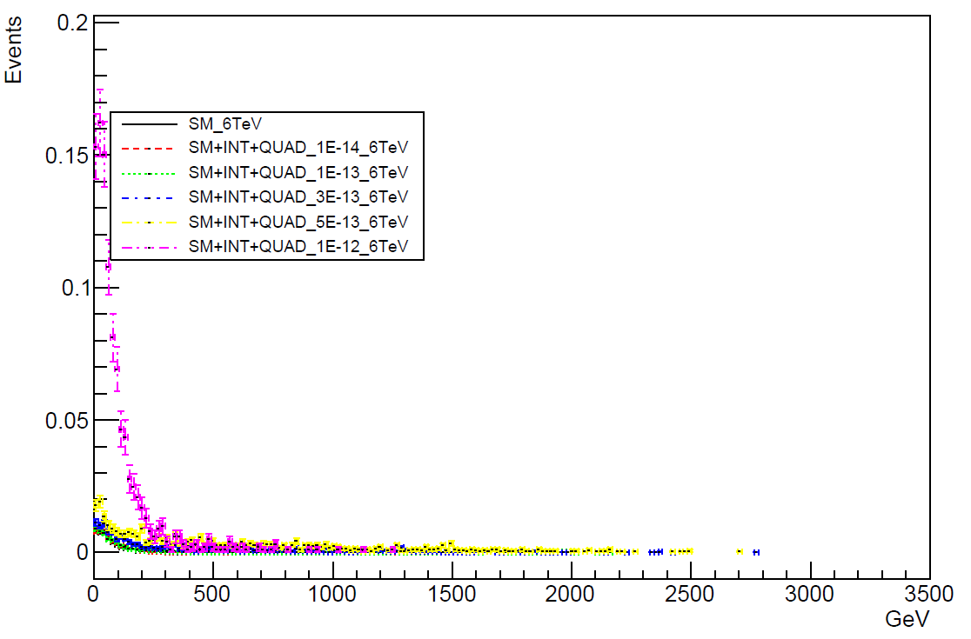
Reco level plots
mu_P (Inclusive)
mu_pT (inclusive)

Slide 13
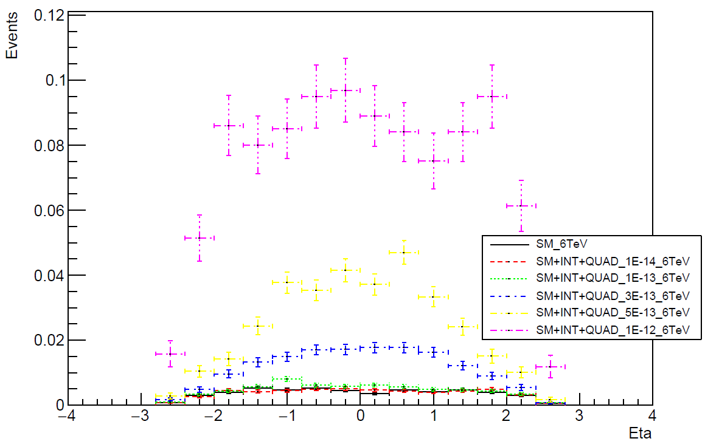
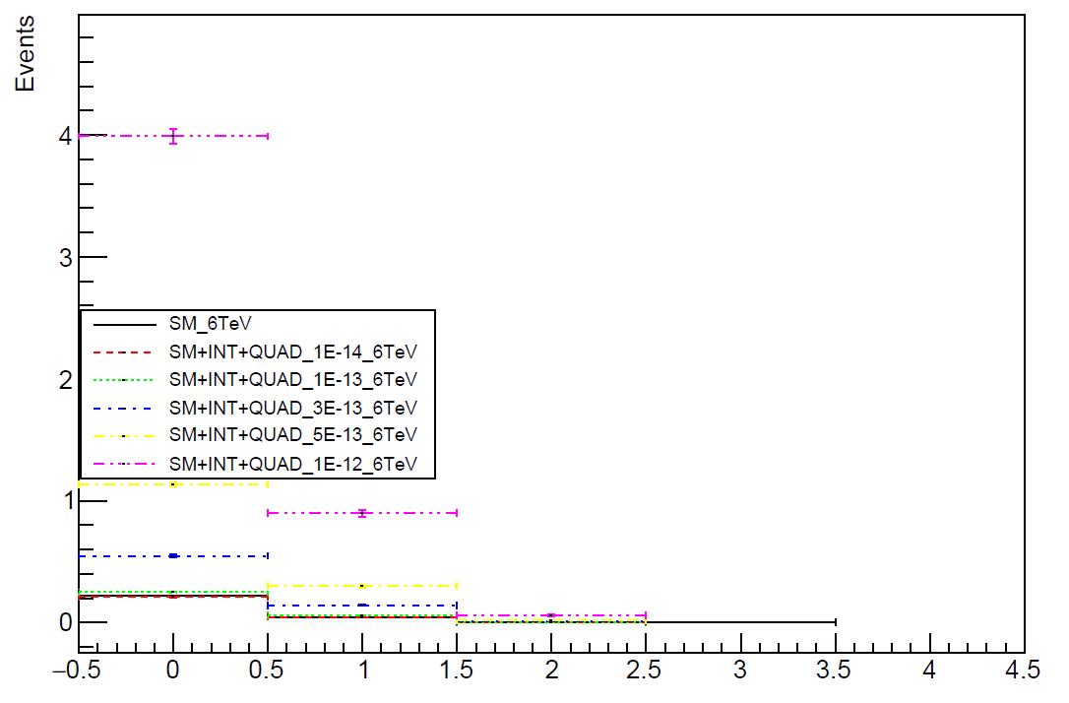
Reco level plots
mu_eta (Inclusive)
mu_multiplicity

Slide 14
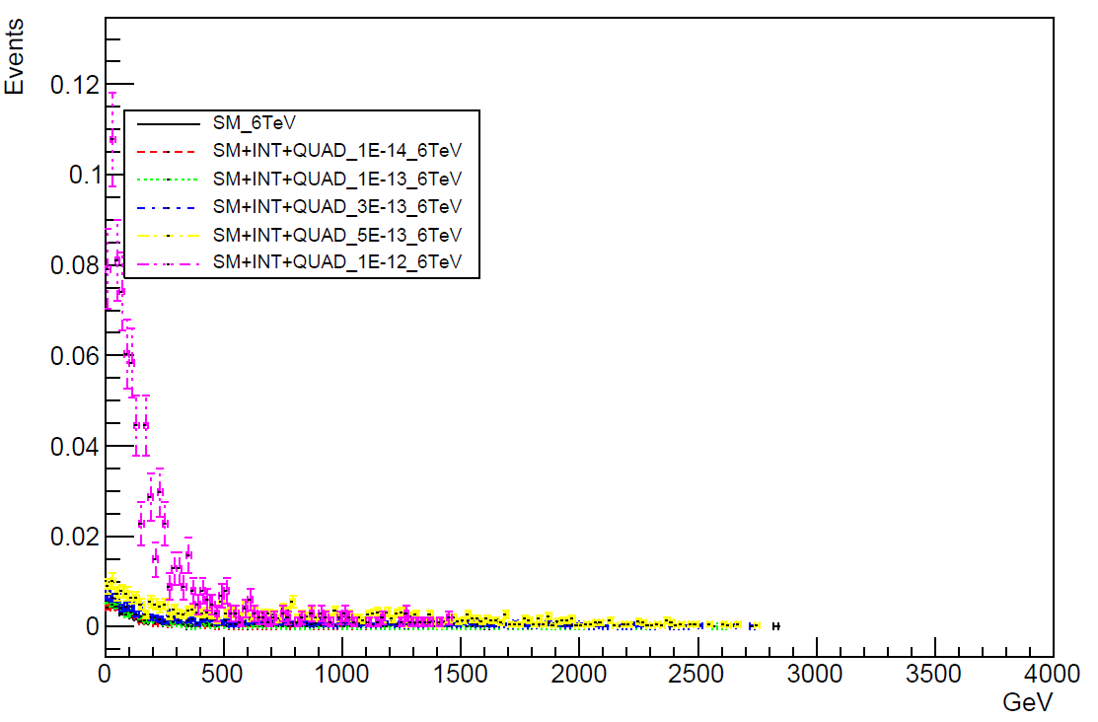
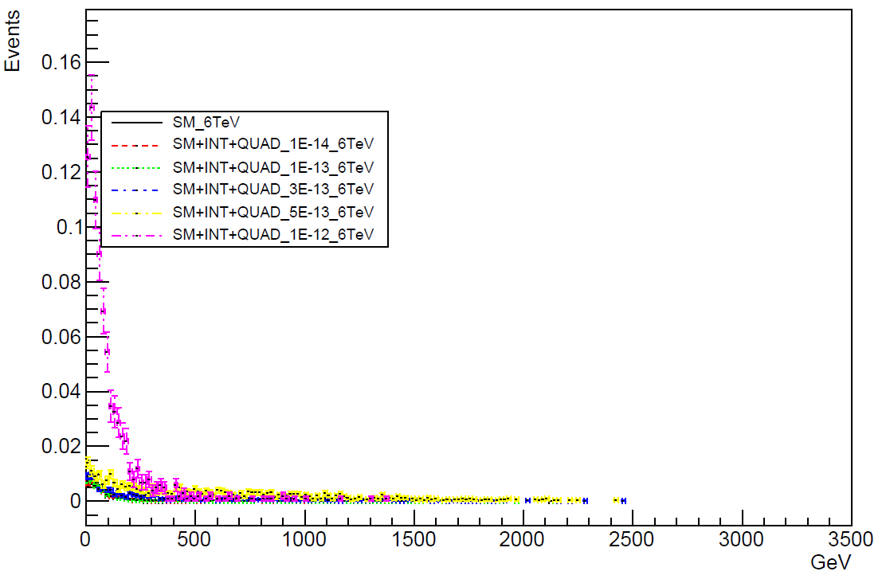
Reco level plots
e_P (Inclusive)
e_pT (inclusive)

Slide 15
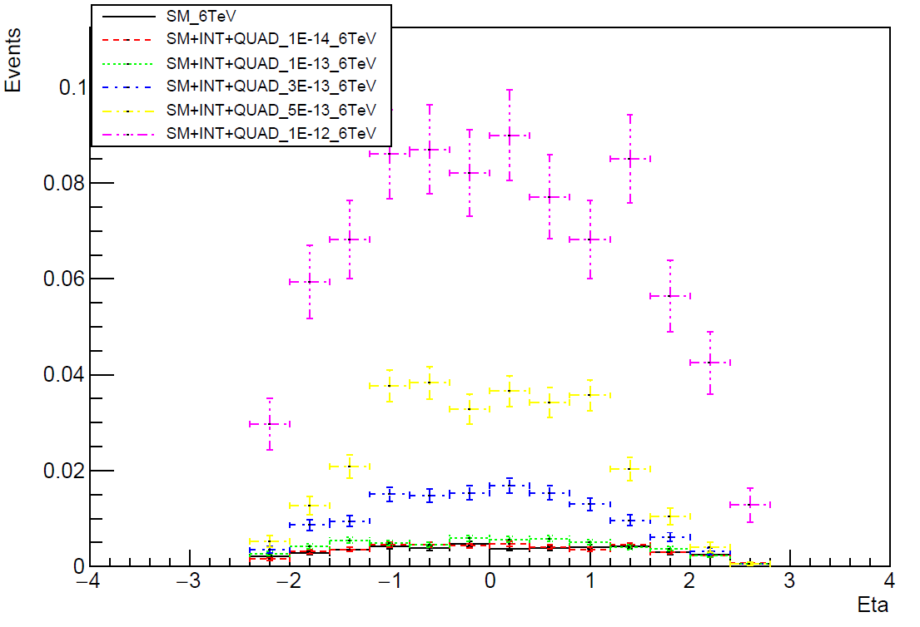
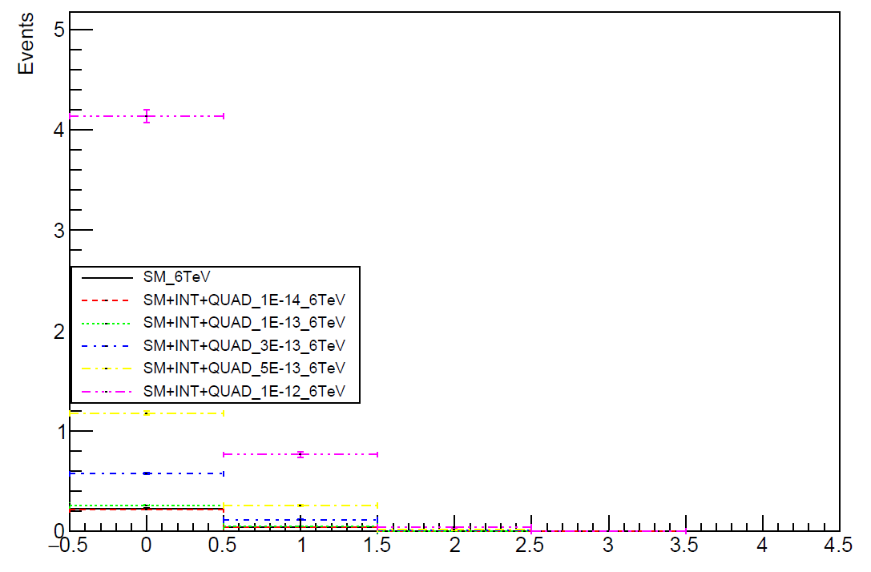
Reco level plots
e_eta (Inclusive)
e_multiplicity

Slide 16
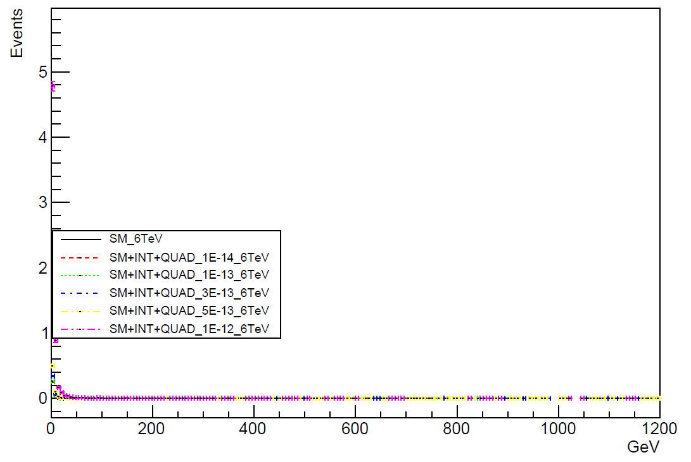
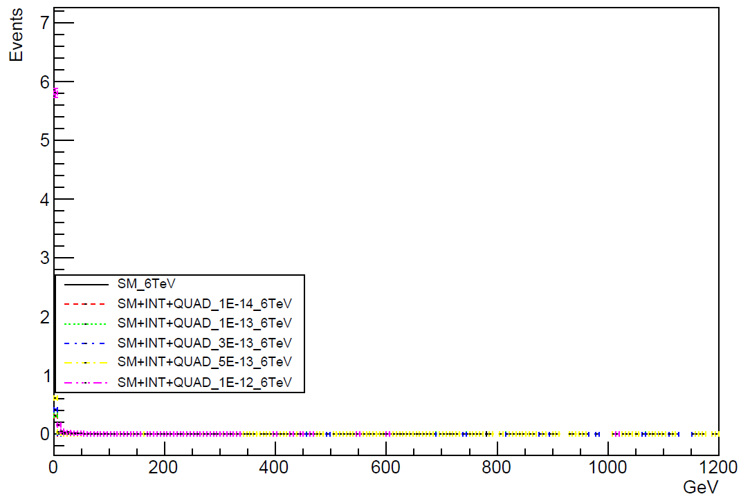
Reco level plots
photon_P (Inclusive)
photon_pT (inclusive)

Slide 17
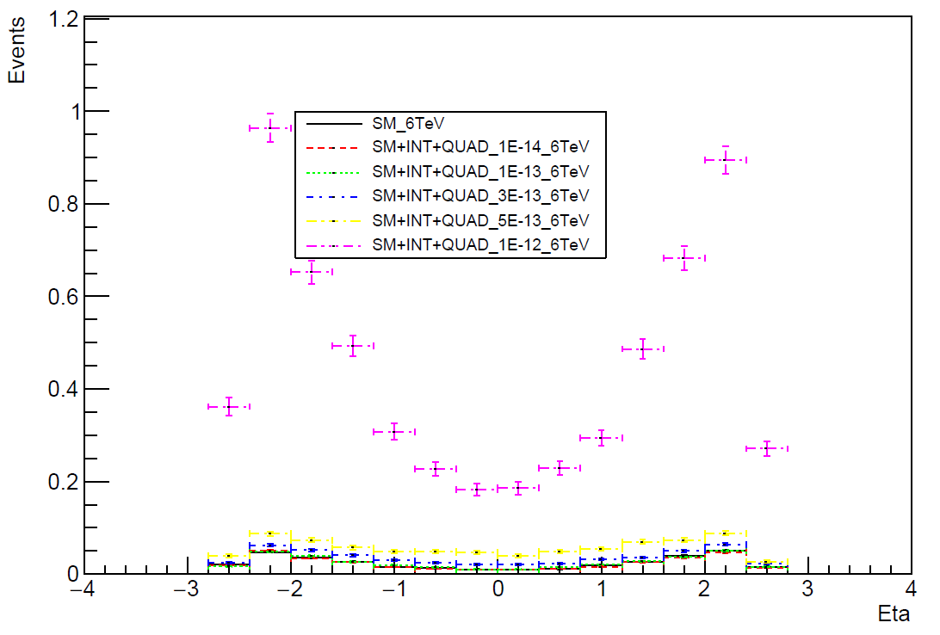
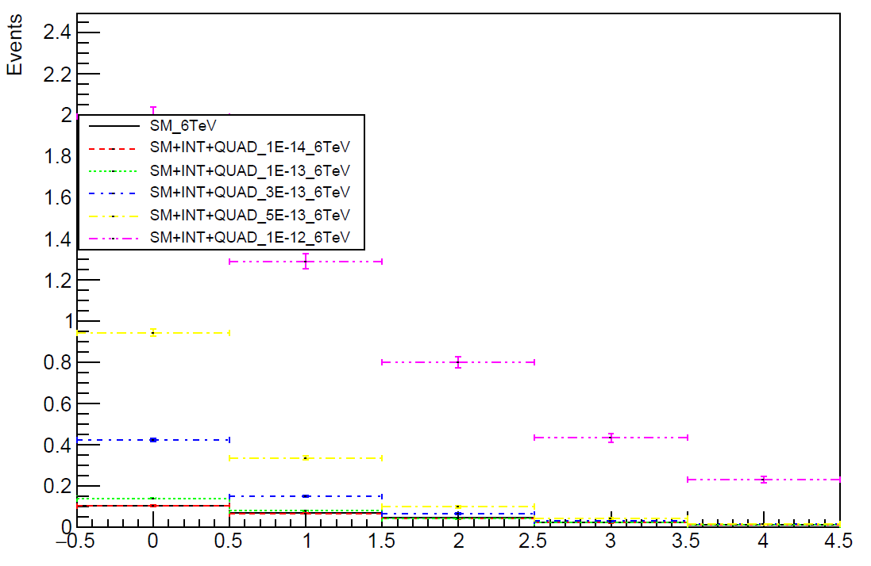
Reco level plots
photon_eta (Inclusive)
photon_multiplicity

Slide 18
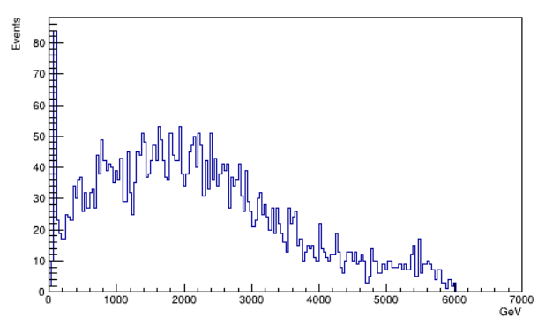
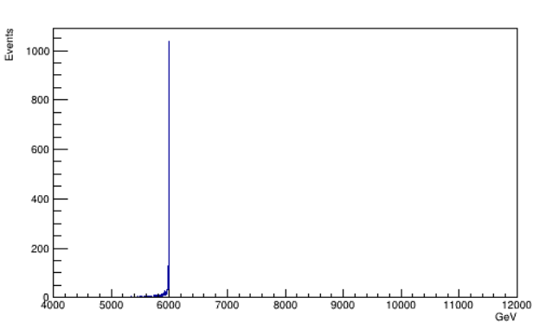
Missing Mass (FULL_1E-12)
e + μ + ϒ + GenJet
e + μ + ϒ

Slide 19
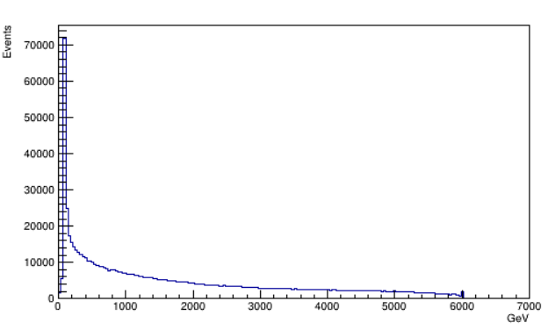
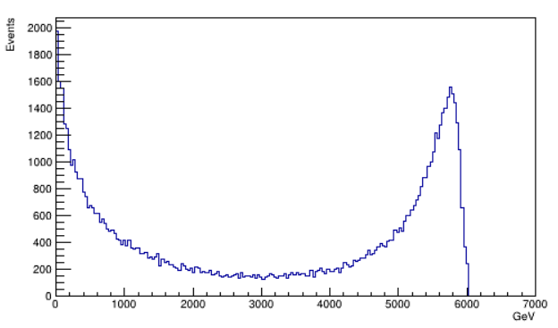
Missing Mass (e + μ + ϒ + GenJet)
wpwmz_ztonunu
ggwpwm

