Slide 1
Goals and Plans
I have written an initial draft of “goals and plans” the intent is to:
  Define the goals for the background simulation and simulation environment
  Define the goals for understanding background and detector response
  Define the minimum set of physics studies

Slide 2
Simulation Environment
Our work will focus on the development of the LCSIM framework, while we continue to utilize and extend the work already done using the ILCROOT system. Fermilab is in the process of submitting a Fieldwork Proposal with SLAC to provide support to implement the changes needed in LCSIM to support future lepton collider simulation.
Tasks:
  Implementation of MCD01 – A model with double layer silicon tracking, larger tracker mass, dual readout calorimetry.
  Implementation of MCD02 – A model similar to MCD01, but with fine sampling calorimetry.
  Incorporation of MARS background into LCSIM with muon decay-based file structure and proper timing.
  Comparison of LCSIM and ILCROOT background analysis
  Simulation of full background events.

Slide 3
Background Analysis
The large background at the Muon collider is the primary experimental challenge. Providing a framework to generate and utilize the background events is a significant computing challenge. It is also important to understand the background in sufficient detail to provide an efficient parameterization of the backgrounds suitable for fast simulation.
Tasks:
  Provide a procedure for utilizing weighted individual muon decay events produced by MARS
  Define a framework and procedure for full background event simulation
  Use full background simulation to understand how events can be simulated using parameterization of backgrounds in the tracking and calorimeter detectors. Can the backgrounds be separated into “parametrizable” and full simulation components? What are the event-to-event fluctuations?

Slide 4
Detector Response
A result of our initial studies is that time resolution will be crucial to a successful Muon Collider detector. A set of studies will be needed to understand how to implement detectors with appropriate time and position resolution and what resolution is needed.
Tasks:
  Study the effects of timing on resolution for dual readout hadron calorimeters.
  Study the effects of timing for fine samping calorimeters. Investigate PFA schemes with Muon Collider background.
  Study tracker background rejection for fast timing systems and the effects of double correlated layers

Slide 5
Physics Studies
A few physics processes should be studied, both in fast and full simulation. A set of these studies were described at Telluride. The focus may change as data becomes available from LHC. Initial fast simulation studies would be limited to studying the effects of the forward “nose” and more massive tracker. Full simulation studies would include MARS event backgrounds. An intermediate set might include parameterized backgrounds.
Physics topics:
  Z’
  Slepton
  Heavy Higgs
  WW fusion?
  (others as interest and time dictate)

Slide 6

Minimum Momenta
(Weinstein)
Dr | 3.00E-04 | M
B | 5 | tesla
Pcut | 10 | GeV
k(pmin) | 0.075 | 1/m
layer | Radius(m) | Pmin (GeV) | r*dphi (Pcut)
1 | 0.20 | 0.15 | 4.50E-06
2 | 0.46 | 0.342 | 1.03E-05
3 | 0.71 | 0.53325 | 1.60E-05
4 | 0.97 | 0.72525 | 2.18E-05
5 | 1.22 | 0.91725 | 2.75E-05

Slide 7
Cluster Width
dl
300 μ

Slide 8
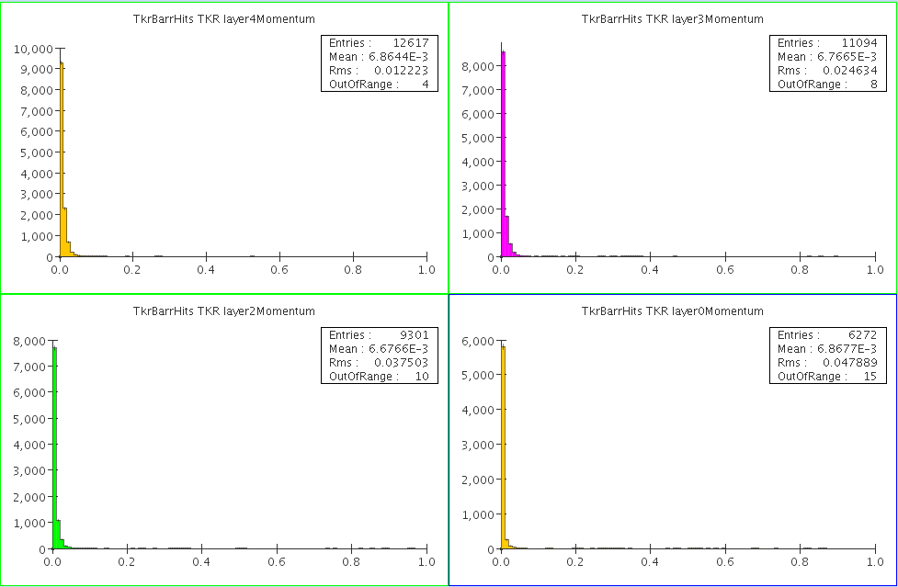
Background Track momentum distribution layers 4, 3, 2, 0

Slide 9
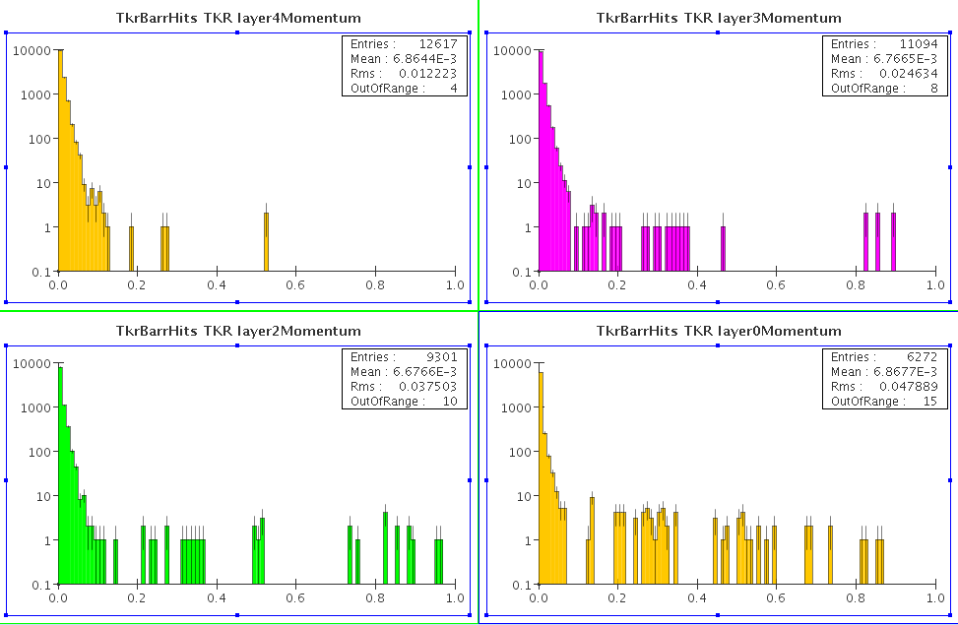
Background Momentum distribution, log scale

Slide 10
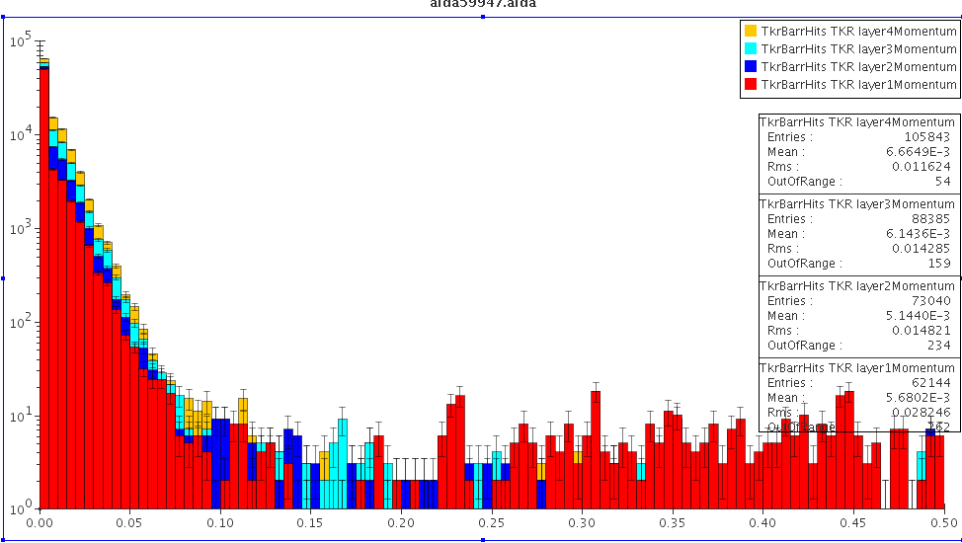
Background Momentum distribution

Slide 11
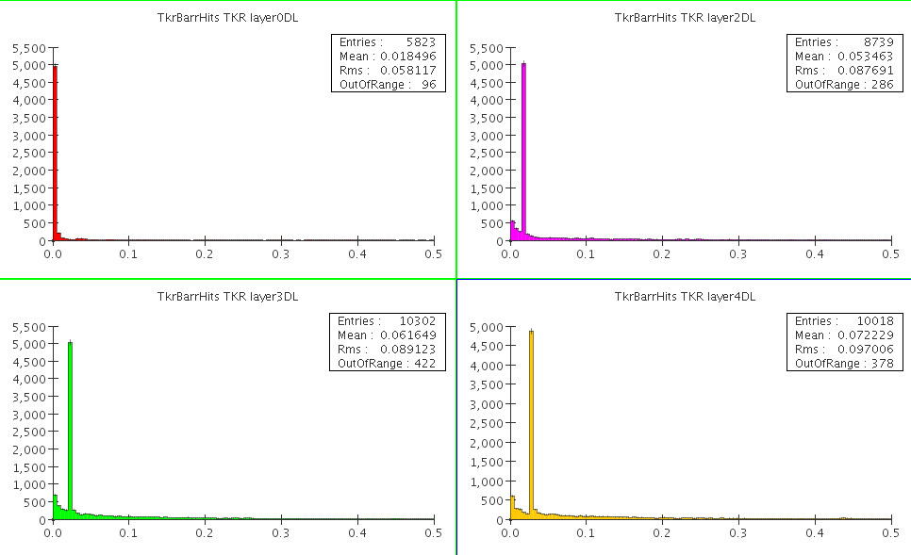
R*dphi(out-in) in 300 micron silicon, 10 GeV electrons

Slide 12
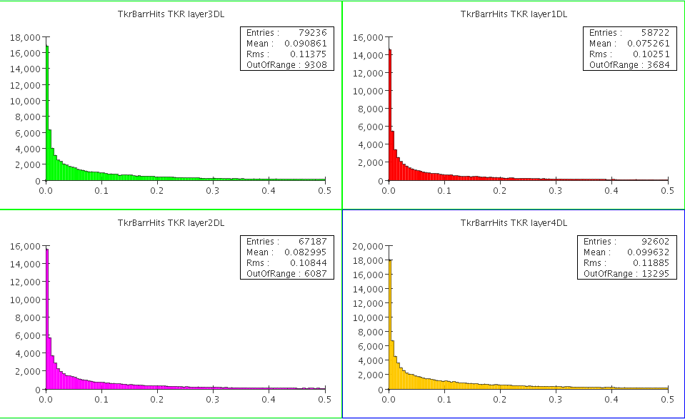
R*dphi(out-in) in 300 micron silicon, background

Slide 13
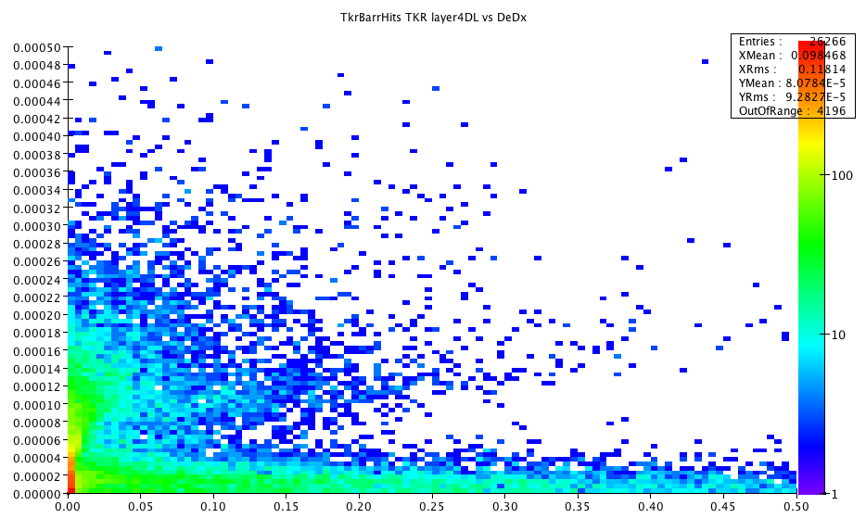
R*dphi vs dedx background layer 4

Slide 14
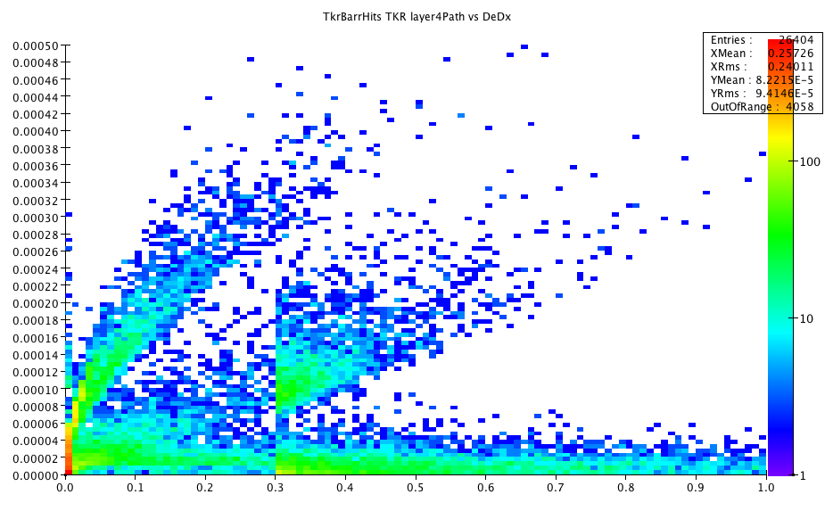
Layer 4, total path vs dedx background
Detector Thickness

Slide 15
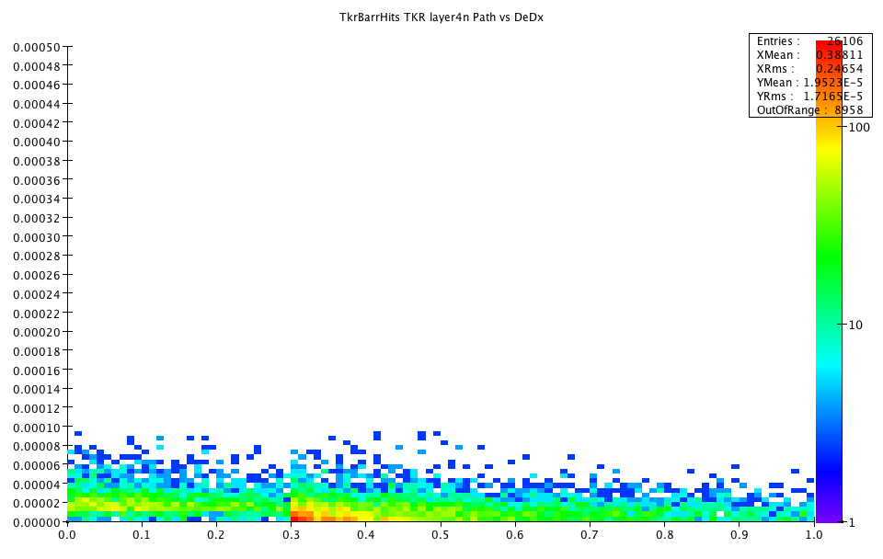
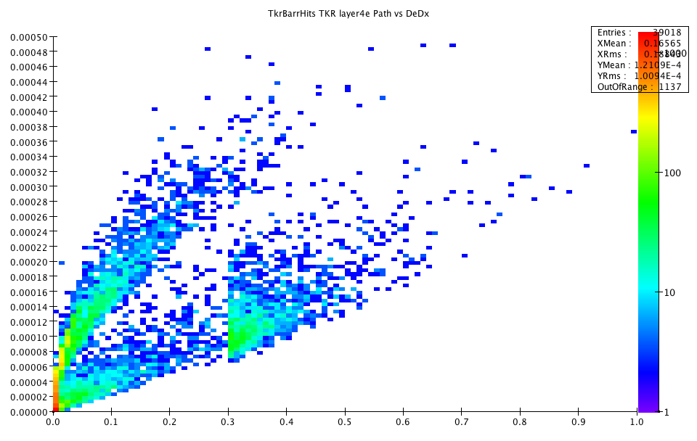
Layer 4, total path vs dedx background
Neutrons
electrons

Slide 16
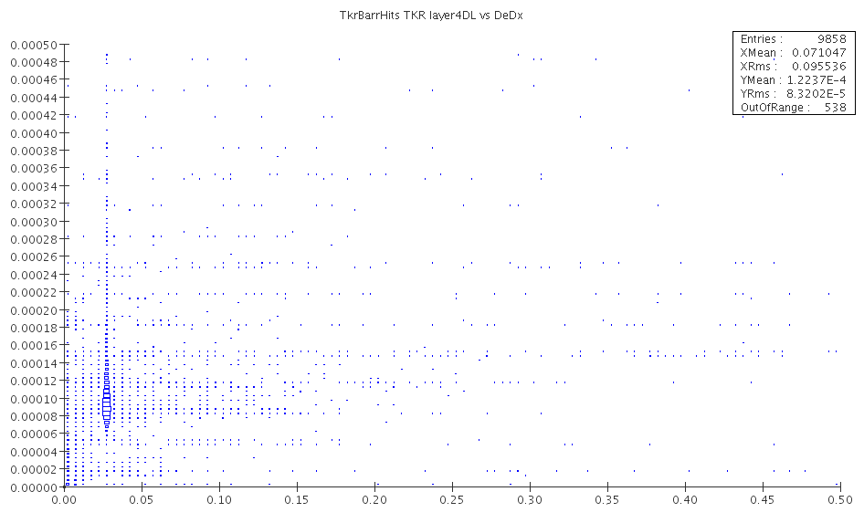
R*dphi vs dedx 10 GeV mu layer 4

Slide 17
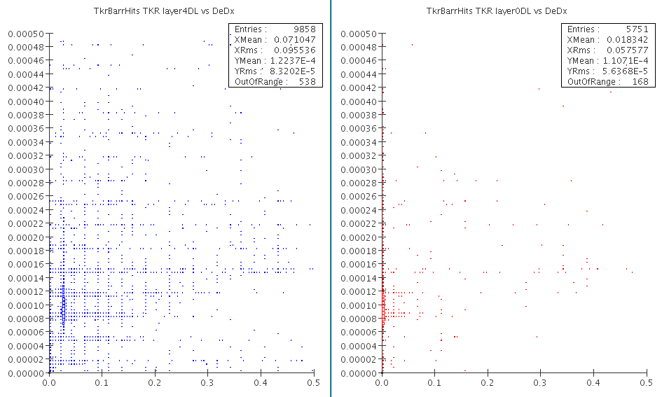
R*dphi vs dedx 10 GeV e layer 0, 4

Slide 18
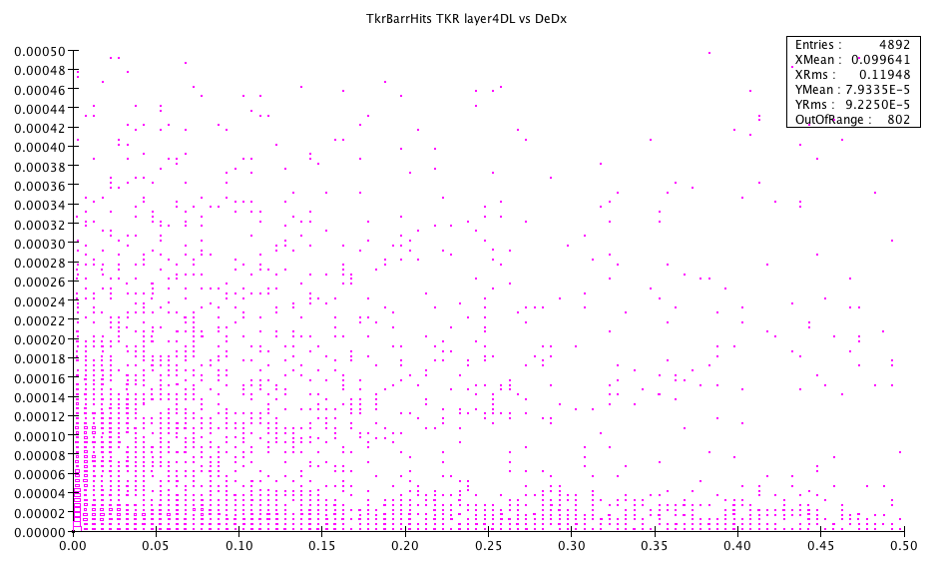
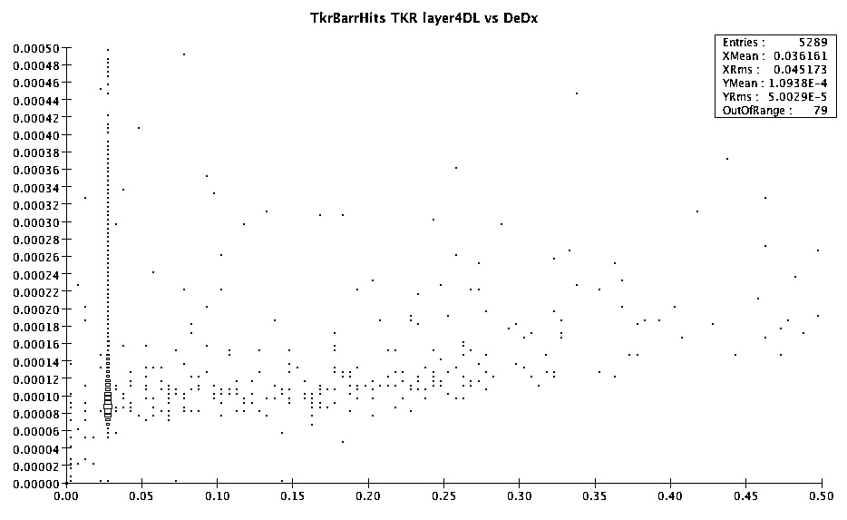
DeDx vs Drphi for bkd and 10 GeV Muons

Slide 19
Dedx and Drphi cuts
Assume DeDx cut of 5x10⁻⁵
Drphi cut set by minimum momentum: ~300 microns for 1 GeV tracks in 5T field
Closely separated pairs would provide rejection of
B | 5 | tesla
Pcut | 10 | GeV
k(pmin) | 0.075 | 1/m
dedx cut | 5.00E-05
Drphi cut | 3.00E-04 | M
layer | Radius(m) | Pmin (GeV) | r*dphi (Pcut) | Bkd survive
1 | 0.20 | 0.15 | 4.50E-06 | 6.12E-01
2 | 0.46 | 0.342 | 1.03E-05 | 5.38E-01
3 | 0.71 | 0.53325 | 1.60E-05 | 4.76E-01
4 | 0.97 | 0.72525 | 2.18E-05 | 4.24E-01
5 | 1.22 | 0.91725 | 2.75E-05 | 3.84E-01

