Slide 1
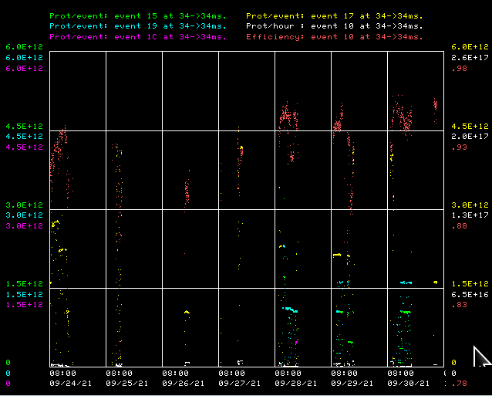
Booster Operations 9/24/21 – 10/1/21
F
T
F
F
Sa
Su
M
F
F
F
W
F
Sa
W
F
F
F
F
F
F
F
Sa
Su
Su
M
Tu
F
F
F
M
M
Su
M
Th
F
M
W
W
W
Th
Sa
W
F
F
Sa
Tu
F
Sa
F
F
Sa
Su
M
F
M
F
Sa
Su
M
Sa
Su
M
Tu
Th
Su
Su
Sa
Su
F
Sa
M
F
Sa
F
W
Su
W
F
M
W
Th
F
Sa
M
F
Sa
Su
W
Th
F
F
Su
W
F
Sa
Su
M
Tu
Sa
M
Su
M
M
W
Th
F
M
F
Su
M
W
Sa
Su
u
F
Sa
Th
Sa
M
W
F
Sa
Su
W
F
Su
M
Booster beam to MI/RR
Booster Studies
Capture/Transition Issues
BRF8 Cable Fault
DOGL3 Flow Switch
Collimator Studies
This week:
Running beam from 1E12 to 4.5E12 as needed. Beam needs work at 4.5E12. 4E12 per pulse beam is good at 93% efficiency.
Running beam to MI/RR for beam commissioning since Tuesday.
Supported MI8 line characterization studies.
Replaced RFA/B cables from LLRF DDS to A/B ENI amps.
Booster Studies last weekend.
Access on Monday to check out BRF 1 and 20.
Laser Notching was established mid week.
RF Stations 1, 14 and 20 recovered early in week. All RF Stations available
General tuning.
Tuning for higher beam intensities.
Gradient Magnet prep work for move to TD for E4R tests

