Slide 1



First Experience with Nb₃Sn Accelerator Magnets
Giorgio Ambrosio,
with contributions from MQXFA and MQXFB teams

Slide 2
Acknowledgement
US HL-LHC Accelerator Upgrade Project (AUP)
  BNL: K. Amm, M. Anerella, A. Ben Yahia, H. Hocker, P. Joshi, J. Muratore, J. Schmalzle, H. Song, P. Wanderer
  FNAL: G. Ambrosio, G. Apollinari, M. Baldini, J. Blowers, R. Bossert, R. Carcagno, G. Chlachidze, J. DiMarco, S. Feher, S. Krave, V. Lombardo, C. Narug, A. Nobrega, V. Marinozzi, C. Orozco, T. Page M. Parker, S. Stoynev, T. Strauss, M. Turenne, D. Turrioni, A. Vouris, M. Yu
  LBNL: D. Cheng, P. Ferracin, E. Lee, M. Marchevsky, M. Naus, H. Pan, I. Pong, S. Prestemon, K. Ray, G. Sabbi, G. Vallone, X. Wang
  NHMFL: L. Cooley, J. Levitan, J. Lu, R. Walsh
CERN: HL-LHC Project
  A. Ballarino, H. Bajas, M. Bajko, B. Bordini, N. Bourcey, J.C. Perez, S. Izquierdo Bermudez, S. Ferradas Troitino, L. Fiscarelli, J. Fleiter, M. Guinchard, O. Housiaux, F. Lackner, F. Mangiarotti, A. Milanese, P. Moyret, H. Prin, R. Principe, E. Ravaioli, T. Sahner, S. Sequeira Tavares, E. Takala, E. Todesco

Slide 3
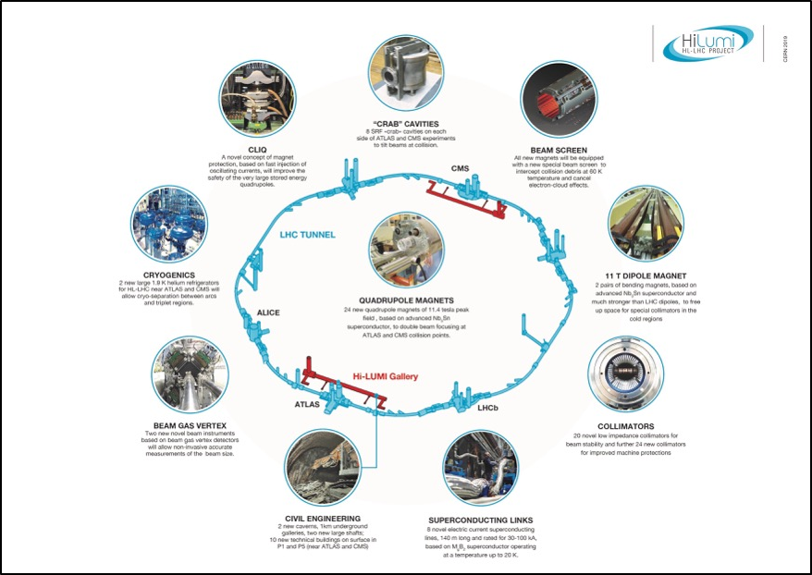
High Luminosity LHC (HL-LHC)
The main objective of HiLumi LHC Design Study is to extend the LHC lifetime by another decade and to determine a hardware configuration and a set of beam parameters that will allow the LHC to reach the following targets:
A peak luminosity of L_{peak} = 5×10³⁴ cm⁻²s⁻¹ with levelling, allowing:
An integrated luminosity of 250 fb⁻¹ per year, enabling the goal of L_{int} = 3000 fb⁻¹ twelve years after the upgrade.
This luminosity is more than ten times the luminosity reach of the first 10 years of the LHC lifetime.
Ultimate performance established 2015-2016. With same hardware and same beam parameters, by using engineering margins:
L_{peak ult} ≅ 7.5 10³⁴ cm⁻²s⁻¹ and Ultimate Integrated L_{int ult} ∼ 4000 fb⁻¹
LHC should not be the limit, would Physics require more than nominal
Project approved by CERN Council in June 2016

Slide 4
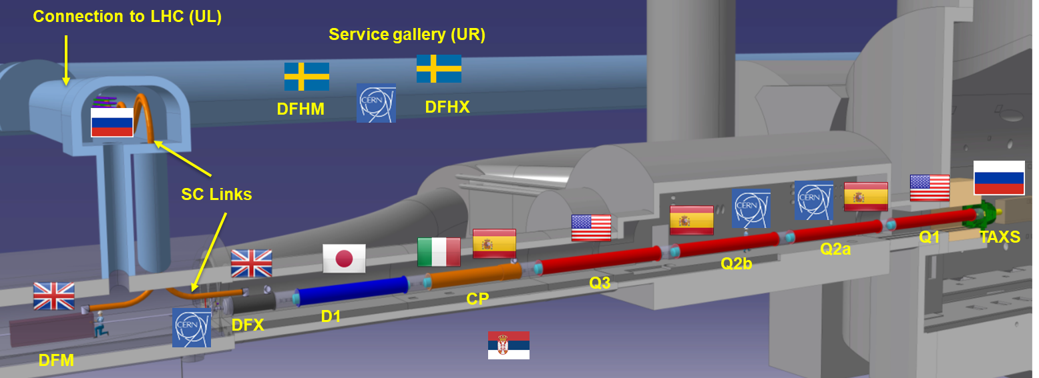


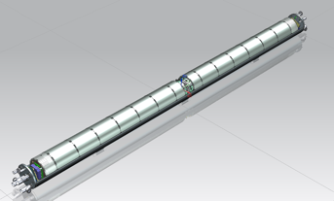
Inner Triplet @ ATLAS and CMS
US-AUP: Q1 and Q3
  2 magnets per cryo-assembly
CERN: Q2a and Q2b
  1 magnet per cryo-assembly
MQXFA
Magnet
Cold Mass
Assembly
Cryo-Assembly

Slide 5
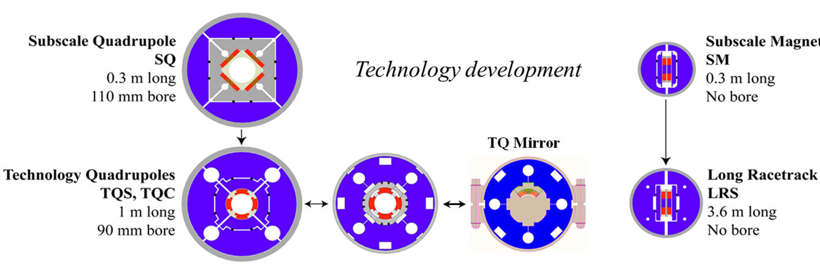
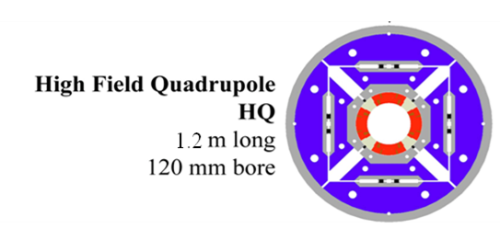
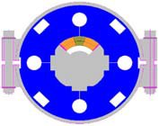
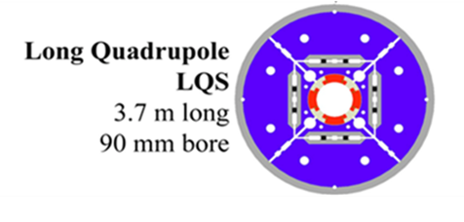
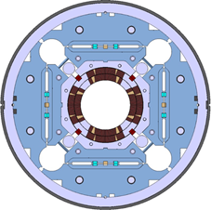
Model Magnet Development Chart (by LARP)
Started from simple configurations directed at basic technology studies and progressed to incorporate all requirements for operation in the accelerator
2003
Coil design selection
Structure selection
Lessons Learned
HQM
HQ and LQ Mirrors
Large aperture quadrupoles
Long quadrupoles
MQXF design in collaboration with CERN
2018

Slide 6
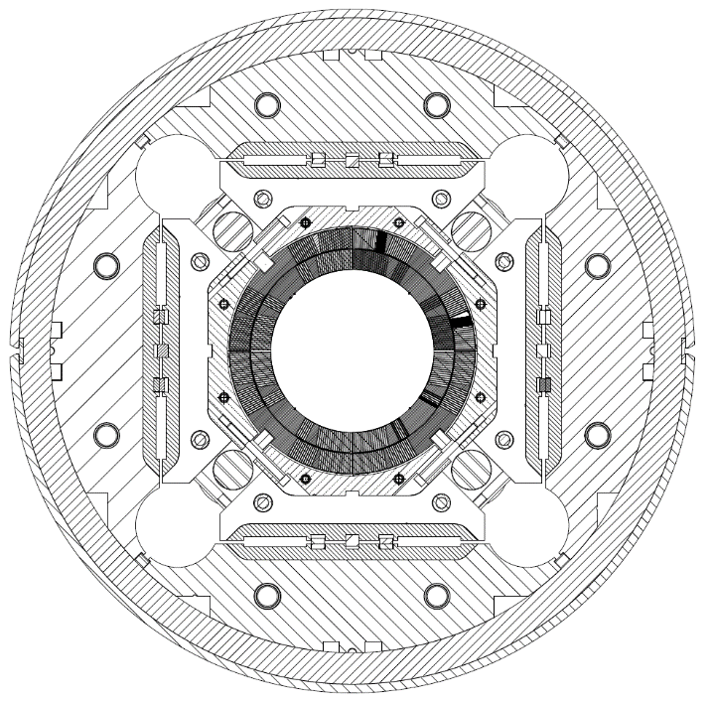
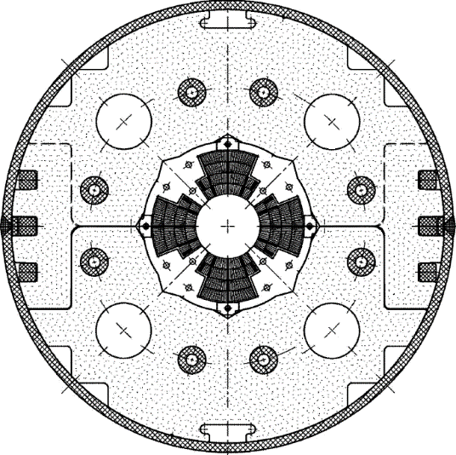
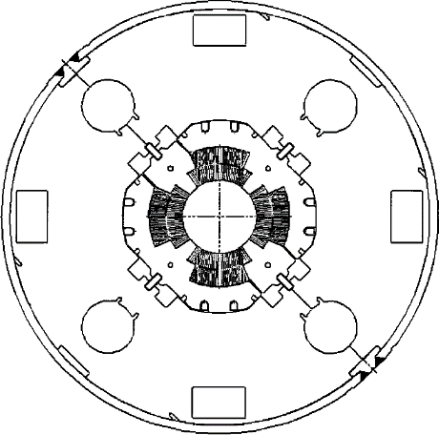
Low-β quadrupole magnets from LHC to HL-LHC
Cold mass OD from 490/420 to 630 mm
More than double the aperture: from 70 to 150 mm
~4 times the e.m. forces in straight section
~6 times the e.m. forces in the ends
State of the art quadrupoles at the time of LHC construction
MQXF
MQXA
MQXB
Same scale for all 3 plots

Slide 7
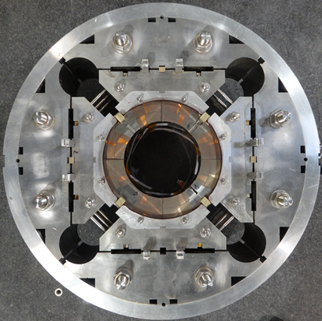
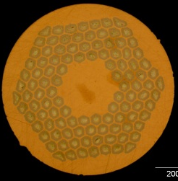
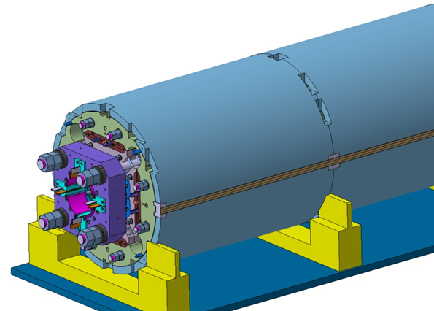
MQXFA/B Design
Parameter | Unit | MQXFA/B
Coil aperture | mm | 150
Magnetic length | m | 4.2/7.15
N. of layers |  | 2
N. of turns Inner-Outer layer |  | 22-28
Operation temperature | K | 1.9
Nominal gradient | T/m | 132.2
Nominal current | kA | 16.23
Peak field at nom. current | T | 11.3
Stored energy at nom. curr. | MJ/m | 1.15
Diff. inductance | mH/m | 8.26
Strand diameter | mm | 0.85
Strand number |  | 40
Cable width | mm | 18.15
Cable mid thickness | mm | 1.525
Keystone angle |  | 0.4
Nb₃Sn Conductor
RRP 108/127
P. Ferracin et al., “Development of MQXF, the Nb₃Sn Low-β Quadrupole for the HiLumi LHC ” IEEE Trans App. Supercond. Vol. 26, no. 4, 4000207
G. Ambrosio et al., “First Test Results of the 150 mm Aperture IR Quadrupole Models for the High Luminosity LHC” NAPAC16, FERMILAB-CONF-16-440-TD

Slide 8
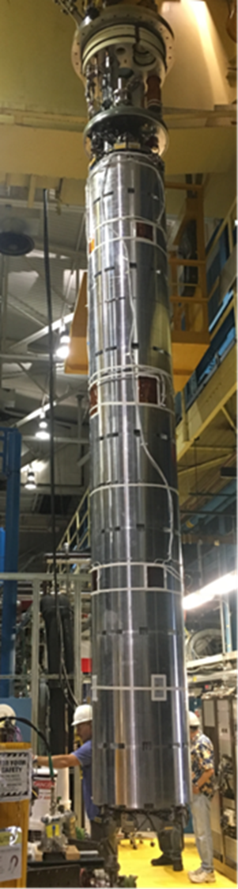
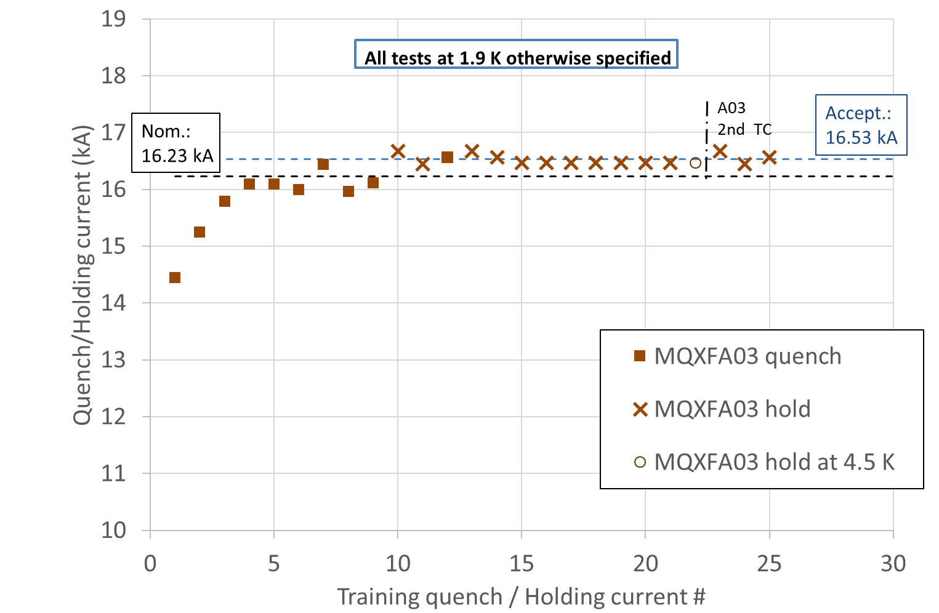
MQXFA Vertical Test
Operation above 7 Tev
Temperature margin
Excellent memory
J. Muratore et al., “Test Results of the First Pre-Series Quadrupole Magnets for the LHC Hi-Lumi Upgrade”, IEEE Trans. Appl. Superc. 2021, #4001804

Slide 9
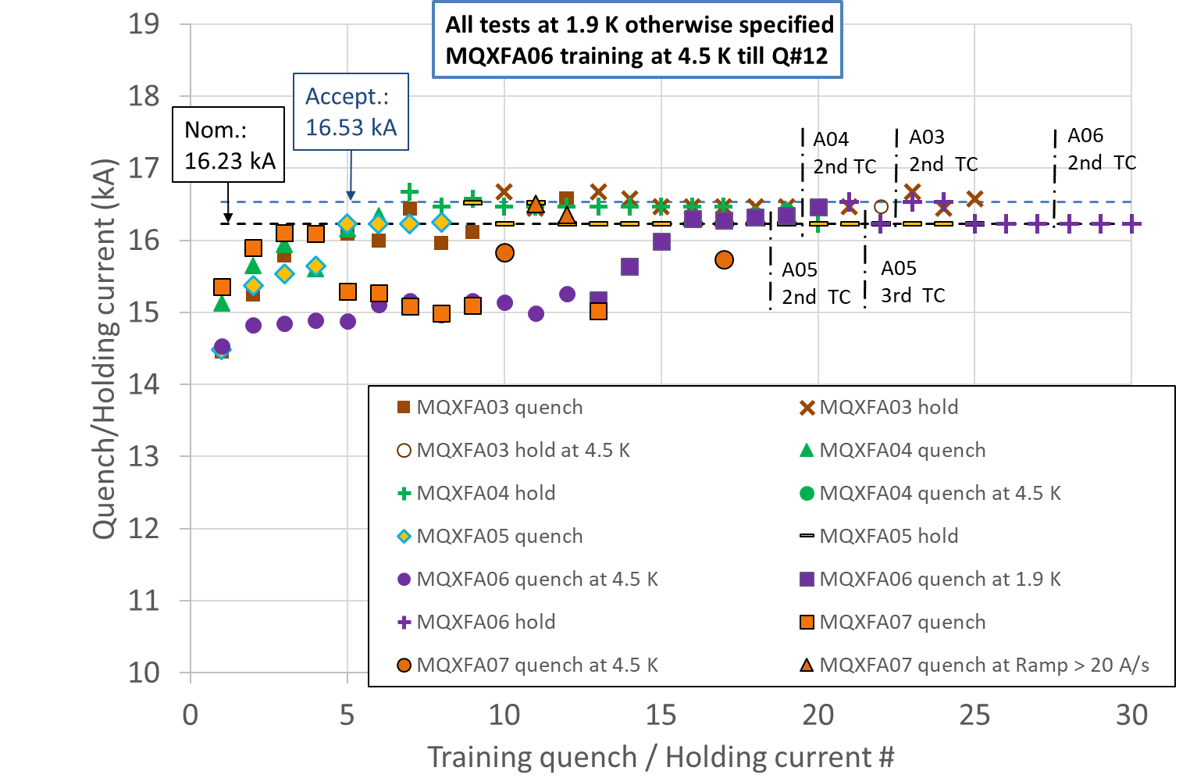
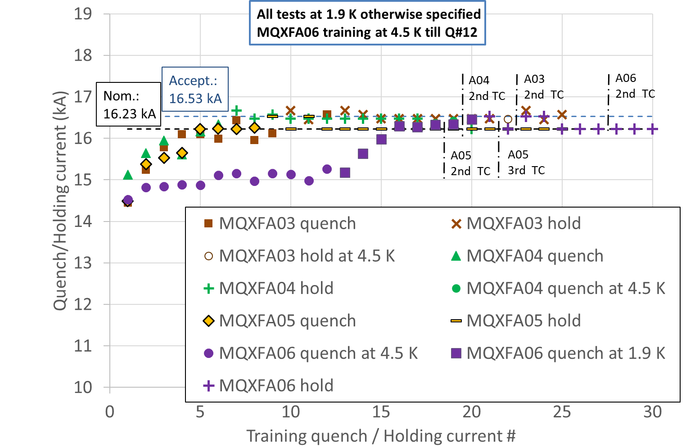
MQXFA03/4/5/6/7 Vertical Test

Slide 10
Plans for MQXFA07 ➔ MQXFA07b
MQXFA07 is limited by one coil
It will be dis-assembled in order to remove the limiting coil and replace it with a new coil
  It will be re-assembled and pre-loaded
  It will be tested in Vertical condition
AUP Baseline assumes that 4 magnets out of 20 are going to fail the 1st vertical test
Limiting coil was affected by COVID lockdown
  14 weeks stop during fabrication
  We are going to perform tomography (CERN lead)

Slide 11
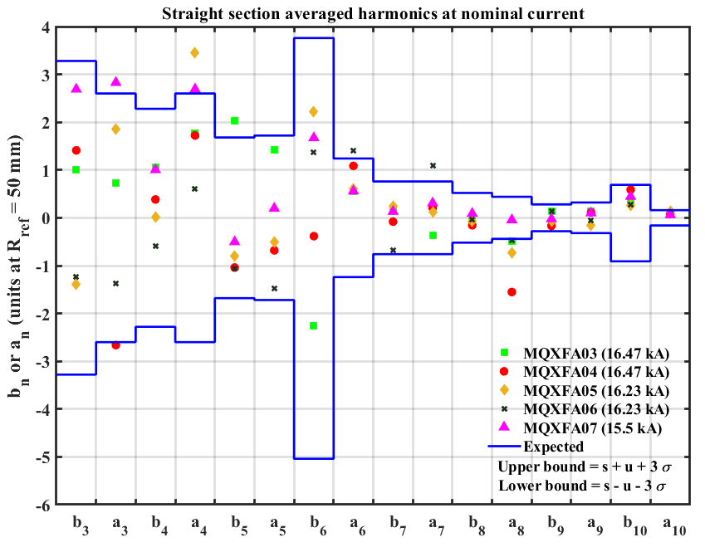
MQXFA03/4/5/6 – Average Straight Section Harmonics at Nominal
Integral harmonics to be measured in Coldmass
Based on short model FQ b6 correction introduced in one coil on MQXFA04 and all subsequent coils:
125 um shift toward midplane
Magnetic shims used to correct low order harmonics
Integrated Gradient and Magnetic Length within specs

Slide 12

Vertical Test Summary
MQXFA03/4/5/6
Requirements & Test Goals:
  Hold current at nominal current + 300 A
  Ramp to/from I_nom at ±30 A/s
  100 A/s ramp down w/o quench
  Temperature margin
  Training memory
  Magnetic measurements
  Splice resistance
  All electrical requirements
MQXFA03 and MQXFA04 are being used for the assembly of the 1st LMQXFA Cold Mass

Slide 13
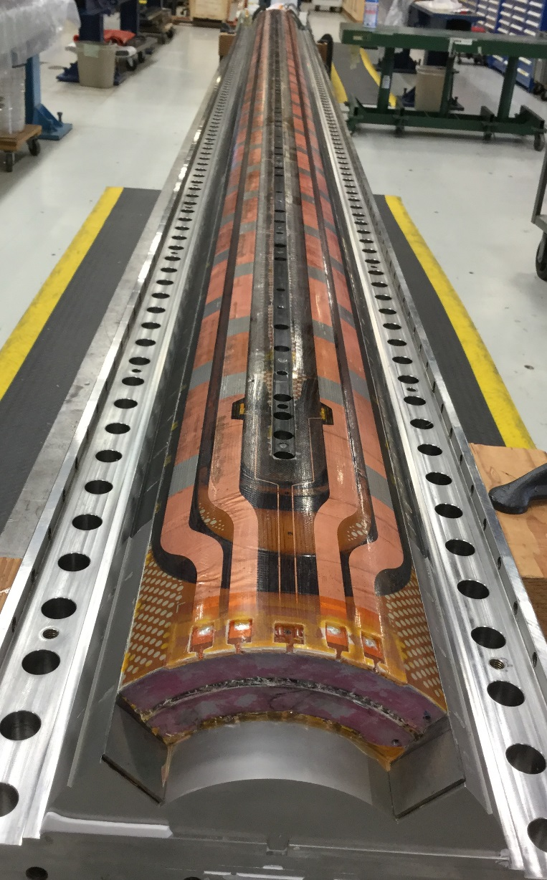
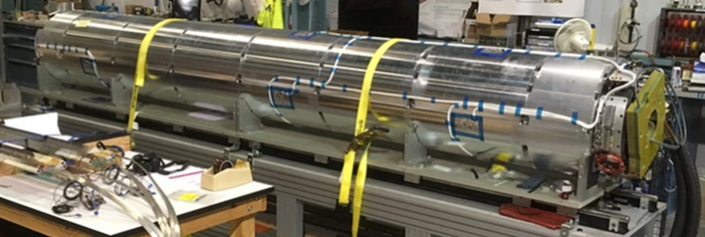
MQXFA Yield Assumptions and Actual
All magnet fabrication steps are at peak production rate
Yield assumptions based on LARP program:
 | Cable Fabr. & Insulation | Coil Fabrication | Total Coil Yield* | Magnet Vertical Test
Assumption | 90% |  | 87.5% | 80%
Actual | 92.1% | 87.2% | 84.5% | 80%
% complete | 73% | 55% |  | 25%
* Including magnet assembly and vertical test
Coil after epoxy impregnation
Fully assembled magnet

Slide 14
MQXFB at CERN
MQXFB magnets are too long for vertical test
Two MQXFB prototypes have been tested in temporary cryo-assembly:
  MQXFBP1 was limited around 15 kA due to degradation in the center of a coil
  MQXFBP2 reached ~nominal current w/o margin
In both magnets the cold-mass provided additional prestress to the coils;
➔ Cold-mass specifications were changed in order to minimize additional prestress
Assembly of third prototype is in progress

Slide 15
Main Lessons Learned
LARP used lower Hipot voltages than AUP
Estimate peak voltages as early as possible
Design Criteria were not finalized before Prototypes
Finalize Design Criteria (Structural, Electrical, …) as early as possible
“Learning curve” with low coil yield was longer than prototyping phase
Equipment changes from short to long coils and larger technician number may negatively affect coil yield in the early phase of production
G. Ambrosio et al., “Lessons learned from the prototypes of the MQXFA Low-Beta Quadrupoles for HL-LHC and status of production in the US”, IEEE Trans. Appl. Superconductivity, 2021, #4001105

Slide 16
LL: Step before Large Scale Production
Before scaling up production by one or two orders of magnitude an intense effort should be spent to develop 2nd generation Nb₃Sn coil fabrication technology for accelerator magnets,
Goal: Cost reduction
  Significant reduction of touch labor.
Automation may be part of the solution, nonetheless, preparation for this step will require significant effort and extended time.
  The development of the present technology took about 20 years.

Slide 17
Conclusions
The fabrication of MQXFA (HL-LHC low-beta) magnets by US-AUP is at peak production rate
Yields of magnets and sub-components are consistent with AUP assumptions
AUP is demonstrating that Nb₃Sn magnets are a viable option for particle accelerators
The development of 2nd generation Nb₃Sn coils & magnets is needed before large scale production

Slide 18
Back up Slides

Slide 19

Below the Surface…
Before MQXFA Pre-Series Magnets:
  Several Nb₃Sn quadrupoles magnets with bladder & Key structure by the LHC Accelerator Research Program (LARP)
  One MQXF short coil and one long coil tested in “mirror magnet” by LARP
  Five MQXFS short models, many re-assemblies and many tests by LARP/CERN/AUP (S1a/b/c/d/e) and CERN (S3a/b/c, S4a/b/c, S5, S6a/b/c)
  Two MQXFA prototypes and one re-assembly by LARP/AUP
  One MQXFB prototype by CERN

