Slide 1
CEF4 - Physics Education, Sijbrand de Jong, Sudhir Malik, Randy Ruchti Contributed Paper Working Groups
Career/Education
Meeting the Challenges and the Opportunities - Educational Preparation and Training for Particle Physics and Related Research and Technical Careers.
General Education – K/12 and Up
Rethinking Science and Mathematics in Secondary Education - Bridging of K/12 Education and Research Science.
Particle Physics Specific Education
Restructuring the Particle Physics Curriculum in Higher Education to meet Twenty-first Century Challenges.
Global Software Issues and HEP
Recasting Software and Computing Education to Drive Experimental and Theoretical Advances in Particle Physics.
Public Engagement and International Connections
Particle Physics Education Without Boundaries

Slide 2
CEF4/CP5
Topic: Public Engagement and International Connections
Review of International Engagement
Programs/Collaborations e.g. QuarkNet IPPOG, CERN REU, RET
Focus on value for U.S. high school students, undergraduates, teachers
Need examples from the community:
Do you know of additional REU/RET programs that offer international experiences?
Do you know of other similar teacher and student programs?
We want to include these if we can. Please share this information!
Static version of recent draft: http://cern.ch/go/fX9D
Email your examples to kcecire@nd.edu

Slide 3
CP3 Particle Physics Survey and Forum Main topic: What are the missing elements in current particle physics curriculums and how to improve it in the next decade?

Slide 4
Survey Goals & Outcomes
Goals (Undergrad and Grad) | Outcomes (Examples)
Students' satisfaction about overall physics/particle physics experience | How does it depend on type of institution? How does it vary with education/research quality?
formal skills (ex: academic coursework) technical skills (ex: computer programming) professional skills (ex: CV writing, presentations)* students are getting from their programs | Skills commonly attained and rarely attained Current medium/method to learn these skills What trainings should be added to the future curriculum?
career goals upon graduation Short-term (ex: grad school, industry, non-science) Long-term (intended careers) | Do students change their initial career plans/disciplines? How does this vary with their education quality and research exposure?
*Skills focused especially on those useful for particle physics careers.

Slide 5
Participants | Intention
Focus on Grad/Undergrad students from R1-Research Institutions Liberal Arts Colleges Community Colleges Public and Private Institutions | Hear the voice: Students’ satisfaction/struggling and urgent needs Education background’s influence on career choices
Encourage (early career) postdoc, faculty, researcher, and engineer participants | Learn from hindsight: What are the vital skills for career success?
Timeline | To-dos
Present | Testing/debugging Obtaining Berkeley IRB (Institutional Review Boards) approval for the survey
Late November (tentative) | Release survey
December 21 - January 22 | Data collection
Before March deadline | Finalize results and write paper
Please share the survey (when available) with your colleagues in other frontiers or at your institutions.
If you know of any mass communication lists that will reach undergrad-focused institutions, please let us know…this would be greatly appreciated.

Slide 6
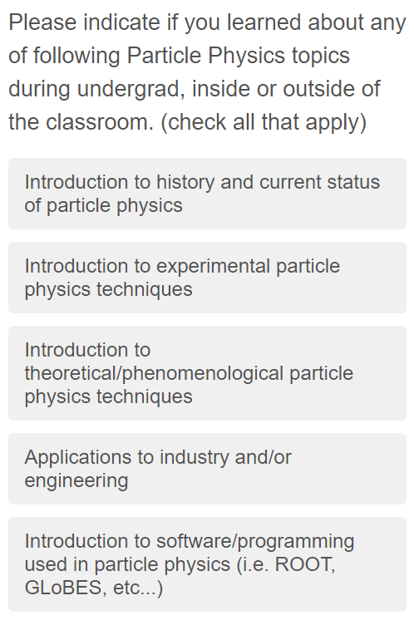
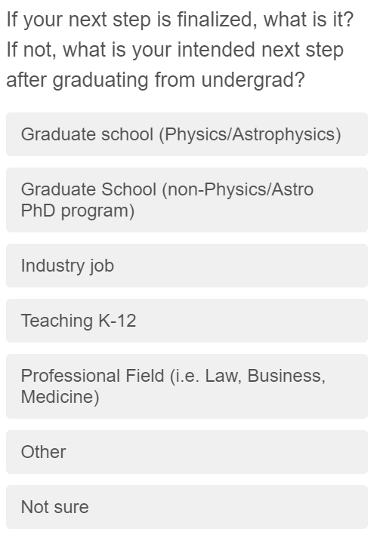
Sample Questions-Undergrad

Slide 7
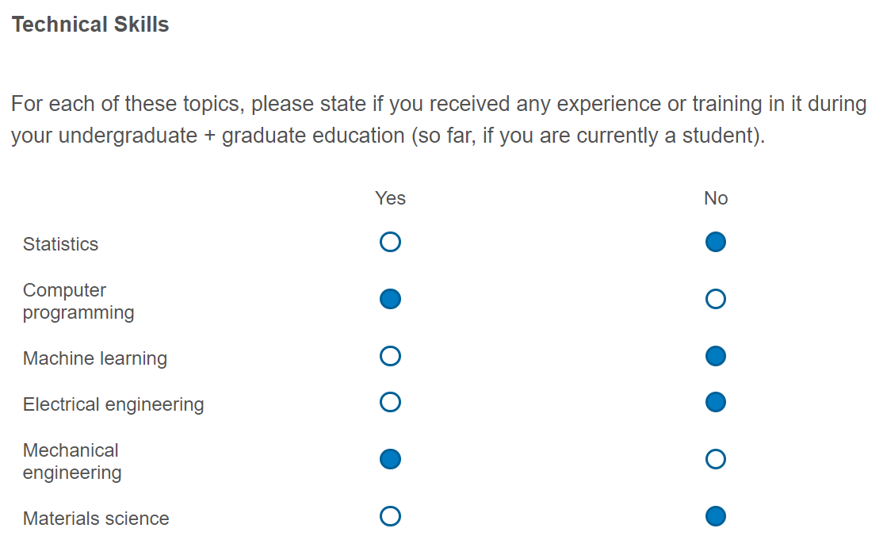
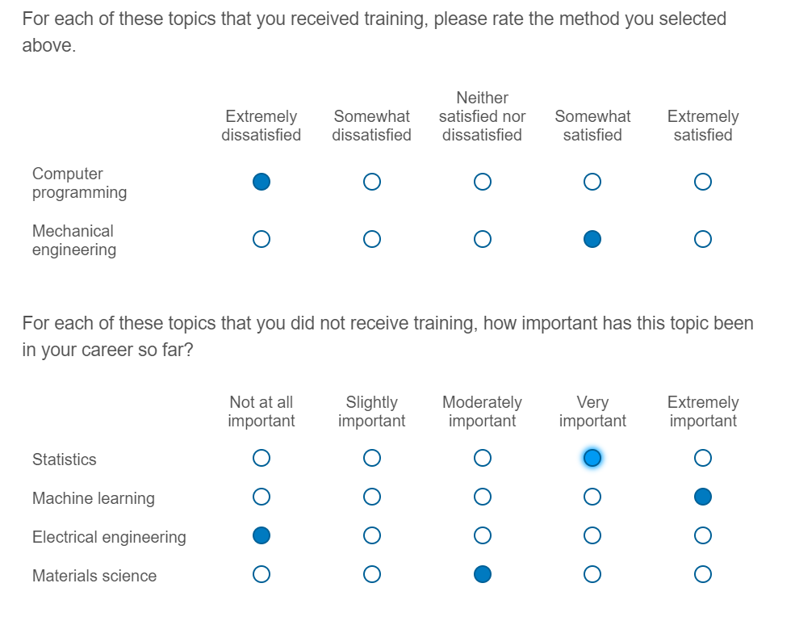
Sample Questions-Grad/Professionals*
*Postdocs, Faculty, Researchers, Engineers

Slide 8
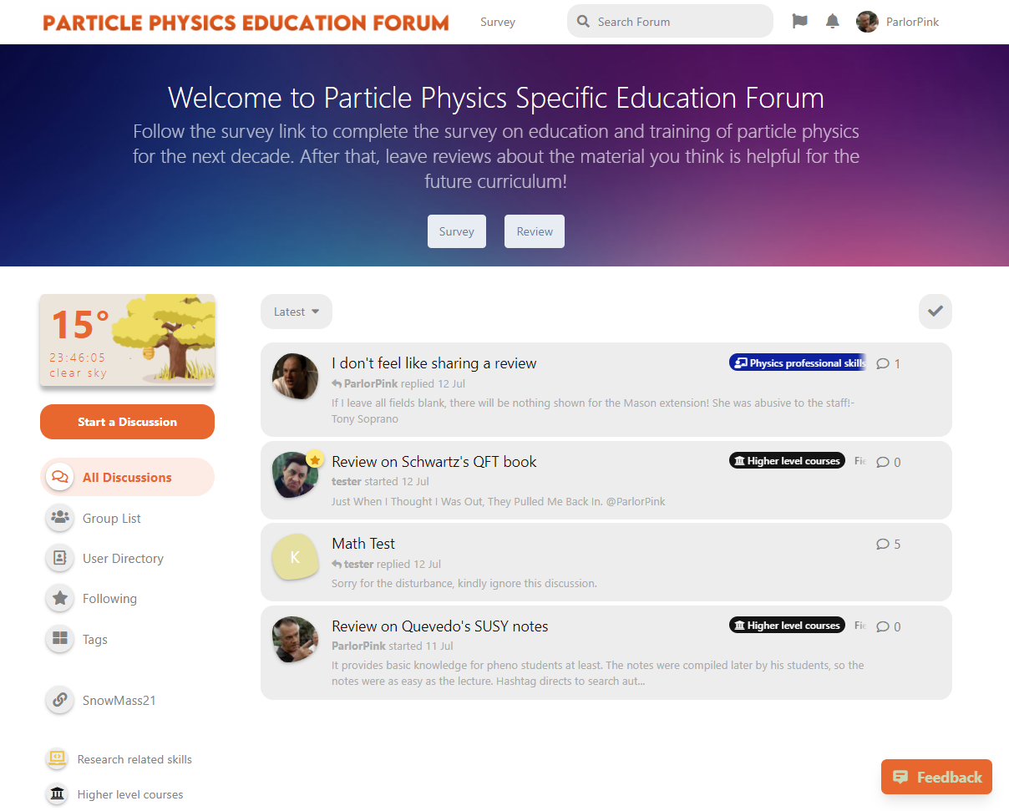
A companion forum
Single function
Goal: Form a “toolset” of materials to guide new curriculum designs
Ideal format: An up-to-date pool of materials, similar to –
Alternative format: A forum that launches with the survey, for maximum spreading
To-do: Seed the forum before launch
Promote survey
Rate professor
Rate/discuss materials

Slide 9
Group Discussion: Combination of CP1/CP4 issues Contribution from: M. Muether, Wichita State University
CP1 Career and Education – interested in discussion of Masters Degrees as a means of expanding career options in high energy physics and other scientific and technical domains and broadening participation.
Focus area: existing masters programs and their motivation, what works, what communities are served, career impact and new ideas.
Contacts: Sudhir Mahlik (malik@fnal.gov), Randy Ruchti (rruchti@nd.edu)
CP4, Global Software Issues and HEP – interested in discussion of interconnections and models of collaboration of between high energy physics and experts in Data Science.
Focus areas: existing programs and their motivation, what works, what communities are served, career impacts, sustainability of programs.
Contacts: Sudhir Mahlik (malik@fnal.gov), David DeMuth (david.demuth@vcsu.edu)

Slide 10
CEF4 - Physics Education, Sijbrand de Jong, Sudhir Malik, Randy Ruchti
For those interested or just curious:
We have weekly meetings, Tuesdays, 13:00ET with information that can be found on the Snowmass CEF4 Listserv:
https://listserv.fnal.gov/scripts/wa.exe?A0=SNOWMASS-COMMF-04-PHYS_EDU
We have a google drive with Contributed Paper information and content:
https://drive.google.com/drive/folders/1evkFhL5OV7k8FYR6YLlPvPE8liEumsXw

