Slide 1
MQXFA10 Coil Pack and Shimming Proposal
Dan Cheng, Katherine Ray, Paolo Ferracin, Mike Solis
Oct 8,2021
LBNL

Slide 2
Outline
Coil Selection Review Recap
Coil CMM Summary
Coil Matrix
Proposed Coil Pack and shimming
Summary

Slide 3
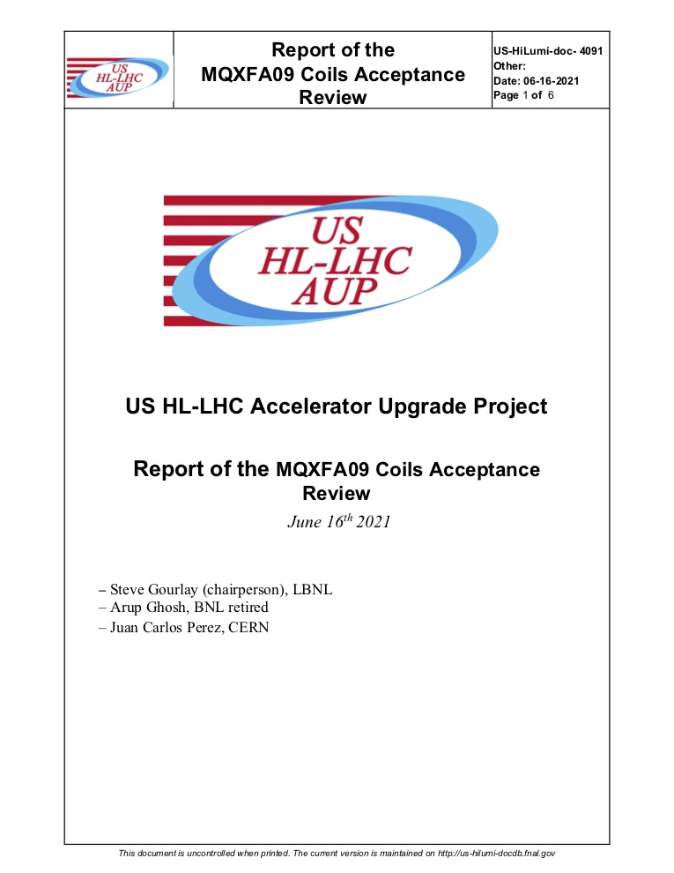
Coil Selection Review Report Summary
Coil Selection Review was held 08-Sep-2021
See https://indico.fnal.gov/event/50739/
Suggested that the use of Coil 220 wait until MQXFA07 is disassembled and limiting coil is examined, due to cable instabilities observed during coil fabrication
All coils have b6 correction
All electrical QC passed
Fabrication reports and CMM reported
OD and midplanes (arc length excess) all within specifications
Inner radial sizes out of tolerance in several locations in all coils except 221
No key slots out of tolerance

Slide 4
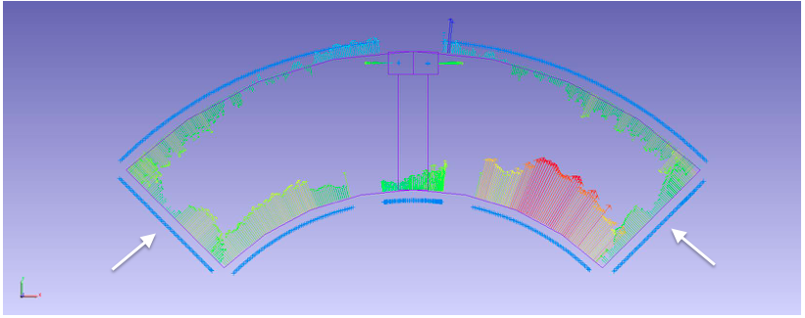
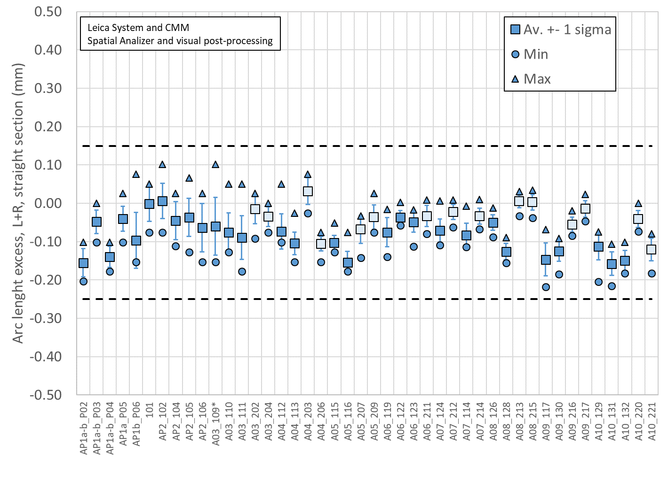
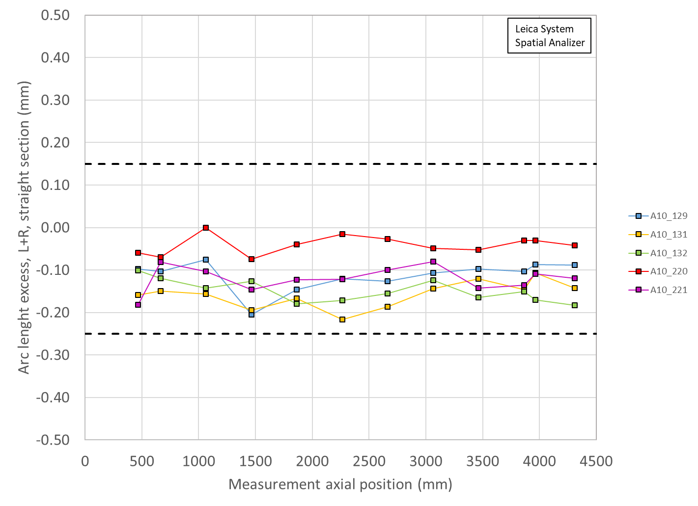
Total Arc Length Excess (Leica)
Depiction
Coil Selection Review Coil data shown at https://indico.fnal.gov/event/50739/
3965 mm is location of SG
129 ~50 µm smaller per side
131 ~50 µm smaller per side
132 ~75 µm smaller per side
220 ~10 µm (~nominal)
221 ~50 µm

Slide 5
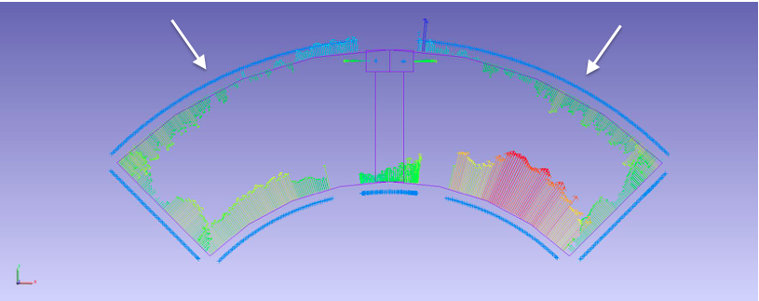
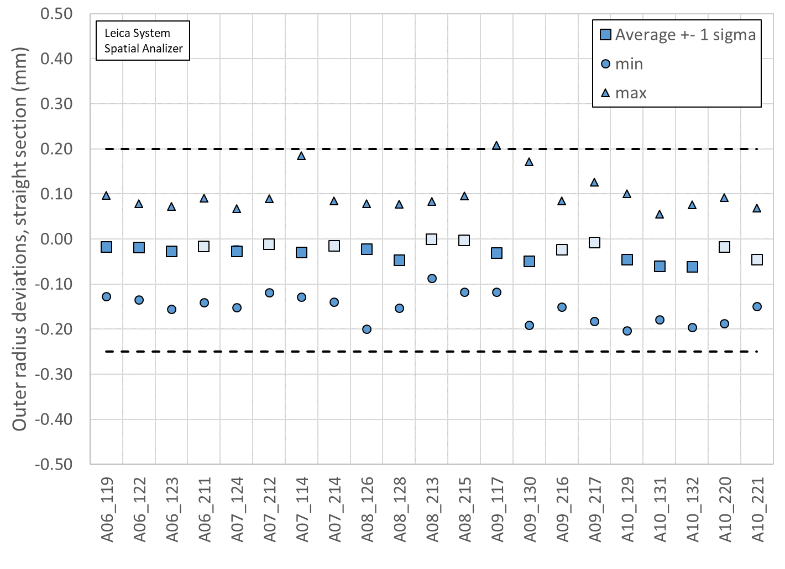
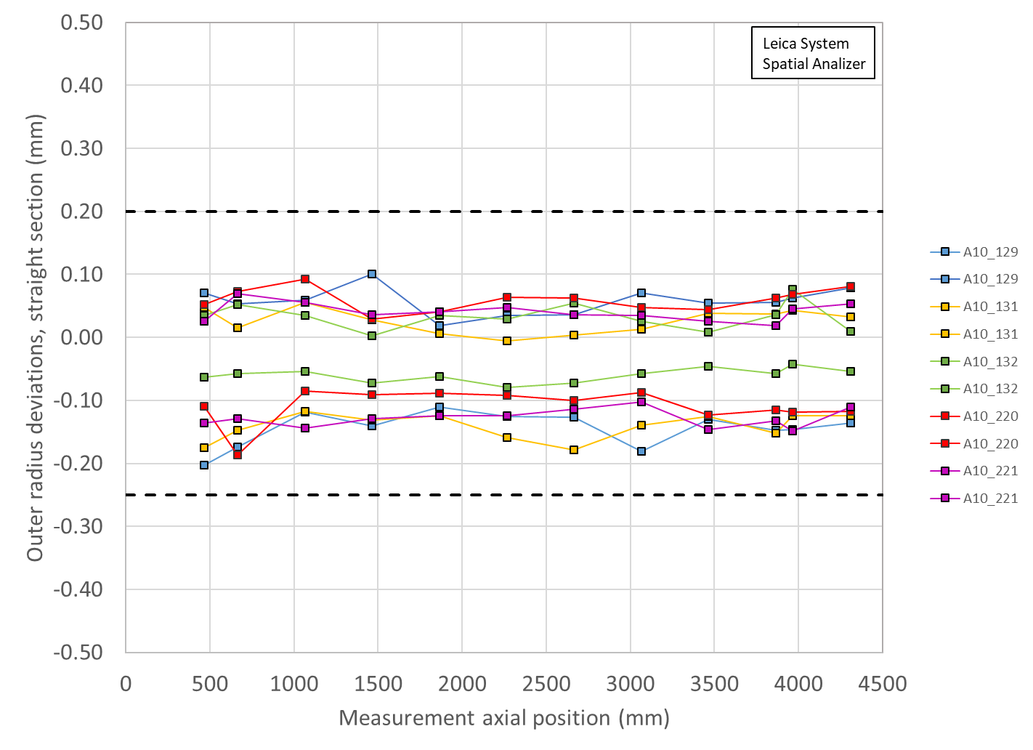
Outer Radius Profile Deviations (Leica)
Coil Selection Review Coil data shown at https://indico.fnal.gov/event/50739/
Depiction
Outer Radius deviation ranges are all similar among the coils

Slide 6
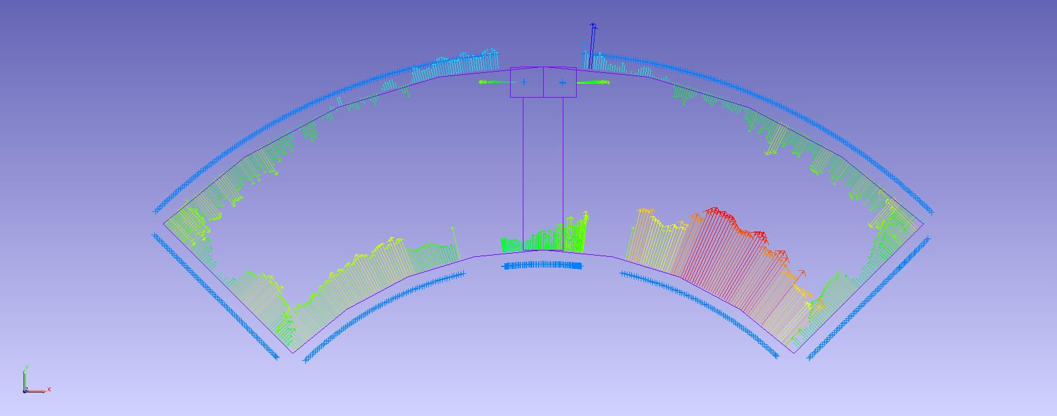
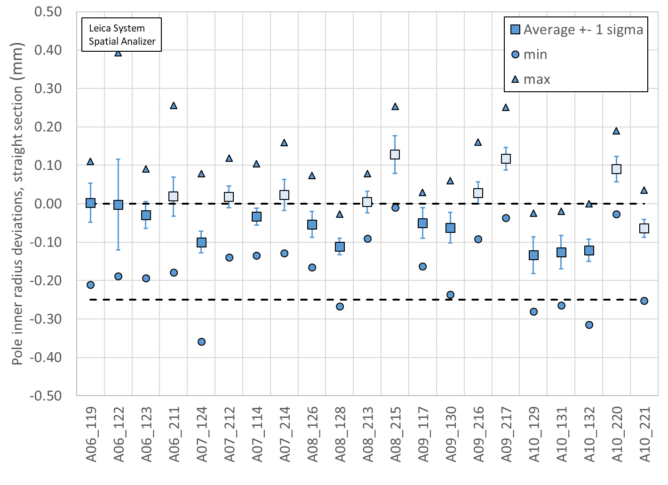
Pole Inner Radius Deviations (Pion Locations)
Coil Selection Review Coil data shown at https://indico.fnal.gov/event/50739/
Depiction
Inner Radius of the pole key is small (deviation into the bore) on Coils 220, and two places on 221

Slide 7
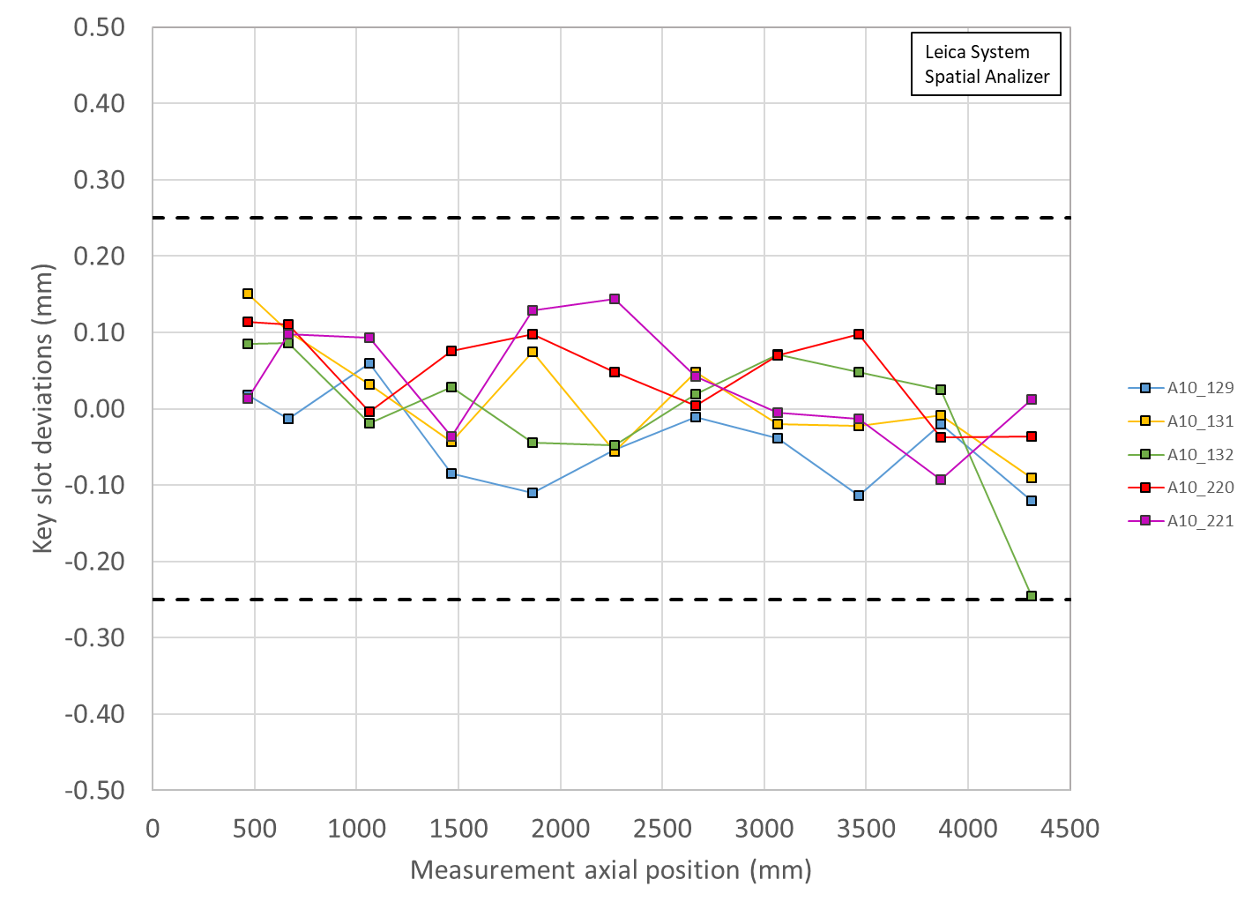
Keyway Offset
All coils showed keyway slots to be in spec

Slide 8
MQXFA10 Coils Matrix
Coil | b6 Corr. | Keyway shift | Pole Inner R Dev | Avg R Dev. | Avg. Midpl Dev./side
131 | Yes | Ok | ~120 µm under | ~-50 µm | ~-75 µm
129 | Yes | Ok | ~120 µm under | ~-50 µm | ~-50 µm
132 | Yes | Ok | ~120 µm under | ~-50 µm | ~-75 µm
220 | Yes | Ok | ~100 µm over | ~-20 µm | ~0µm
221 | Yes | Ok | ~50 µm under | ~-50 µm | ~-50 µm
Coil 220 Pole inner Radius shows deviation into the bore
OR: All coils are undersized
Avg. Midplane (arc length excess) are mostly ~50-75 µm small per side, with the exception of 220
LBNL measurements are using Leica system data

Slide 9
MQXFA10 Coils Matrix
Coil | b6 Corr. | Keyway shift | Pole Inner R Dev | Avg R Dev. | Avg. Midpl Dev./side
131 | Yes | Ok | ~120 µm under | ~-50 µm | ~-75 µm
129 | Yes | Ok | ~120 µm under | ~-50 µm | ~-50 µm
132 | Yes | Ok | ~120 µm under | ~-50 µm | ~-75 µm
220 | Yes | Ok | ~100 µm over | ~-20 µm | ~0µm
221 | Yes | Ok | ~50 µm under | ~-50 µm | ~-50 µm
Coil 220 Pole inner Radius shows deviation into the bore
OR: All coils are undersized
Avg. Midplane (arc length excess) are mostly ~50-75 µm small per side, with the exception of 220
LBNL measurements are using Leica system data

Slide 10
Acceptible coil orderings
There are 67 acceptable coil orderings with voltage < 353 V that are common for both rolled and minor edge RRR values (values reported for rolled RRR)
P1 | P2 | P3 | P4 | V
220 | 221 | 131 | 132 | 333
221 | 220 | 132 | 131 | 334
221 | 220 | 131 | 132 | 334
220 | 129 | 131 | 132 | 334
221 | 129 | 132 | 131 | 335
221 | 129 | 131 | 132 | 335
220 | 129 | 221 | 131 | 335
220 | 129 | 131 | 221 | 335
221 | 220 | 131 | 129 | 336
221 | 129 | 132 | 220 | 336
221 | 129 | 131 | 220 | 336
220 | 129 | 221 | 132 | 336
220 | 129 | 132 | 131 | 336
129 | 220 | 221 | 132 | 336
129 | 220 | 221 | 131 | 336
220 | 129 | 132 | 221 | 337
131 | 221 | 132 | 220 | 337
131 | 220 | 132 | 221 | 337
131 | 221 | 132 | 129 | 338
131 | 129 | 132 | 221 | 338
131 | 220 | 132 | 129 | 339
131 | 129 | 221 | 220 | 339
131 | 129 | 132 | 220 | 339
132 | 221 | 131 | 220 | 340
132 | 220 | 131 | 221 | 340
221 | 220 | 132 | 129 | 341
P1 | P2 | P3 | P4 | V
131 | 132 | 221 | 129 | 341
221 | 131 | 220 | 129 | 342
220 | 131 | 221 | 132 | 342
132 | 129 | 131 | 221 | 342
131 | 132 | 221 | 220 | 342
129 | 221 | 220 | 131 | 342
221 | 129 | 220 | 131 | 343
132 | 221 | 131 | 129 | 343
132 | 131 | 221 | 220 | 343
132 | 131 | 221 | 129 | 343
131 | 129 | 221 | 132 | 343
131 | 129 | 220 | 221 | 343
132 | 129 | 131 | 220 | 344
131 | 220 | 221 | 132 | 344
221 | 132 | 220 | 129 | 345
132 | 220 | 221 | 131 | 345
132 | 129 | 221 | 131 | 345
129 | 220 | 132 | 131 | 345
220 | 221 | 132 | 131 | 346
220 | 132 | 221 | 131 | 346
132 | 220 | 131 | 129 | 346
221 | 129 | 220 | 132 | 347
132 | 129 | 221 | 220 | 347
129 | 221 | 220 | 132 | 347
129 | 220 | 132 | 221 | 347
129 | 132 | 220 | 221 | 347
P1 | P2 | P3 | P4 | V
132 | 220 | 221 | 129 | 349
132 | 129 | 220 | 221 | 349
131 | 132 | 220 | 129 | 349
129 | 132 | 220 | 131 | 349
221 | 132 | 131 | 220 | 350
221 | 131 | 132 | 220 | 350
132 | 221 | 220 | 129 | 350
132 | 131 | 220 | 129 | 351
132 | 129 | 220 | 131 | 352
129 | 221 | 132 | 131 | 352
129 | 132 | 221 | 131 | 352
12 Configurations available with Coil 220 as the spare
Only one Configuration with Coils 221 and 132 as upper pair. These are the coils with largest ID deviations into bore.
These coils will also have FBG gauges installed

Slide 11
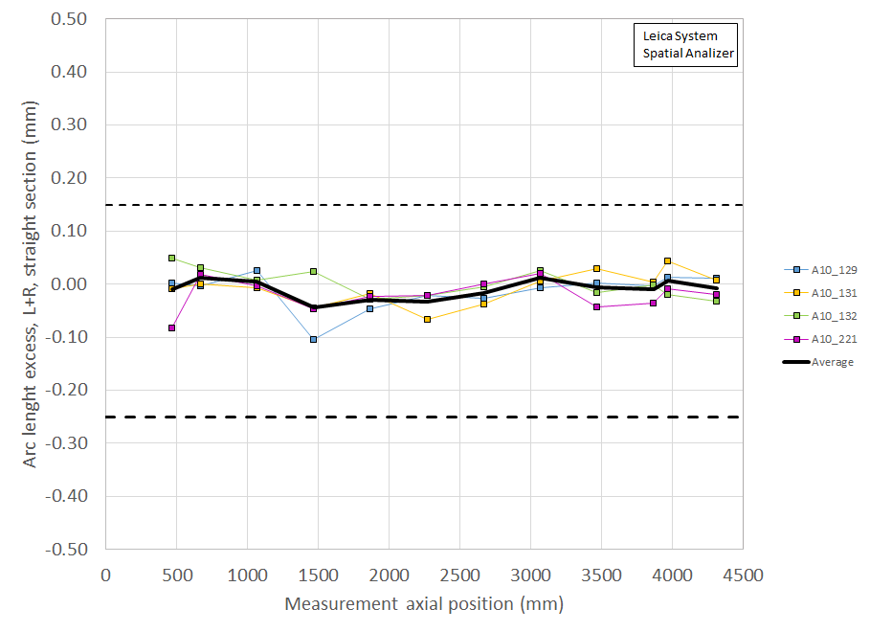
Coil Size estimates with midplane shims
Coil measurement plots created to show the effect of adding shims to each midplane of Coils 129, 131, 132, 221
Unshimmed
Shimmed 0.002” on each midplane for
coils 221 and 129;
0.003” on each midplane for
coils 131 and 132

Slide 12
MQXFA10 Proposed Coil Arrangement
8 x δ_{midplane} = 2 π x δR_{OR}
~0.002” Undersized R
neglected
~.002” Undersized per Midpl.
Neglected
Add 0.002” shim per side
~0.002” Undersized R
Neglected
~0.003” Undersized per Midpl.
Neglected
Add 0.003” shim per side
221
132
Q2
Q1
Q3
Q4
131
129
~-.002” Undersized R
Neglected
~-.003” Undersized per Midpl.
Add 0.003” shim per side
~.002” Undersized R
Neglected
~0.002” Undersized per midpl.
Add 0.002” shim per side
Coil Electrical Order: A :132 – 129 – 221 – 131: B
Conforms to a favorable order based on RRR data
(see Indico page for info)

Slide 13
MQXFA10 Coil Pack Build 1 (Fuji)
Nominal Collar R: 114 mm
Nominal Coil R: 113.376 mm
Nominal Radial shim = 0.025” (0.624 mm)
But we still target ~0.020”
Fuji radial stack up is ~0.021” (~0.54 mm)
0.0045” Coil GPI + 0.007” Fuji + 0.005” Kapton & 0.005” G11
Add 0.002” to 221, 129 midplanes
Add 0.003” to 131, 132 midplanes
 | 132 | 221 | 131 | 129
Kapton Ground plane insulation | 0.0045” (0.114 mm)
Coil Specific Radial Shim | 0 | 0 | 0 | 0
Coil-specific midplane shim | 0.003” 0.075 mm | 0.002” 0.050 mm | 0.003” 0.075 mm | 0.002” 0.050 mm
Fuji paper | 0.007” (0.175 mm)
Radial Shim | 0.005” Polyimide + 0.005” G11 (~0.25 mm)

Slide 14
MQXFA10 Coil Pack Build (Final)
Nominal Collar R: 114 mm
Nominal Coil R: 113.376 mm
Nominal Radial shim = 0.025” (0.624 mm)
But we still target ~0.020”
Actual radial stack up is ~0.020” (~0.51 mm)
0.0045” Coil GPI + 0.005” Kapton + 0.005” Kapton & 0.005” G11
Add 0.002” to 221, 129 midplanes
Add 0.003” to 131, 132 midplanes
 | 132 | 221 | 131 | 129
Kapton Ground plane insulation | 0.0045” (0.114 mm)
Coil Specific Radial Shim | 0 | 0 | 0 | 0
Coil-specific midplane shim | 0.003” 0.075 mm | 0.002” 0.050 mm | 0.003” 0.075 mm | 0.002” 0.050 mm
Fuji paper | 0.000” (0.0 mm)
Radial Shim | 0.005” Polyimide + 0.005” Polyimide + 0.005” G11 (~0.38 mm)

Slide 15
Summary
Coil 220 will be the spare
Coils 129, 131, 132, 221 chosen for MQXFA10
Coils 129, 221 will have 0.002” midplane shims added
Coils 131, 132 will have 0.003” midplane shims added
Coil 221, 132 will be upper coils due to less critical pion interface with upper coils
Coil circuit order is 132-129-221-131
Conforms to a favorable order based on RRR data

Slide 16
Additional Slides

