Slide 1


MQXFA10 Structure and Status
Dan Cheng, for the AUP team
8-Oct-2021
LBNL

Slide 2
MQXFA08 Structure Assembly
Coil Pack Assembly Plans
Pion machining
Preload Assembly Operations
Status and Expected Completion

Slide 3
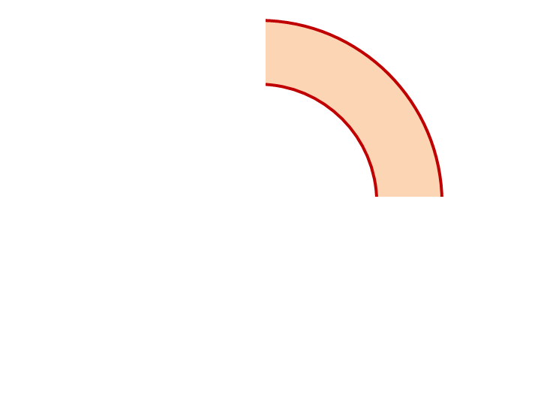
MQXFA10 Proposed Coil Arrangement
8 x δ_{midplane} = 2 π x δR_{OR}
~0.002” Undersized R
neglected
~.002” Undersized per Midpl.
Neglected
Add 0.002” shim per side
~0.002” Undersized R
Neglected
~0.003” Undersized per Midpl.
Neglected
Add 0.003” shim per side
221
132
Q2
Q1
Q3
Q4
131
129
~-.002” Undersized R
Neglected
~-.003” Undersized per Midpl.
Add 0.003” shim per side
~.002” Undersized R
Neglected
~0.002” Undersized per midpl.
Add 0.002” shim per side
Coil Electrical Order: A :132 – 129 – 221 – 131: B
Conforms to a favorable order based on RRR data
(see Indico page for info)

Slide 4
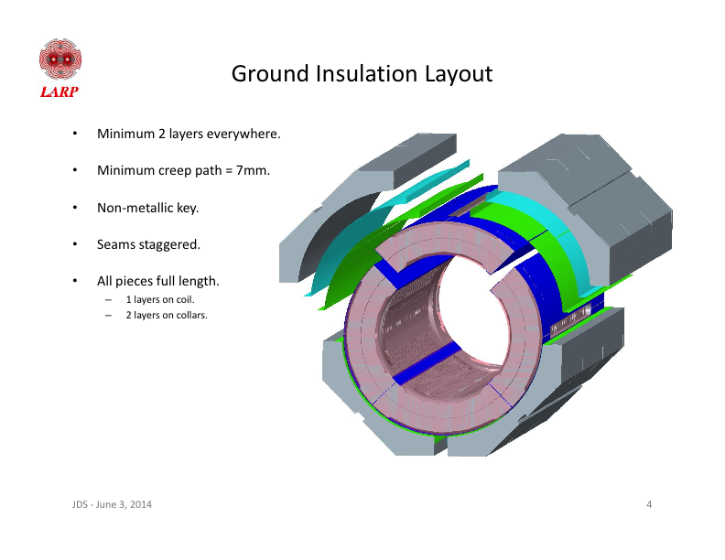
MQXFA10 Coil Pack Build 1 (Fuji)
Nominal Collar R: 114 mm
Nominal Coil R: 113.376 mm
Nominal Radial shim = 0.025” (0.624 mm)
  But we still target ~0.020”
Fuji radial stack up is ~0.021” (~0.54 mm)
  0.0045” Coil GPI + 0.007” Fuji + 0.005” Kapton & 0.005” G11
Add 0.002” to 221, 129 midplanes
Add 0.003” to 131, 132 midplanes
 | 132 | 221 | 131 | 129
Kapton Ground plane insulation | 0.0045” (0.114 mm)
Coil Specific Radial Shim | 0 | 0 | 0 | 0
Coil-specific midplane shim | 0.003” 0.075 mm | 0.002” 0.050 mm | 0.003” 0.075 mm | 0.002” 0.050 mm
Fuji paper | 0.007” (0.175 mm)
Radial Shim | 0.005” Polyimide + 0.005” G11 (~0.25 mm)

Slide 5
MQXFA10 Coil Pack Build (Final)
Nominal Collar R: 114 mm
Nominal Coil R: 113.376 mm
Nominal Radial shim = 0.025” (0.624 mm)
  But we still target ~0.020”
Actual radial stack up is ~0.020” (~0.51 mm)
  0.0045” Coil GPI + 0.005” Kapton + 0.005” Kapton & 0.005” G11
Add 0.002” to 221, 129 midplanes
Add 0.003” to 131, 132 midplanes
 | 132 | 221 | 131 | 129
Kapton Ground plane insulation | 0.0045” (0.114 mm)
Coil Specific Radial Shim | 0 | 0 | 0 | 0
Coil-specific midplane shim | 0.003” 0.075 mm | 0.002” 0.050 mm | 0.003” 0.075 mm | 0.002” 0.050 mm
Fuji paper | 0.000” (0.0 mm)
Radial Shim | 0.005” Polyimide + 0.005” Polyimide + 0.005” G11 (~0.38 mm)

Slide 6
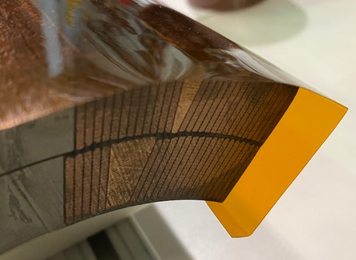
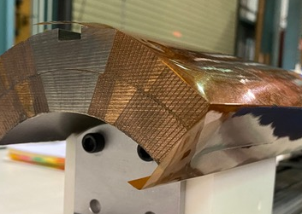
Fuji Assembly Notes (1)
GPI Layers will have 2 folds
  Kapton GPI will be folded in the ID of the magnet as well
  Process developed and incorporated into MQXFA07 and later coils

Slide 7
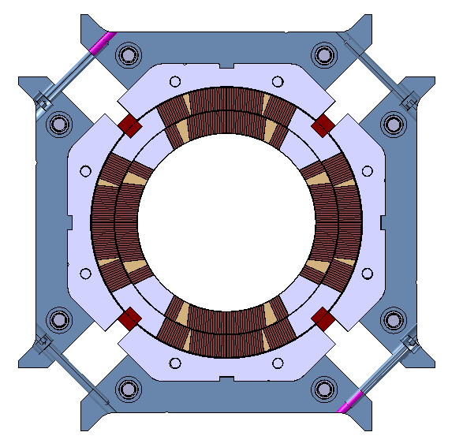
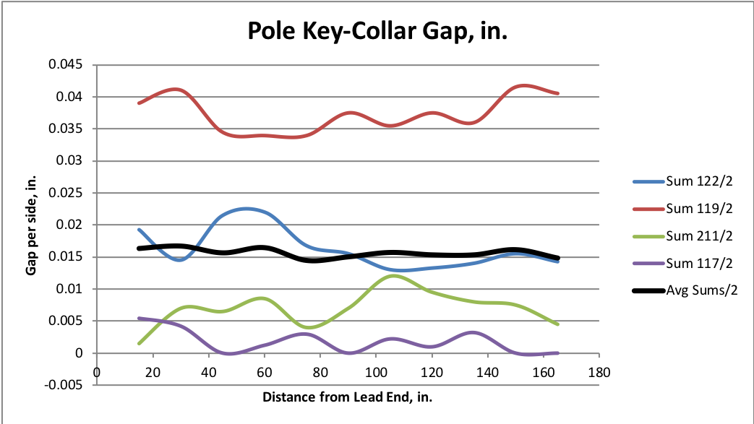
Fuji Assembly Notes (2)
The Fuji paper build, along with mechanical measurements, is an important QC check in the coil pack build, but the following notes apply:
  Some mechanical measurements may not be square due to not shifting/squaring up pads
    Standard torque values achieved, but we avoid sliding surfaces which may cause inaccurate Fuji exposures
  Gaps will be larger
    The Kapton radial shim will only be partially present, therefore the expected average pole key gap will be ~0.015” larger than that of the final build
Large gaps
Large gaps
Q2
Q1
Q3
Q4
Small gaps
Small gaps
Depiction not to scale
MQXFA06 Fuji Gaps

Slide 8
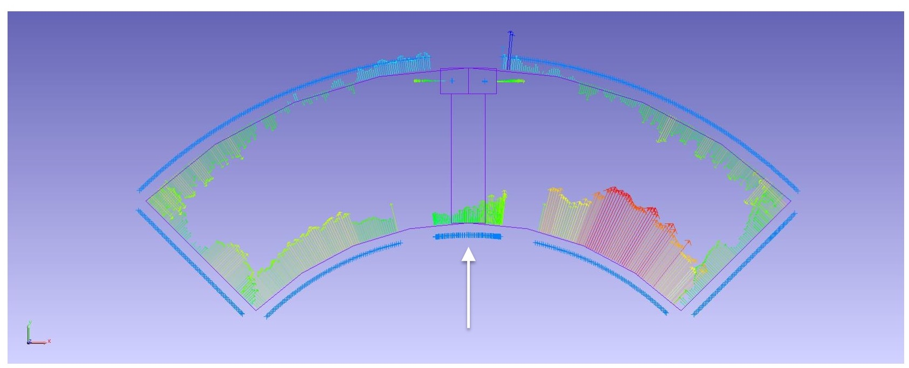
Pion Machining, Details
Used “average” values as starting point
  Measurements based on best-fit of combined Outer Radius and Midplane deviations
Positive deviations = extra material in bore
  This is what needs to be removed from a nominal 1.2 mm thick pion
Negative deviations will not require “addition” of material
  Nothing will be done to these pions
For MQXFA10 only one pion needs to be modified from nominal

Slide 9
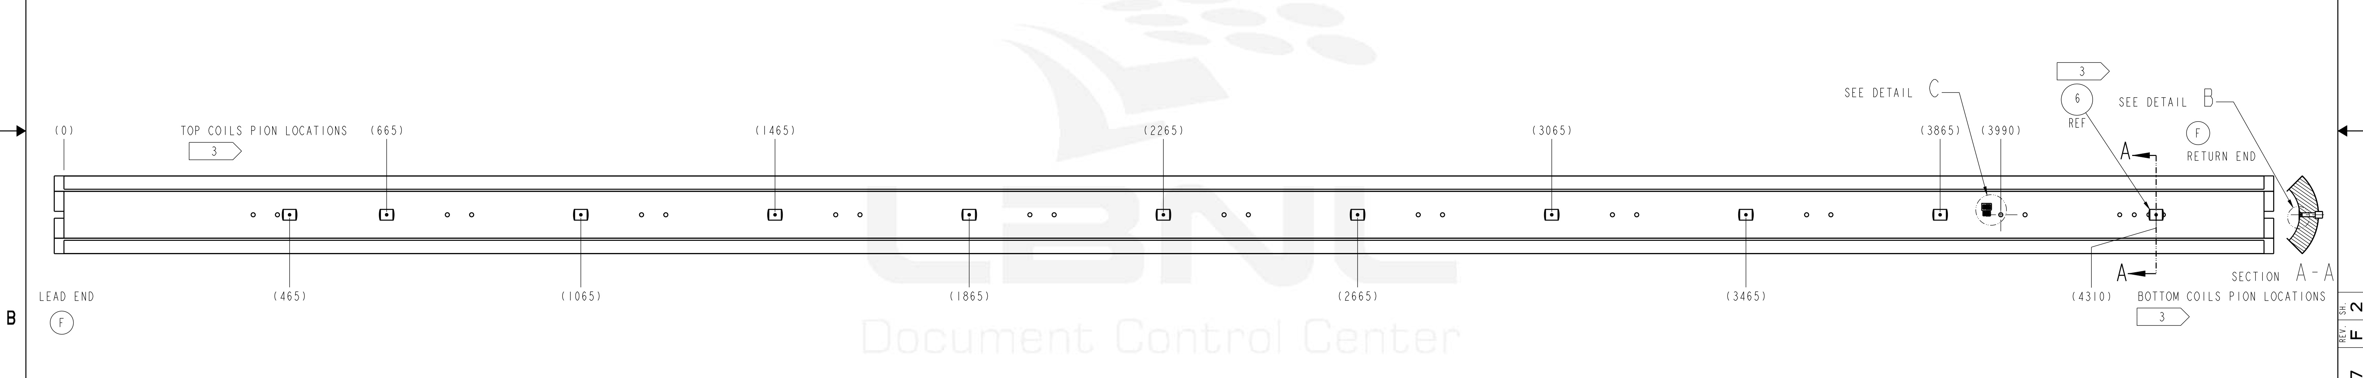
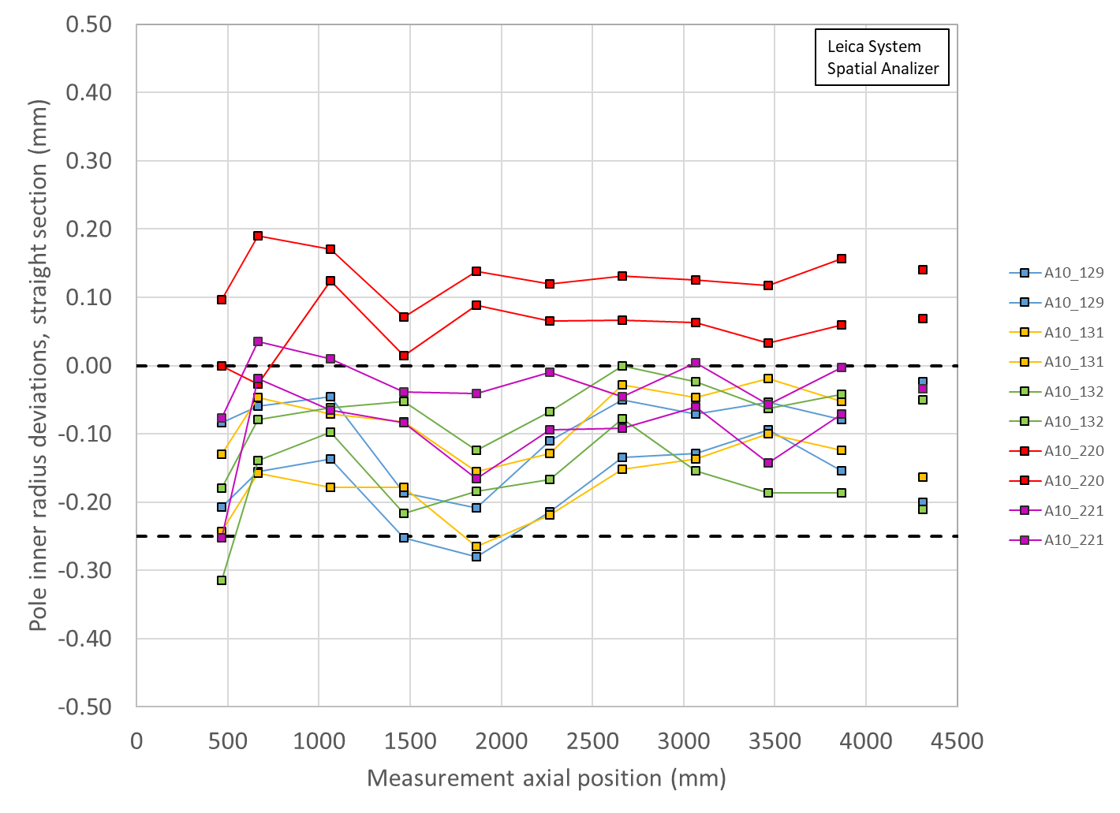
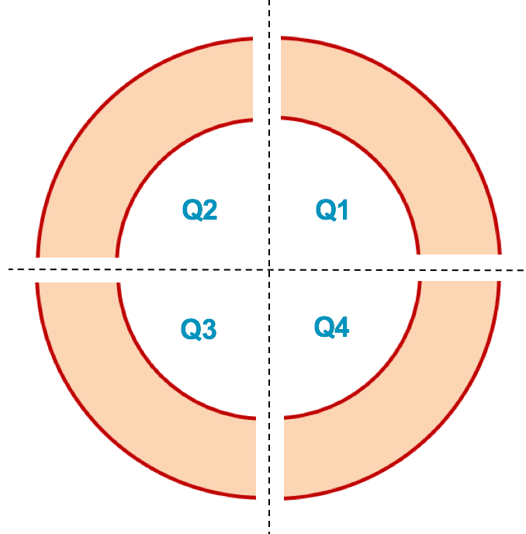
Pion Machining Positions
Upper Coils, Pion thickness (mm)
Loc. | 665 | 1465 | 2265 | 3065 | 3865
132 | 1.2 | 1.2 | 1.2 | 1.2 | 1.2
221 | 1.15 | 1.2 | 1.2 | 1.2 | 1.2
Lower Coils, Pion thickness (mm)
Loc. | 465 | 1065 | 1865 | 2665 | 3465 | 4310
131 | 1.2 | 1.2 | 1.2 | 1.2 | 1.2 | 1.2
129 | 1.2 | 1.2 | 1.2 | 1.2 | 1.2 | 1.2
Upper Coils
Upper Coils
221 132
Lower Coils
Lower Coils
131 129

Slide 10
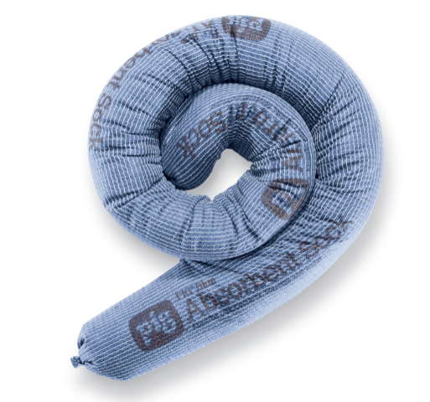
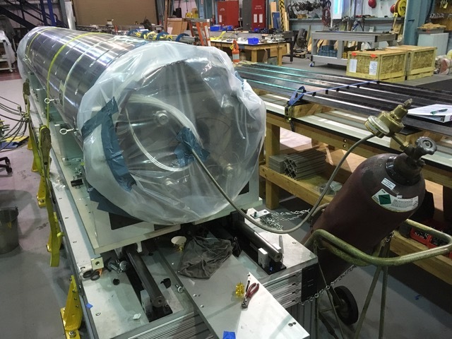
Avoiding Electrical Issues
Updated procedures first used in magnet MQXFA05 will continue to be used
  Avoiding water in the system due to bladder failures
    Absorbent socks in cooling holes to better dam and prevent pooling of water
    Dehumidifiers on hand during bladder operations to bag and flow immediately after operations are complete
    Increase load key step sizes to 0.005” (reduces the number of bladder cycles)
  NOTE: Dehumidifier (along with absorbent socks) was used on MQXFA08, which experienced 50% bladder failures; EQC tests passed without issue
3” dia. absorbent sock

Slide 11
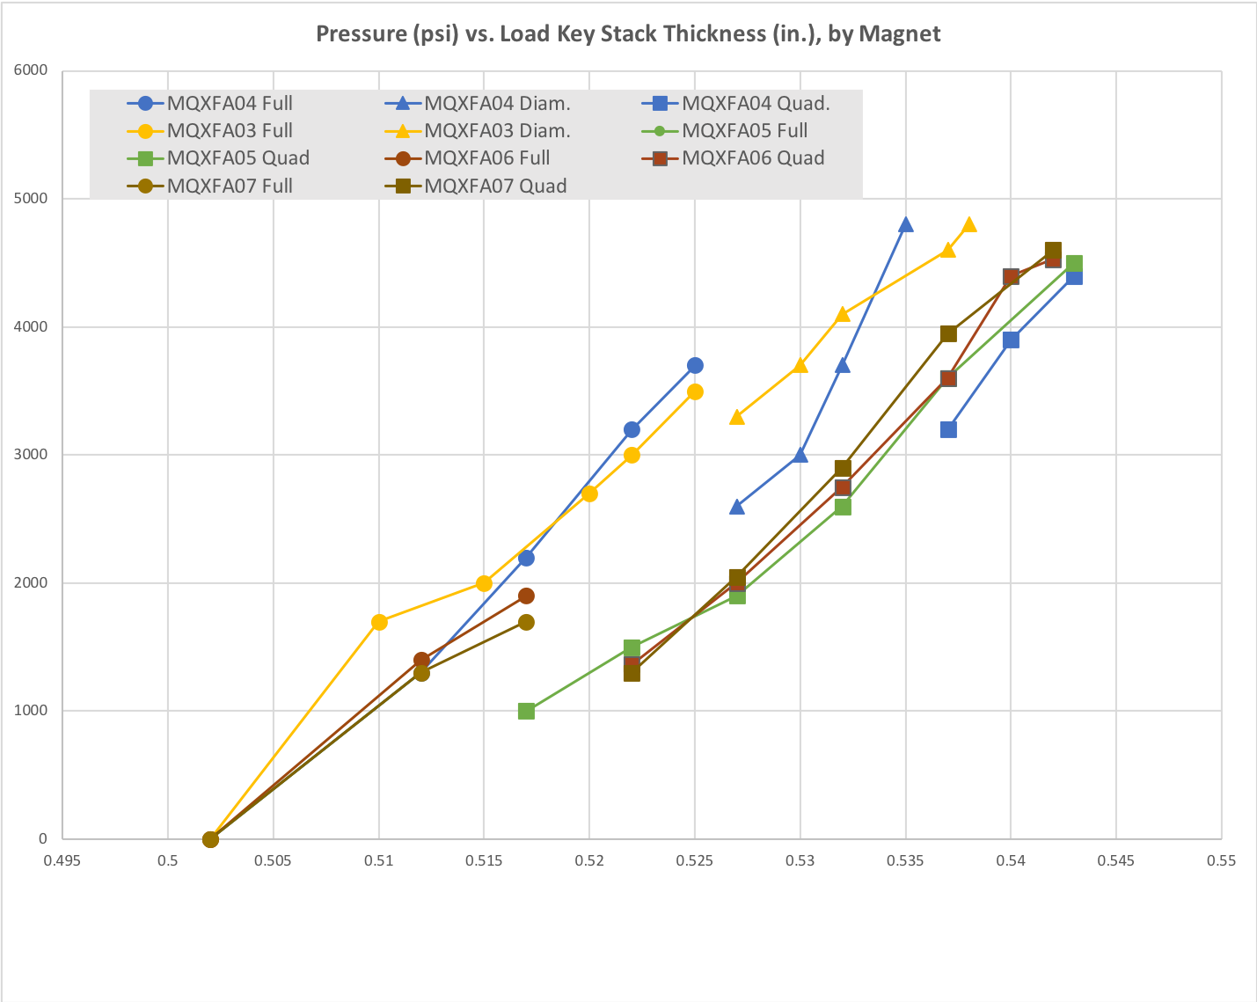
Reducing Bladder Cycles
Based on the bladder failure/load key incident experienced in MQXFA04 we successfully introduced procedural changes starting with MQXFA05
Magnet preload operations will continue to implement the following:
  A pressure check at the beginning of operations
  A “stable hold” at target pressures
  Fewer pressure cycles by using 0.005” thick shim steps (about 8 steps expected)
  Spare keys on hand to replace as needed, and/or second set of keys ready to replace
50% Azimuthal load
Starting with MQXFA06 an additional 0.005” step was added using all bladders before transitioning to quadrant loading.
MQXFA09 will continue following that experience

Slide 12
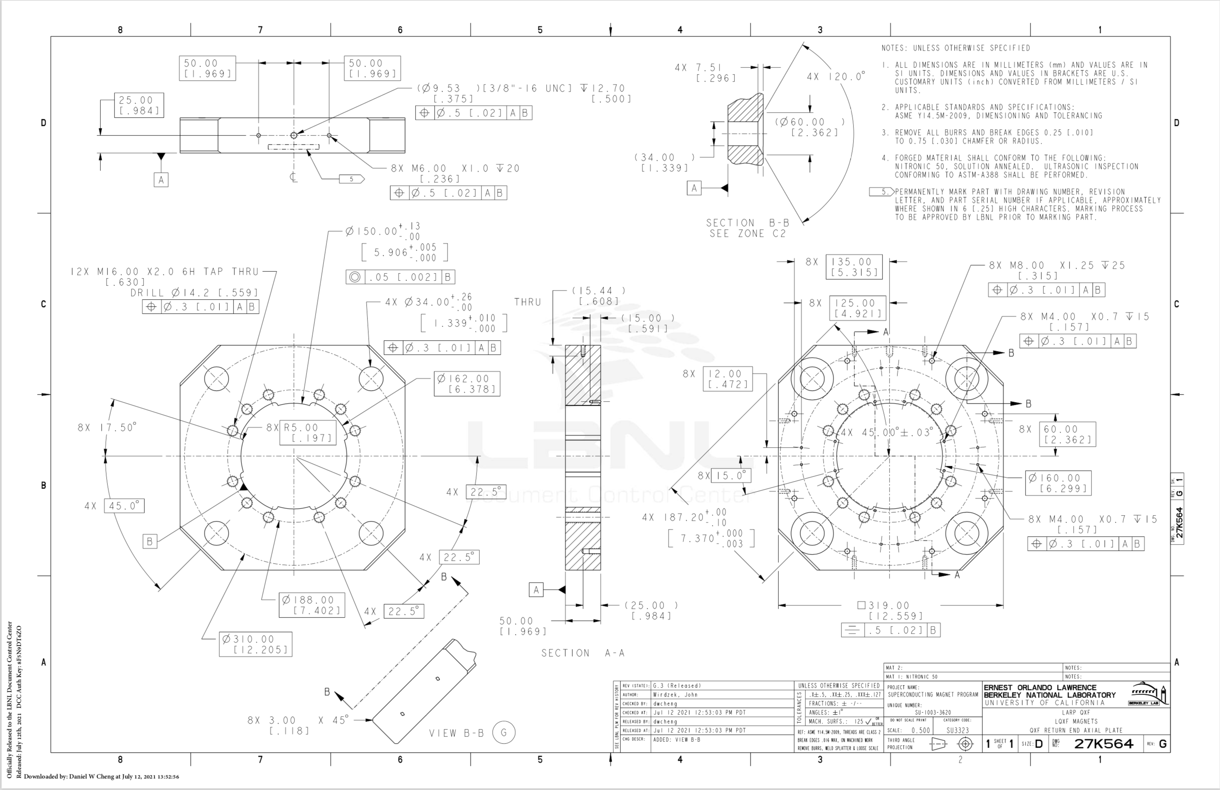
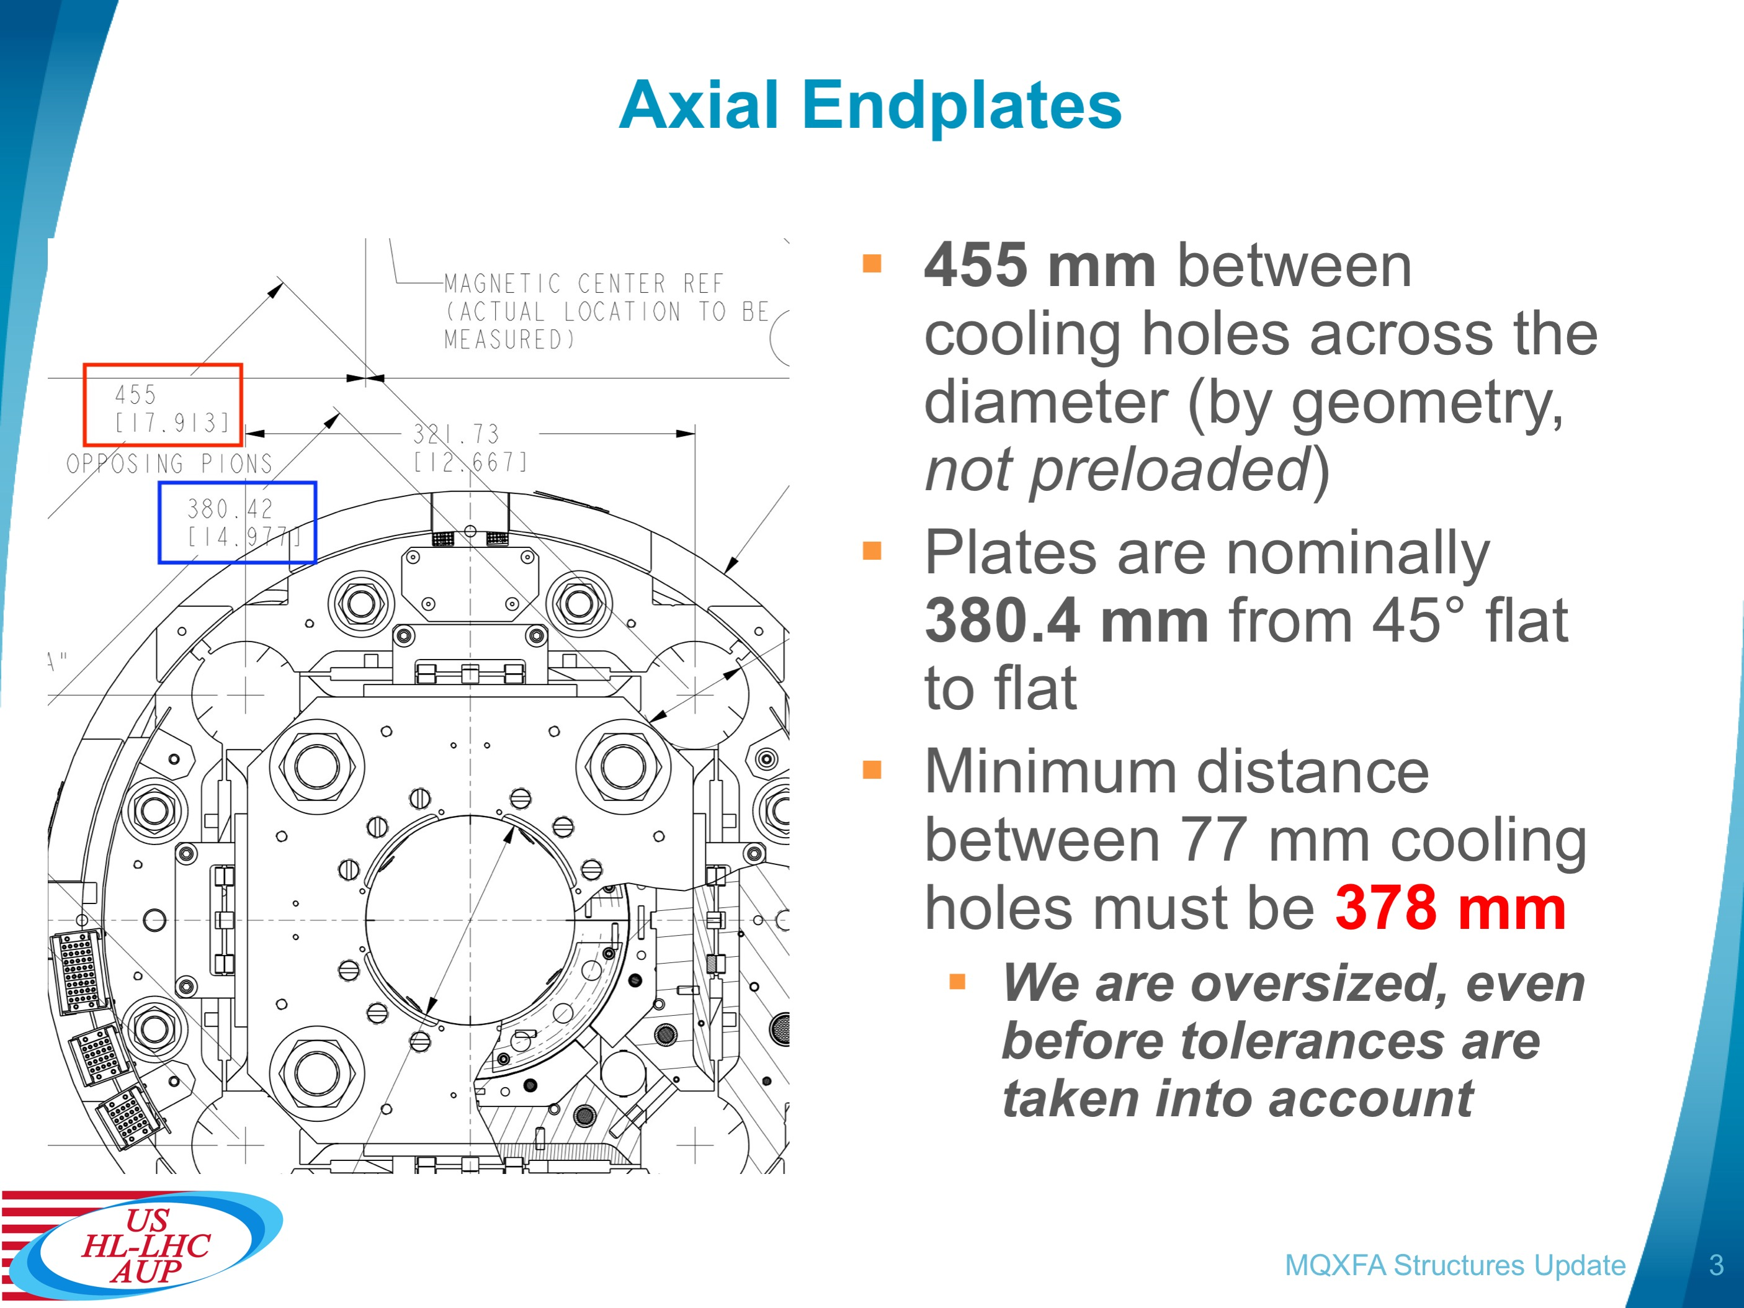
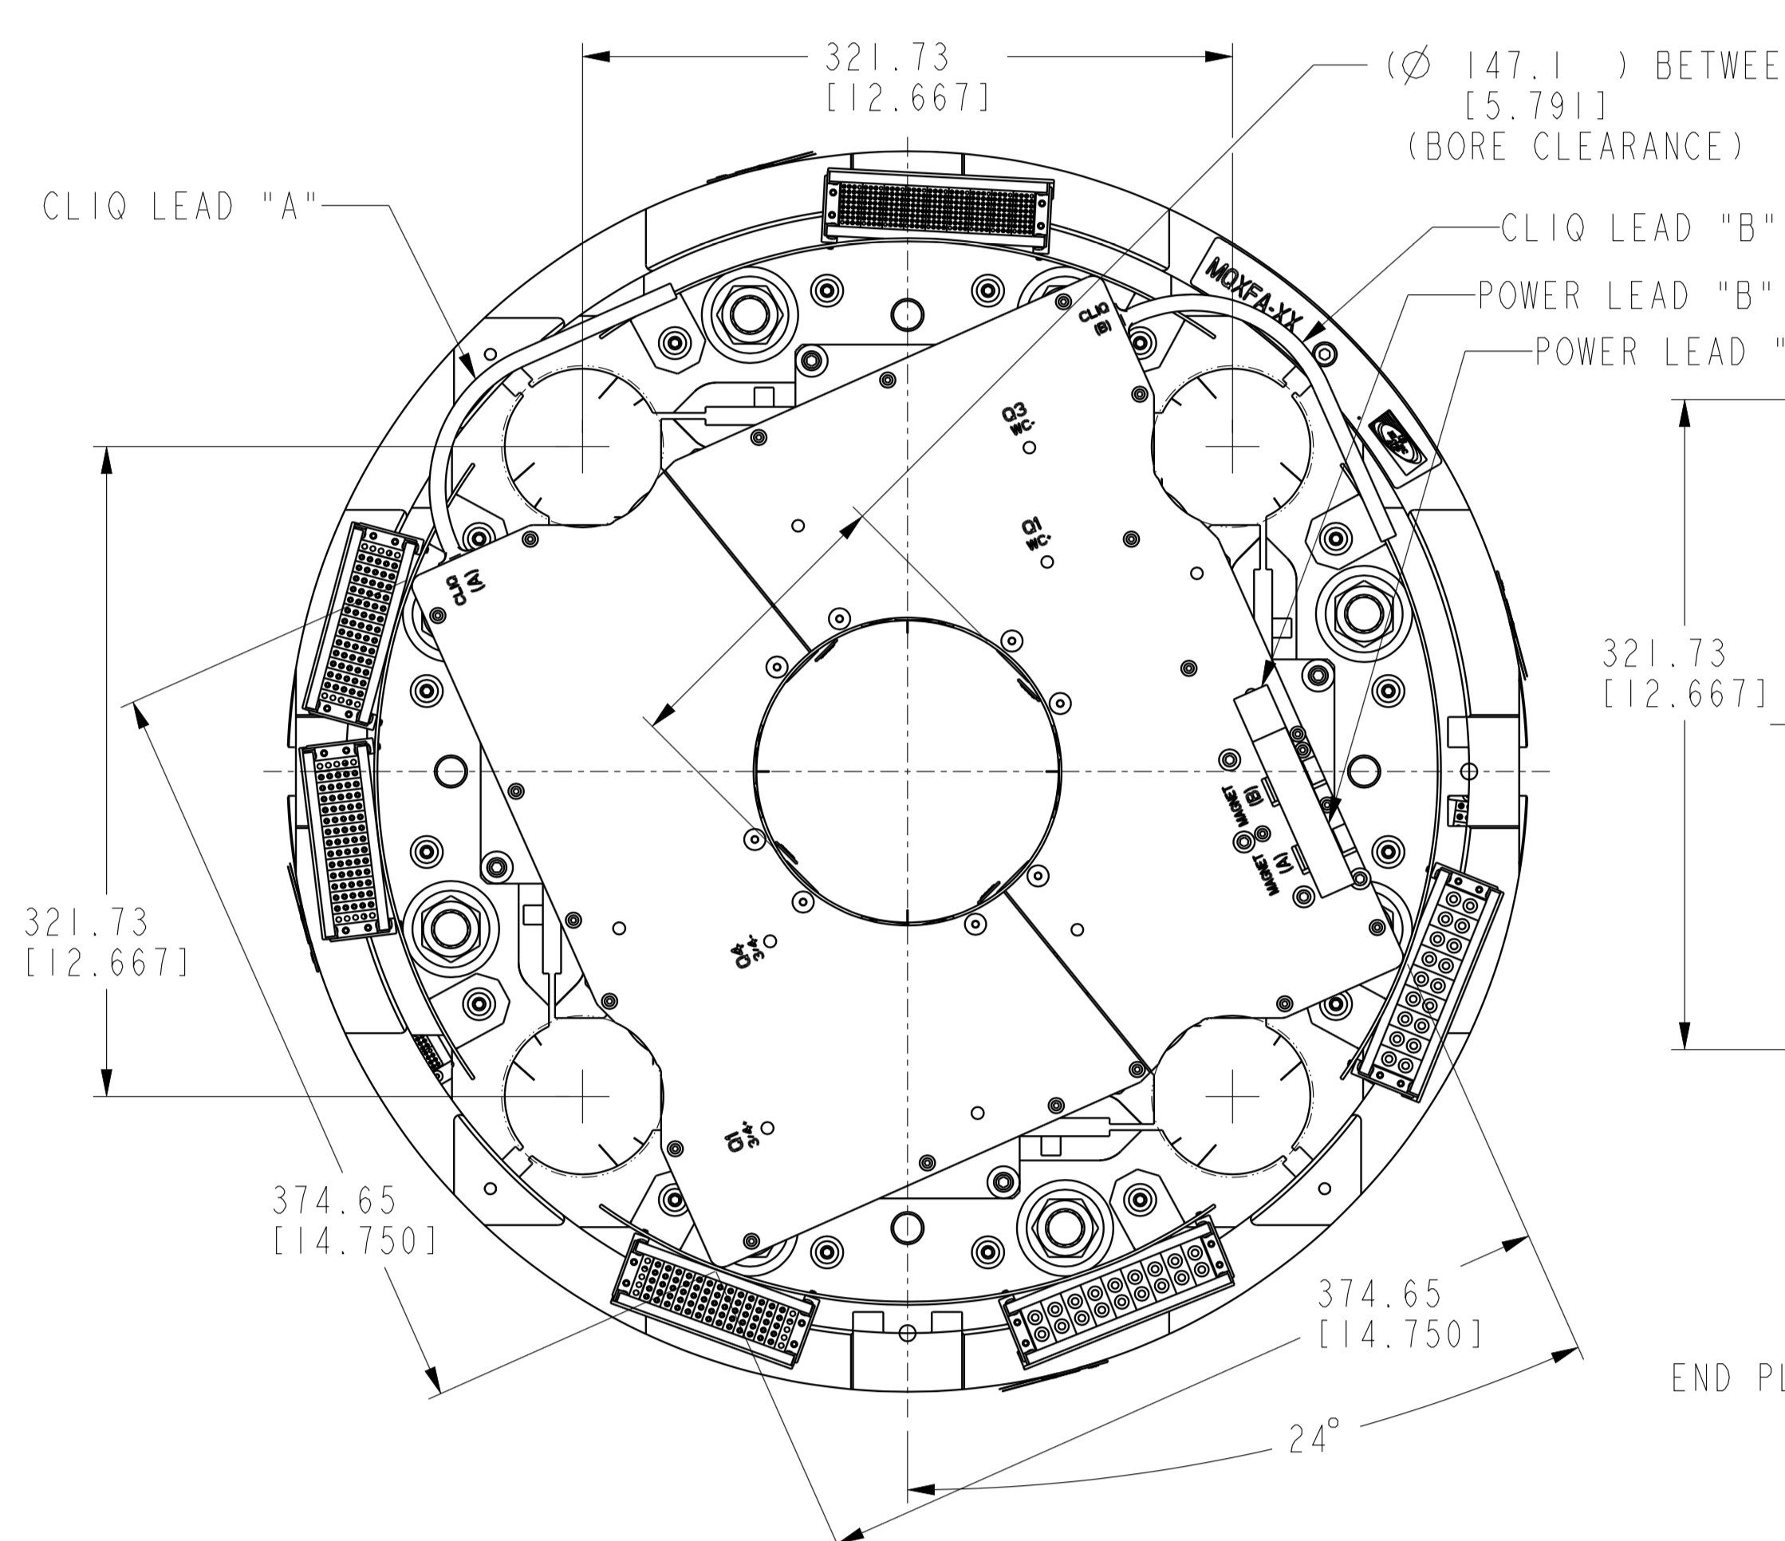
Heat Exchanger Interference Modifications
Interference with the axial endplates and the splice box was discovered at FNAL during cold mass assembly
  https://indico.fnal.gov/event/49413/
Endplates and splice box were modified

Slide 13
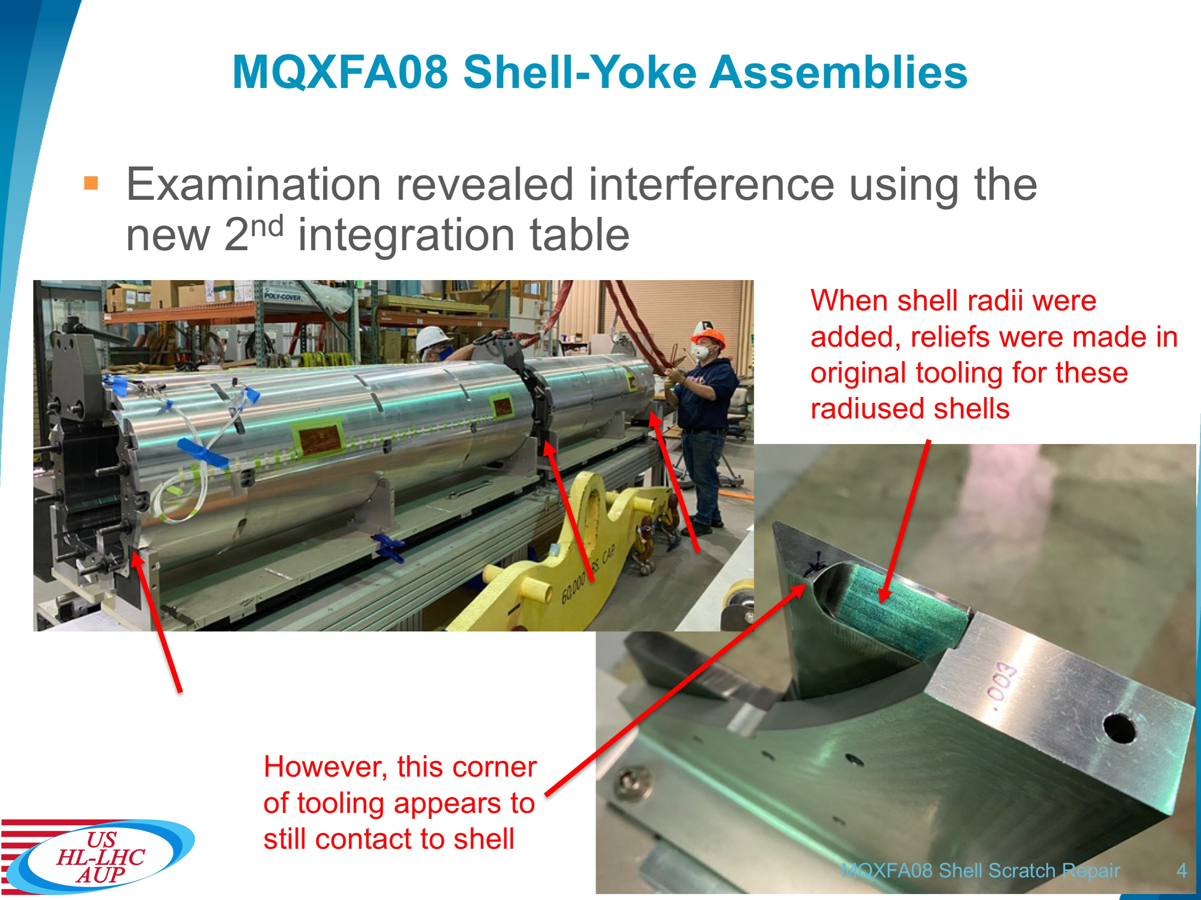
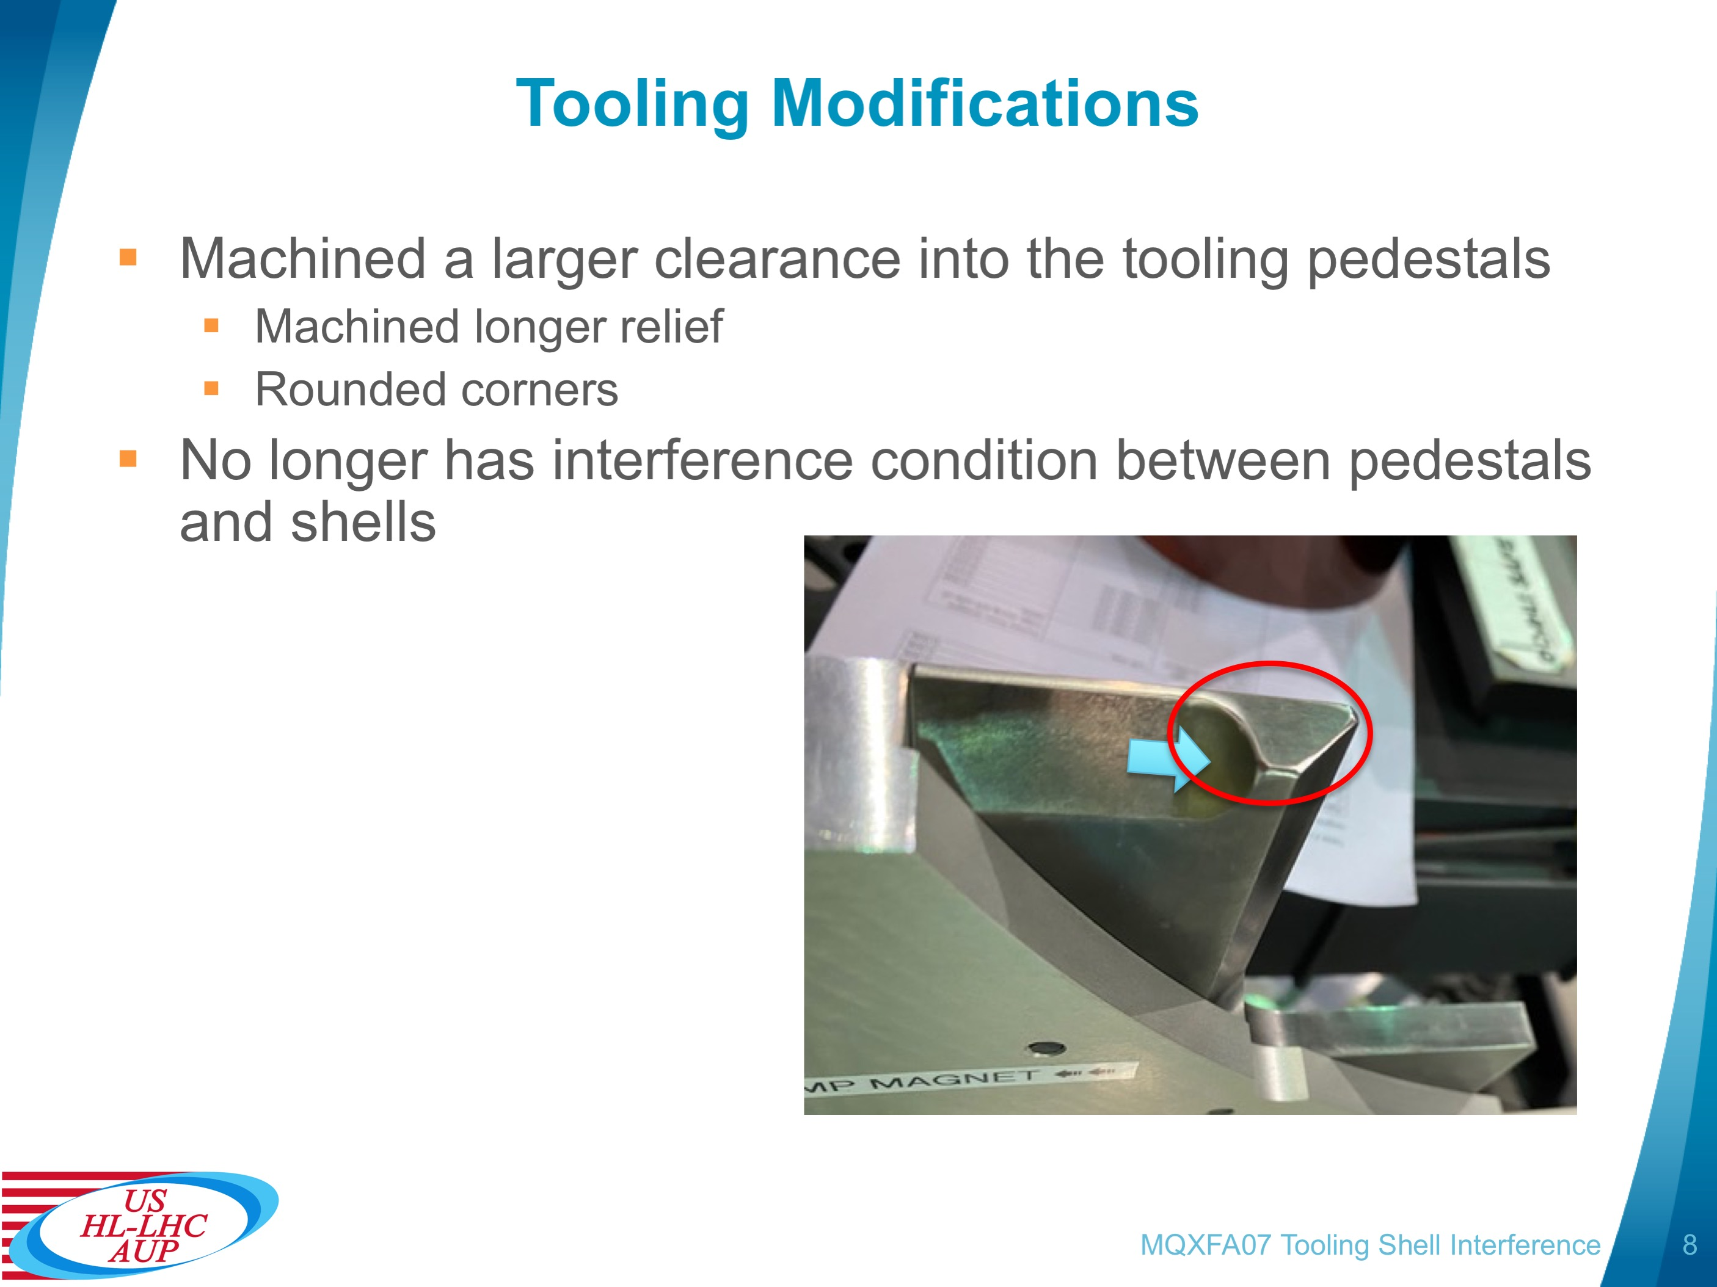
Integration Table Interference Modifications
During the survey of the new magnet integration table with MQXFA08 shell-yoke assemblies an interference was found in the tooling that contacted the radii of the shells
Pedestal supports were machined and dressed to ensure clearance and no further contact to the shells

Slide 14
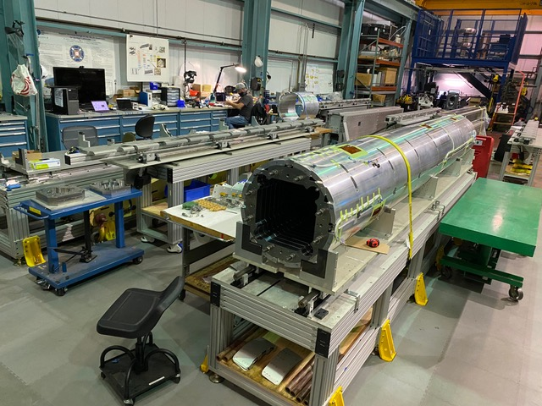
MQXFA10 Structure Status
All parts have arrived
  Shells & rods have been instrumented
  Axial loading components on site
  Yoke pre-stacks completed, RE shell yoke assembly
  Pad pre-stacks and collars (arriving from off-site)
  Master Keys (arriving from off-site)
Coils
  129, 131, 132, 221; 220 is spare
  SG instrumented, GPI’d, midplanes attached
  Instrumenting FBG strain gauges prior to coil pack build
2nd magnet assembly line will be used for MQXFA10 (MQXFA09 occupies 1st assembly table)
Both magnets can be worked on concurrently
Second Magnet assembly line
First Magnet assembly line
(MQXFA09)

Slide 15
Projected Schedule for Completed Assembly
MQXFA09 is being assembled
  Coil pack is being inserted into shell-yoke structure
  To be shipped early November, after delays
MQXFA10 assembly has started
  Balance of structure parts on site next week
  Expected to complete magnet early December

Slide 16
Summary
Coils are dressed
  Fiber optic strain gauges will be installed on two coils prior to coil pack assembly
MQXFA10 parts are on site and arriving from offsite storage
Coil 220 is the spare coil
Pion locations identified that require modification
MQXFA10 will continue the use of techniques that were successfully applied in MQXFA05-08 Preventing significant moisture (affecting electrical QC)
  Also prevents a repeat of a partially inserted load key
MQXFA10 is expected to be completed early December while MQXFA09 is being assembled

Slide 17
Additional Slides

Slide 18
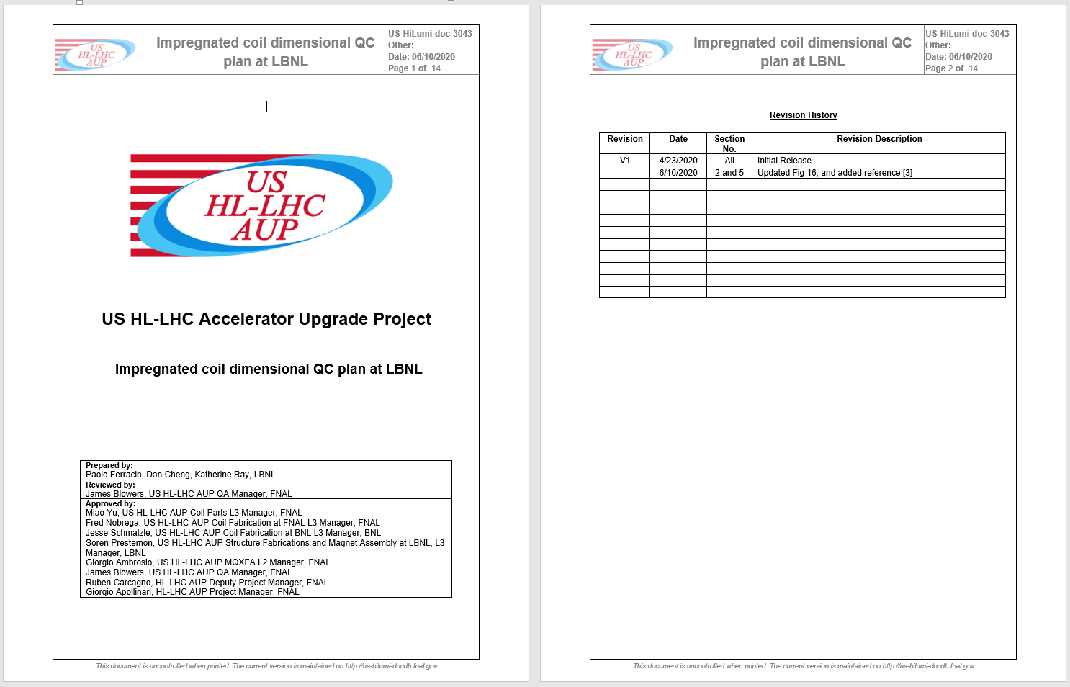
Impregnated coil dimensional tolerances
(for series coils)

Slide 19
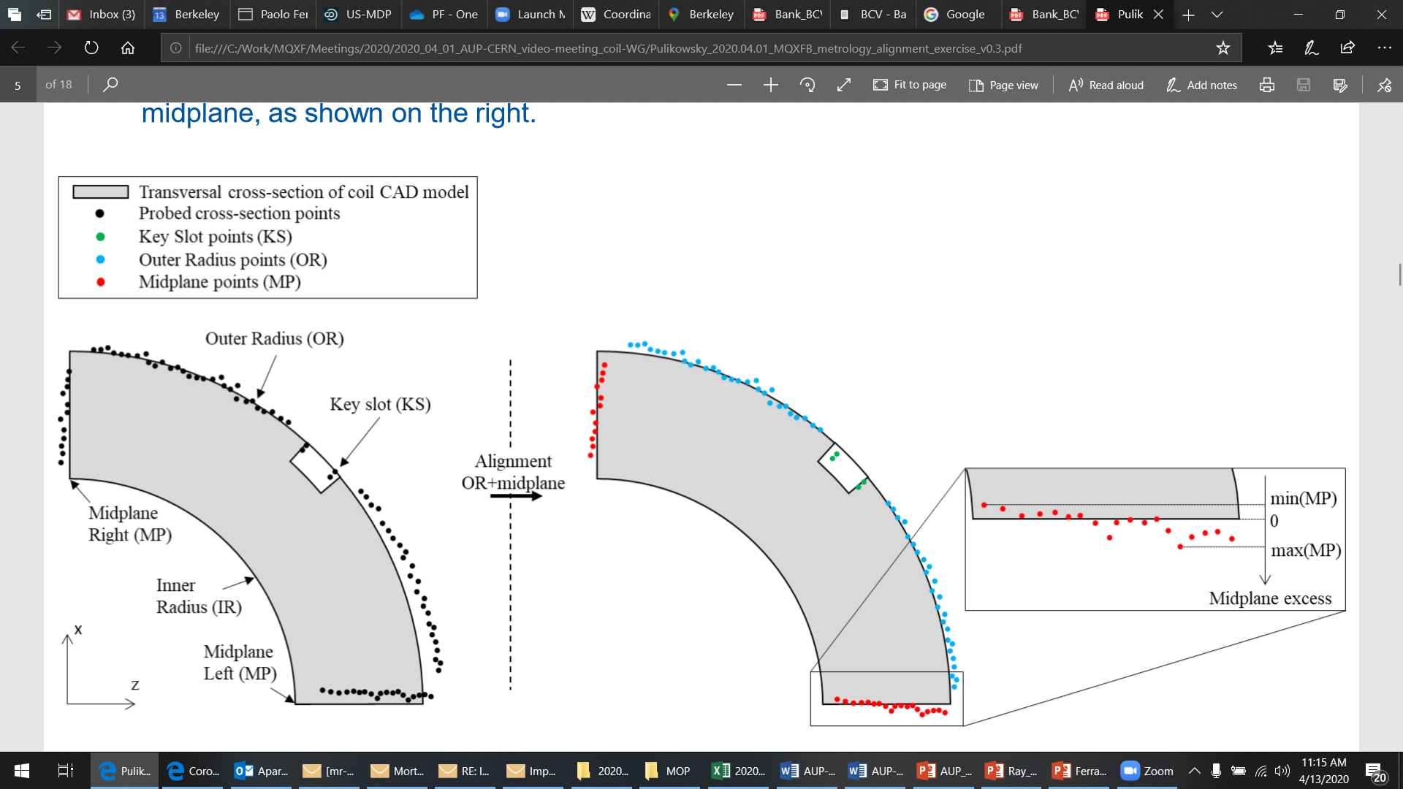
Impregnated coil dimensional tolerances
Arc length excess
The impregnated coil is accepted for use in MQXFA if its arc length excesses along the straight section are within the following tolerances: +0.150/-0.250 mm
The arc length excess, which is difference between the measured coil arc length and the nominal one, is determined by fitting outer radius and mid-planes points with the nominal profile, with equal weighting and imposing as symmetrical the two mid-planes offsets. The sum of the two measured mid-plane offsets provides the arc length excess

Slide 20
Impregnated coil dimensional tolerances
Outer radius profile deviation
The impregnated coil is accepted for use in MQXFA if its outer radius profile deviations along the straight section are within the following tolerances: +0.200/-0.250 mm
The outer radius profile deviation, which is given by the variation of each point on the outer radius with respect to the nominal outer radius, is determined by fitting outer radius and mid-planes points with the nominal profile, with equal weighting and imposing as symmetrical the two mid-planes offsets. Positive deviation indicates more material than nominal, negative indicates less material than nominal.

Slide 21
Impregnated coil dimensional tolerances
“Coil blocks” inner radius profile deviation
The impregnated coil is accepted for use in MQXFA if its “coil blocks” inner radius profile deviations (E-F in next slide) along the straight section are within the following tolerances: +0.150/-0.250 mm
The “coil blocks” inner radius profile deviations, which is given by the variation of each point on the inner radius with respect to the nominal radius, is determined by fitting outer radius and mid-planes points with the nominal profile, with equal weighting and imposing as symmetrical the two mid-planes offsets. Positive deviation indicates more material than nominal, negative indicates less material than nominal.

Slide 22
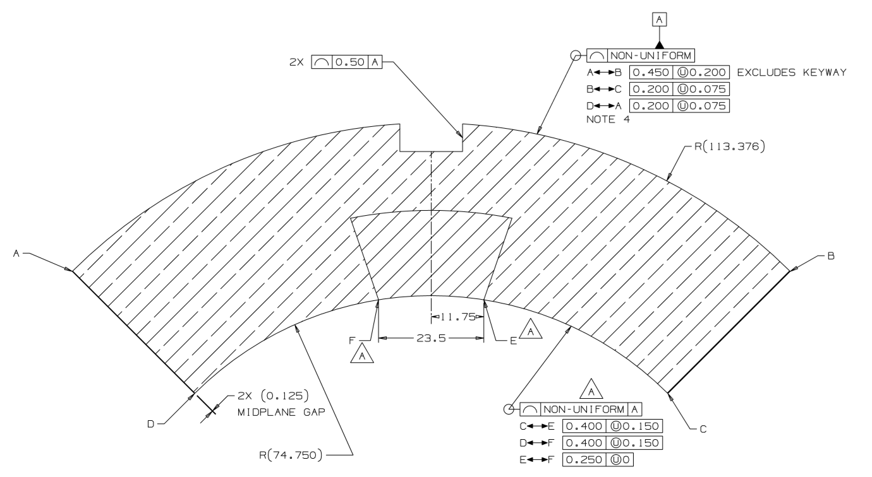
Impregnated coil dimensional tolerances

Slide 23
Impregnated coil dimensional tolerances
“Pole” inner radius profile deviation
The impregnated coil is accepted for use in MQXFA if its “pole” inner radius profile deviations (C-E and D-F in next slide) along the straight section are within the following tolerances: +0.000/-0.250 mm*
The “pole” inner radius profile deviations, which is given by the variation of each point on the inner radius with respect to the nominal radius, is determined by fitting outer radius and mid-planes points with the nominal profile, with equal weighting and imposing as symmetrical the two mid-planes offsets. Positive deviation indicates more material than nominal, negative indicates less material than nominal.

Slide 24
Impregnated coil dimensional tolerances
* Cross-section measurements shall be taken close to all possible bumper locations. In addition, data shall be taken on the surface surrounding the pole holes where bumpers are inserted and projected on the closest measured cross-section.

Slide 25
Impregnated coil dimensional tolerances
Pole key slot mis-alignment
The impregnated coil is accepted for use in MQXFA if its pole key slot mis-alignment along the straight section are within the following tolerances: +0.250/-0.250 mm
The pole key slot mis-alignment, which is the misalignment of the center of the pole key slot with respect to the nominal position, is determined by fitting outer radius and mid-planes points with the nominal profile, with equal weighting and imposing as symmetrical the two mid-planes offsets.
  View from LE, positive shift towards left

Slide 26
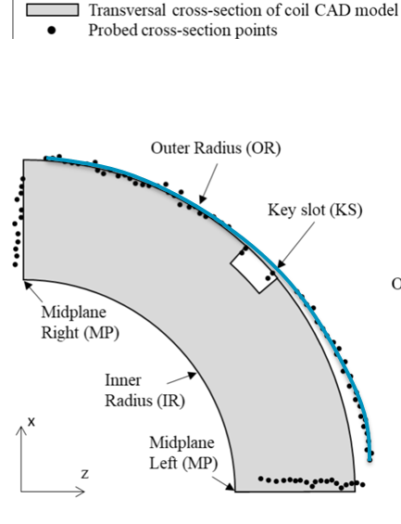
Best-fit outer radius
The best-fit outer radius is determined by best-fitting only the outer radius points.
No tolerance is specified
  Used to monitor coil-to-collar contact surfaces (“LQ effect”)

