Slide 1
MQXFA10 Preload Targets
D. Cheng, P. Ferracin, L. Garcia-Fajardo, C. Myers, H. Pan
For the LBNL AUP Team
8-Oct-2021
LBNL

Slide 2
Outline
Preload targets
Overview of MQXFA03-08 pre-loads achieved
Proposed preload process

Slide 3
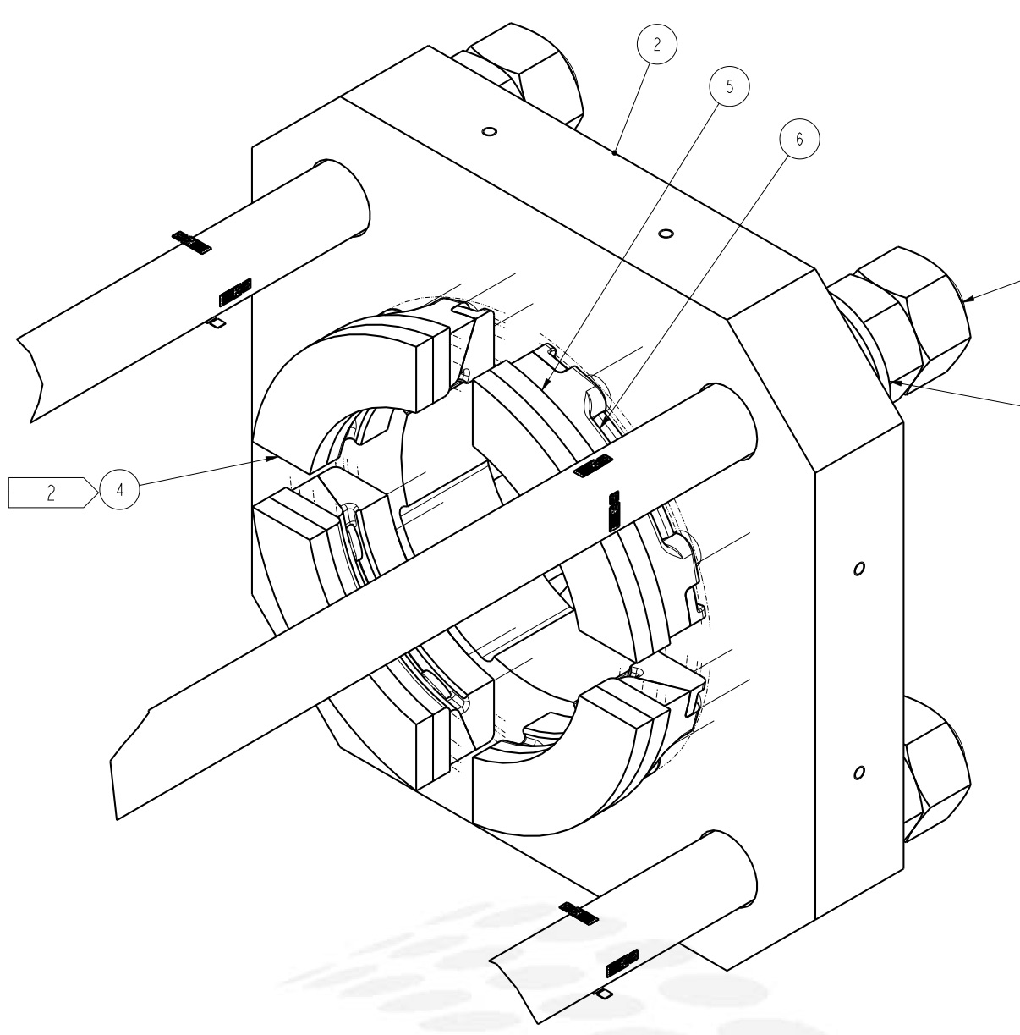
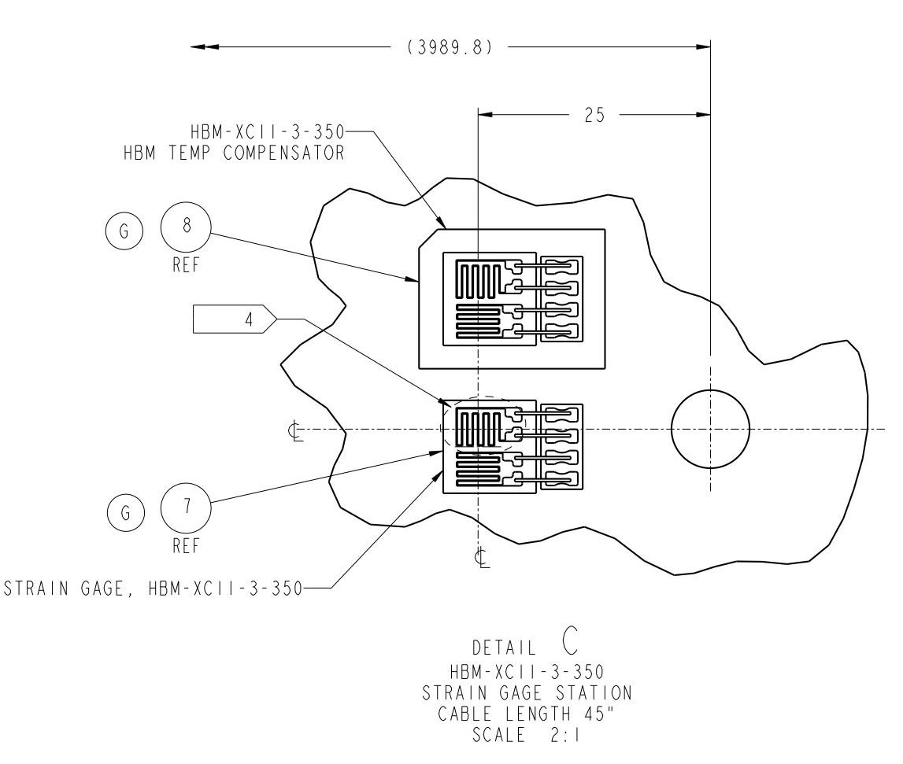
MQXFA SG Gauges Layout (Std)
LE
MID
RE
Shell 2
Shell 4
Shell 7
HBM gauges and FBG (next slide) gauges are installed
Shell gauges --- three axial locations:
Shell gauges (T & Z): on shell 2, 4, & 7
Coil gauges (T & Z): on the axial location of 3989 mm (RE) from LE.
Rod stations are located on the RE (see inset)
Each station is full bridge with four individual gauges.
Coil Stations
Rod Stations
RE axial plate assembly

Slide 4
MQXFA SG Gauges Layout (FBG)
FBG Coil gauges (T & Z): on three axial locations:
715 mm, 1915 mm, and 3725 mm from LE.
Based on experience with MQXFA09
Shell 7

Slide 5
MQXFA Preload Targets
Pole key gap: 0.008” (~200µm) per side
Azimuthal pre-load
Target coil pre-stress at cold of 100 MPa requires:
~80 MPa at R.T. after 24 hours
Assumes 5-10 MPa decrease in 24 hours
We set as maximum coil stress to 110 MPa during loading
Axial pre-load
The total force at cold is: 1.0 MN
~950 με at R.T
Equates to total rod force ~0.58 MN at R.T.
These targets have remained unchanged for Pre-Series magnets MQXFA03-MQXFA07, and are captured in the Series Magnet Specifications Document (US-Hilumi-Doc-4009)

Slide 6
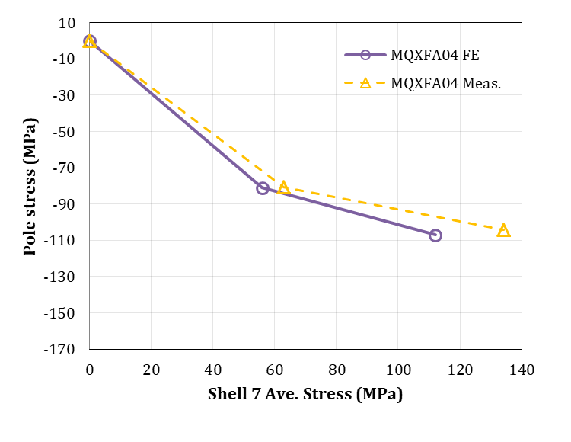
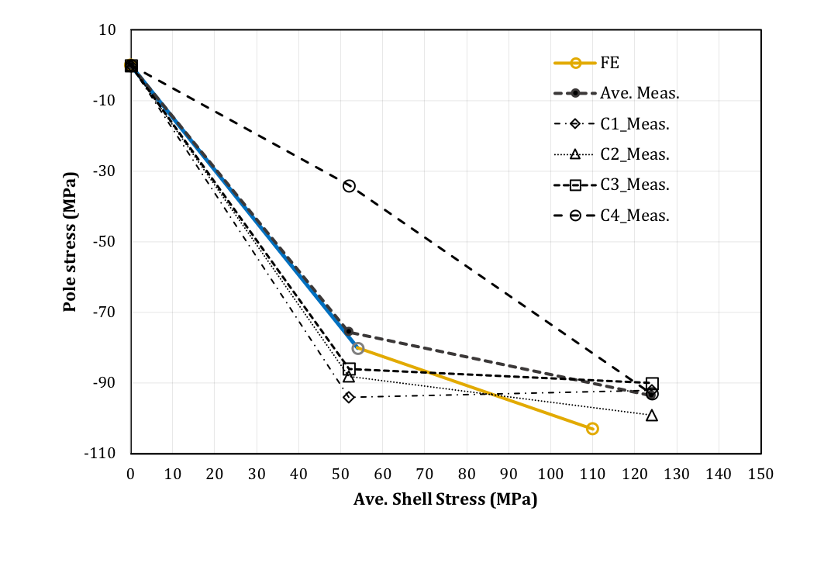
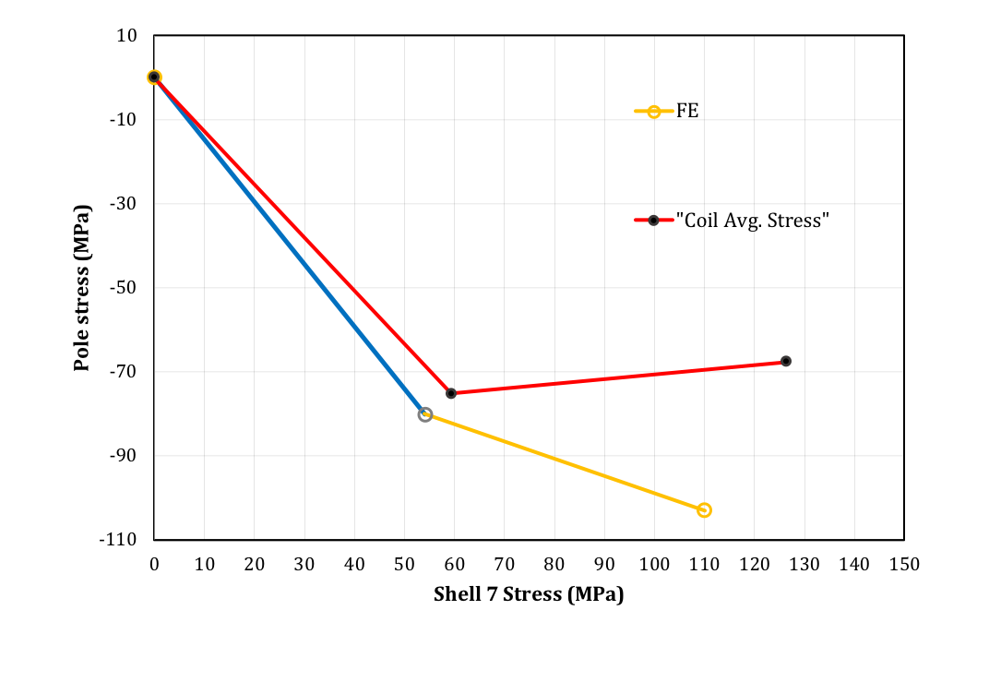
Preloads Measured at RT for MQXFA Magnets
 |  | Target | MQXFA03 | MQXFA04 | MQXFA05 | MQXFA06 | MQXFA07 | MQXFA08
R.T. | Coil | -80 ± 8 | -79 | -76 | -82 | -81 | -75 | -68
 | Shell 7 | 53 ± 6 | 54 | 64 | 62 | 62 | 58 | 51
Cold | Coil | -103
 | Shell 7 | 110
Cooldown values are not reliable
MQXFA04
MQXFA05
MQXFA06

Slide 7
Transfer Function at RT for MQXFA Magnets

Slide 8
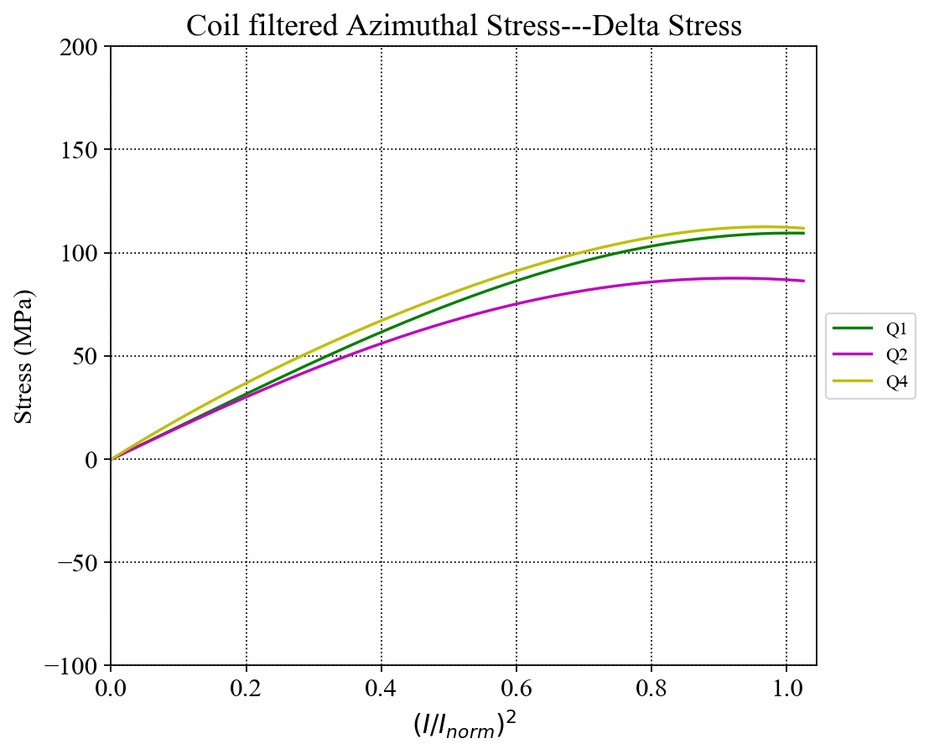
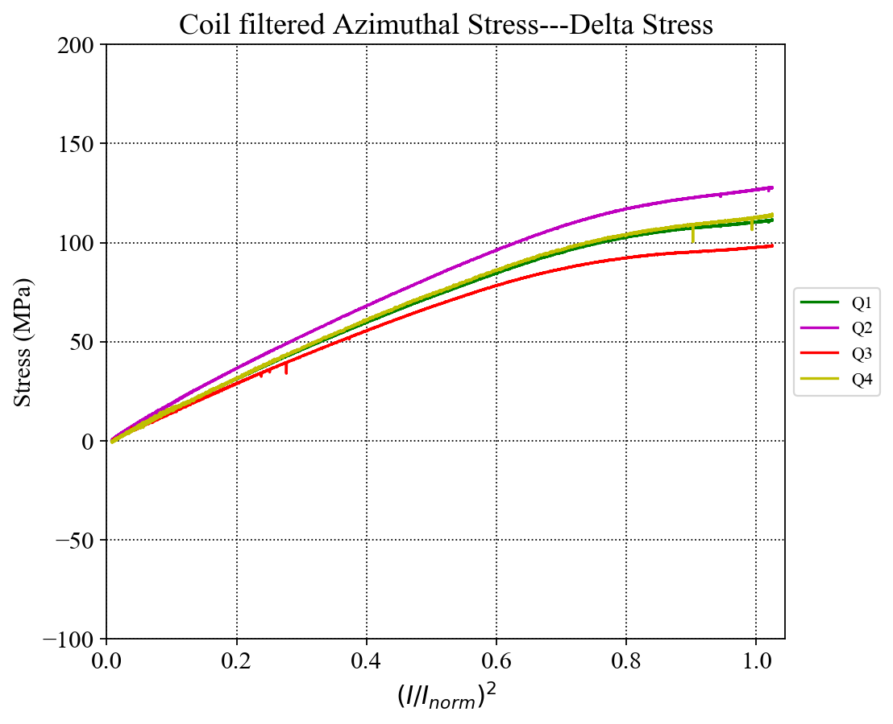
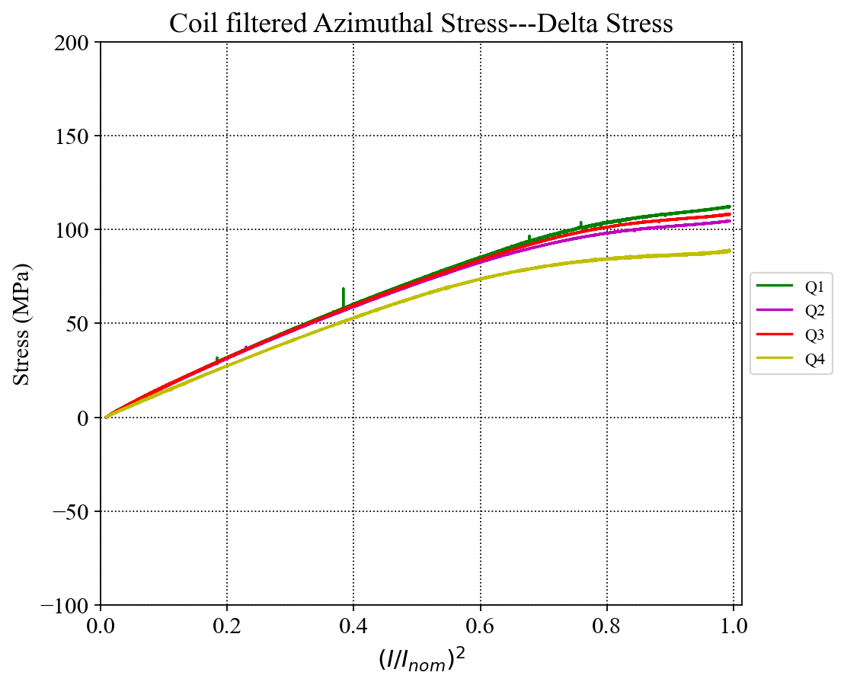
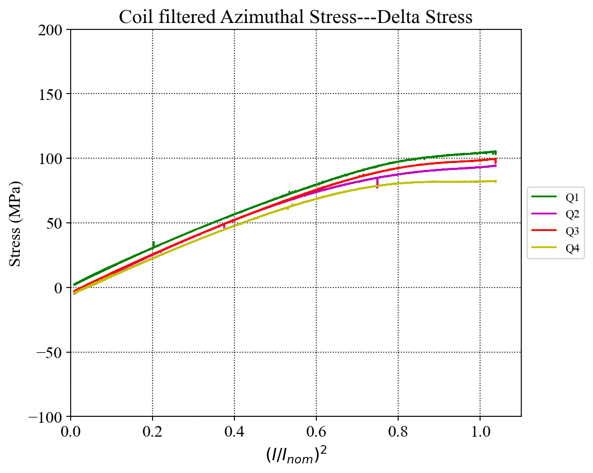
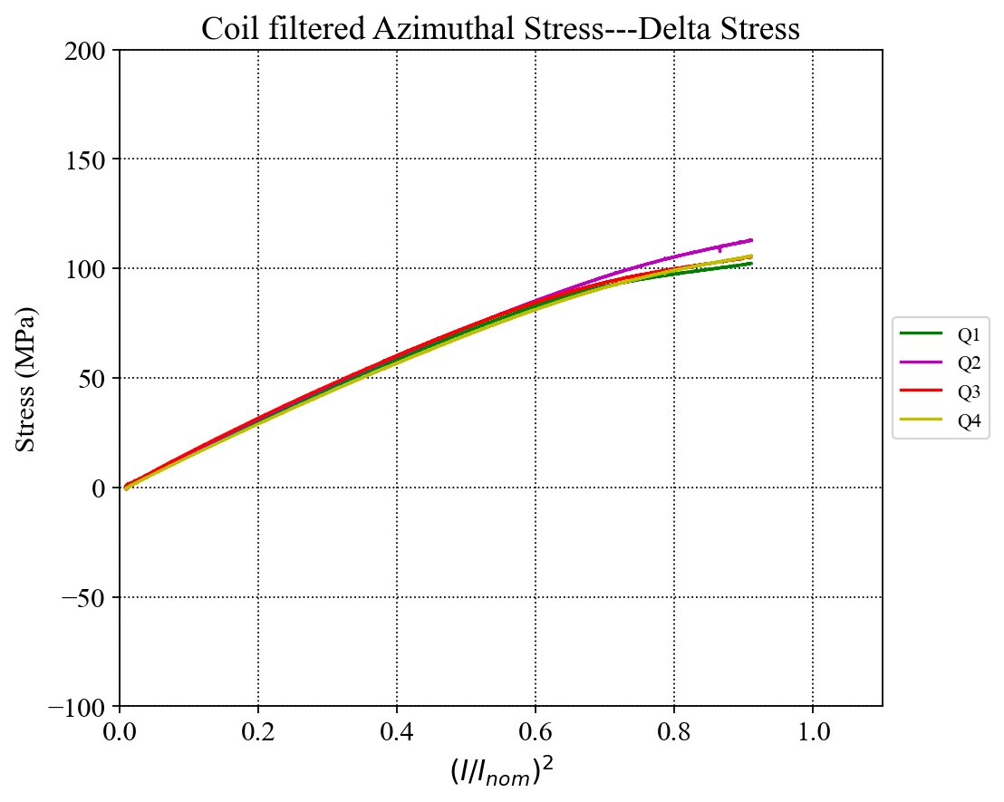
MQXFA03-MQXFA07 Unloading Comparison, corrected Ramps, Deltas
MQXFA03
Ramp to 16670 A
MQXFA04
Ramp to 16670 A
MQXFA05
Ramp to 16230 A
MQXFA06
Ramp to 16530 A
MQXFA07
Ramp to 15500 A
Achieved ~100-110 MPa of preload, based on powering
Corrected values shown
Ramp-up and ramp-down readings are averaged at each current level (must use same ramp rates)

Slide 9
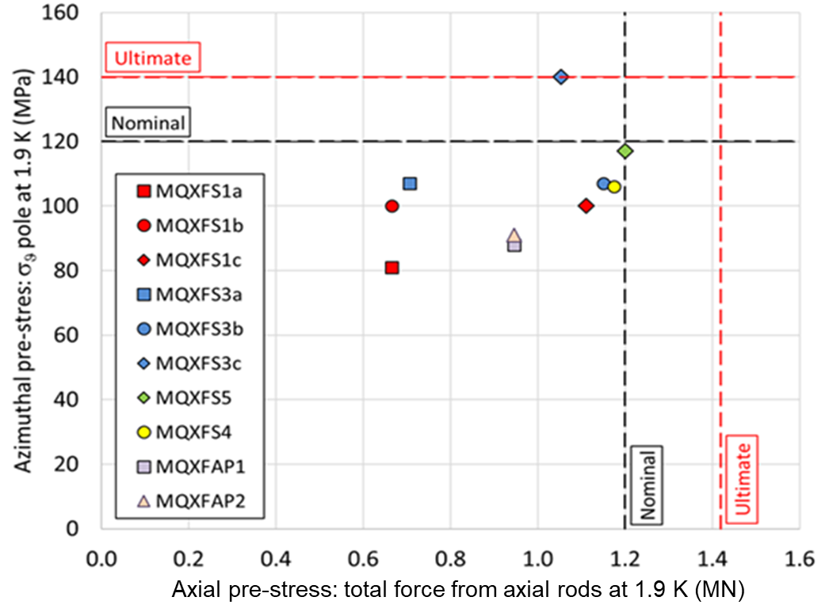
The Load Condition after CD (based on powering)
MXQFA04
MXQFA03
MXQFA07
MXQFA05
MXQFA06

Slide 10
Standard Preload Process
The pre-load sequence:
Pre-loaded axial rods with average ~50 µε;
50% azimuthal pre-load (~0.030” shims, or total 13.52 mm)
50% axial pre-load (~470 µε)
100% azimuthal pre-load (~.040” shims, or total ~13.8 mm)
100% axial pre-load (~950 µε)
The pre-load process:
We preloaded MQXFA05 quadrant by quadrant from the initial 0.010” shims (total 13.01mm) in 0.005” steps, reaching a peak bladder pressure of 4500 psi.
All subsequent magnets used quadrant by quadrant loading after the 0.015” shims step (total ~13.14 mm)
MQXFA05 Coil 115 slope may have been caused by “locking in” a position too early in the preload process

Slide 11
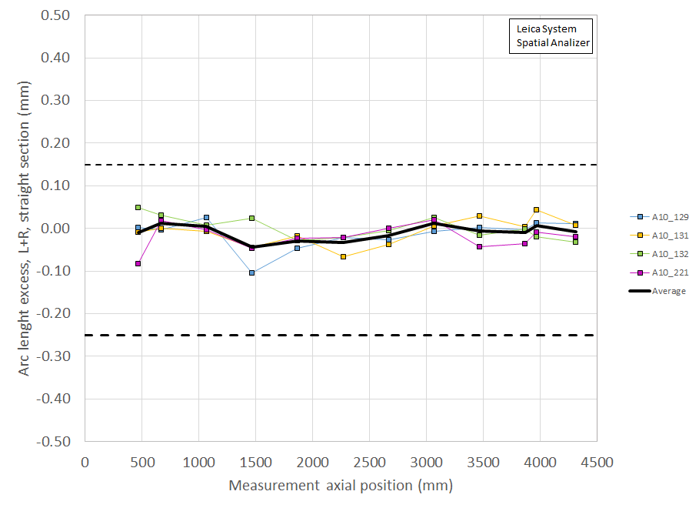
Variation of MQXFA10 Pre-Stress due to Coil Variations
Based on Coil CMM average
Shimmed 0.002” on each midplane for
coils 221 and 129;
0.003” on each midplane for
coils 131 and 132
Starting with MQXFA08 coils there is now a CMM measurement at the SG location
SG location nearly the max. average size; two of the measured locations may see a slightly higher stress than what is measured at the SG

Slide 12
Axial Preload for MQXFA
The axial preload of MQXFA08 is targeting to the same level of MQXFA04 - 07:
MQXFA07 Proposal | Room Temperature | 1.9 K | Nominal Current
Preload | 950 µε ± 95 µε | 1700 µε | 1750 µε
Axial Force (MN) | 0.6 | 1.07 | 1.12
Ratio to the e.m. force at nominal current | 50% | 90% | 93%
Total axial e.m. force is 1.2 MN at nominal current.

Slide 13
Summary
The R.T. preload targets for MQXFA10 remain unchanged and follow the Magnet Specifications:
Shell Stress: 53 ± 6 MPa
Coil Stress: -80 ± 8 MPa
Rod strain: 950 ± 95 µε
Cold powering values are used to determine the preload on the coils
Average coil size (arc length) after shimming is within ±25 µm with respect to average coil size measured at the strain gauge location
Strain gauge location also nearly the max. average
The preload process will start quadrant by quadrant loading after the ~13.14 mm load key step
Intended to prevent “locking in” a position too early

Slide 14
Additional Slides

Slide 15
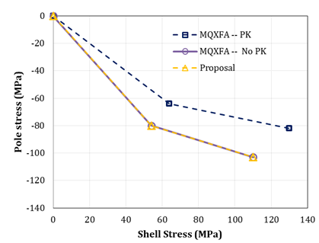
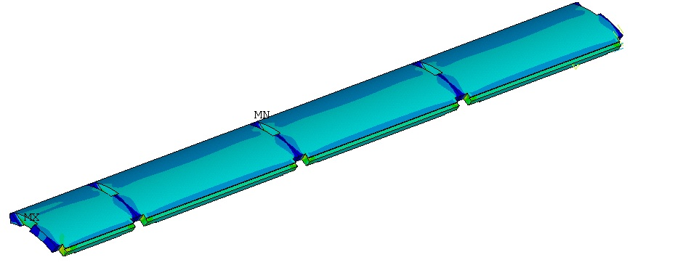
Preload Targets for MQXFA
We have kept the same pole-gap since MQXFA03:
About ≥ 5.5 mil/side: will not fully close at cold
 | Value
Interference (µm) | 470
Polekey gap (µm/side) | 145
Polekey interception F_{pole}/F_{shell} (1.9K) | 0
 | 1.9 K | 16.47 kA | 17.89 kA | 19 kA
Shell Average Von Mises Stress (MPa) | 116 | 121 | 125 | 129
Shell Peak Stress (MPa) | 488 | 481 | 481 | 480

Slide 16
MQXFA05 &6 Load Key Shimming Summary
From MQXFA05, we reduced number of operations from ~10 steps to 7 steps using a constant 0.005” shim increment
Magnets MQXFA03 to -05 were plotted together
Shows full-quadrant loading, diametrical loading, and quadrant loading
Load key shims stacks are shown vs. pump pressure required to achieve insertion
Pressures shown are the highest pressure required (in the case of diametrical and/or quadrant) to complete a full round of shimming

Slide 17
Analysis of low stress in MQXFA05 coil 115

Slide 18
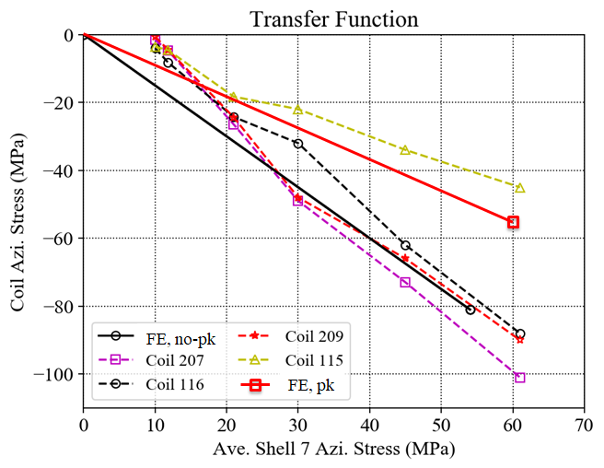
Coils TF
Detailed data points in next slide

Slide 19
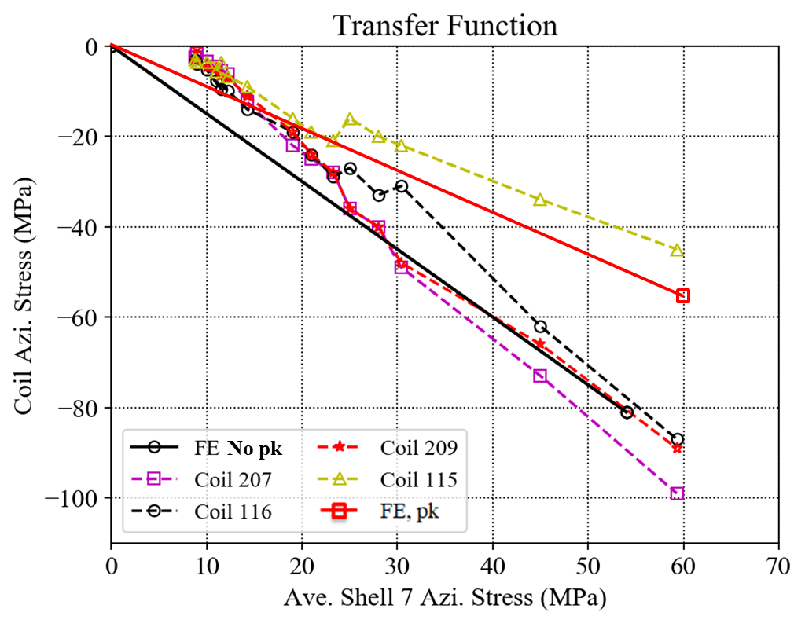
Coils TF (detailed)
Detailed data points from 20 mil to 30 mil shims

Slide 20
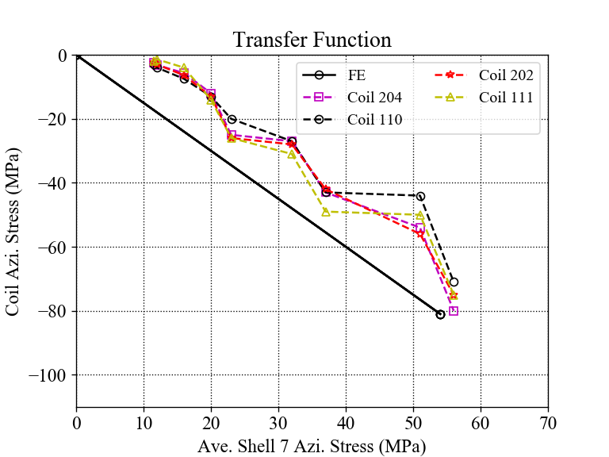
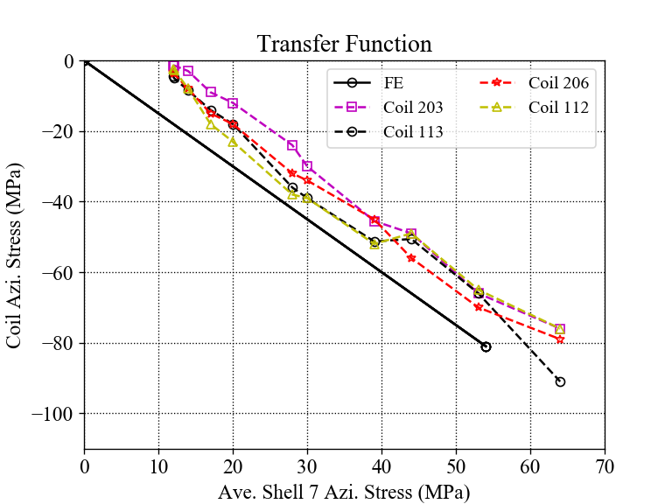
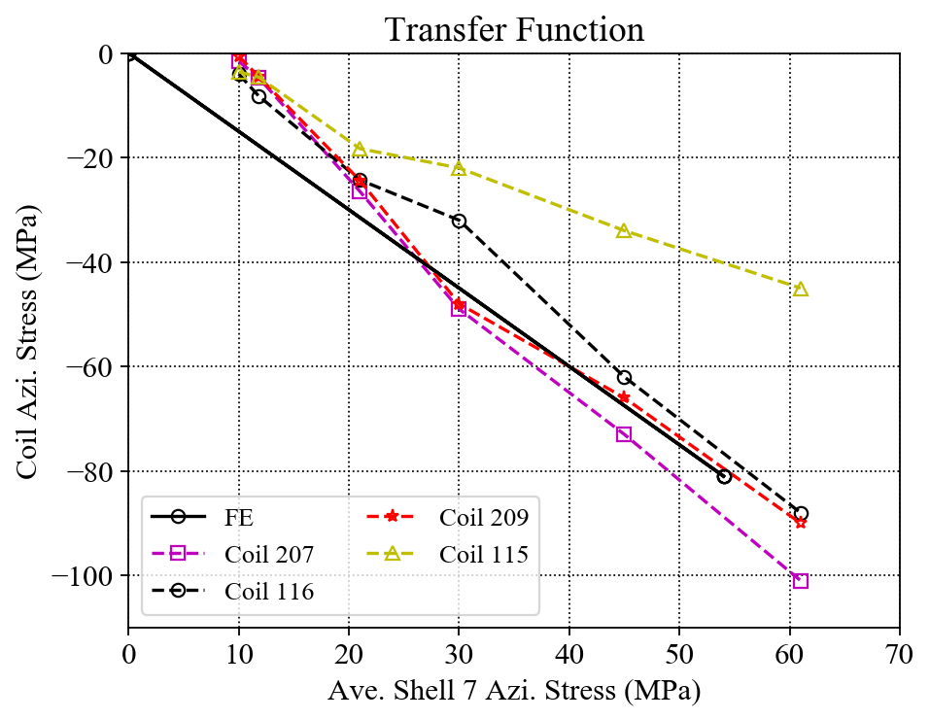
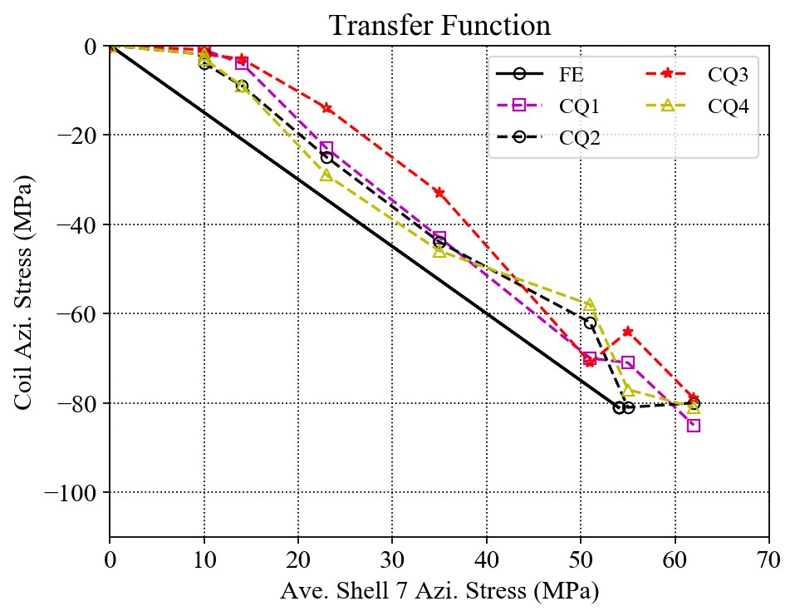
Individual Coil TF Comparisons
MQXFA03
MQXFA04
MQXFA05
MQXFA06
In general, coil stress spreads in MQXFA03 and A06 are much smaller.

Slide 21
Previous cases

Slide 22
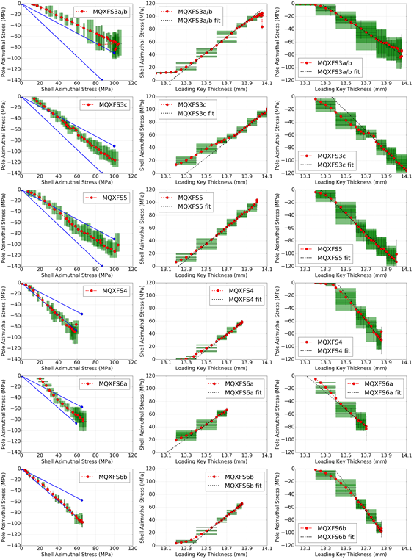

Slide 23
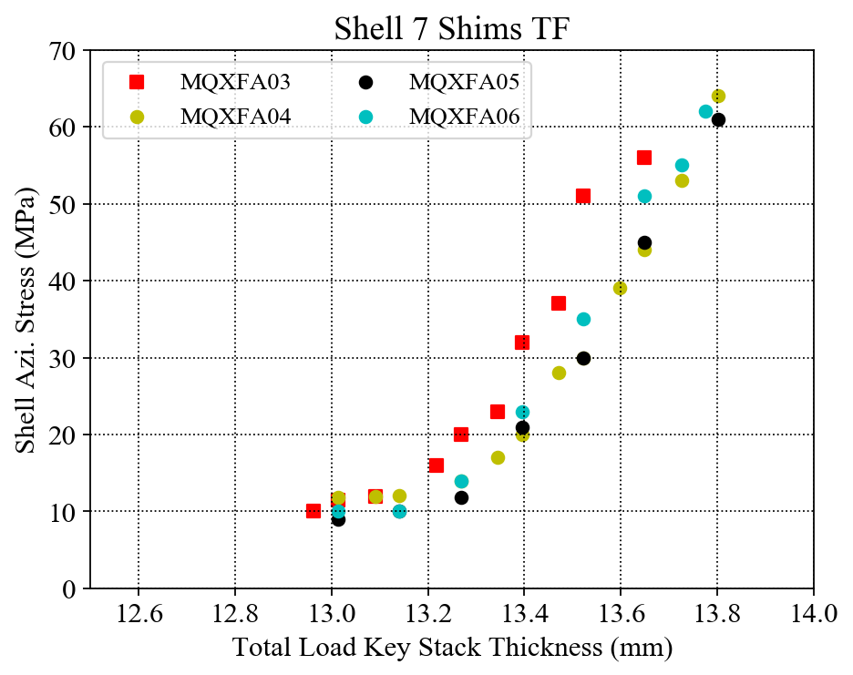
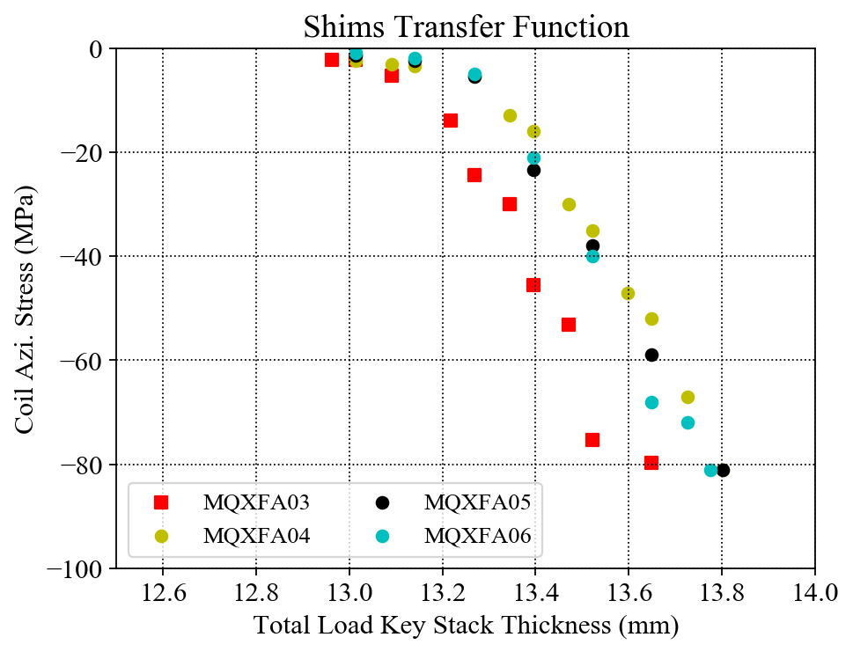
MQXFA03 - 06 Shims TF Plots
The correlations of the total load key thickness and the average coil / shell azimuthal stresses are investigated;
The slopes of the linear part of the three magnets are very close.

Slide 24
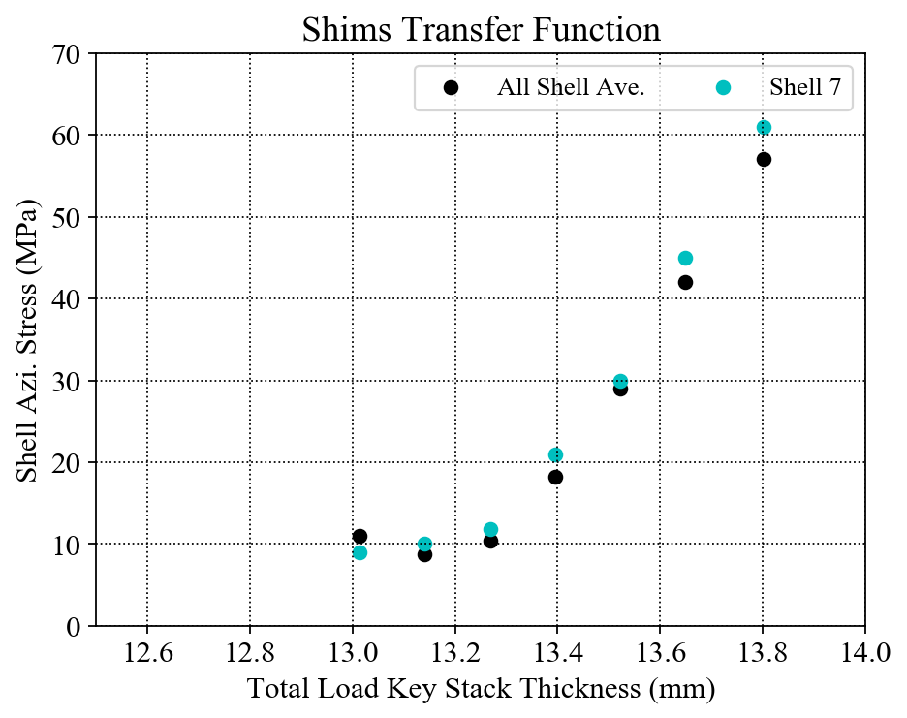
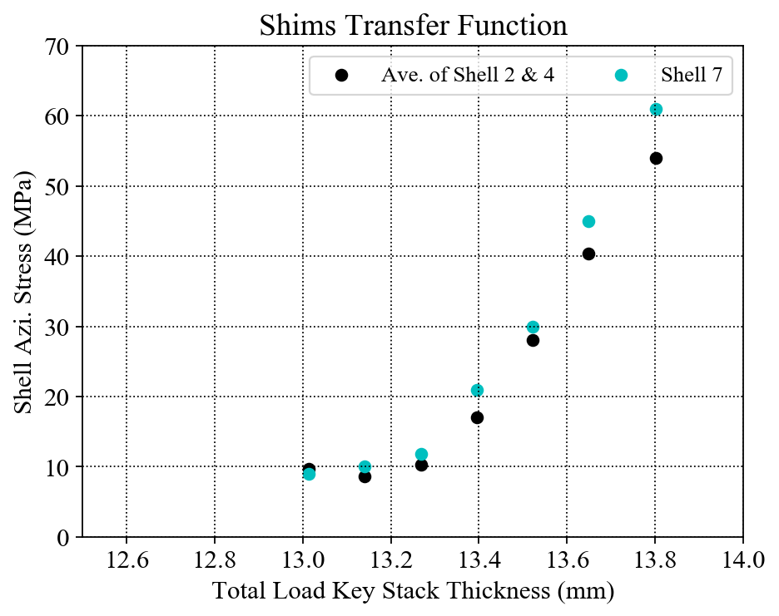
Shim TF only for MQXFA05
Only MQXFA05
The average stress of all the shells (shell 2, shell 4 and shell 7) seems linear (red line) ;
The average stress of the shells 2 & 4 seems linear (Dark blue line) ;
The average stress of shell 7 seems to have slope change (green line).

Slide 25
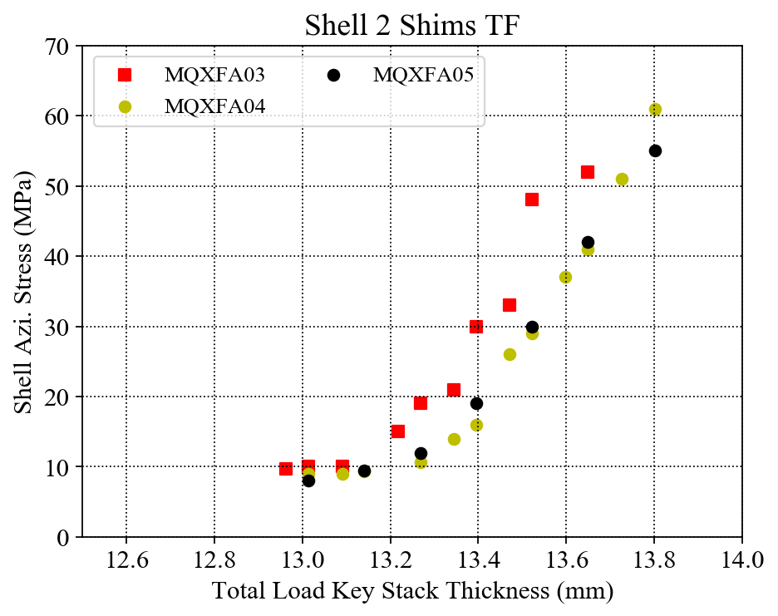
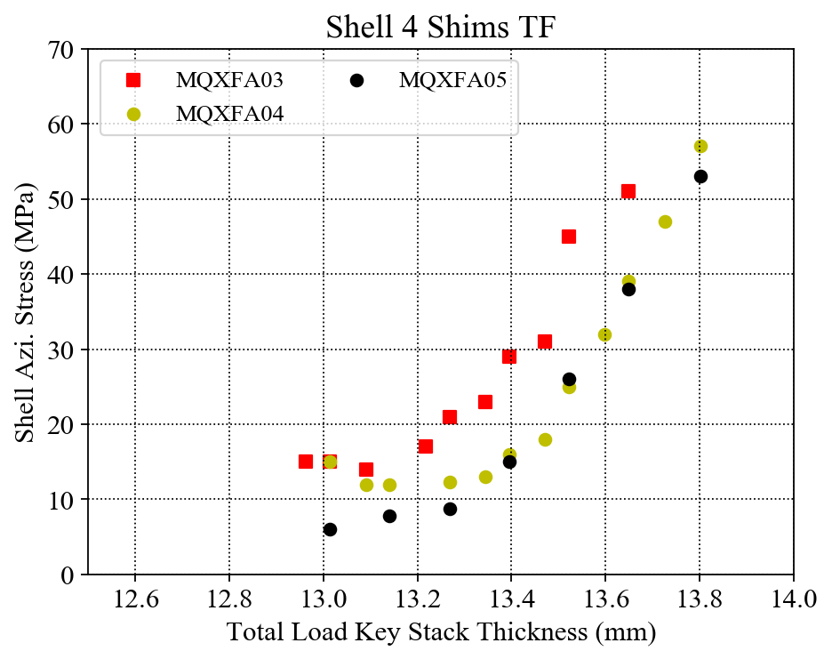
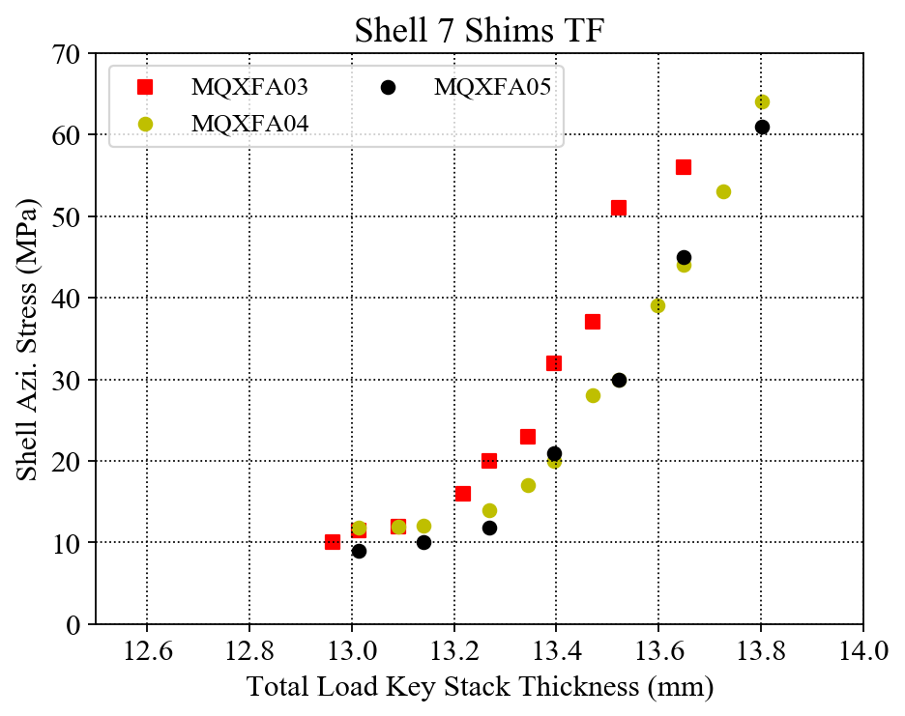
Individual Shell Shim TF Comparison
Individual shell stress with error bar at each final data point.

Slide 26
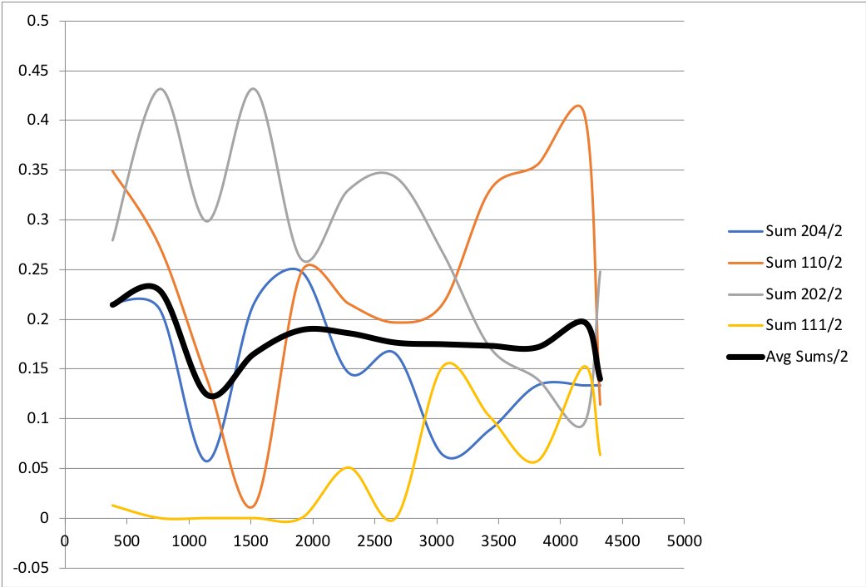
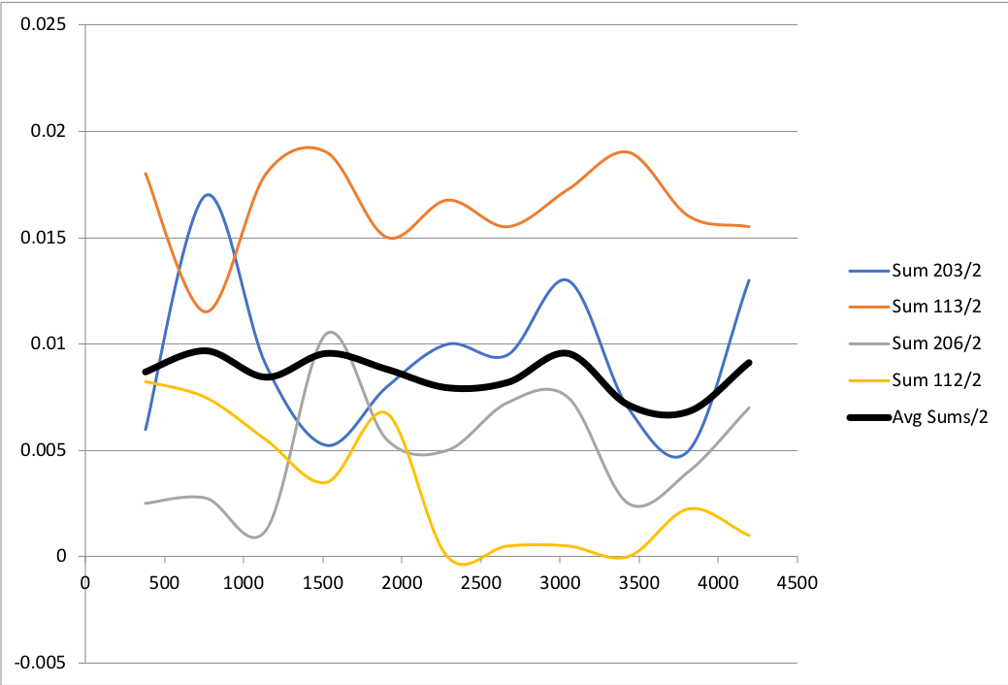
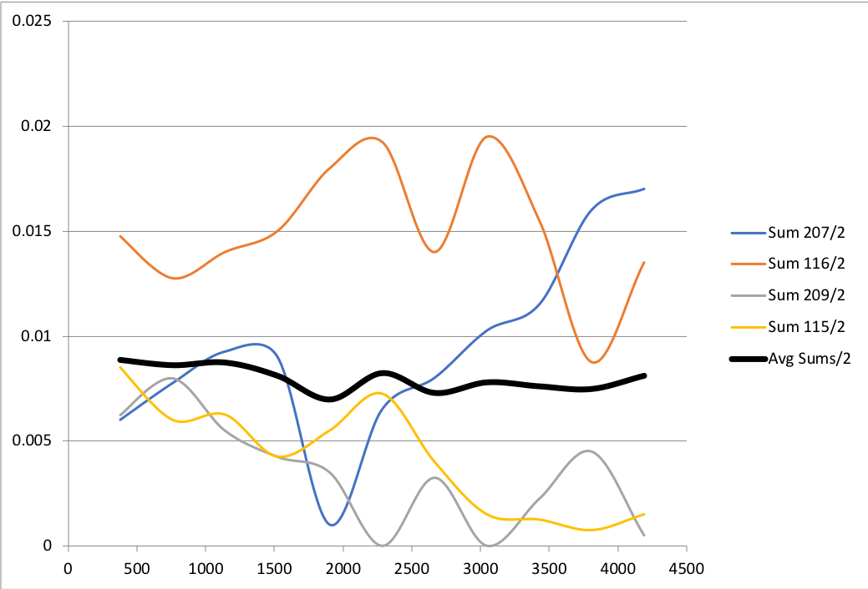
Coil Pack Pole-key Gaps
mm
inch
inch
MQXFA03
MQXFA04
MQXFA05

Slide 27
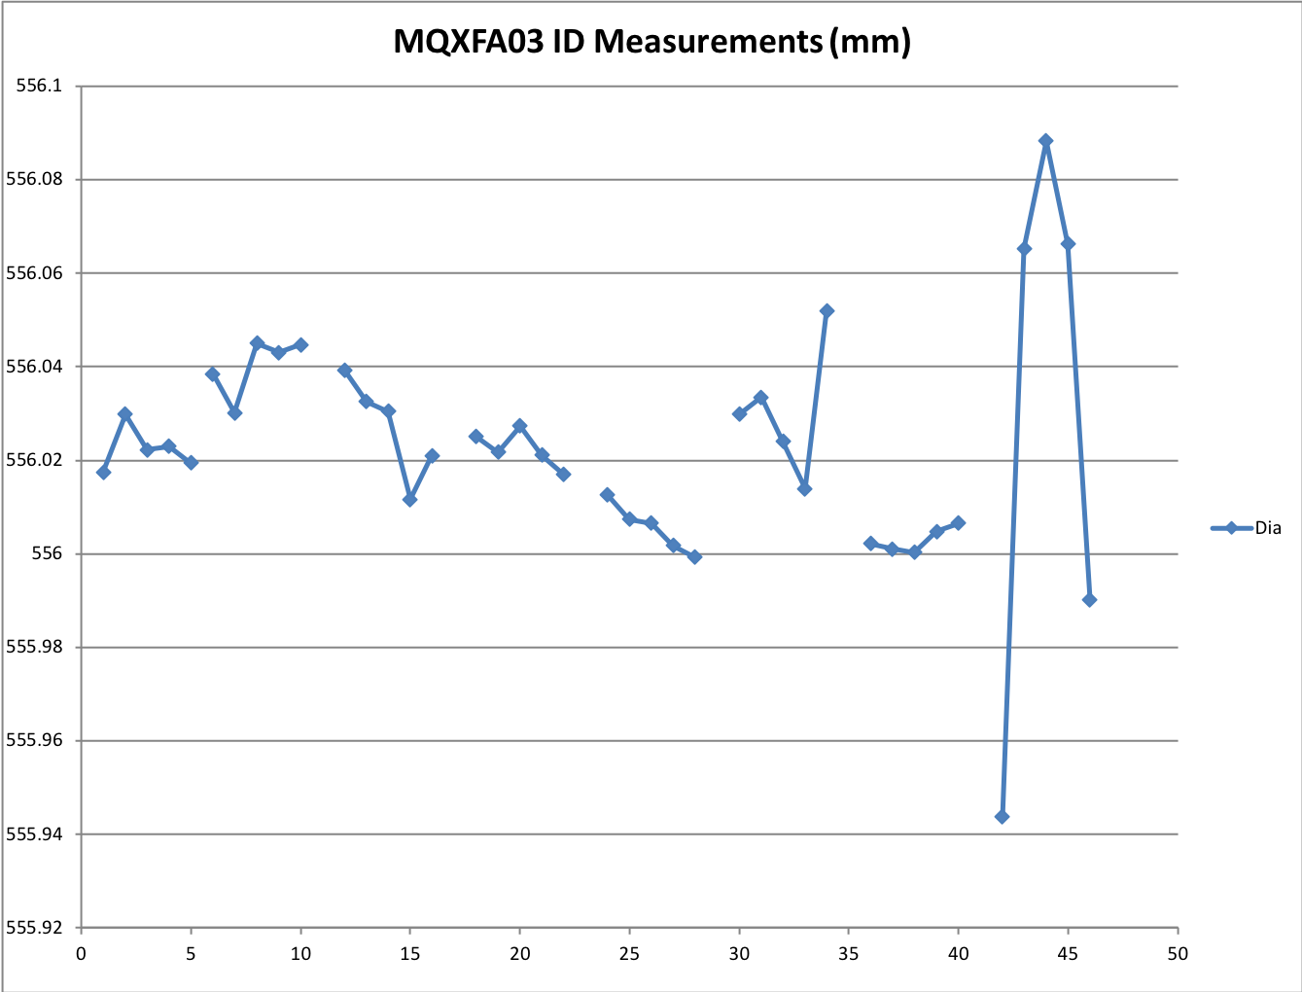
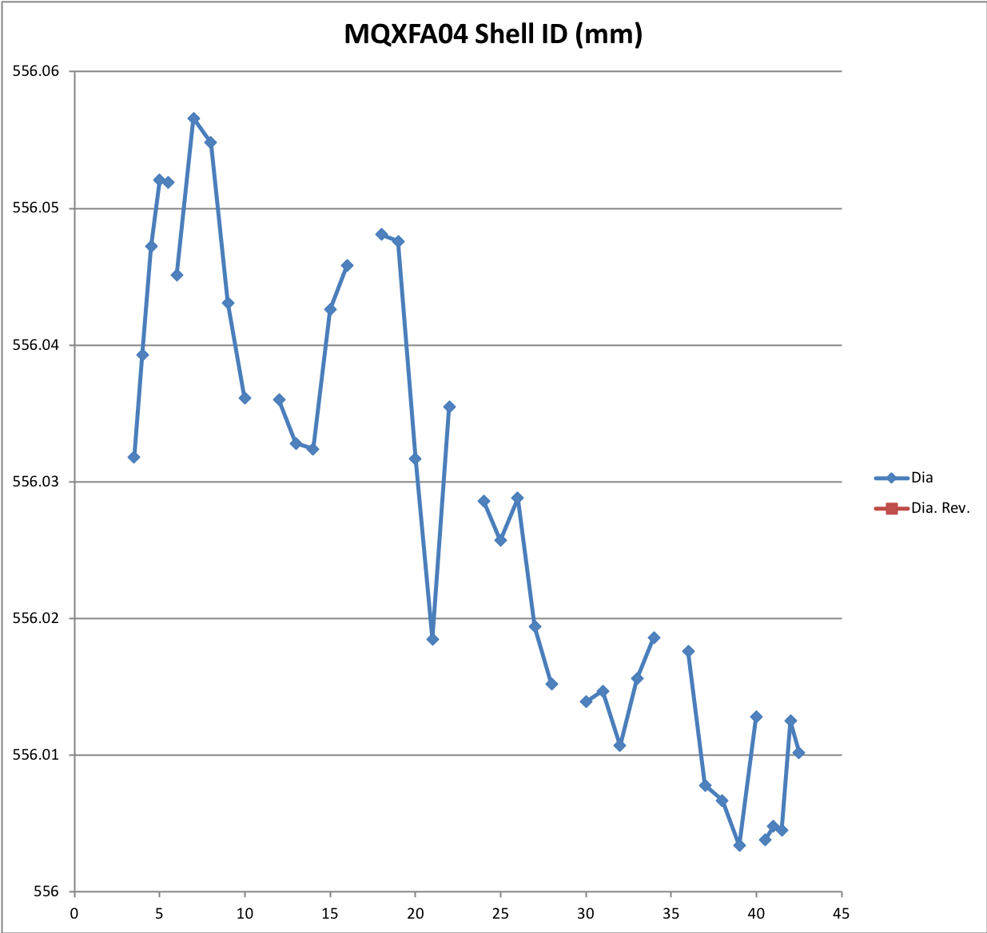
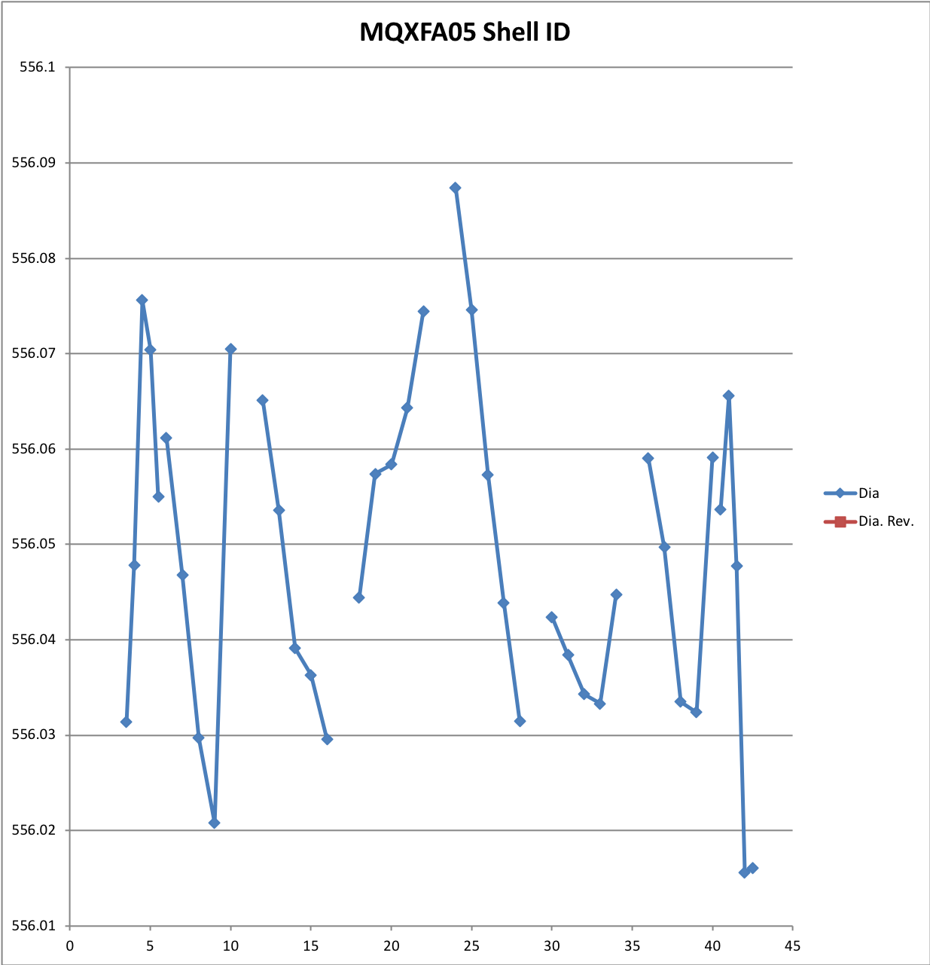
Shell ID Measurements
Unit: mm

Slide 28
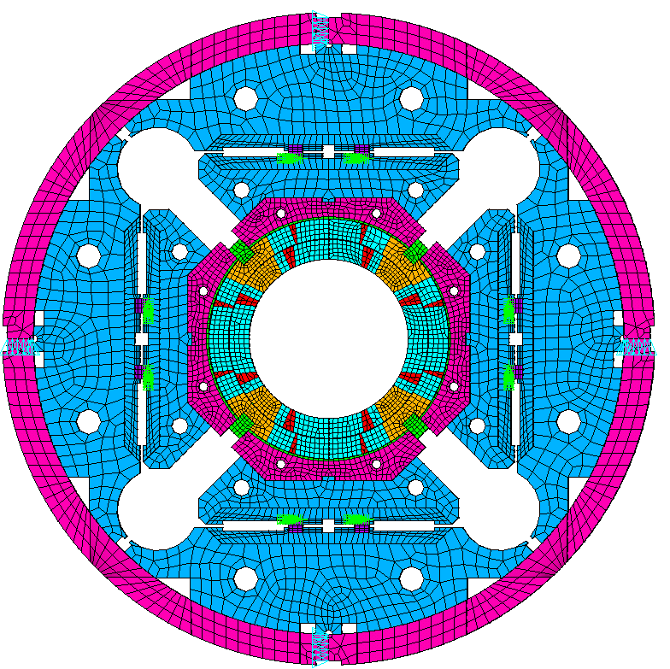
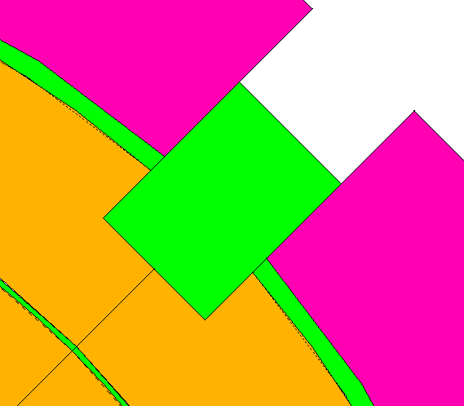
Appendix: Possible Polekey Interception in Q4
2D model Basic Settings:
X-lock
Full size 2D model.
The pad is assumed as only iron.
Initial pole key gap is 140 μm / side in quadrant 1 to 3.
No pole key gap in quadrant 4.
No axial loading in the 2D model.
All components are in contact using contact elements
Contact172
Target169
Baseline Friction coefficient is 0.2
Y-lock
Q2
Q1
Q3
Q4
Boundary conditions:
Apply uy=0 and ux=0 on Y-lock and X-lock, respectively
Apply interference at the loadkey and p-master interface
No Gap
No Gap

Slide 29
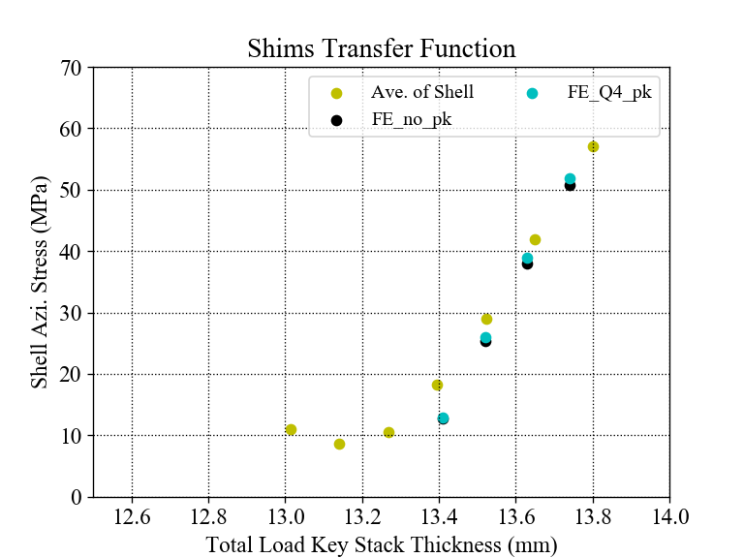
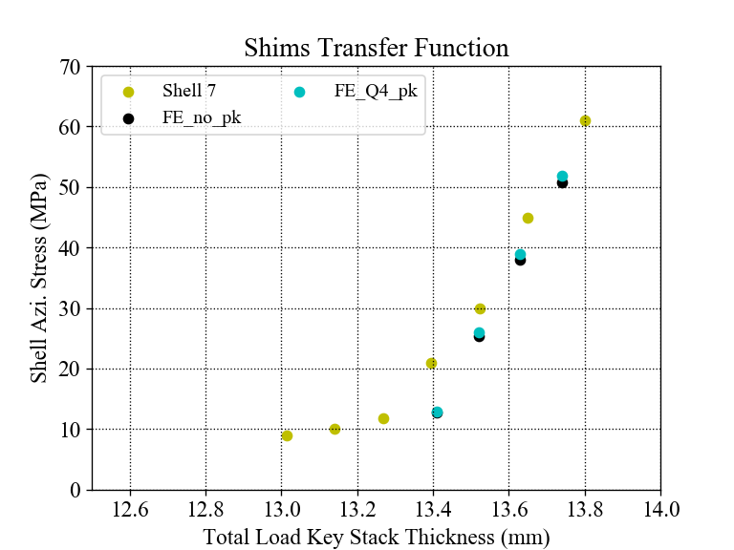
Shim TF (with FE simulations)
With simulations
The slope of average stress of FE is slightly higher than the measurements;
However, the slopes of the simulation results are not different obviously to make a clear comparison with the measurements.

Slide 30
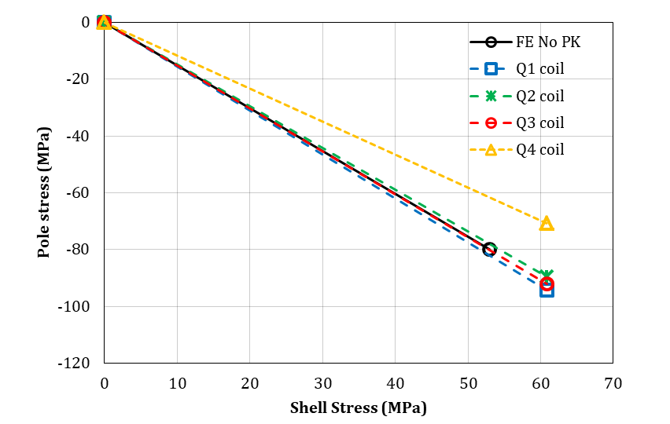
Measurements vs. Simulation
Measurements
No polekey gap in Q4

Slide 31
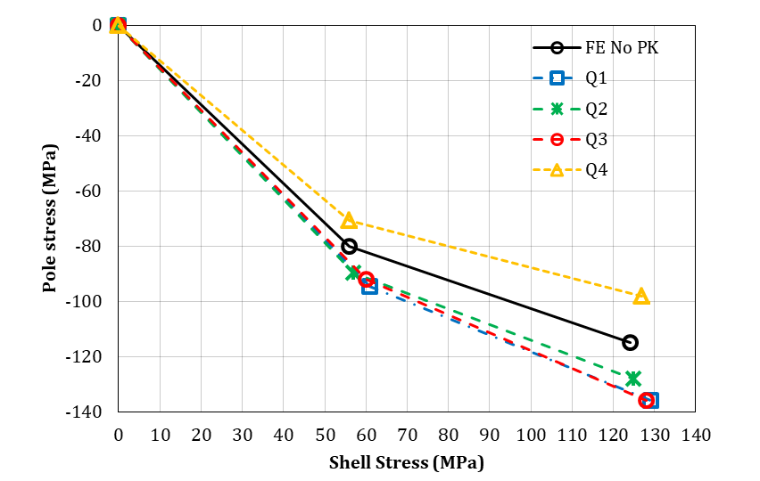
TF of the Simulation
No polekey gap in Q4

Slide 32
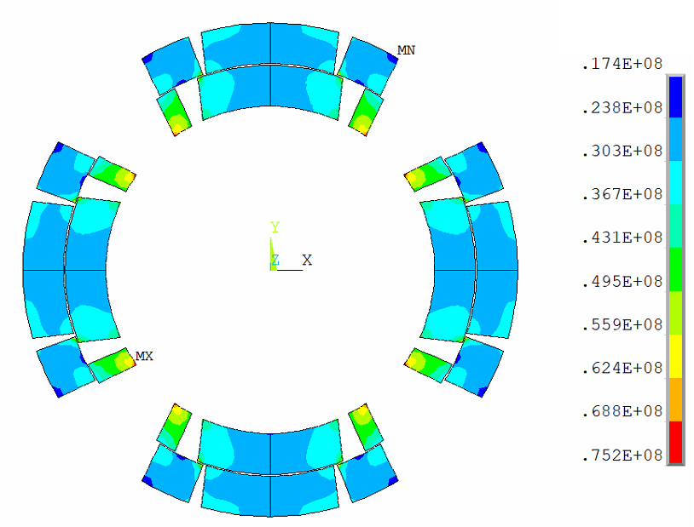
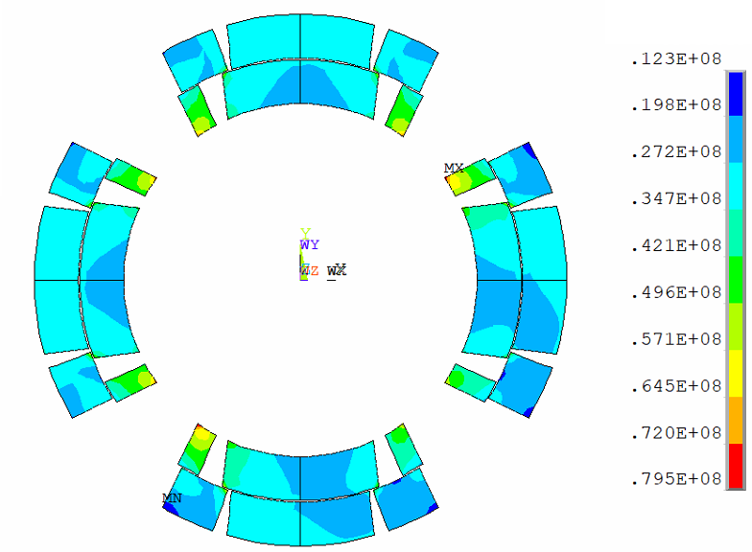
Coil stress distribution
Coil Von Mises Stress after preloads:
All quadrants with polekey gap (8 mil /side)
No polekey gap in Q4, 8 mil /side gap in the rest quadrants
Pa
Pa

Slide 33
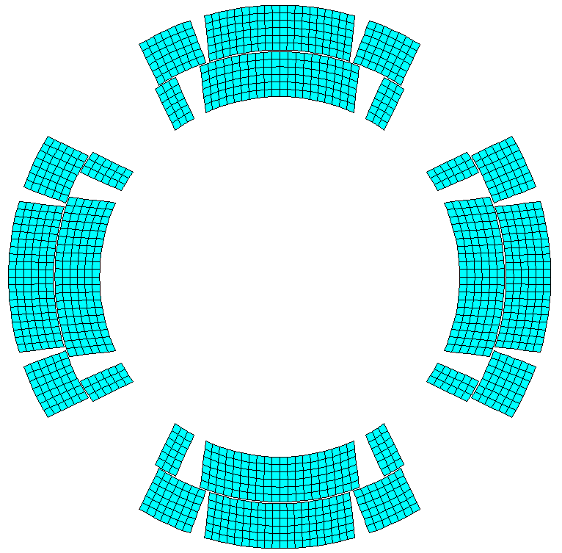
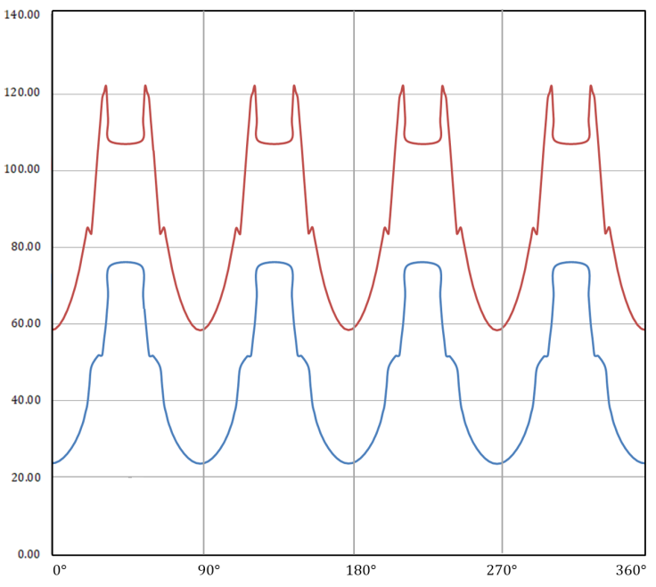
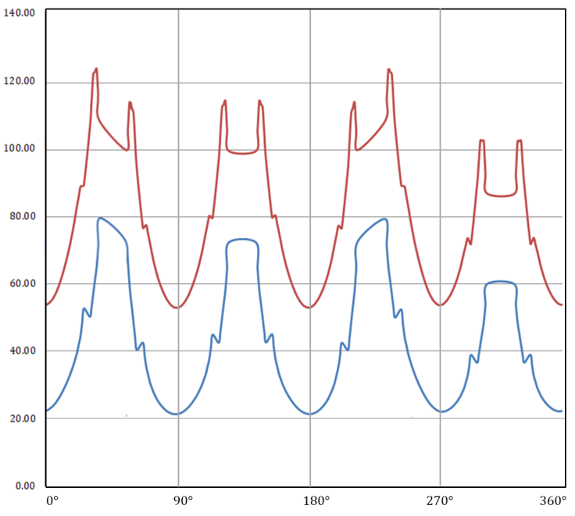
Coil stress distribution
90°
Coil Von Mises Stress on the path (red dash line):
0°
180°
All quadrants with polekey gap (8 mil /side)
No polekey gap in Q4, 8 mil /side gap in the rest quadrants
270°
Cooldown
Cooldown
Stress (MPa)
Stress (MPa)
R.T.
R.T.

