Slide 1
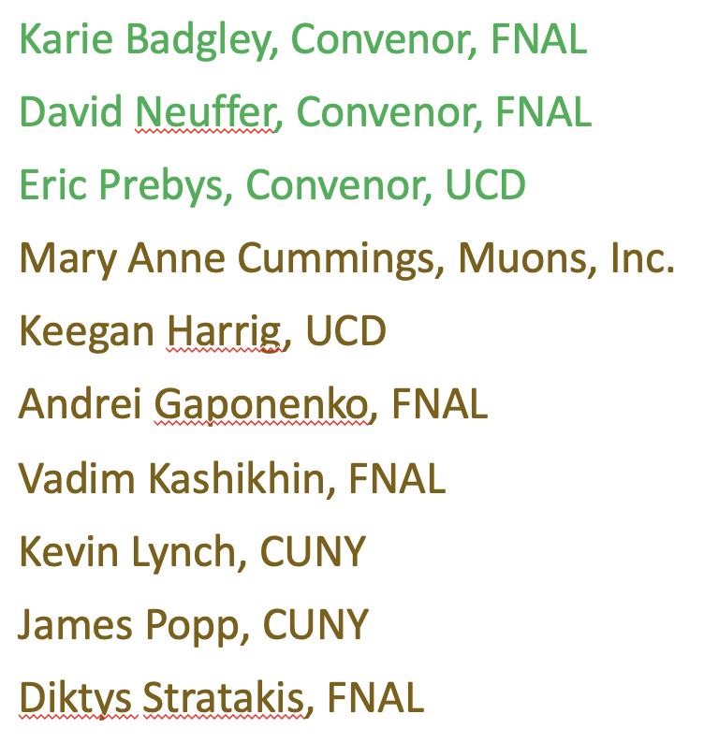
Next Generation Muon to electron conversion experiment and the muon collider
Eric Prebys*
*representing Mu2e-II accelerator group:

Slide 2
Outline
Beam needs of next generation muon to electron conversion experiment.
Plans for beam delivery from PIP-II
Targetry Issues
Synergy with Muon Collider Program

Slide 3
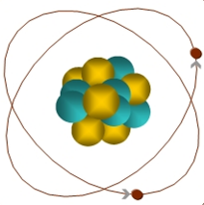
Reminder: Experimental Signature of μ+N → e+N
When captured by a nucleus, a muon will have an enhanced probability of exchanging a virtual particle with the nucleus.
This reaction recoils against the entire nucleus, producing a mono-energetic electron carrying most of the muon rest energy
Very clean experimental signature!
μ
~105 MeV e⁻

Slide 4
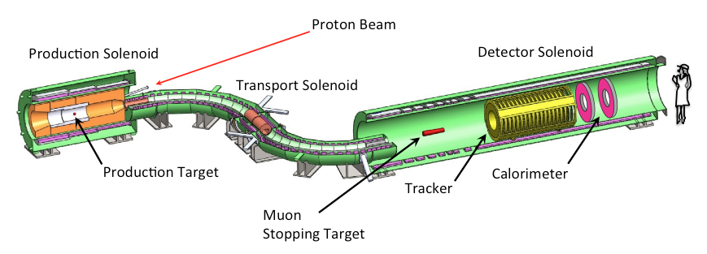
How Mu2e Works
Production Target
  Proton beam strikes target, producing mostly pions
Production Solenoid
  Contains backwards pions/muons and reflects slow forward pions/muons
Transport Solenoid
  Selects low momentum, negative muons
Capture Target, Detector, and Detector Solenoid
  Capture muons on target and wait for them to decay
  Detector blind to ordinary (Michel) decays, with E ≤ ½m_{μ}c²
  Optimized for E ~ m_{μ}c²

Slide 5
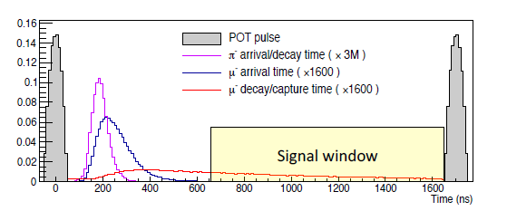
Beam Needs for Muon to Electron Conversion
Short, intense proton bunches
Time for muons to straggle and pions to decay away
Live window
The goal of Mu2e will be to increase the beam power by about a factor of 10 over Mu2e, to about 100 kW, using beam directly from PIP-II

Slide 6
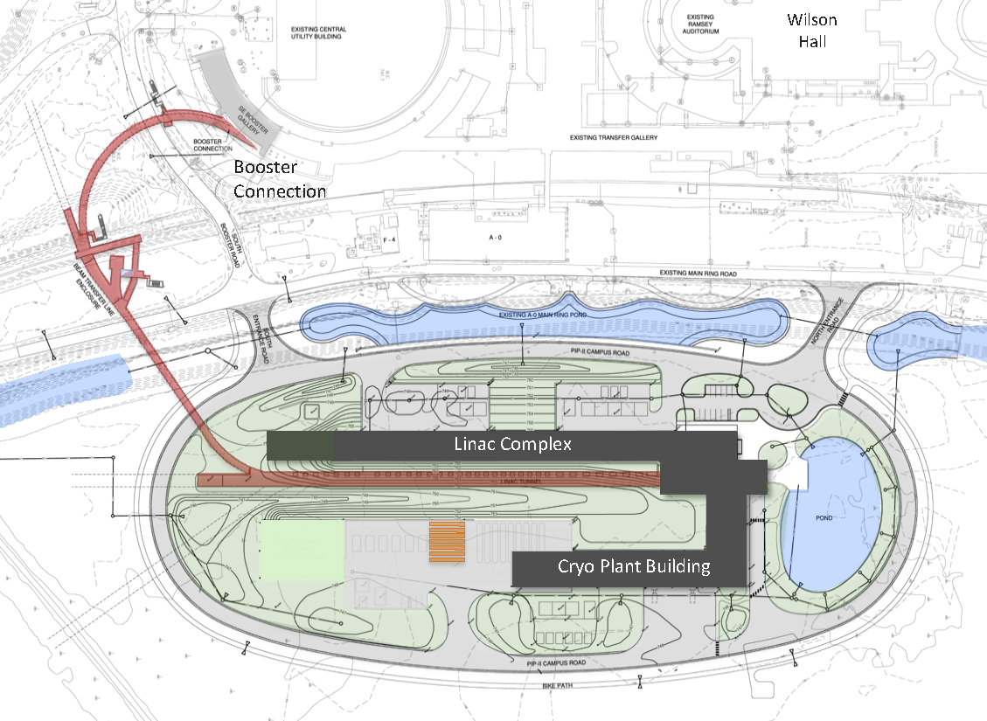
PIP-II Scope Overview
800 MeV H− linac
  Up to 165 MHz bunches
  Up to 2 mA CW
  Up 1.6 MW
Upgraded Booster
  20 Hz, 800 MeV injection
  New injection area
Upgraded Recycler & Main Injector
  RF in both rings
Protons for the High Energy Program
  .55 ms injection into Booster at 20 Hz
  ~1% of available beam!
Additional beam
  All the beam?
  3-way beam split?
To mu2e
The PIP-II scope enables the accelerator complex to reach 1.2 MW proton beam on LBNF target.

Slide 7
PIP-II and Next Generation Mu2e
PIP-II Features
  800 MeV beam will a selectable, arbitrary beam pattern up to 162.5 MHz
    Peak current up 5 mA (2.0x10⁸/bunch)
    CW average up to 2 mA (0.8x10⁸/bunch)
  High Energy (≧8 GeV) limited to ~1% of available beam
Mu2e-II
  Use PIP-II (800 MeV) as beam source
  Reuse as much as possible of the baseline Mu2e experiment
    Follow similar experimental scenario
    Improve if possible

Slide 8
Bunch Switching
The full bunch rate out of the PIP-II linac is 162.5 MHz
  Arbitrary pattern selectable on a bunch-by-bunch basis
The high energy (≧8GeV) program will use about 1% of the potentially available beam
  Limited by the 20 Hz rep. rate of the upgraded Booster
I’m assuming beam headed for the Booster will be switched by a 20 Hz switching magnet (not challenging)
If we’re the only other user, then we would access to the full 162.5 MHz; however
If we’re not the only user, our ~600 kHz bunch rate is certainly too fast for a pulsed kicker.
If there are multiple 800 MeV users, then the most likely solution is an RF beam separator.

Slide 9
RF Beam Splitting
The Beam will go through an RF deflector running at 162.5/4=40.625 MHz
Individual beam lines are selected by choosing which bunches to populate.

Slide 10
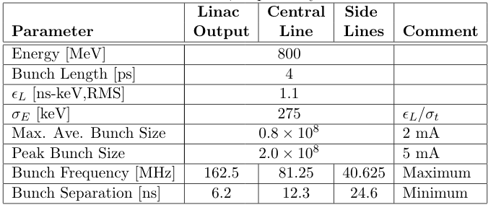
PIP-II Linac Beam Parameters
Up to ~100 μs or so
Limit for short bursts.
Cannot be changed quickly (we’ll be tied to this number during NOvA/LBNF operation!)

Slide 11
Input from PIP-II
We had a very productive meeting with Eduard Pozdaev from PIP-II
Important revelations:
  Bunch intensity cannot be changed quickly (minutes to hours)
    Injection into the Booster for LBNF will be subject to the 2 mA limit
    Luckily, in order to paint into the 53 MHz buckets, not every bunch will be populated, so bunch size will be 1.4x10⁸ rather than .08x10⁸
      Everything I presented before needs to be scaled by 1.4/2.0 = .7
        Power 70% or pulses 40% longer or somewhere in between
  Space charge effects will lead to significant longitudinal shearing, meaning either the RF separator would either have to go right after the Linac (as Eduard usually draws it) or we would need additional RF to rebunch the beam

Slide 12
General: Calculating Beam Rate and Power
Assume we have n_{b} bunches with N_{b} protons in each bunch every T seconds
Reminder: Limits
  N_{b,max}: 2x10⁸ (5 mA peak)
  Max. I_{ave}: 2 mA
0.8x10⁸ @ 162.5 MHz = 1.6MW
1.6x10⁸ @ 81.25 MHz = 1.6MW
2.0x10⁸ @ 40.625 MHz = 1.0MW
2.0x10⁸ @ 20.312 MHz = 0.5MW
Important note! if running with high energy neutrinos, bunch size fixed at 1.4x10⁸

Slide 13
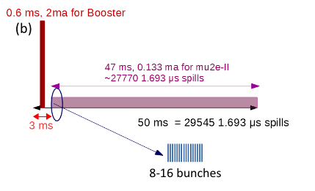
Mu2e-II Beam formation* (changes in red)
Possible beam structure (100 kW):
  10 bunch burst @ 600 kHz
  1.4x10⁸ protons/bunch
  600 kHz repetition rate
  = 100 kW
  3% duty factor
  0.12 mA
  These numbers are
  independent from the
  instantaneous bunch rate!
    ie, which line we’re in
The bunch rate only affects the pulse width
  162.5 MHz = 60 ns
  81.25 MHz = 120 ns
  40.625 MHz = 240 ns
All of these numbers would double for 200 kW
~275 162.5 MHz buckets
That’s all that would be needed from the accelerator end!
*https://www.snowmass21.org/docs/files/summaries/AF/SNOWMASS21-AF5_AF0-RF5_RF0_Prebys-204.pdf

Slide 14
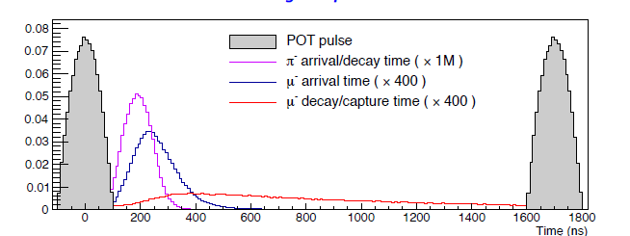
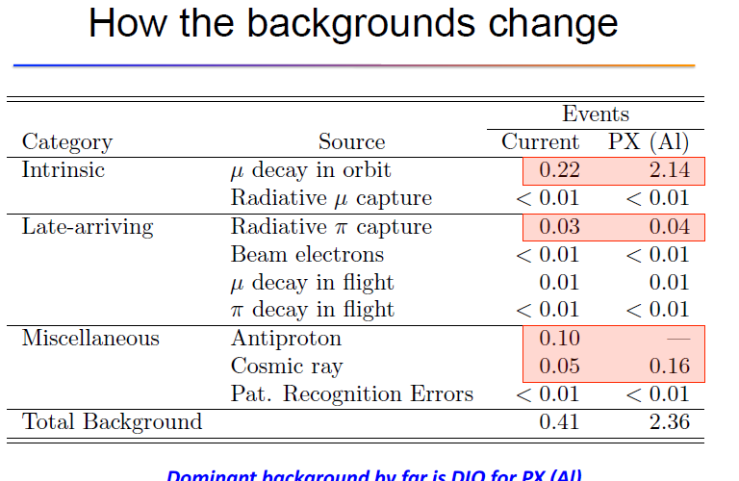
mu2e→mu2e-II
mu2e →mu2e-II
  shorter pulses @
  100 kW
Timing comparison
  K. Knoepfel et al.
Still dominated by
beam straggling

Slide 15
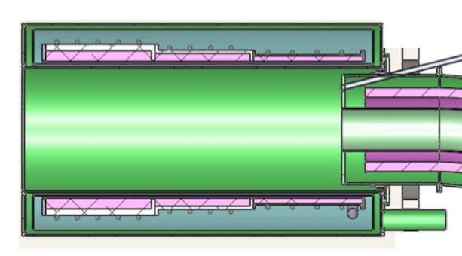
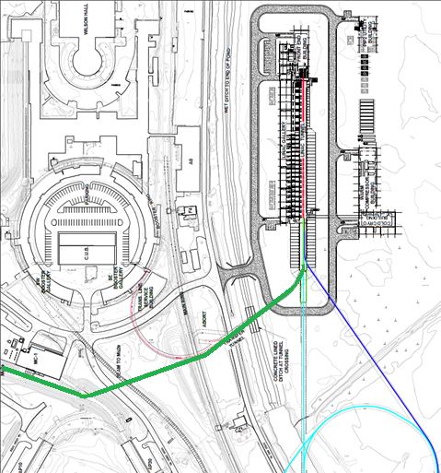
PIP –II delivery on target
PIP-II Linac is H⁻
  beam enters ~4T field
    14º → ~0.9 T transverse
    H⁻ stripping time (W. Chou)
    P=1.463 GeV/c
    βγcτ = ~12cm
  Beam should be stripped upstream
    orbit bump onto stripper foil could add to extinction (Roberts ….)

Slide 16
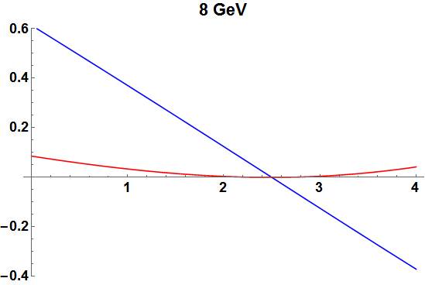
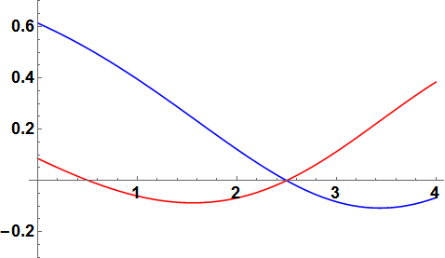
Beam Deflection 8 GeV vs 800 MeV
x
y
8 GeV
x
x
800 MeV
y

Slide 17
Targetry Issues
This is where there’s likely to be the most synergy with Muon Collider Development
Here, I’m primarily presenting the LDRD work of I. Fang, K. Lynch, D.Neuffer, V. Pronskikh, J.Popp, and D. Pushka, as presented by Vitaly Pronskikh at the Snowmass Joint Targetry Workshop, on Sept. 23, 2021.
There might be other talks at that workshop of interest to the Muon Collider community
  https://indico.fnal.gov/event/46752/

Slide 18
Scope of LDRD
Use MARS15 and g4beamline to evaluate and compare 3 conceptual designs for a 100 kW target for Mu2e-II
  Rotating Elements
  Fixed granular
  Granular conveyor belt
Choose the best concept and develop a preliminary design for the target.

Slide 19
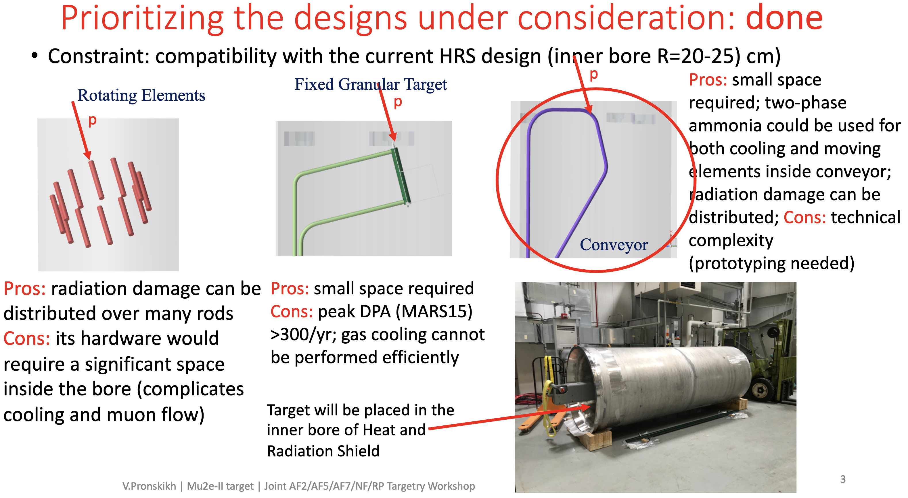

Slide 20
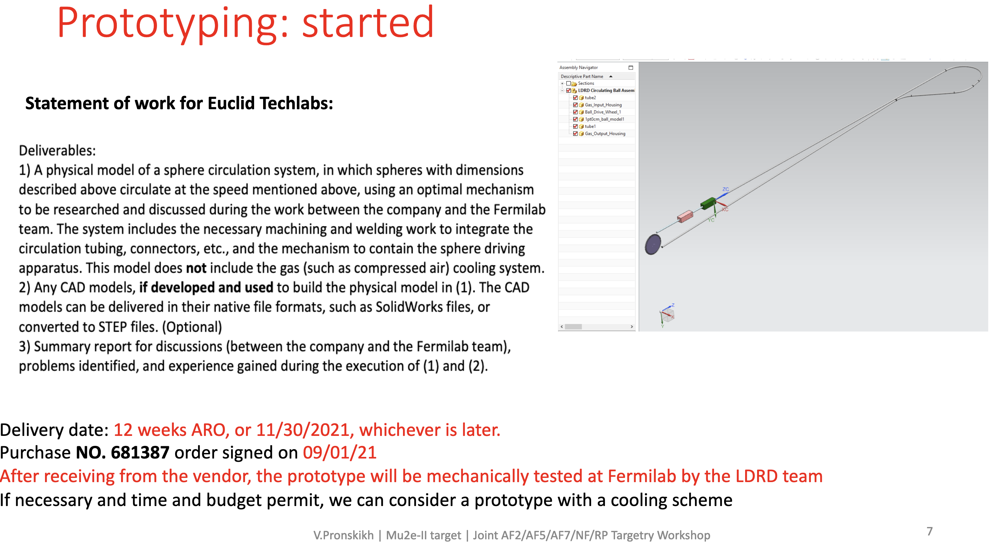

Slide 21
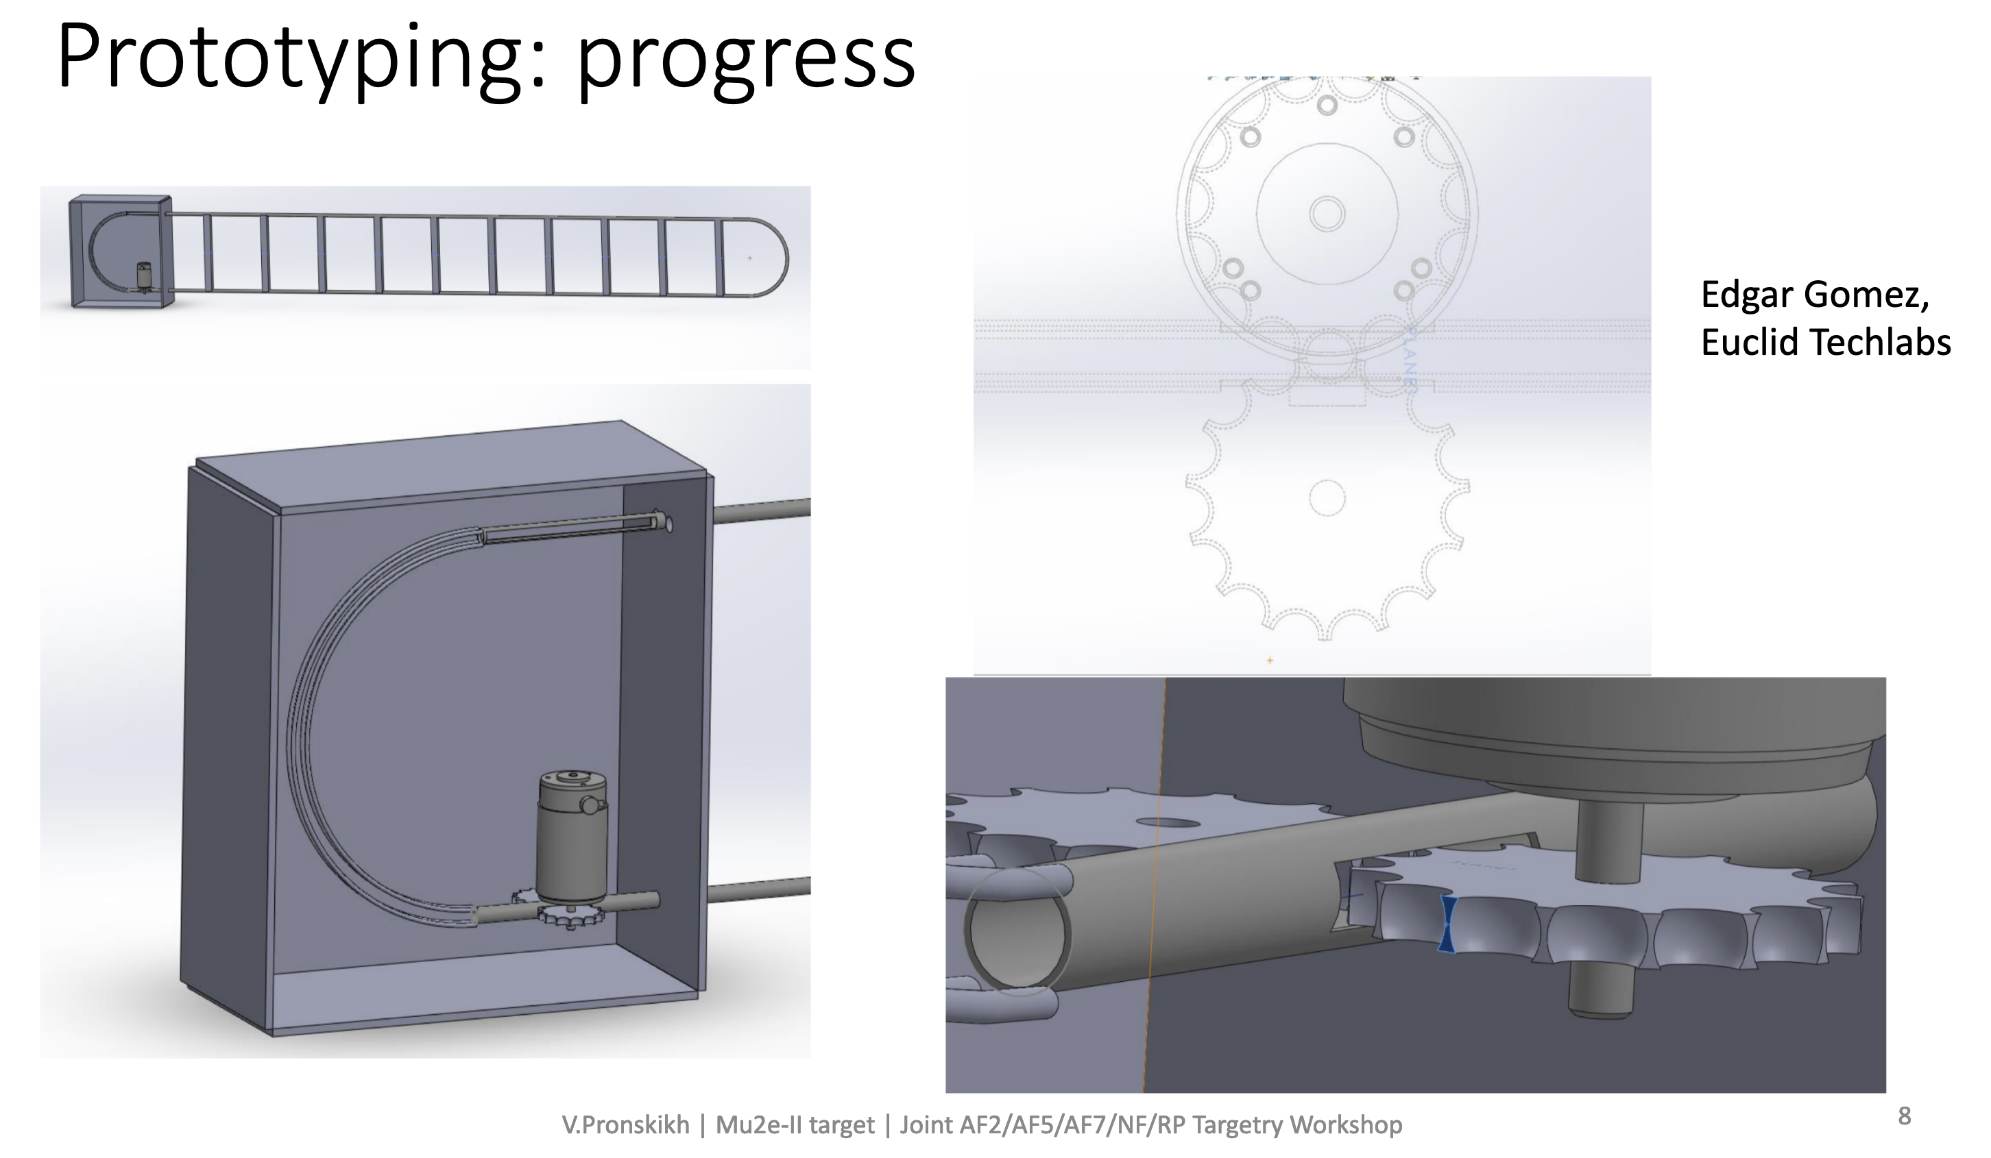

Slide 22
Need for a Bunch Compressor
Even if the beam power is sufficient, the 2x10⁸ bunch size limit is much too small for some experiments:
  Example: an FFGA-based Mu2e would need ~10¹² protons in <30 ns at 100-1000 Hz
    10¹² = 5000x10⁸ = 31μs @ 162.5 MHz = 1000 times too long!
For these experiments, we need some sort of “bunch compressor” to accumulate beam into larger bunches, and then extract them to experiments.
Two LoIs were submitted related to this:
  E. Prebys, et al, “Letter of Interest: Bunch Compressor for the PIP-II Linac”, https://www.snowmass21.org/docs/files/summaries/AF/SNOWMASS21-AF5_AF0-RF5_RF0_Prebys2-203.pdf
  W. Pellico, et al, “FNAL Booster Storage Ring”, https://www.snowmass21.org/docs/files/summaries/RF/SNOWMASS21-RF6_RF0_pellico-029.pdf
Unfortunately, because of rep rate and space charge issues, getting to the desired 1MW is very challenging.

Slide 23
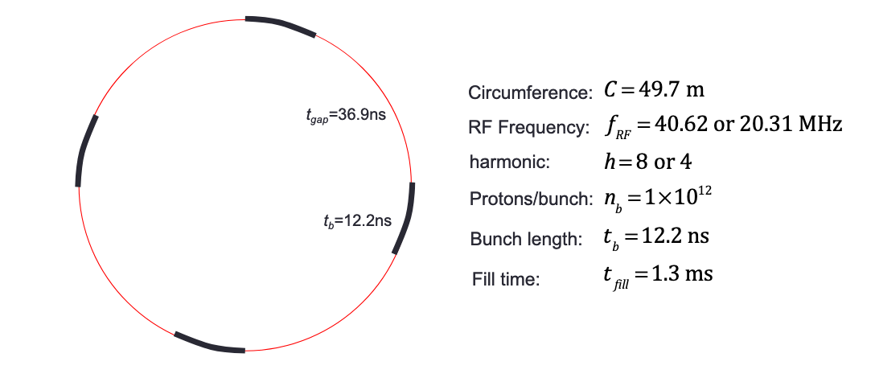
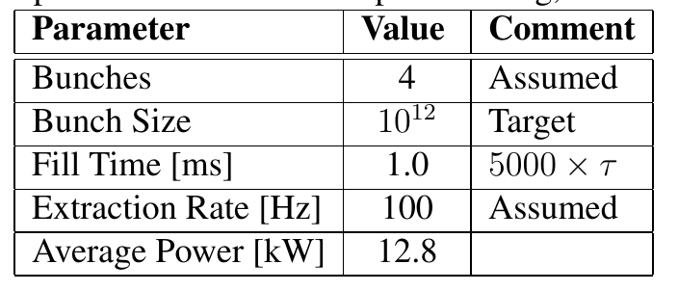
Prebys, et al: Conventional Magnets in a Green Field
Straw man parameters (FFA-base mu2e-ii)
Used wrong bunch size. Should be 5000
This is too low! Need R&D to push rep rate or bunch size!

Slide 24
Synergies with Muon Collider
Utilizing PIP-II
Compressor ring more compatible?
High power target design.
High power targets inside of powerful magnetic fields.
Radiation tolerant materials.
Radiation safety and hot handling.
And of course, we’re always looking for ways we could exploit Muon Collider development for a next next generation Muon 2 electron conversion experiment.

