Slide 1
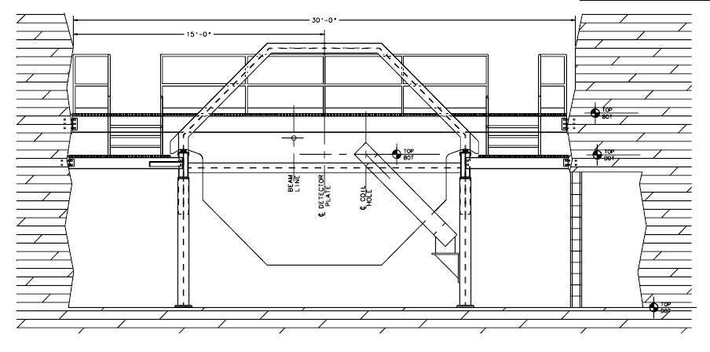
Far Detector Engineering
We are using the MINOS near detector as a starting point
≈ 1kT
Plates are 1” thick and roughly 4 X 5 m
B > 1T (for most of area)

Slide 2
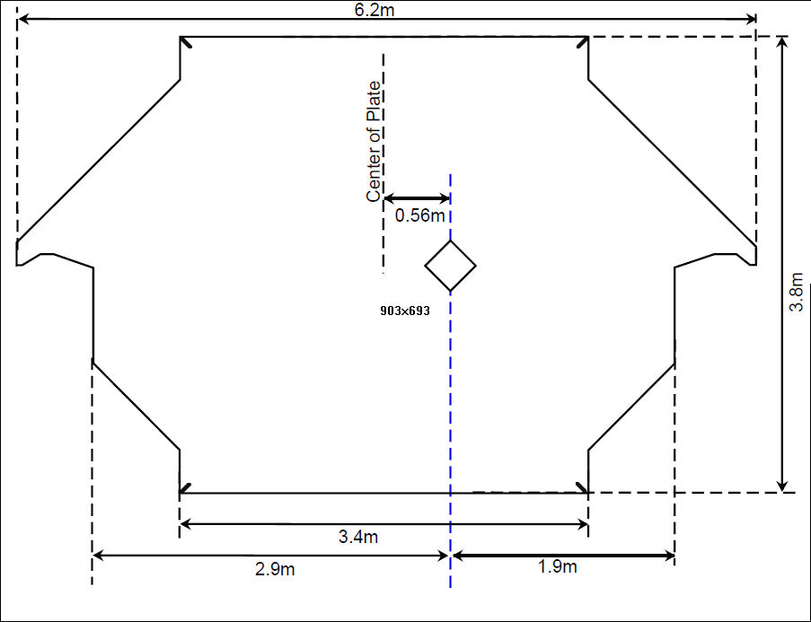
MINOS ND Plate
30 cm square hole for Cu (and H₂O cooling)
40 kA-turns

Slide 3
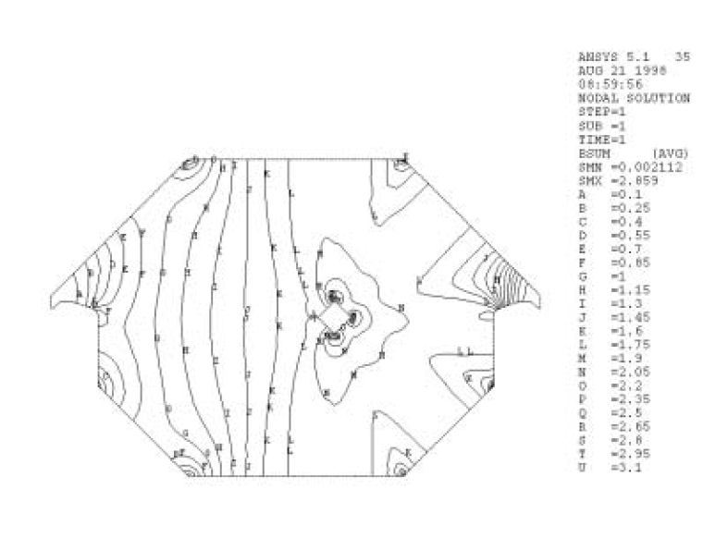
MINOS ND Field Map

Slide 4
VLENF Far Detector
Must do better w/r to muon charge ID than MINOS currently is capable of doing with their ND
VLENF-FD assumptions:
5-6 m diameter plate (round) with 20 cm hole in the middle
Approach “ideal” toroidal field
1 cm thick
Welded together from two ½ circles
X-Y measurement (2 scintillator planes) between each plate
≈ 270 kA-turns excitation current
3 turns of SCTL

Slide 5
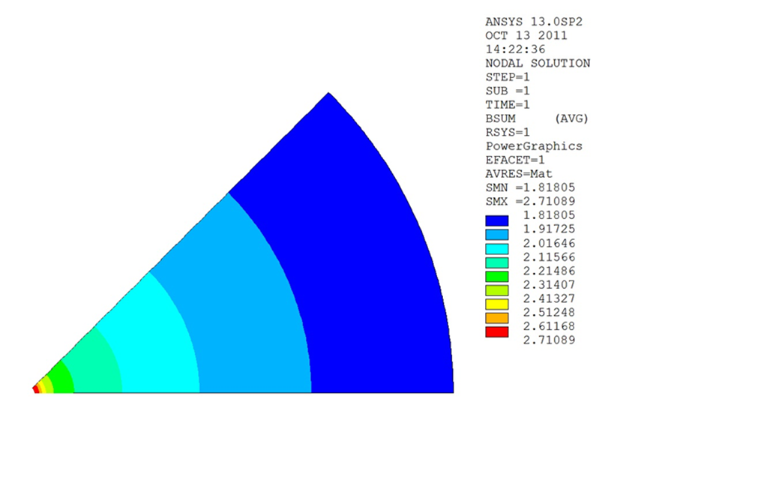
Far Detector - SuperBIND
Quick first pass at B (Bob Wands)
B>1.8T everywhere
6m Diameter Plate

Slide 6
Outlook
PPD mechanical is working on detailed design for plate
Once that is done, the ANSY group can generate a detailed field map
At that point, we would be ready to do full GEANT4 simulation

