Slide 1
48 Hour Summary
Kevin McDonough
Friday 09:00 Meeting
October 08, 2021

Slide 2
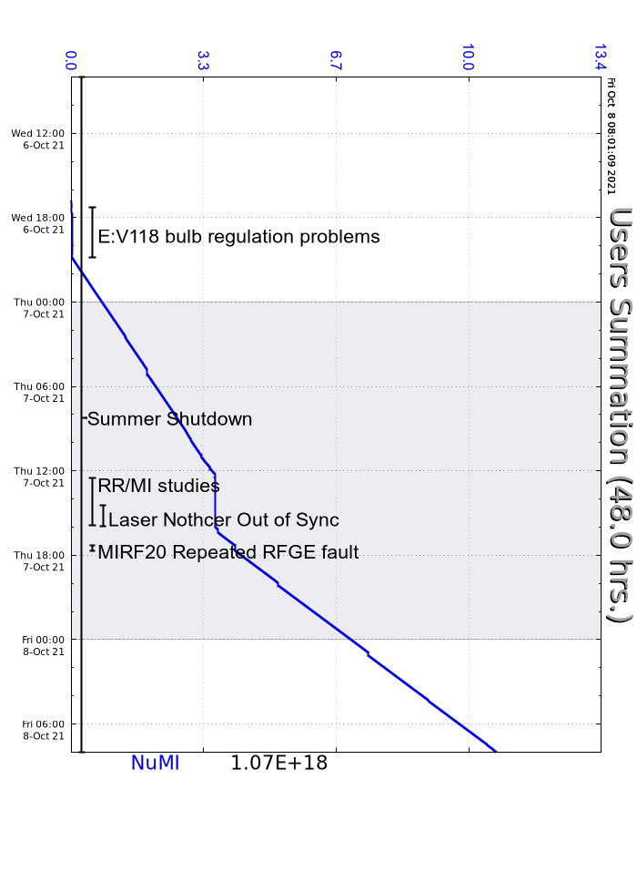
Wedneday
F2 manhole was dropped and re-secured
MI65 and MINOS Absorber secured (Crew chief BT5 on the roller up door)
HEP officially started at 1647 with beam to NUMI (6 batch $23 beam).
Problems with E:V118 regulation caused some downtime to NUMI while experts dealt with it.
Booster experts asked us to limit NUMI to 6 turns for this evening.
Thursday
Recycler and MI studies this morning.
MI8 studies this morning through end of shift.
The LabVIEW process for the laser notcher died. Experts rebooted the PC.
MIRF20 faulted off several times due to repeated RFGE. RF experts replaced the grid power supply on the modulator.
Bypassed MIRF05 from the NuMI permit due to repeated dissipation faults.

