Slide 1
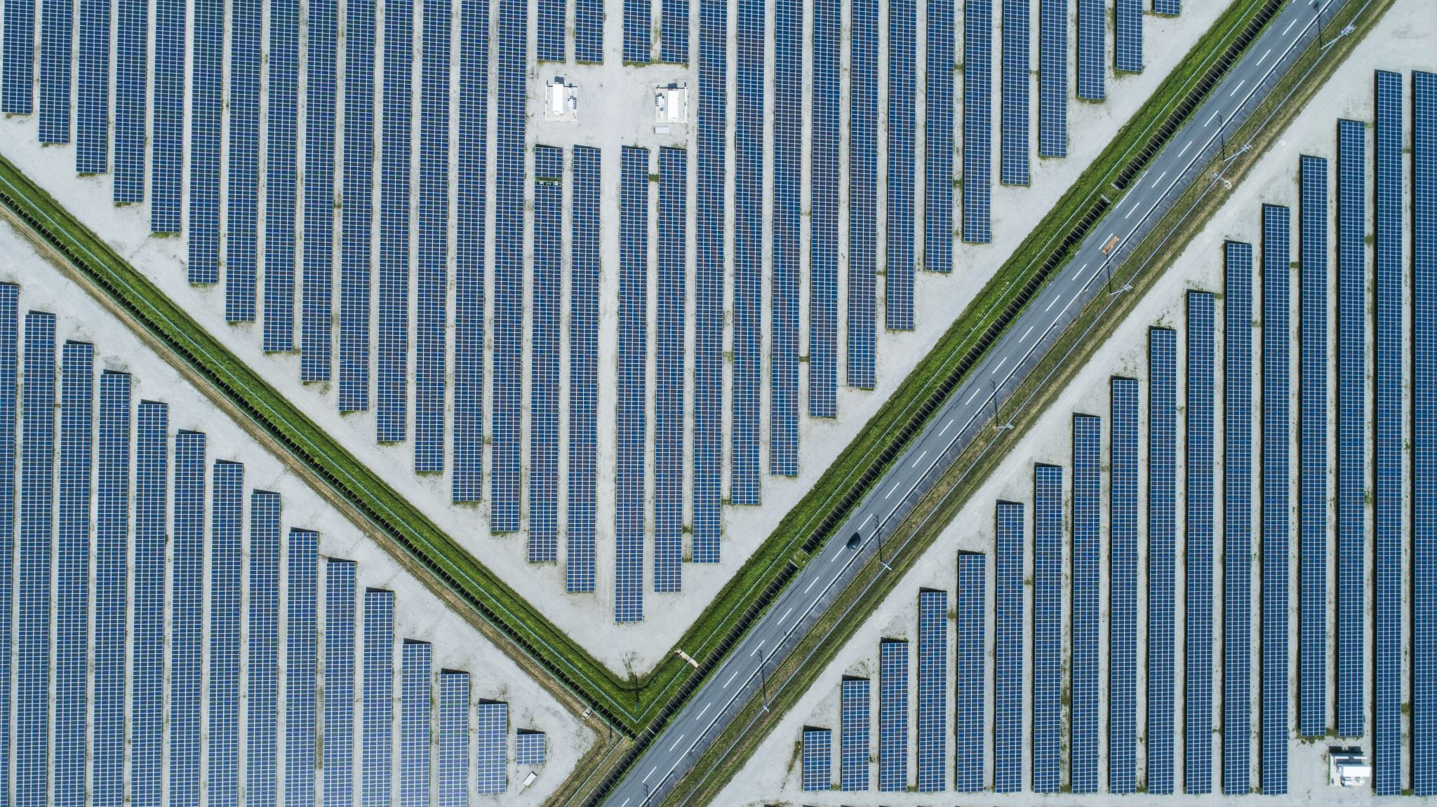
Coldboxes at CERN
Giovanna Lehmann Miotto
October 11th 2021

Slide 2
Setups at CERN – near term
NP02
System running with 3 SSP boards (50 MHz)
Integration with dunedaq urgent (and hopefully imminent)
Proposed file names: partitionName_runxxx_fileindex_timestamp.hdf5 (partition=np02_arapucas)
VST
Test crate (in DAQ barrack) with 4 WIB1 cards to validate DAQ integration
Up and running
Proposed file names: partitionName _runxxx_fileindex_timestamp.hdf5 (partition=np04_vst)
VD Coldbox
DAQ will readout only 3.5 WIB1 boards (bottom electronics) for the first run
Closing of the box foreseen next week
Proposed file names: partitionName _runxxx_fileindex_timestamp.hdf5 (partition=np02_bde_coldbox)
HD Coldbox
DAQ will readout 5 WIB1 boards (full APA) for the first run
Run foreseen in November 2021
Proposed file names: partitionName _runxxx_fileindex_timestamp.hdf5 (partition=np04_coldbox)

Slide 3
Coldboxes – next rounds
VD coldbox
There will be 4 runs:
Run 2 (Q1 ‘22): possibly some integration with PDS
Run 3&4 (Q3/4 ‘22): switching to WIB2, integration of top electronics (ethernet + WR)
HD coldbox
Next run foreseen in April 2022:
Integration with PDS
Switching to WIB2

Slide 4
DAQ preparations
Release
Release dunedaq v2.8.1 with all the feature we must have (this week) to run the coldboxes
SW area
Prepare an area to create the right environment for running
Incl detector specific SW /nfs/sw/dunedaq-v2.8.1/
Configs
Prepare an area with the suitable configurations:
/nfs/sw/dunedaq-v2.8.1/configurations

