Slide 1
72 Hour Summary
Michael Guzman
Monday 09:00 Meeting
October 11th, 2021

Slide 2
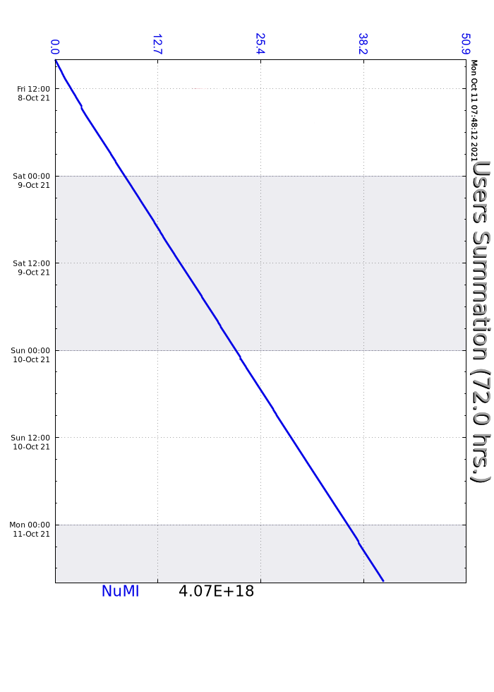
Weekend
Minimal downtime
MIRF5
Ops secured M02
Current conditions:
6 Batches to NuMI

