Slide 1
SAND Technical Meetings
Scope and Organization
C. Montanari
FNAL – INFN Pavia
SAND Technical Meeting - October 12, 2021

Slide 2
SAND Technical Meeting
  Scope of the meeting:
    Follow and inform about the evolution of design, prototyping, construction, installation and commissioning processes leading to the implementation of SAND in DUNE’s ND facility.
    Develop, organize and overview the integration between detector subcomponents.
  Format of the meeting:
    Recent news and updates (from TL, CL, + others) ≈ 10 minutes
    Topical presentation(s) ≤ 30 minutes
    Open discussion ≈ 15 minutes
    AoB 5-10 minutes
  All meetings will be recorded (no minutes) and the recordings will be posted on the respective indico pages.

Slide 3
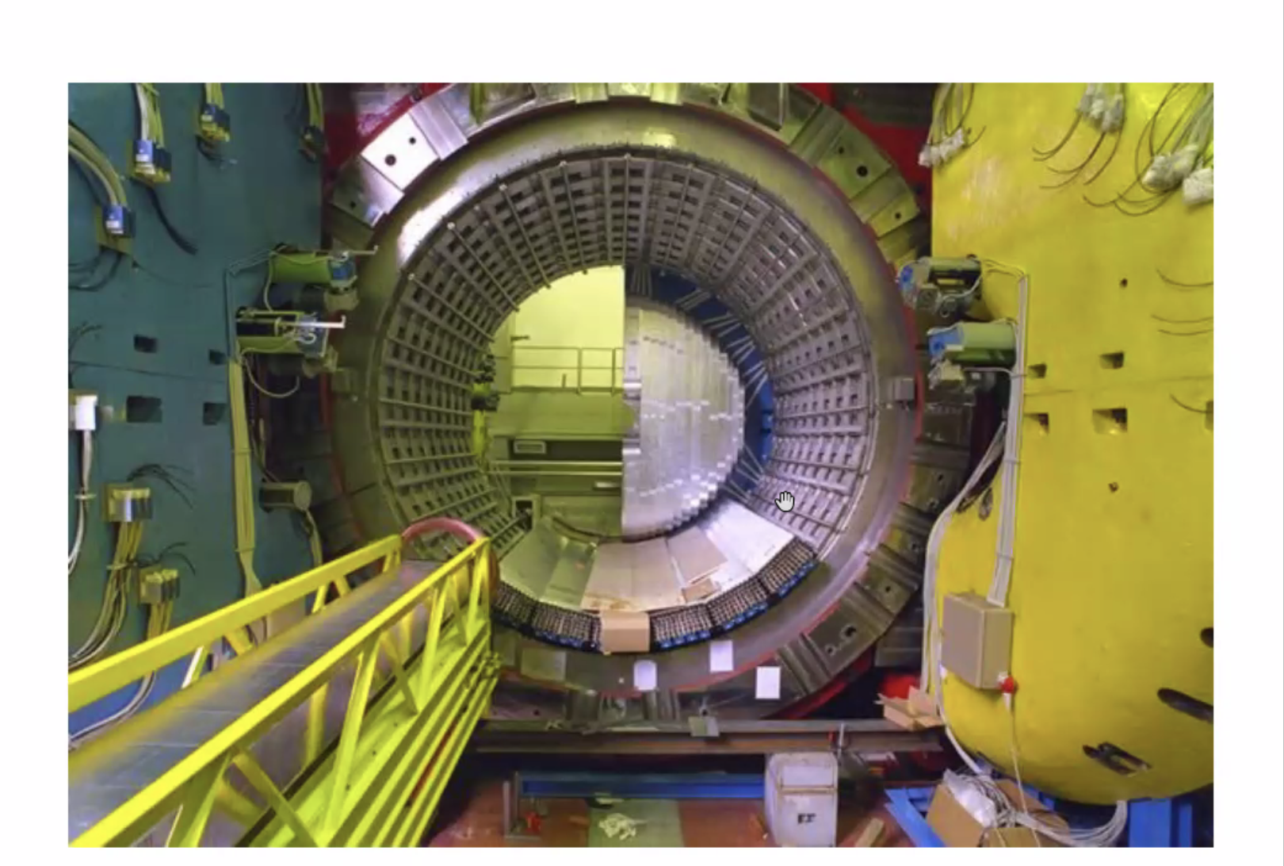
SAND
ECAL
Pb - scintillating fiber sampling calorimeter::
1 mm diameter sci.-fi.
grooved lead foils from molding .5 mm plates
Calorimeter thickness = 23 cm
Total scintillator thickness ~ 10 cm
24 barrel modules, 4.3 m total length (4 tons each)
2x32 endcaps modules
MAGNET
ECAL
barrel
ECAL
endcap
INNER
TRACKER
Coil parameters
Drawing to be updated
Guaranteed heat loads
Inner Tracker: STT + GRAIN
Magnet and Yoke (62 pieces) exploded drawing

Slide 4
Technical Working Groups and Interfaces
  The following working groups can be easily identified on the basis of deliverables:
    Magnet and yoke
    ECAL
    Inner Tracker (this will be split in sub-WGs)
    GRAIN
    Muon chambers (decision making process)
    Slow controls (reference persons)
    DAQ, trigger and Beam interface (reference persons)
  The following interfaces are also required:
    Electrical equipment
    Installation & Integration (logistic)
    Cryogenics (interface)
    Safety
    Data Management and Computing (shared with Software and Analysis Board)
  Also very important:
    Documents collection, organization and distribution
Straw tubes and targets construction
Readout electronics
Gas system
Support structure, mechanics and alignments
Design & prototyping
Design & prototyping
Additional working groups can be defined, according to specific needs.

Slide 5
Workflow
  For new sub-components, like STT and GRAIN the workflow can be summarized as:
  For existing sub-components (ECAL, Magnet and Yoke) the workflow becomes:
  Preliminary to both design and definition of upgrades it is fundamental to clearly define a set of basic parameters/requirements such as spatial and timing resolutions, mechanical alignments, constraints (dimensions, weights, power consumption, heat dissipation, …), data rates, etc.. This process requires a close interaction between the community that developed the conceptual design and the one that is taking the responsibility of realizing the sub-components and integrating them. Additional constraints, defined at the management level (time schedule, external resources, standards, …), are also to be integrated at the design phase.
PROCUREMENTS/CONSTRUCTION
DESIGN
PROTOTYPING
INSTALLATION
TEST
COMMISSIONING
DEFINITION OF UPGRADES
PROCUREMENTS
IMPLEMENTATION
TEST
COMMISSIONING
DISASSEMBLY
TRANSPORT
ASSEMBLY

Slide 6
Next steps
  Next Technical Meeting, on October 26, Fabrice Matichard, the lead engineer of DUNE-ND Integration and Installation team, will give an overview of the I&I team scope and status.
  We will start a discussion to define all parameters required for the design and upgrading phases.
  Initiate e reflection on what kind of contribution, both individuals and groups, are willing to make to the realization of SAND.
  This meeting will continue to be advertised to Dune-nd-sand@fnal.gov, however, all those interested in following more closely the technical evolution of the experiment are invited to subscribe to dune-nd-sand-tech@fnal.gov mailing list.

