Slide 1
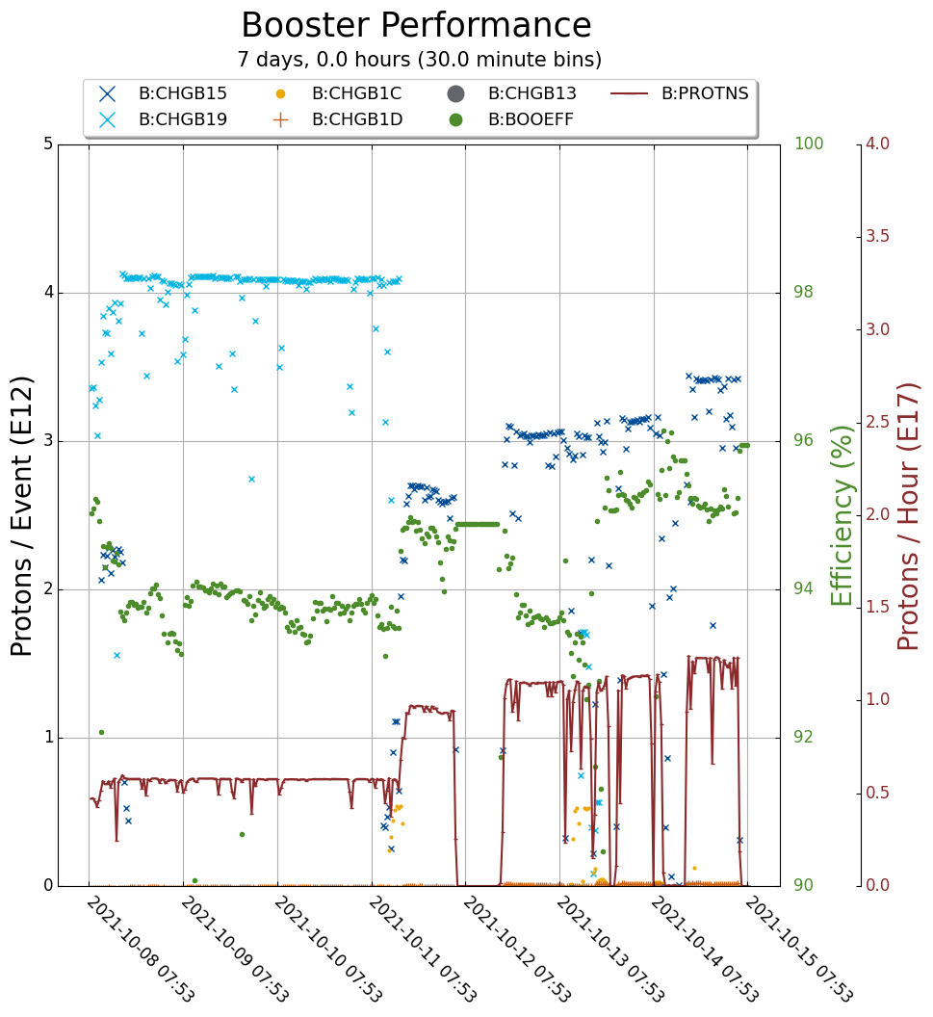
Booster Operations
Switched to $15s on Monday. 3.4e12 p/pulse, 1.25e17p/hr.
Tuning up for higher intensity.
Working to understand loss profile.
Two gradient magnets and chokes in the X-gallery highbay. Will move next week to TD for flag installation, and then to E4R.

