Slide 1
Main Injector/Recycler Startup
Marty Murphy
AD 0900 Scheduling Meeting
15 October 2021

Slide 2
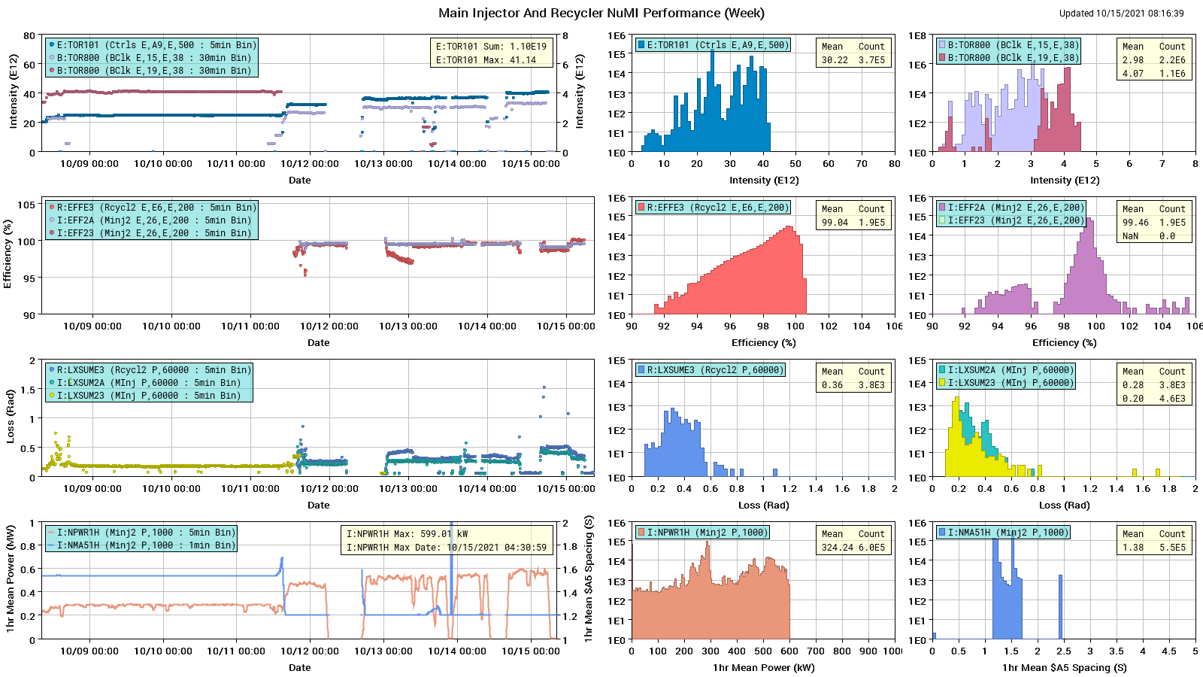
HEP Beam to NuMI

Slide 3
This Week
Peak power to NuMI ~550 KW
Big Items:
Tuesday – access to address stuck MI extraction septa. Upstream motor on upstream septa was stuck. MI people un-stuck it in the tunnel. Seems to be working with a “dead zone” in the very far outside position, which we can live with. Thanks to RSO & Team-RunCo for their nimble and agile response.
Wednesday
Parasitic RR lattice measurements.
H612 regulator over-temp Wed. evening. Thanks to EE-support for their prompt response.
Thursday – Dedicated MI-8 to RR lattice measurements.
MI8 access to remove MW811 from beam (broken motor) Thanks to Rich and Stephen for their quick response and work.
Today
Beam off for NOνA FD downtime.
Study: MI $21 flattop tunes & orbits

Slide 4
Start-up Activities
Beam Commissioning Continues
MI:
Start-up P1, P2 and P3 beam line power supplies. In Progress
Commission SY slow spill to SY dump. Next week
RR:
Establish “off-momentum” injection. Done
Parasitic scans – feed-down, sextupole, etc. Minimal impact
Provide beam for Muon Campus tune-up. As requested
RR in Two Weeks
MI8-RR lattice measurement Dedicated study 4-6 hours

