Slide 1
Some Thoughts on Themes in TPC Gain
Ben Jones, University of Texas at Arlington

Slide 2
Tradeoffs involved in choice of gain mechanism / readout:
Stable operation
High charge or light yield
Small fluctuations
Fine granularity of imaging
Must play well with others
Low system complexity
Solutions exist for solving each of these independently,
But doing one of these things better often means doing another worse.
The most challenging technical applications of TPCs now require all of them at once.
This suggests a possible framework for discussing the technological challenges and promising solutions.

Slide 3
Tradeoffs involved in choice of gain mechanism and readout:
Stable operation
High charge or light yield
Small fluctuations
Fine granularity of imaging
Must play well with others
Low system complexity
Often requires a quencher…
Promising technological solution:
scintillating quenched gas mixture with light emitted in visible.
In order to apply enough E field to achieve this.
Ar/CF₄ (99/1%) @ 10bar
5500eV
(180ph/MeV)
1400eV
(700ph/MeV)
But quencher inhibits scintillation emission

Slide 4
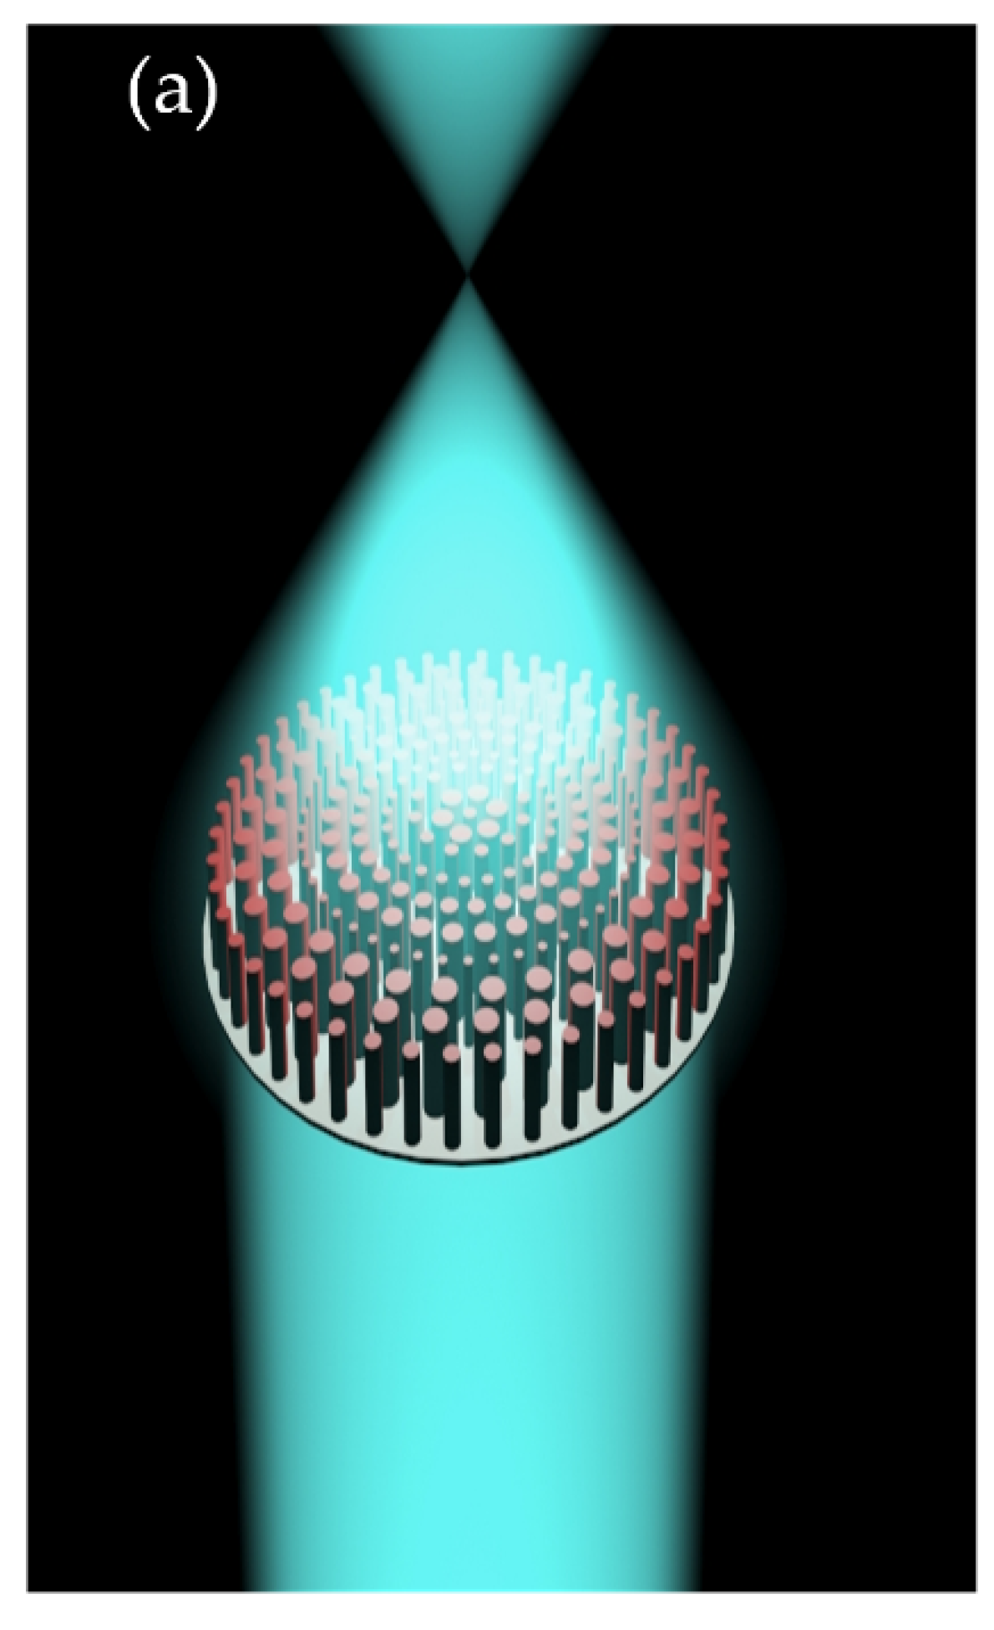
Tradeoffs involved in choice of gain mechanism and readout:
Stable operation
High charge or light yield
Small fluctuations
Fine granularity of imaging
Must play well with others
Low system complexity
Promising technological solutions:
Couple EL gain with advanced optical solutions
Optical focusing with metalenses
High reflective materials
Higher collection efficiency light collection systems
Etc…
Highest gain is achieved in avalanche mode
But electroluminescence mode needed to achieve
low Fano factor for e.g. 0nubb energy resolution
EL gain…

Slide 5
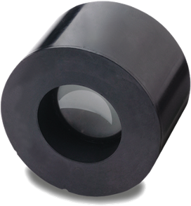
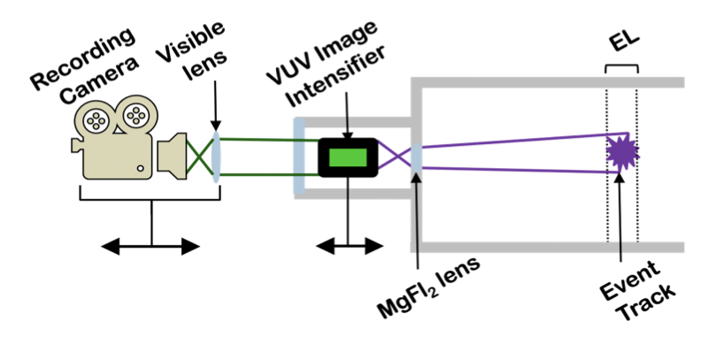
Tradeoffs involved in choice of gain mechanism and readout:
Stable operation
High charge or light yield
Small fluctuations
Fine granularity of imaging
Must play well with others
Low system complexity
Promising technological solution:
Achieve gain externally with standalone commercial image intensifiers and UV optics, coupled to high speed cameras
Fine granularity means high readout channel density
But system complexity grows faster than linearly,
as does control of radioactivity, heat load, etc…

Slide 6
Play well with others
Stable operation
Fill in your favorites!
Scintillating gas mixtures
Advanced gain structures (FAT-GEM, etc)
Low complexity
Scintillating gas mixtures
High yield
Radiopure internal multiplexing electronics
Spherical TPCs
VUV image intensification
Advanced optical elements for EL
(metalenses, fiber collection, etc)
Fine granularity
Small fluctuations

