Slide 1
Barium daughter tagging for more sensitive 0νββ decay detection
William Fairbank
Putting together input from the NEXT and nEXO Collaborations

Slide 2

Novel instrumentation: ¹³⁶Ba daughter tagging in ββ decay
“Physics areas”
Neutrinoless double beta decay
The only known sensitive way to establish the Majorana nature of the neutrino
Observation would establish violation of lepton number conservation.
Potential window into matter-antimatter asymmetry in the Universe.
Would shed light on neutrino mass and the origin of that mass.
¹³⁶Xe double beta decay
Detecting ¹³⁶Ba daughter provides final discrimination against all non-ββ decay backgrounds and increases 0νββ sensitivity
Both the NEXT and nEXO collaborations are developing methods of Ba tagging for use in future 0ν ββ detectors

Slide 3
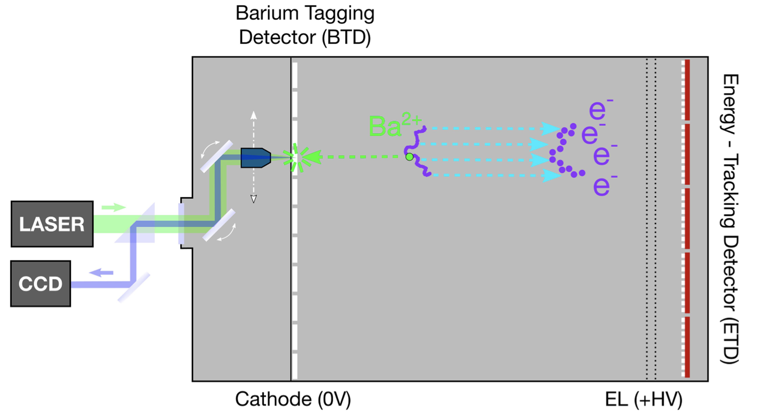
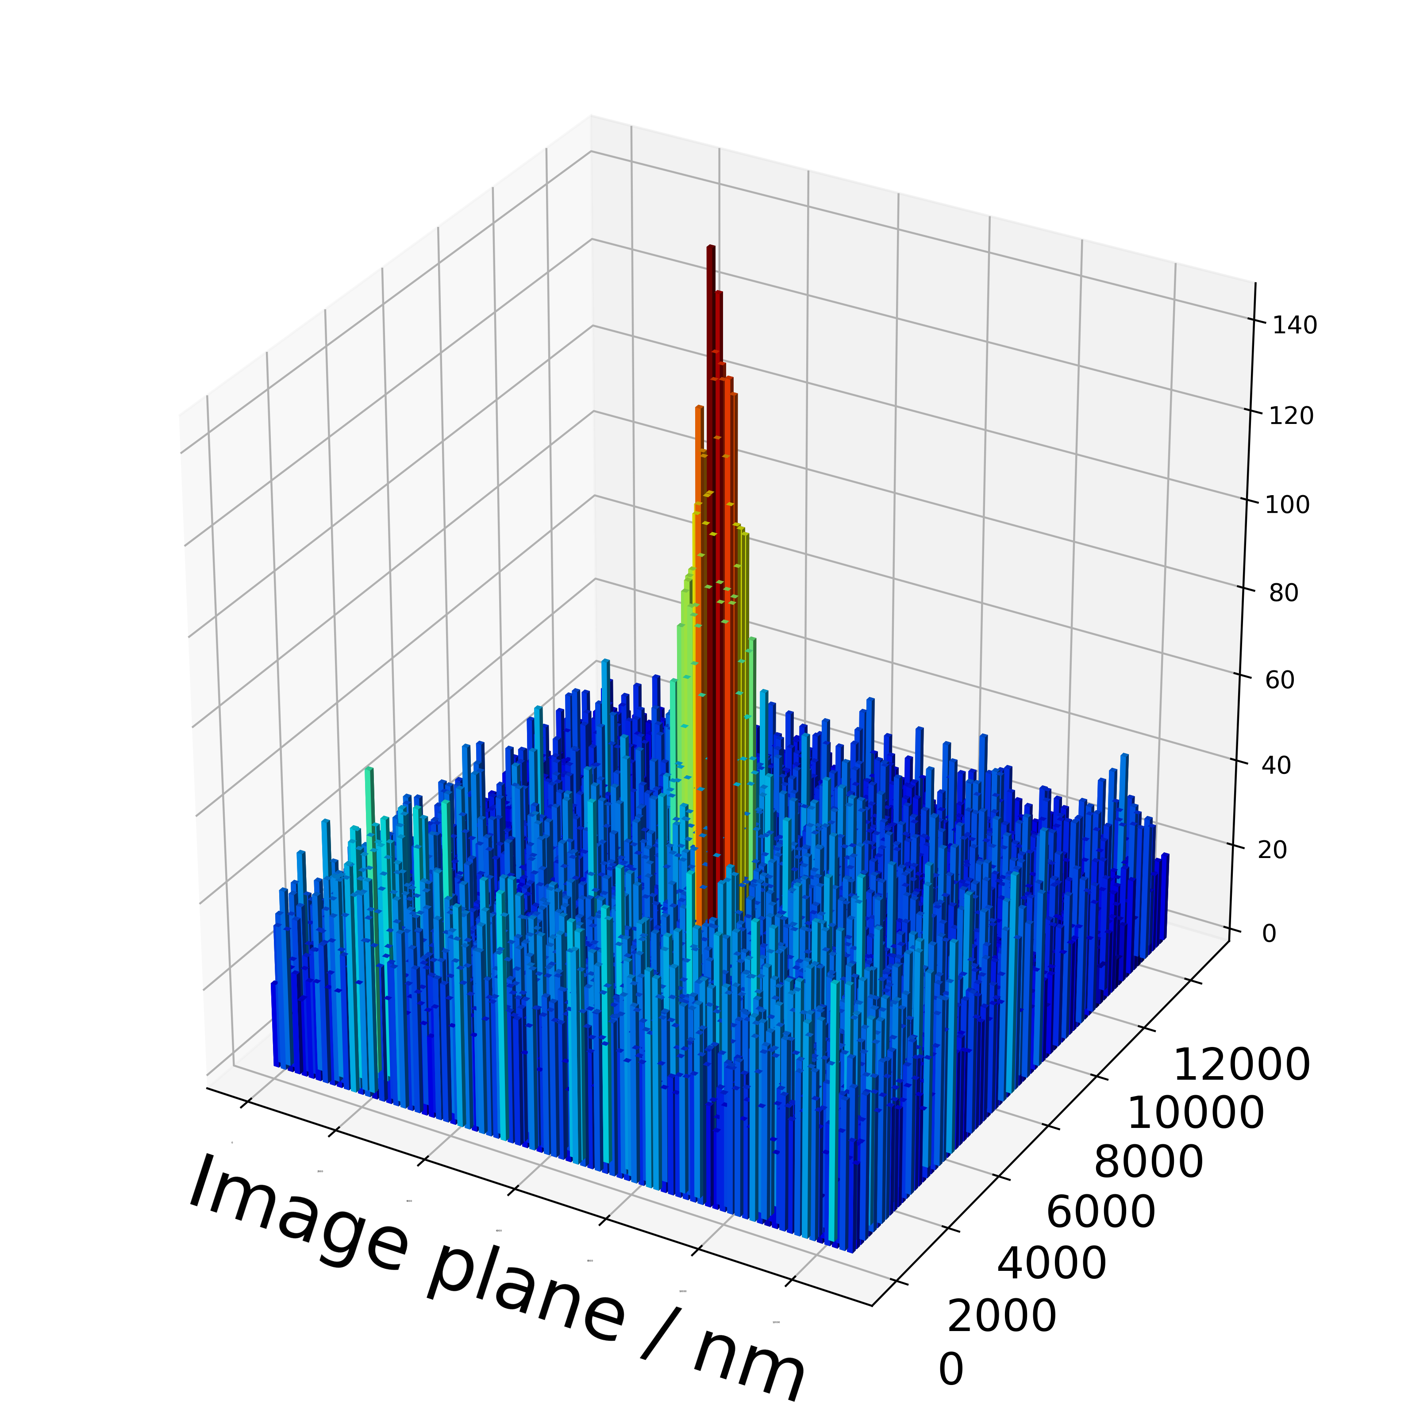
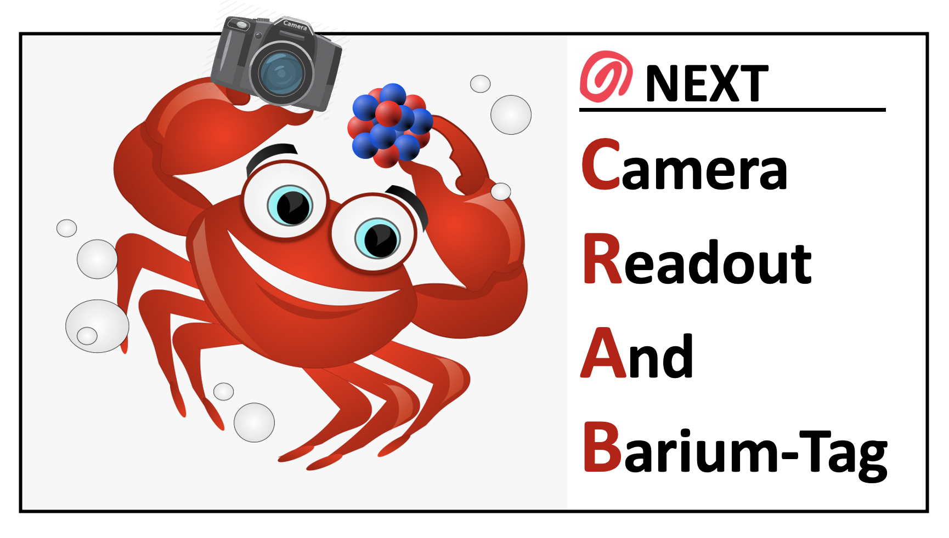
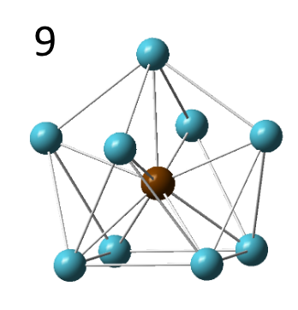
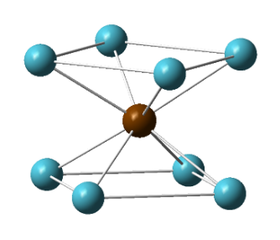
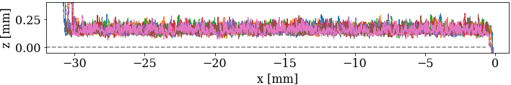
Demonstrators
NEXT-BTX concept:
Single ion sensor development is now fairly advanced
Important R&D remains for ion concentration and collection:
  Sensor-to-ion (BTX concept)
  Ion-to-sensor (CRAB concept)
NEXT-CRAB concept:
2. Single Ba²⁺ ion tagging w/SMFI
Molecules found that fluoresce when Ba⁺⁺ ion is captured
Single molecules with Ba++ can be imaged
EL (+HV)
Ba⁺⁺ ion
10 bar Xe
Ba²⁺
e
RFC
e
CCD
e
CCD
TPX
Cam
TPX
Cam
NEXT Data
3. RF Carpet ion transport in xenon gas
CCD
CCD
+
-
+
-
+
-
+
-
+
-
+
-
+
-
+
-
+
-
+
-
+
-
+
-
SIMION simulation
→ Demonstrator phases under intensive development on 2-3 year timescale

Slide 4
Ba tagging with single Ba ions extracted to Xe gas and vacuum
Upgraded nEXO TPC
RF funnel has been operated and is being improved.
Linear Paul Trap, Quadrupole mass filter and MRTOF have been built are being commissioned.
Work on demonstration of a laser ablation source in high-pressure gas

Slide 5
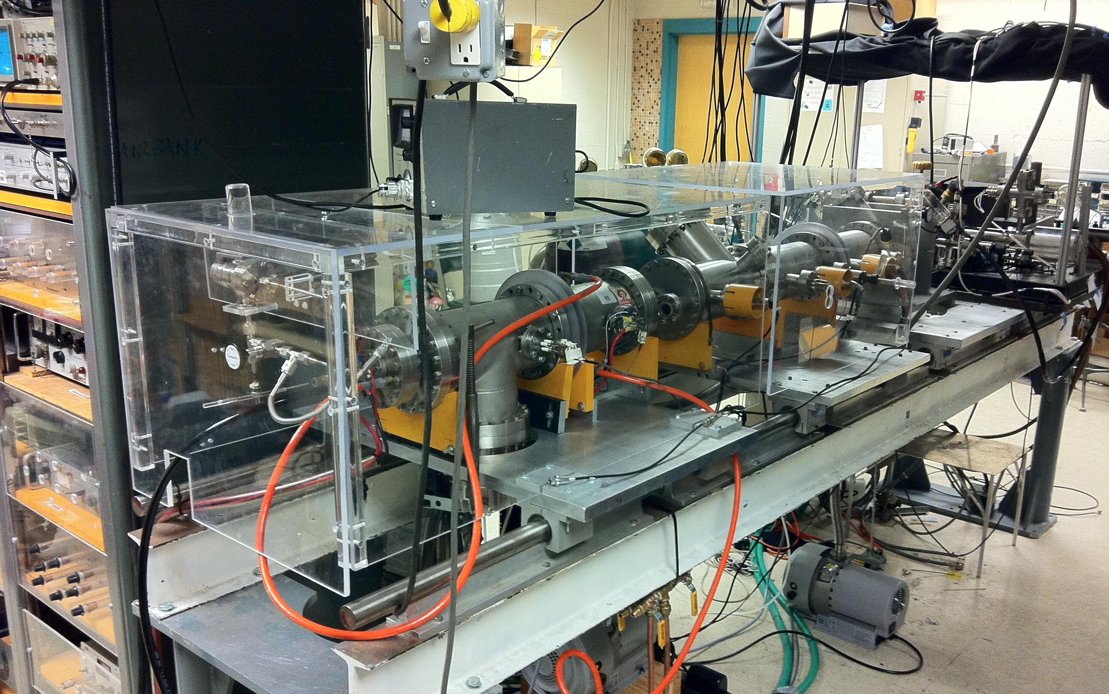
Barium tagging by imaging of single Ba atoms and ions in solid Xe
ExB Filter
Ion Source
Cryostat
Concept tested with mass-selected Ba⁺ ion beam in vacuum
SXe on cryoprobe frozen from LXe and raised
Window with a little frozen SXe

Slide 6
"Instrumentation Requirements"
Instrumentation Requirements include:
Extraction of the daughter ¹³⁶Ba from a large 0νββ TPC
Transport to a single Ba detection region
Count 1 or 0 Ba atom
Do all this with high efficiency and selectivity
Do it with equipment that does not compromise event detection capability and uses low background materials.

Slide 7
"Instrumentation Challenges"
Instrumentation challenges include:
Detecting single Ba atoms – much progress but continued R&D to achieve high efficiency and selectivity
R&D on extraction and transport in each case
Implement controlled and characterized sources of Ba isotopes for tests
  e.g., radioactive Cs isotopes beta decay to Ba isotopes
  Eventually 2νββ decays as a source
Detect Ba daughters from individual decays - Cs beta decays in small Xe test cell and then 2νββ decays in a large enough TPC
Engineering of a 0νββ decay detector with Ba tagging

Slide 8
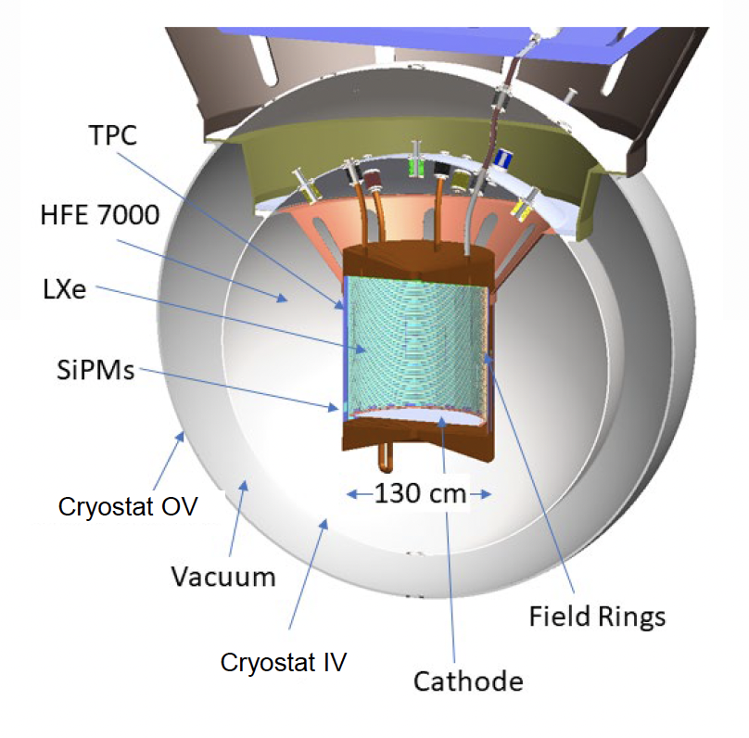
For nEXO, Ba tagging is envisioned as a possible upgrade after n years of operation.
nEXO TPC:
Some of the next phase work beginning
Experiments with ¹³⁹Ba daughters from ¹³⁹Cs β decay planned at TRIUMF
Development of technology to extract daughter ¹³⁶Ba from anywhere in a LXe detector vessel
There are considerable engineering challenges even after Ba tagging is demonstrated on a smaller system.

Slide 9
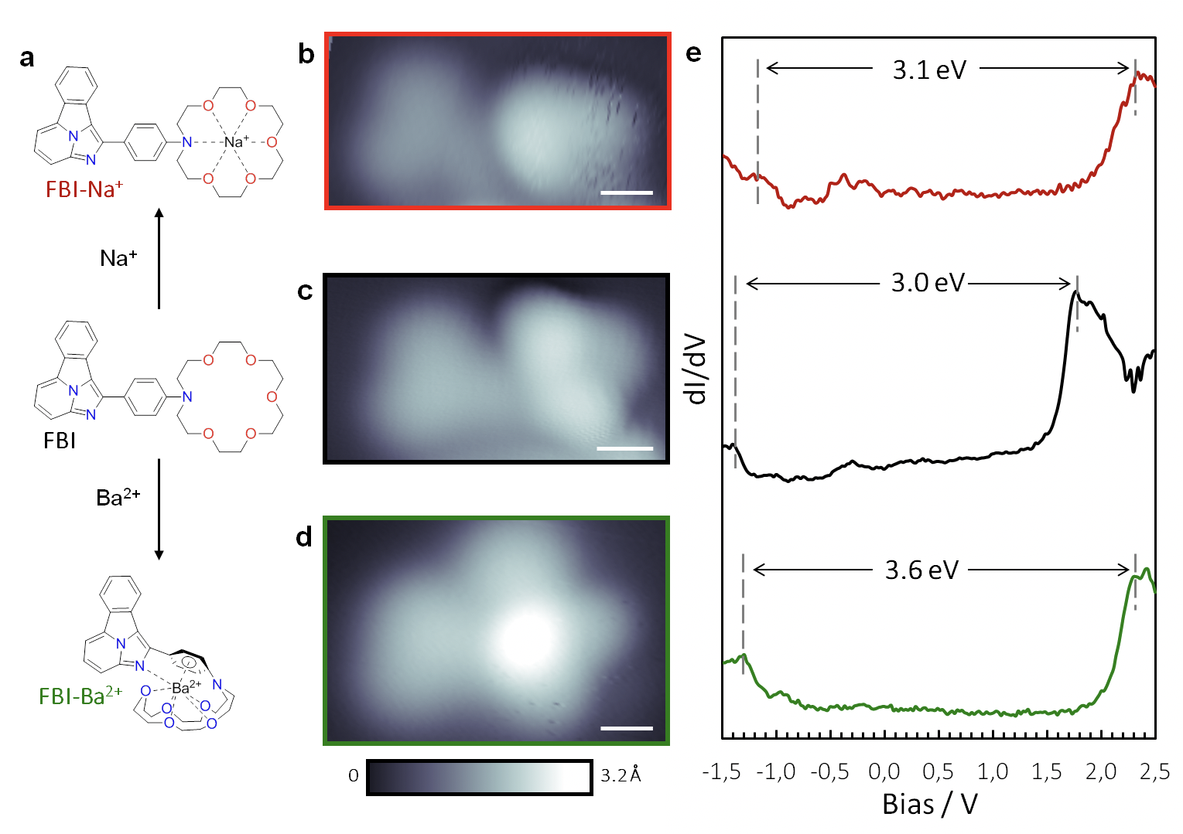
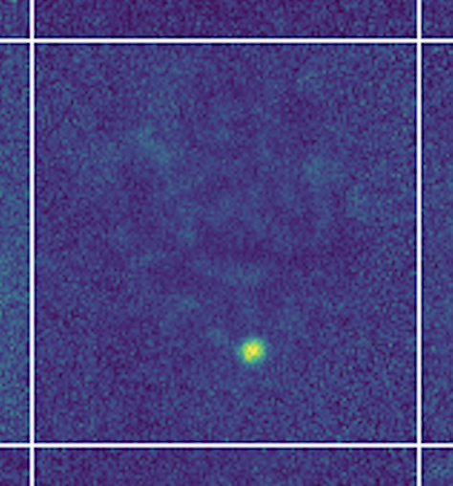
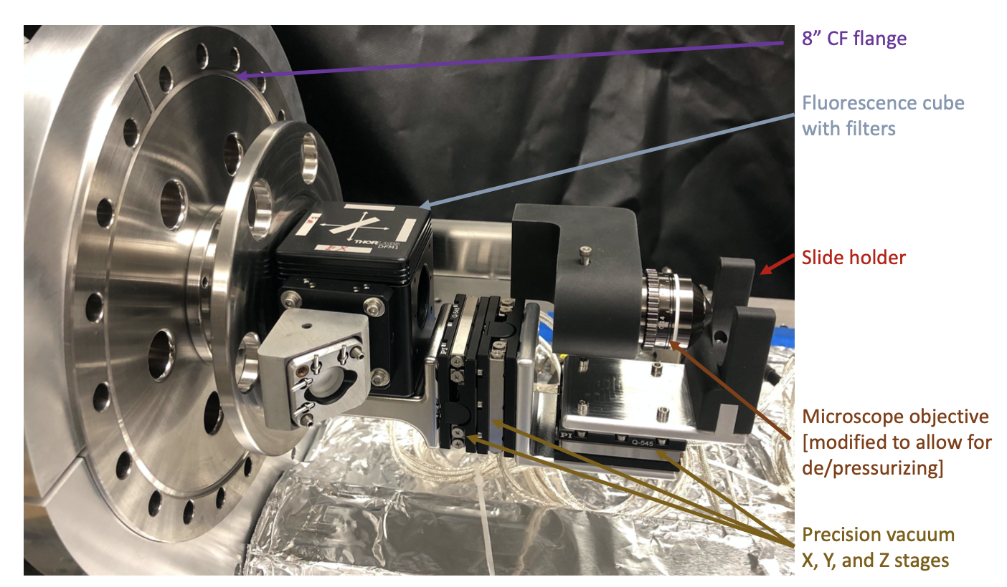
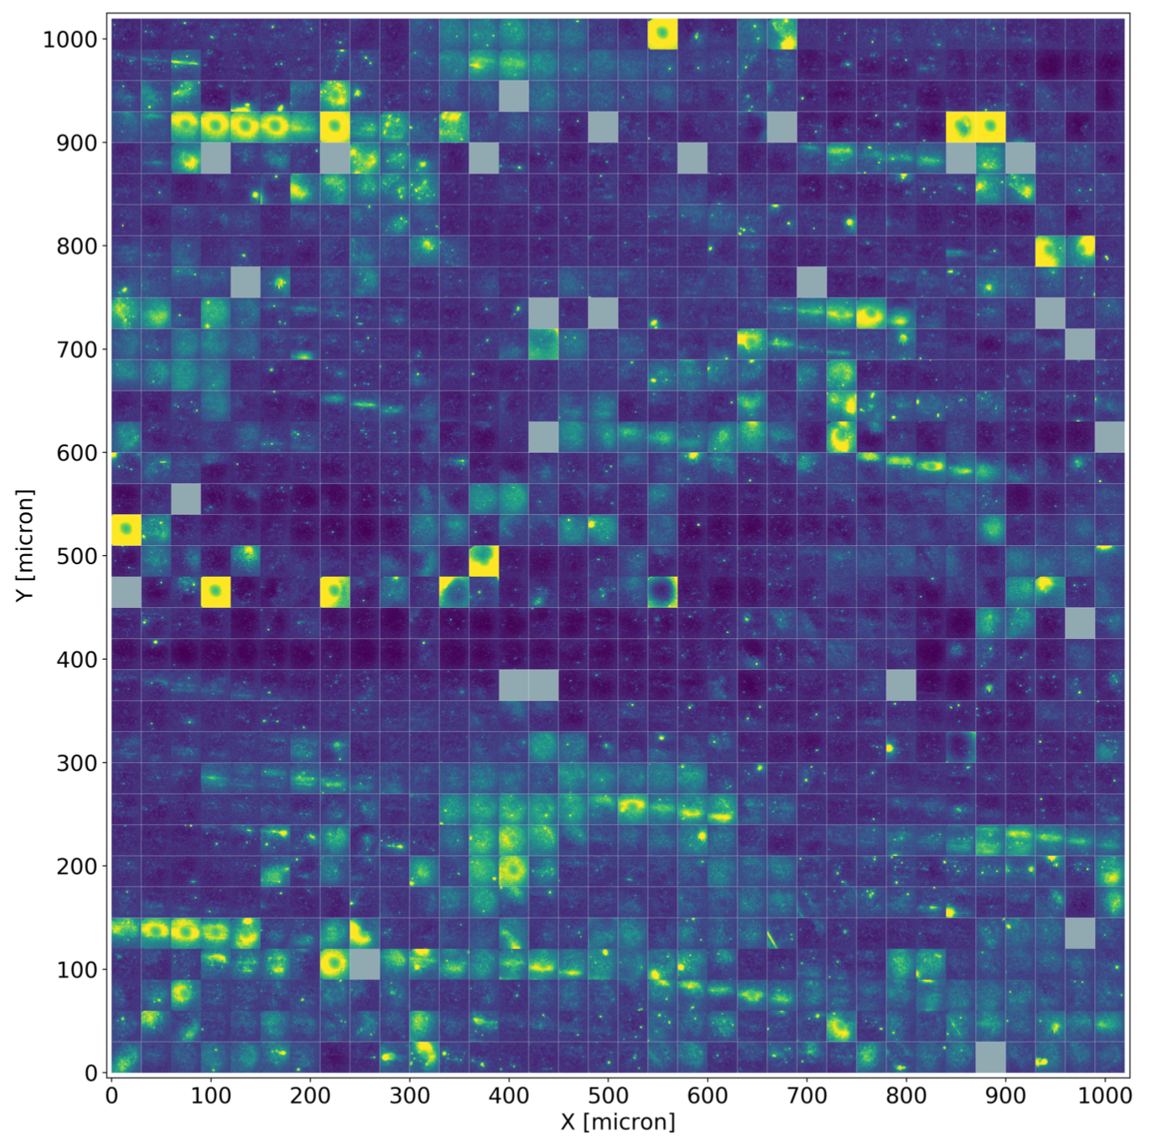
STM showing dry barium chelation in crown ether complex
For NEXT, Ba tagging is envisioned as a capability for second module in an N-module system
Planning for first NEXT-Ton module without barium tagging at Canfranc is underway, with EOI submitted to LSC in 2021.
Outline of NEXT Ba tagging activities for Snowmass period:
Sensors (both molecules and microscopes) under continuing optimization for efficient dry ion sensing using both Ba⁺⁺ and Rn⁺⁺ beams at table-top scale, targeting convergence in ~2-3yr.
At least one of ion-to-sensor or sensor-to-ion transport methodologies must be proven. Focus is now shifting onto this challenging aspect of the problem.
Ambition is to follow R&D in first half of Snowmass period with tests using Ba from 2nubb in demonstrator-scale ¹³⁶Xe underground system(s) during the second half.
High pressure single molecule microscopy in xenon gas

Slide 10
Summary
Single Ba atoms and ions can be detected by laser imaging techniques – many photons from one atom or ion
R&D on methods of ¹³⁶Ba daughter transport to a single Ba detection region continues through Snowmass period
Staged approach toward demonstrator detectors is planned for the Snowmass period.
¹³⁶Ba daughter tagging is considered an important technique for background free neutrinoless double decay detectors of the future

