Slide 1
NCP Mapmaking with Tianlai Dish Array
Ying-Feng Liu
Nev 3, 2021

Slide 2
Bright Source & North Celestial Pole Mapmaking
Data Analysis Steps
RFI flagging
Point source calibration
Crosstalk removing
Gridding
Bright Source Mapmaking
NCP Mapmaking
Data in use
201801,

Slide 3
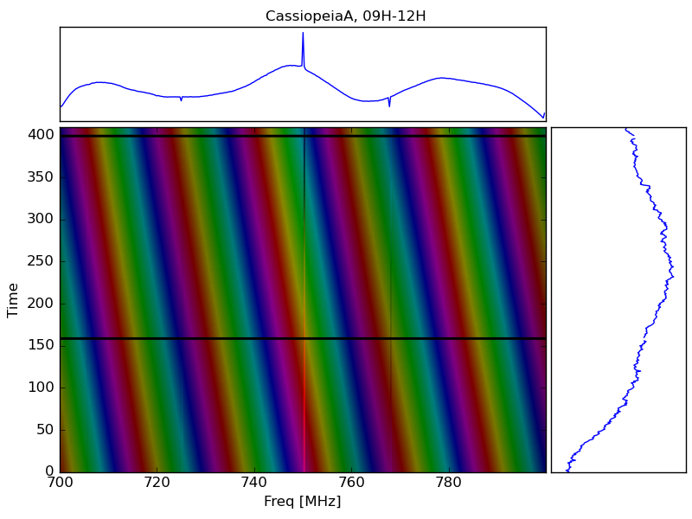
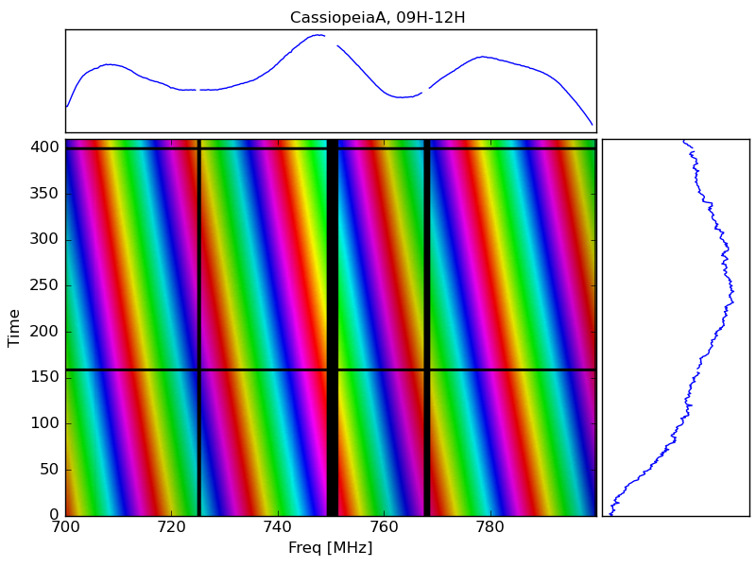
RFI of Bright Source
Cas A raw visibility, baseline 09H-12H， 20180101 data

Slide 4
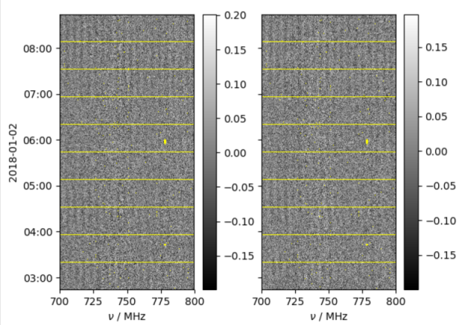
RFI flagging of NCP night data
Using nighttime data only
RFI is flagged by tlpipe
SumThreshold
Scale-invariant Rank (SIR)
Our site has low RFI
Baseline 1H-4H, 6h data, 20180101

Slide 5
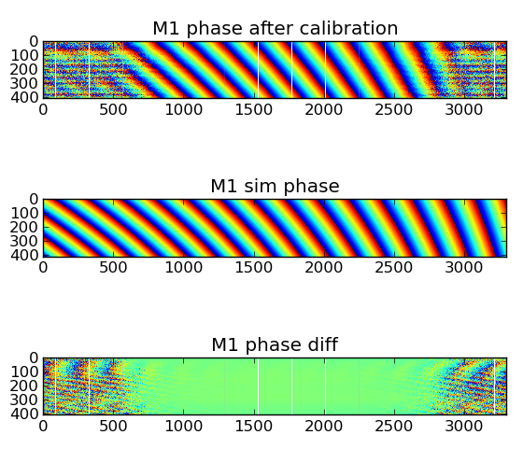
Phase calibration of bright source
Point source calibration by tlpipe
ps_cal only
Simulated phase by aipy.
beam pattern
M1 phase calibrated by CasA, 8V-13V

Slide 6
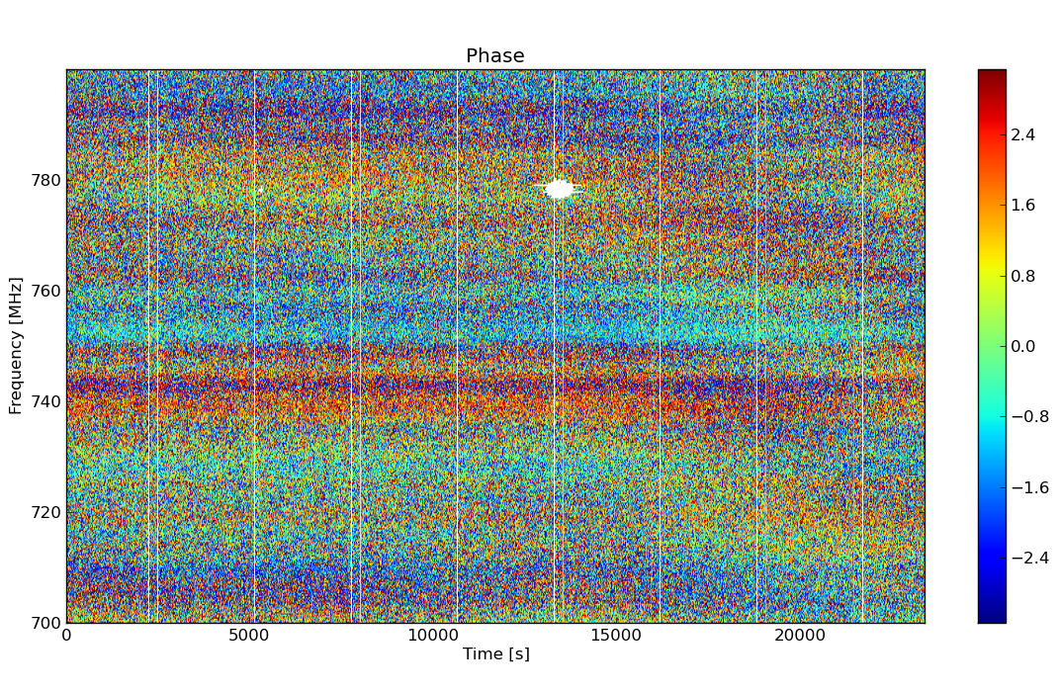
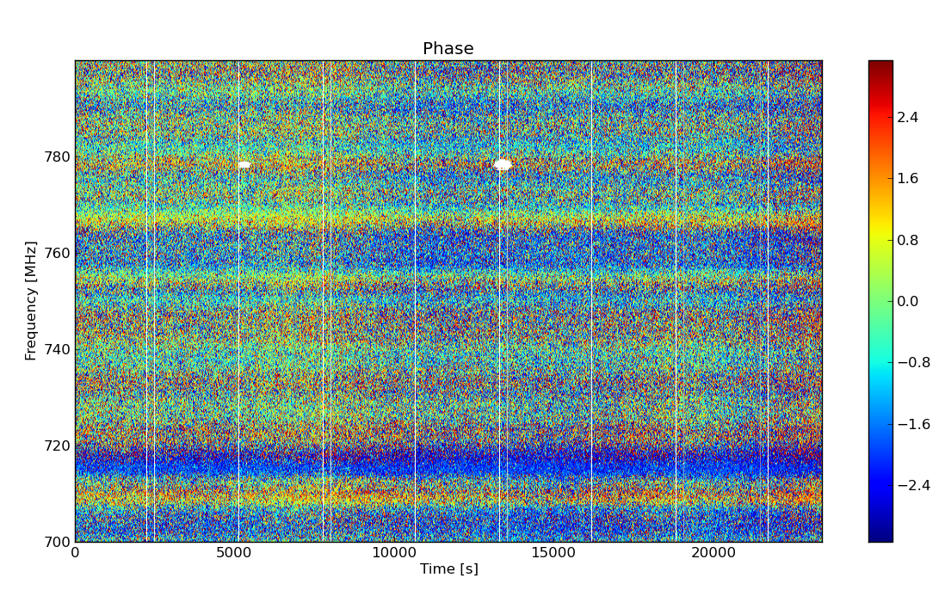
Phase calibration of NCP Data
Baseline 1V-8V, 20180101 9h
Baseline 8V-13V, 20180101, 9h
sky map – real part
beam pattern

Slide 7
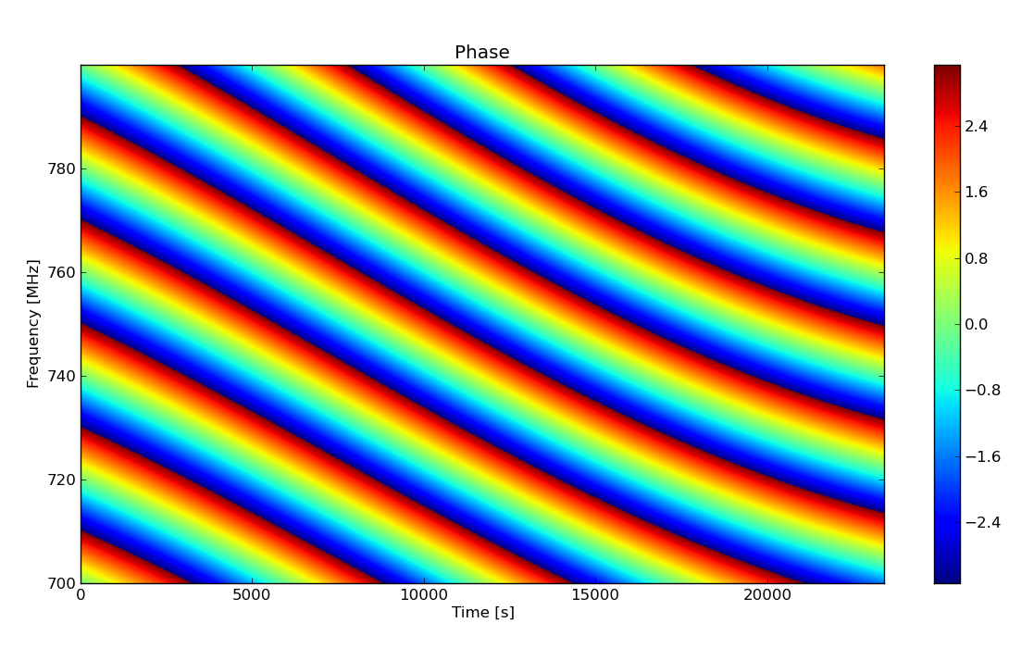
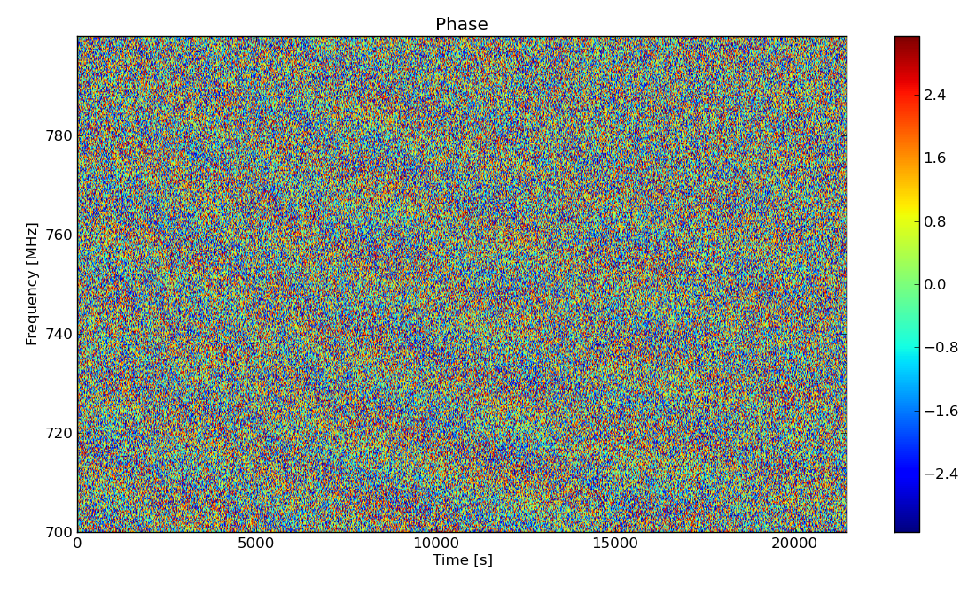
Crosstalk removing
After removing the nightly mean value, the most obvious fringe from 3c61.1 can be seen.
Baseline 1X-8X, 20180101
Simulated 3c61.1 phase
sky map – real part
beam pattern

Slide 8
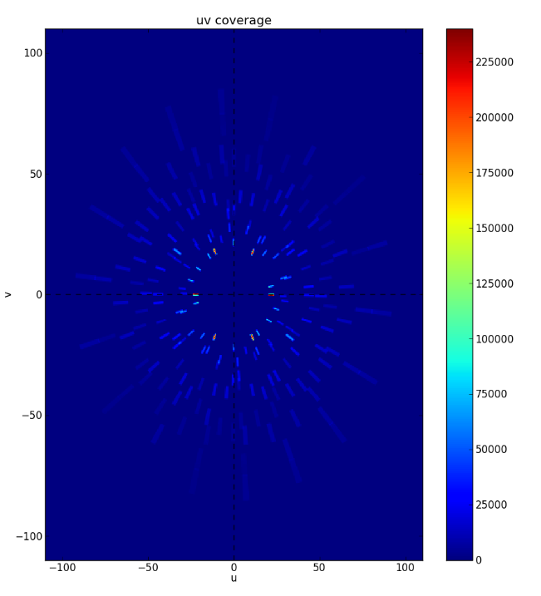
Gridding
Natural weighting: ${\text{ω}}_{j}=\frac{1}{N_{s}\left(j\right)}$
beam pattern
M1
NCP, 80h of 10 nights, all baseline
Weighted UV matrix

Slide 9
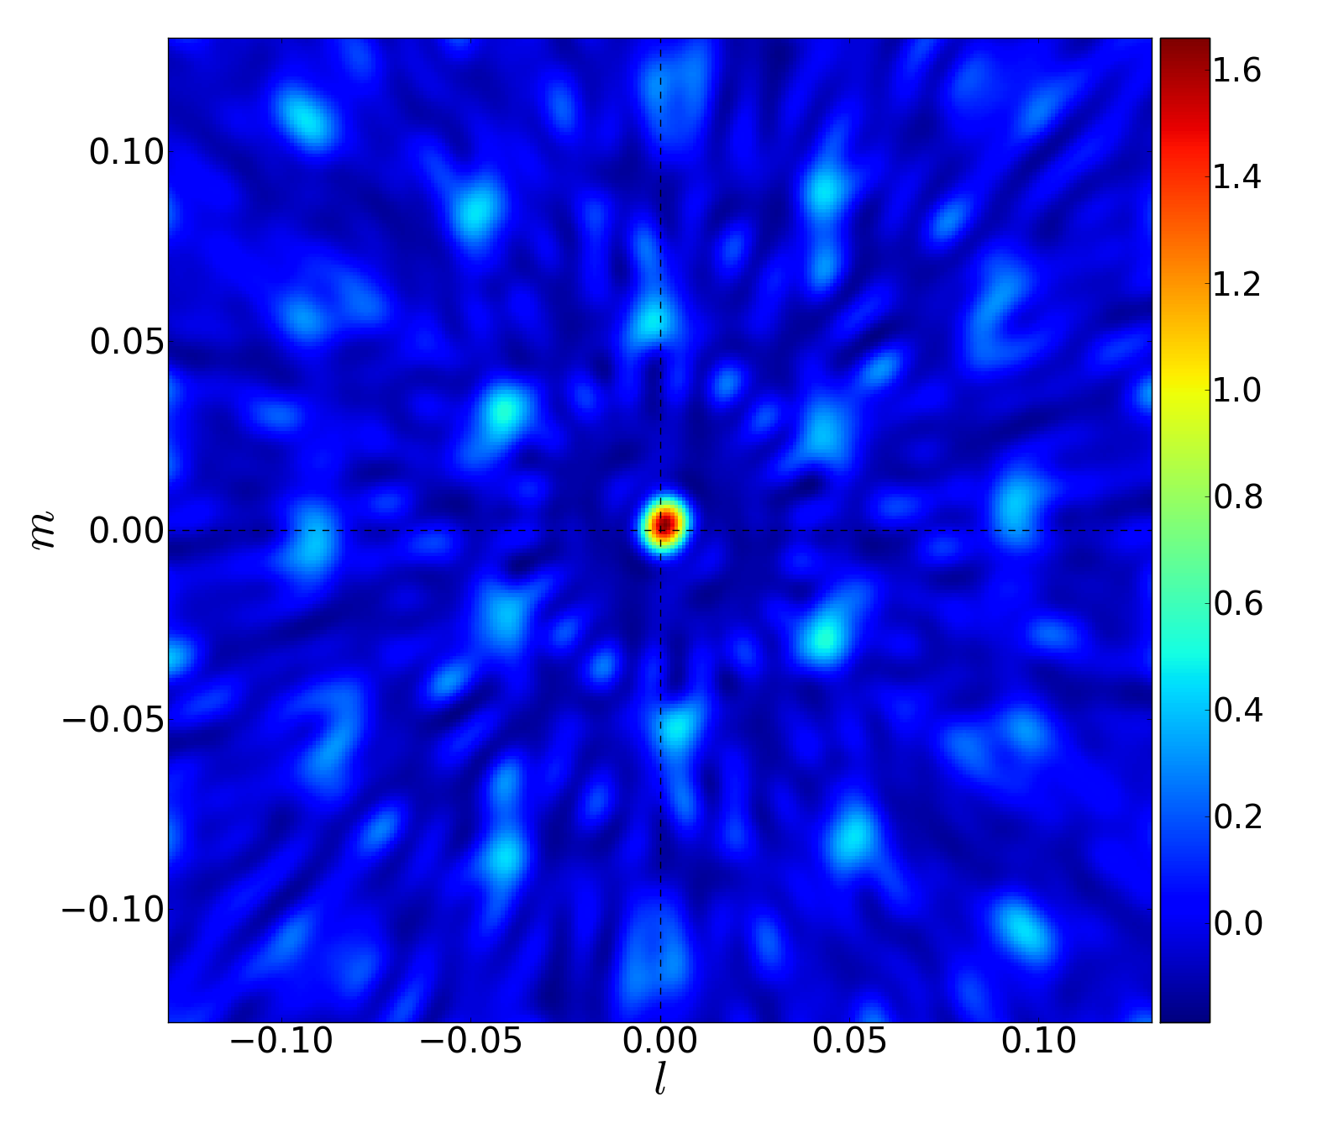
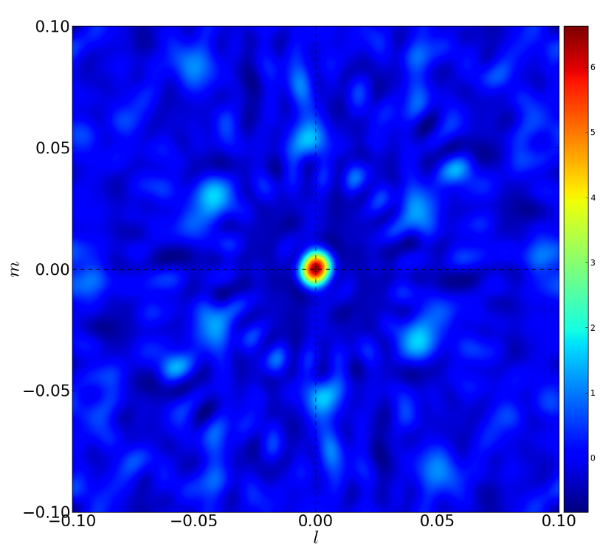
Bright Source imaging
sky map – real part
Cassiopeia A dirty image
20180101
beam pattern
M1 dirty image
20180101

Slide 10
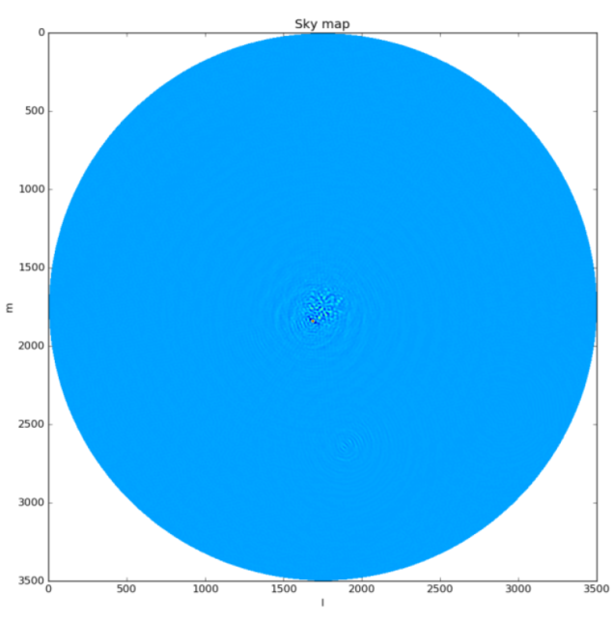
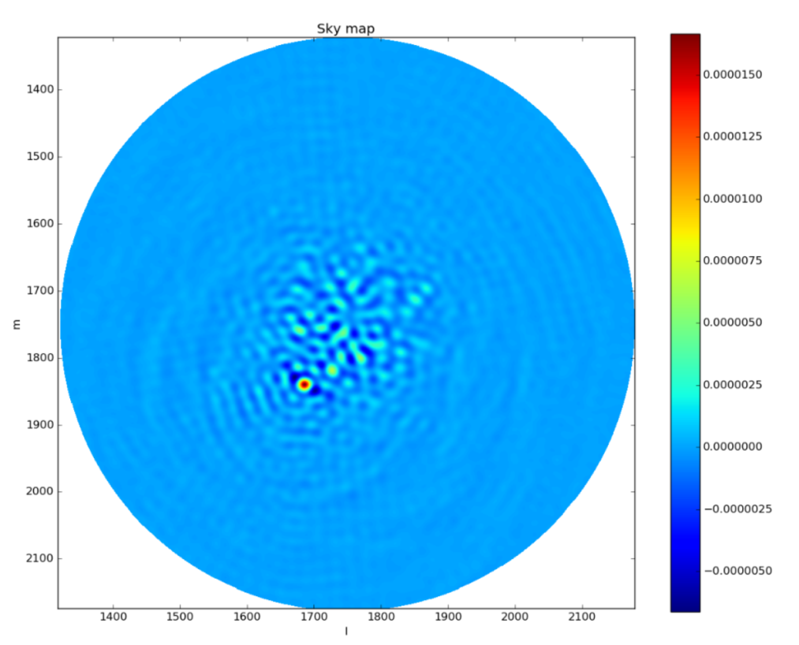
NCP imaging
3C061.1
3C061.1
Cassiopeia A

Slide 11
TODO
add noise source calibration
use better gridding method
CLEAN the image

