Slide 1
Main Injector/Recycler Startup
Marty Murphy
AD 0900 Scheduling Meeting
22 October 2021

Slide 2
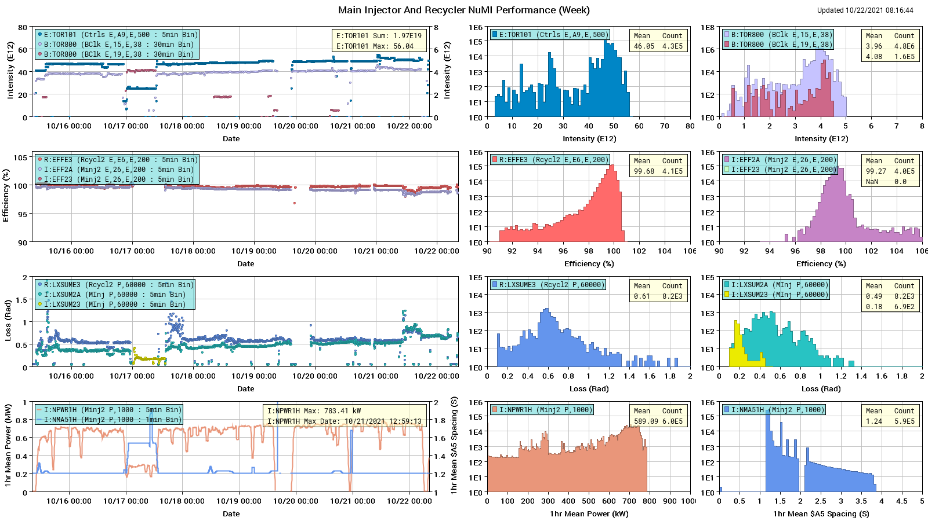
HEP Beam to NuMI

Slide 3
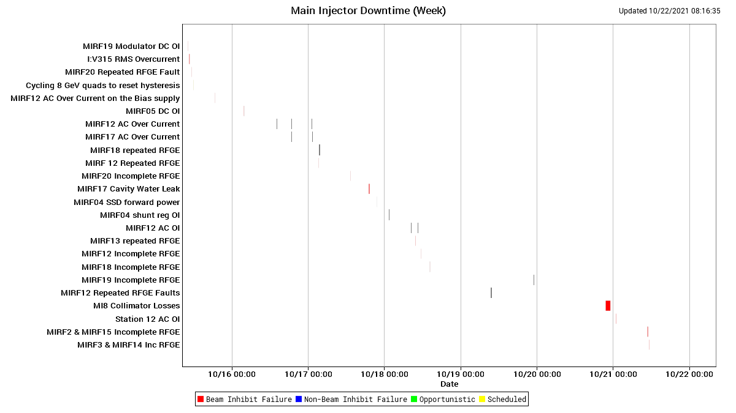
MI Down Time

Slide 4
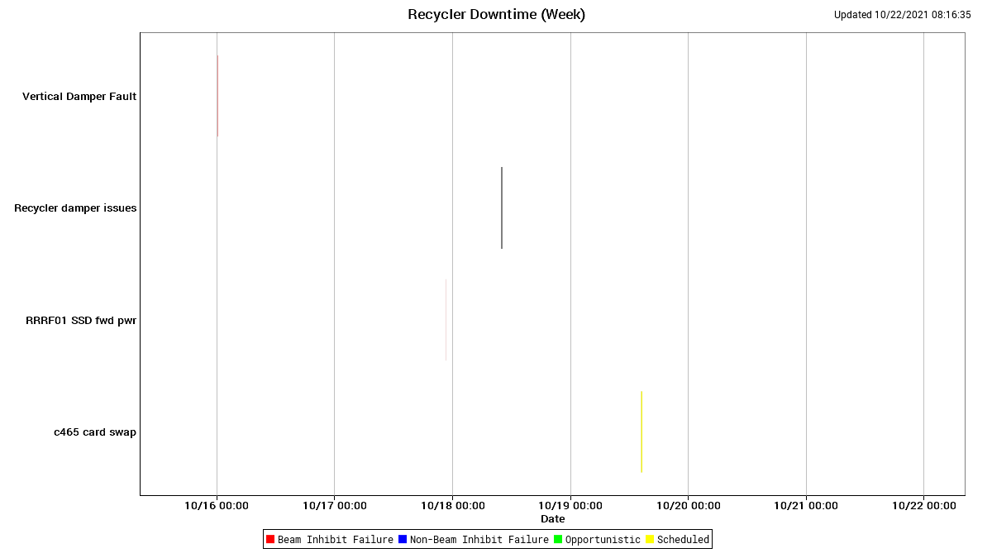
RR Down Time

Slide 5
This Week
Peak power to NuMI ~863 KW, but not for one hour.
Big Items:
All-week: Parasitic RR beam measurements during day shifts.
Sunday/Monday – RR damper borad failure; MI only-beam ($23)
Tuesday – investigation into MIRF gap voltage oddities.
Wednesday - MI8 collimator move after FE reboot; working with Controls to resolve.
Thursday - Worked improving MI collimation arrangement.
Today
Test newly installed VFD at MI50 for MI52 pond pump.
Implement new base tune in RR; has been tested and it works.
Continue tuning RR & MI for increased power and reduced losses.
Provide beam to Muon Campus as requested.

Slide 6
Start-up Activities
Beam Commissioning Continues
MI:
Start-up P1, P2 and P3 beam line power supplies. In Progress
Commission SY slow spill to SY dump. Next week
RR:
Parasitic scans as requested by physicists; one cycle per minute, Minimal impact
Provide beam for Muon Campus tune-up. As requested
RR in the future;
MI8-RR lattice measurement Dedicated study 4-6 hours. Will schedule with RunCo. Not soon.

Slide 7
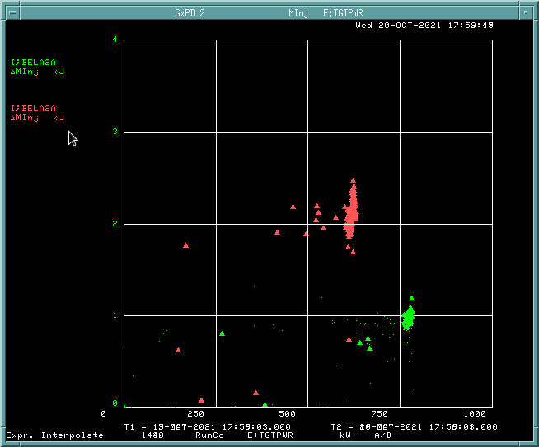
Comparison of MI Beam Loss Before/After Off-p Injection
The plot at right is a comparison of average Beam Power Lost (BEL) on the NuMI cycle ($2A) using original RR injection scheme and new off-momentum scheme. BELA2A is now about 50% lower with maximum beam intensity.
The red points represent BELA2A for a whole day in mid-May 2021. The green dots represent BELA2A for 24 hours as of Wednesday.

