Slide 1
MATF/FSD Cryostat Update-10-20-21
Jay Jablonski
TPC A&T Meeting
October 20, 2021

Slide 2
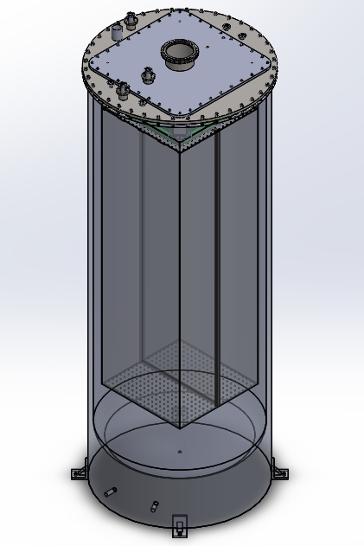
Current Cryostat

Slide 3
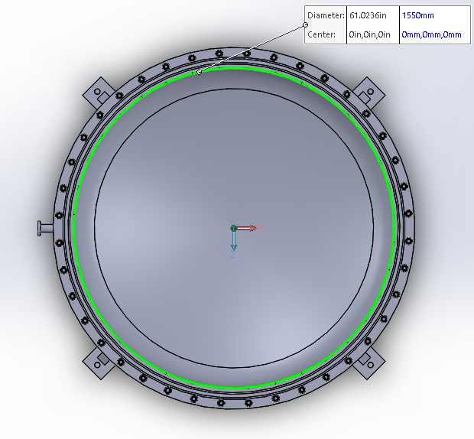
1550mm Cryostat ID

Slide 4
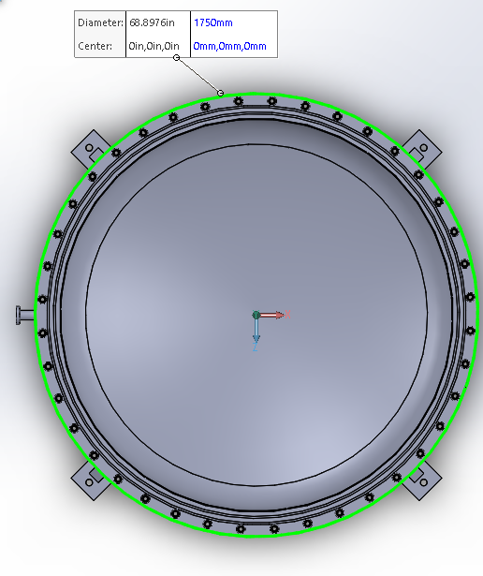
1750mm Cryostat Flange OD

Slide 5
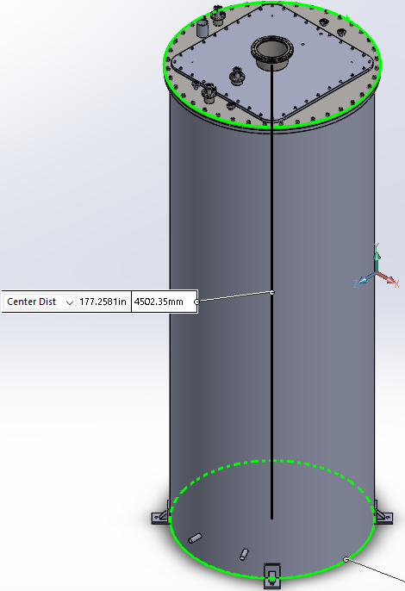
4502mm Floor-Utility lid Height

Slide 6
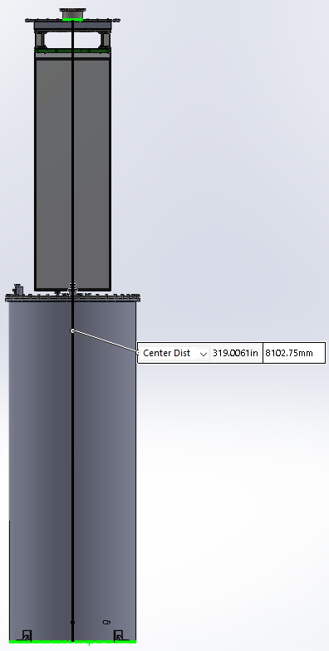
8102 mm Floor-Utility lid at Lifted Height

Slide 7
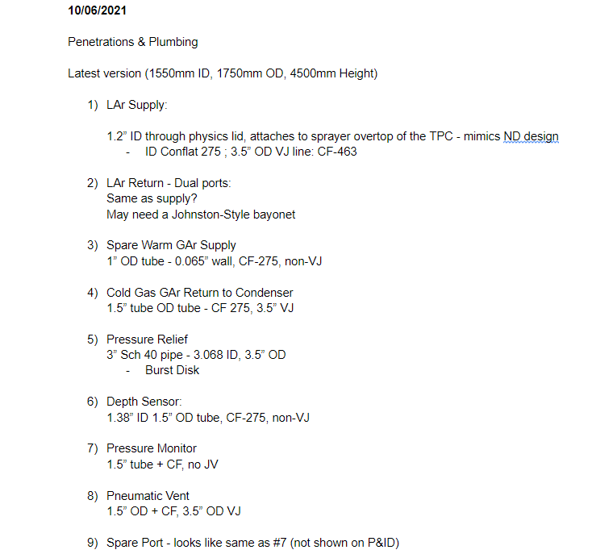
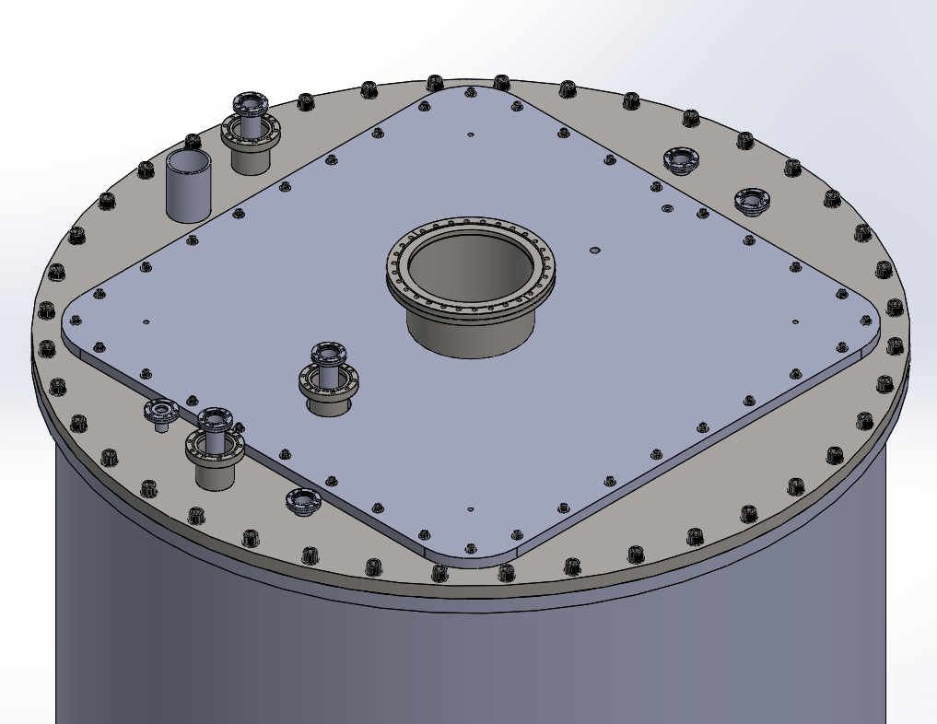
5
8
7
9
3
1
4
6
2

Slide 8
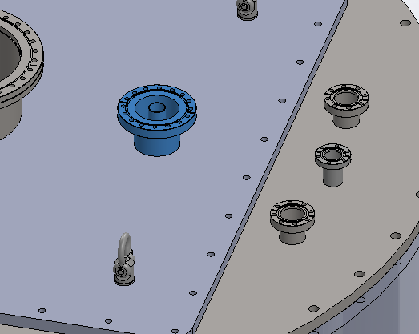
1-LAr Supply-Top
1.2” ID Supply Line
CF-275-Supply
3.0” OD Vacuum Jacket
CF-463-VJ

Slide 9
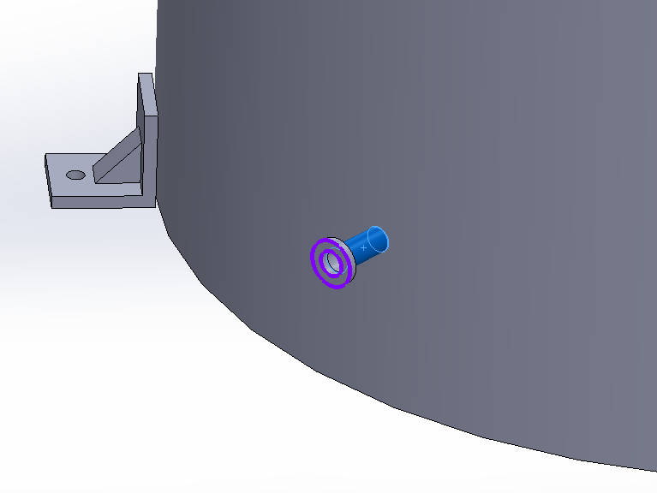
2-Bottom LAr Return
1.2” ID Supply Line
CF-275-Supply
3.0” OD Vacuum Jacket
CF-463-VJ

Slide 10
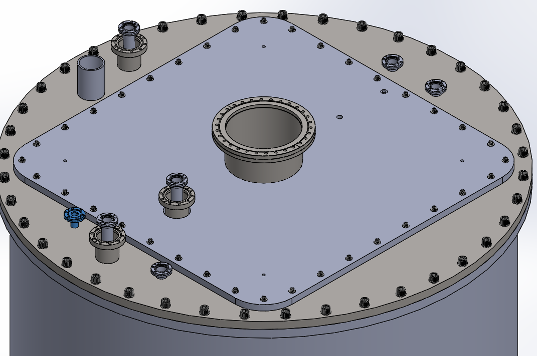
3-Spare Warm GAr Supply
1” Tube Supply Line
CF-275
No Vacuum Jacket

Slide 11
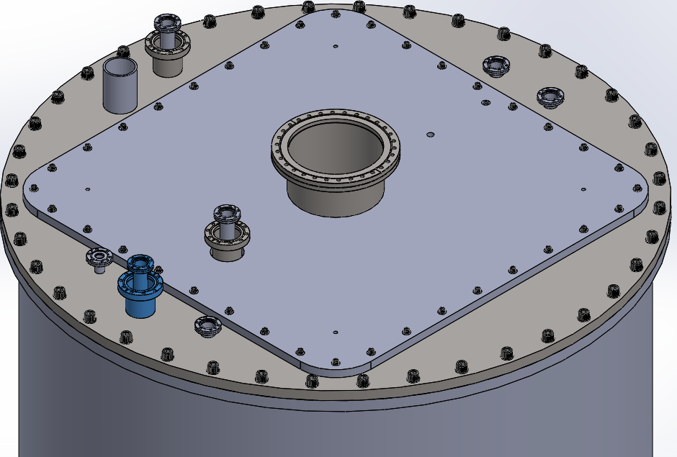
4-Cold GAr Return to Condensor
1.5” Tube Return Line
CF-275
Vacuum Jacket

Slide 12
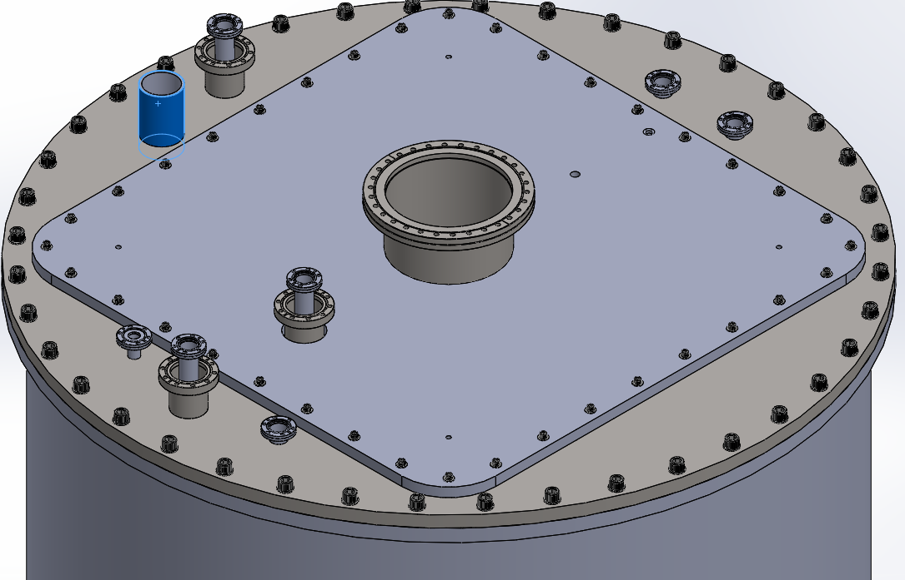
5-Pressure Relief
3” Sch 40 Pipe
3.5” od
Rupture Disk shall be rated for vacuum
Consider 2nd port

Slide 13
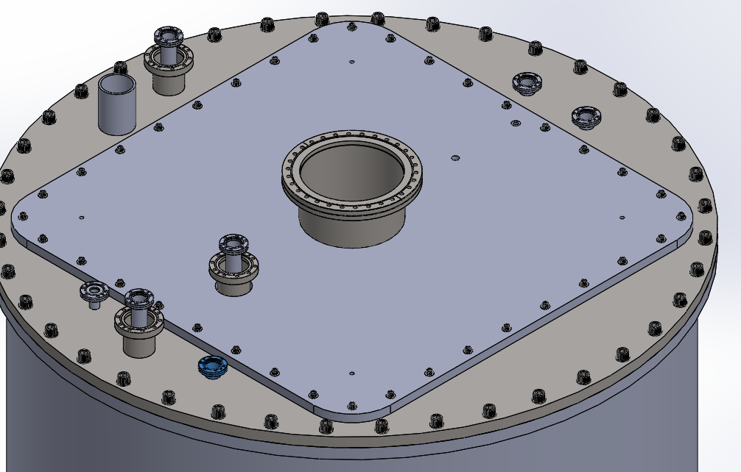
6-Depth Sensor
1.38”ID x 1.5” OD Tube
CF-275
No VJ

Slide 14
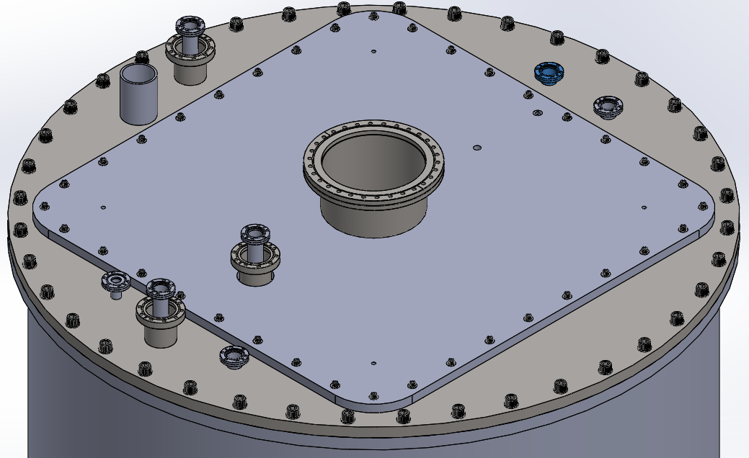
7-Pressure Monitor
1.5” Tube
CF-275
No VJ

Slide 15
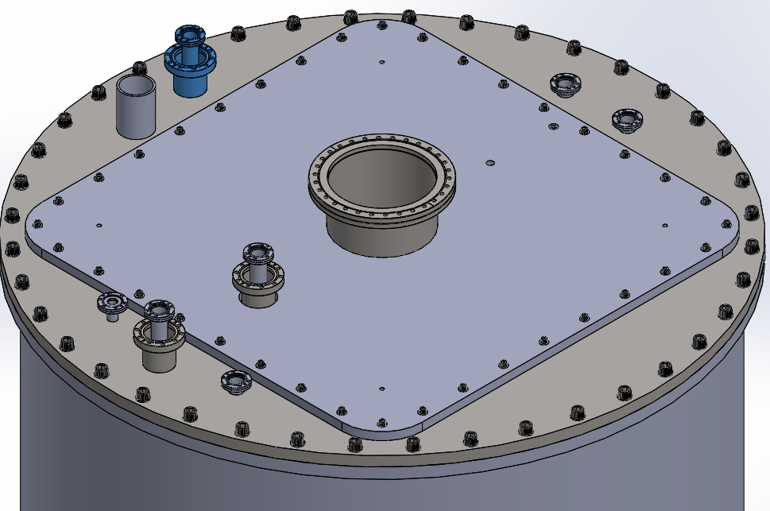
8-Pneumatic Vent
1.5” Tube
CF-275
VJ

Slide 16
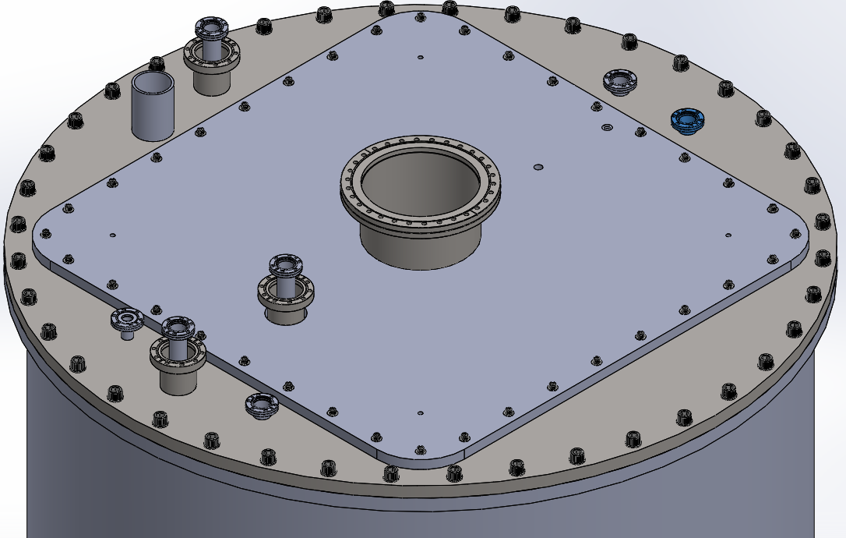
9-Spare
Possible Vacuum Port

