Slide 1
DUNE-ND I&I/Systems
Tuesday 26th October 2021
Fabrice Matichard

Slide 2
ND Systems Engineering, Integration, Installation
Power distribution and DAQ
Coordinate development with the detector groups and conventional facilities
Installation
Cryogenics
Energy chain and traveling systems
Conventional Facilities
Beam line monitor
Muon Spectrometer
Liquid Argon detector

Slide 3
Systems Engineering

Slide 4
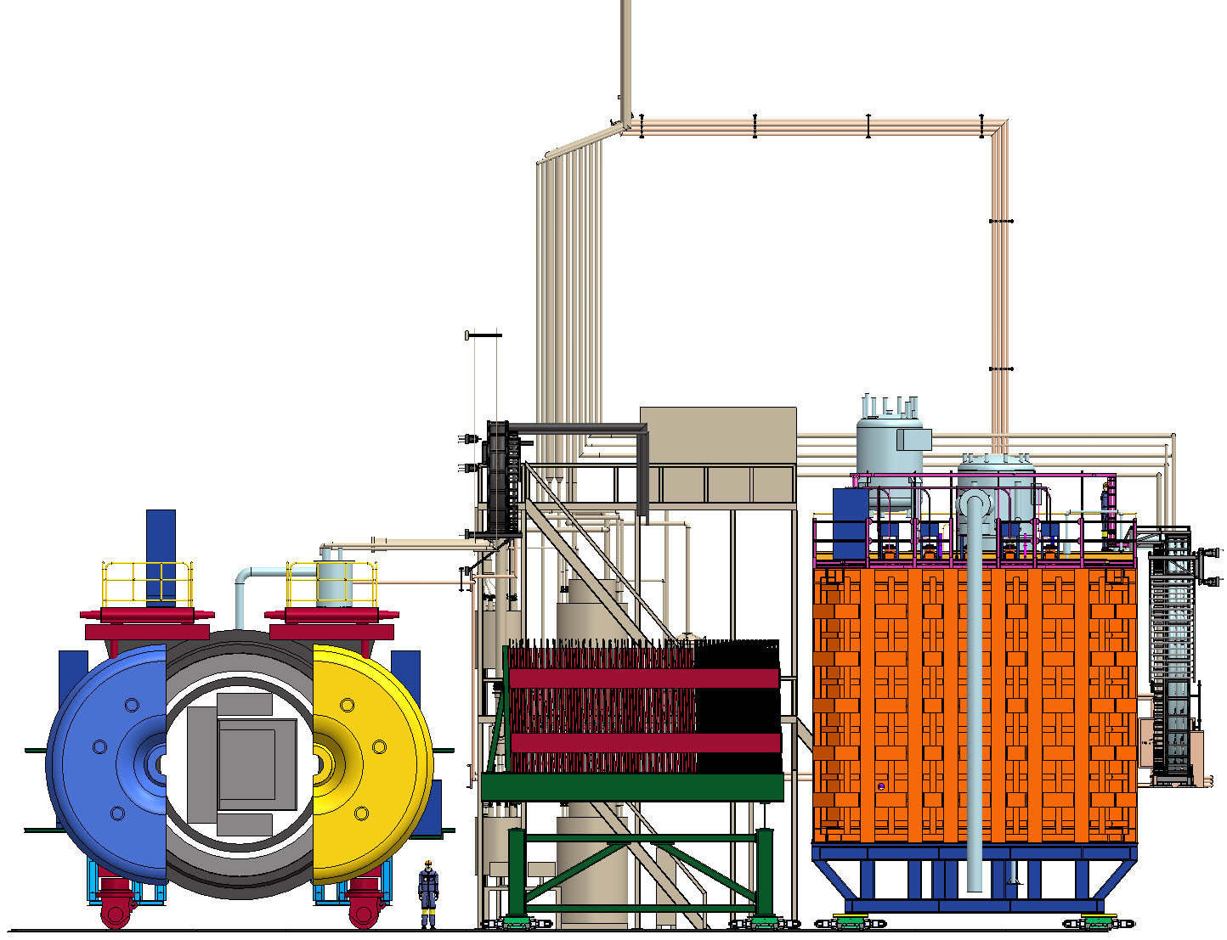
DUNE Near Detector: Requirements and Interfaces
LHe Cryo
LAr Cryo
ND-LAr Detector
SAND Beam Monitor
TMS
PRISM

Slide 5
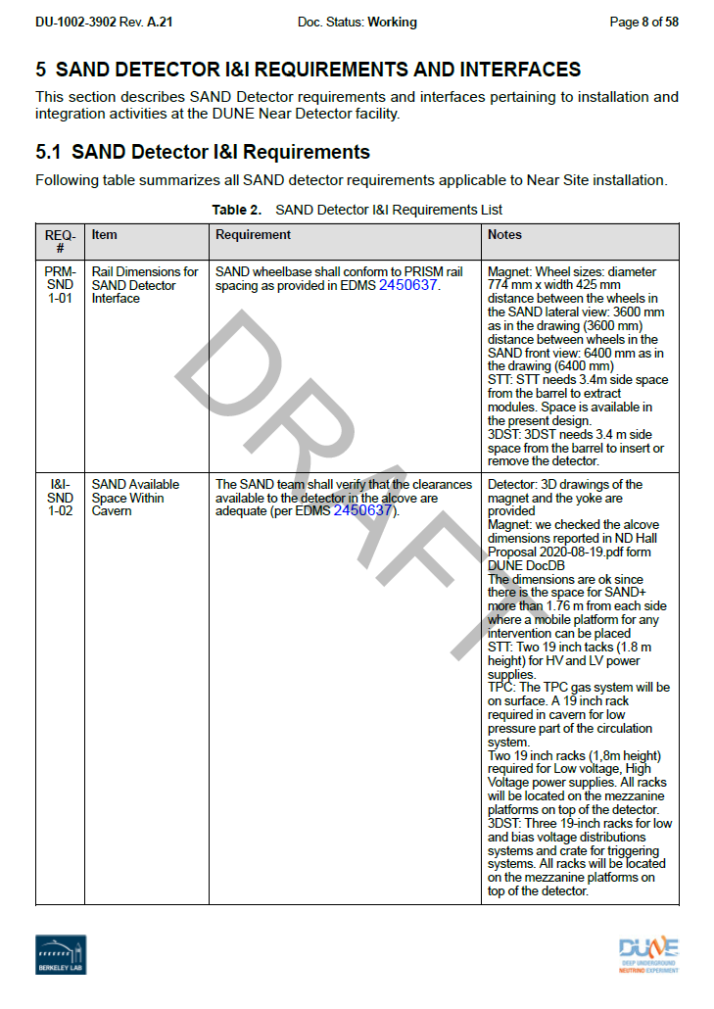
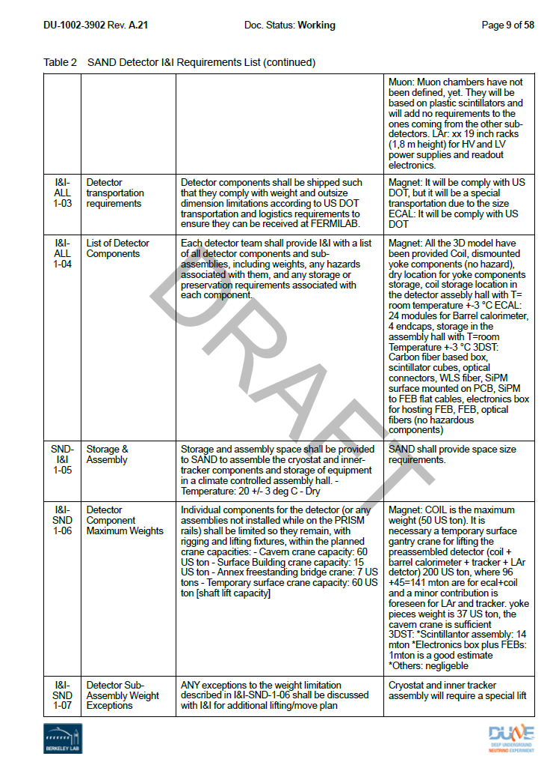
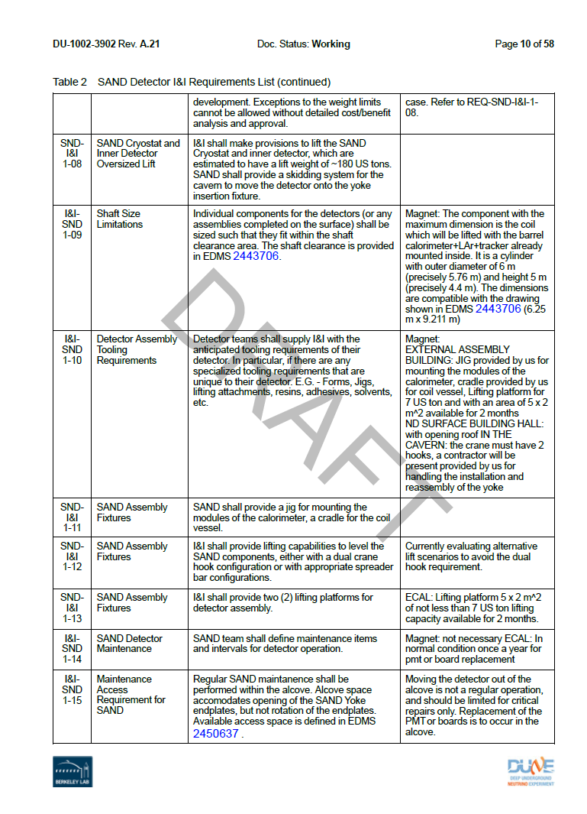
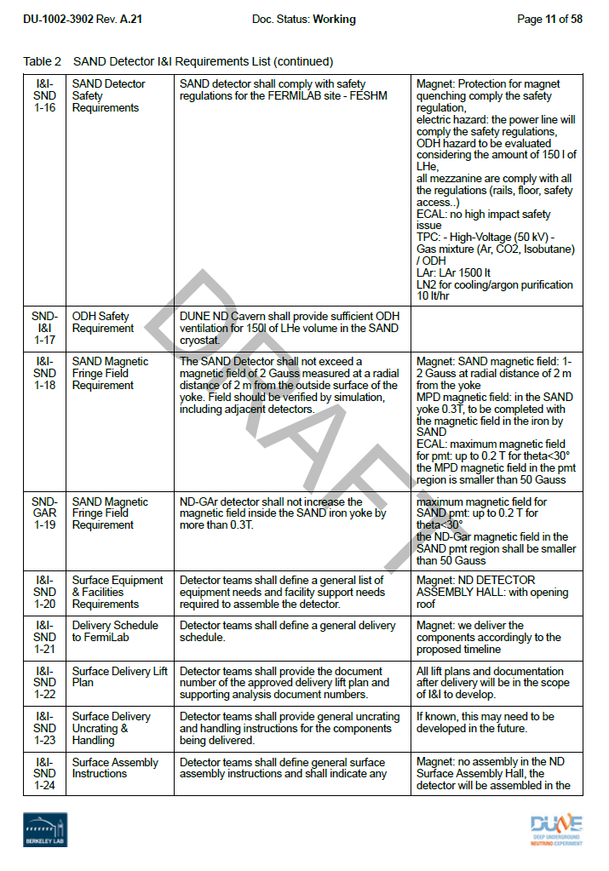
Interface Control Documentation – Detectors
Safety
Dimensions
Locations
Weight
Transportation
Assembly, Installation

Slide 6
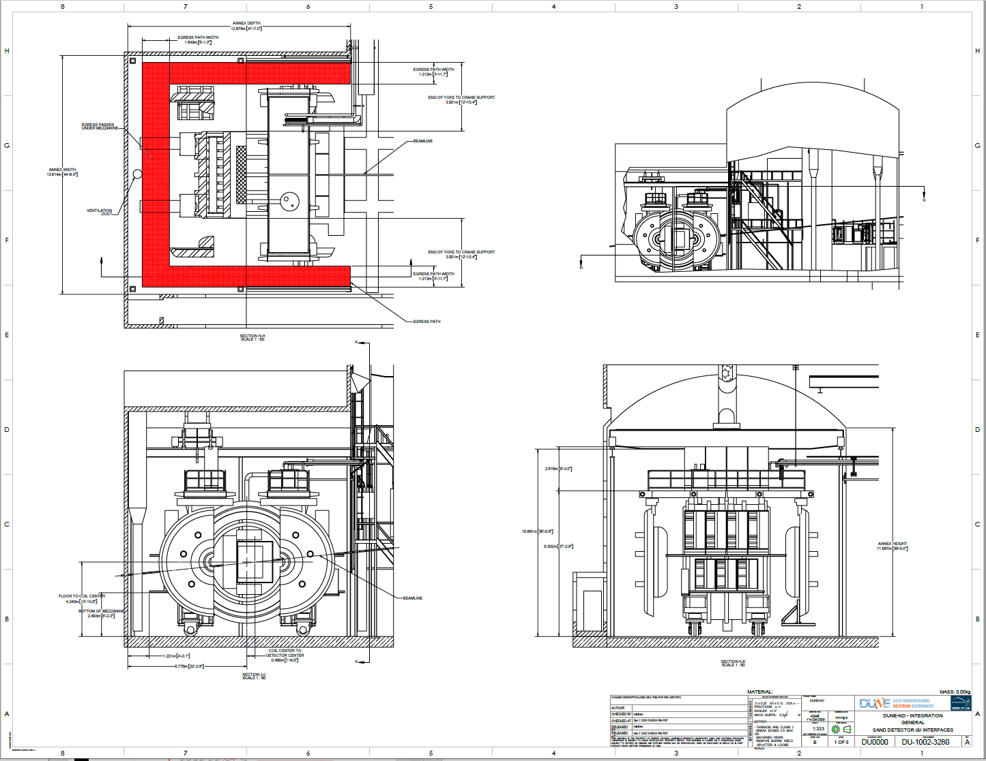
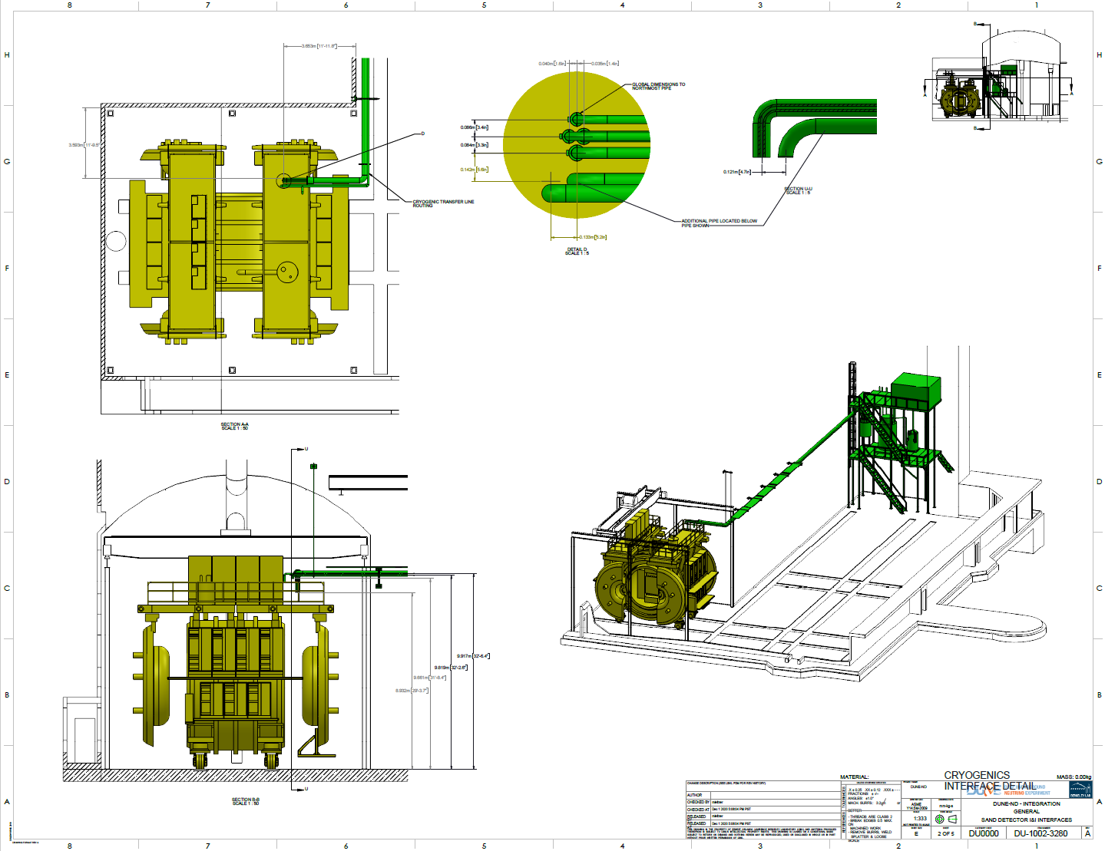
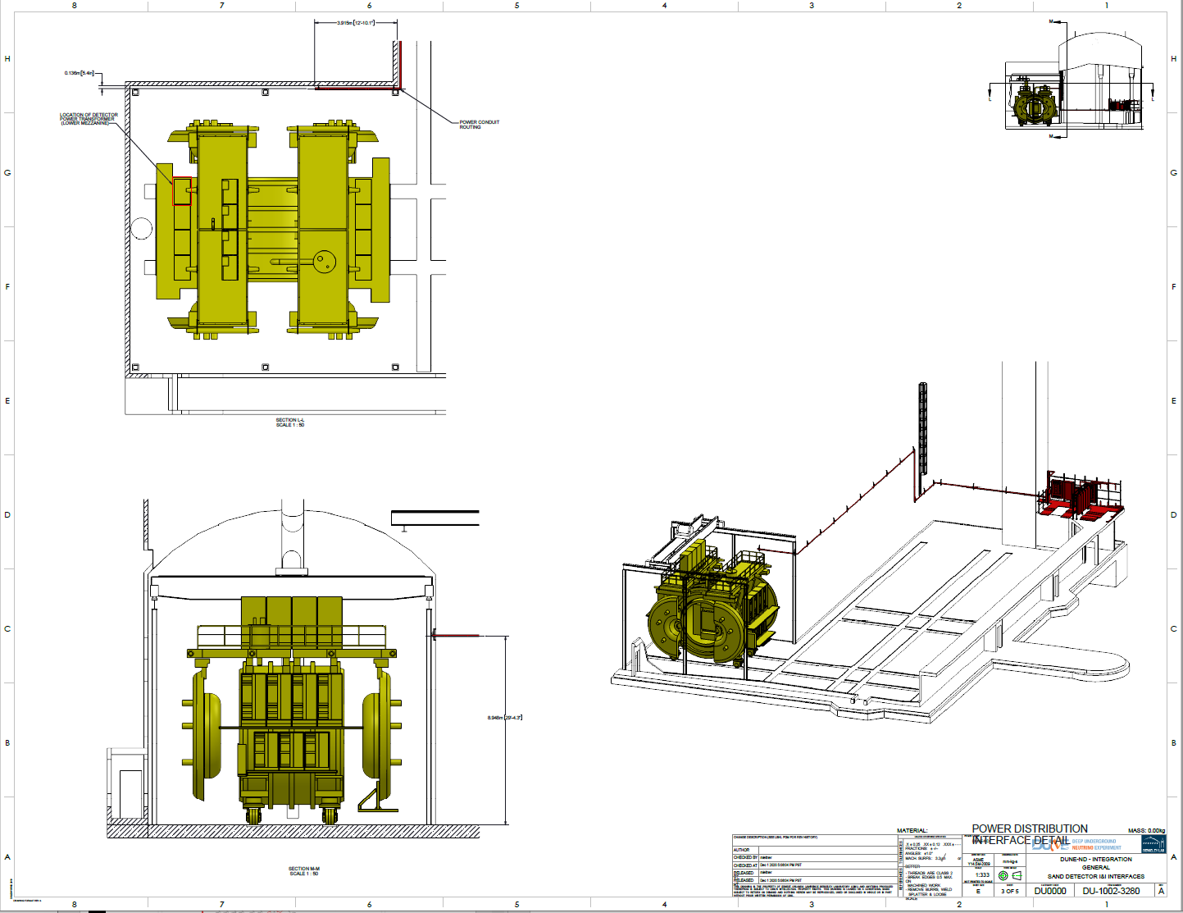
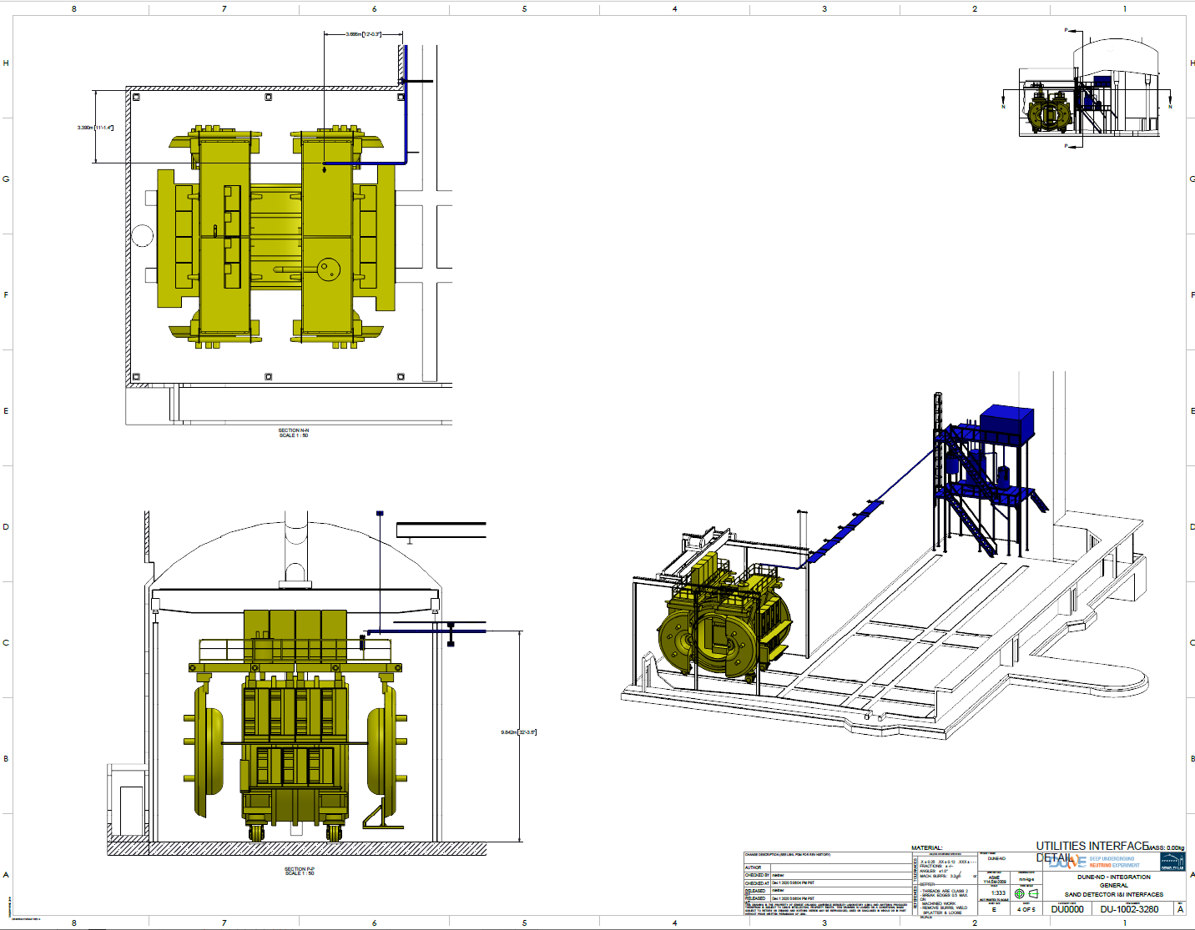
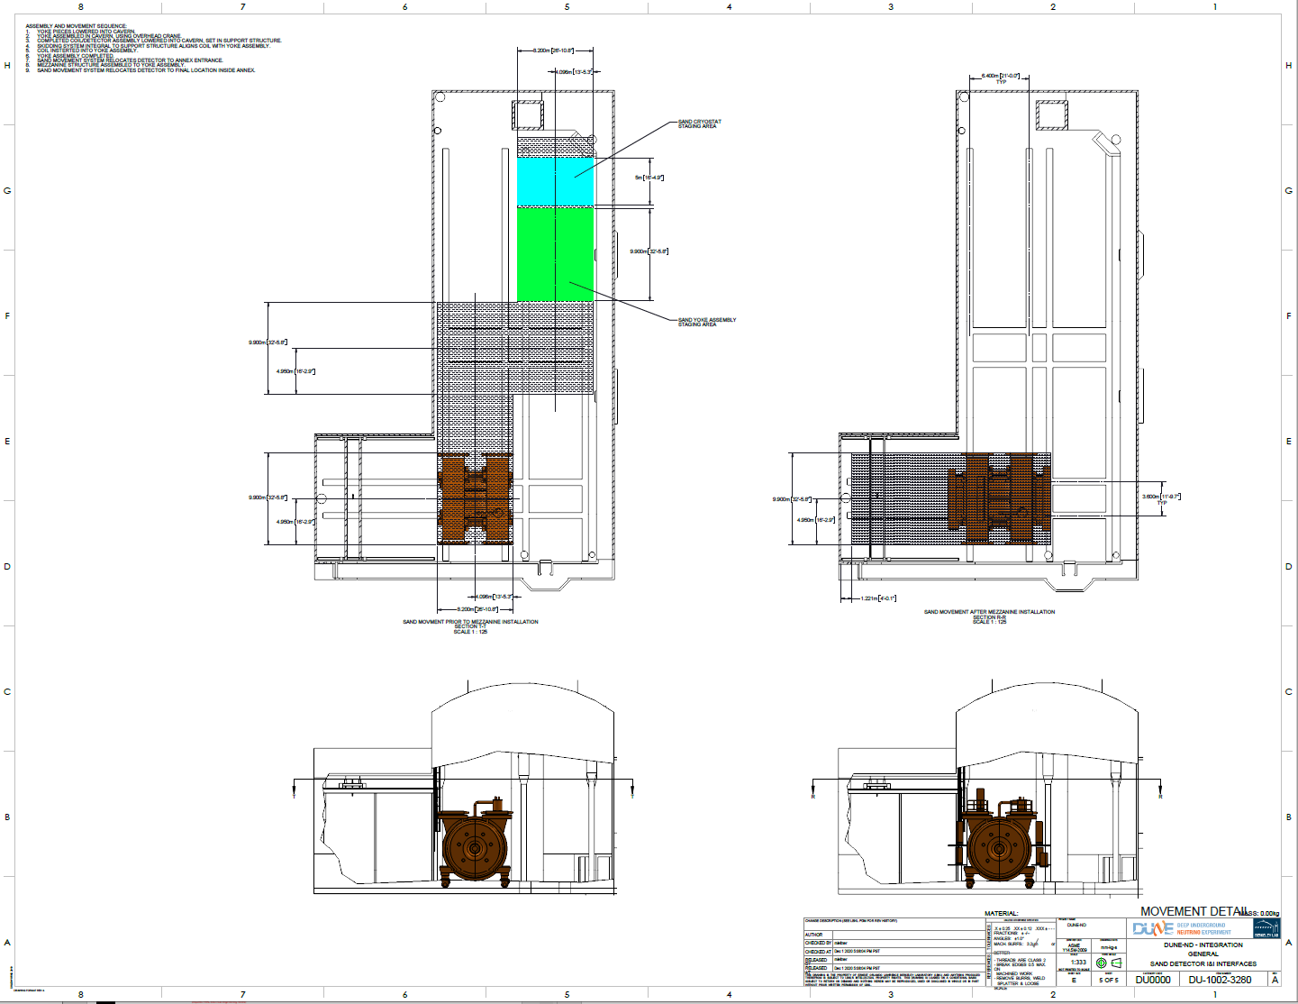
Interface Control Drawings - Detectors
Assembly
Installation
Dimensions
Routings
Electrical
Cryogenics

Slide 7
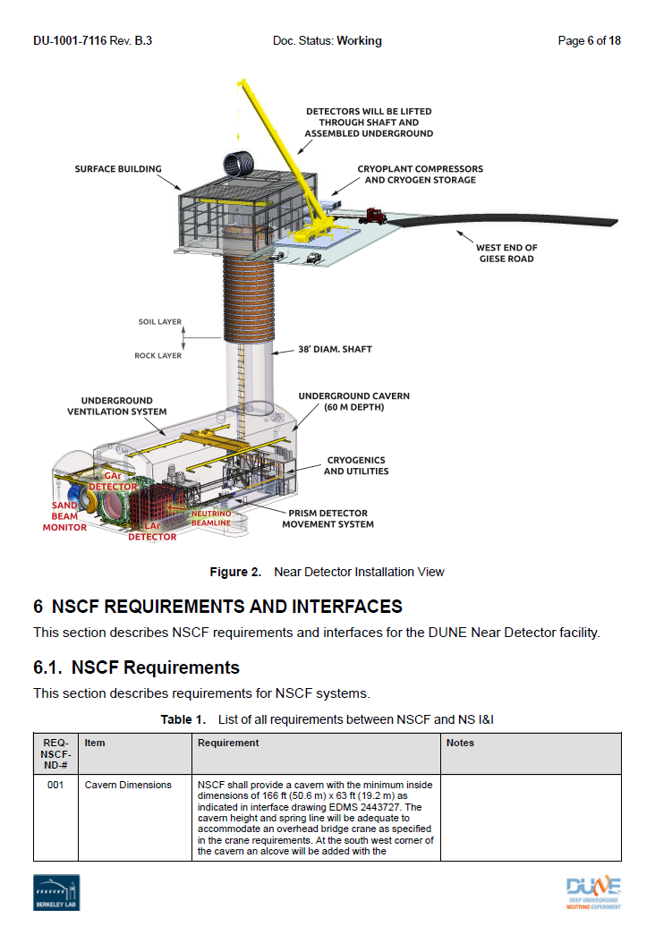
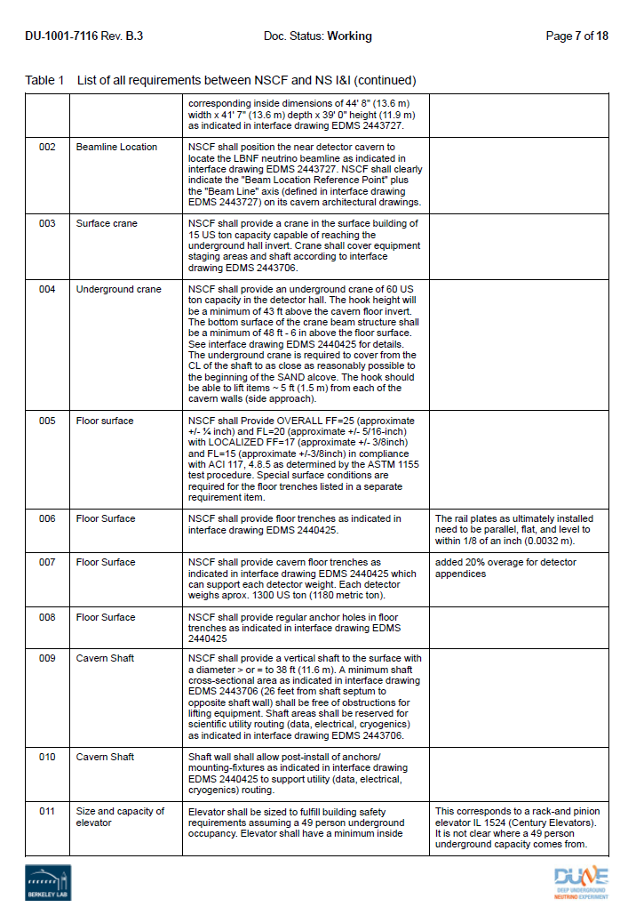
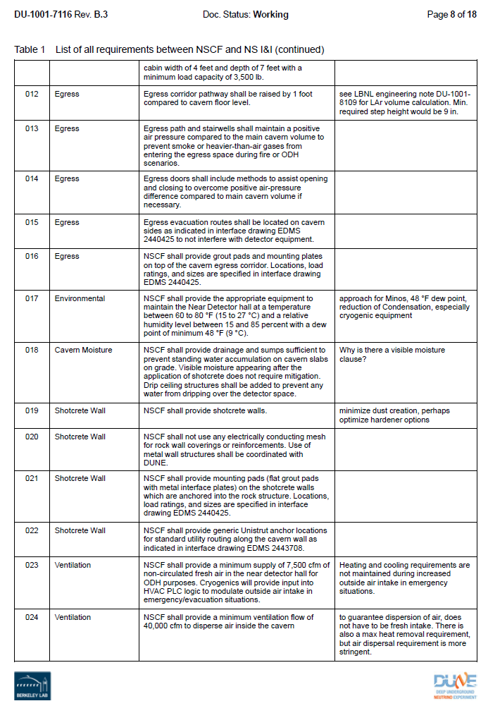
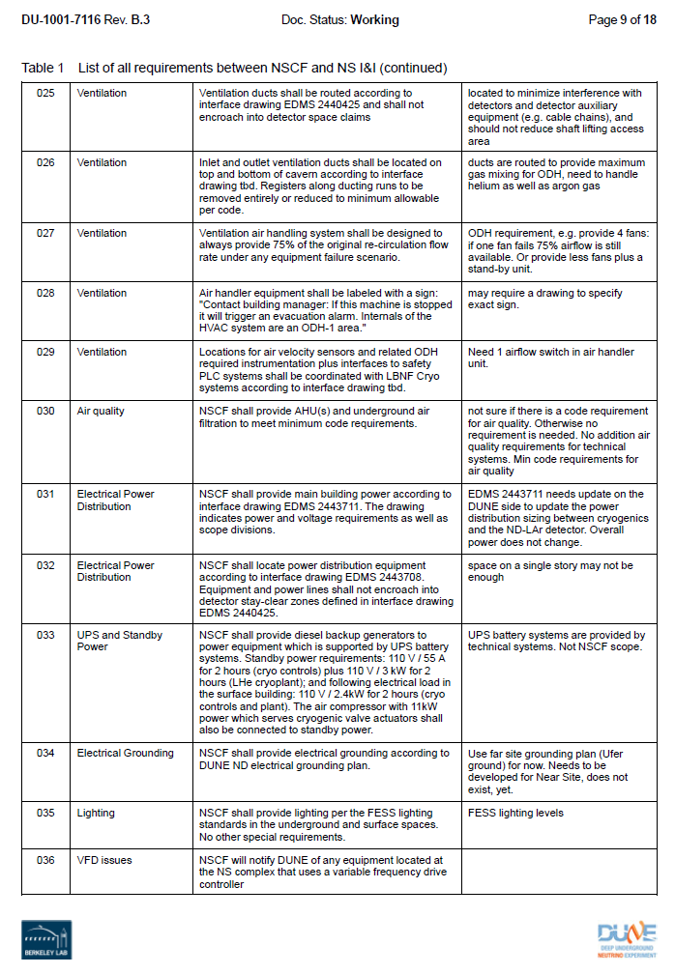
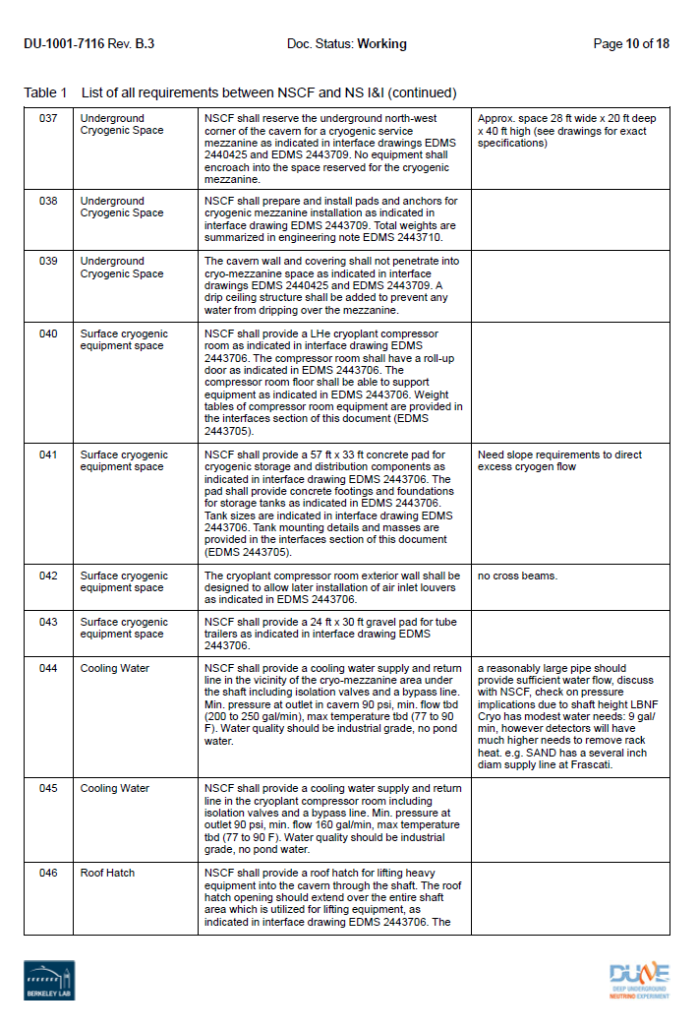
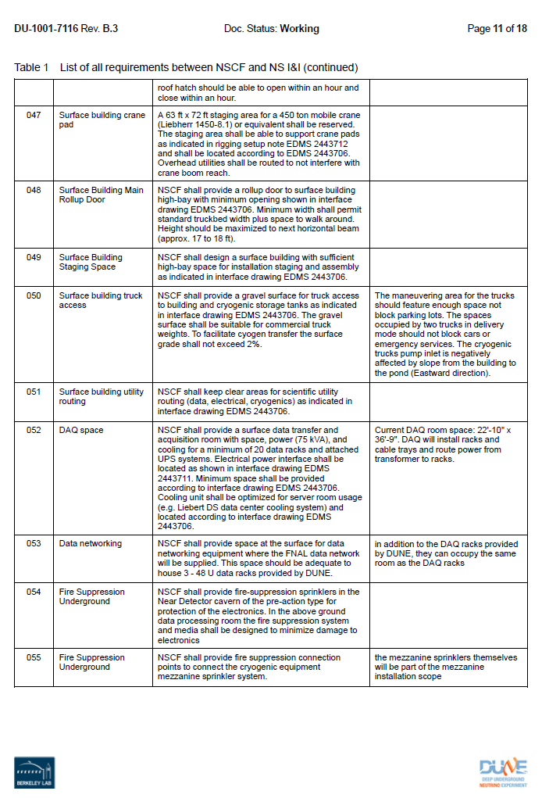
Interface Control Documentation - Facilities
DAQ, Safety
Dimensions
Egress,
Ventilation
Power
Cryogenics

Slide 8
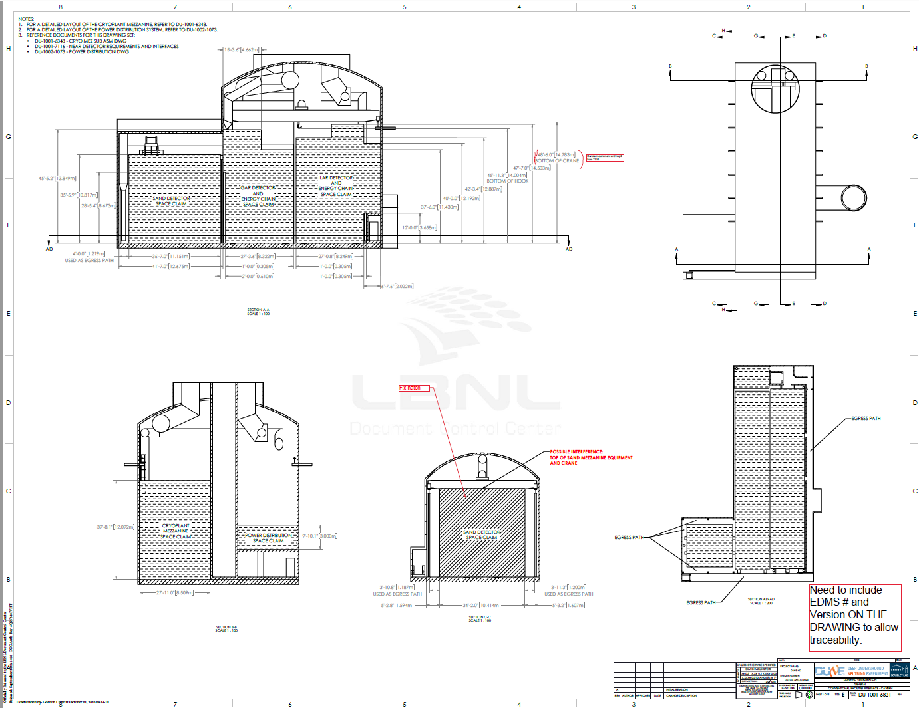
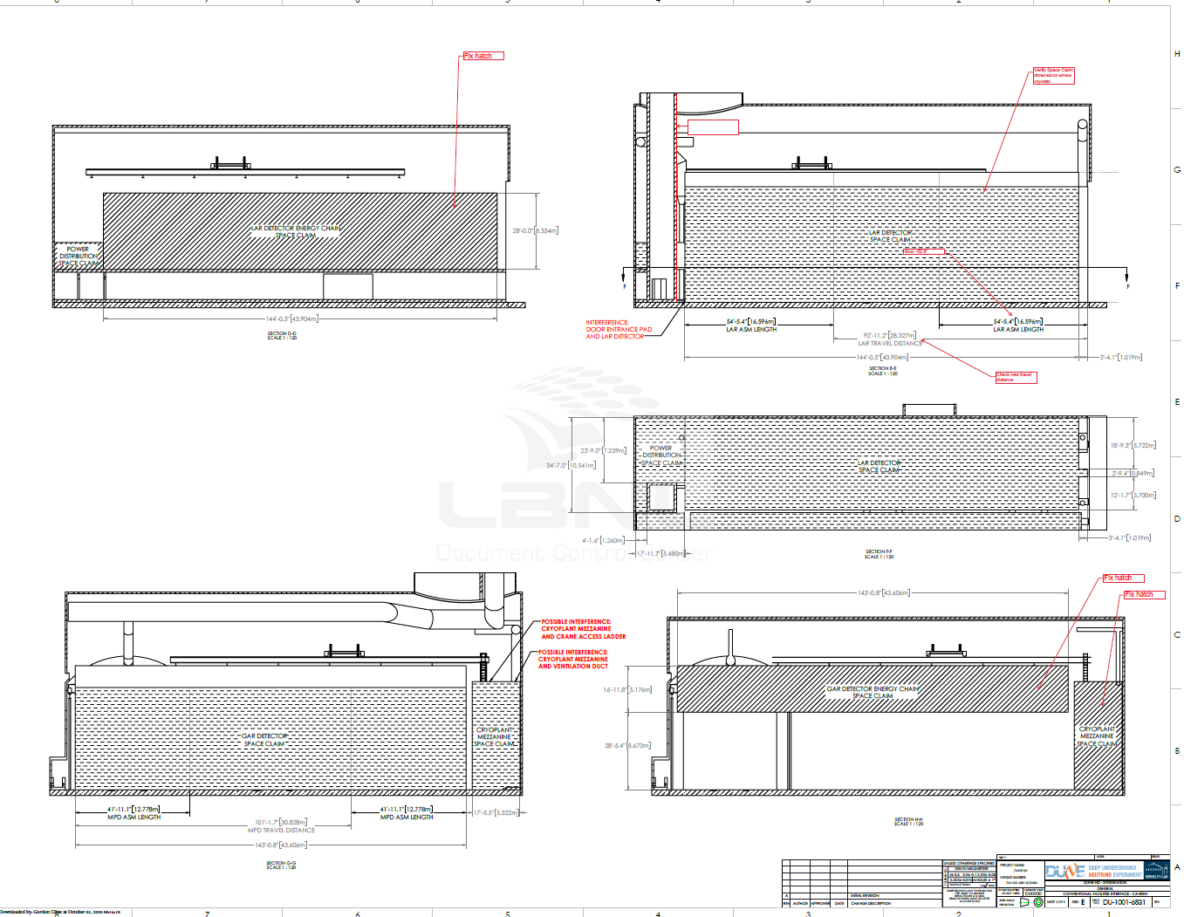
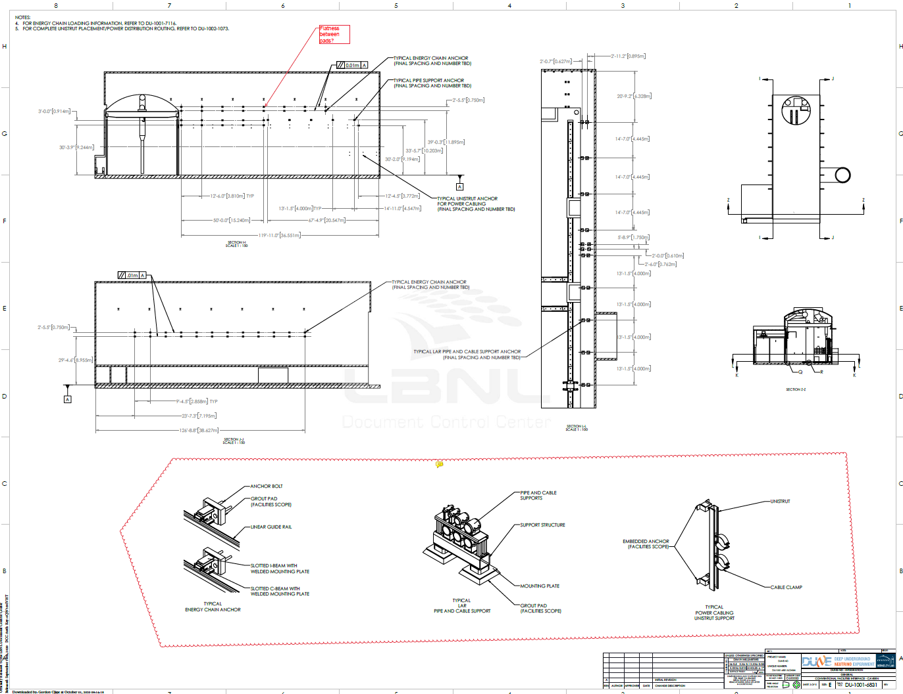
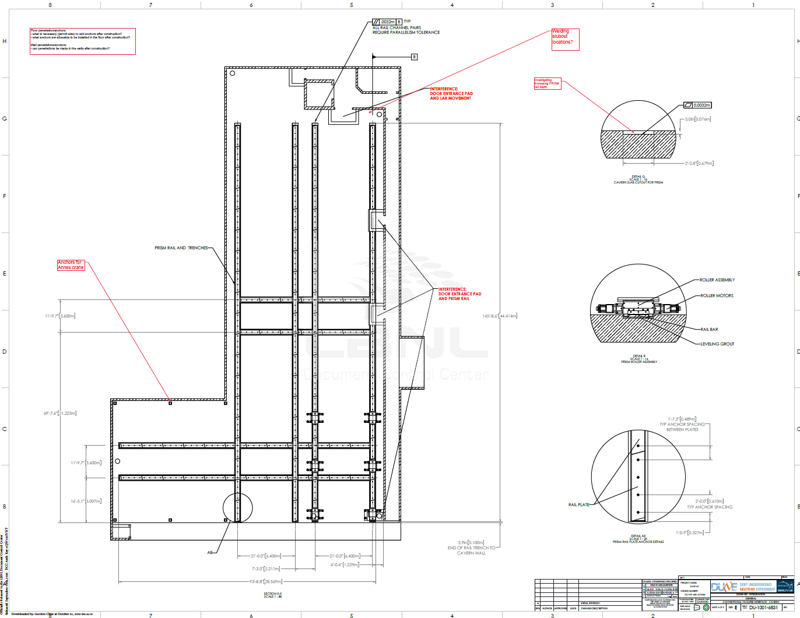
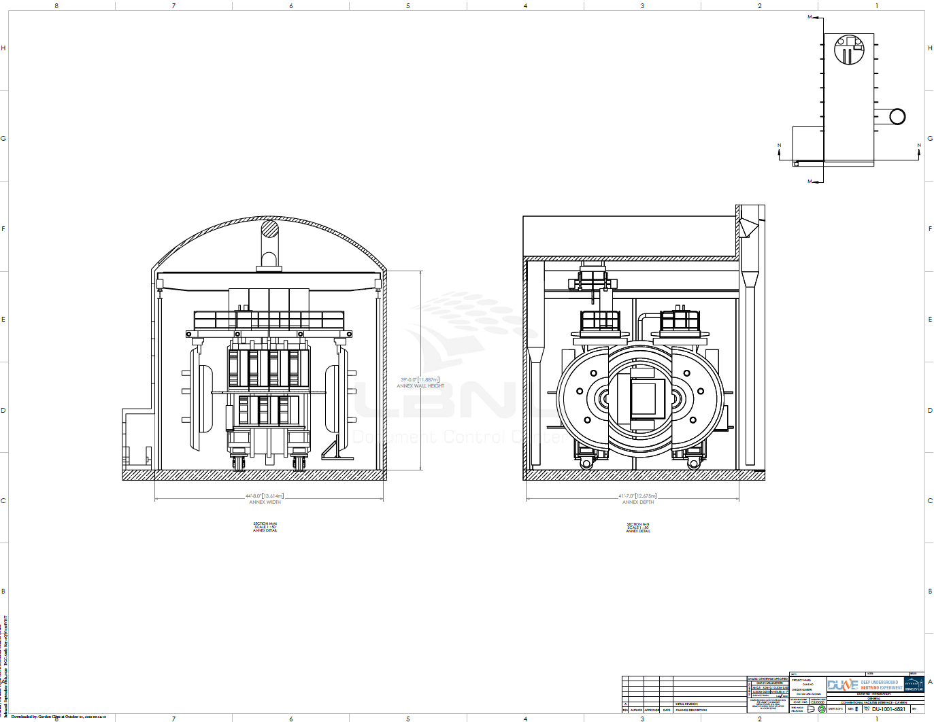
Interface Control Drawings with Facilities
Floor layouts
Detector interface
Detector space
Crane
Coverage
Anchor points

Slide 9
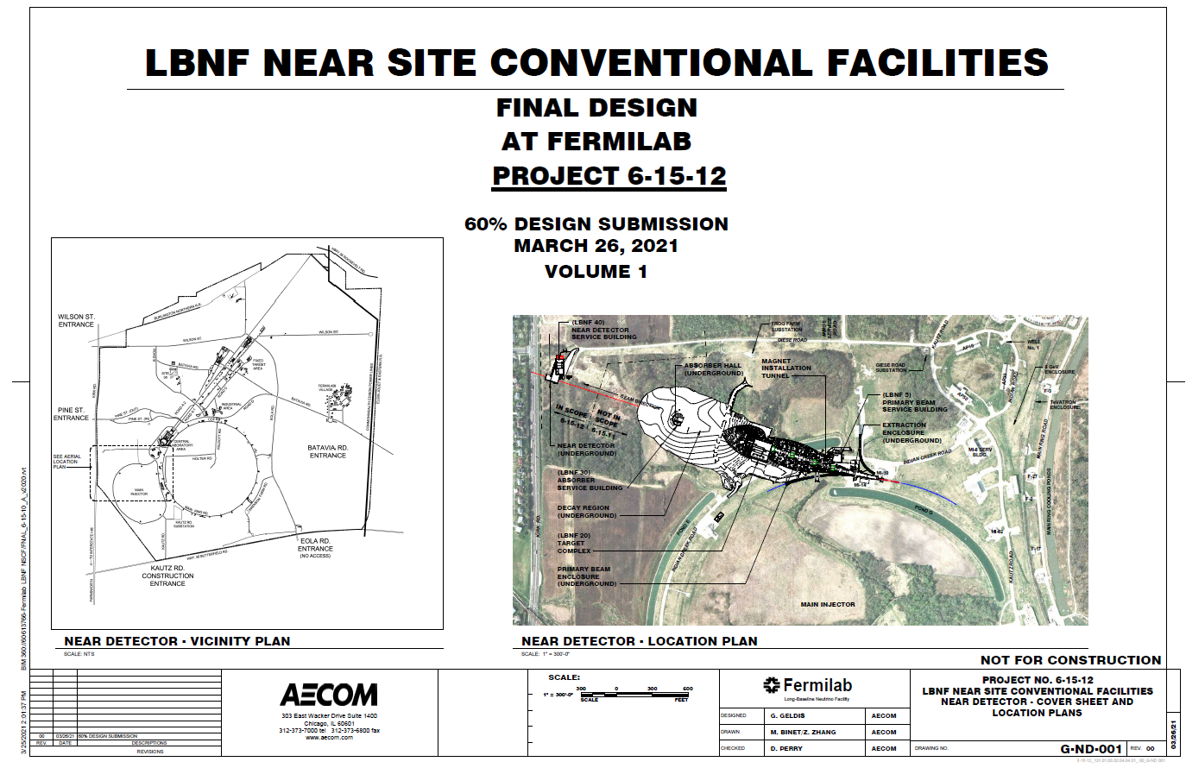
NSCF
Power, SLED
Grounding
Egress
PRISM
Interference
Stay Clear zone

Slide 10
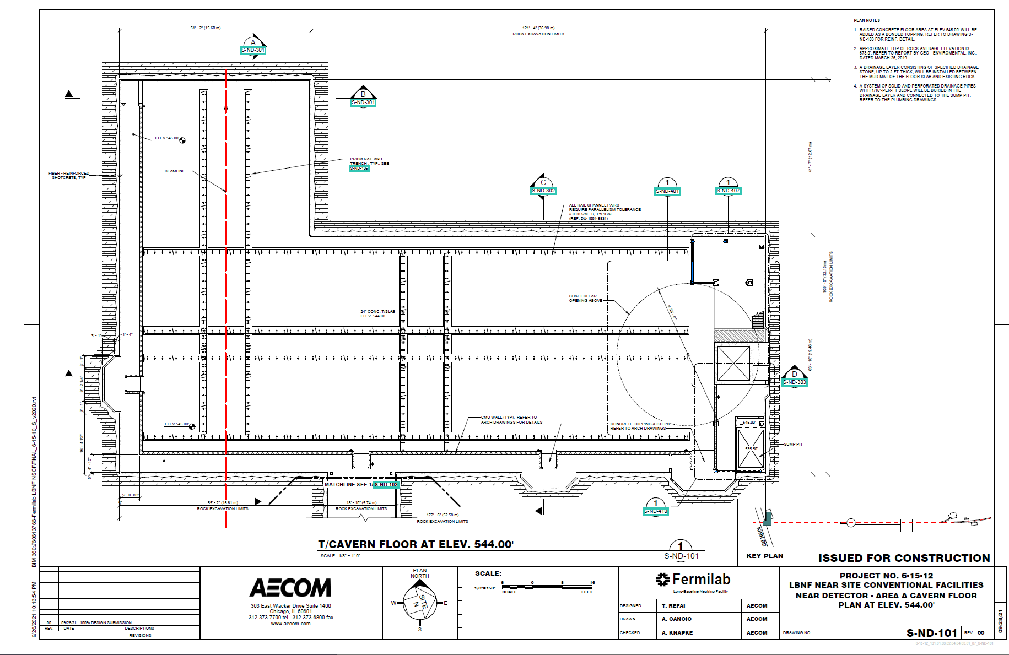
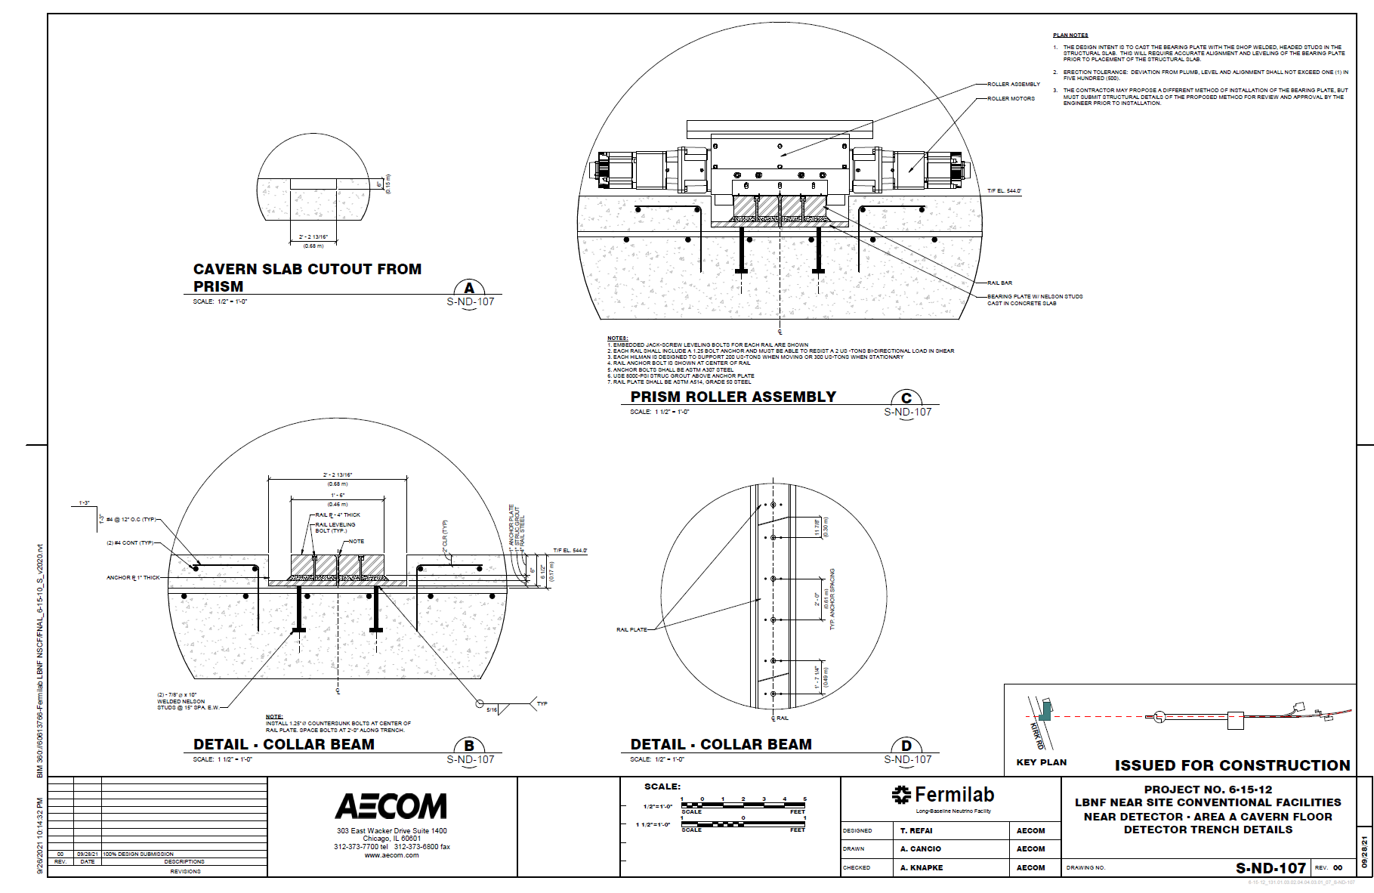
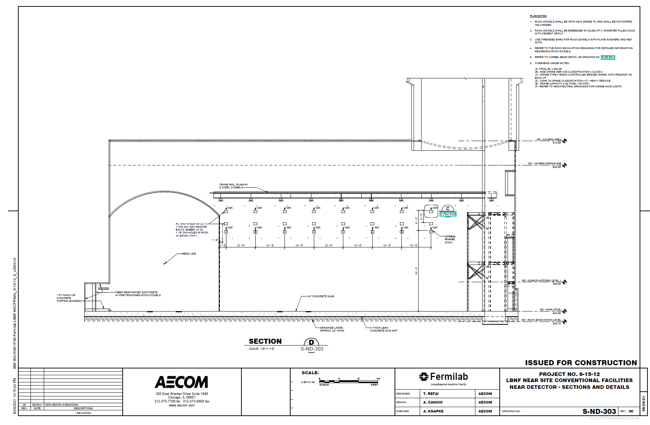
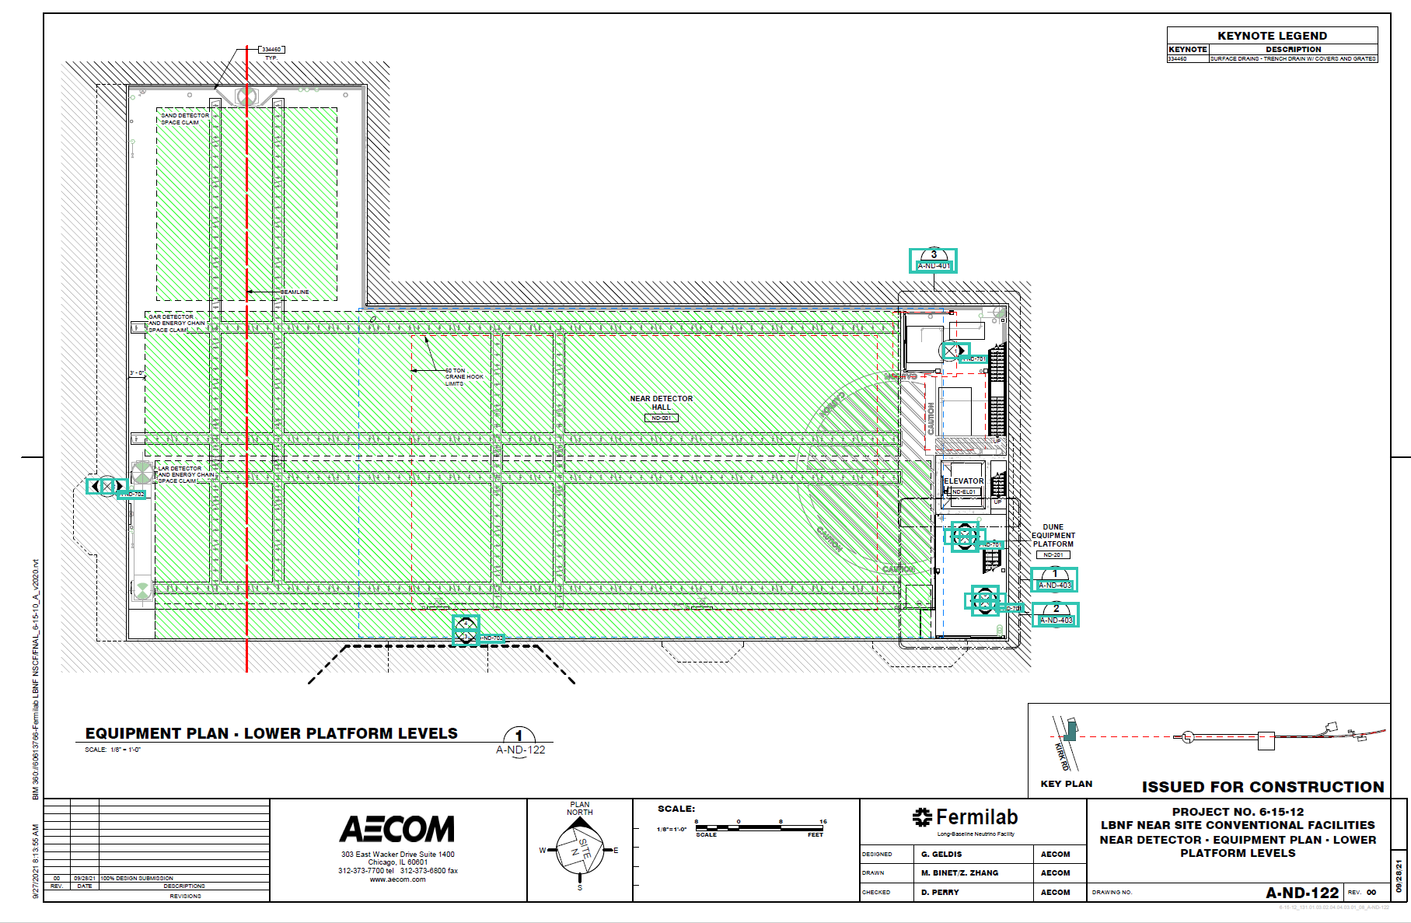

Slide 11
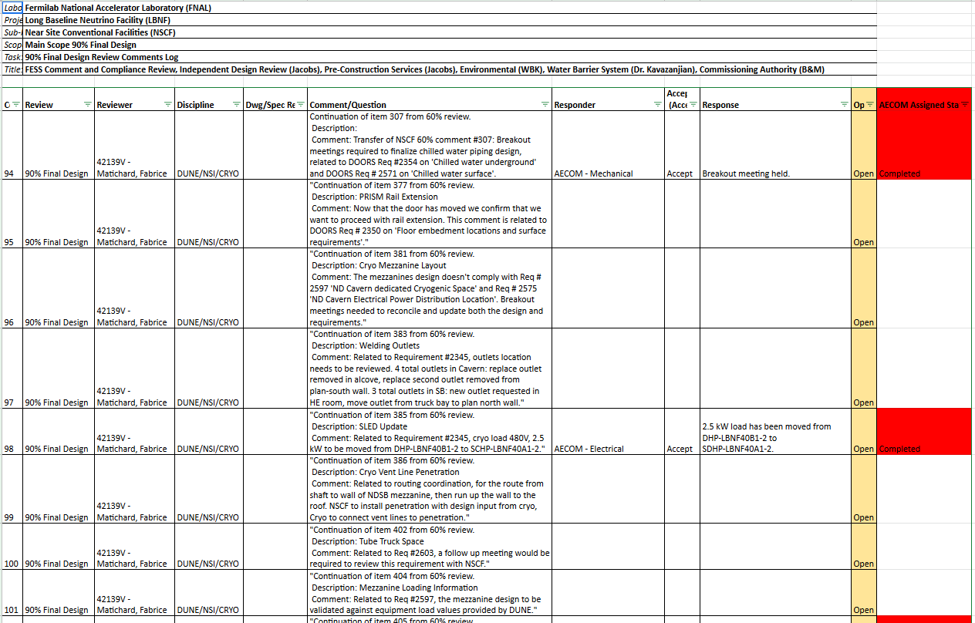
Verification

Slide 12
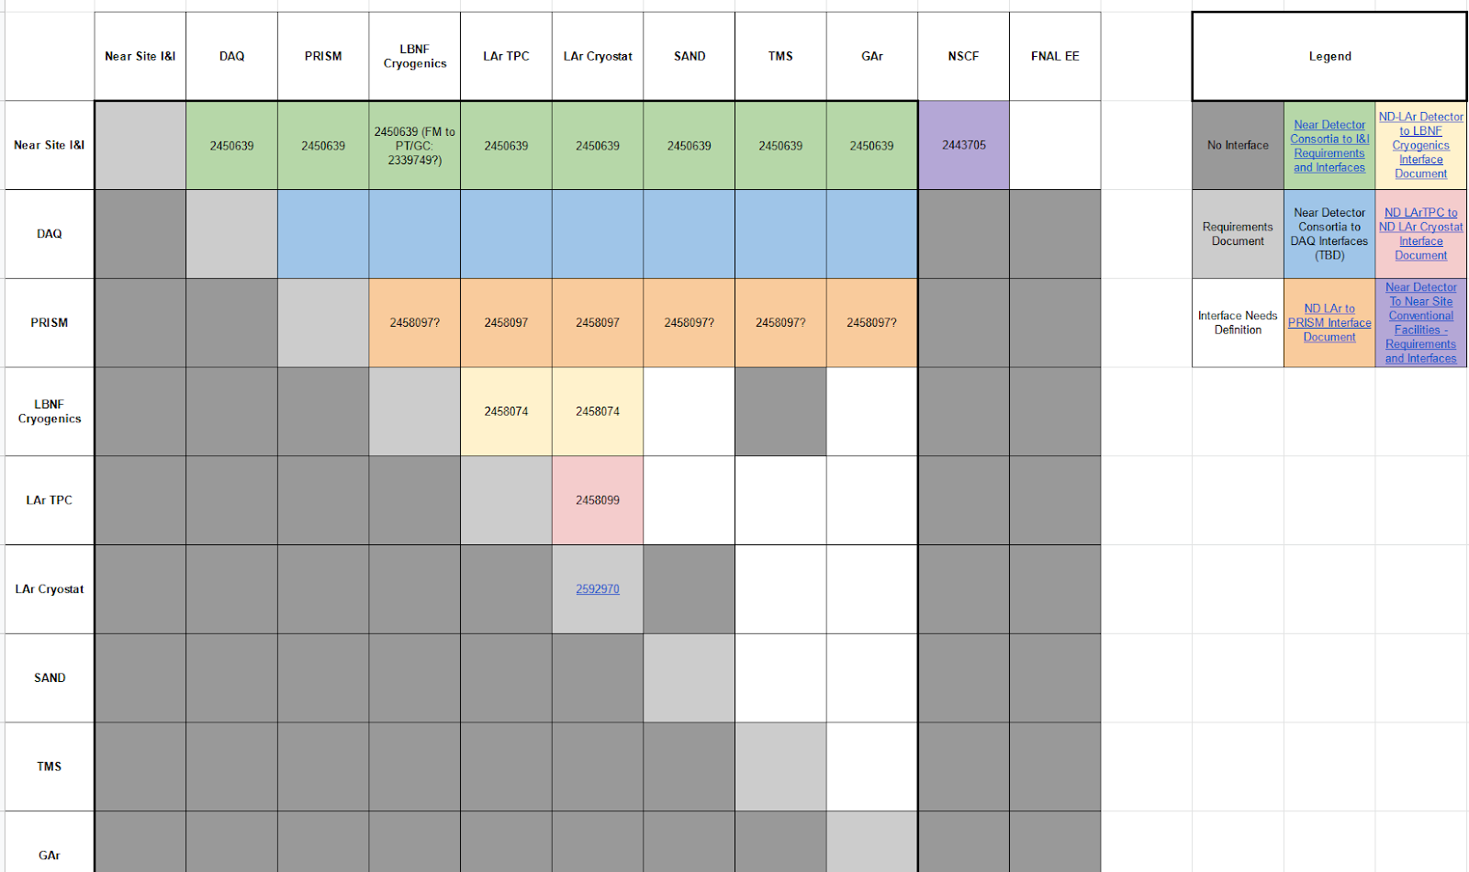
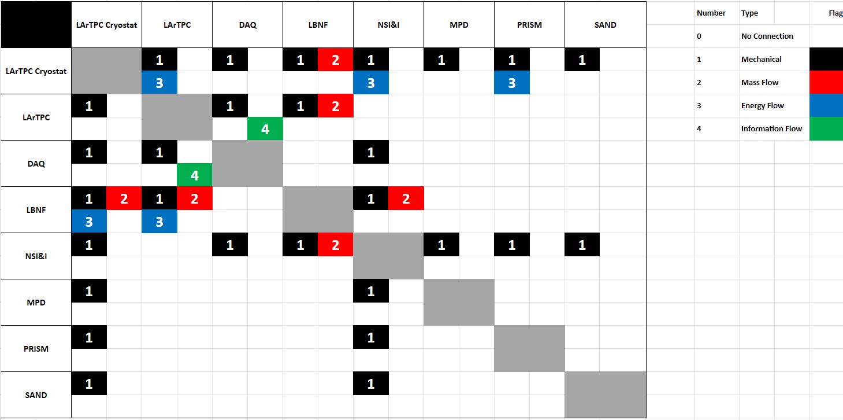
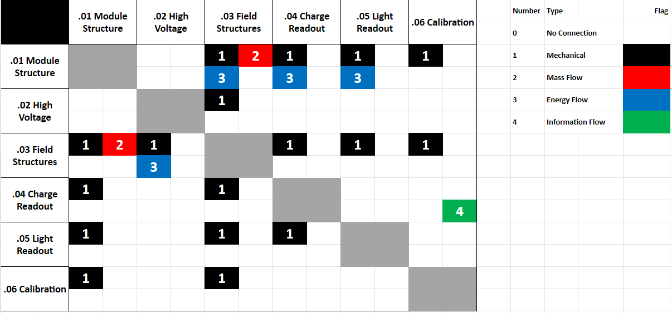
N² matrices
Interface
Documentation
System
Interfaces
Sub-System Interfaces
Credits: Peter Tennessen, Andrew Lambert, LBNL/DUNE

Slide 13
Risks & Hazards Analysis

Slide 14
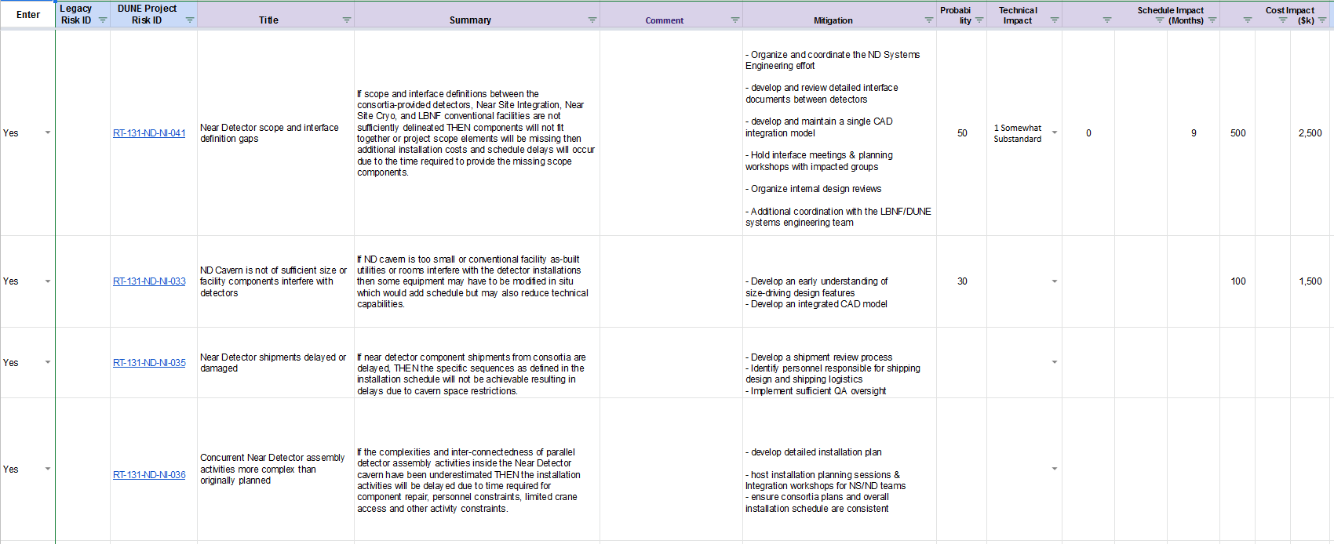

Slide 15
Integrated design

Slide 16
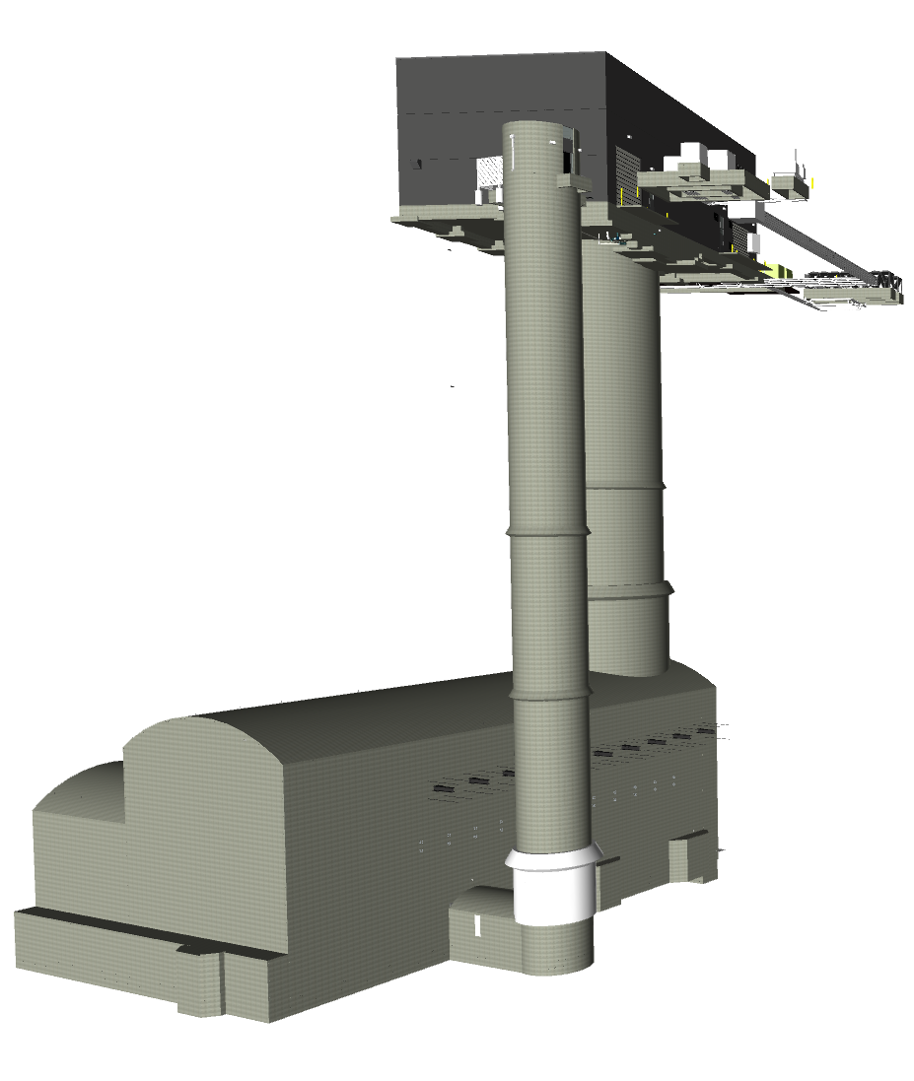
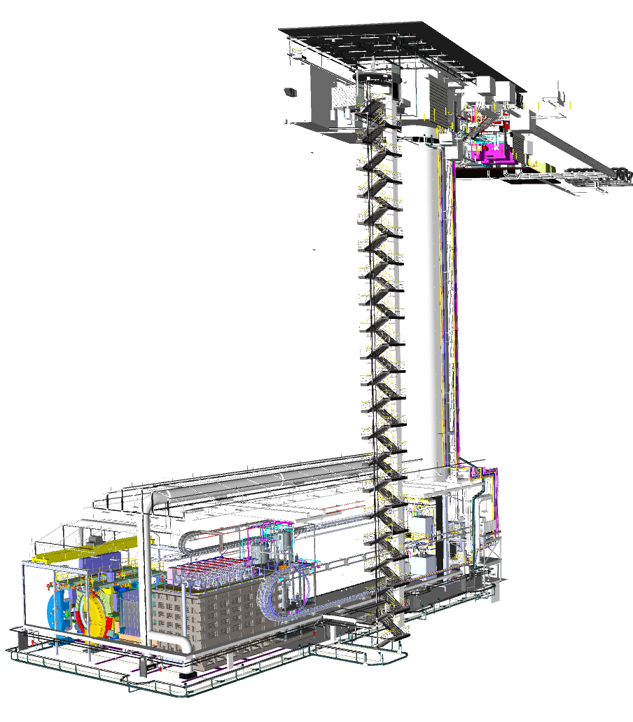
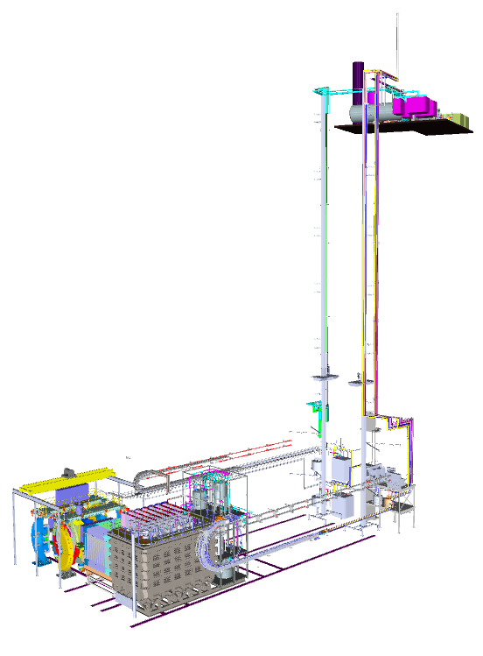
Integrated Design
ND Building
Facilities and Detectors
Auxiliary Systems
Above ground
Surface building
Cryogenics
Cavern
(52m long)
Under
ground
Shaft
(60m long)
Detectors
Neutrino
Beam Direction
Rails and Energy Chains
Notes:
Uncertainties:
Energy Spectrum and intensity of the beam we are producing (flux) - Probability of neutrino interaction in Argon (all three detectors use Argon) - How does a LAR TPC respond to neutrino events (detector response)
Beams parameters are not stable enough to stop probing
ND serves other purposes (physics and learning ways to reduce uncertainties)

Slide 17
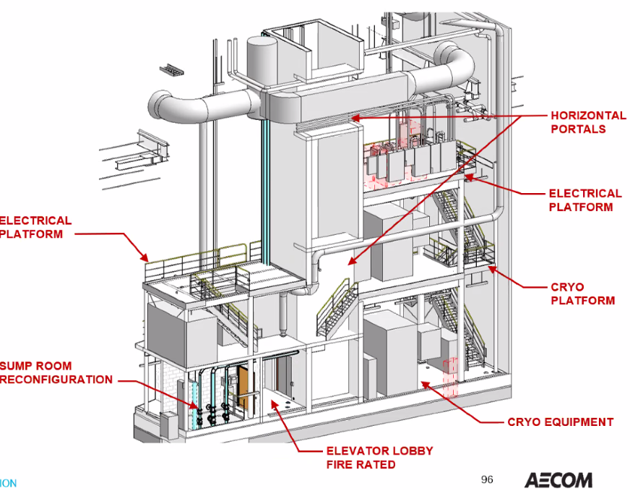
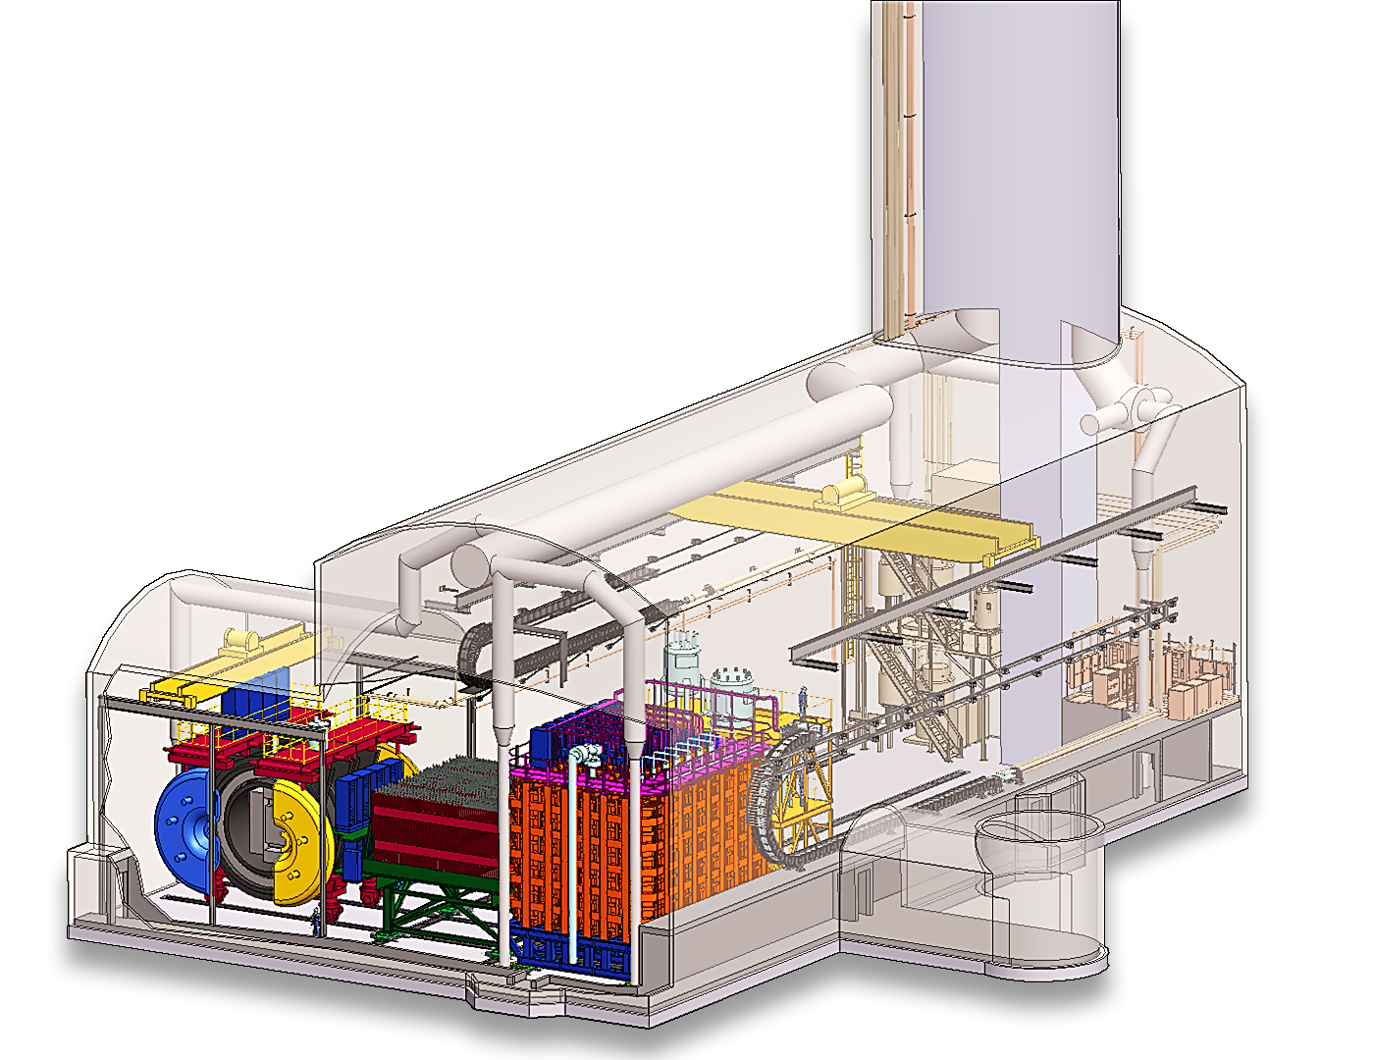
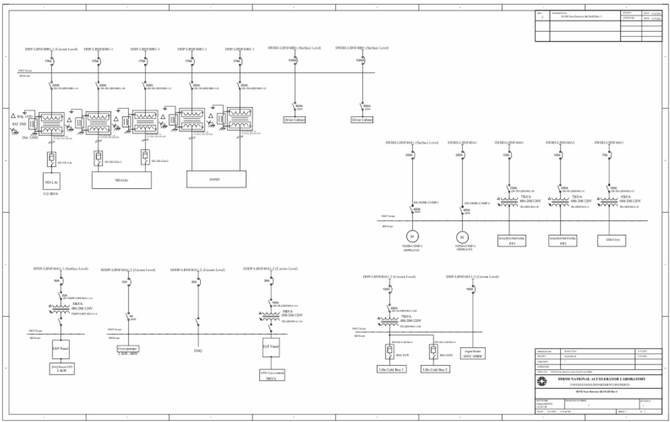
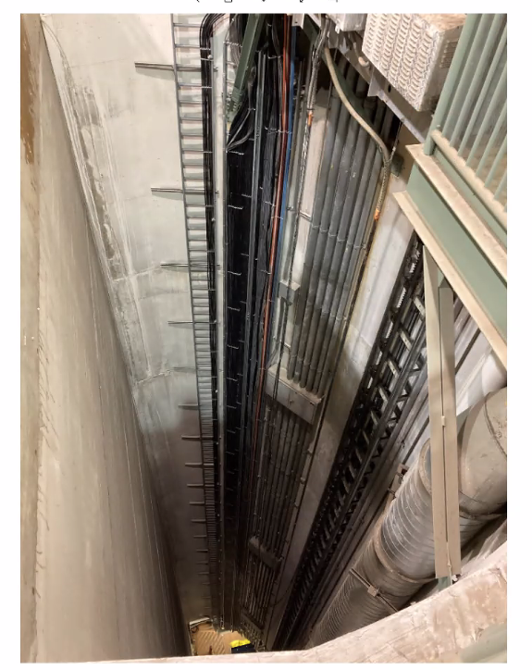
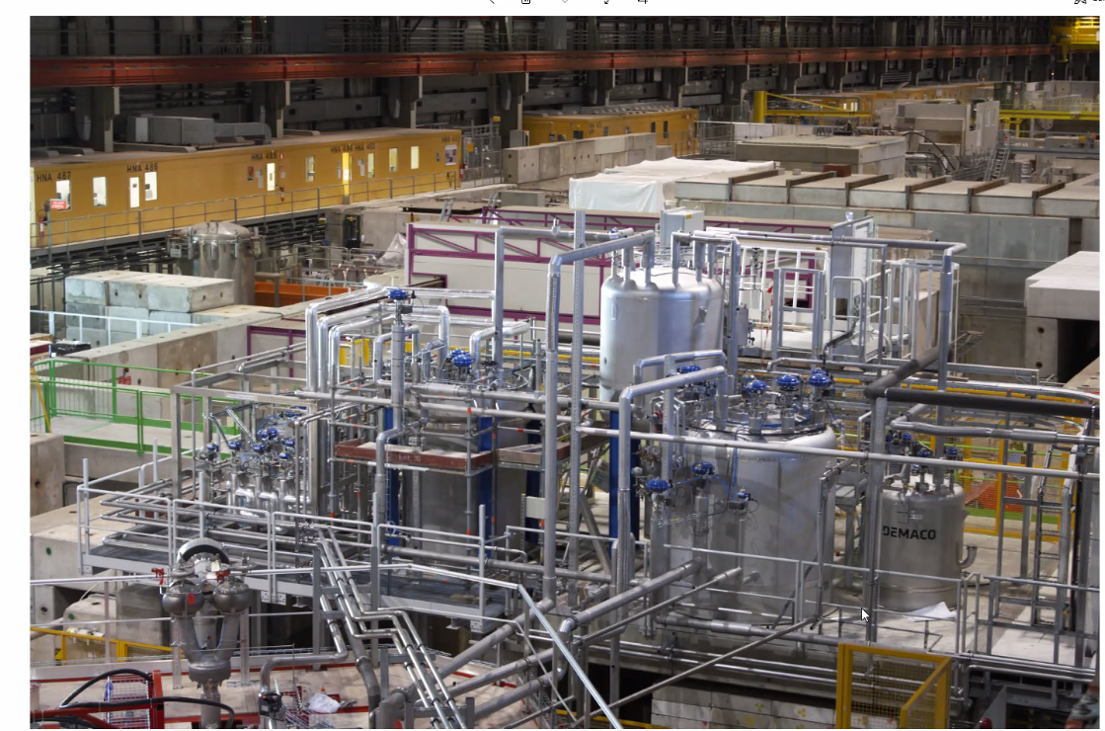
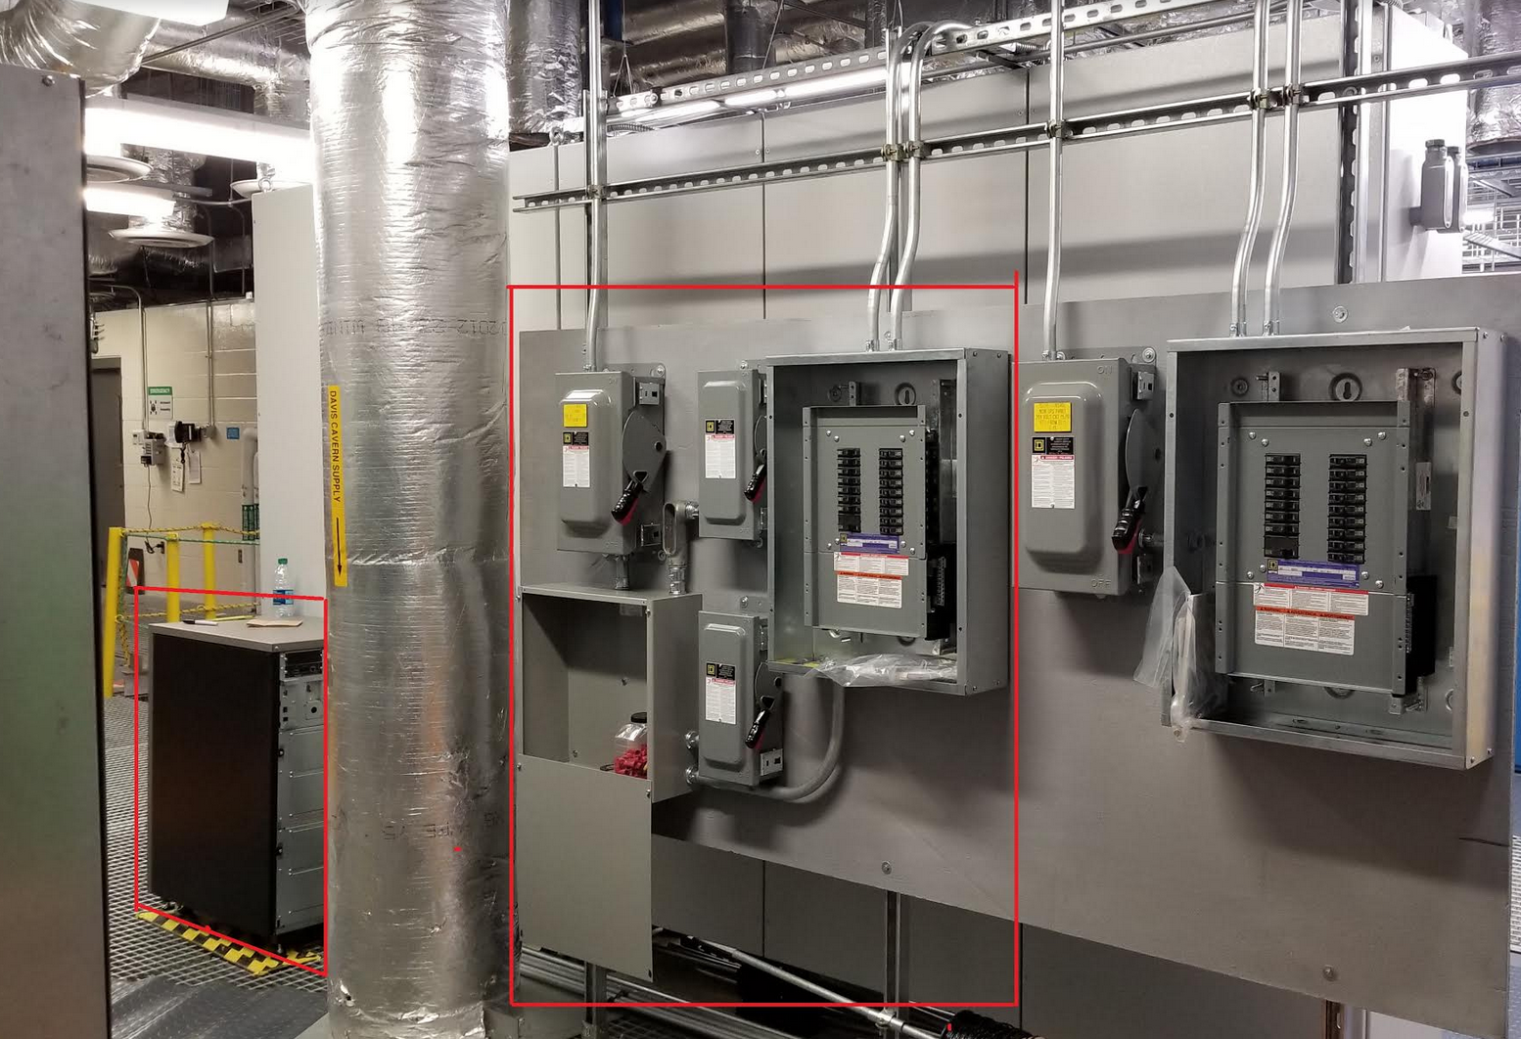
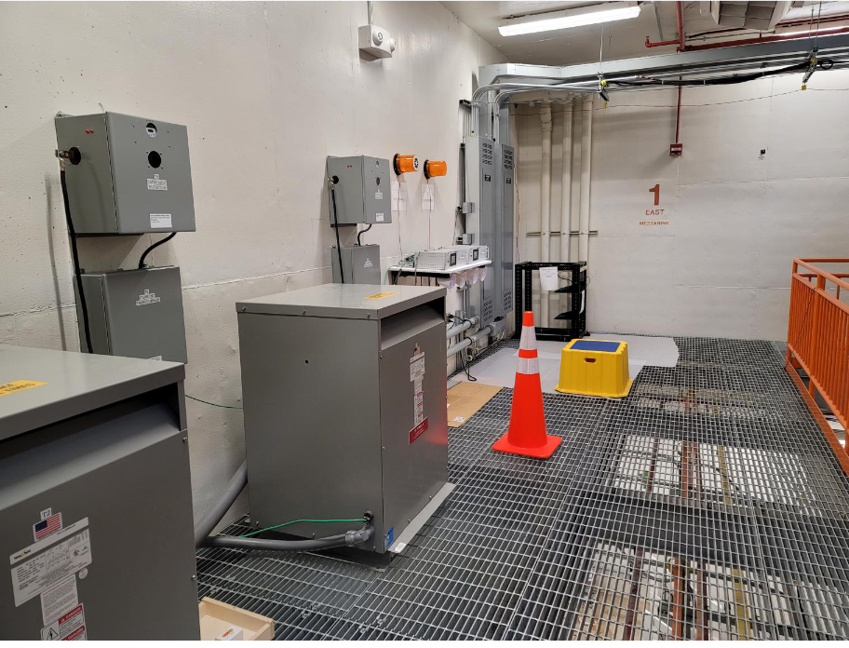
Integration
Disconnects, panels
Transformers
Monitoring
Routing
Cryogenics

Slide 18
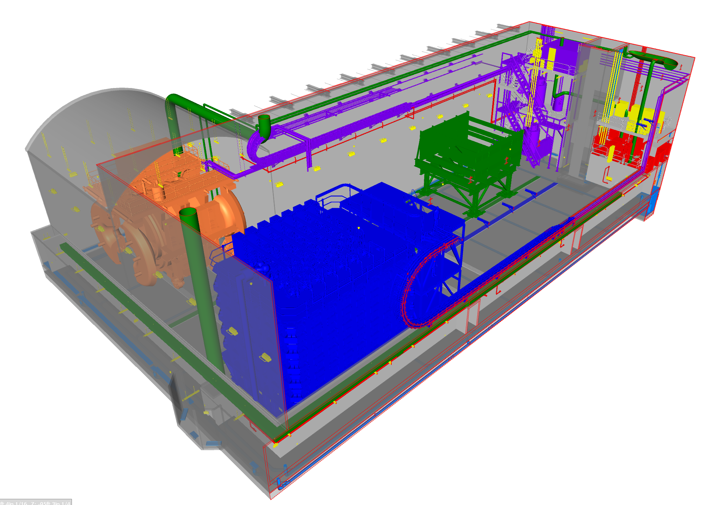
Models Export
Solidworks/STEPS
Navisworks

Slide 19
System level analysis and surveys

Slide 20
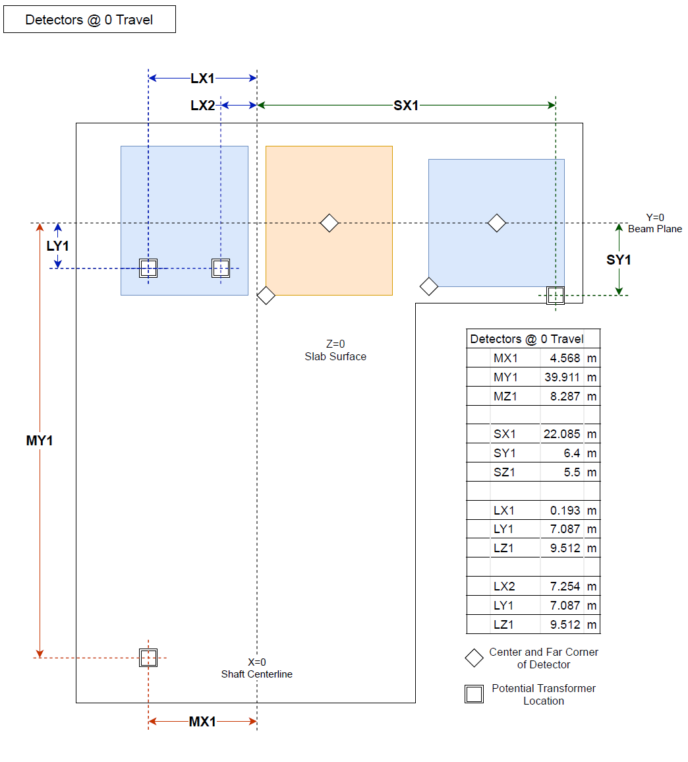
EM Field maps
and
Requirements

Slide 21
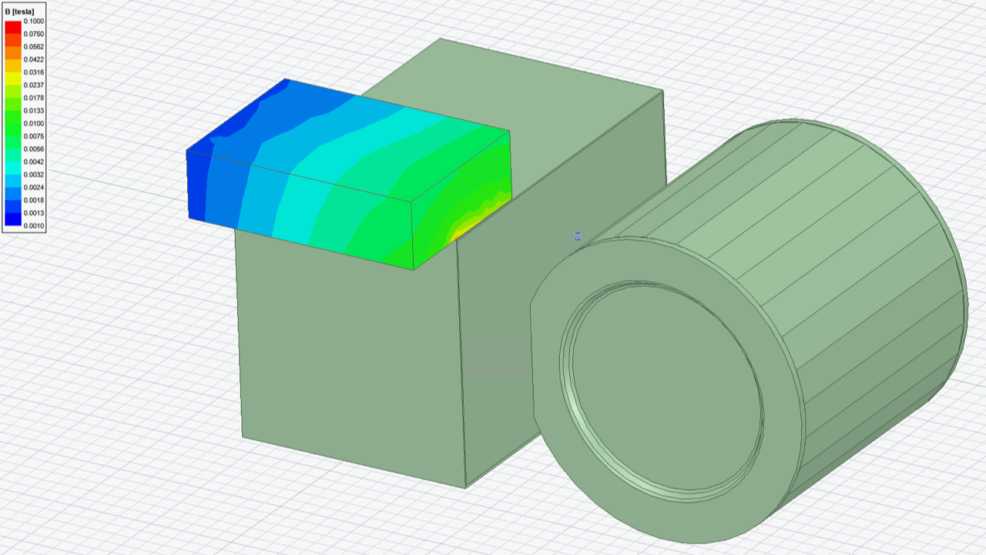
EM Field maps and
Requirements
~100 gauss at planned ND-LAr transformer location.
Similar field strength where ND-LAr electronics cabinets are intended.
AC to DC field ratio?
100 Gauss ~ 1-2 % of saturation level?
AC designed at 98-99% of saturation?
DC shielding difficult
No reference of applications operating at this DC field
Magnetic fields tolerable in ND LAr. What deflection/bias does it introduce? Face sheets need to be included in the simulations.
Only in active region of LAr, passive doesn’t matter.
What about all the other electronics. Inductors (including filters), transformers /power supplies. Saturation at a factor of 2 lower.
Fringe field induced by cut-out in ND-GAr yoke. Fallback: instrumented yoke (layers of iron and scintillator)?
System level analysis

Slide 22
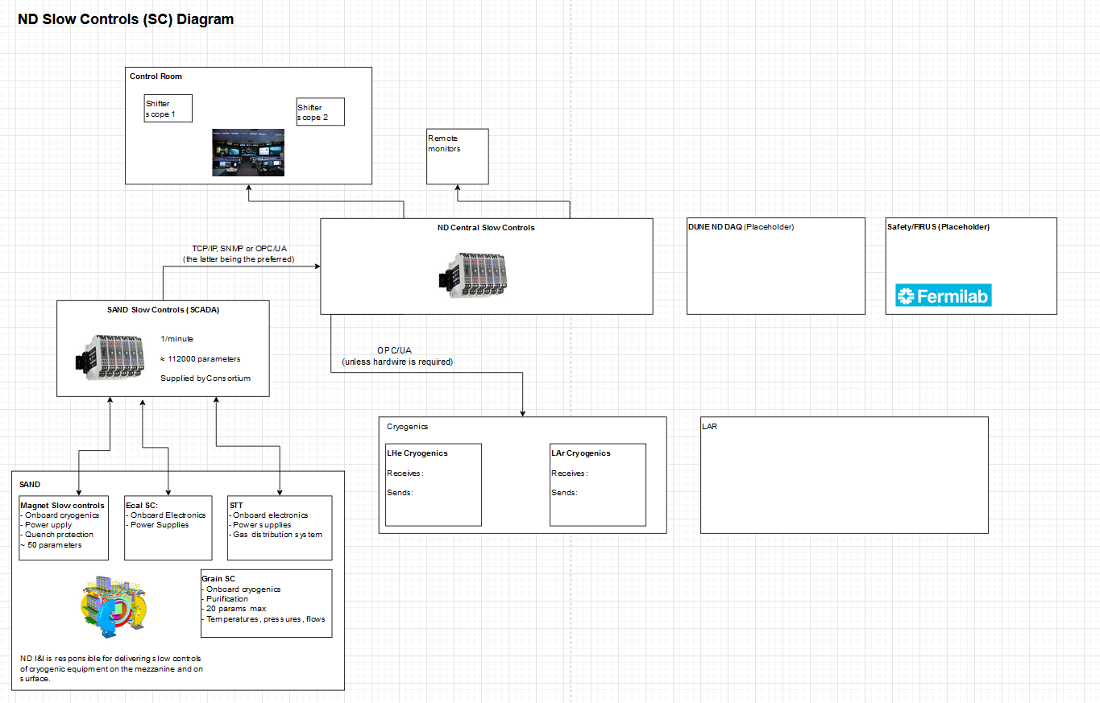
Slow Controls

Slide 23
Installation planning

Slide 24
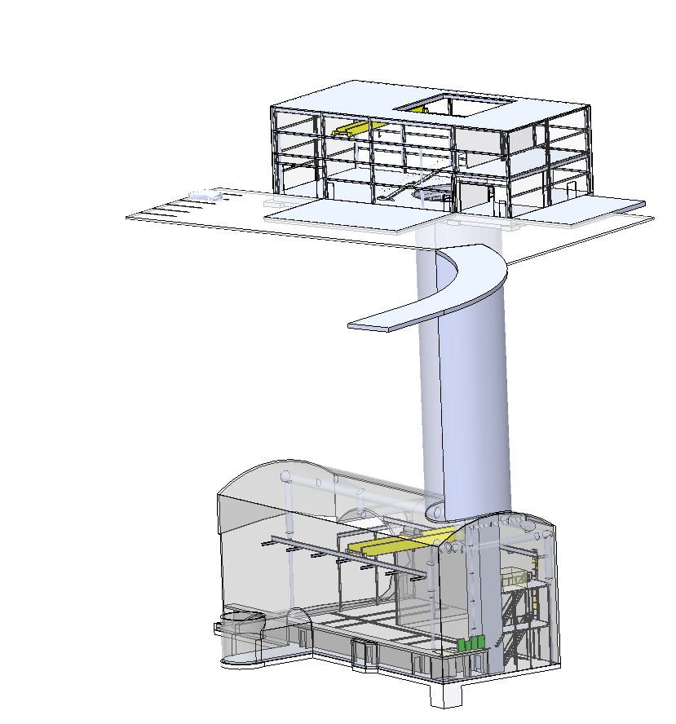
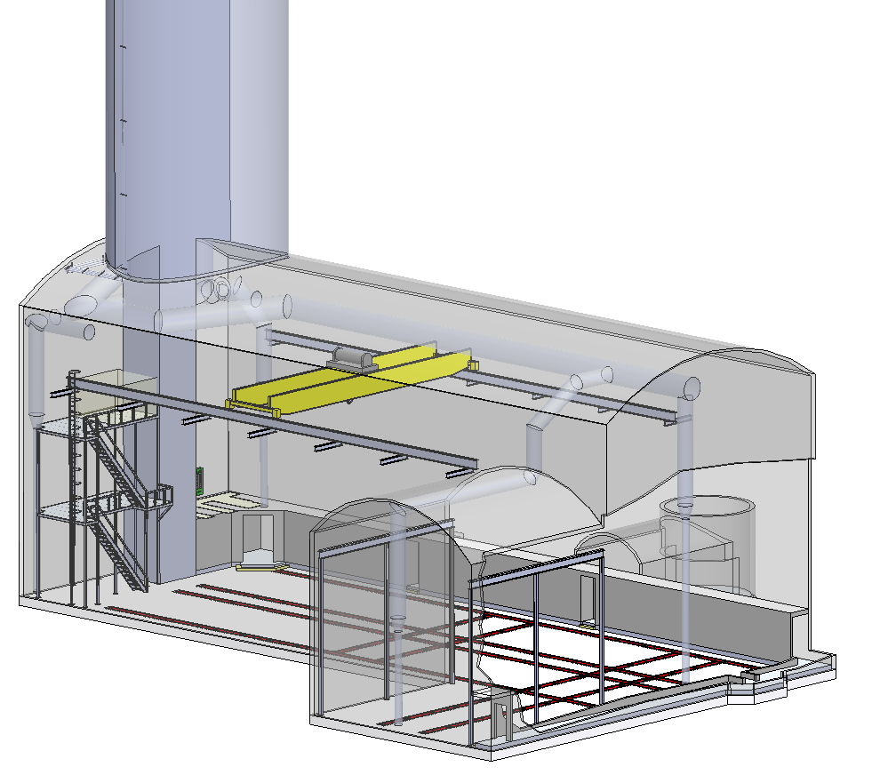
Installation Sequence : Resources and Parallel activities
Surface building
beneficial occupancy
Underground cavern
beneficial occupancy

Slide 25
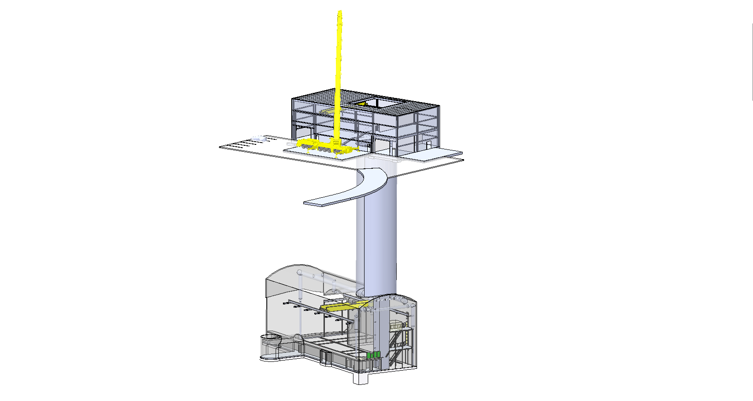
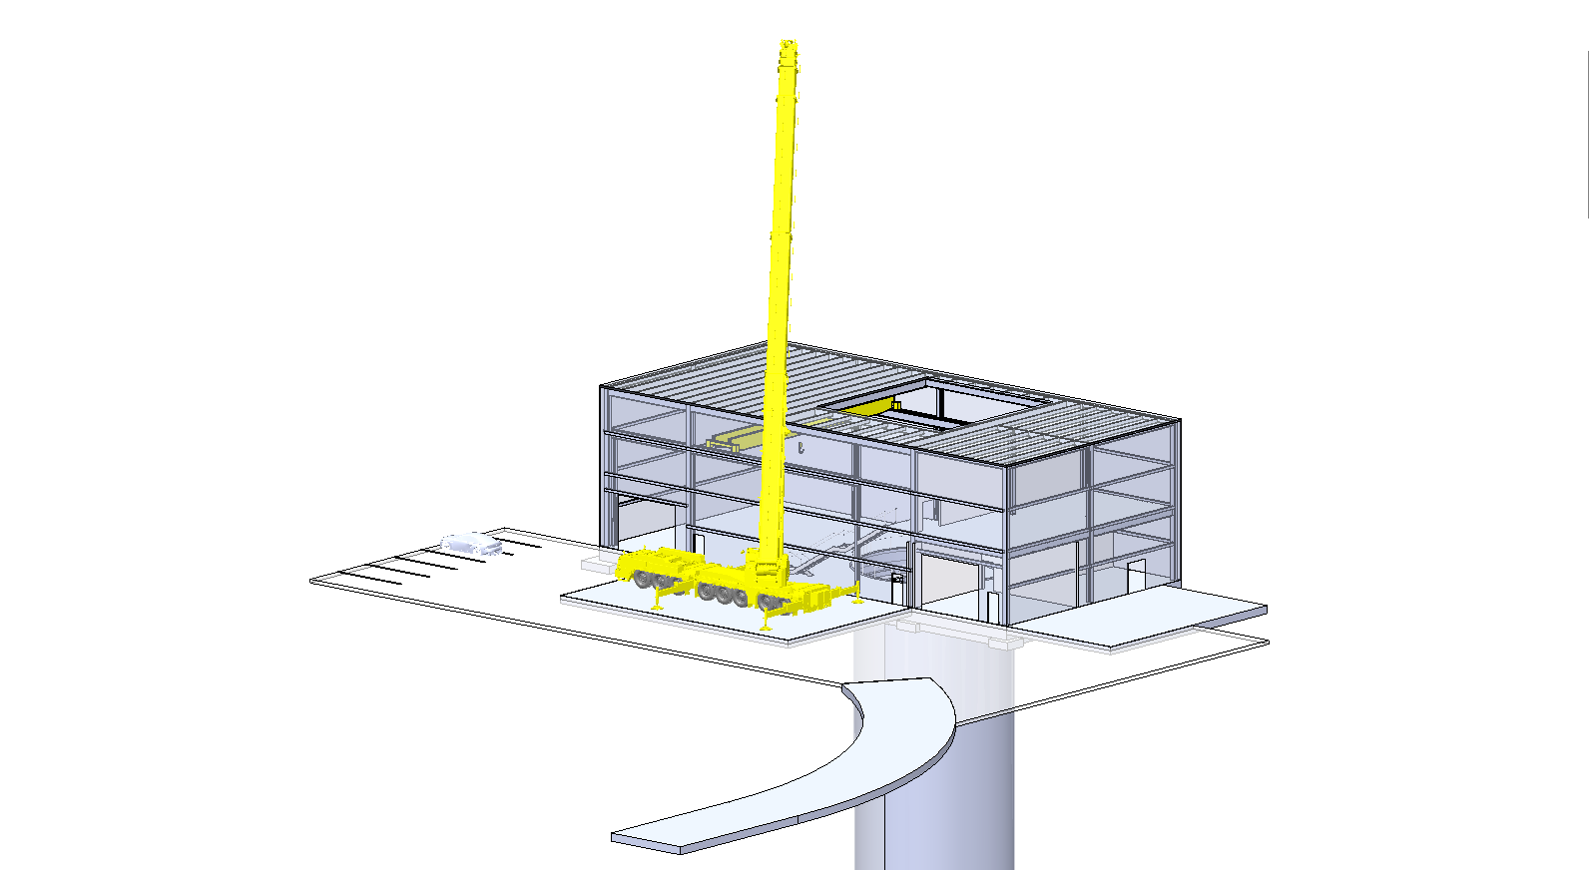
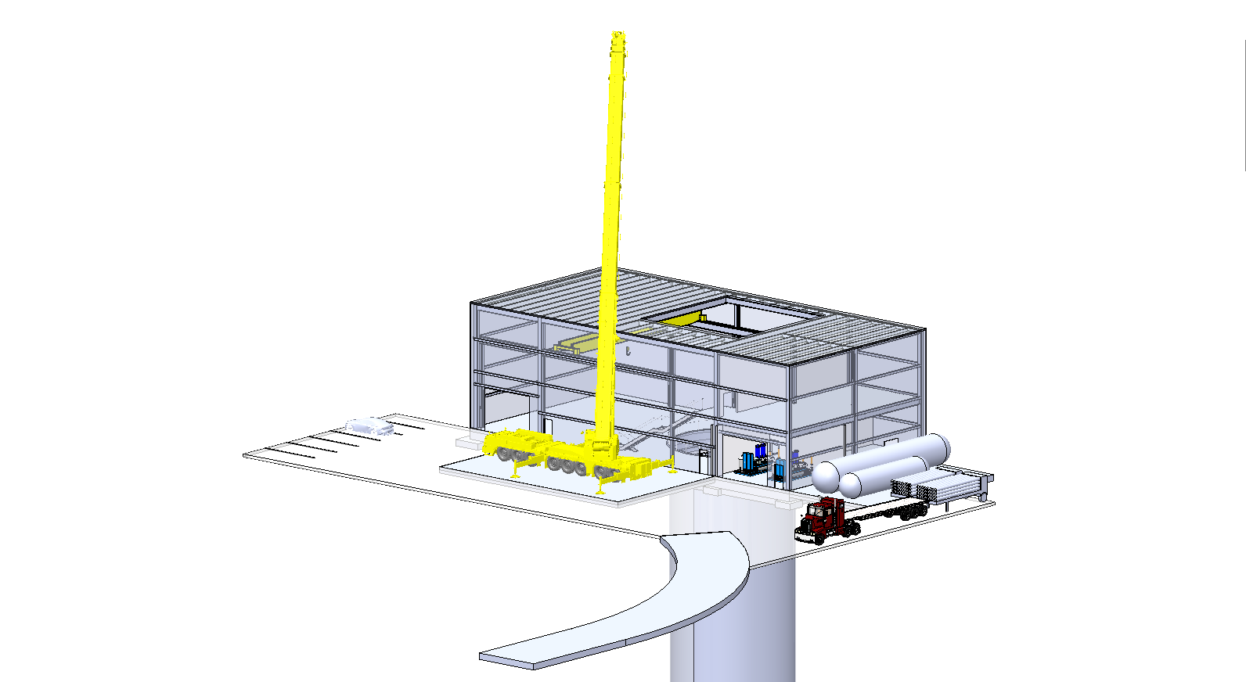
Installation planning
Installation sequence
Resources: labor, equipment, rental
Needed to baseline the project
Assembly & Installation tooling
Integrated to the sub-system development
Integrated safety considerations
Power needs (outlets, currents…)
Credits/Sources – Austin Turner, LBNL/DUNE

Slide 26
Install Sequence – Q1 2027
Cryostat - Surface
SAND assembly
DAQ
Cryogenics
Energy Chains
Helium Room

Slide 27
Installation planning: resources, schedules
Credits/Source: Installation planning, LBNL/DUNE

Slide 28
Installation planning: workflows, procedures
Credits/Sources – Andrew Lambert, ND-LAr Detector documentation, LBNL/DUNE

