Slide 1
Injection into RFFAG First Preliminary Ideas
Jaroslaw Pasternak
Imperial College/RAL STFC
VLENF meeting,
January 20, 2012

Slide 2
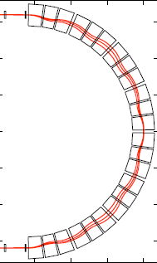
Assumptions and observations (1)
The RFFAG ring by J-B. Lagrange and Mori-san is designed for muons:
-magnetic fields are for +-20% momentum deviation,
-betatron functions at mean value of 27 m in the drift are set to maximise
the neutrino efficiency (decreasing the muon production efficiency
from pion decay).
The drift lengths in the arcs are very small.

Slide 3
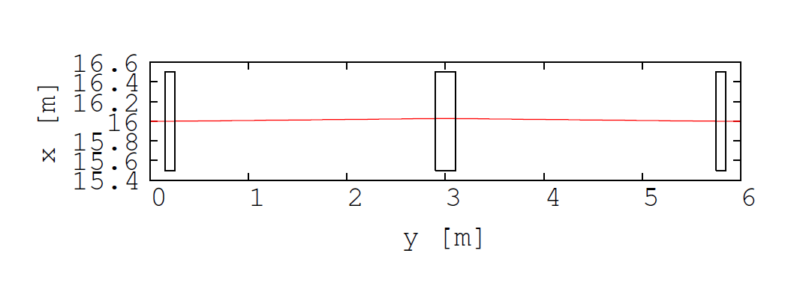
Assumptions and observations (2)
The drift length in the straights are long ( about 2.8 m)!
In this short talk I make the first attempt to estimate
the kicker/septum parameters for this ring
assuming 2 GeV/c muon injection.

Slide 4
Preliminary injection (1)
The long drifts are the natural place for septum and kickers.
Kickers must be distributed in a few cells
(the more the weaker they are).
Optics of the drift has been reproduced and zero chromaticity
condition confirmed.
Closed orbits have been calculated.
The septum was assumed to be located downstream the D magnet.
The needed orbit separation was estimated based on
the acceptance plots in the RFFAG paper ( by J-B and Mori-san)
and is about 12cm*2+1cm~25 cm.
The additional separation to clear the magnet was assumed
to be about 30 cm.

Slide 5
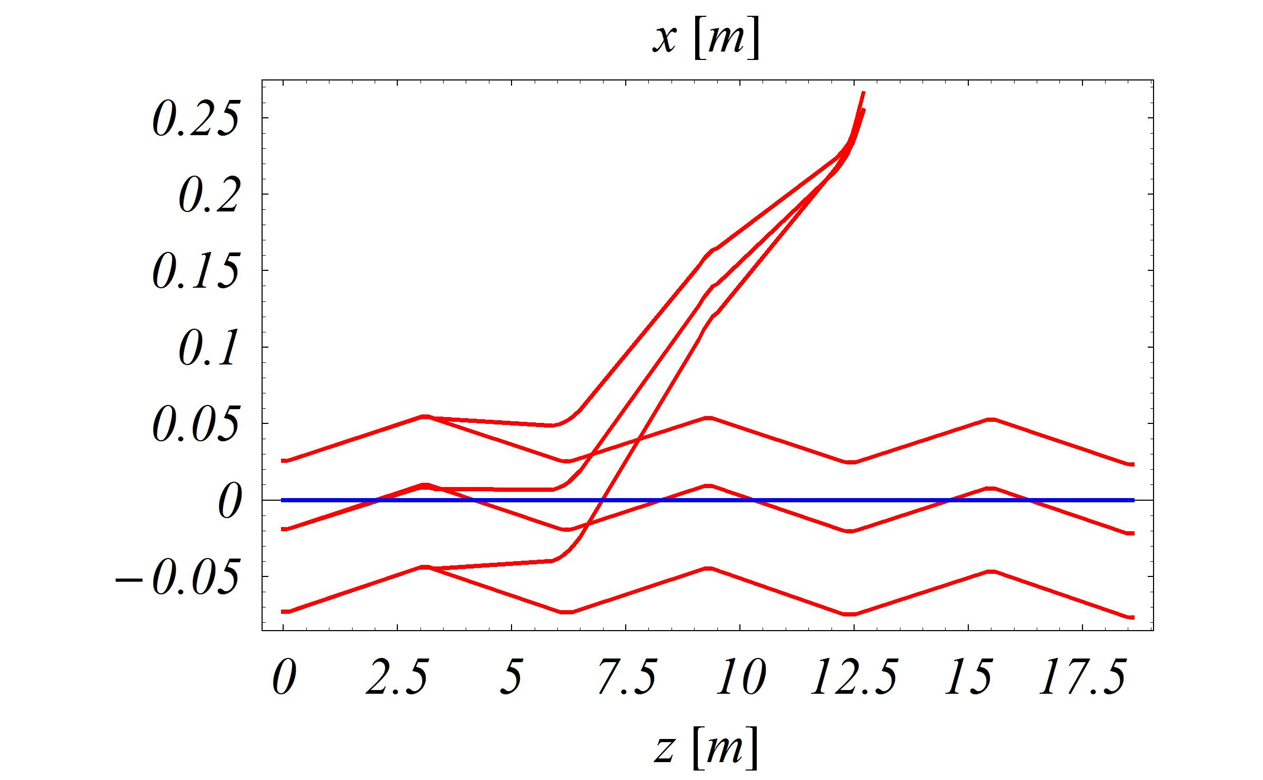
Preliminary injection (2)
Injected beam
Circulating beam orbits
0 and +/- 20% dp/p

Slide 6
Preliminary injection - parameters
Number of kickers 3
Kicker B field 0.05 T
Kicker length 2.6 m
Kicker aperture 60x30 cm
Septum B field 0.6 T
Septum length 2.6 m in length and
Septum aperture 30x30 cm

Slide 7
Summary and future plans
Single turn 2 GeV/c muon injection into RFFAG is possible.
If more kickers would be used weaker strength could be obtained.
This scheme requires a relatively long decay channel in order to
generate the muon beam from the pion decay before the injection into the RFFAG.
Is this possible and acceptable?
The multi-turn muon injection could be an option.
The pion decay into the RFFAG-type ring should also be studied.
This is almost certainly possible! -> Next task...

Slide 8
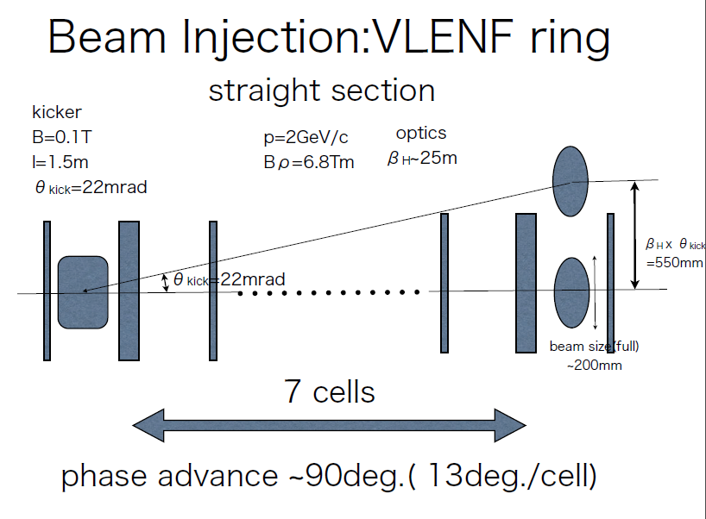
From Mori-san

