Slide 1
LBNC Meeting: ND-LAr Design and Documentation
December 2nd, 2021
Andrew Lambert (LBNL)
Lead Engineer ND-LAr Consortium

Slide 2
Agenda
Scope
Design Progress
Documentation Progress
Concerns
Summary

Slide 3
ND-LAr: Scope Overview

Slide 4
ND-LAr: Scope Overview
ND-LAr Subsystems:
Module Structure (Bern)
High Voltage (Bern)
Field Structure (SLAC)
Charge Readout (LBNL)
Light Readout (JINR)
Calibration (MSU/UHawaii)
TPC Assembly & Test (CSU)
TPC Integration & Installation (UTA/LBNL)
ND-LAr Test Facilities:
Full-Scale Demonstrator Test Facility (SLAC)
ArgonCube Full Scale Demonstrator Test Facility (Bern)
Module Assembly and Test Facility (FNAL)
2x2 @ LArTF/MINOS (FNAL)

Slide 5
DESIGN

Slide 6
ND-LAr: Design Progress
Subsystem design refinements over the past few months:
Module Structures: Row support frame, liquid argon distribution lines, module support plate
High Voltage: Updated filter design, connectors, power supplies
Field Structures: Anode layout and field shell structural connections, clearance holes for cable/fiber connectors, LAr weir volume above module, HV cable
Charge Readout: Cable routing design, connector choice, tile mounting, warm electronics enclosures, board layouts, v2b ASIC
Light Readout: Updated PCBs, LCM backing plate material, anode attachment
Calibration: Target attachment, light injection methods
CAD Development:
*K. Skarpaas (SLAC)
*A. Lawrence (LBNL)
*R. Hanni (Bern)
*S. Sokolov (JINR)

Slide 7
ND-LAr: Design Progress
Module Support Structure
ArCLight Tile
LCM Tile
Updated warm feedthrough and front end electronics
Updated support structure for TPC and interface to Anode Panel
Light Power/Data Cables
Charge Power/Data Cables
Pixel Tile w/ASICs
Anode Support Panel
Calibration Fiber
CAD Development:
*K. Skarpaas (SLAC)
*A. Lawrence (LBNL)
*R. Hanni (Bern)
*S. Sokolov (JINR)
Field Shell

Slide 8
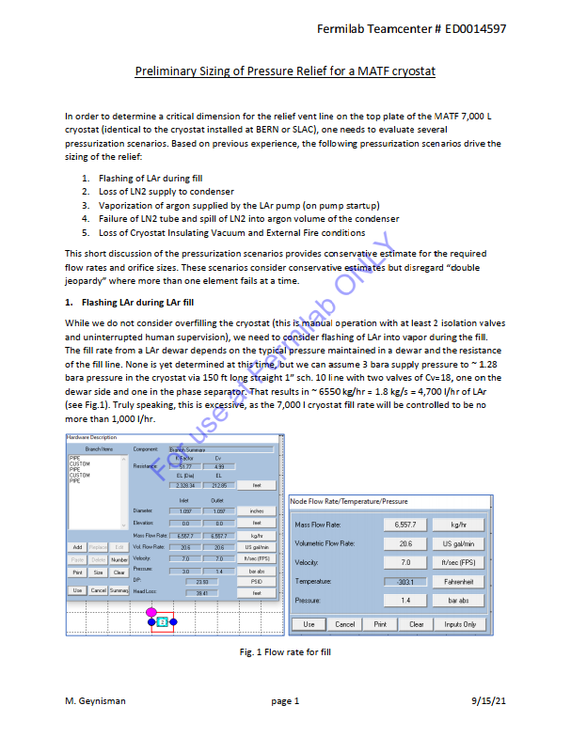
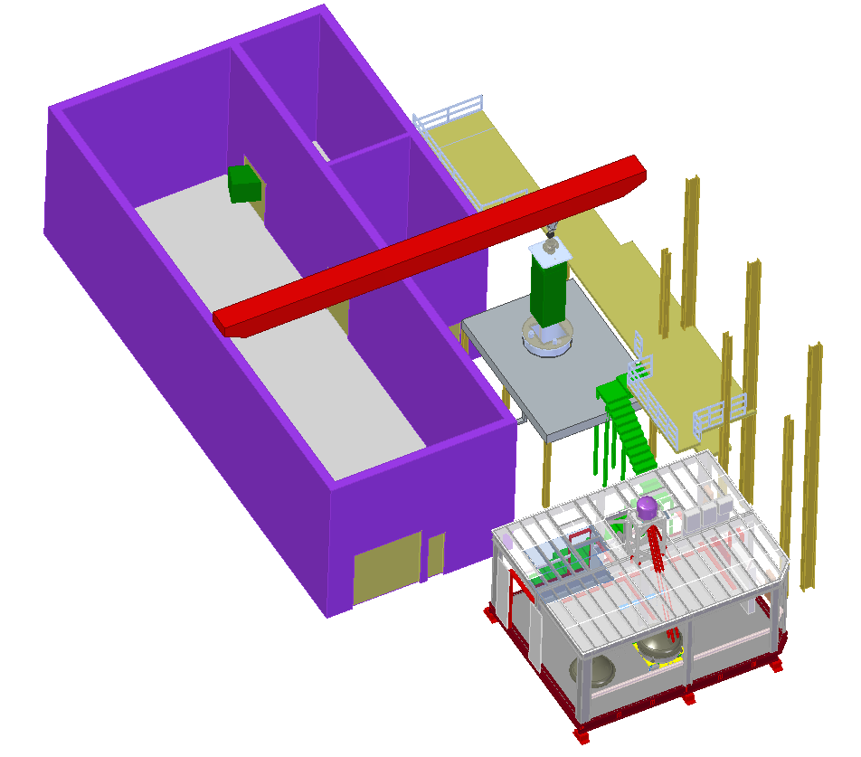
ND-LAr Design Progress: Facilities
FSD Cryostat Lid Design
*J. Jablonski (CSU)
FSD P&ID
*M. Oriunno (SLAC)
MATF Test Vessel Pressure Relief Note
*M. Geynisman (FNAL)
FSD Layout
*M. Oriunno (SLAC)

Slide 9
ND-LAr: Design Progress, Integrated FEA Studies with Cryostat Lid
Further design optimization studies for row support structures design (R.Hanni, Bern) to examine:
Effect of box beam thickness on row support deflections
Effect of box beam cross section on row support deflections
Evaluation of multiple load cases
Gravity only (lifting & handling)
Gravity + LAr buoyancy (half-filled)
Gravity + LAr buoyancy (fully-filled)
Gravity + LAr buoyancy + internal pressure (operations)
Investigating stresses, deflections, modal frequencies
*Giorgio Vallone (LBNL)
Engagement with LAr Cryostat engineer Peter Tennessen (LBNL) on integrated Finite Element Analyses (FEA) of TPC row support structure and cryostat lid
Potential design change to remove center row supports to de-couple row deflection from cryostat lid deflection
*Giorgio Vallone (LBNL)

Slide 10
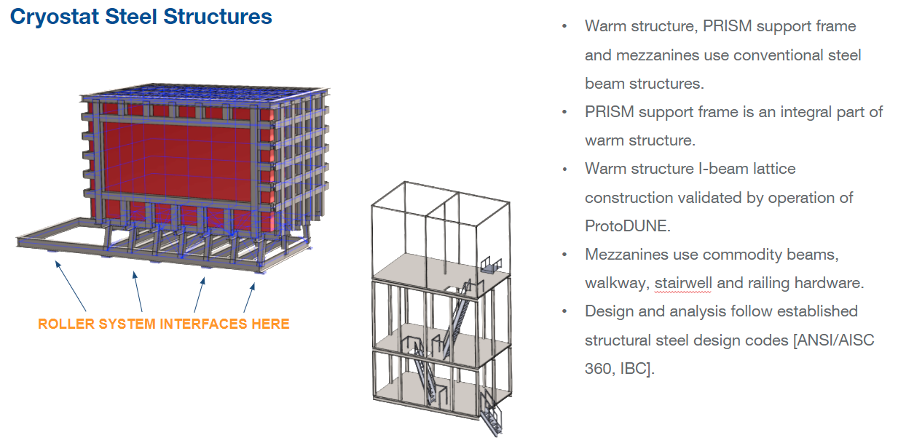
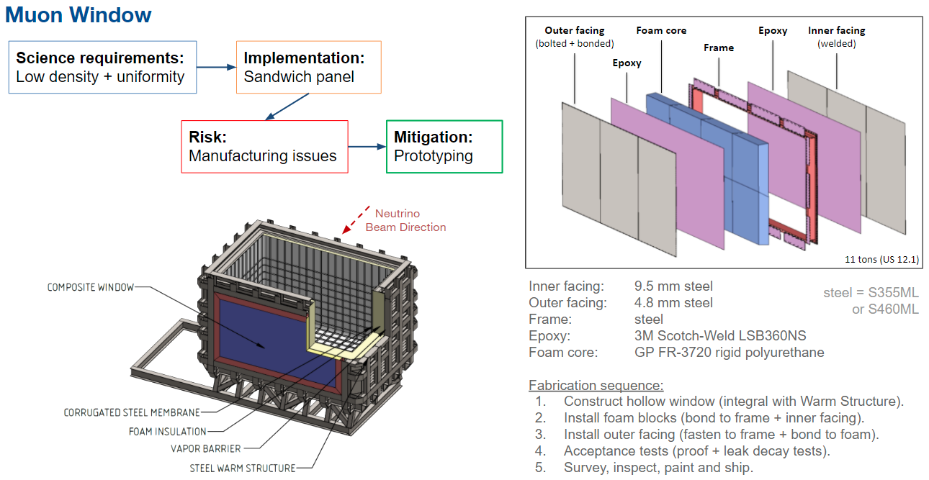
ND-LAr: Key Interface - LAr Cryostat Team: P. Tennessen (LBNL), J. Silber (LBNL)

Slide 11
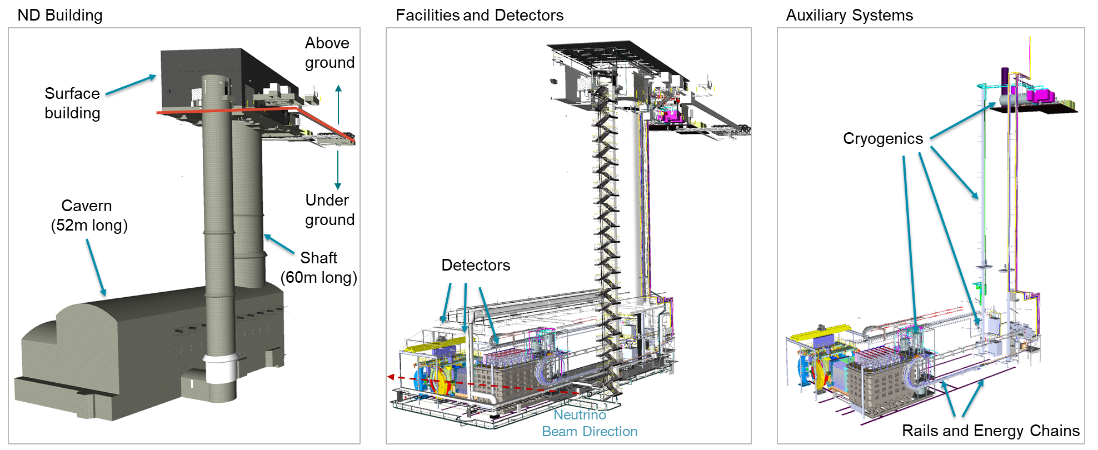
ND-LAr: Key Interface - Near Site Engineering Team: F. Matichard (LBNL), G. Cline (LBNL), B. Flight (U-Rochester), A. Lawrence (LBNL)
Interface between ND-LAr and NSCF
Collection of requirements and interfaces with Near Site Conventional Facilities
Collection of installation needs:
Resources
Equipment
Assembly Space
Schedule
Cooperation on system diagrams and key interfaces with other detectors

Slide 12
DOCUMENTATION

Slide 13
PDR documentation schedule → ND-LAr has worked according to a schedule to develop PDR documents, presented in weekly engineering meetings

Slide 14
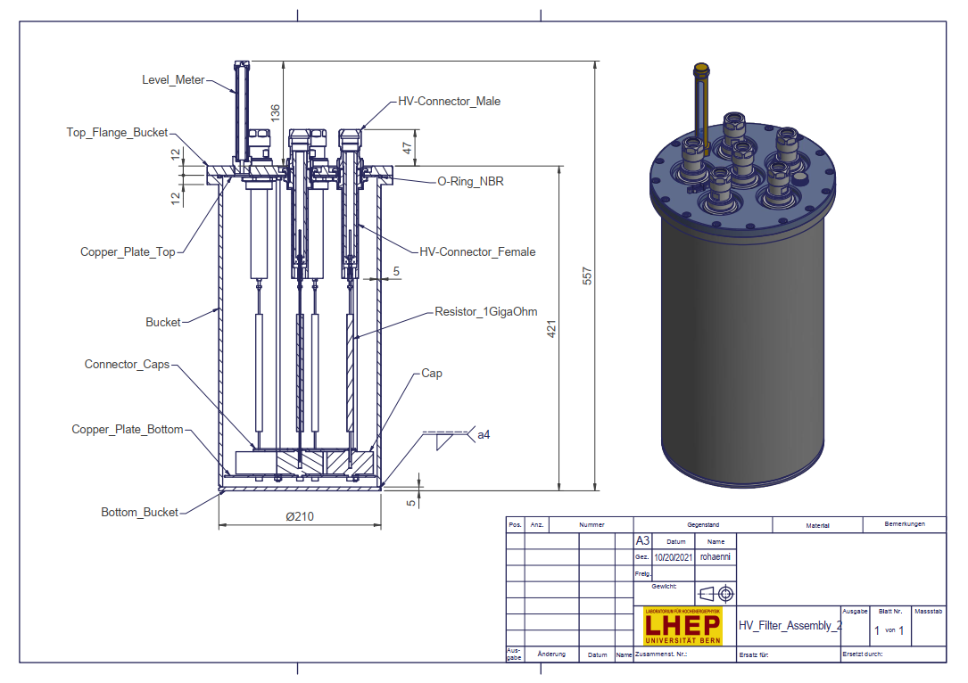
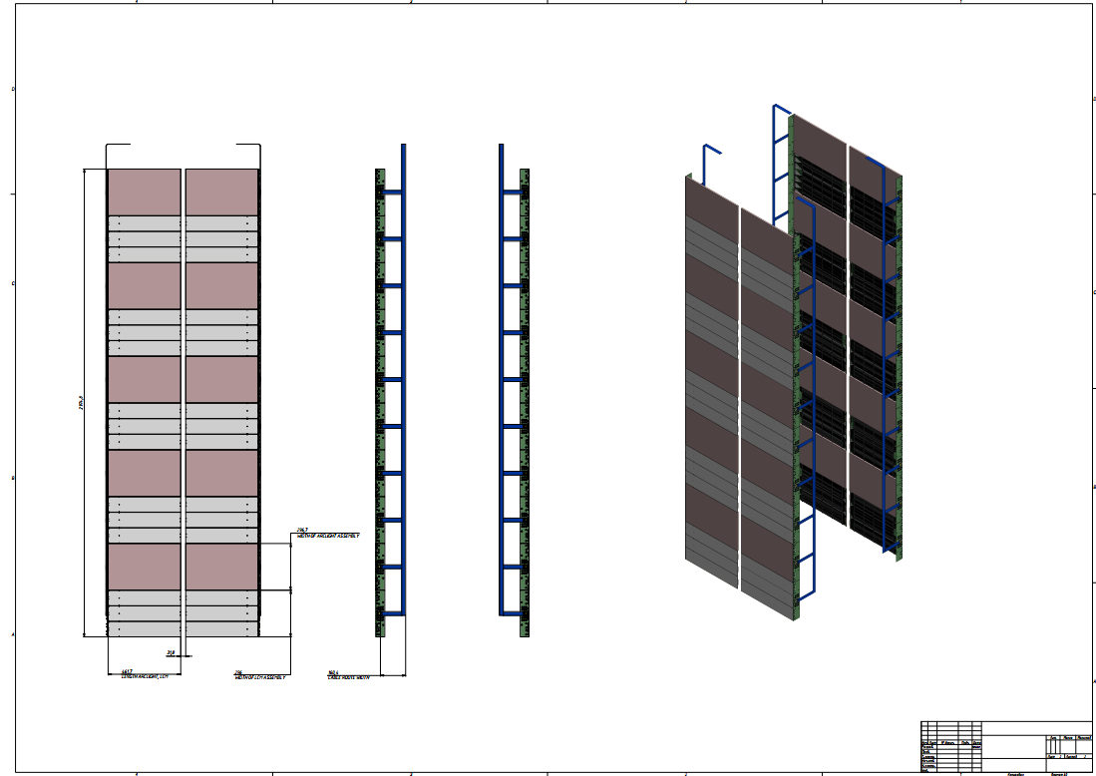
ND-LAr: Sub-system assembly drawings
Charge System Assembly Drawing
*A. Lawrence (LBNL)
Field Structure and HV Cable Assembly Drawing
*K. Skarpaas (SLAC)
HV Filter Assembly Drawing
*R. Hanni (Bern)
Light System Assembly Drawing
*S. Sokolov (JINR)

Slide 15
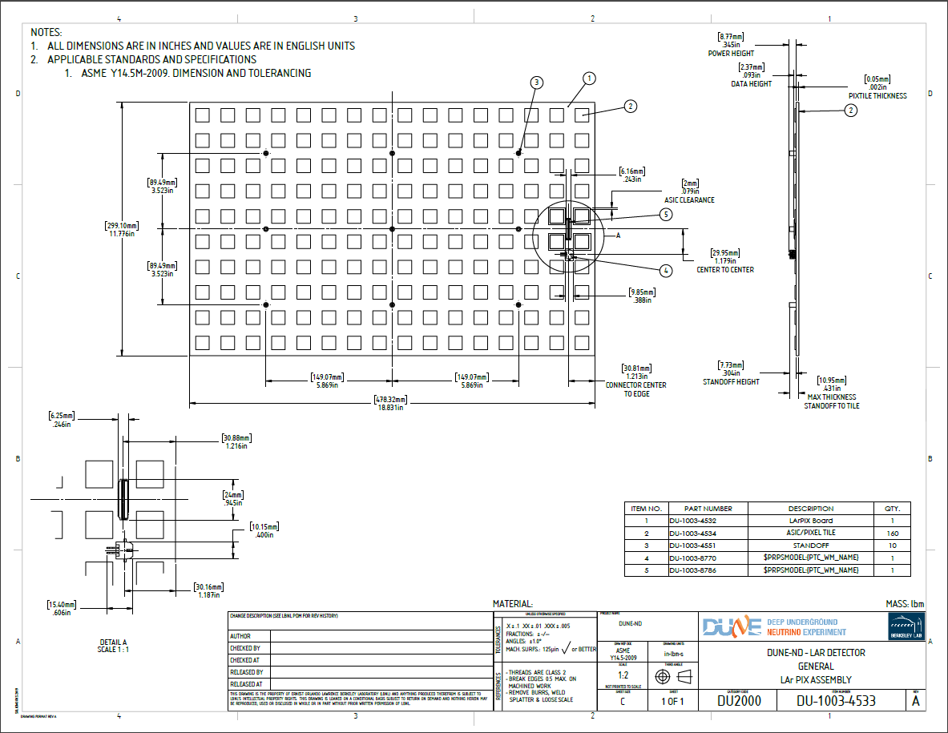
ND-LAr: Sub-system component drawings
Feedthrough and Pixel Tile Drawing
*A. Lawrence (LBNL)
LCM Fiber Clamp
*S. Sokolov (JINR)

Slide 16
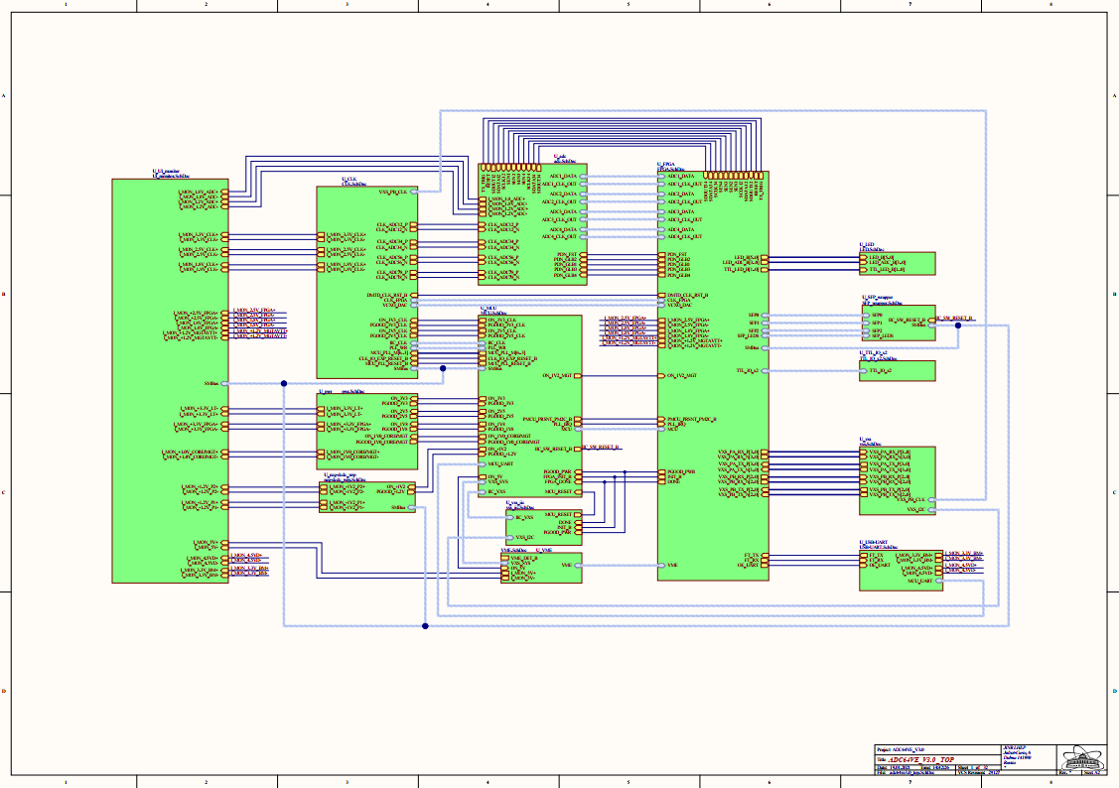
ND-LAr: Sub-system electrical schematics/layouts
Light System ADC Schematic
*A. Selyunin (JINR)
VGA Schematic
*A. Selyunin (JINR)
Light System Adapter Schematic
*A. Selyunin (JINR)

Slide 17
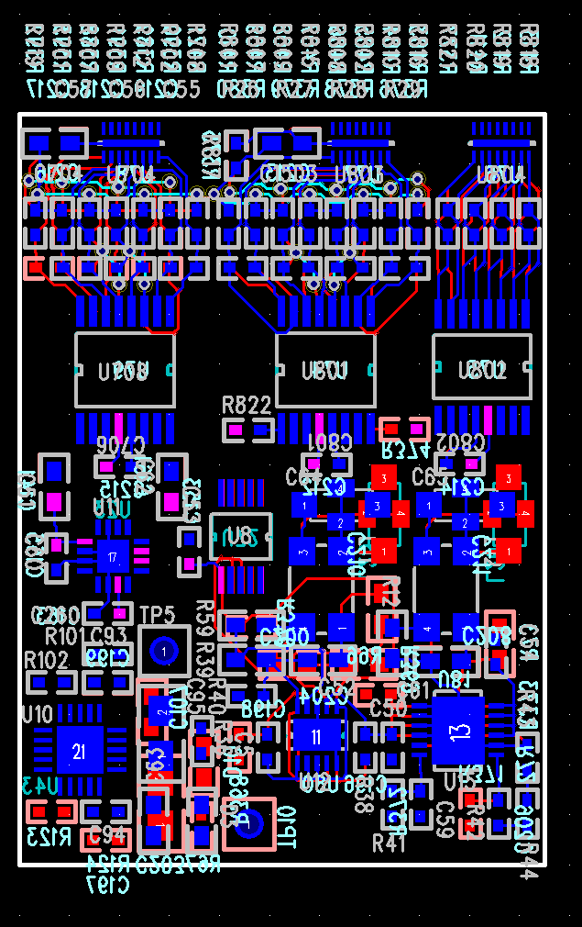
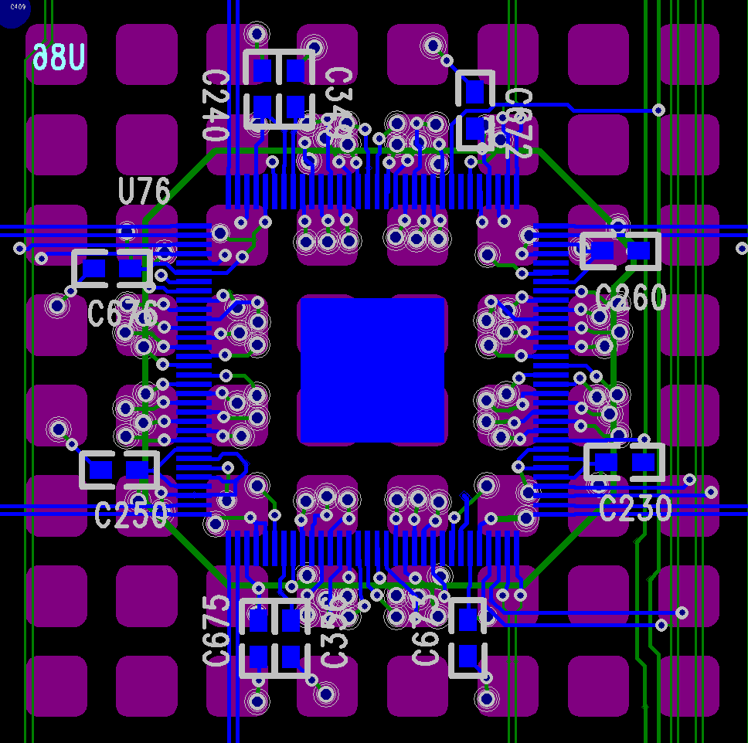
ND-LAr: Sub-system electrical schematics/layouts
PACMAN power & data layout (in-progress)
*H. Berns (UC Davis)
PACMAN timing system interface
*H. Berns (UC Davis)
V2A pixel tile
- 100 pins
- 49 channels
*A. Karcher (LBNL)
V2B pixel tile
- 128 pins
- 64 channels
*A. Karcher (LBNL)

Slide 18
ND-LAr: Systems Engineering
Significant effort by ND-LAr partners to define system-level requirements, interfaces, and design
Co-development with subsystem mangers and engineers → living document as design evolves → weekly engineering meetings
Provide “Big Picture” of ND-LAr
System design diagram (right) provides an overview of system design and sub-system integration
Physical interfaces
Power / Ground / Signal
Thermal / Flow (Liquid + Gas)
Etc.
EDMS 2636568
Identifies how Science Signals flows out of detector

Slide 19
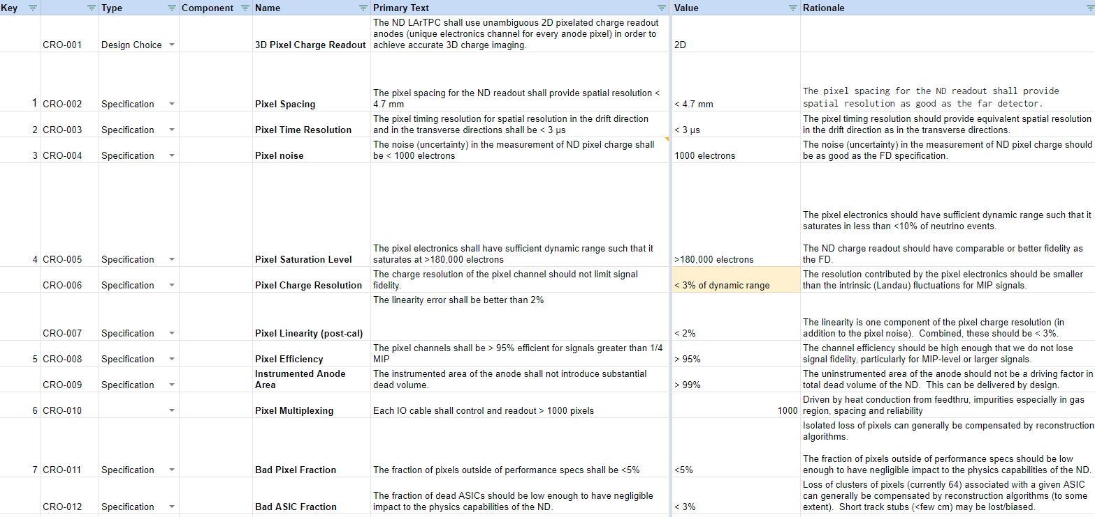
ND-LAr: Requirements developed and drive system design
ND-LAr Technical Specifications Spreadsheet
Working version of ND-LAr requirements
Exported to Requirement Documents on EDMS

Slide 20
ND-LAr: Requirements verification methods largely identified, next step verification planning, integration of prototyping program procedures
Informed by 2x2 system performance and FSD performance
Requirements well developed, component specifications under development
Informed by component QC procedures / processes in 2x2 program understand verification needs
Creating drawings for PDR, final drawings, travelers, work instructions at FDR

Slide 21
ND-LAr: Interface definitions developed with the system design
Interfaces defined where subsystems meet
ND-LAr System Level Design and Interface Diagram
As designs have matured, interfaces iterated, refined, and documented in Interface Control Documents (ICDs)
Tracking via hyperlinked N2-Matrix to identify functional interfaces, use of ICD tracking list developed
Level of maturity of ICDs rated by Phase:
Phase 1: At Preliminary Design maturity--scope, boundaries and responsibilities defined.
Phase 2: Design-driven refinements to boundaries and responsibilities. Loads, flows, and functional requirements defined.
Phase 3: At Final Design maturity--all details fully-documented. Subsystems can finalize their respective designs independently.
Note that interfaces within subsystems are managed by subsystem managers

Slide 22
ND-LAr: System-level interfaces defined
Populated cells indicate where an interface exists and shows type of interface and provides hyperlink to ICD → 36 functional interfaces identified
Will consolidate (or expand) as necessary
All ICDs advanced as possible at this moment
15 of 36 ICDs are at Phase 2
Most Phase 1 are approaching Phase 2
ICDs tracked in EDMS 2667883
Updated N² Matrix -> Identify functional interfaces, borrowing management methodology from Dark Energy Spectroscopic Instrument (DESI), ICD matrix development by R. Besuner (DESI Systems Engineer)
EDMS 2640807: Each cell to hyperlink to ICD (matrix in-progress)

Slide 23
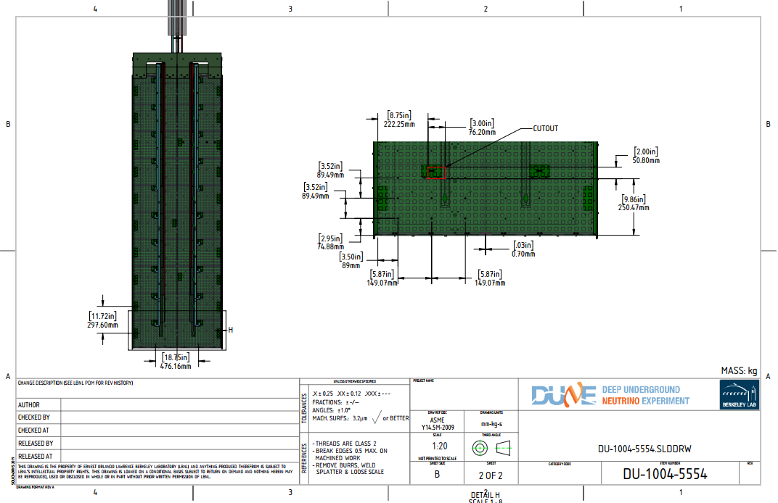
ND-LAr: Functional ICD between cold charge electronics and anode support panel
Functional interface managed via weekly meeting between engineering teams
Technical discussion
Establish scope and work boundaries
Clear communication of need
Iterate to a common solution that works for both teams
Design driven effort from both K.Skarpaas (SLAC) and A.Lawrence (LBNL) settled this interface quickly and effectively
ND-LAr subsystem managers and engineers have done a commendable job of identifying and working out interfaces
Nearly all interfaces within the detector are in the stage of “design driven refinements”
Significant work remains towards final ICDs, but progress is very encouraging

Slide 24
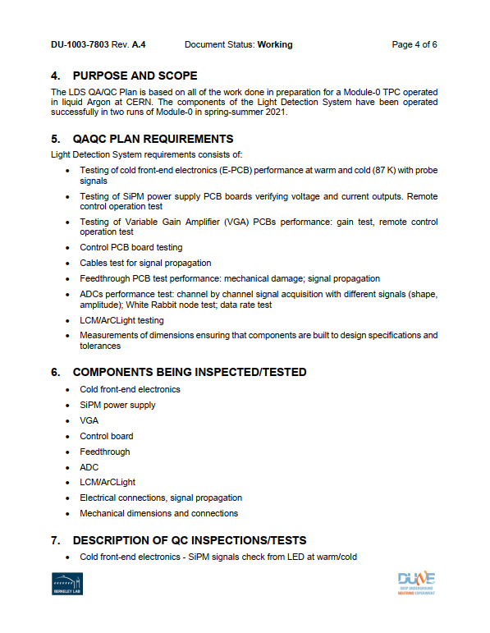
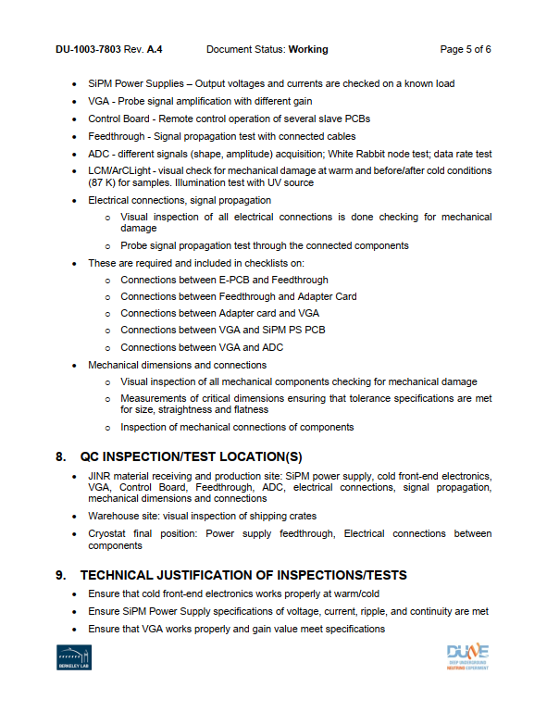
ND-LAr: QA/QC being implemented within subsystems
ND-LAr Subsystems have created draft QAQC documents and uploaded to EDMS:
QAQC Plans
Manufacturing and Procurement Plans
Prototyping Plans
ND-LAr leadership in process of reviewing subsystem QAQC documentation
Suggestions & comments phase → moving towards revisions and first release
2x2 program experience used to develop acceptance criteria and functional verification procedures for both ND-LAr components and ND-LAr system
Successful operation of Module 0 @ Bern in 2021 proved significant in the context of generating procedures for sub-systems and system-level acceptance checks

Slide 25
ND-LAr: QA/QC being implemented during prototyping
Established flow diagram with decision “gateways” dependent on quality control and functional verifications during detector fabrication, assembly, and testing
Warm Test of Components
Warm Test of Integrated Module 0: Pre-Sleeve Installation
Power, Grounding, Comms
Sub-systems shall give the “OK” to move from this test - #nd-lar-run SLACK Channel
Final Electrical Check: Cryostat is closed, last check prior to evacuation & cool-down
Tests of Light System & Charge System Both
Power, Grounding, Comms, Noise, Thresholds
Sequentially re-check after cabling-up new electrical connections to top flange
Sub-systems shall give the “OK” to move from this test - #nd-lar-run SLACK Channel
Decision gateways require input from all affected subsystems → maintain SME involvement during entire process

Slide 26
ND-LAr: Change Control on EDMS
EDMS is repository for official ND-LAr documents
Team also works with Consortium Google Drive to co-edit and share documentation during the development phase
Subsystems have done significant work to increase design documentation → weekly updates in engineering meetings by subsystem
Documentation structure implemented on EDMS
Implements change control on documentation through release process
Extensive upload of documentation since May/June internal review; in process of documentation review, revision, and first release

Slide 27
ND-LAr: Hazard Registry → Identify hazards to personnel/equipment and implement mitigations → Initial discussion with Duane Newhart (DUNE ESH, FNAL)
 |  | Hazard Identification |  | Un-Mitigated Hazard and Risk Level |  |  |  |  |  | Mitigation Method / Updated Hazard and Risk Level |  |  |  |  |  | Verification
# | Subsystem | Type | Title | Hazard Description | Severity | Probability | Risk Value | Risk Category | Mitigation Strategy | Mitigation Description | Severity | Probability | Risk Value | Risk Category | Verif Method | Verification Plan | Protection System?
2 | NDLArTPC
2.01 | NDLArTPC | Press/Vac | Piping Systems | Piping systems need to be designed, fabricated and tested according to specific requirements in order to safely operate them.. | 2 | B | 5 | High | Control hazard | Design, fabrication, testing, implementation and operation according to standards and regulations.Including but not limited to overpressure protection safety devices. | 3 | E | 17 | Medium | Audit | Part of FESHM 5032 cryogenic system review. For specific requirements see FESHM 5031.1 Piping Systems
2.02 | NDLArTPC | Mech | Below the Hook Lifting Devices | Below-the-hook lifting devices must be designed, fabricated, and tested in order to be safely put into service, failure to do so could result in harm to personnel or the instrument | 2 | E | 15 | Medium | Control hazard | Design, fabrication, testing, implementation and operation according to standards and regulations. FESHM 10110 governs Below-the-Hook lifting devices | 4 | D | 19 | Low | Test | Part of lifting plan review. Design and test of lifting fixture per FESHM 10100
2.03 | NDLArTPC | Elec | Electrical Equipment Safety | Electrical equiment that is improperly sized or grounded could result in harm to personnel or damage to the instrument | 2 | C | 6 | Serious | Control hazard | Design, fabrication, and testing of electrical equipment must adhere to FESHM requirements | 4 | D | 19 | Low | Audit | Electrical Safety Program FESHM 9100
2.04 | NDLArTPC | Elec | High Voltage Safety | High voltage systems that are not properly designed and rated could result in harm to personnel or damamge to the instrument | 2 | C | 6 | Serious | Control hazard | Design, fabrication, and testing of high voltage systems shall adhere to FESHM requirements | 3 | D | 14 | Medium | Inspection | TBD
2.05 | NDLArTPC | Struc | Structural Design | Structural design must be safe for the service loads, otherwise there could be a failure that results in personnel injury or instrument damage | 3 | C | 11 | Medium | Control hazard | Design, fabrication and proof testing of all load bearing equipment. Design must meet requirements laid out in FESHM | 4 | E | 20 | Low | Review | Design of structures governed by FESHM 5100
2.06 | NDLArTPC | Env | Oxygen Deficiency (ODH) - SLAC | Cryogen leaks or spill poses an Oxygen Deficiency Hazard (ODH) during FSDTF operations | 1 | C | 4 | High | Warning device | Alarms and ventilation | 3 |  | #N/A | #N/A | Review | Governed by home institution ODH requirements (FNAL, SLAC)
 | NDLArTPC | Env | Oxygen Deficiency (ODH) - FNAL | Cryogen leaks or spill poses an Oxygen Deficiency Hazard (ODH) during MATF and Near Site operations | 1 | C | 4 | High | Warning device | Alarms and ventilation
2.07 | NDLArTPC | Therm/Cryo | Cryogenic Safety | Cryogenic service lines can pose a hazard to personnel and instrument due to leaks and or over-pressure | 2 | D | 10 | Medium | Safety feature | Cryogenic lines shall be outfitted with PRVs as required by institutional safety requirements, with PRVs positioned such that they vent to non-occupied volumes or areas of the facility | 4 | D | 19 | Low | Review | Part of FESHM 5032 cryogenic system review. For specific requirements see FESHM 5031.1 Piping Systems
2.08 | NDLArTPC | Env | Fall Hazards | Working on elevated surfaces at the FSDTF, MATF, and Near Site poses a fall hazard to personnel | 1 | D | 8 | Serious | Procedure, training | Fall protection training and fall protection hardnesses shall be required for all work that has an associated fall hazard, along with any additional requirements per home insitution ES&H manuals. All work done that has an associated fall hazard must be done in a team or two or greater. | 3 | D | 14 | Medium | Process control | Governed by FESHM 7060
2.09 | NDLArTPC | Env | Ladders and Scaffolds | Working on ladders and scaffolds at the FSDTF, MATF, and Near Site can pose a hazard to personnel | 1 | D | 8 | Serious | Procedure, training | Ladder and scaffold training shall be required per host insitution ES&H | 3 | D | 14 | Medium | Process control | Governed by FESHM 7070
2.10 | NDLArTPC | Fire | Egress | If egress is not preserved then personnel are unable to exit the facility in the event of a fire | 1 | C | 4 | High | Control hazard | Egress requirements per host institution shall be maintained. All personnel shall be trained by host insitution for proper evacuation routes and congregation points. | 3 | D | 14 | Medium | Inspection | Governed by FESHM 6020.4
2.11 | NDLArTPC | Elec | Cable Tray Systems | Cable tray systems pose an electrical shock risk to personnel if they are not properly grounded or shielded from the environment | 2 | C | 6 | Serious | Control hazard | Cable trays shall adhere to host institution requirements for electrical safety | 4 | D | 19 | Low | Review | Governed by FESHM 9130
2.12 | NDLArTPC | Press/Vac | Feedthrough Pressure Safety | Feedthroughs contain internal cryostat pressure and must be structural sound against cryostat MAWP, failure could result in personnel injury or instrument damage | 1 | C | 4 | High | Control hazard | Feedthrough design, fabrication, and testing shall adhere to the requirements as specified in FESHM. | 4 | D | 19 | Low | Test | Governed by FESHM 5031 & FESHM 5034
2.13 | NDLArTPC | Struc | Slings and Rigging Hardware | Slings and rigging hardware pose a personnel and instrument hazard in the event that there is a strucrtural failure | 1 | C | 4 | High | Procedure, training | Slings and rigging hardware procurement and use procedures shall adhere to requirements per the host institution | 4 | D | 19 | Low | Inspection | Governed by FESHM 10130 (FNAL) & ESH Manual (SLAC)
2.14 | NDLArTPC | Elec | Power Grounding | If electical cables and connections are not properly grounded it could result in personnel injury or instrument damage | 1 | C | 4 | High | Control hazard | Power delivery systems shall be grounded per the requirements as specified in FESHM | 3 | D | 14 | Medium | Review | Grounding requirements per FESHM 10130

Slide 28
Preliminary Design Documentation Directory
Document Name | EDMS Number | Owner | Type | Status
ND-LAr Environment, Safety, and Health | 2602421 | System Level | Safety | In Work
ND-LAr TPC Grounding Document | 2459152 | System Level | Grounding | In Work
ND-LAr Grounding Document | 2459151 | System Level | Grounding | In Work
ND-LAr Consoritium Prototyping Plan | 2459149 | System Level | Prototyping | In Work
Light Readout QAQC Plan | 2587876 | Light Readout | QA | In Work
Light Readout Manufacturing Plan | 2605604 | Light Readout | QA | In Work
Light Readout Procurement Plan | 2605605 | Light Readout | QA | In Work
Charge Readout QAQC Plan | 2605601 | Charge Readout | QA | In Work
Charge Readout Manufacturing Plan | 2605602 | Charge Readout | QA | In Work
Charge Readout Procurement Plan | 2605603 | Charge Readout | QA | In Work
TPC I&I QAQC Plan | 2609927 | TPC I&I | QA | In Work
TPC I&I Manufacturing Plan | 2609929 | TPC I&I | QA | In Work
TPC I&I Procurement Plan | 2609928 | TPC I&I | QA | In Work
High Voltage QAQC Plan | 2611197 | High Voltage | QA | In Work
High Voltage Manufacturing Plan | 2611198 | High Voltage | QA | In Work
High Voltage Procurement Plan | 2611199 | High Voltage | QA | In Work
Integrated TPC | 2458075 | System Level | Interface | In Work
Integrated TPC to TPC Assembly & Testing | 2610895 | System Level | Interface | In Work
Integrated TPC to TPC Integration & Installation | 2610896 | System Level | Interface | In Work
TPC Assembly & Testing to TPC Integration & Installation | 2610894 | System Level | Interface | In Work
TPC Assembly & Testing to 2x2 LArTF/MINOS | 2610897 | TPC A&T | Interface | In Work
TPC Assembly & Testing to Full Scale Demonstartor Test Facility | 2610898 | TPC A&T | Interface | In Work
TPC Assembly & Testing to Module Assembly & Testing Facility | 2458077 | TPC A&T | Interface | In Work
ND-LAr Schedule | 2603073 | System Level | Schedule | In Work
Module Structure QAQC Plan | 2613192 | Module Structures | QA | In Work
Module Structure Manufacturing Plan | 2613193 | Module Structures | QA | In Work
Module Structure Procurement Plan | 2613194 | Module Structures | QA | In Work
Module Structures Requirements | 2612980 | Module Structures | Requirements | In Work
High Voltage Requirements | 2612981 | High Voltage | Requirements | In Work
Field Structures Requirements | 2612982 | Field Structures | Requirements | In Work
Charge Readout Requirements | 2612983 | Charge Readout | Requirements | In Work
Light Readout Requirements | 2612984 | Light Readout | Requirements | In Work
Calibration Requirements | 2612985 | Calibration | Requirements | In Work
TPC Assembly & Testing Requirements | 2612986 | TPC A&T | Requirements | In Work
TPC Integration & Installation Requirements | 2612987 | TPC I&I | Requirements | In Work
Module Assembly & Test Facility Requirements | 2612988 | MATF | Requirements | In Work
Fullscale Demonstrator Test Facility Requirements | 2612989 | FSDTF | Requirements | In Work
ND-LAr System Level (L2) Requirements | 2589287 | System Level | Requirements | In Work
Field Structures QAQC Plan |  | Field Structures | QA | In Work
Field Structure Manufacturing Plan |  | Field Structures | QA | In Work
Field Structure Procurement Plan |  | Field Structures | QA | In Work
Developed documentation directory to provide a filterable list of documents
By Subsystem/Owner
By Document Type
By Document Status

Slide 29
Concerns
New funding profile has resulted in a delay to all TPC Integration and Installation scope
No resources available to work on:
TPC integration and installation fixtures, analyses, procedures, critical lifts, etc.
Design impacts of delayed TPC I&I is unclear
Potential impacts to other systems and maintaining design effort
Concurrent design and prototyping programs that are both aggressive in scope and schedule → accomplished by the same teams!!
Subsystem managers, engineers, designers, technicians, postdocs, and students deserve credit for delivering on both of these despite on-going pandemic related barriers (travel/work)
Documentation does need to be matured for PDR → this will be the challenge and goal over the next 2-3 months

Slide 30
Summary
Significant design progress since earlier 2021, all sub-systems have made design improvements
Integrated analyses with other ND systems underway, specifically where there is an key interface (LArTPC to LAr Cryostat)
Work towards a schedule to deliver design documentation → weekly documentation presentations during engineering meetings
Systems Engineering practices applied to ND-LAr requirements & interface management; development in cooperation with ND-LAr subsystems
QAQC is being integrated into subsystem plans and worked into prototyping efforts
Funding profile and design/prototyping challenges; COVID-19 travel/work restrictions

