Slide 1
ArgonCube Engineering Meeting
01/14/2022

Slide 2
Outline
Follow up from Previous Meeting
QAQC
Slow Control
LAr Detector Alignment
Schedule & BOEs
Rack Protection – Linda Bagby (FNAL)
Module 0 / Module 1 / AOB
Slides on Indico: https://indico.fnal.gov/event/51690/
Also on Consortium Google Drive

Slide 3
QAQC Documentation Review
Reviewing latest version of your QAQC Documents
QAQC Plan, Procurement Plan, Manufacturing Plan -> if last submitted copy is the latest version that is OK
Round of comments & revisions -> post official version release to EDMS (v1)
Jan 14th – Comments sent out
Completed for: Charge Readout, Light Readout, High Voltage
Working through remaining docs today
Next steps -> Implement Revisions -> Release v1; -> Jan 24th
Overall the plans look good, many of the edits are cosmetic and minor. Component lists and descriptions of QC tests are in good shape
General suggestion –> build table of EDMS links to QC test plans for each component, we will update these links as those plans materialize

Slide 4
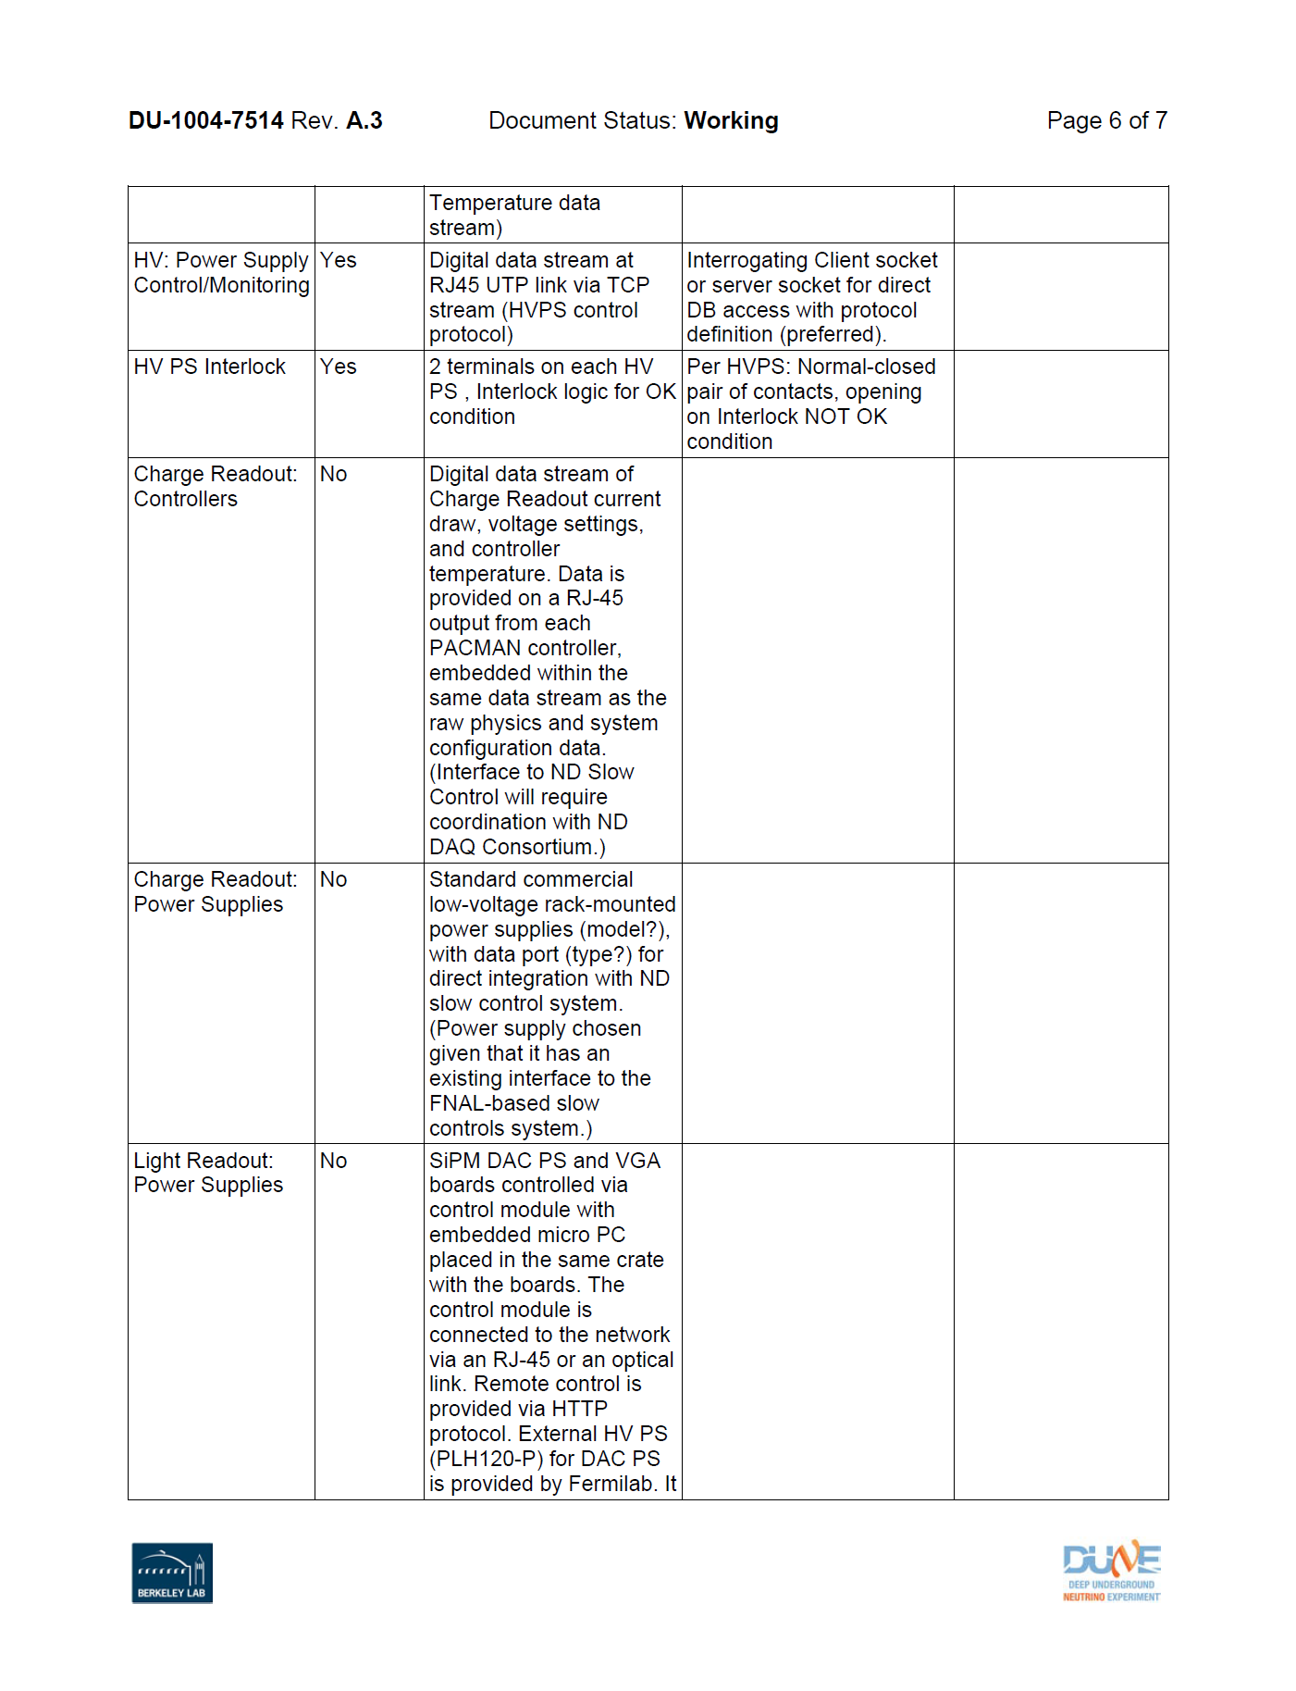
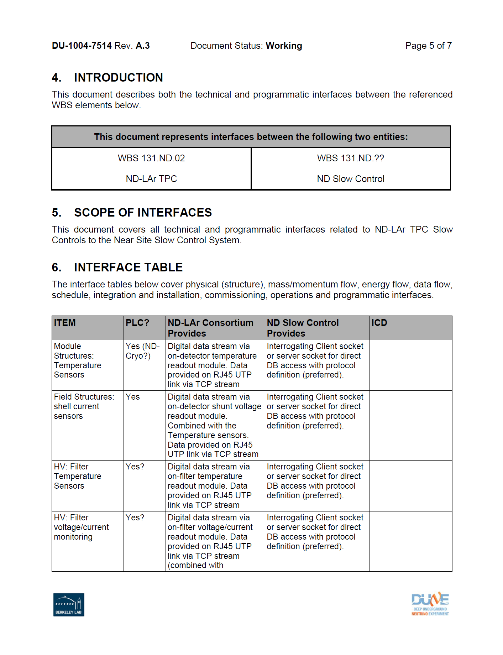
ND-LAr Slow Control Summary
Content for module structure, HV, field structure, charge readout, light readout
Not yet defined:
Slow control on calibration laser or power supply?
Monitoring in electronics racks: temperature, humidity, smoke, etc.?
See upcoming talk from Linda Bagby (FNAL)
Next steps: document in draft ICD and pass to ND Systems Engineering (G. Cline) and ND Slow Controls (S. Luitz, T. Jonhson)
Current PDF draft at: EDMS 2667881
Source File: Windchill Link
Doodle sent out for initial meeting next week

Slide 5
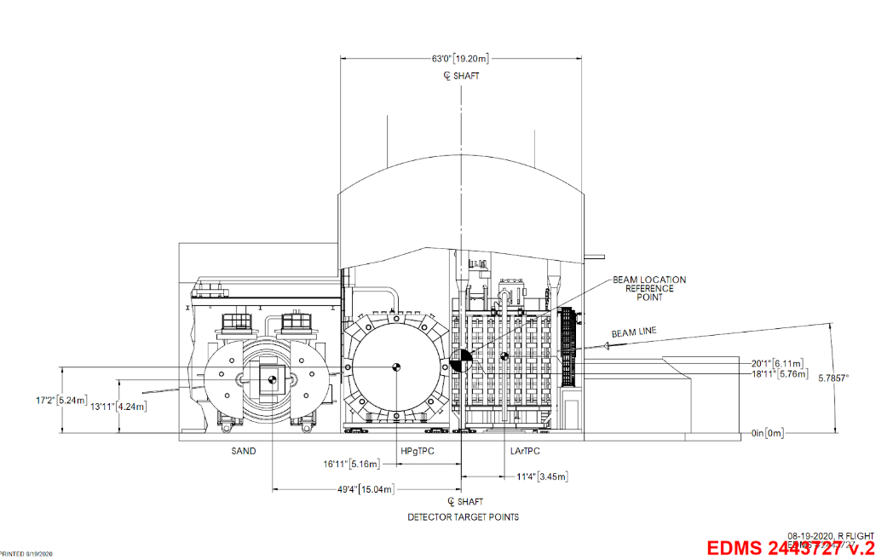
What is ND-LAr high-level requirement for alignment of detector on beam?
Adjustability in the PRISM direction
None in the beam or vertical directions once installed
Don’t need an answer today but would be good to have some type of best estimate requirement by 1/20 SE meeting
Necessary input for tolerance stack-up analyses & deflection calculations
*F. Matichard, Sys. Eng. Meeting (Jan. 20th, 2022)
Dan: Beam is broad in shape, azimuthally symmetric (ideally) – placement of detector on beam axis -> tens of centimeters accuracy…but need to know where the beam is.
Need to know where ND-LAr is w.r.t. other ND detectors and FD detectors
Assess beam neutrino flux going to far detector – could be meters off axis and can still assess
What designed beam center and what is actual beam center?
Should worry a lot that we can measure post facto where the detectors are w.r.t. neutrino beam & FDs (Global CS)

Slide 6
Schedule & BOEs
January – February
Meeting with subsystem managers to review schedule and BOEs
Review labor costs & profiles
Review M&S costs
Goal is to have a robust and confident estimate by March for the CD-1rr schedule freeze
This has the most impact on US partners but would like to take the opportunity to help improve all subsystem schedules and estimates -> meet with all ND-LAr partners

Slide 7
Rack Protection
Linda Bagby (FNAL)

Slide 8
Module 0 / Module 1 Updates
Module 0
Moved to LArTF
Module 1
All components in Bern (2nd PACMAN shipped, delivery Jan. 10th)
Testing of TPC#2 with PACMAN#1 – hopefully finish this week
Once PACMAN#2 arrives will verify operation and begin assembling of TPC#2
Once TPC#2 is assembled with cabling – check IO connections – consult with Brooke
Before insertion to sleeve need some kind of group sign-off on collected data

