Slide 1
DUNE-ND: Infrastructure Options
Linda Bagby
DUNE ArgonCube Engineering
January 14, 2022

Slide 2
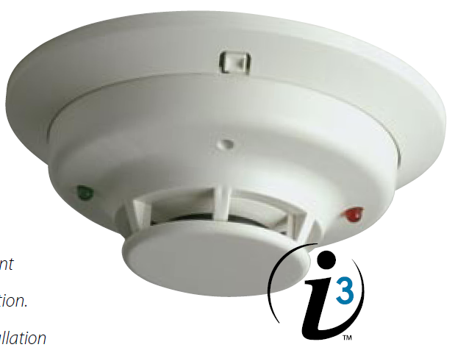
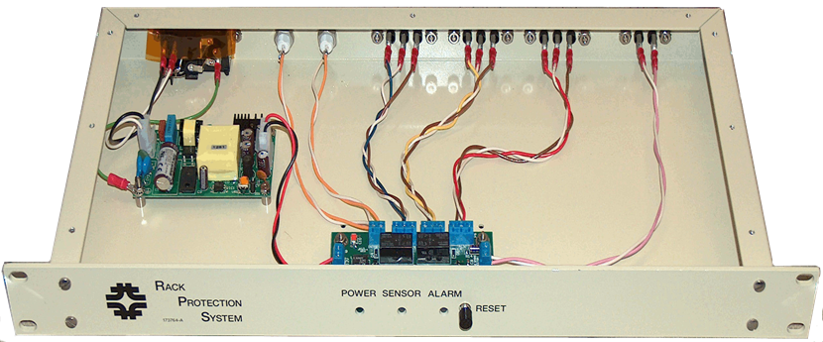
Rack Protection System
Consists of two parts—chassis and smoke sensor (SS 2WT-B)
Economical solution
Design includes:
System Sensor photoelectric smoke sensor.
EPO (Emergency Power Off for UPS).
+12V Voltage output interlock.
Two sets of NO/NC interlock contacts, AUX1 and AUX2.
Audible alarm.
Front panel reset button.
Status bit to Slow Controls.

Slide 3
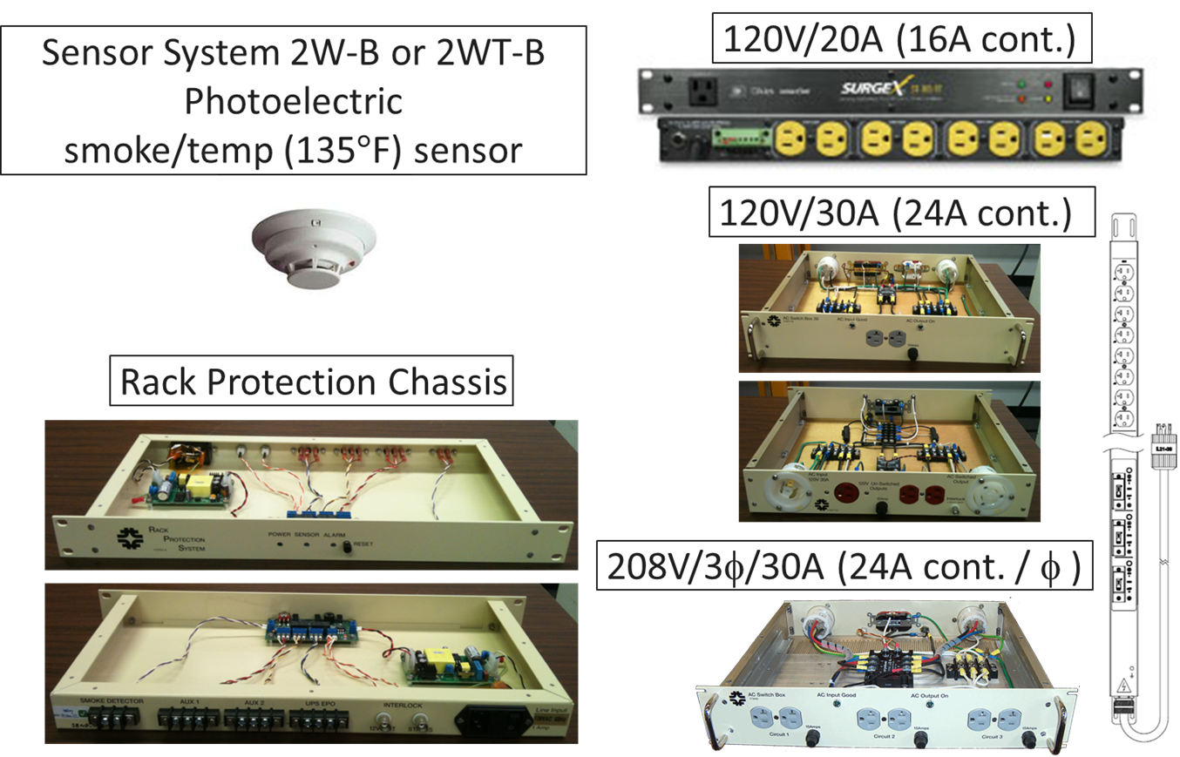
Power Distribution Options

