Slide 1
Neutrino Beamline
Horns B & C
Preliminary Design Review
Requirements, Interfaces, Parameters
Cory Crowley
3 December 2021

Slide 2
Outline
System Overview + Parameters
CERN EDMS Requirement Listing
  Requirements Applicable to Horns B & C
Interfaces
  Interface Matrix
  Major Interfaces
Parameters & Specifications Document
Summary

Slide 3
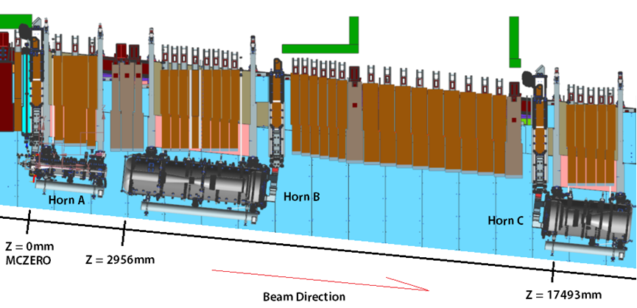
System Overview
Horns B & C complete the 3-horn system in the optimized beamline.
  Horn B is a result of a segmented Horn A, which was split apart for manufacturing, and accounts for roughly 25% of the neutrino flux.
  Approximately 50% of Horn A components carried over to Horns B & C.
  Horns B & C are designed for 1.2MW, though upgradable to 2.4MW.

Slide 4
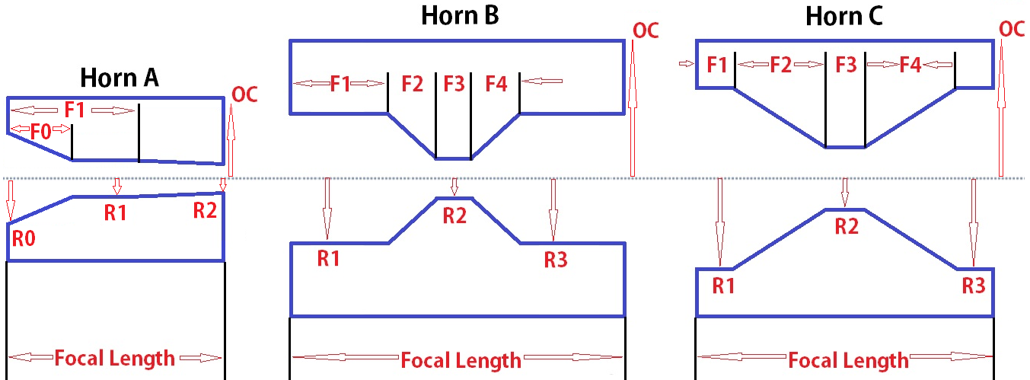
Engineered Horn Parameters
Horn Conductor Parameters | Horn B @ 1.2MW | Horn C @ 1.2MW
Horn Focal Length, In (mm) | 154.803 (3932) | 85.984 (2184)
R1, In (mm) | 6.260 (159) | 10.630 (270)*
F1, In (mm) | 47.989 (1218.92) | 17.197 (436.8)
F2, In (mm) | 34.057 (865.04) | 7.739 (196.56)
R2, In (mm) | 3.189 (81) | 5.157 (131)
F3, In (mm) | 3.096 (78.64) | 6.019 (152.88)
F4, In (mm) | 24.769 (629.12) | 30.095 (764.4)
R3, In (mm) | 8.858 (225) | 14.252 (362)
OC Radius, In (mm) | 23.622 (600)** | 23.622 (600)**
Beamline Position Relative to MC-ZERO, Meters | 116.378 (2956) | 688.701 (17493)
Horn Inner Conductor Thickness, In (mm) | 0.118 (3) | .157 (4)
Horn Outer Conductor Thickness, In (mm) | 1.000 (25.4) | 1.000 (25.4)
Drain Hole Port Diameter, Maximum | 4.000 (101.6) | 4.000 (101.6)
Horns B & C retain nearly all dimensions from the Beam Optimization Task Force Report, DUNE-doc-2901.
Focal Radius R1 for Horn C reduced from 284mm to 270mm, allowing for flexibility in weld sample generation (billet vs. forging)*.
O.C. Radii lowered from 634 to 600**.
Current equalization sections are appended to conductors at lengths of 0.67% outer conductor O.D.

Slide 5
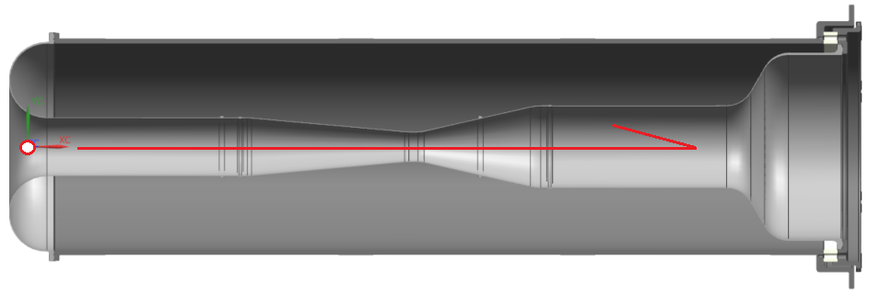
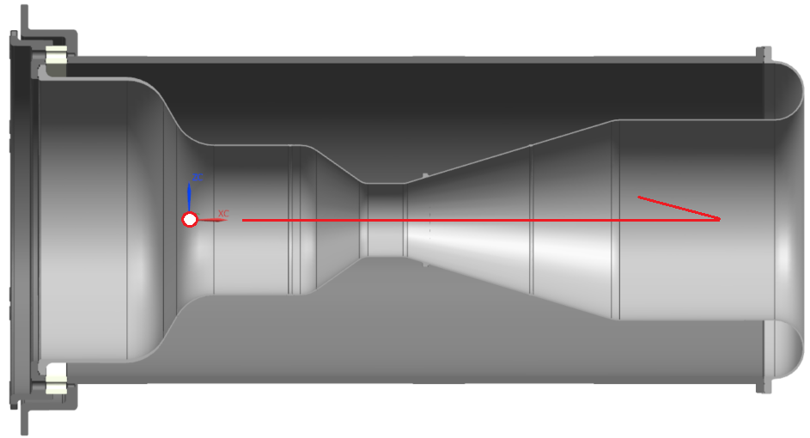
Engineered Horn Shapes
BOTF parameters used to revolve engineering 3D models.
End bells, flanges, ceramics, & equalization sections incorporated.
0.66*D approach.
Original designs had equalization sections external to water cooled conductor volumes (BNB style).
Preliminary FEA indicated material creep and eventual failure of striplines.
Striplines need cooled terminals (+ N2) on B & C in order to survive EDEP + J.

Slide 6
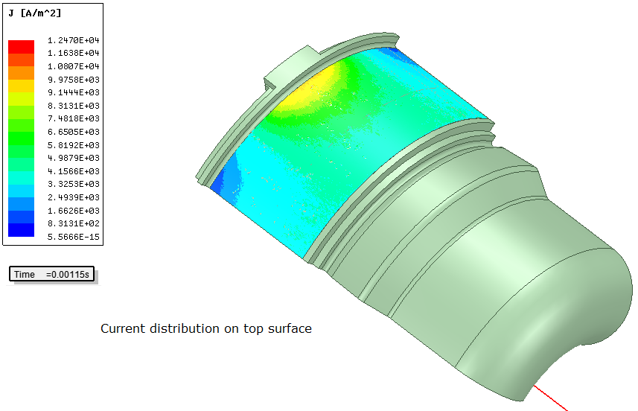
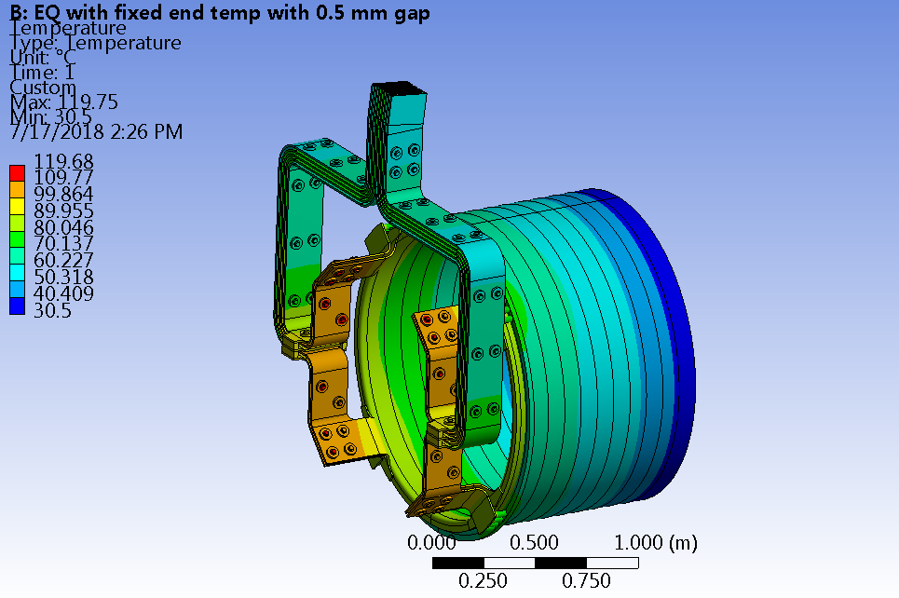
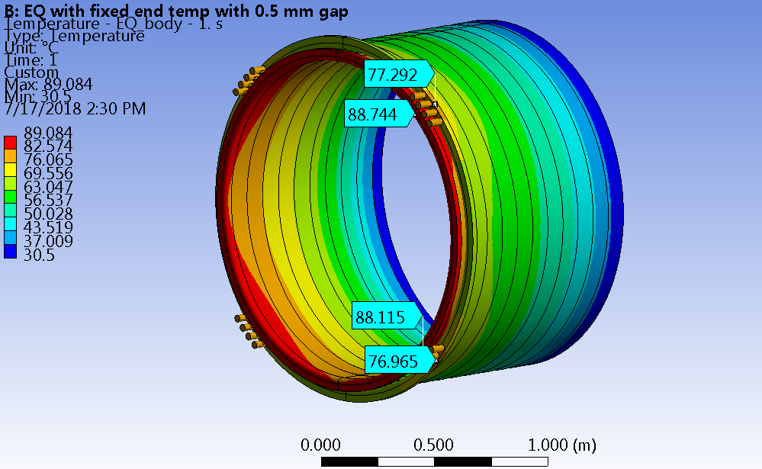
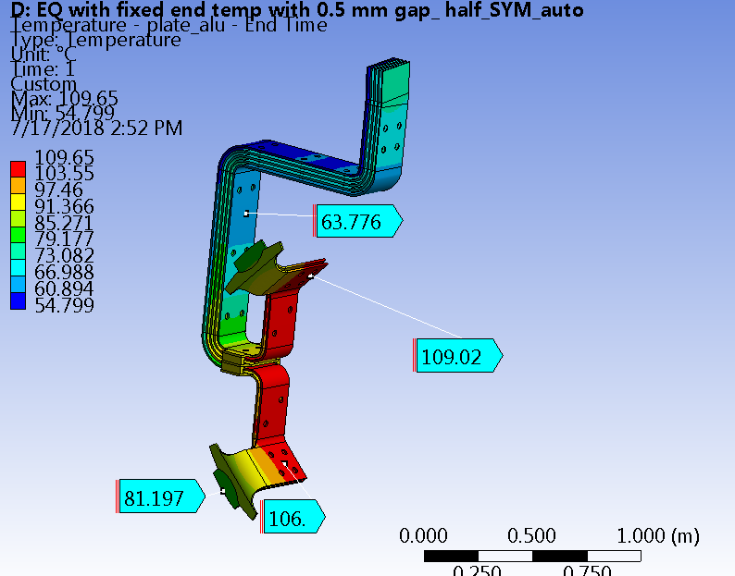
Engineered Horn Shapes

Slide 7
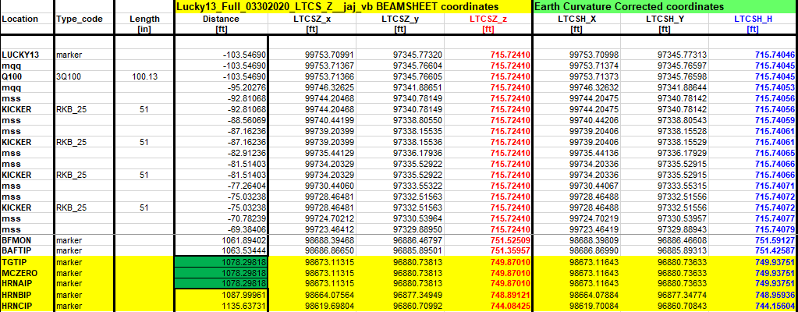
Beam-Sheet Positions
Final Horn B & C positions are reflected on the beam-sheet, DUNE-doc-418.
  HRNBIP & HRNCIP are the “insertion points” and coincide with the start of the focal length.
  The focal lengths ignore the current equalization section (U.S. end on Horn C), and split the transition bell depth (U.S. end on Horn B).

Slide 8
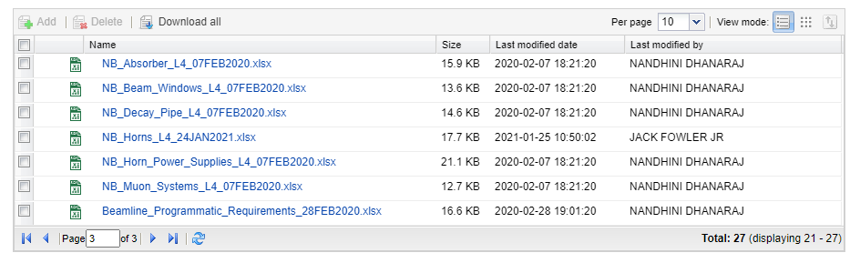
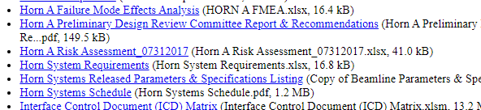
CERN EDMS Requirement Listing

Slide 9
CERN EDMS Requirement Listing
id | Artifact Type | Name | Primary Text
1299 | Requirement | Horns - event rate | The horns shall be designed to maximize the neutrino event rate in the far detectors in the desired energy range that covers the first and second neutrino oscillation maxima
1300 | Requirement | Horns - conductor heating | The horns shall have conductors that are able to endure the combined heat load from beam heating and resistive heating
1301 | Requirement | Horns - conductor thickness | The horns shall have inner conductors whose thicknesses are minimized to avoid absorbing the mesons
1302 | Requirement | Horns - conductor stresses | The horns shall survive repetitive thermal and magnetic stresses over a minimum of 100,000,000 pulses
1303 | Requirement | Horns - remote operation | The horns shall have connections that are able to be made or unmade remotely
1305 | Requirement | Horns - inert gas | The horns shall be filled and actively flushed with inert gas
1306 | Requirement | Horns - exhaust hydrogen | The horns shall have the provision to exhaust accumulated hydrogen gas
1307 | Requirement | Horns - conductor shape | The horns shall be constructed of aluminum for maximum event rate and ease of manufacturing.
1308 | Requirement | Horns - water drain port | The horns shall minimize the required size and locational impact of the water drain ports, to minimize magnetic field distortion.
1316 | Specification | Horns - life | The horns shall be designed to last for at least 2 years or 100 million pulses

Slide 10
CERN EDMS Requirement Listing
1317 | Design choice | Horns - conductor straightness | The horns shall have an inner conductor straightness tolerance of 0.5 mm
1318 | Specification | Horns - conductor variation | The horns shall have an inner conductor thickness azimuthal variation < 2%
1319 | Specification | Horns - chase width | The horns shall fit within a minimum target chase width of 78.5 inches and this space shall be uniform around all horns.
1321 | Specification | Horn B - I.C. Thickness | Horn B shall maintain an inner conductor thickness of 3mm where possible
1322 | Specification | Horn C - I.C. Thickness | Horn C shall maintain an inner conductor thickness of 4mm where possible
1323 | Design choice | Current Equalization Sections | All horns shall integrate current equalization sections into the inner and outer conductors where possible.
LBNF/DUNE Requirement Listing broadly covers what Horn Systems are expected to deliver.
  Some items are direct, such as conductor straightness (1317), variation (1318) & thickness (1321 / 1322).
  Many of the difficult engineering concepts & designs have been solved for Horn A and carry over to B & C:
  The unique work for B & C is how to accomplish straightness, wall variation, & thickness requirements.
    Reduce weld count; select correct forging + machining vendor.

Slide 11
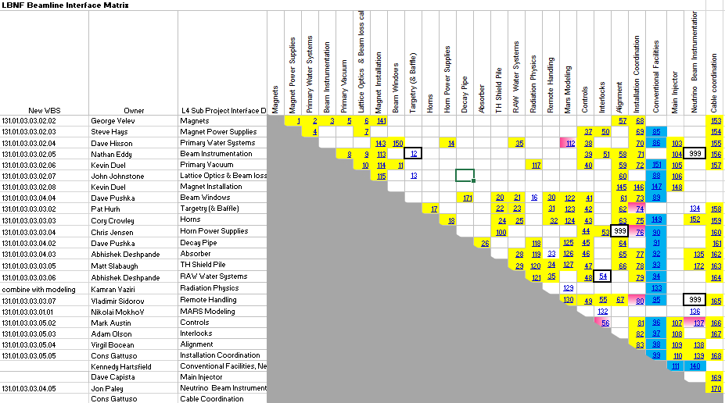
Interface Matrix
Interfacing elements with Horn B & C have been identified & defined as part of efforts to establish & approve interfaces for Horn A.
Not currently under change control.

Slide 12
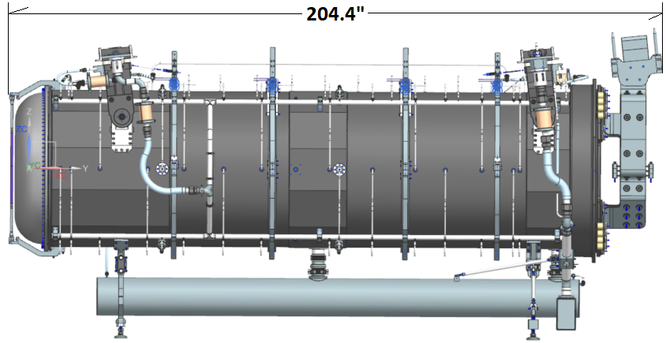
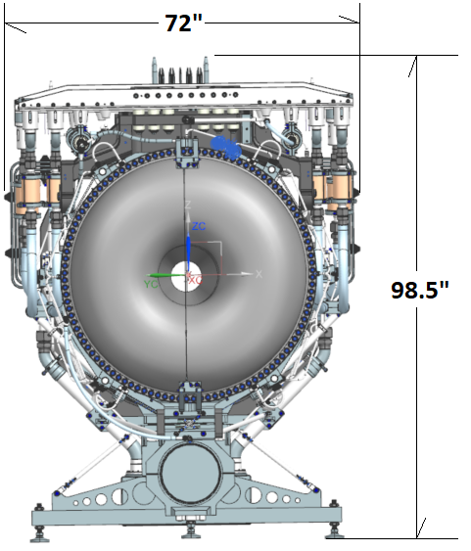
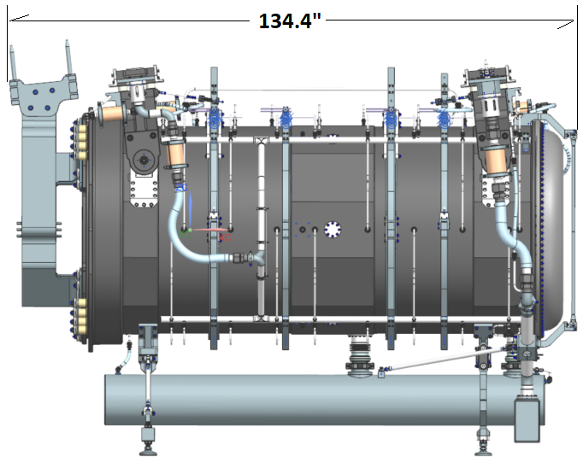
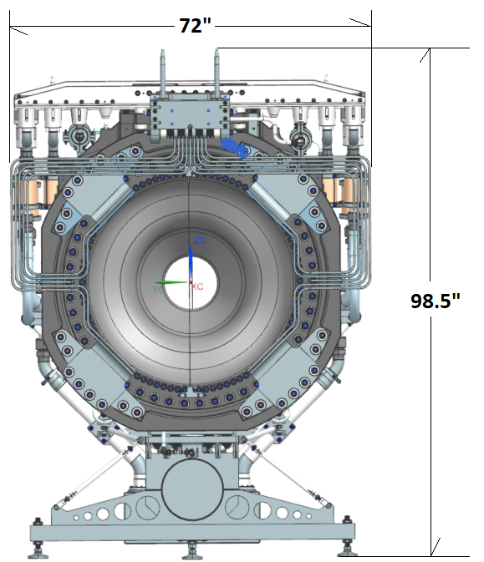
Horn B + C Overall Dimensions

Slide 13
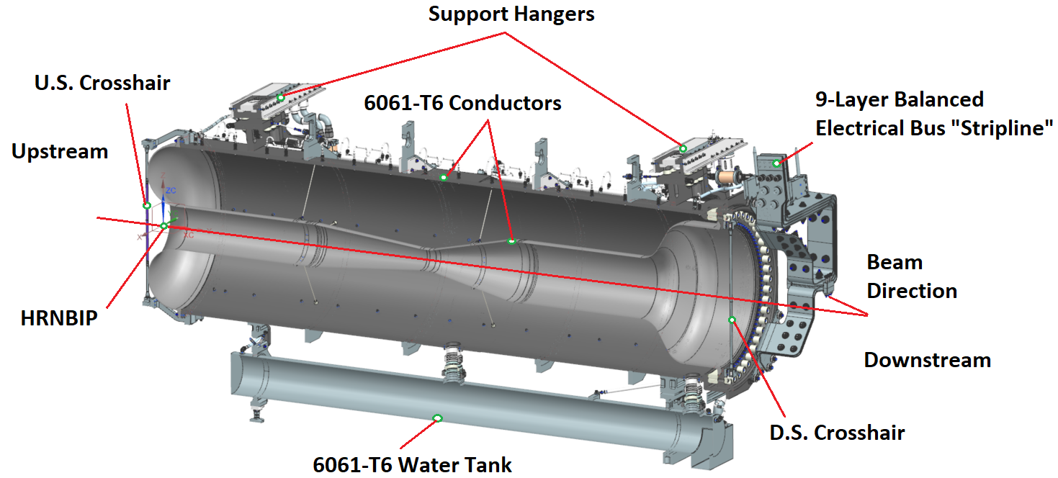
Horn B Overview

Slide 14
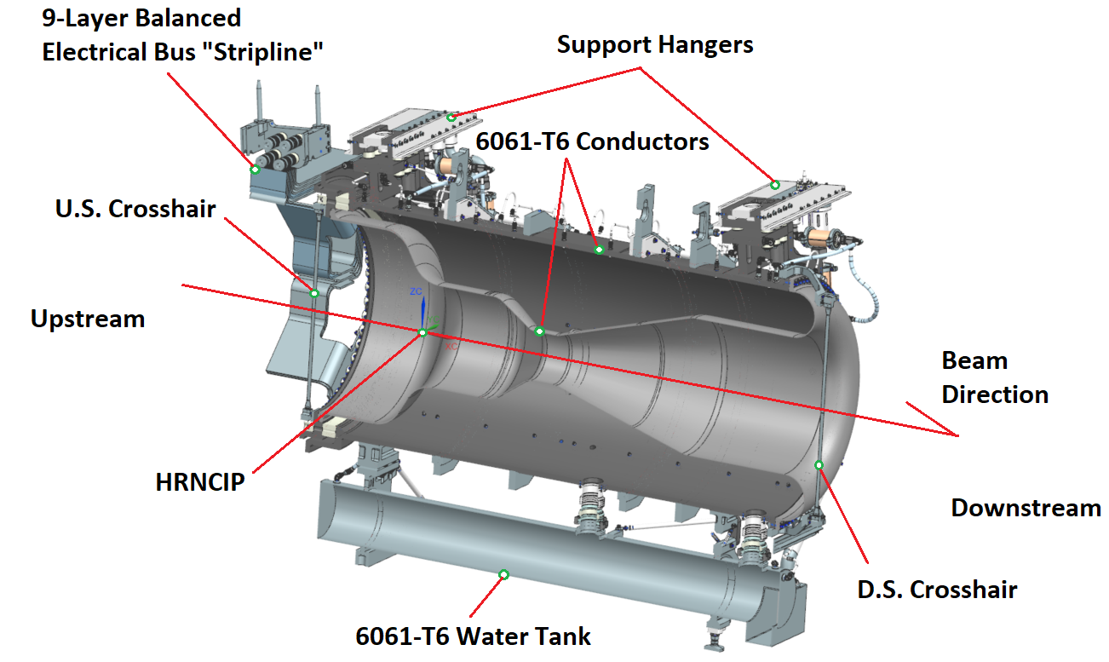
Horn C Overview

Slide 15
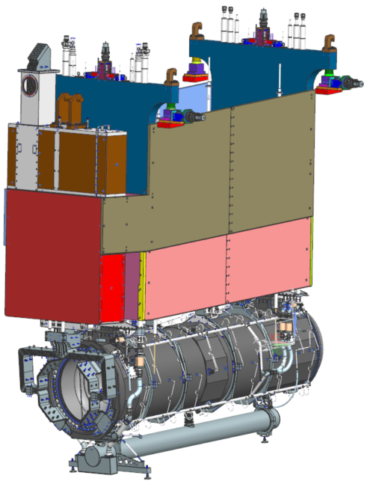
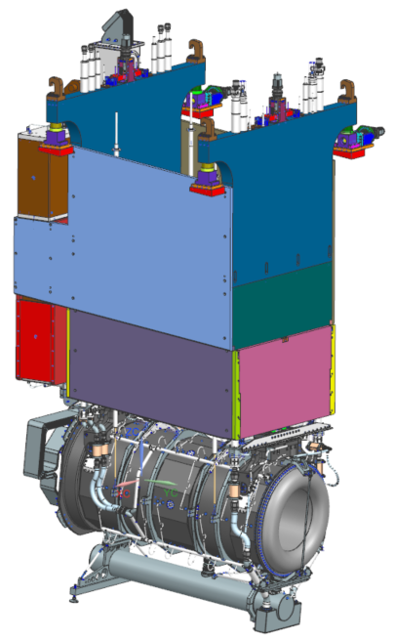
Horn / Module Assemblies
Horn B / C are mounted to respective module mainframes and SLB’s in identical fashion to Horn A.
Complexity of Target Utility Block (TUB) is not present.
Feature | Range
Vertical Travel | +/- .25” (6.35mm)
Horizontal Travel | +/- .25” (6.35mm)
Axial Variation | +/- .040” (1mm)
Vertical Position | +/- .010” (.25mm)
Horizontal Position | +/- .010” (.25mm)
Utility Line Radial Clearance | +/- .125” (3.18mm)
Minimum U.S. / D.S. Remote Handling Clearance | 6” (152.4mm)

Slide 16
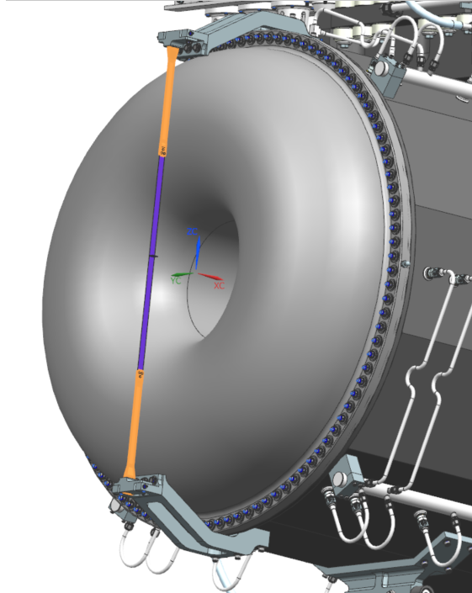
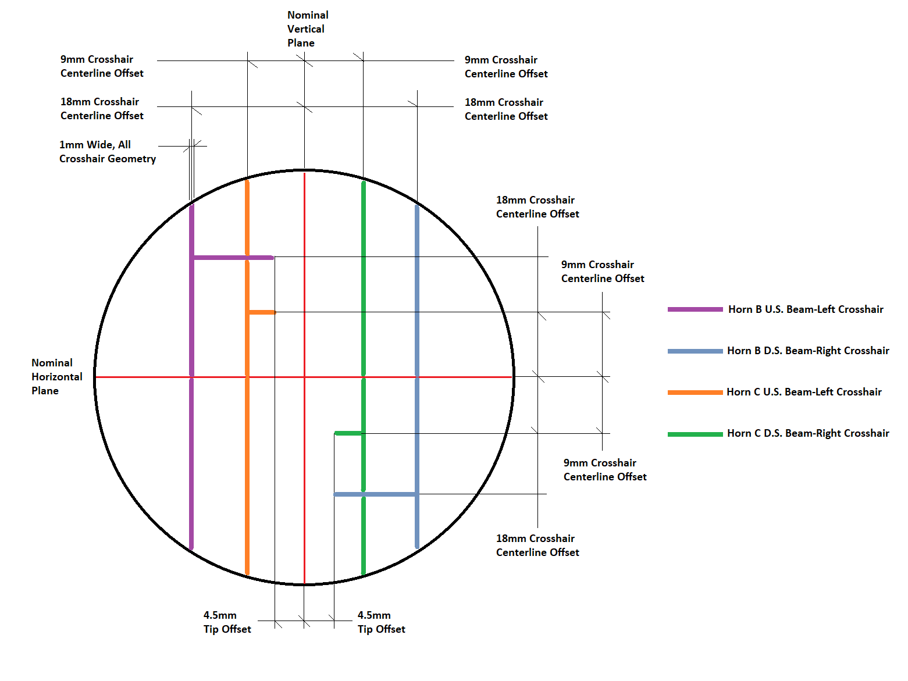
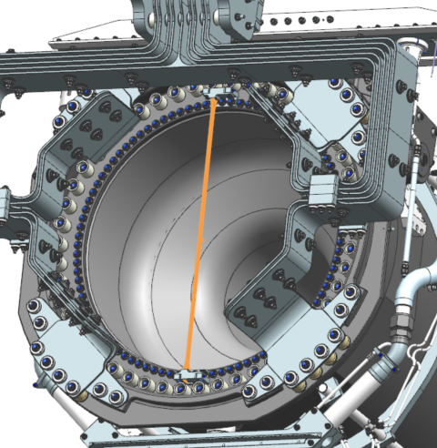
Interfaces – Beam Instrumentation (Crosshairs)

Slide 17
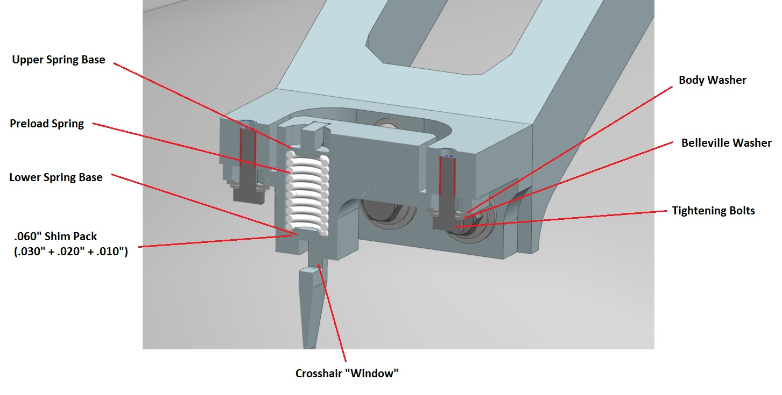
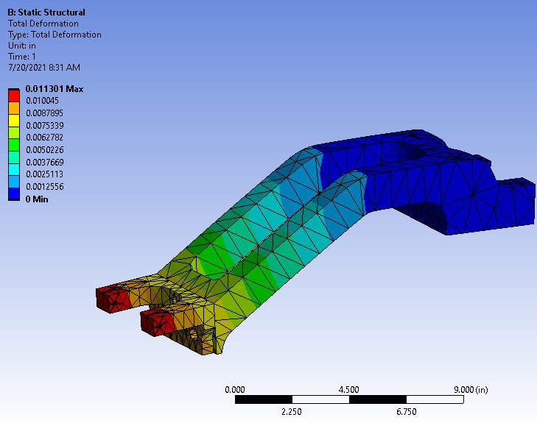
Interfaces – Beam Instrumentation (Crosshairs)

Slide 18
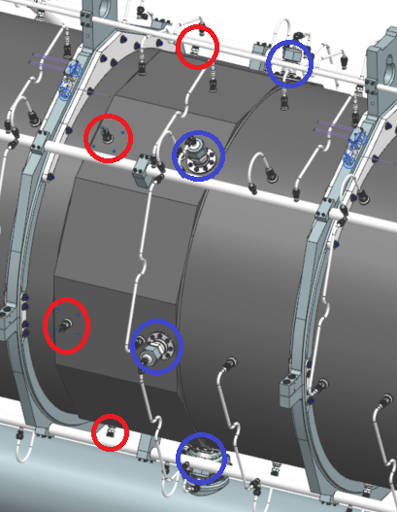
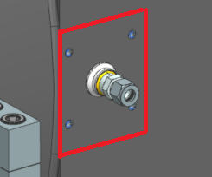
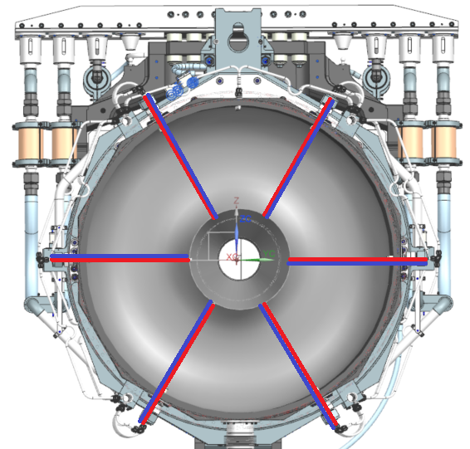
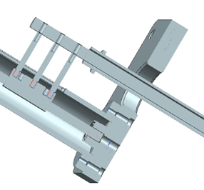
Interfaces – Testing + Field Probe Fitment
Well defined fiducial surfaces exist for depth mic measurements.
Dedicated ports added for radial field mapping with opposing ports to simplify data analysis & resolution of magnetic centerline.

Slide 19
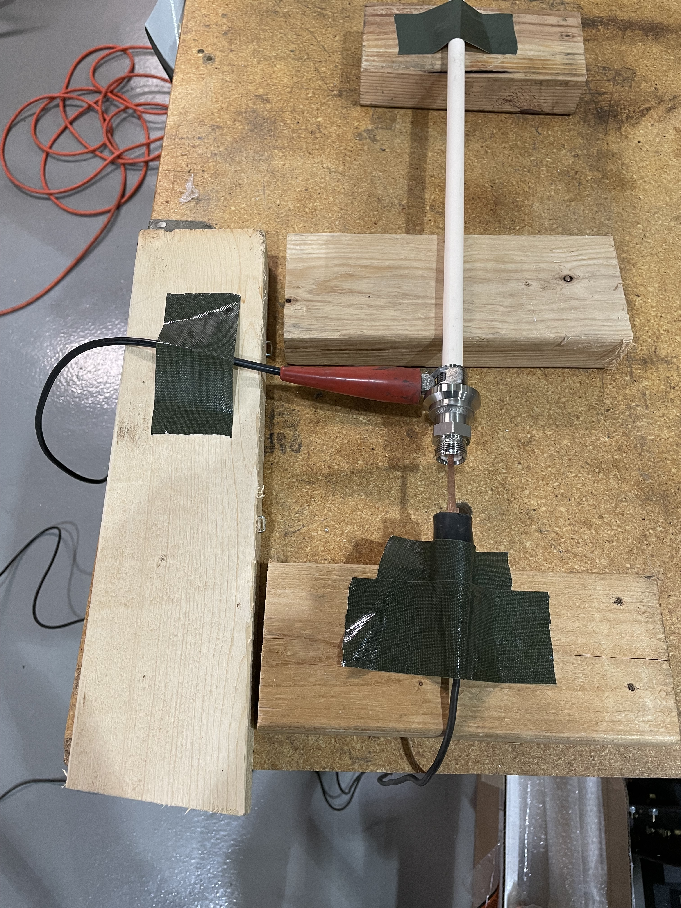
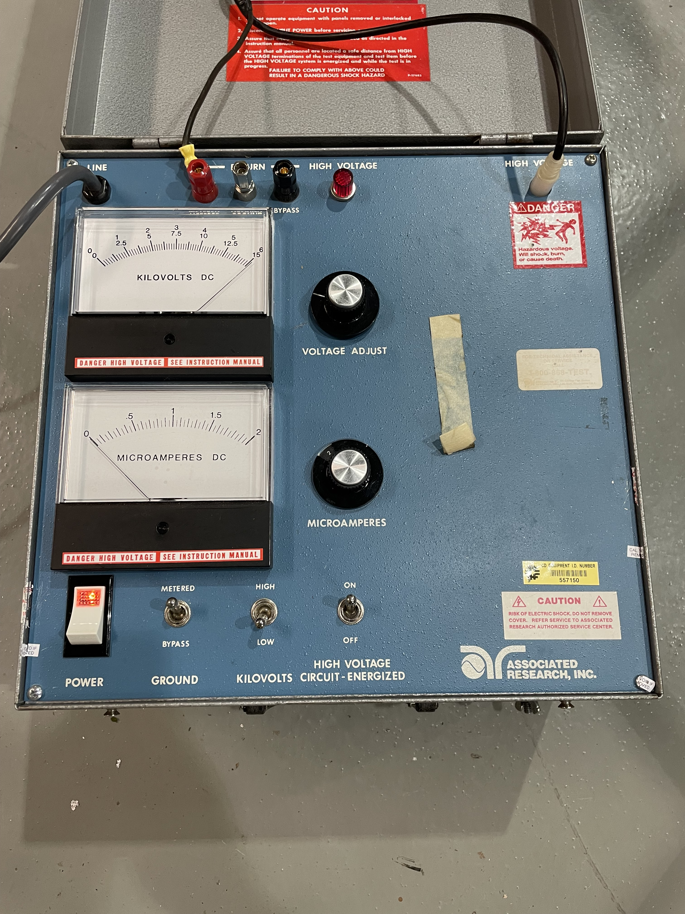
Interfaces – Testing + Field Probe Fitment
Have successfully tested field probe fitment through available port while encapsulated in ceramic isolation tube.
HIPOT to 6kV (<5kV max horn service on test stand) and no arcing present.
We found we will need to slightly enlarge ports over ½” tube OD to get ceramic tubes to fit.
Ream out field probe ports to .520” max.
Could consider OD grinding of ceramic tube but need to investigate.

Slide 20
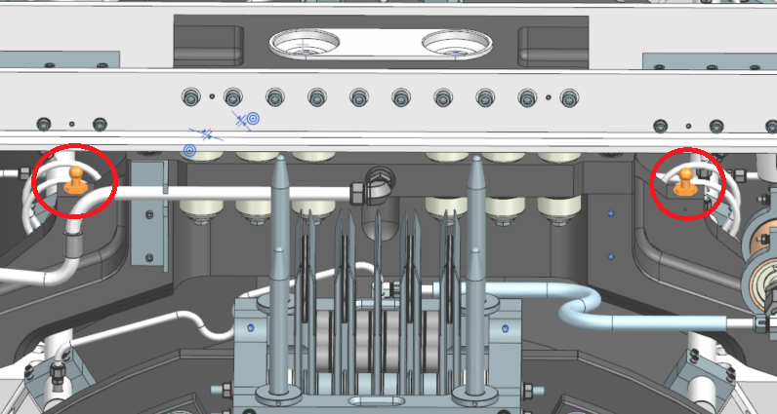
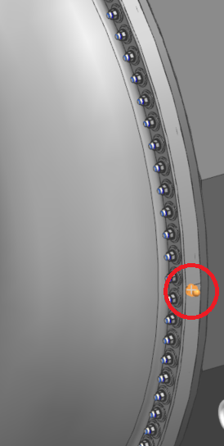
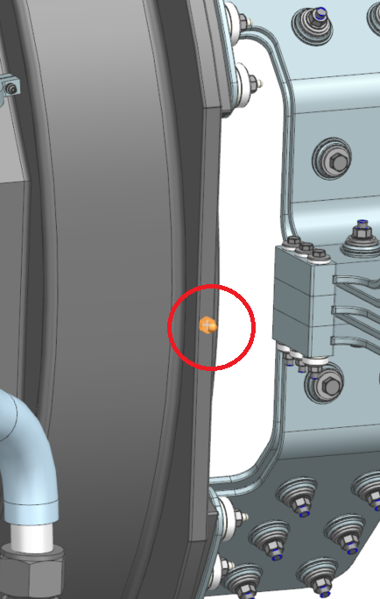
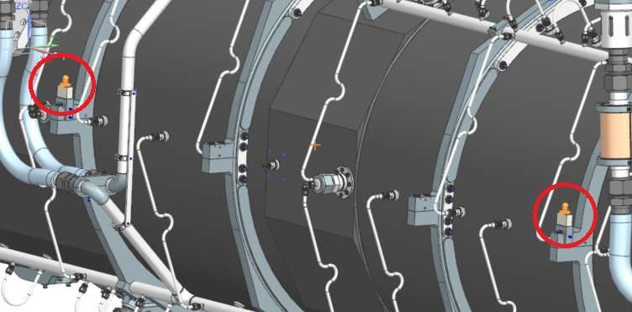
Interfaces - Alignment
Tooling Balls present for conductors, hanger reference, & HLS.
Able to reference conductor centerlines & crosshair position.

Slide 21
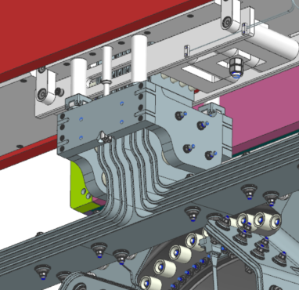
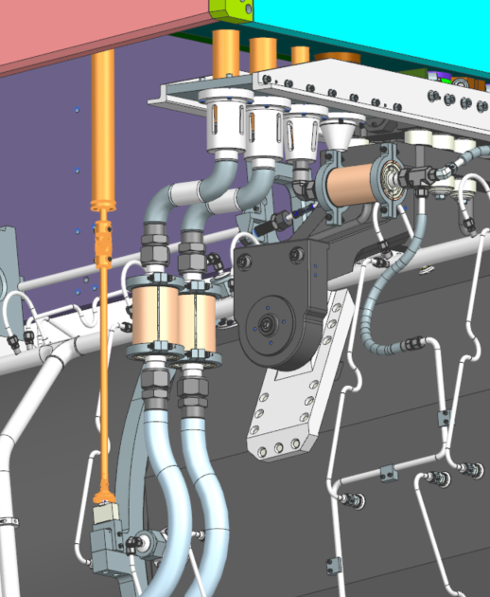
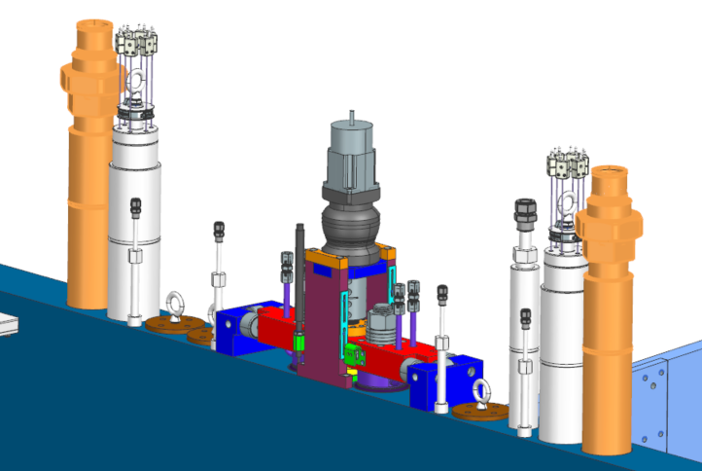
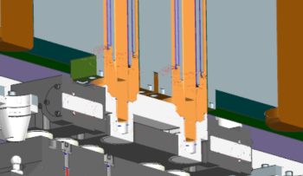
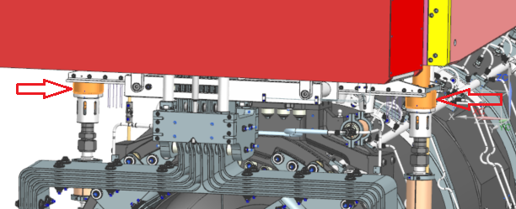
Interfaces – Module
Mostly identical to Horn A with a few minor modifications.

Slide 22
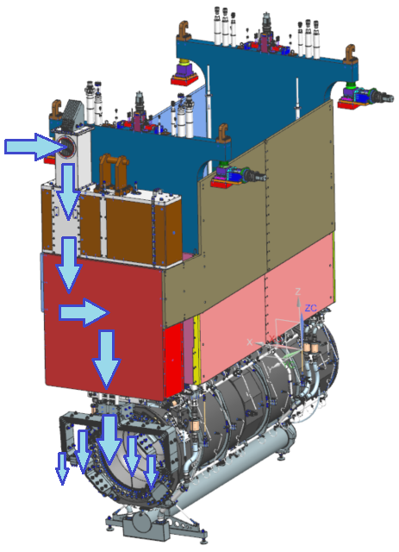
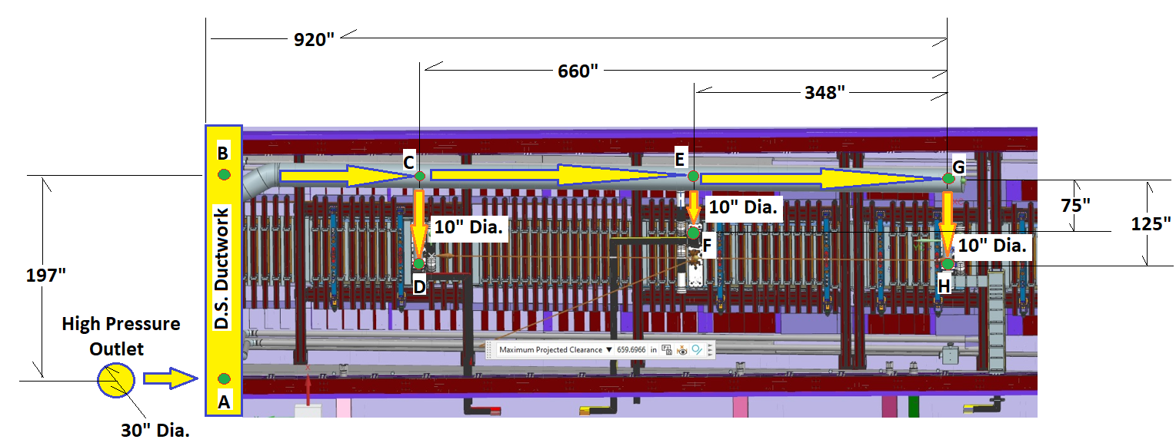
Interfaces – Nitrogen Handling System
Nitrogen handling system (and dedicated supply ductwork) is crucial to horn B & C operation.
EDEP is too high for bulk chase flow to remove heat. An air diverter approach as used for NuMI 700kW is not feasible to provide velocities required to drive heat transfer coefficients.
Solution is similar to that pursued for NuMI 1MW upgrade: dual purpose stripline shield block penetration & forced (nitrogen) duct.

Slide 23
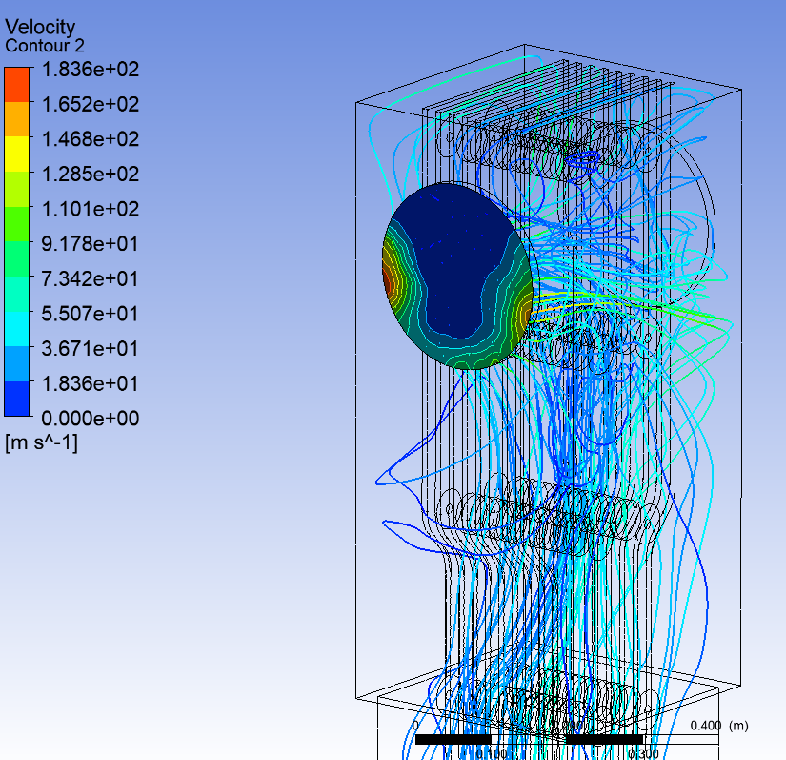
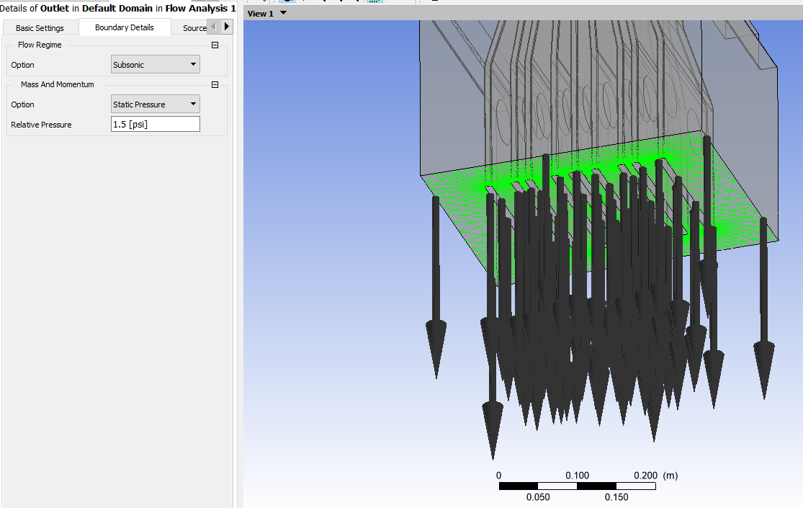
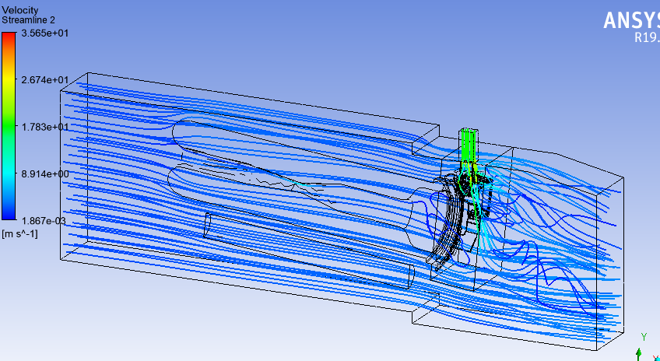
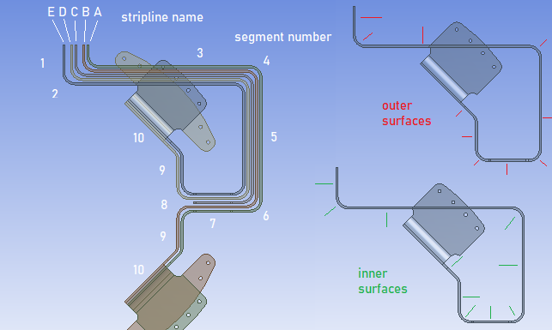
Interfaces – Nitrogen Handling System
stripline | A |  | B |  | C |  | D |  | E
side | outer | inner | outer | inner | outer | inner | outer | inner | outer | inner
segment
1 | 104.4 | 106.4 | 103.9 | 114.5 | 113.7 | 103.3 | 101.9 | 117.0 | 122.9
2 | 82.3 | 88.5 | 89.3 | 108.2 | 97.4 | 82.4 | 80.5 | 105.1 | 96.9 | 43.7
3 | 80.9 | 52.9 | 56.5 | 72.7 | 77.2 | 59.3 | 63.2 | 80.2 | 84.9 | 39.6
4 | 45.7 | 33.3 | 32.4 | 24.8 | 28.3 | 25.9 | 29.0 | 38.9 | 42.0 | 28.2
5 | 29.8 | 33.3 | 32.7 | 31.8 | 32.1 | 33.1 | 34.0 | 35.7 | 34.0 | 36.5
6 | 31.7 | 35.0 | 35.1 | 35.0 | 36.3 | 33.9 | 36.3 | 31.7 | 35.1 | 36.1
7 | 30.1 | 17.8 | 15.2 | 17.9 | 17.4 | 19.1 | 16.3 | 19.2 | 19.6 | 22.5
8 | 25.1 | 8.8 | 8.6 | 26.3 |  |  | 27.1 | 6.6 | 7.2 | 16.6
9 | 35.4 | 18.0 | 17.0 | 35.9 |  |  | 31.4 | 12.6 | 13.6 | 21.7
10 | 40.1 | 20.3 | 20.2 | 31.9 |  |  | 35.5 | 25.4 | 26.2 | 37.2
11 | 28.1 | 12.9 | 12.7 | 24.3 |  |  | 33.4 | 24.0 | 25.0 | 23.7
12 | 29.3 |  | 12.5 |  |  |  |  | 14.0 |  | 32.5

Slide 24
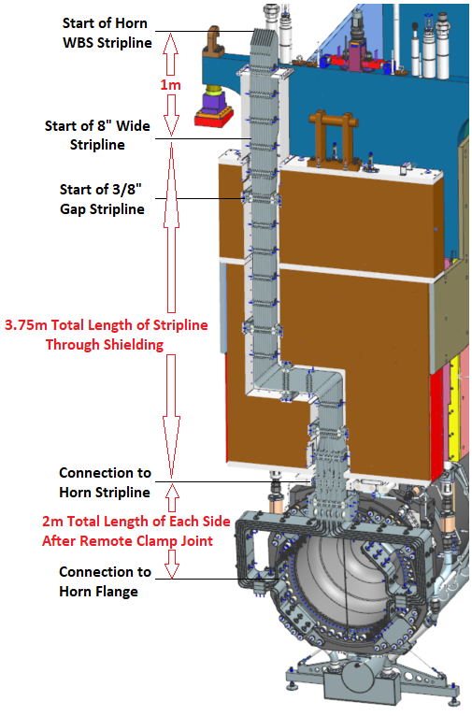
Interfaces – Power Supply
Interface to Power Supply occurs at top of stripline shield block.
Horn parameters (part of this scope) drive majority of design & analysis requirements.
Horn B sets requirements for largest voltage drop across horn terminals (~1500V).
Horn B has highest inductive load (~1.211µH).
Horns B & C share all ceramics with Horn A. The ceramic insulating ring for the main conductor assembly, and the enlarged water drain ceramic, are the only unique items to the large horns.

Slide 25
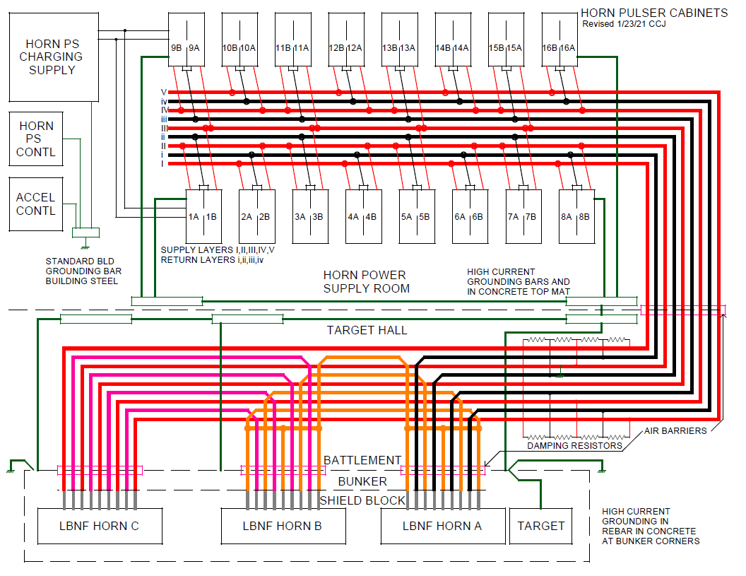
Major Interfaces – Power Supply
Credit: EE Support

Slide 26
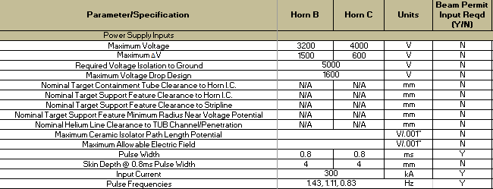
Major Interfaces – Power Supply
Horn B & C maximum voltage and voltage drop is defined.
Analysis work used these nominal voltages to meet acceptable safety factors for corona inception in an ionizing environment based on BNB operational history.
Pulsed power parameters have remained unchanged since inception of LBNF optimized design: (300kA, 0.8ms half sine pulse, 1.43Hz rep rate).

Slide 27
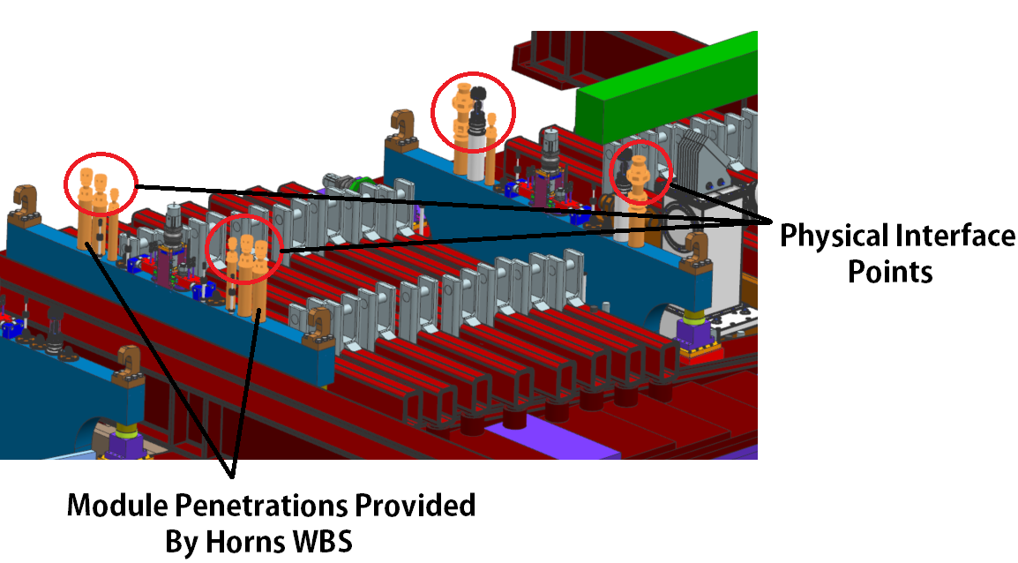

Interfaces – Radioactive Water Systems
Interface has understood line loads, supports, and overall routing.
Line loads flow through module utilities to Horn B & C hangers.
Loads on Horn B & C hangers affect conductor position.
  And by default, integrated crosshair position.
Heat load from MARS is verified with FEA & transferred to RAW for exchanger sizing given pressure, flow, and temperature requirements.

Slide 28

Interfaces – Radioactive Water Systems
Critical Interfaces (Identical for all horns):
  Maximum filter element pass through sizing (20 micron).
  Maximum purge system
  flow (~9L min).
  All manifold pressures
  (40 PSIG nominal).
  Material Allowances.
  RAW supply temp range
  (70F Nominal, +5F / -10F).
  - Line weights through module.

Slide 29


Interfaces – Radioactive Water Systems
All horn water system details are accounted for in RAW pressure / flow / heat removal software (FATHOM).
Dedicated P&ID’s exist between each horn and the supporting RAW skid.
A comprehensive Ar / H / O purge system is documented.
Horn & water tank analysis accounts for these pressures.
Credit: Des D. & Shyamala S.

Slide 30



Interfaces – Remote Handling
Remote handling points mimic Horn A design & allow for C.G. of both Horn B & C assemblies to be located within lift clamps.
Current C.G. + weight totals are well defined & not anticipated to move appreciably. Horn C stripline modeling will be slight modification.
Assembly support feet locations are locked & agreed on.
All remote handling parameters for weight, lift clamp spacing, and support feet position are agreed on & present in specification sheet.

Slide 31




Interfaces – Remote Handling
Horn C stripline & module connection is identical to B’s, though beamline transition angle of 5.789 degrees must be switched to opposite end (weldment only).
Horn C Stripline modeling underway; isolator group placement & most piece parts are identical.

Slide 32
Interface – Procurement
Horn A procurement is complex, but not “expensive” (<250k items). Has generally been straightforward to procure.
Horn B & C procurements happen in tandem due to design similarities.
Some production Horn A parts lumped in, but not driving cost…
  Forgings: 745k
  B & C Inner Conductor Machining: 722k
  Ceramics: 579k
  B & C Nickel Plating: 464k
  B & C Outer Conductor Machining: 376k
  Many more in 100-200k range.
Likely sole sources + DOE site office approval (2X) needed past 250K + procurement plan. Procurement lead times of 6-12 months.
Interfacing with procurement and vendor base is non-trivial effort.

Slide 33

Parameters & Specifications Document
Parameters & Specifications Document captures all engineering details that are being created to meet requirements & interfaces.
Let’s take a look!

Slide 34

Summary
Requirements are known, clearly stated, and drive the design of Horn Systems, continuing with Horn B & C.
Interfaces for Horn B & C are entered, & peer reviewed.
Horn B / C Parameters + Specifications are well defined and are represented in the design and fabrication plans.
The work required for Horn A interface definitions & design directly carried over to Horns B + C. The highly complex target interface was replaced with crosshairs + larger ejector system, both of which entail much less complexity.
Questions?

