Slide 1
Neutrino Beamline Horns B & C Preliminary Design Review
NRE Applied from Horn A
Cory Crowley
3 December 2021

Slide 2
Outline
Horn A – B – C Standardization
Engineering Analysis + Component Design
Component Carry-Over
Hangers & Water Lines
Water Tank
Stabilizers
Spider Supports
Ceramics
Utilities / Instrumentation
Remote Handling
Summary

Slide 3
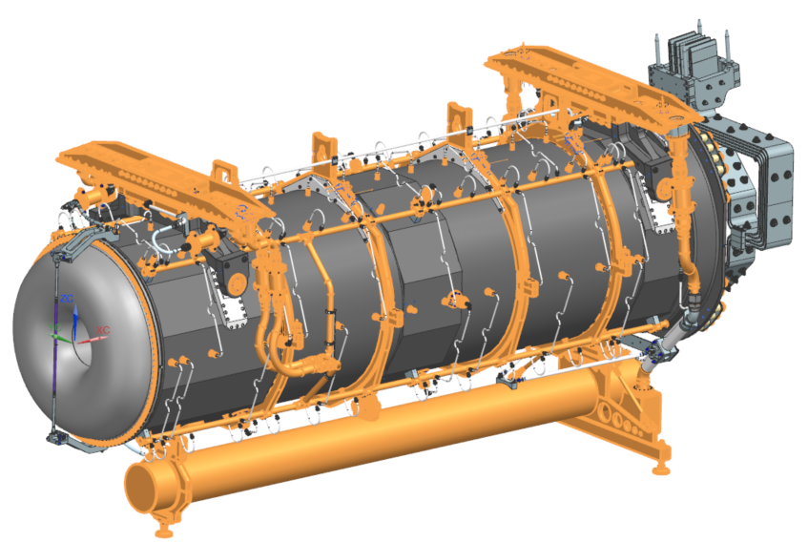
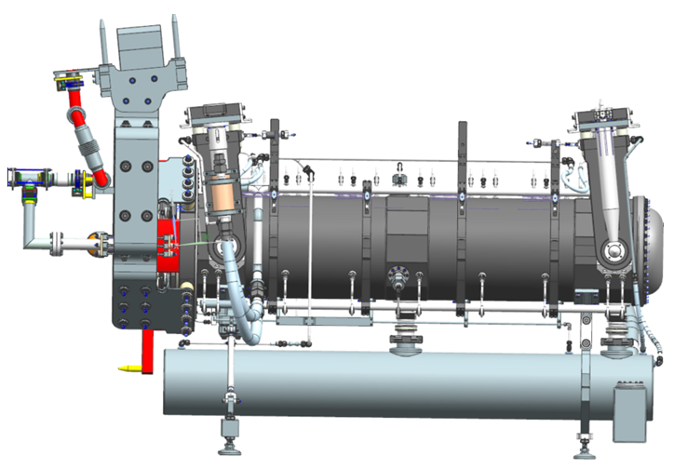
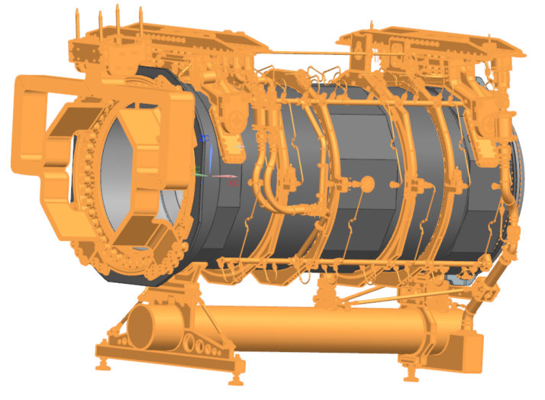
Horn Standardization
~80% of A is procured.
50% of A “shared” with Horn B.
95% of B “shared” with Horn C.

Slide 4
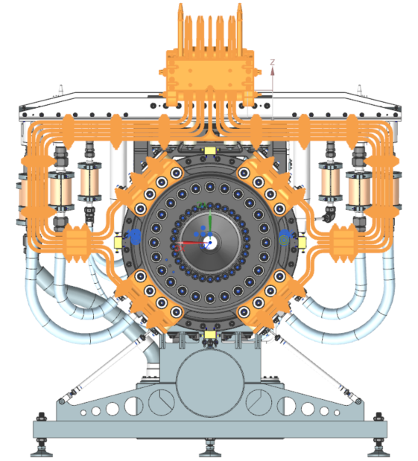
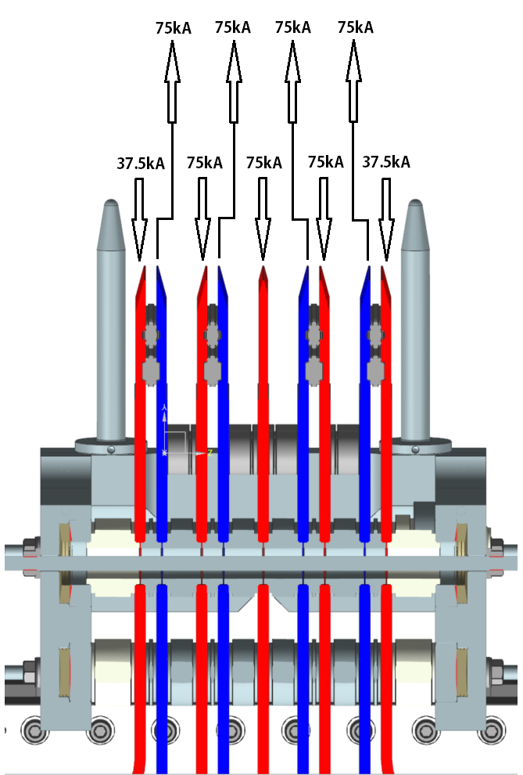
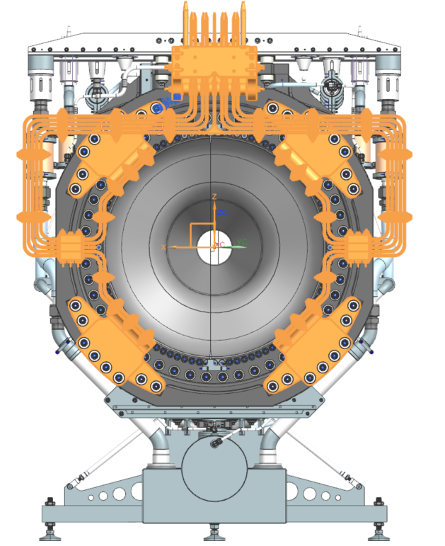
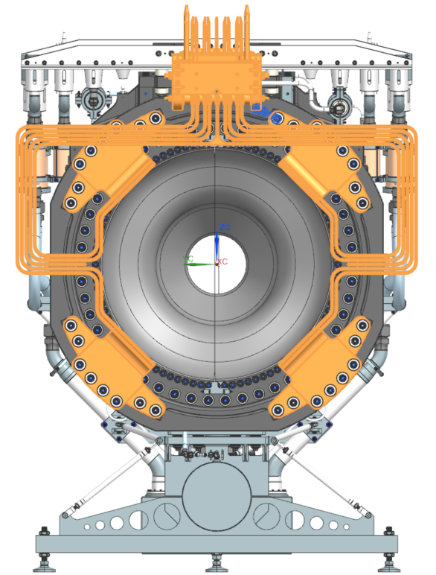
Horn Standardization
Horn A stripline is of different geometry at horn terminals, though overall layout and bolt group spacing carries over to B & C.

Slide 5
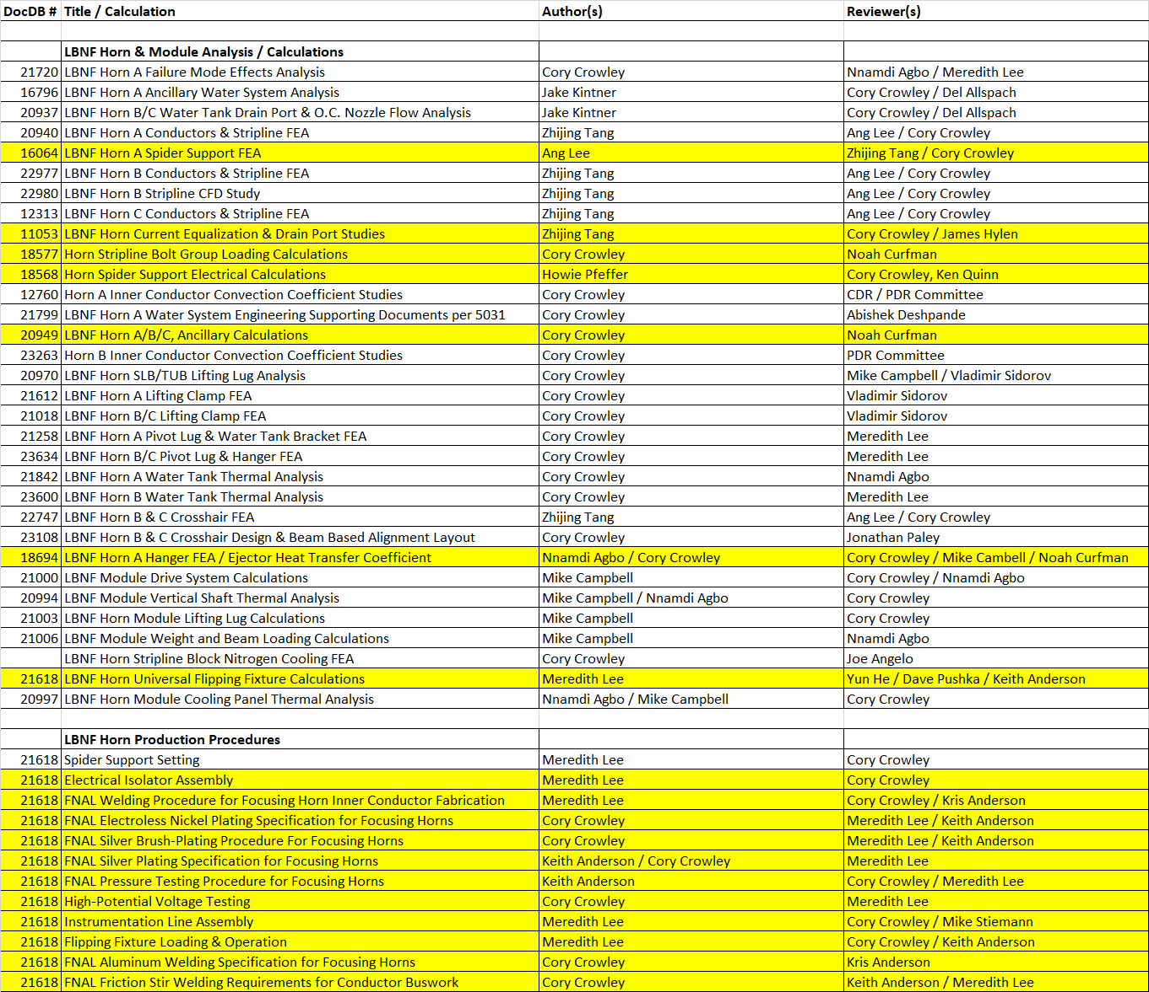
Engineering Analysis
All engineering nearly complete.
Fabrication procedures carry over.
General bolt group / hanger / stripline / spider support & ancillary engineering carries over.
All other analysis followed Horn A blueprint with updated geometry & appropriate EDEP (nominal + 15%).

Slide 6
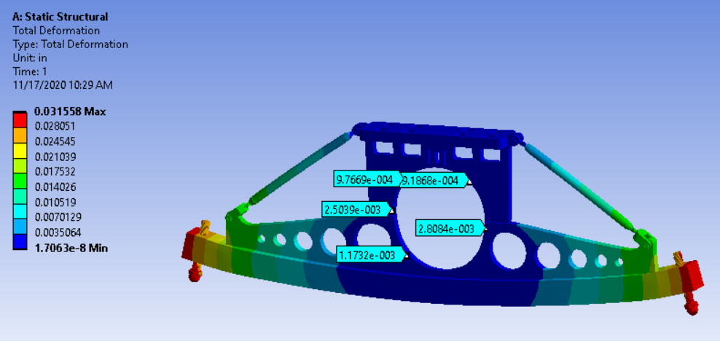
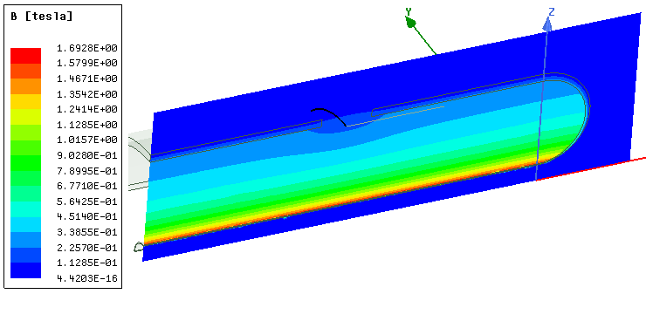
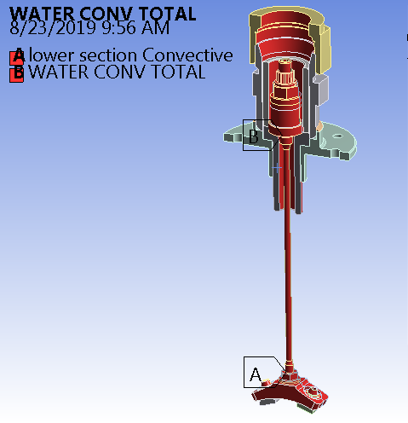
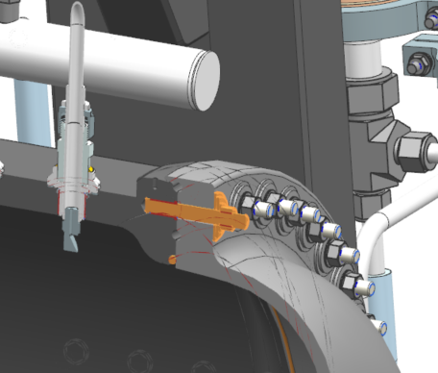
Engineering Analysis
All shared components or scaled concepts were analyzed for worst case scenario across all horns. Example:
Horn A drove water tank thermal loads.
Horn B drove water tank expansion.
R.H. drove water tank structural considerations.
Horn C drives peak ceramic isolation voltage.
Horn B dives peak delta V at terminals.
All captured in Horn A engineering effort.

Slide 7
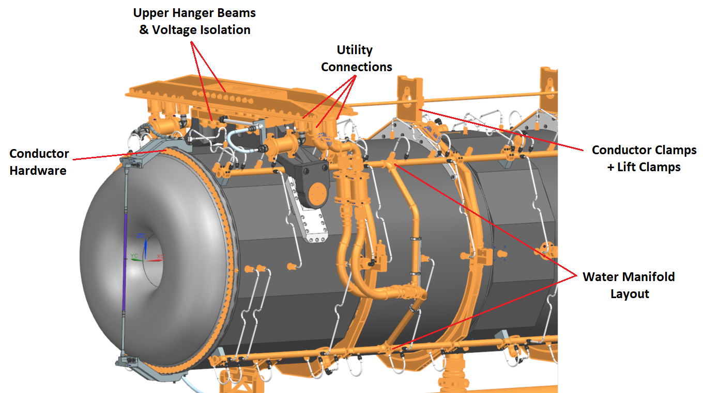
Ancillary Component Carryover to Horns B & C
All ancillary hardware has direct carryover. Many horn A ancillary spare parts have future life on B or C if not used on A.
Assembly differences do not negate shared piece parts for weldments, etc…

Slide 8
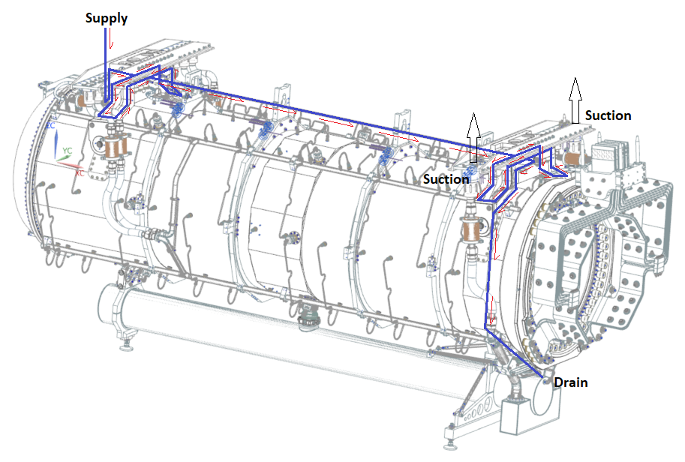
Hanger Cooling Loop Routing
Routing & passage sizes identical to Horn A.
Longer run between hangers is negligible due to tube I.D.
Utilizes same weld preps / tubes / plugs / water bearing structures.

Slide 9
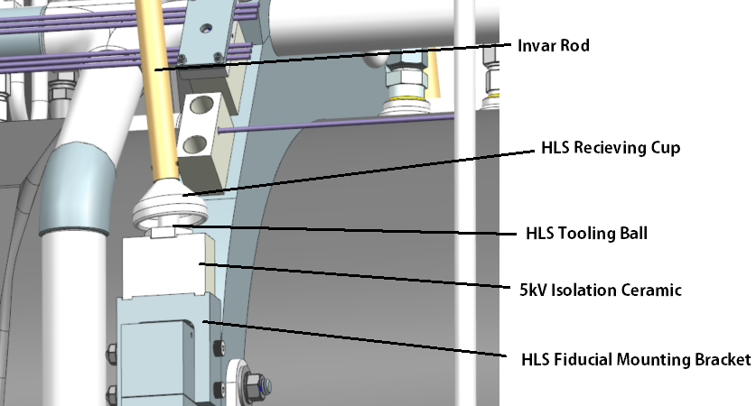
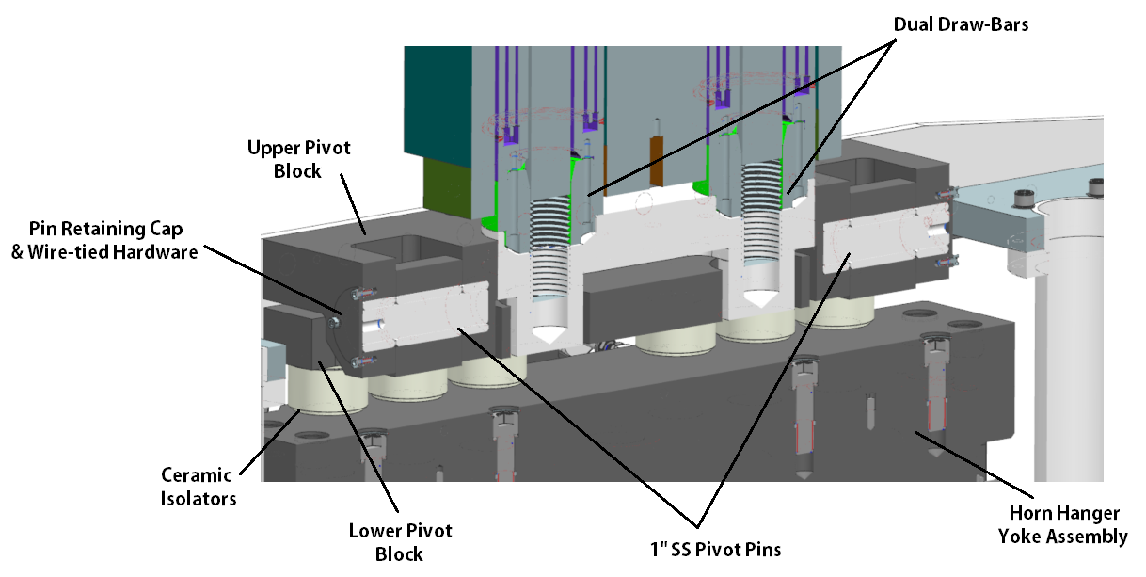
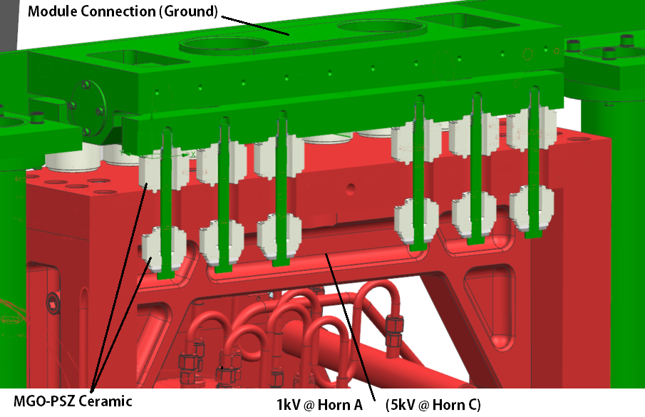
Module Connections / Pivot Links / Electrical Isolation
HLS brackets for Horn A were fitted to larger conductor clamps on B / C.
Drawbar attachment and cooling identical to A, also required for acceptable steady state operation on Horn B.
Grounded isolation bolt scheme on sandwiched ceramics remains (SL equivalent spacing).

Slide 10
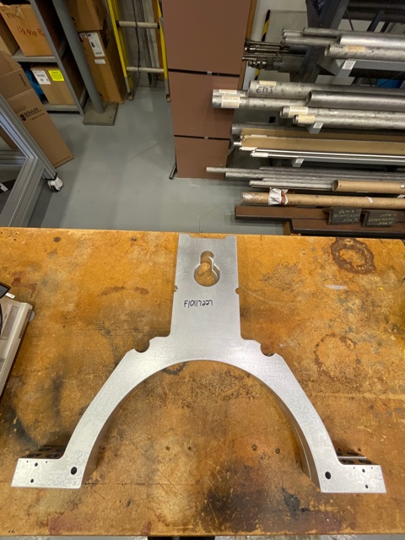
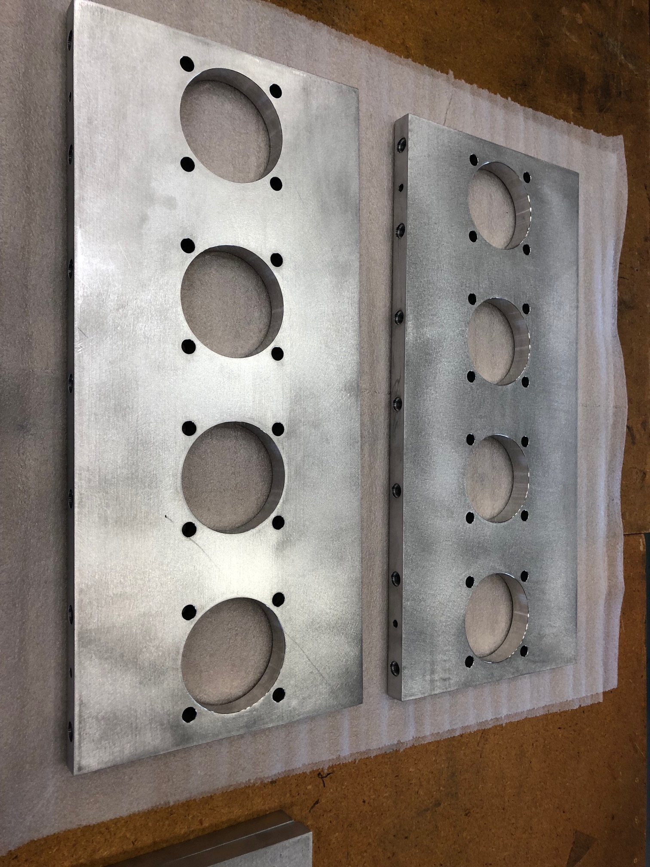
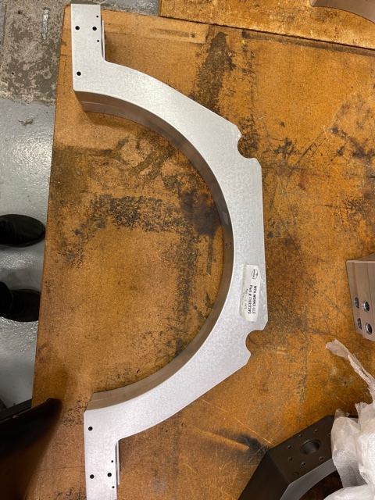
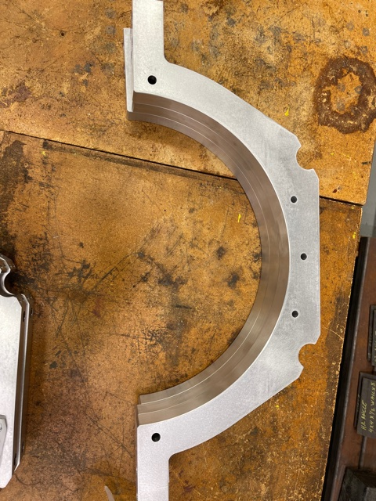
Prototyped Clamp & Hanger Components
Drawing generation / tolerances / vendor base has been mostly successful for incoming clamp & hanger parts.
Fitment to one-another feels appropriate and no-rework has been required to date (for received parts).

Slide 11
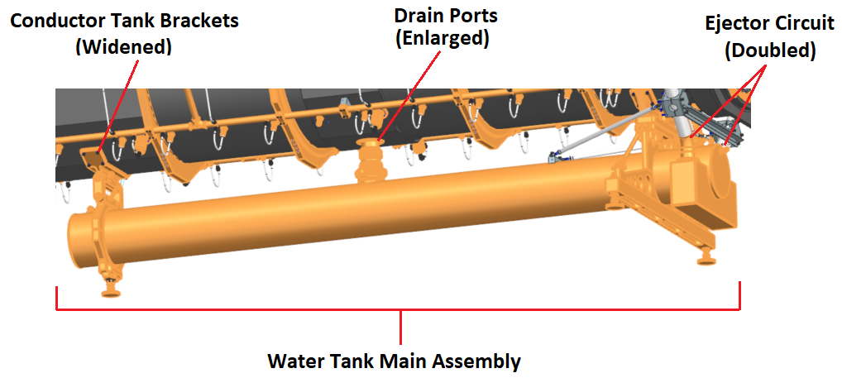
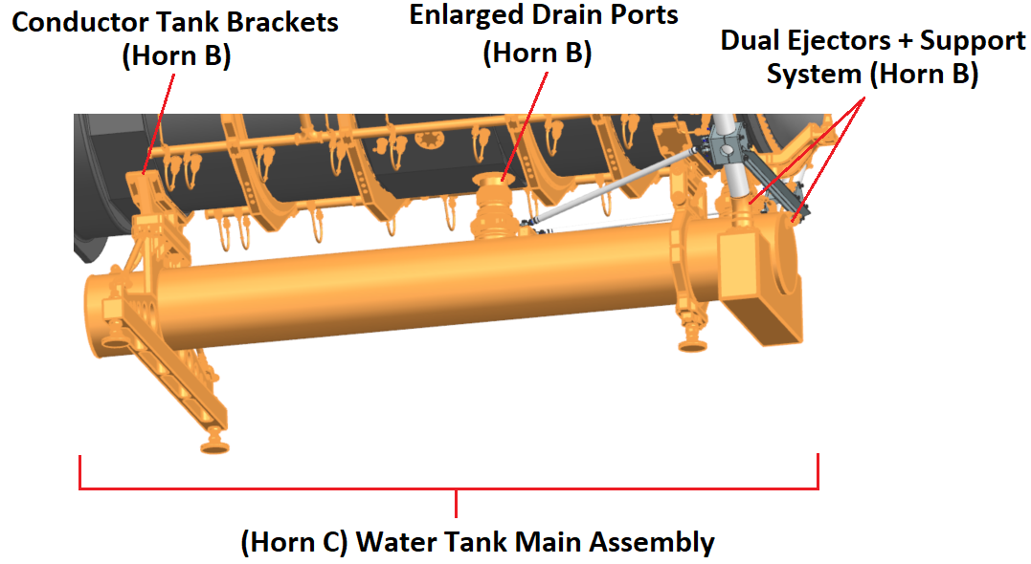
Water Tank Design
Horn B & C water tank designs are near complete replicas of Horn A.
“Stretch the airplane”
Same tank, but longer
All supporting hardware same as currently prototyped.
Conductor mounting brackets are wider for larger horns.
Drain ports increased to 4”.
Ejector system at capacity with 2 circuits installed.
Stabilizer brackets made for long ejector stalks.

Slide 12
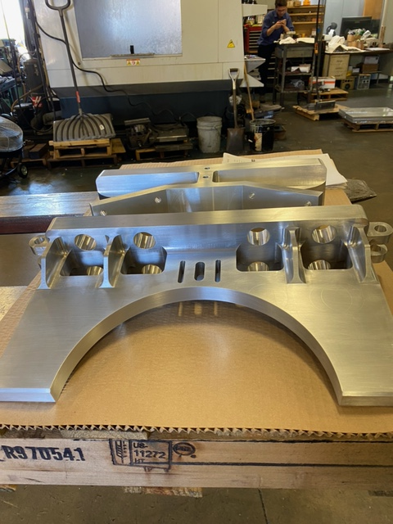
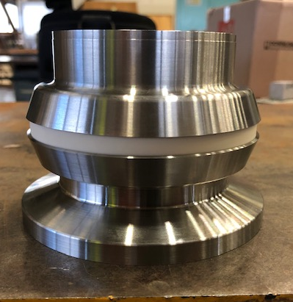
Prototyped Tank to Horn Components

Slide 13
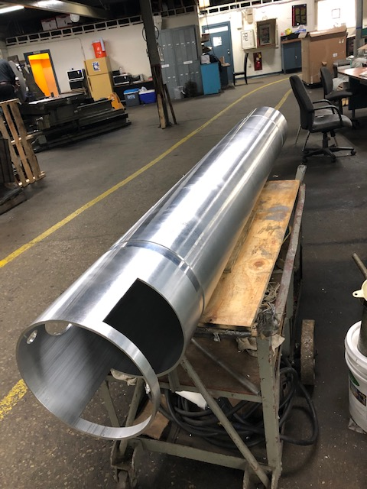
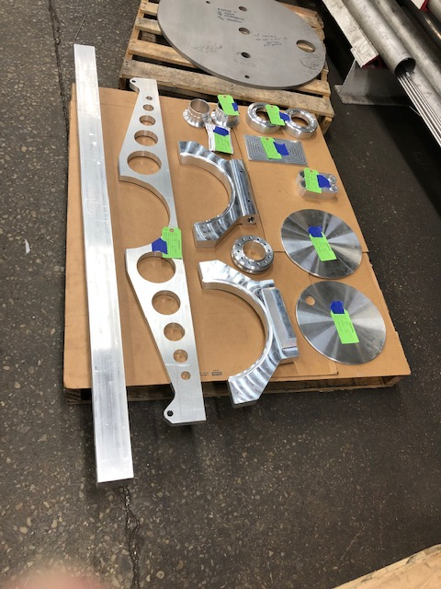
Prototyped Tank Components

Slide 14
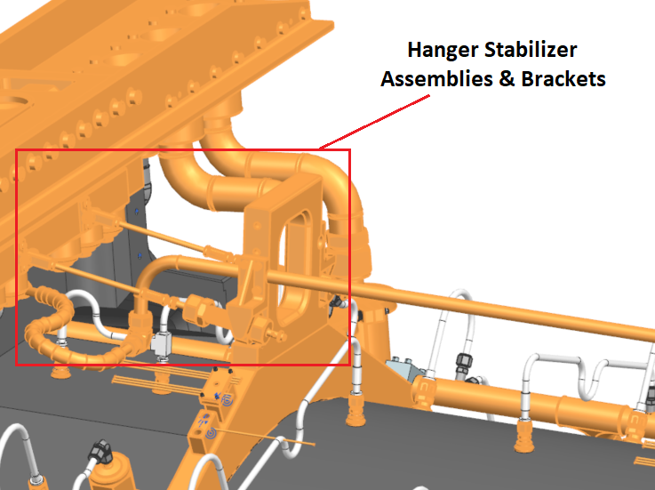
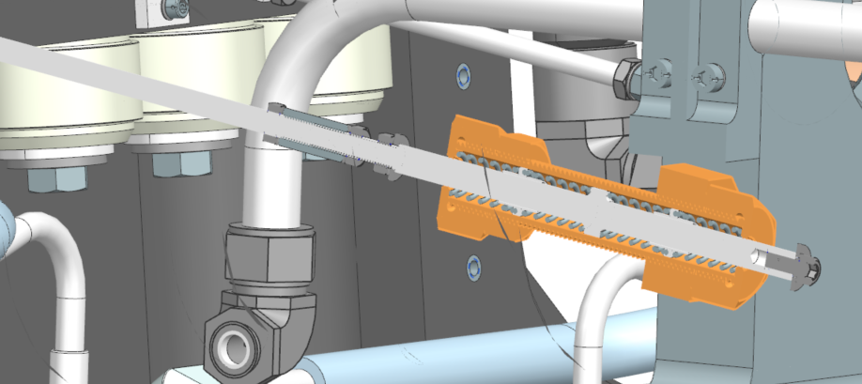
Hanger Stabilizer Assemblies
Horn B & C stabilizers use reconfigured parts from A.
Brackets flipped upside down & extension arms added to reach hangers.
Part fitment good to date.
Need to fine-tune spring rate during build so hangers stay in position but allow compliance during module hookup without breaking.

Slide 15
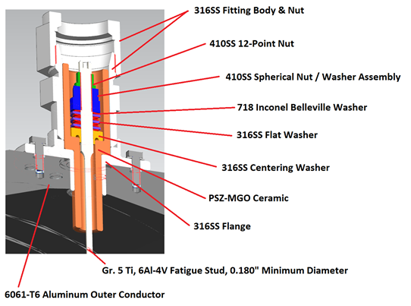
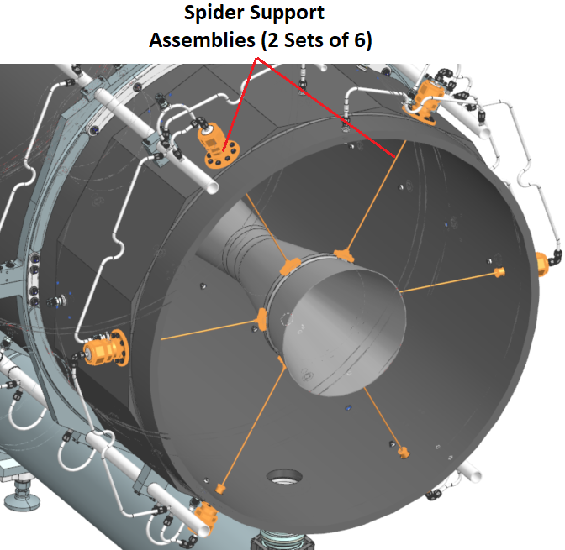
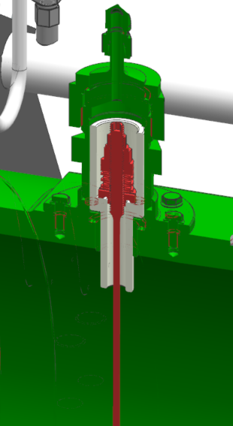
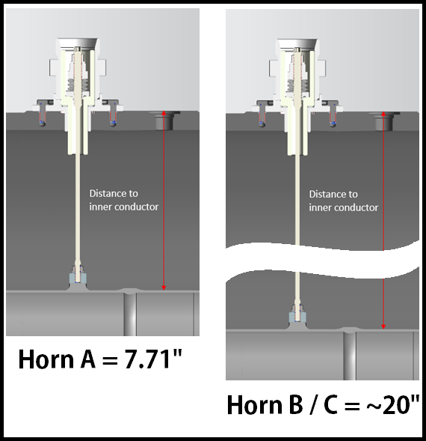
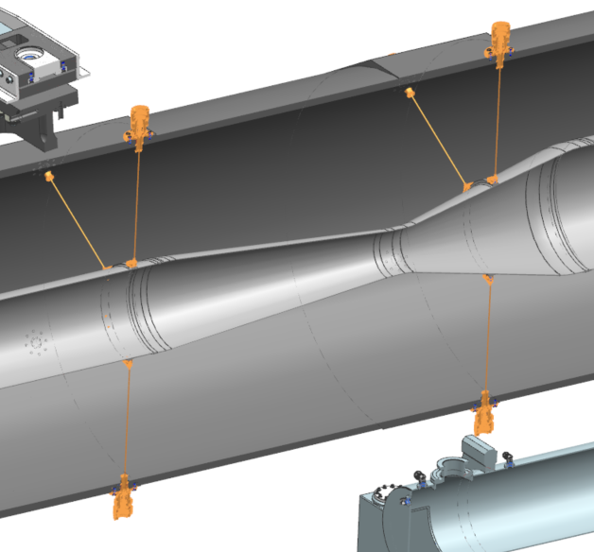
Spider Supports

Slide 16
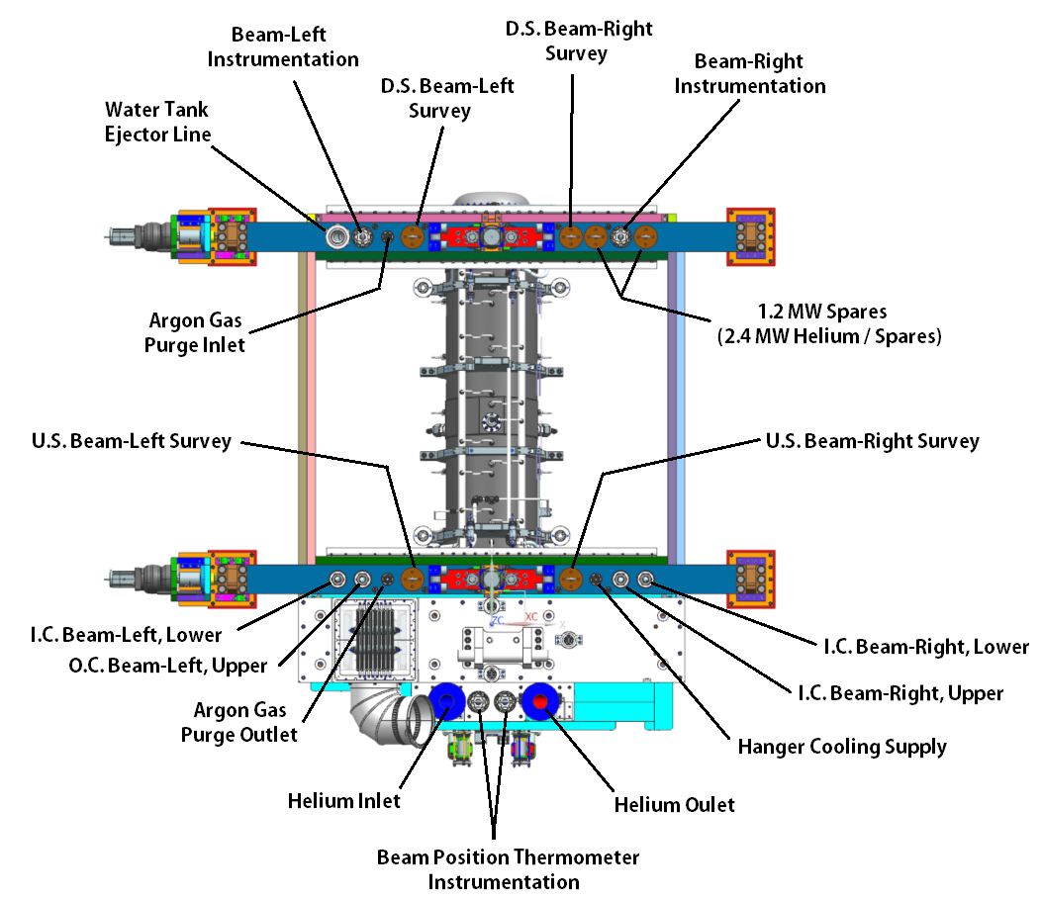
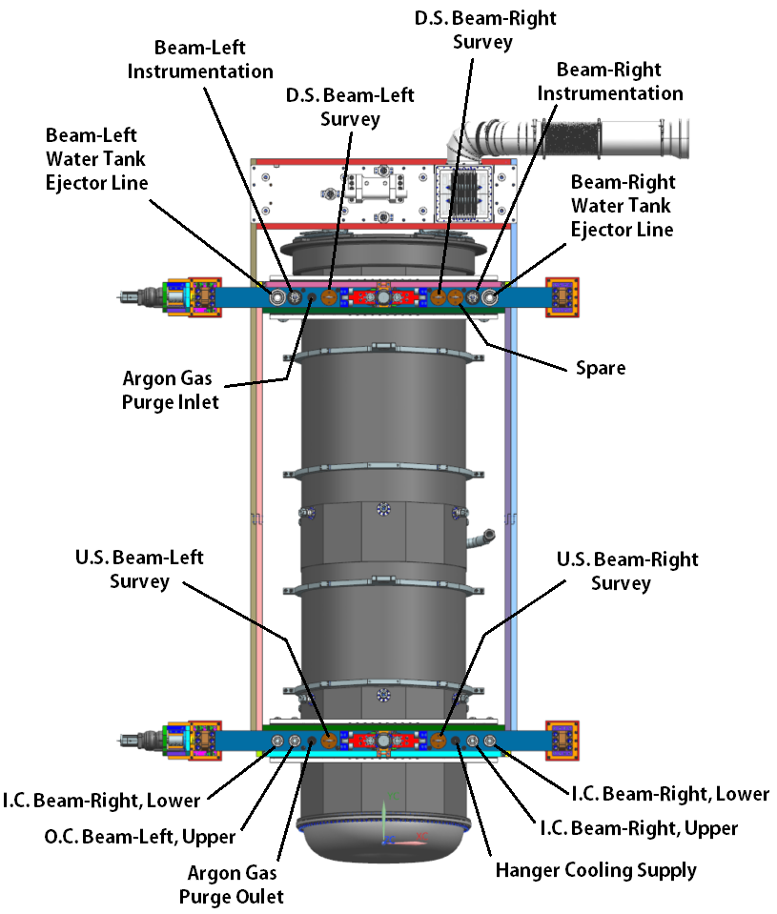
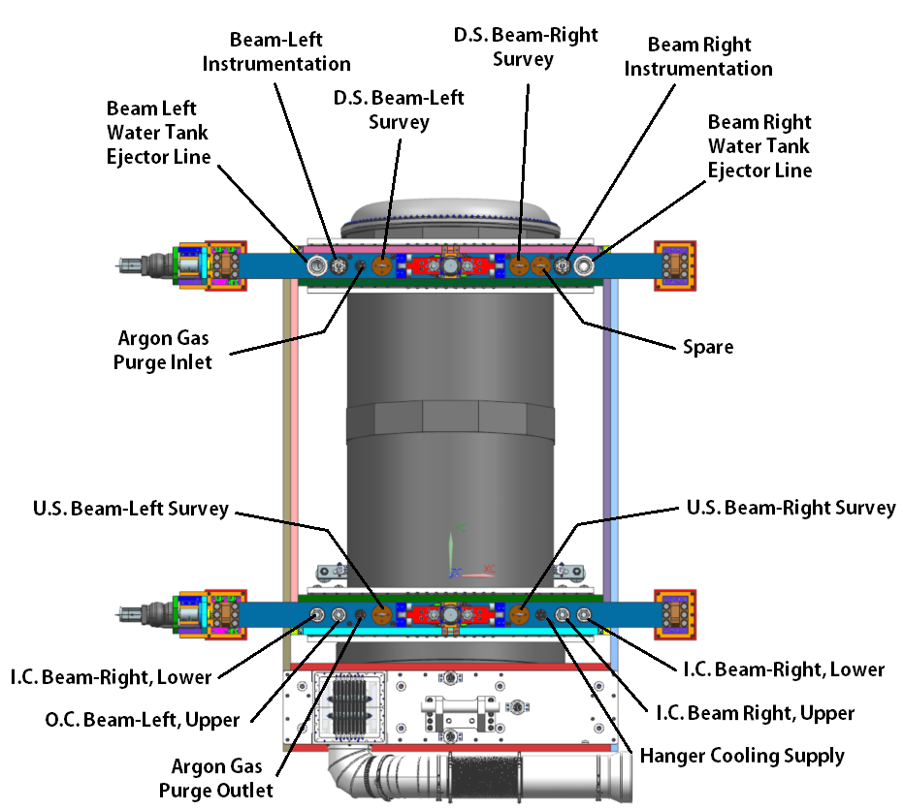
Utility Connections

Slide 17
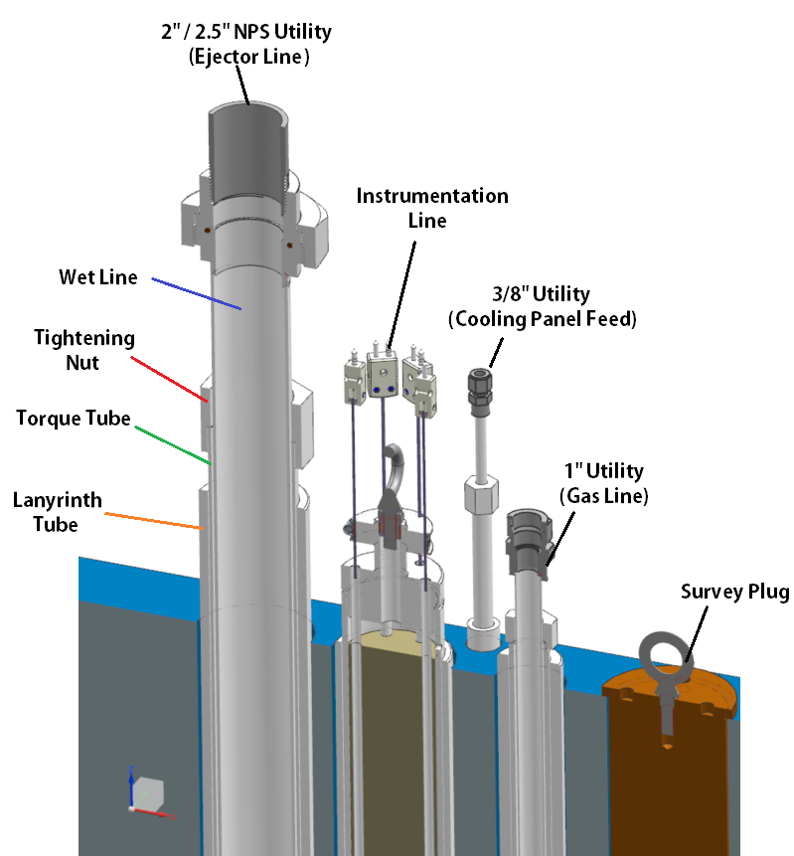
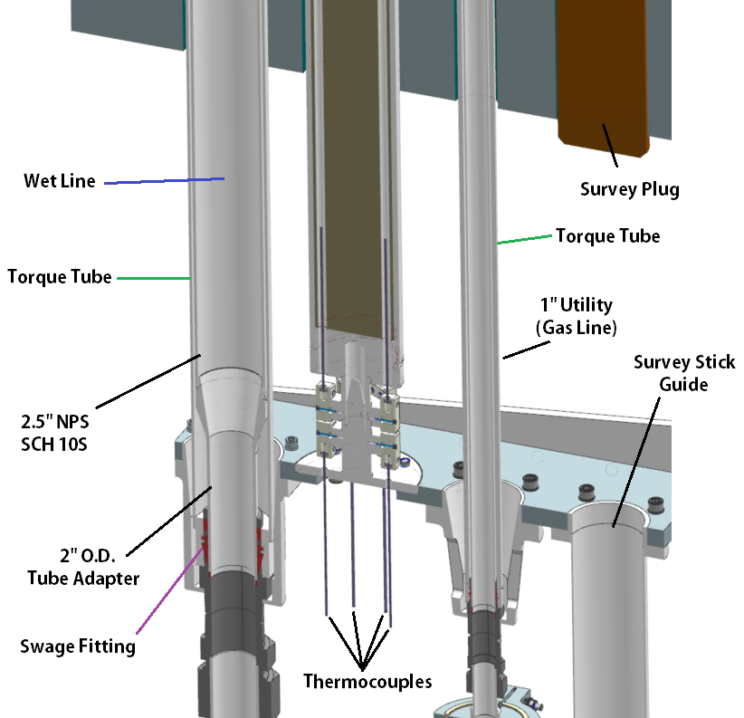
Utility Connections
Water, gas, T.C. line counts are same as A + in identical locations.
Ejector line present on B.R. side, so only 1 spare spot for B / C.

Slide 18
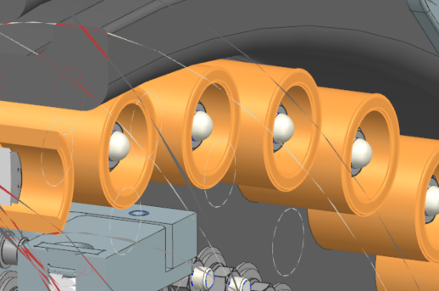
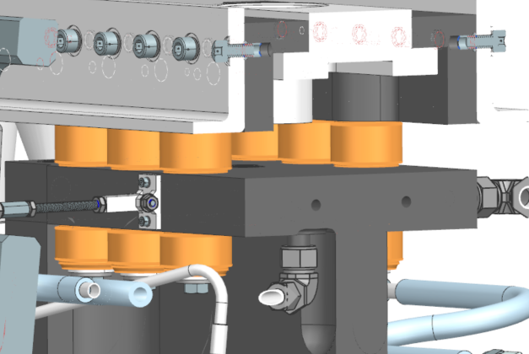
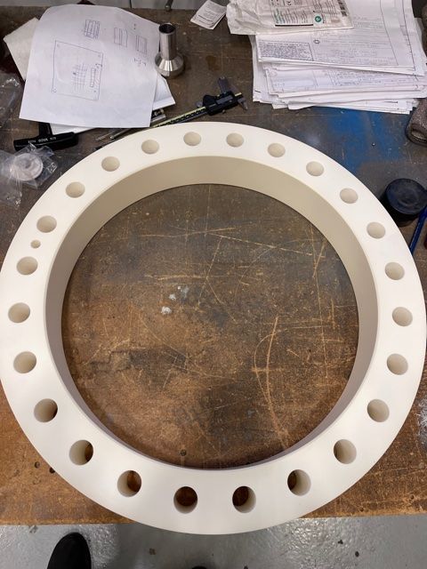
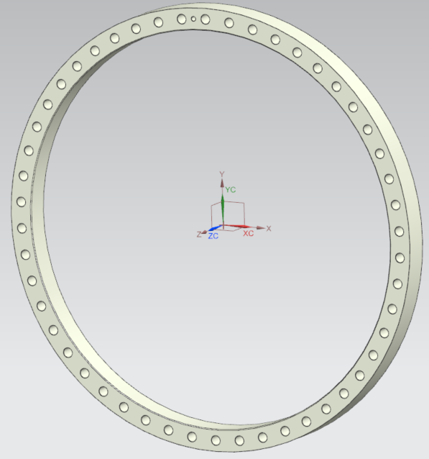
Ceramics
No additional ceramic prototyping warranted for larger horns.
Old designs fully propagated to new assemblies and will test with prototype Horn A.
Large ceramic rings are single point ceramic risk due to limited vendor base. Ensured company would quote rings larger than that in baseline design.
Pricing somewhat dated; vendor unlikely to update.

Slide 19
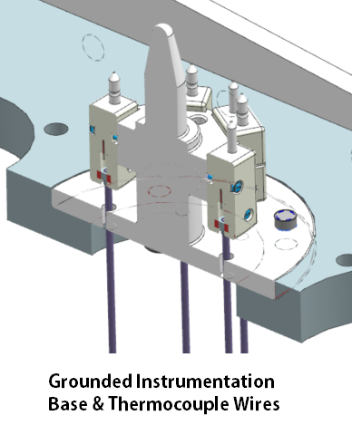
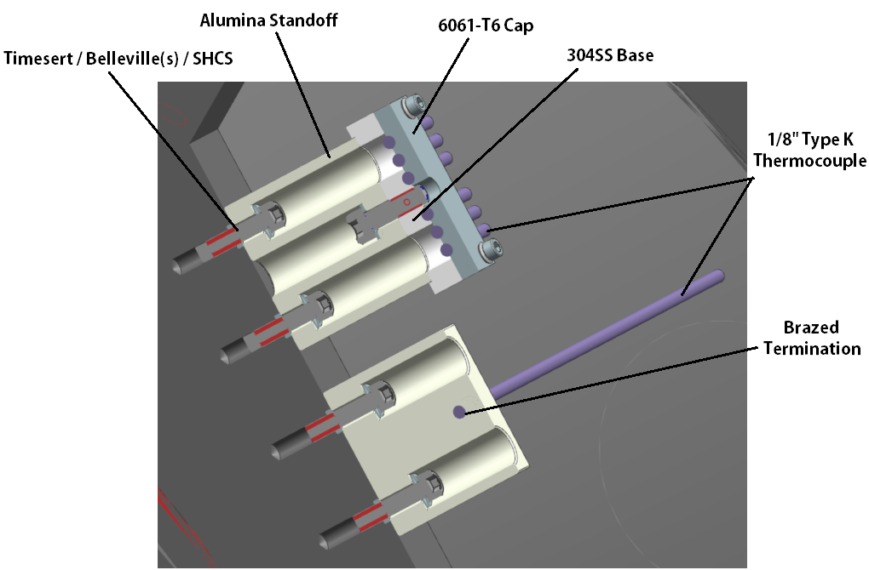
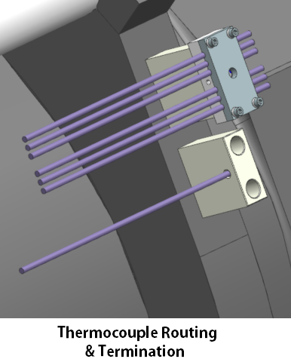
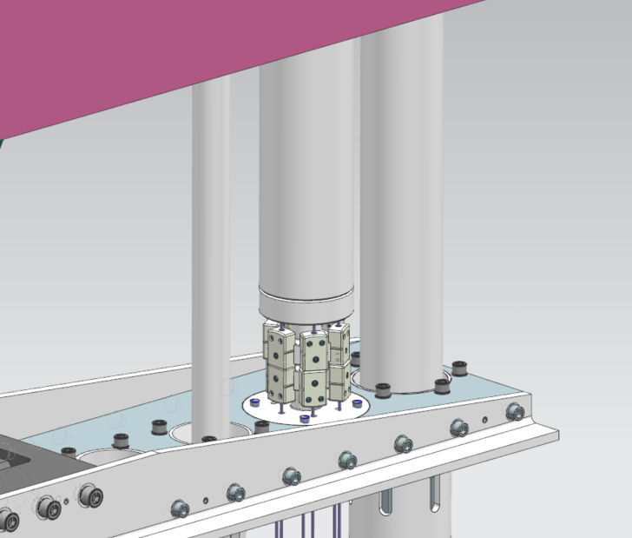
Utility Connections & Line Routing
12 thermocouples per horn mimic that for Horn A.
Horn A has 8 spares available.
B / C likely need to use more TC’s since they are so large.
Upper to lower conductor temperature variation.
Hanger temperature checks.
Stripline Terminals?

Slide 20
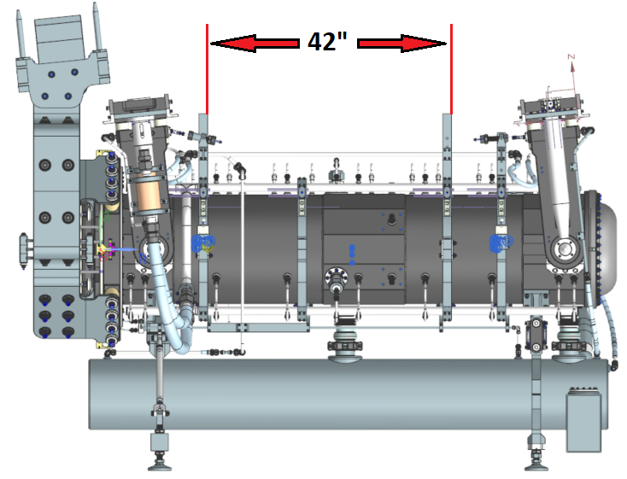
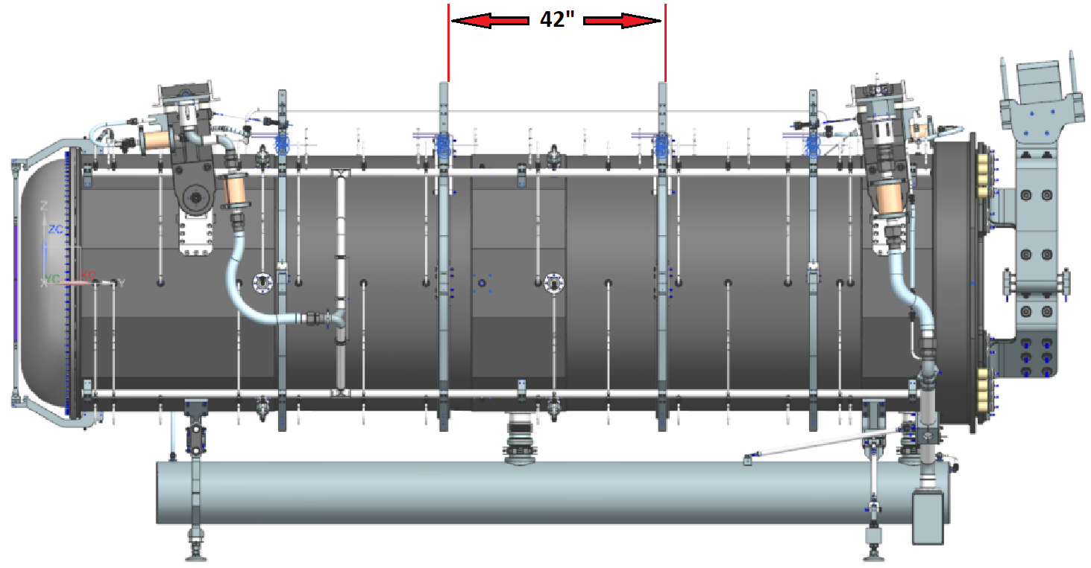
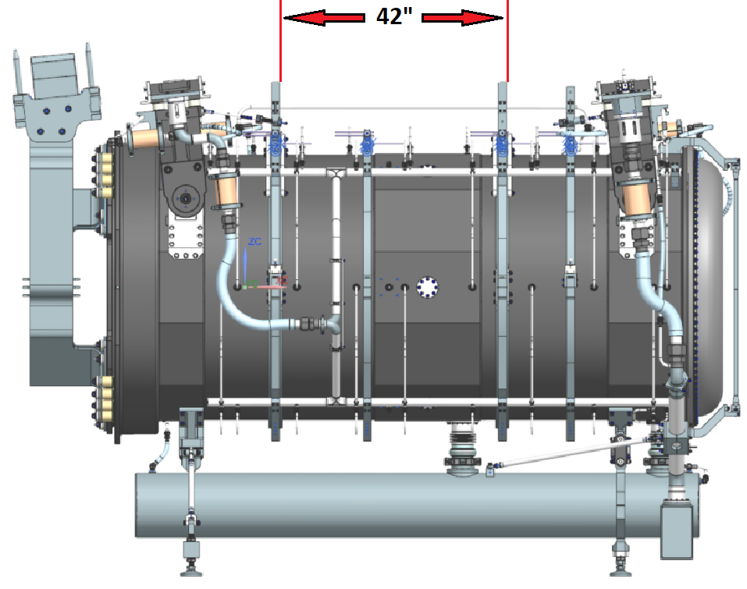
Remote Handling
Main lift clamp span set to 42” for all beamline devices (including baffle).
Span relocated on each horn to ensure C.G. is within range.
Scope of weights known.
Not missing major parts.

Slide 21
Remote Handling
3-point supports utilized for all horns with 60” width.
Length is different for each horn and corresponds to best placement for water tank
support bracket / load path.
“Clean” number not required.

Slide 22
Summary
Horn B & C are direct conceptual copies of Horn A.
100’s of piece parts are shared across the horns.
High level subassemblies share many of the same configurations.
Fabrication and assembly of Horn A will largely apply to Horn B & C.
Assembly fixturing, fabrication procedures, weldment details, & specialized tooling carries over across all horns.
Specialized items need to be made that are specific to the size of Horn B & C.
Nickel plating fixtures
Anodizing fixtures
I.C. & water line weldment tooling.
Engineering efforts for design & analysis have captured worst case loading for any combination of components.
Questions?

