Slide 1
Neutrino Beamline Horns B & C Preliminary Design Review
Horn B & C Ancillary Component Design
Cory Crowley
3 December 2021

Slide 2
Outline
Stripline Terminals
Hanger Main Beams
Crosshairs
Ceramic Insulting Ring
Water Manifolds / Spray Coverage
Water Tank Unique Components
Spider Supports
Lift Clamps
Summary

Slide 3
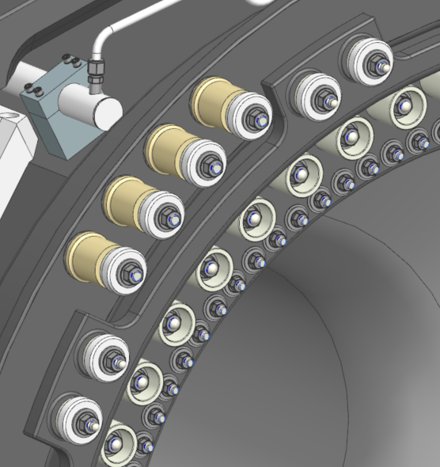
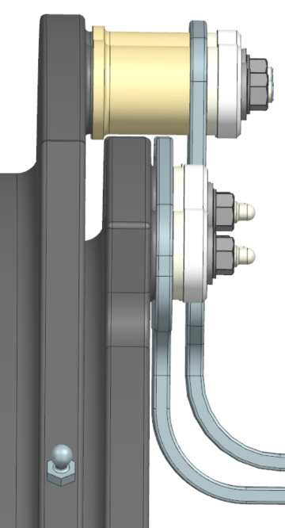
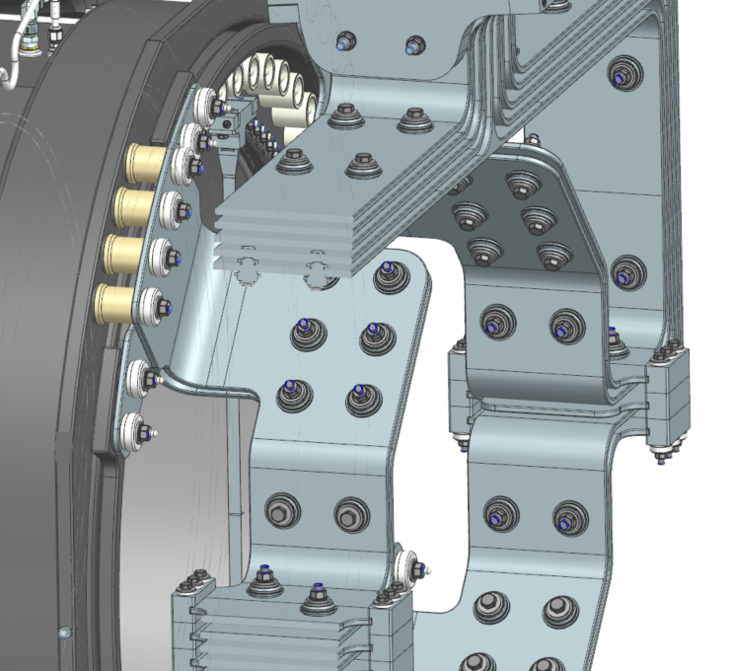
Stripline Terminals
Stripline terminals on B/C are identical, including connecting flanges and O.C. standoff spacers.
Some effort was required to package the terminals and not have the striplines turn inwards due to interaction with pions (separately studied & confirmed by John Back @ Oxford).
We retain same number of terminals per stripline with same geometry as A.

Slide 4
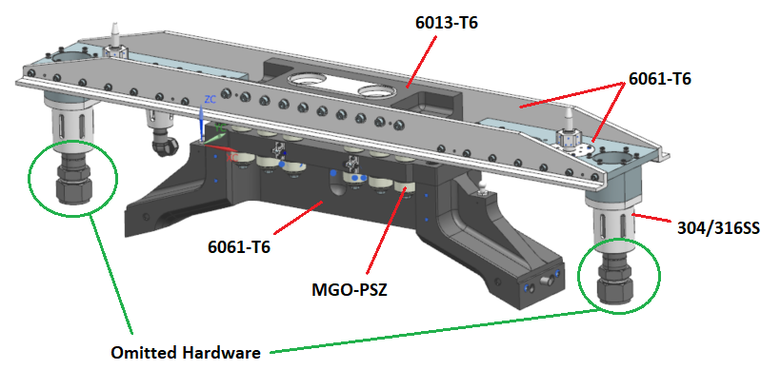
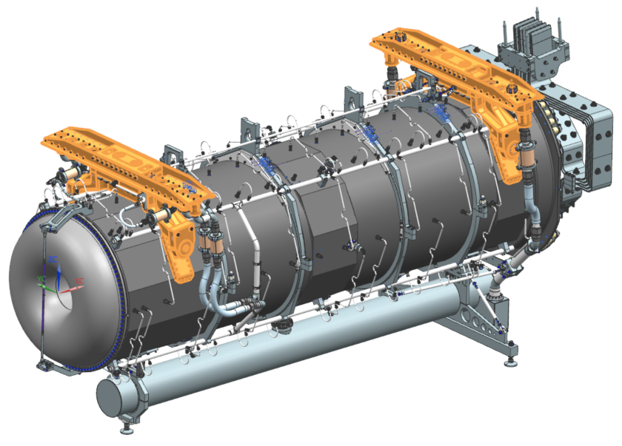
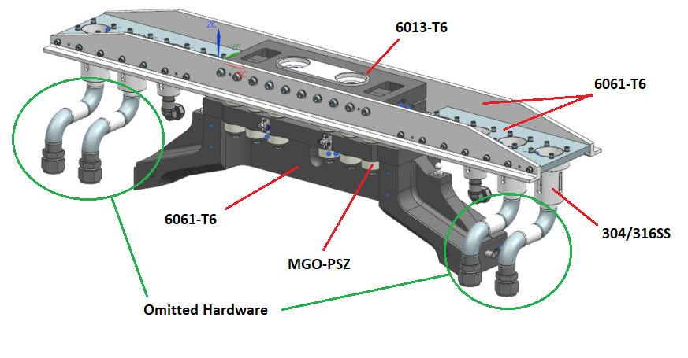
Hanger Main Beams
Hangers for B / C require large section modulus to support horn weight across span without bending.
“Middle ground” picked for pivot.
Horn too wide for location on side.
Horn too tall for putting on top.
Deflection Verified.

Slide 5
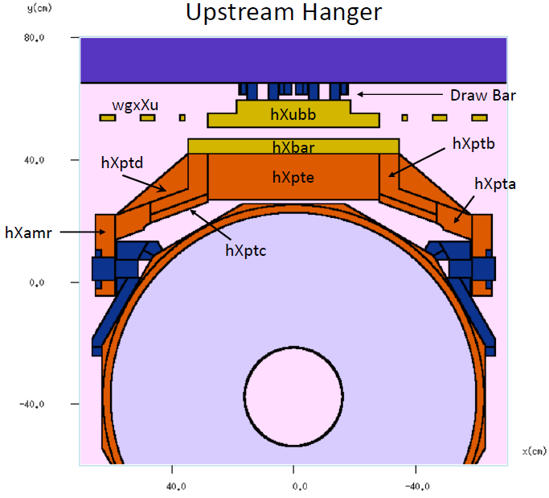
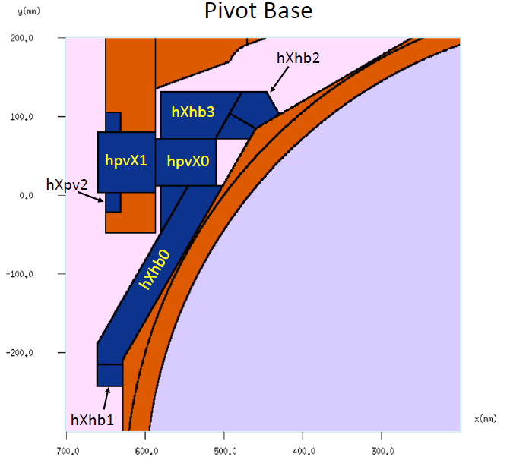
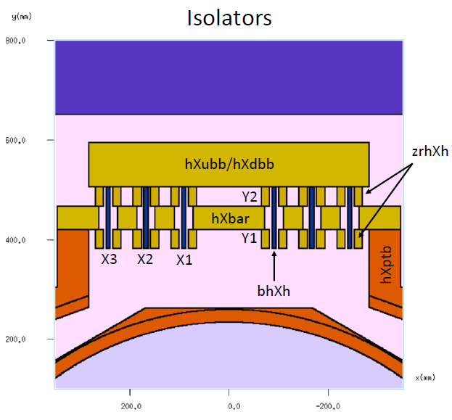
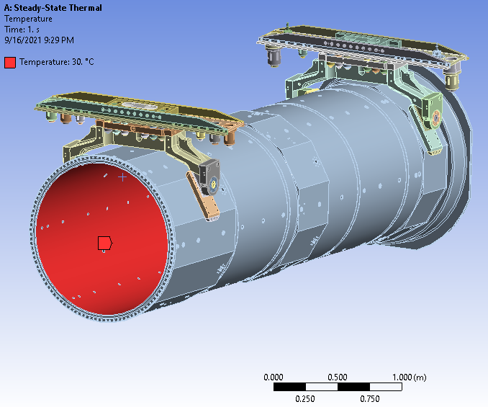
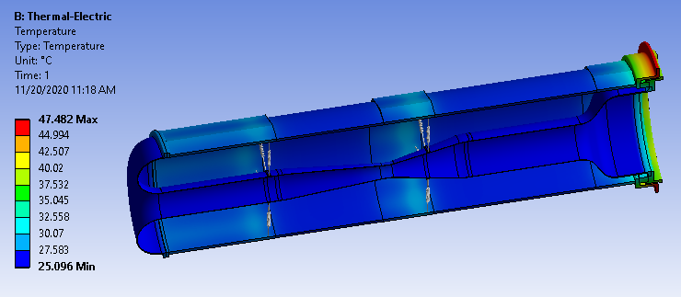
Hanger Main Beams

Slide 6
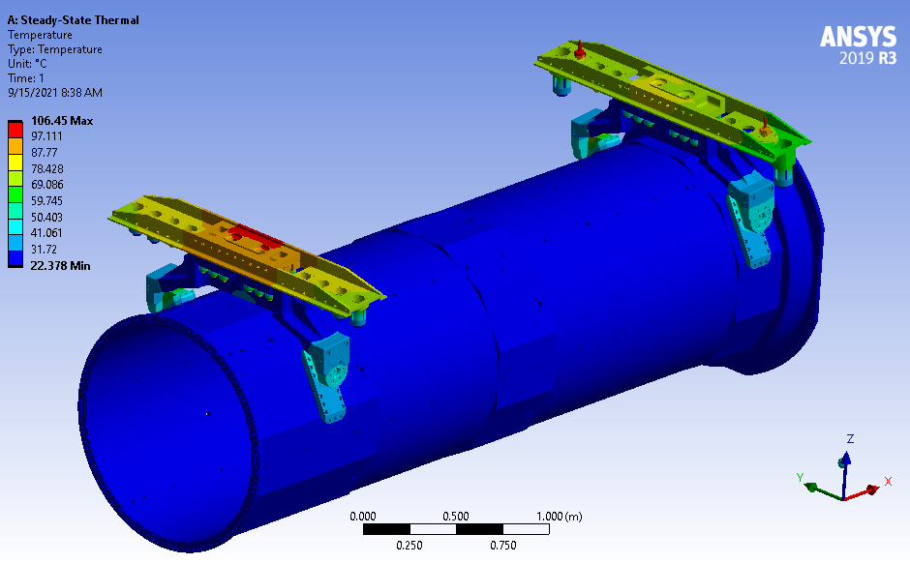
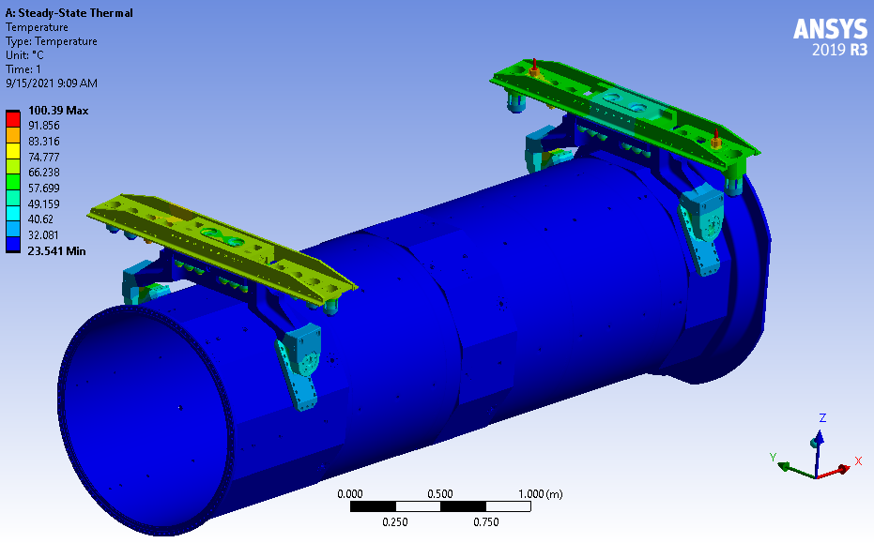
Hanger Main Beams
Drawbar cooling through attachment cups is crucial to avoiding creep on aluminum load path.
No cooling gets too hot (106C+) on 6013 block.
Drawbar cooling modeled as heat flux away from cup contact surfaces and has significant impact.
Only hot spots are encapsulated SS. utility spikes with no water cooling.
No issue with SS + ceramic TC’s.

Slide 7
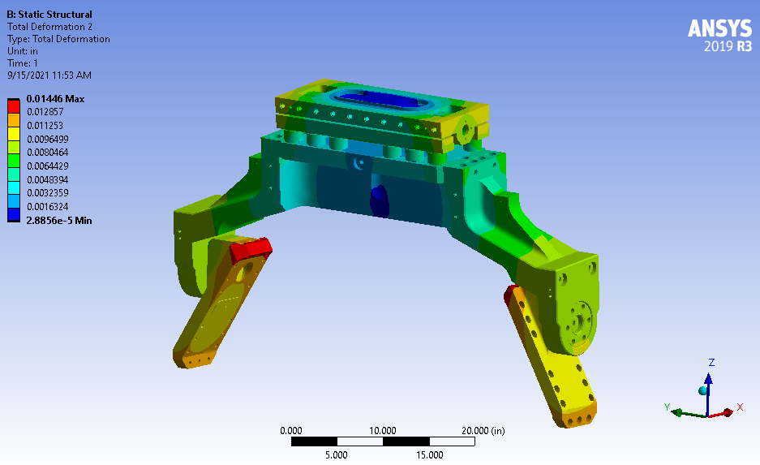
Hanger Main Beams
U.S. Hanger thermal expansion, all structural loads suppressed.
0.014” Less than alignment tolerance. All tracked by HLS / Hadron monitor.

Slide 8
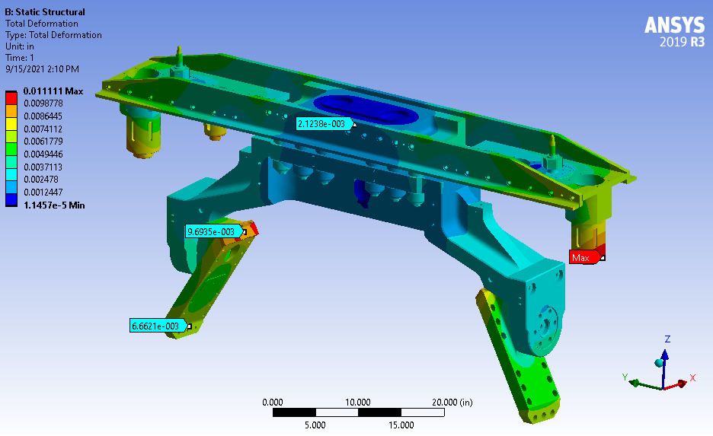
Hanger Main Beams
D.S. Hanger thermal expansion, all structural loads suppressed. .011” < .014”

Slide 9
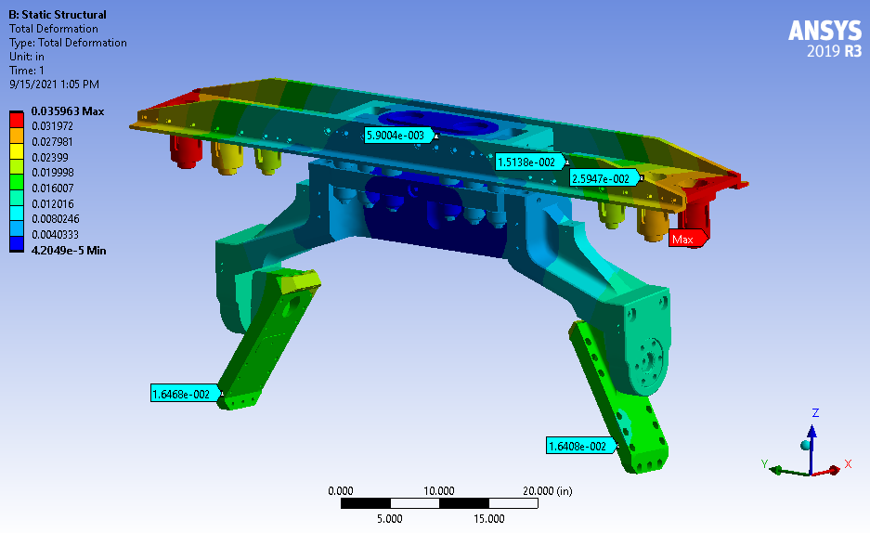
Hanger Main Beams
Maximum thermal + structural displacement, U.S. hanger.
Driven by utility line loads on utility plates.

Slide 10
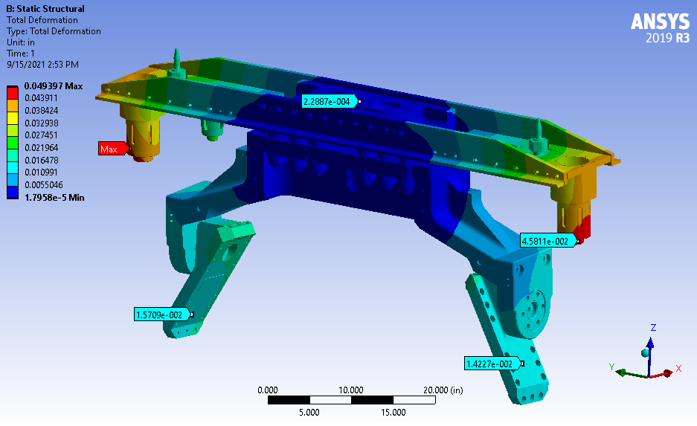
Hanger Main Beams
Maximum thermal + structural displacement, D.S. hanger.
Slightly less than Horn A since twin ejector lines don’t create force couple.

Slide 11
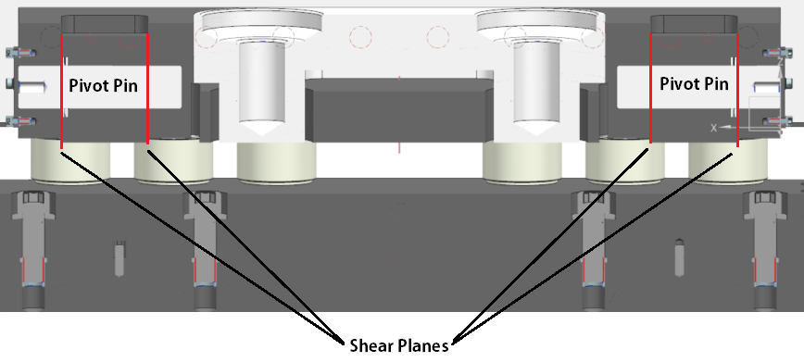
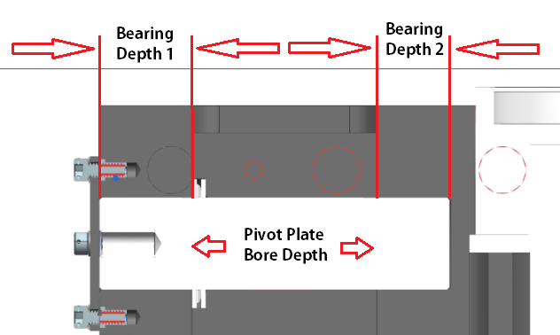
Hanger Plate Loading
Total Estimated Pivot Hanger Load, lbs (Horn B) | 4000.00
Pivot Pin Diameter, inches | 1.25
Pivot Pin Cross-Sectional Area | 1.23
Double Shear Area (per pin) | 2.45
Double Pins in double shear area (total area) | 4.91
Pivot Pin Yield Strength (410SS) | 40000
Total Shear Load Safety Factor on Pivot Pins | 28
Pivot Plate Bore Depth, inches | 2.50
Pivot Plate Section Width, inches | 0.75
Total Pivot Plate Block Tensile Loading area | 3.75
Total Pivot Hanger Load at Each Pivot Block, lbs | 2000
Tensile Stress at Pivot Block | 533.33
Pivot Block Yield Stength (6013-T6) | 52000
Total Tensile Area Safety Factor at Pivot Block | 98
Section Width, inches | 0.75
Bearing Area Depth 1, Inches | 1.25
Bearing Area Depth 2, Inches | 1.00
Total Pivot Hanger Load at Each Pivot Block, lbs | 2000
Total Tensile Area on Depth 1 | 1.88
Total Tensile Area on Depth 2 | 1.50
Total Tensile Load per Tensile Area, lbs | 1000
Tensile Stress at Tensile Plane 1 | 533.33
Tensile Stress at Tensile Plane 2 | 666.67
Pivot Block Yield Stength (6013-T6) | 52000
Total Tensile Area Safety Factor on Tensile Plane 1 | 97.50
Total Tensile Area Safety Factor on Tensile Plane 2 | 78

Slide 12
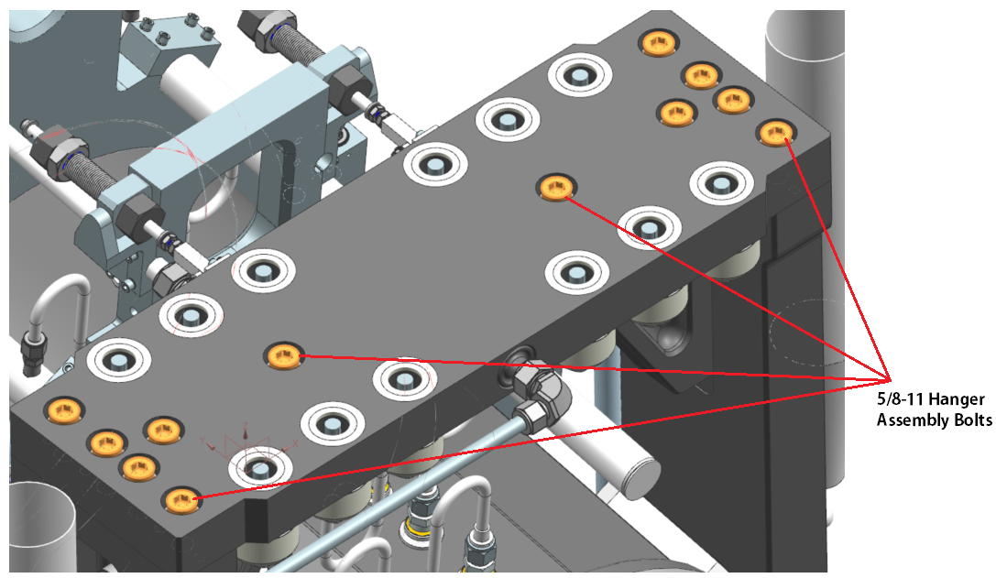
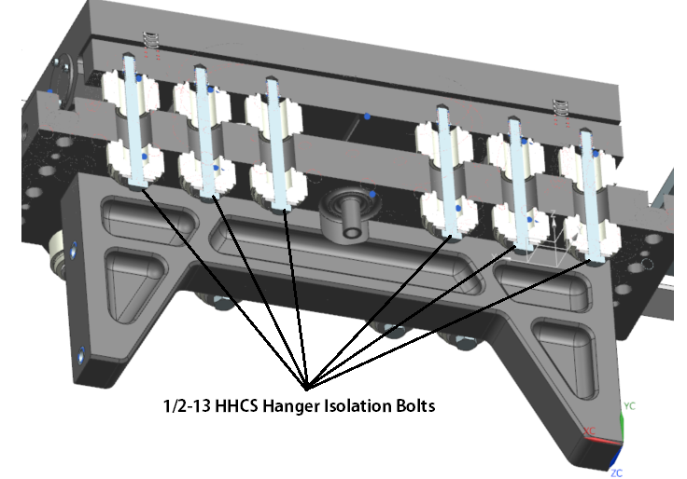
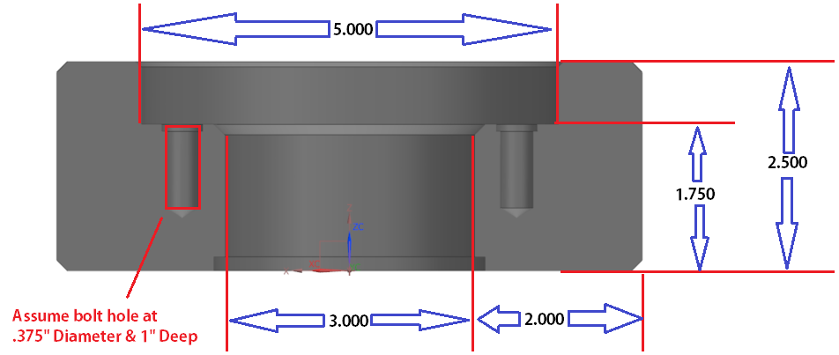
Hanger Plate Loading
Hanger Isolation Bolt Group Size, inches | 0.50
Isolation Bolt Group Minimum Tensile Diameter | 0.40
Tensile Area per Bolt | 0.12
Bolt Count | 12.00
Total Bolt Group Tensile Area | 1.48
Bolt Material Yield Strength (304SS) | 45000
Total Available Bolt Group Clamp Force | 66508
Hanger Isolation Bolt Group Safety Factor | 16.6
Hanger Assembly Bolt Group Size, inches | 0.625
Isolation Bolt Group Minimum Tensile Diameter | 0.5119
Tensile Area per Bolt | 0.205
Bolt Count | 12
Total Bolt Group Tensile Area | 2.469
Bolt Material Yield Strength (304SS) | 45000
Total Available Bolt Group Clamp Force | 111135.7
Hanger Assembly Bolt Group Safety Factor | 27.7
Minimum Hanger Cross-Sectional Area | 7.75
Hanger Leg Yield Strength (6061-T6) | 35000
Hanger Leg Individual Loading Crosscheck for Stripline offset force addition (2825lbs per ED0012923) | 2000
Hanger Leg Tensile Plane Stress | 258
Hanger Leg Tensile Plane Safety Factor | 135.6

Slide 13
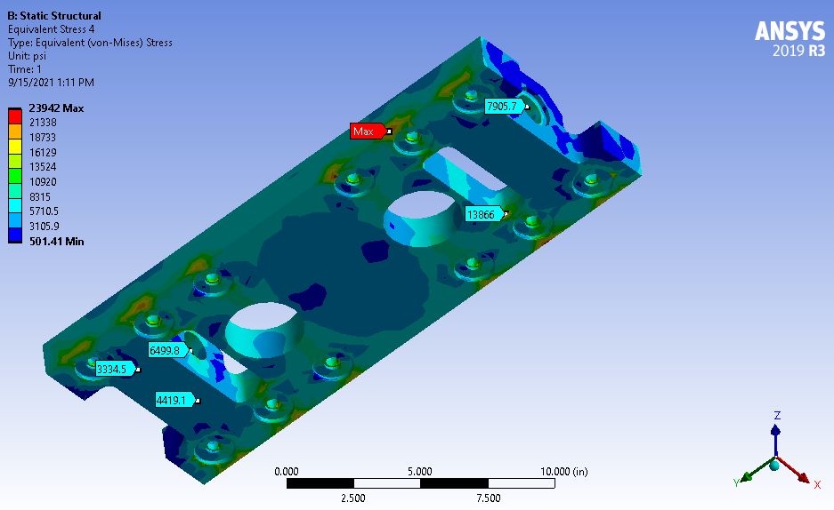
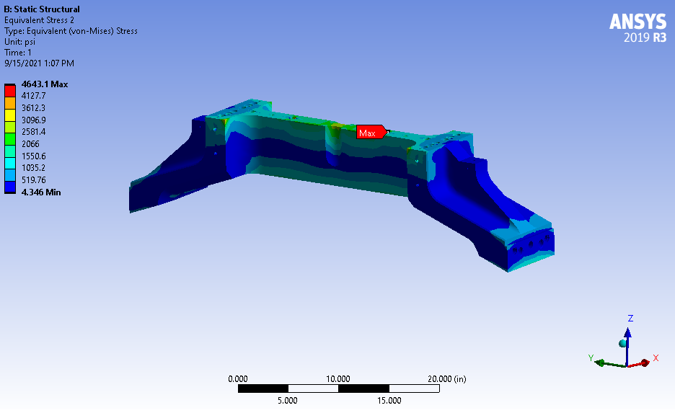
Hanger Main Beam FEA
Main beam spans are very rigid & have very low stress. Should help get horn motion back to module and not promote vibration.
Hanger plates also have low stress aside from over constrained ceramic interfaces with plate. Modeled as bonded instead of frictional and causing high point stresses on single node at corner.
Pin bores / webs well within S.F. 3+ for von mises criteria.

Slide 14
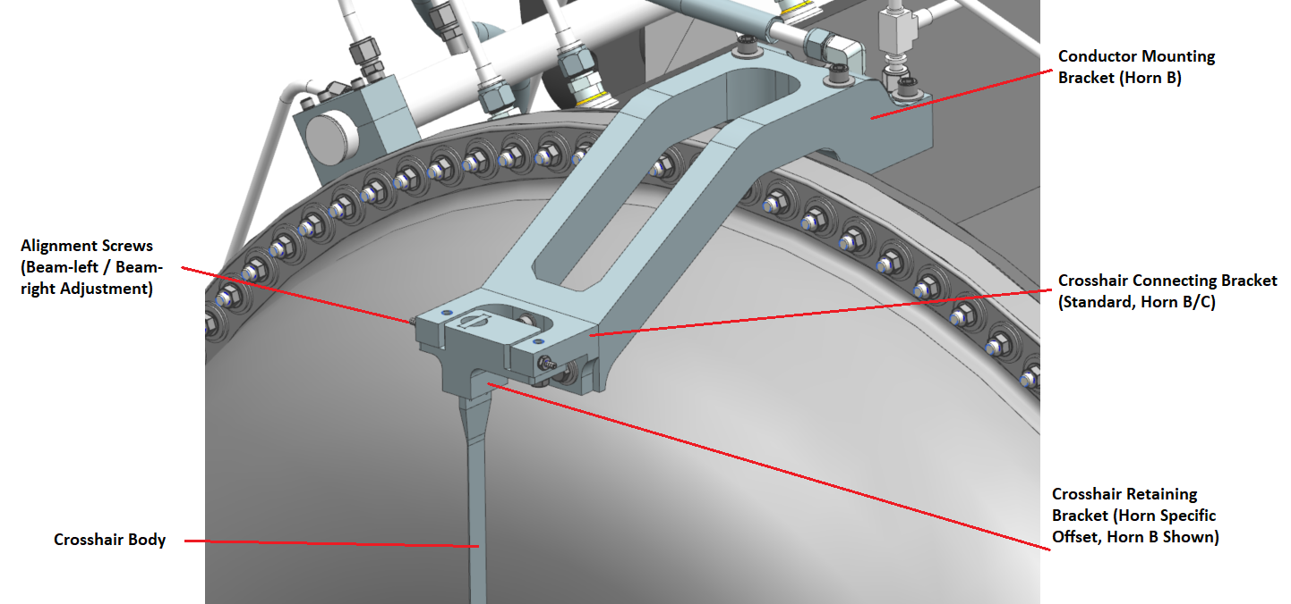
Crosshairs
Concept from NuMI, but sized for LBNF. NuMI flange mount brackets do not lend themselves well to large transition bells and flange diameters.
Stayed away from prying force; chose offset cantilever from O.C. facet face.

Slide 15
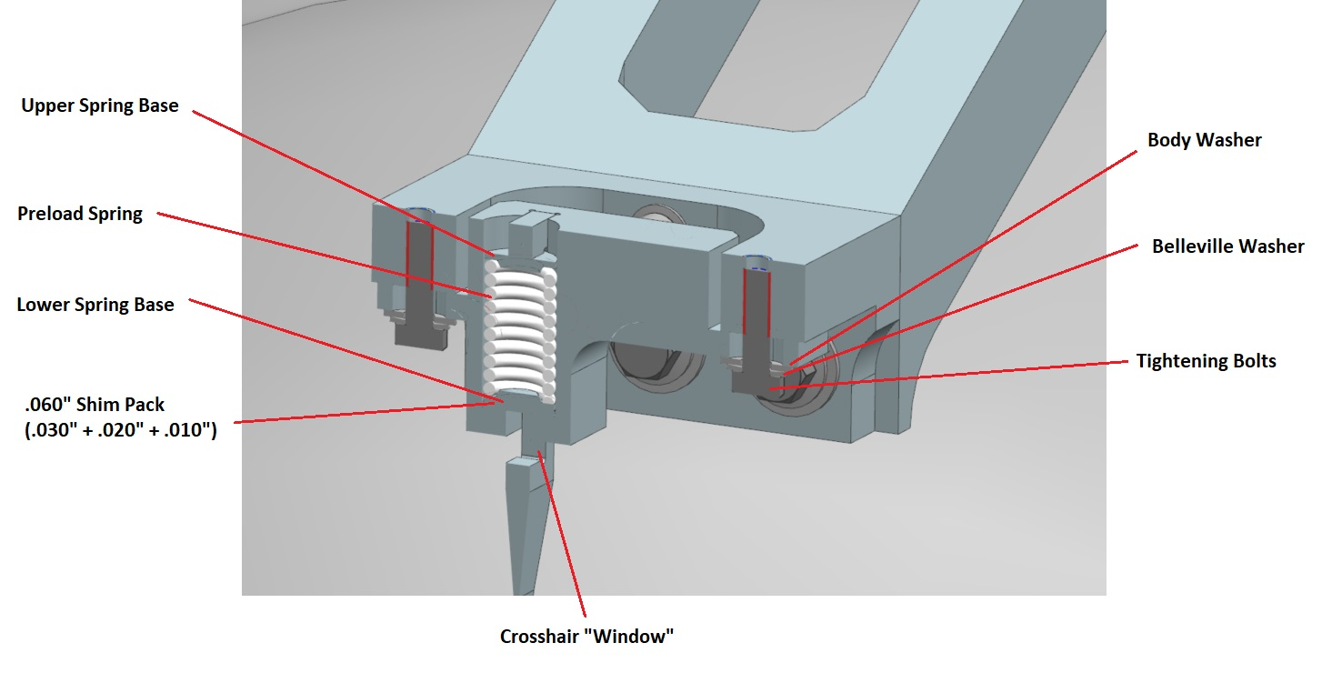
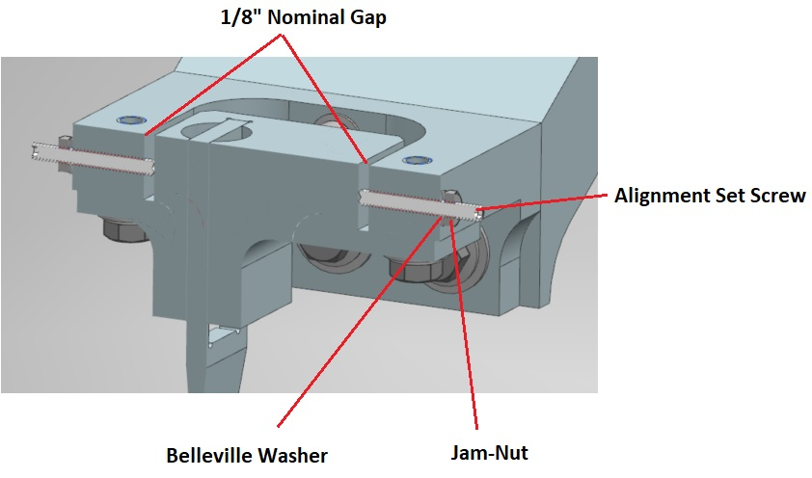
Crosshairs
Crosshair brackets allow for precision BL / BR sweep with integrated alignment screws. Travel +/- 1/8” for final alignment adjustment.
Vertical position altered by shim stacks per NuMI practice. Travel +/- 1/16” for final alignment adjustment.
Main bracket deflection + thermal loading + spring rate on 1m+ long crosshair did not lend design to re-use of belleville washer spring pack concept.
Needed a SS compression spring to provide continued preload at 1-2mm+ deflections anticipated.

Slide 16
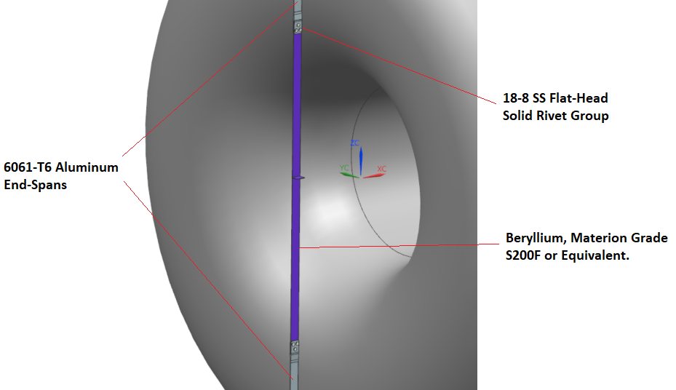
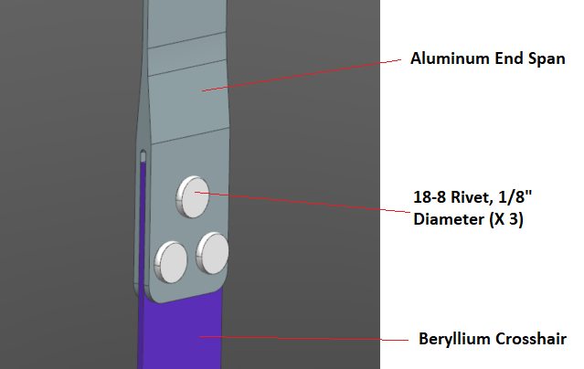
Crosshairs
U.S. Horn B crosshair was most problematic for steady state operations. EDEP put AL crosshair well above creep threshold.
Catastrophic failure unlikely but would slowly loose preload (and likely) correct reference position.
Entire beryllium crosshair pursued, but not feasible (250k-1M+). Materion did not want to quote. Limit of 24” in length was advertised + budgetary quote.
Use 6061-T6 end spans + S200F center. Rivet together (no brazing / welding).

Slide 17
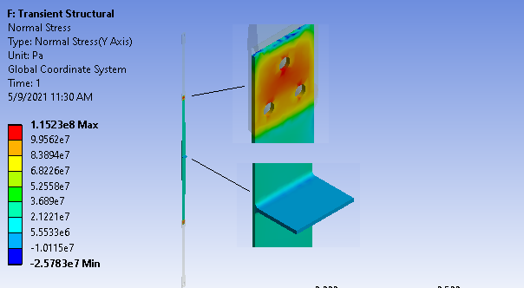
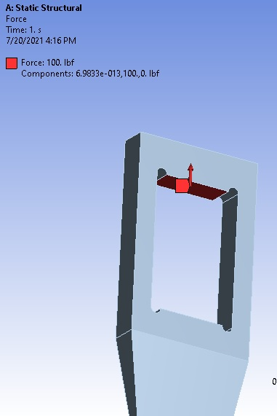
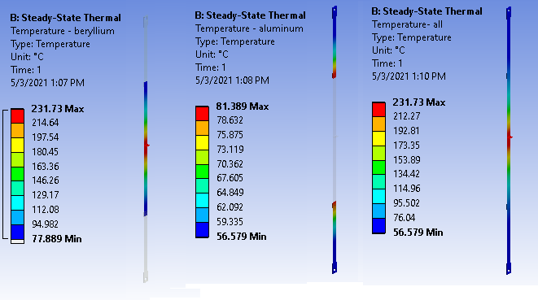
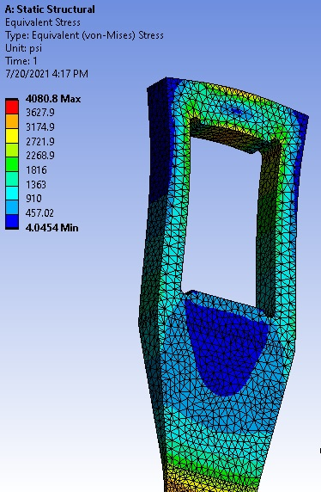
Crosshair Details: FEA
Credit: Z. Tang.

Slide 18
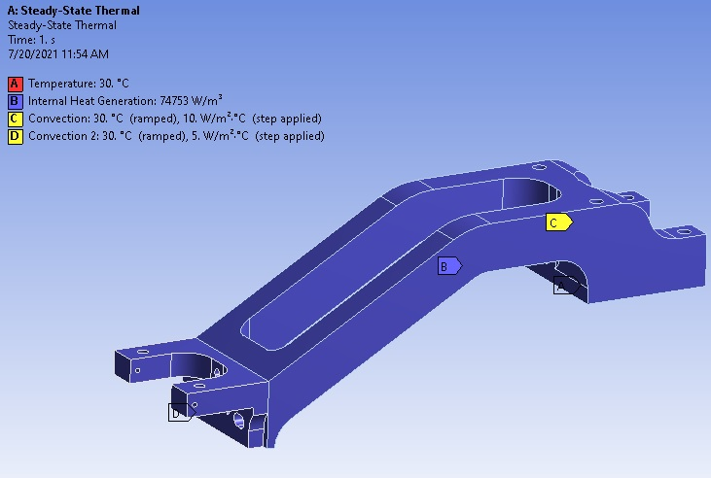
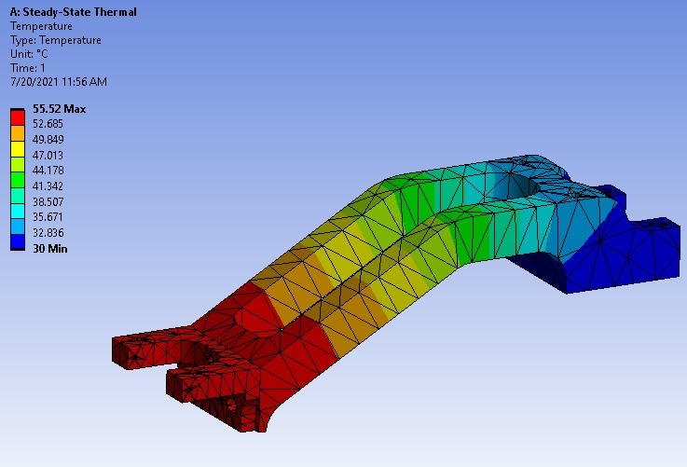
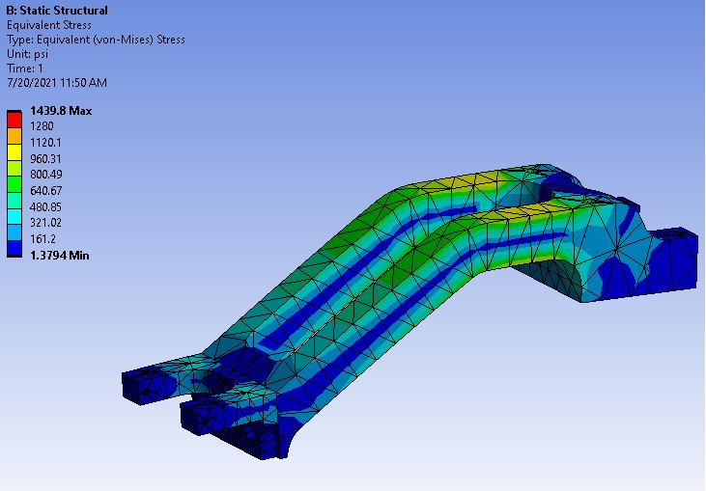
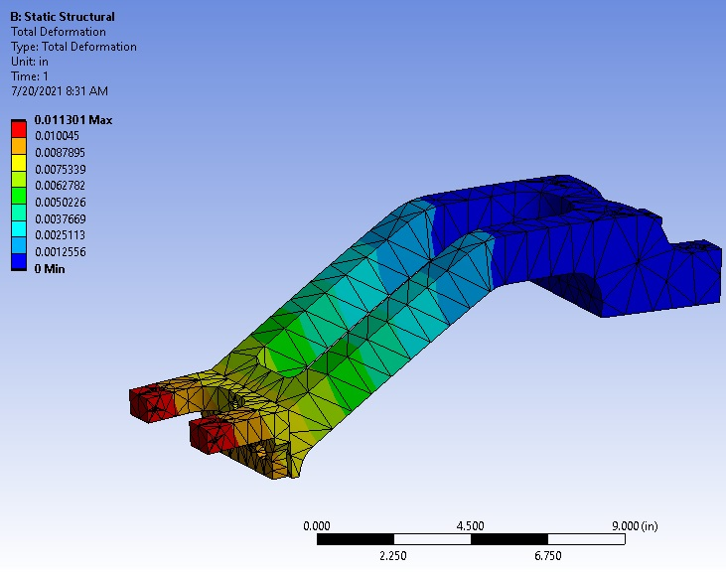
Crosshair Support Bracket FEA

Slide 19
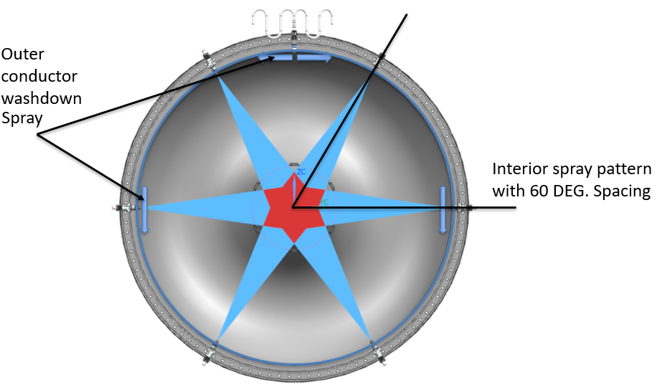
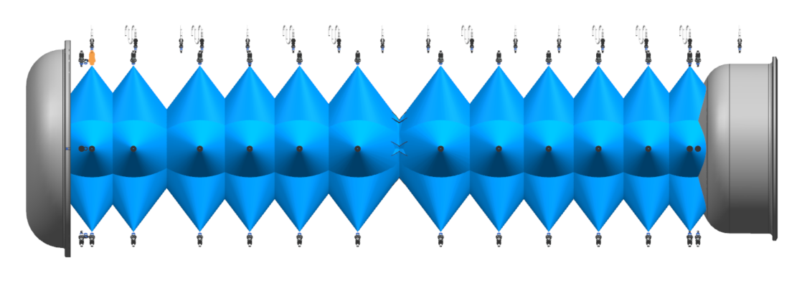
Water Manifolds / Ejector System
Horn B / C approach to conductor cooling is 4 main manifolds supplying 6 sets of nozzles for I.C.
Provides 100% conductor coverage in active spray pattern.
Provides circuit redundancy in event of leak. 75% could remain.
O.C. Still fed from top nozzle line.
Credit:
N. Agbo.

Slide 20
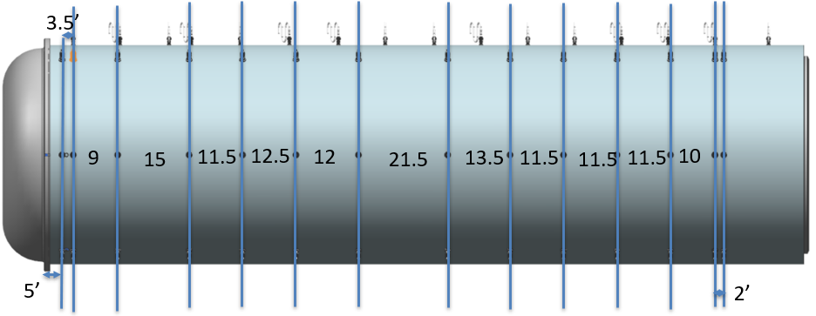
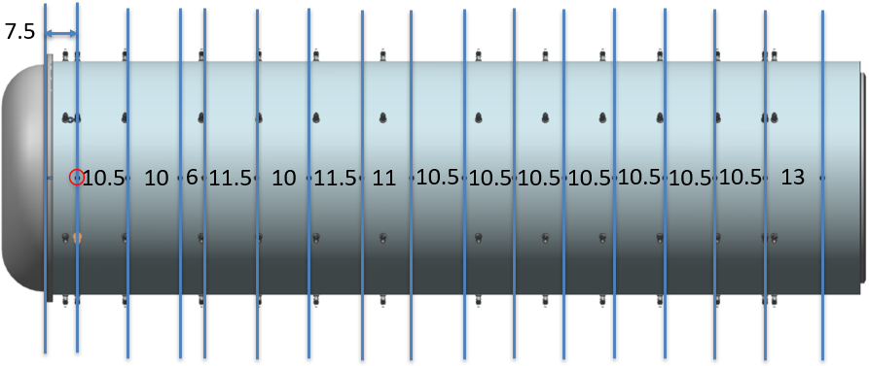
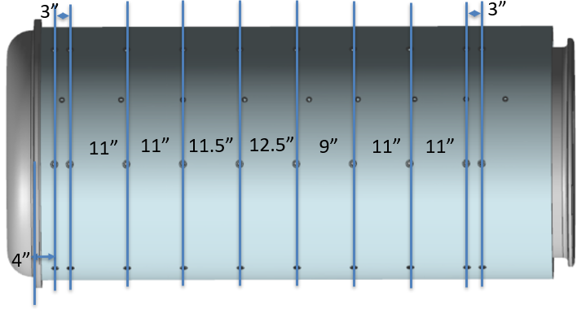
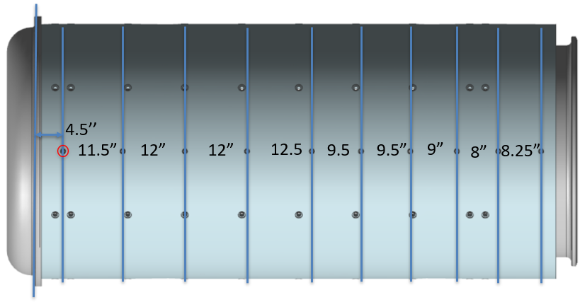
Water Manifolds / Ejector System
Credit: N. Agbo.
Horns B & C each went through successive nozzle placement studies.
Locations defined that achieved 100% coverage while capping flow to original top-line estimates given to RAW group.

Slide 21
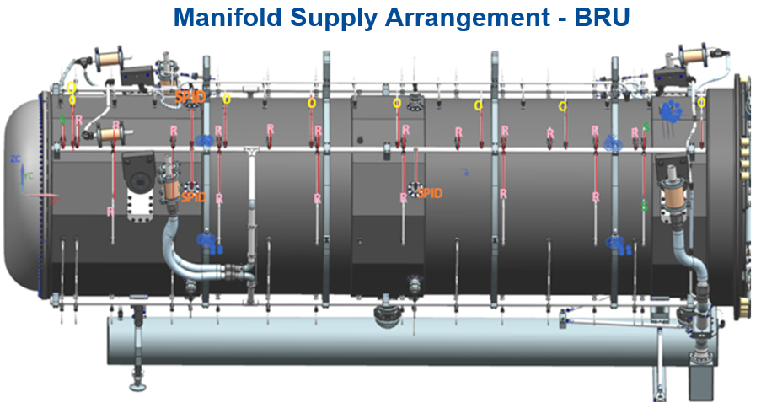
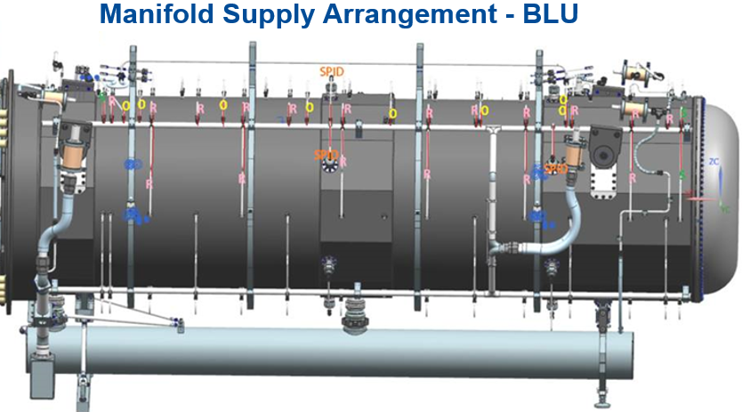
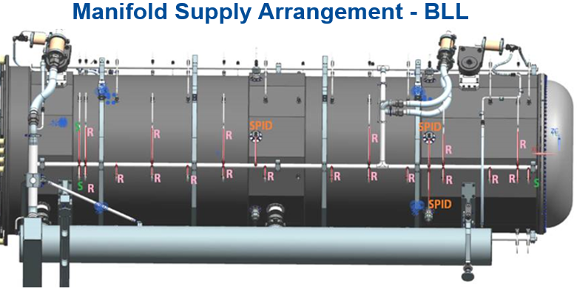
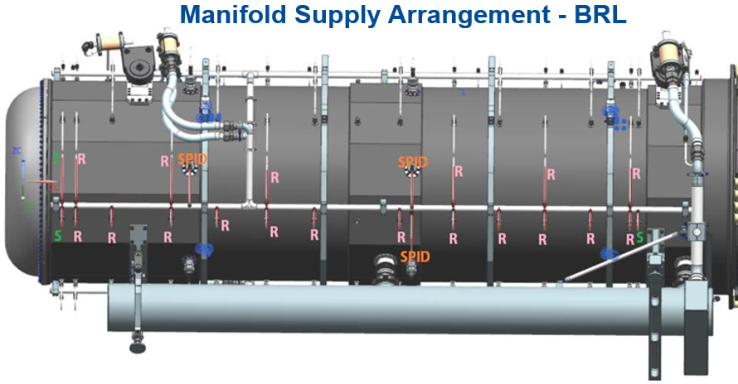
Water Manifolds / Ejector System

Slide 22
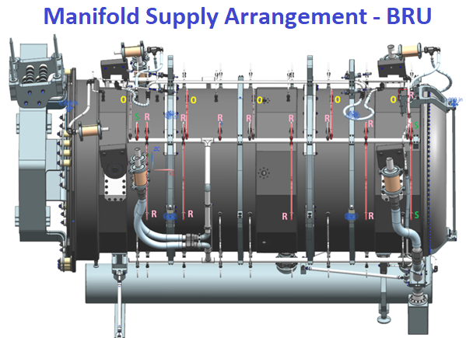
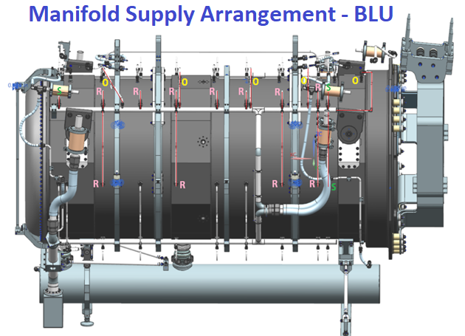
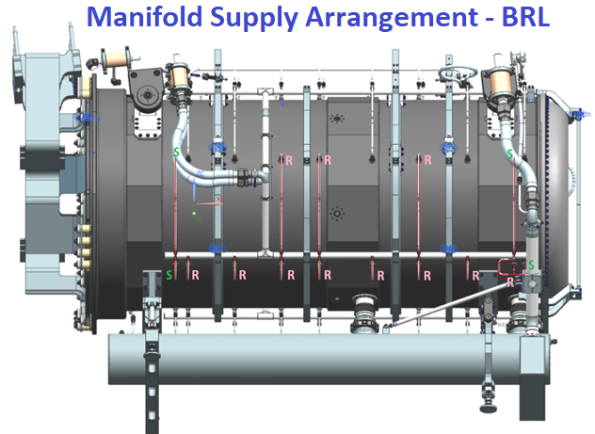
Water Manifolds / Ejector System

Slide 23
Water Manifolds / Ejector System
Horn B nozzle listing & flow table
Manifolds | 1/8HH-316SS5 (*0.95GPM) | 1/8TEK-316SS5 (*1.0GPM) | Spider Support (*0.5GPM) | F10146832 (*1.5GPM) | Total Flow Per Manifold (GPM)
BRU | 18 | 3 | 3 | 8 | 33.6
BLU | 18 | 3 | 3 | 8 | 33.6
BRL | 18 | 3 | 3 | 0 | 21.6
BLL | 18 | 3 | 3 | 0 | 21.6
Horn C nozzle listing & flow table
Manifolds | 1/8HH-316SS5 (*0.95GPM) | 1/8TEK-316SS5 (*1.0GPM) | F10146832 (*1.5GPM) | Total Flow Per Manifold (GPM)
BRU | 12 | 3 | 7.5 | 21.9
BLU | 12 | 3 | 7.5 | 21.9
BRL | 12 | 3 | 0 | 14.4
BLL | 12 | 3 | 0 | 14.4

Slide 24
Water Manifolds / Ejector System
Hanger drain lines for B & C are unique due to length and differing electrical isolation requirements as compared to Horn A.
Drain assembly alone represents 21 different components, fashioned into 10’+ line to route around horn and get back to water tank + isolate voltage.

Slide 25
Water Manifolds / Ejector System

Slide 26
Water Tank Unique Components
Long ejector stalks were vibration concern; taking stress back to aluminum flange weldment as a moment.
Triangulation back to tank was added and made to work for both orientations.

Slide 27
Horn B Spider Supports
Horn B has 2 groups of 6 spider supports at roughly 1/3rd & 3/5ths total span length.
Spiders have ability to pull horn ~.020” into straightness if needed. FEA shows “backwards” approach (apply force to conductor and see how much is bends).
Displacement is 4 orders of magnitude less than conductor scale, so accurate enough to estimate true ability to straighten a bent horn.

Slide 28
Horn C Spider Supports
Spider supports were added to Horn C in first iteration.
Subsequent FEA studies to determine useable offset force indicated they are superfluous; unable to appreciably bend the Horn C conductor into shape.
Limited by thin wall structure for cylindricity concerns (can only pull so hard).
Geometry is difficult to fight due to large diameters = Large moment of inertia.
Horn C needs to come off CNC welder with no expectation of correction.

Slide 29
Horn B / C Lift Clamps
Maximum lift clamp loading will occur on D.S. most clamp, (RC), with a total reaction force equivalent of 6500lbs.
Horn C weight is on order 6500-7000lbs (model properties still being populated), and so it is assumed any lift scenario for C is covered under analysis completed for B.
Lifting fixture design is handled by RH and note generation for BTH lifting fixture will be completed by RH WBS.
Our clamps are considered permanent part of “workpiece” and so must simply meet AISC 2017 equivalency.

Slide 30
Horn B / C Lift Clamps

Slide 31
Horn B / C Lift Clamps

Slide 32
Summary
Designs completed are scaled up from Horn A or borrowed in part from NuMI.
Spider Support system temperatures & deflection is well understood.
Basic yield strength & deflection calculations are backed up by FEA for all critical elements, often reducing the theoretical value.
S.F. for all elements still surpasses S.F. 1.7 / AISC 2017 equivalent.
Per FESHM code, lifting lugs are permanent part of workpiece and do not need to meet documentation requirements of BTH fixtures (though are structurally sufficient).
Propagation of spider supports was necessary for Horn B.
Keep conductor cylindricity within .005”
Move conductor .020”+ to account for welded straightness tolerance.
Horn C does not have apparent advantage of spider support installations.
Questions?

