Slide 1
Neutrino Beamline Horns B and C Preliminary Design Review
Horns B & C Fabrication Plans
Meredith Lee
3 December 2021

Slide 2
Agenda
Weld Progress and Plans
Welding Machine Expansion
Inner Conductor Nickel Plating Fixture
Outer Conductor Anodizing Fixture
Horn Flipping Fixture Configurations
TSIB Layout and Lift Plan
Fabrication Procedures
Summary

Slide 3
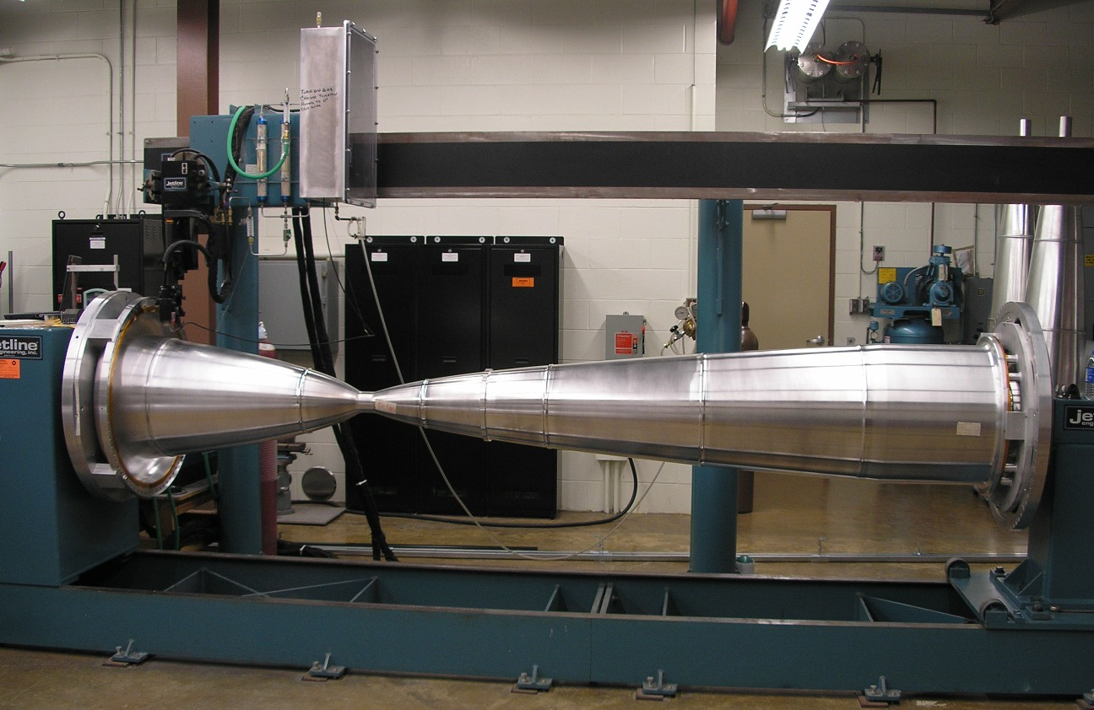
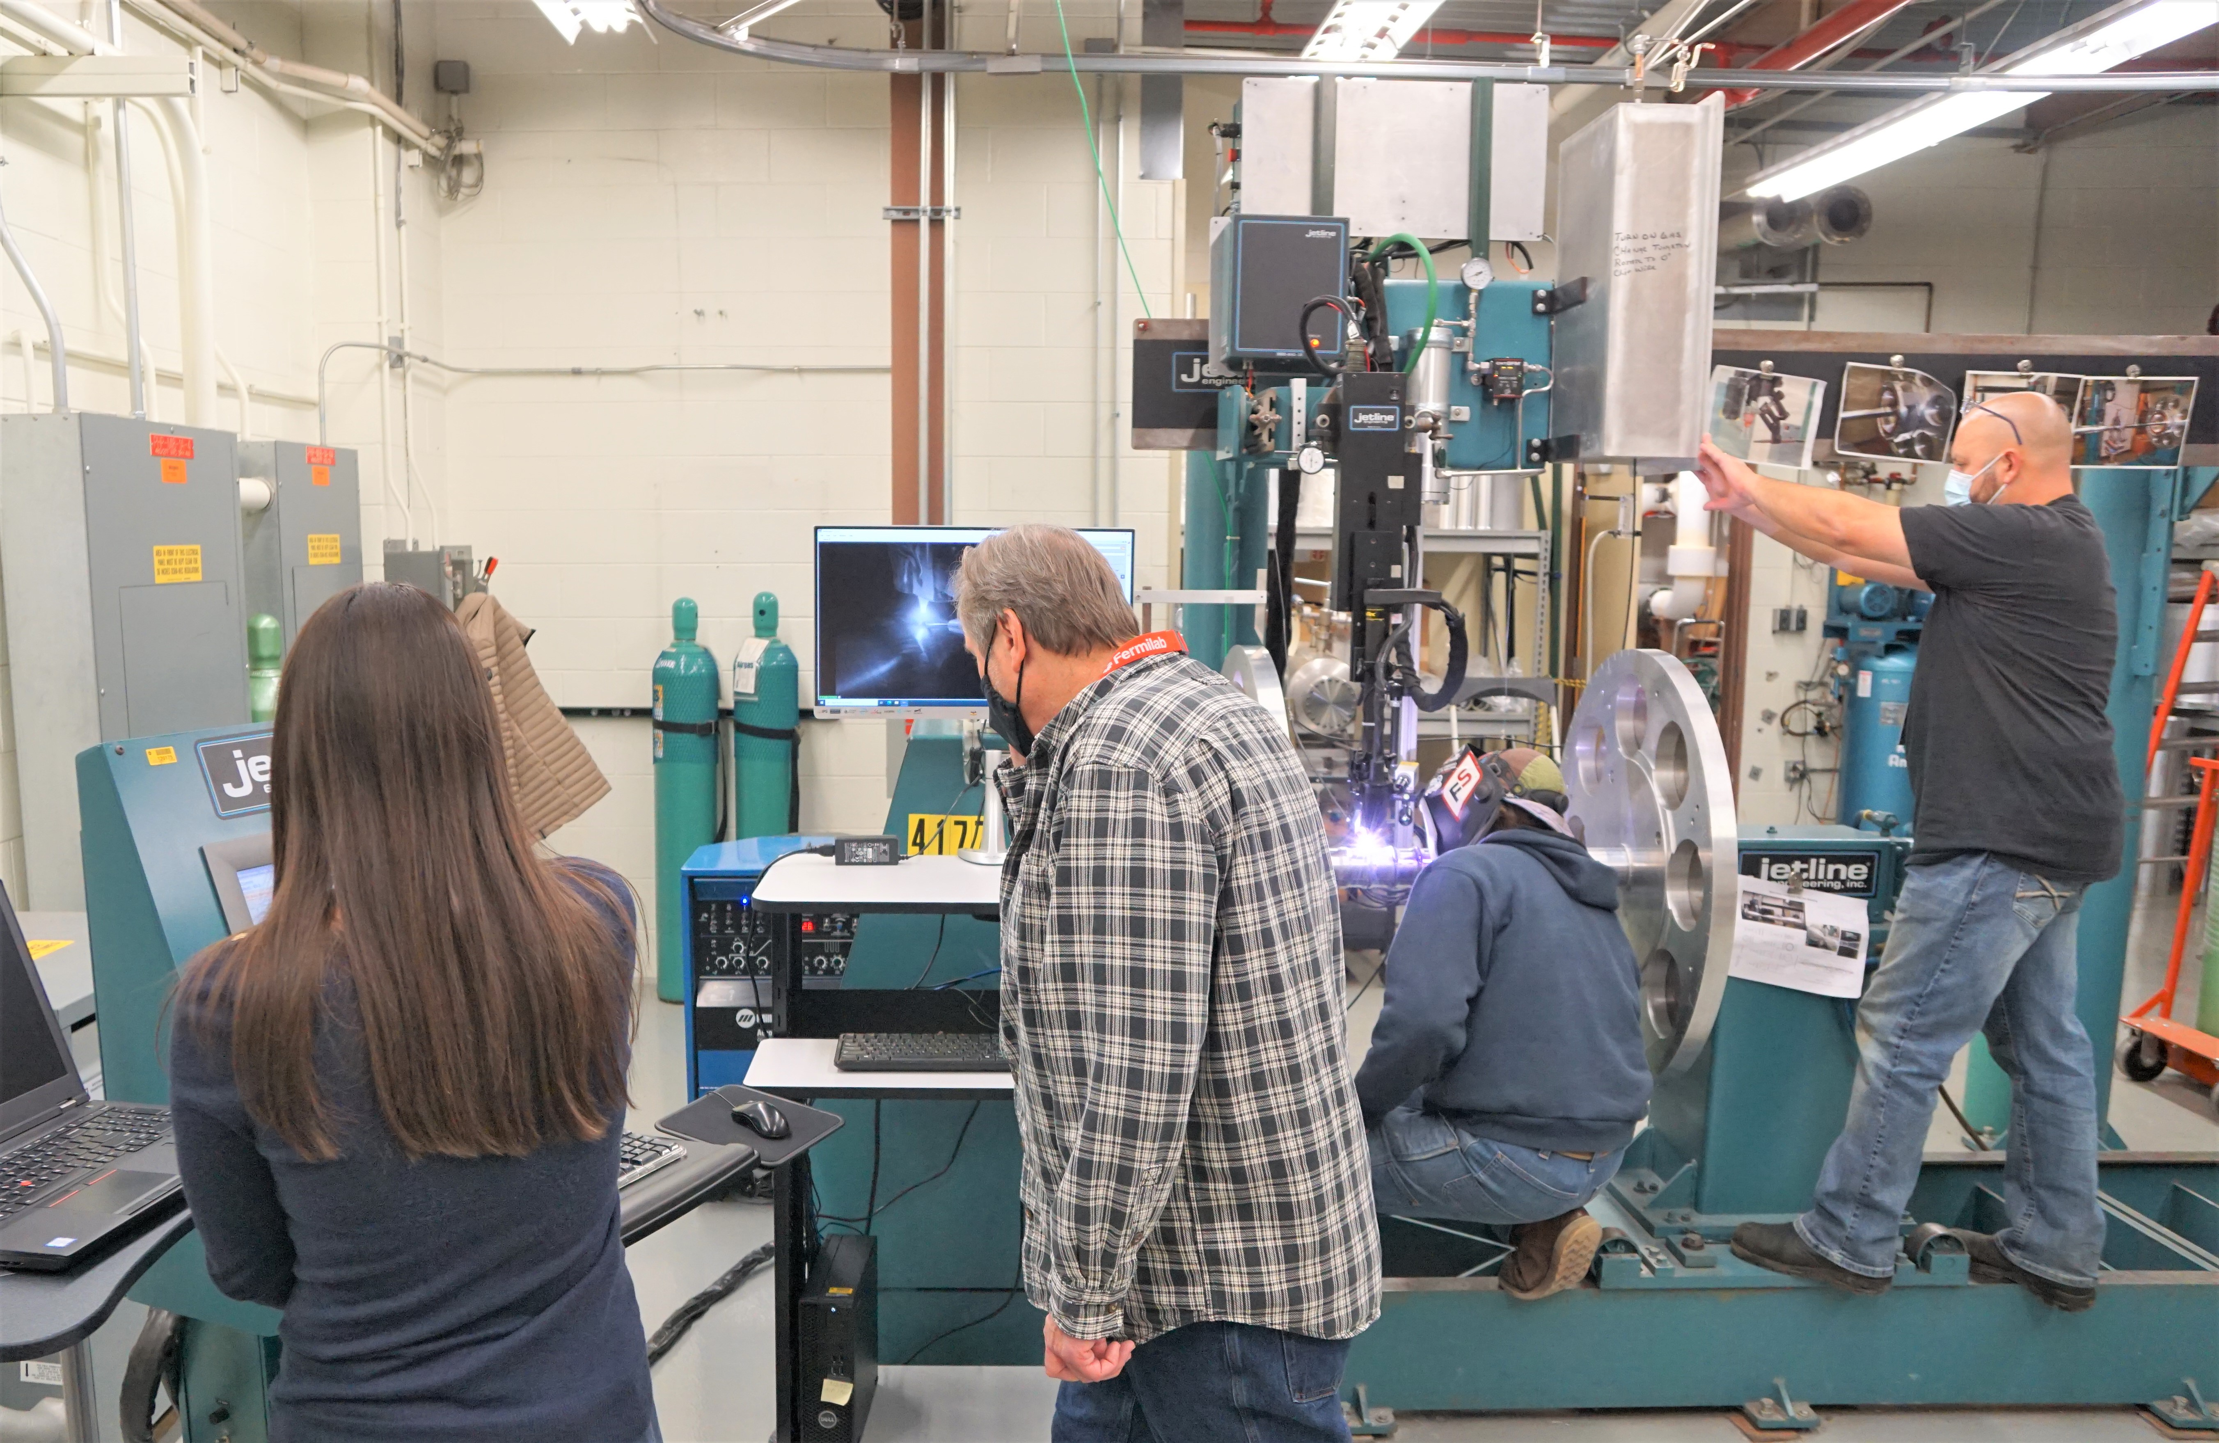
Weld Progress and Plans – Overview
Jetline CNC circumferential welding machine
Used to weld NuMI horn inner conductors
Welding inner conductor sample parts since August 2021
Refine weld routines prior to welding LBNF horn inner conductors
Achieve clean welds with 100% penetration
X-ray and certify to NAS 1514 Class 1
NuMI horn 2 inner conductor on welding machine
Welding Team: Meredith Lee, Kris Anderson, Austin Fletcher, Jaime Sanchez, and Cory Crowley

Slide 4
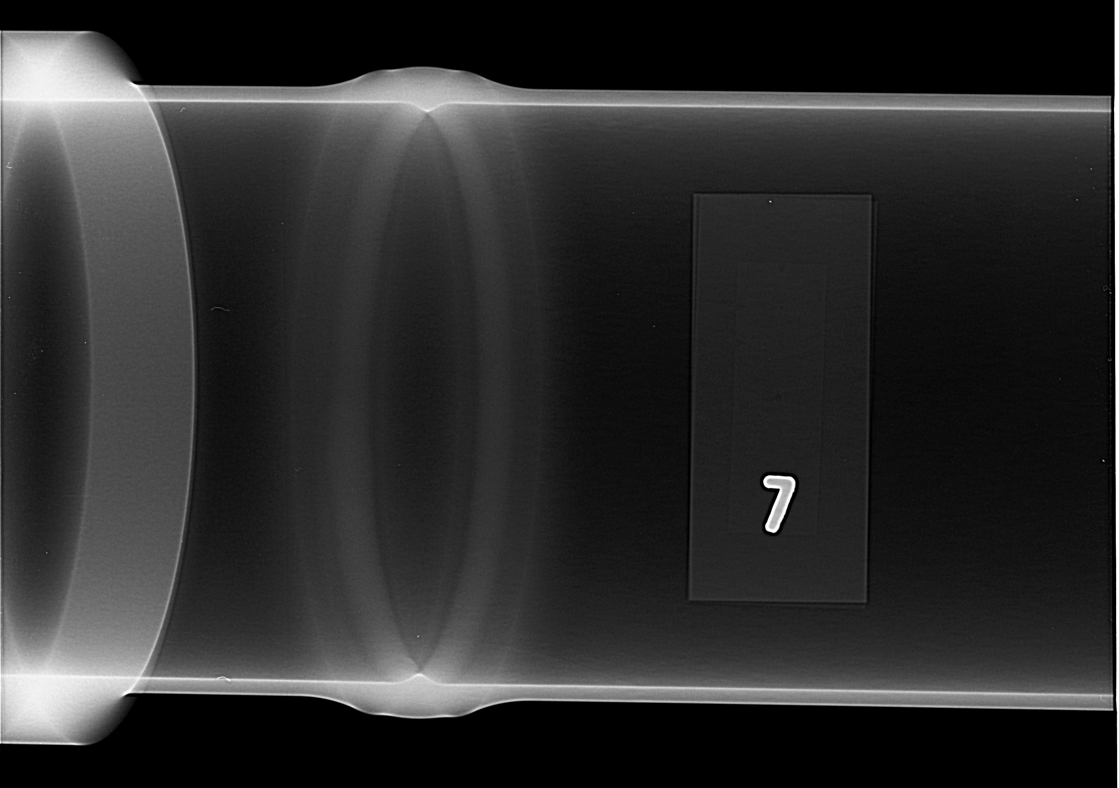
Weld Progress and Plans – Results
Finalized routine parameters for Horn A welds
Clean, 100% penetration welds with crown
Final samples X-rayed and certified to NAS 1514 Class 1
Horn A 3.380” Diameter Sample
Horn A 3.780” Diameter Sample X-ray
Horn A 3.780” Diameter Sample

Slide 5
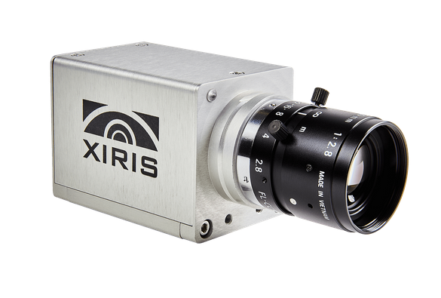
Weld Progress and Plans – QA Documentation
Xiris monochrome weld camera installed to capture videos
Positioned to allow monitoring of weld puddle, tungsten, and wire
Videos conducive to troubleshooting and routine modifications

Slide 6
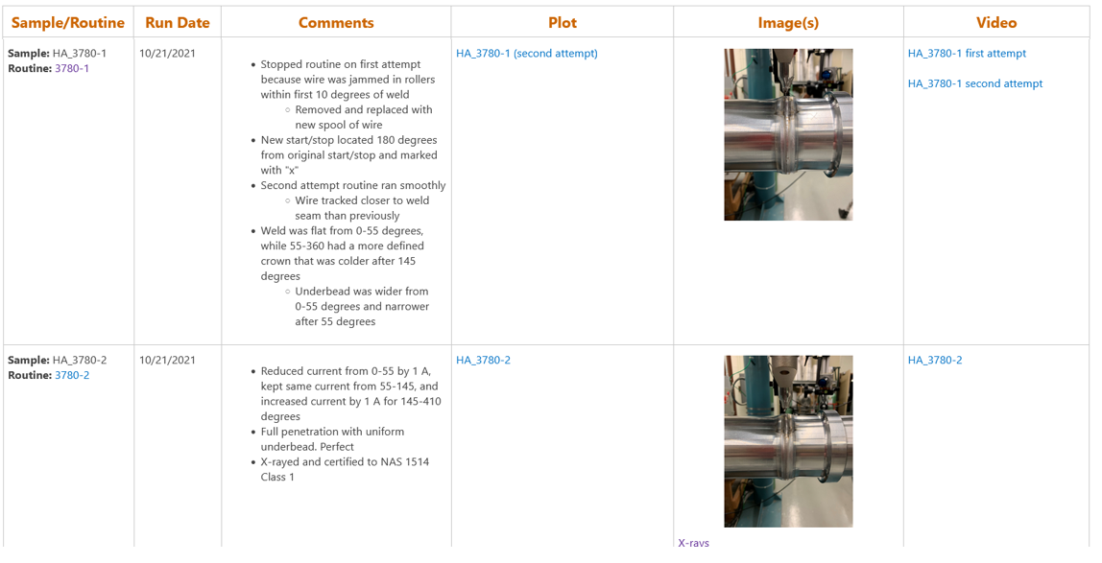
Weld Progress and Plans – QA Documentation
Dedicated SharePoint page contains information for each sample run:
Routine used
Run date
Comments
Plots
Image(s)
Video

Slide 7
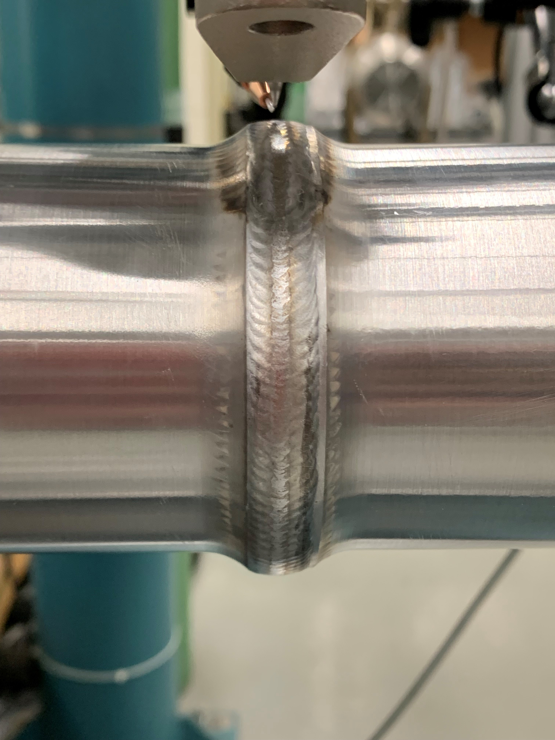
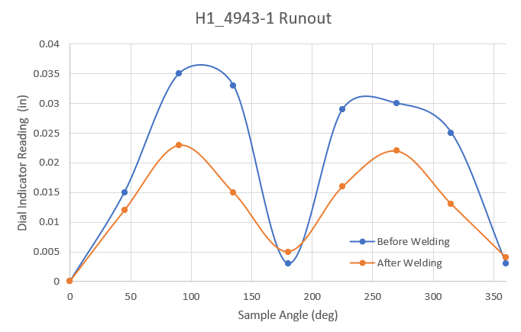
Weld Progress and Plans – Other Capabilities
Routines for missed underbead
Cosmetic overpass routines using mag arc oscillator
Straightening routines to correct runout
DC Cosmetic Overpass Routine – NuMI sample
DC Cosmetic Overpass – NuMI sample

Slide 8
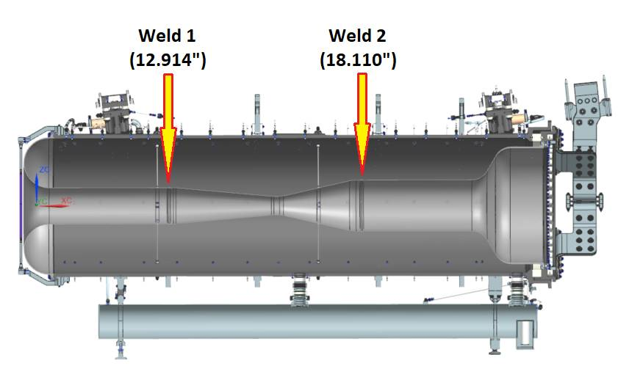
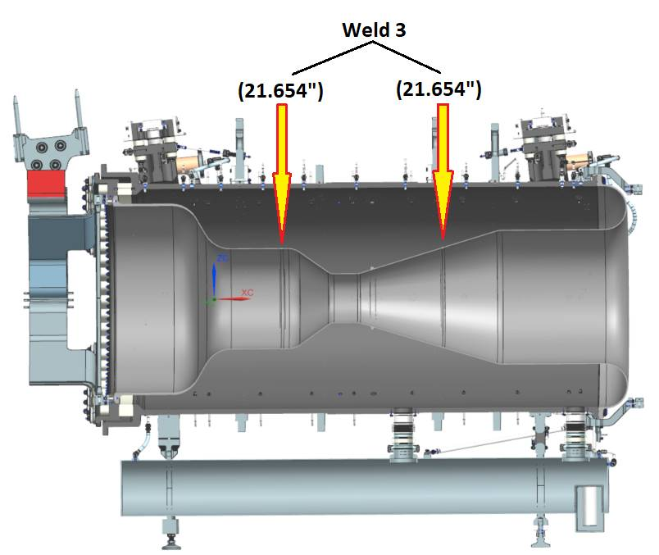
Weld Progress and Plans
Horn B and Horn C inner conductors both consist of 2 welds
Requires weld samples for 3 different diameters
Horn B Weld Diameters and Locations
Horn C Weld Diameters and Locations

Slide 9
Weld Progress and Plans
Program testing and troubleshooting will use a multi-ring sample
Either forged or machined from Al round stock
Multi-ring sample for each weld diameter
Rings spaced closely together: initial routine tests and modifications
Rings spaced moderately apart: near final-stage routine version
Rings spaced far apart: final routine version
Initial routine version test welds
Routine troubleshooting
Near final version test welds
Final version welds

Slide 10
Weld Progress and Plans
Sample sets will be used for final welds prior to horn welds
Two sets of samples for each diameter
Each sample half contains step in and step out
Allows each sample set to be used for two welds
Four total sample welds
1. Complete first weld
2. Cut out weld
3. Weld ends together

Slide 11
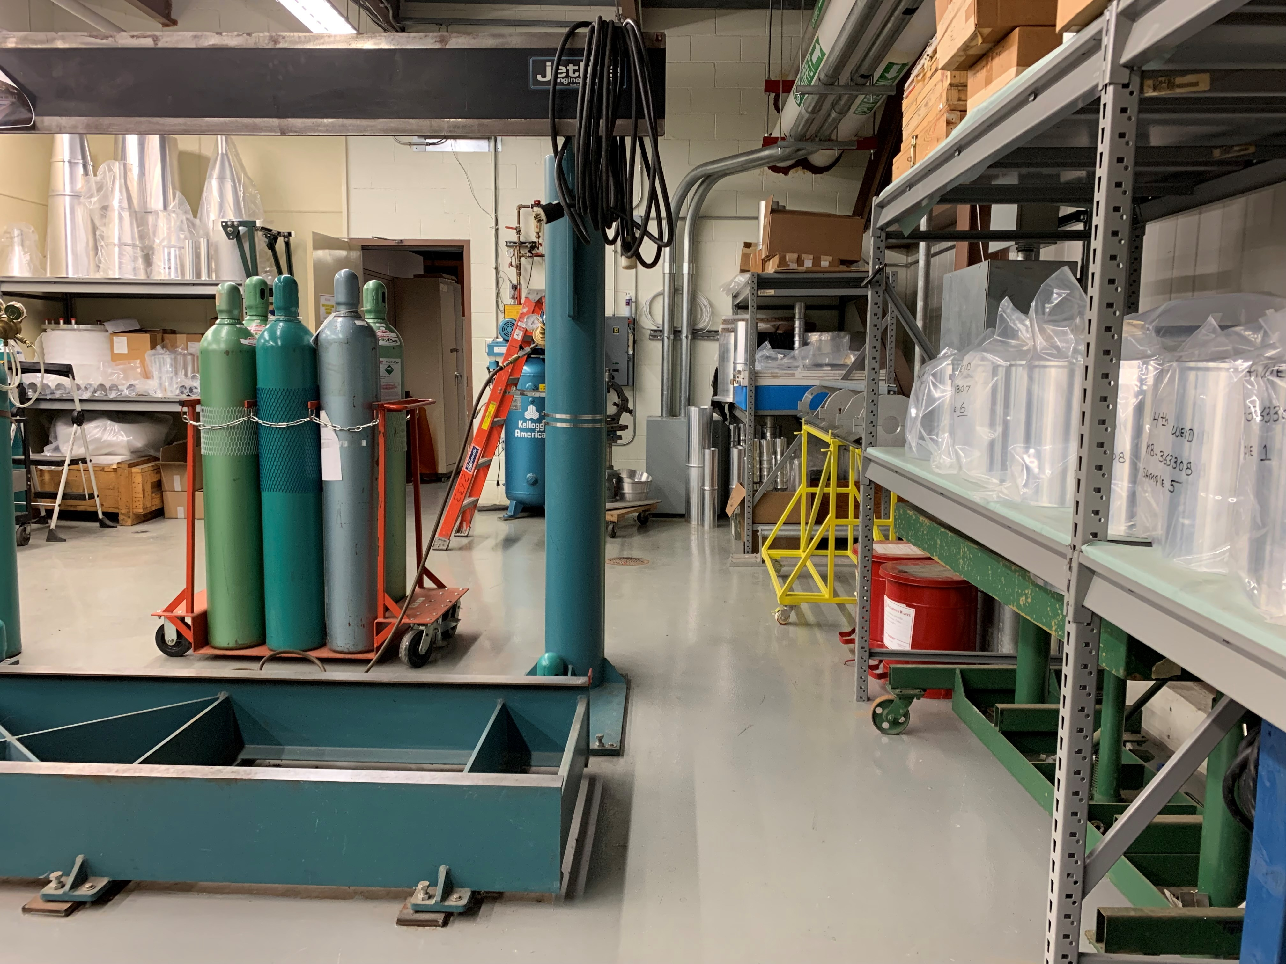
Welding Machine Expansion
Floor rails need to be extended to allow tailstock to accommodate Horn B length
New section will be fabricated and attached to existing rail
Upper rail will not need extension
Welding machine rail extension

Slide 12
Inner Conductor Nickel Plating Fixture
Nickel plating fixture for Horns B & C constrained by process tank size
Cannot exceed length of Horn B
Cannot exceed 58” width
Structure will use 6061-T6 Al
316 SS hardware
Fixture design to occur following Horns B&C Final Design Review
Swivel shackle
Horn B Nickel Plating Fixture Concept

Slide 13
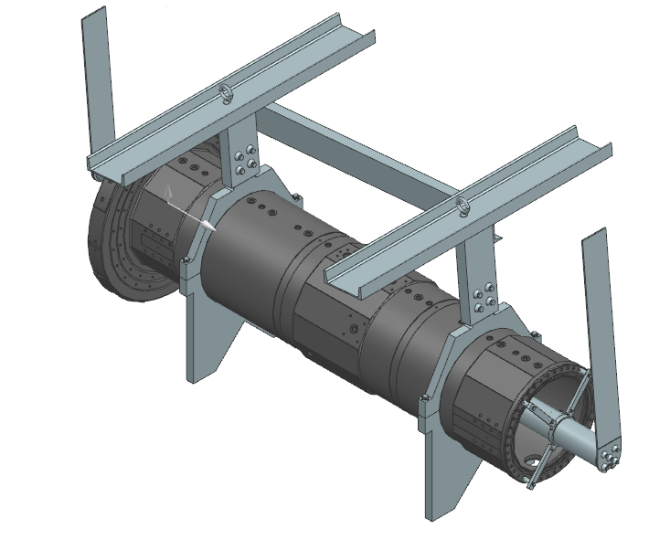
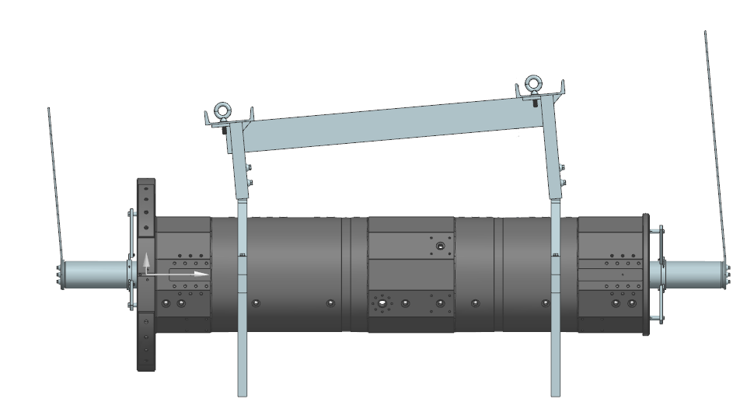
Outer Conductor Anodizing Fixture
Anodizing fixture nearly identical to NuMI design
Design for Horns B & C will be scaled version of Horn A design
Clamps and support channels to hold and lift conductor
Cathode tube assembly inside conductor
Processed in chemical baths at 5$°$ angle
Process tank size is 5’ x 5’ x 16’
Vendor will fabricate tank
Horn A Anodizing Fixture

Slide 14
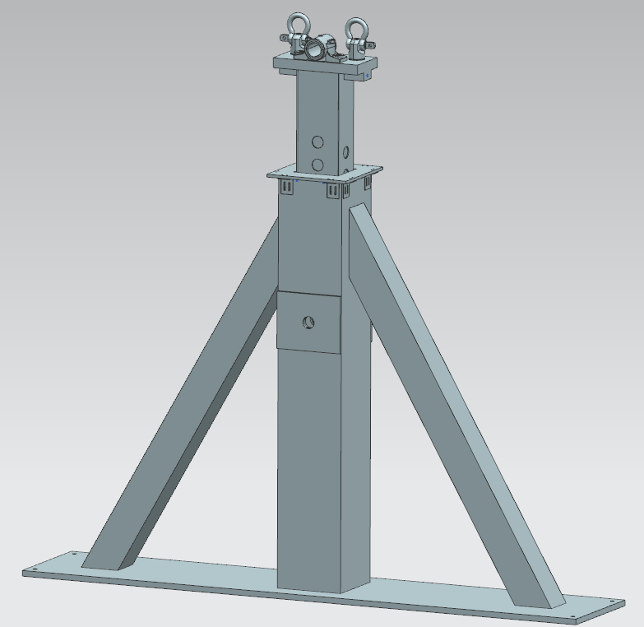
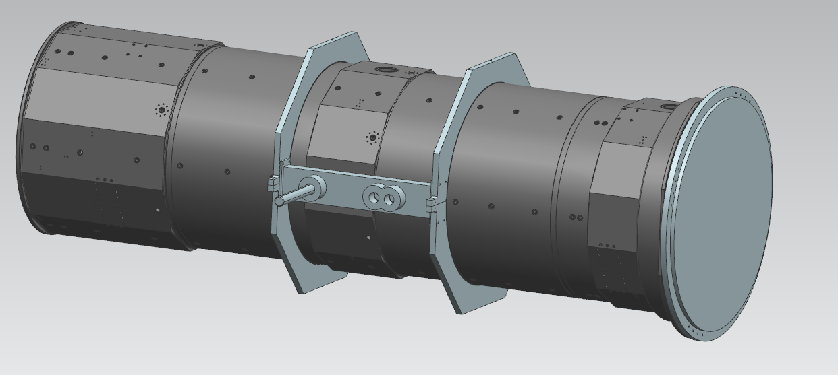
Horn B Assembly in Flipping Fixture
Assemble collars, flanges and shafts on the outer conductor
Bolt counterweight to upstream end of outer conductor
Use plastic washers
Set stand height to Horn C position for Horn B initially
Shaft
Flange
Collars
Counterweight

Slide 15
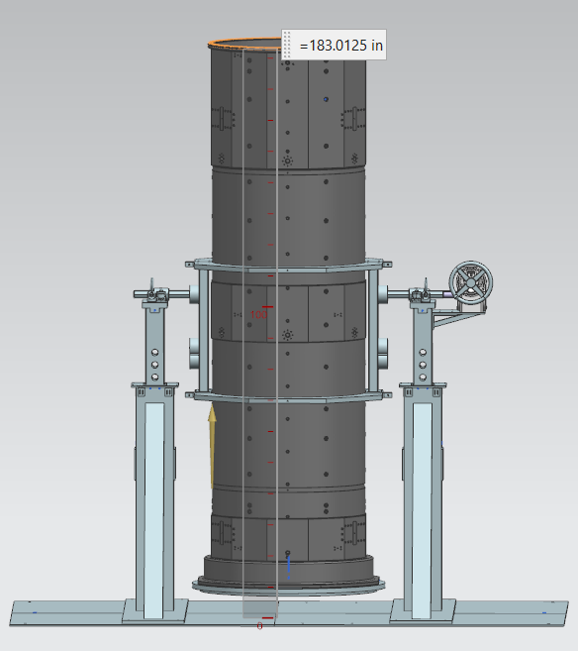
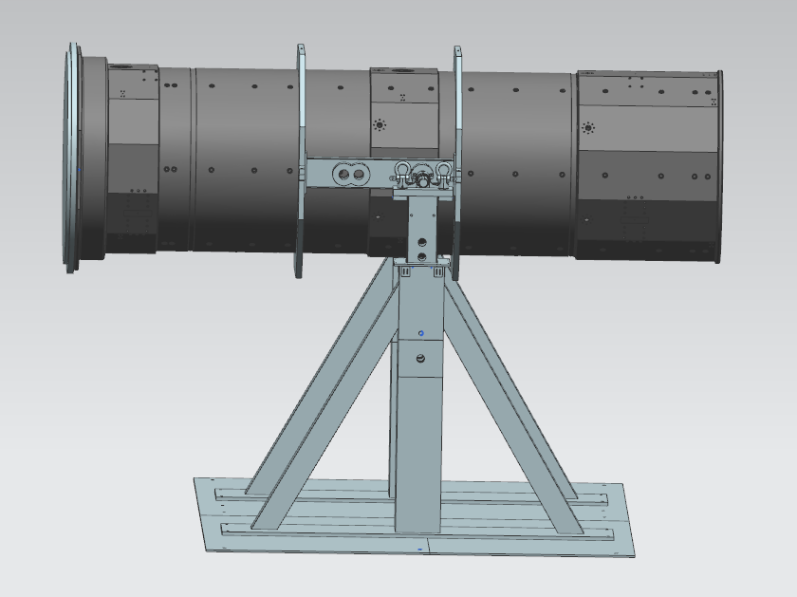
Horn B Assembly in Flipping Fixture
Lift outer conductor and position in stands
Attach shafts to pillow block bearings
Rotate horn to vertical position with counterweight end closest to floor
15.3 ft
7.3 in

Slide 16
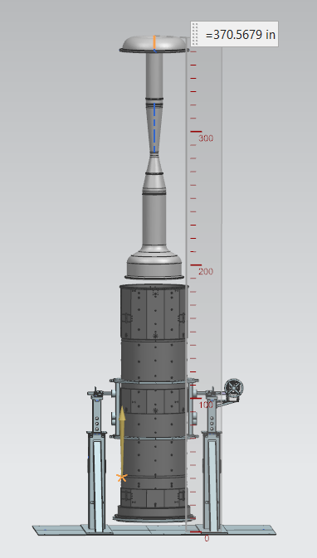
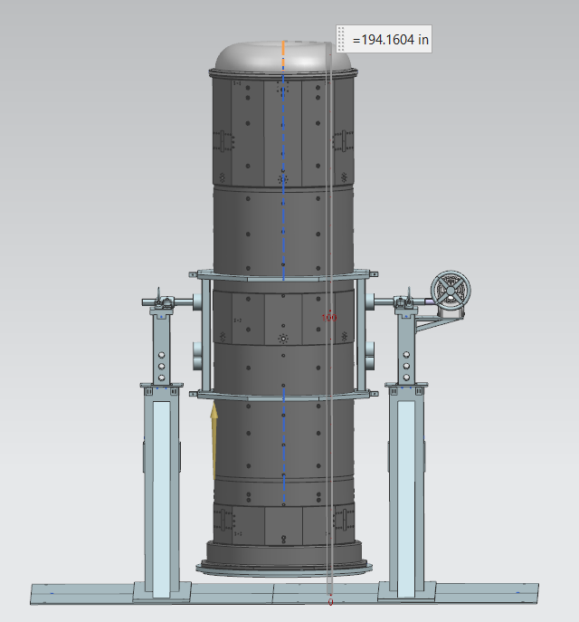
Horn B Assembly in Flipping Fixture
Lower inner conductor and fasten to the outer conductor
30.9 ft
16.2 ft

Slide 17
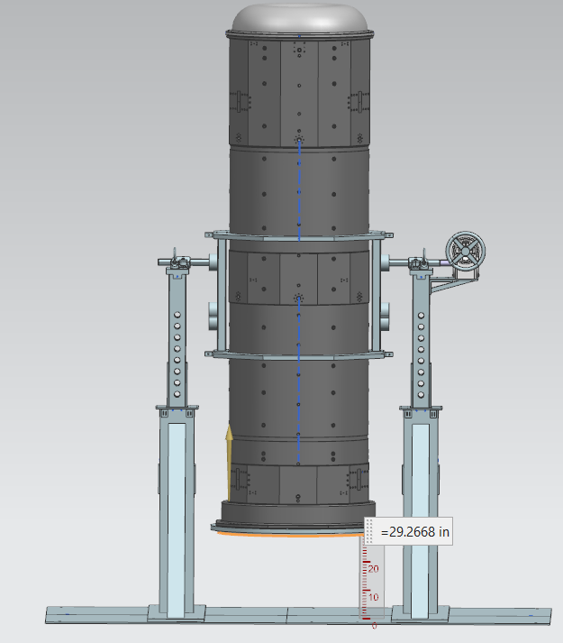
Horn B Assembly in Flipping Fixture
Raise stands to Horn B pin position
Support the counterweight using a hydraulic cart and remove
Place connecting flange and ceramic ring together on hydraulic cart and bolt to the horn
2.4 ft

Slide 18
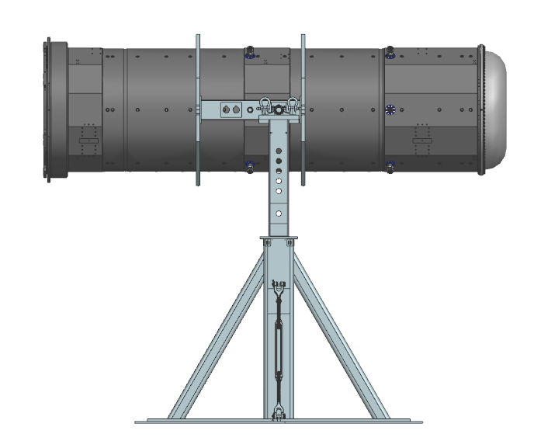
Horn B Assembly in Flipping Fixture
Rotate horn to horizontal position and remove from fixture

Slide 19
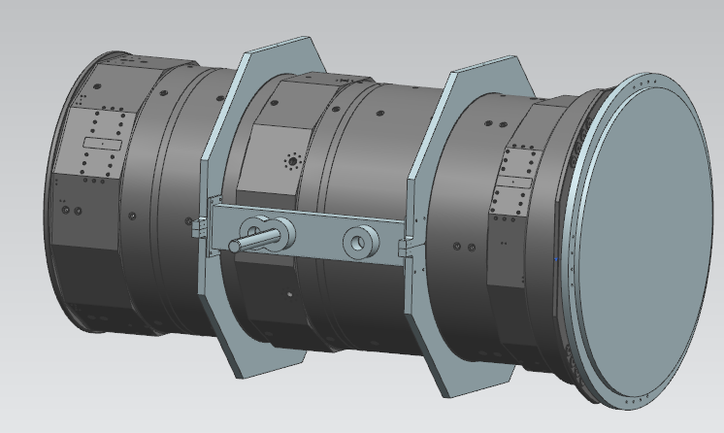
Horn C Assembly
Assemble collar, flange and shafts on the outer conductor
Bolt counterweight to upstream end outer conductor
Use plastic washers
Set stand height to Horn C position

Slide 20
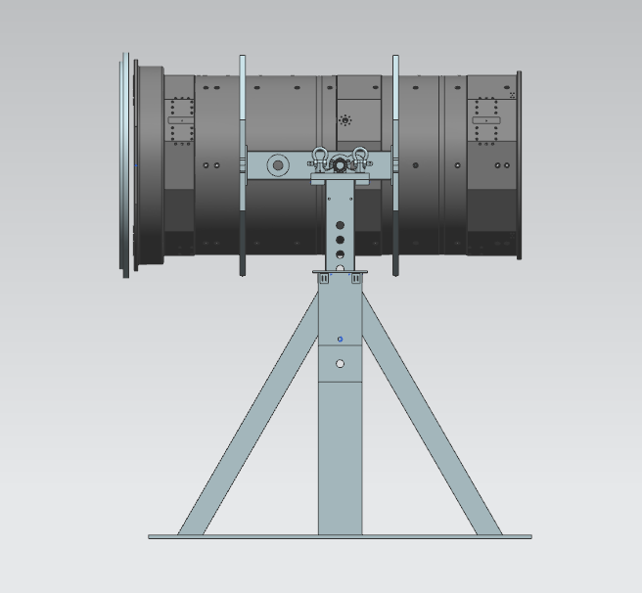
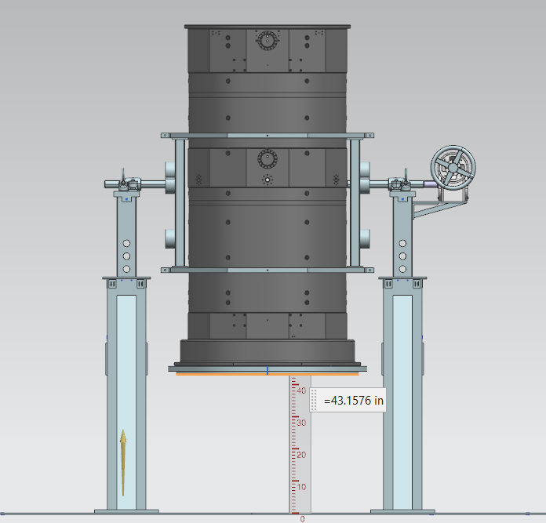
Horn C Assembly
Lift outer conductor and position in stands
Attach shafts to pillow block bearings
Rotate horn to vertical position with counterweight end closest to floor
3.6 ft

Slide 21
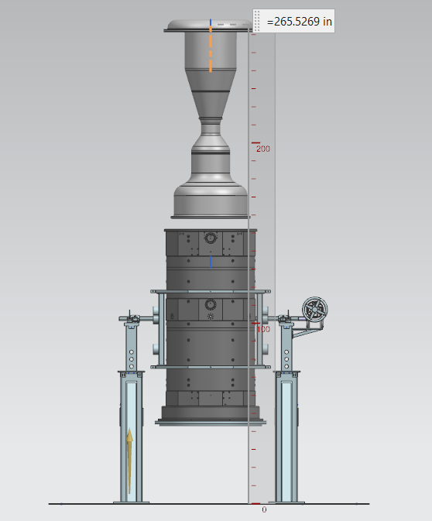
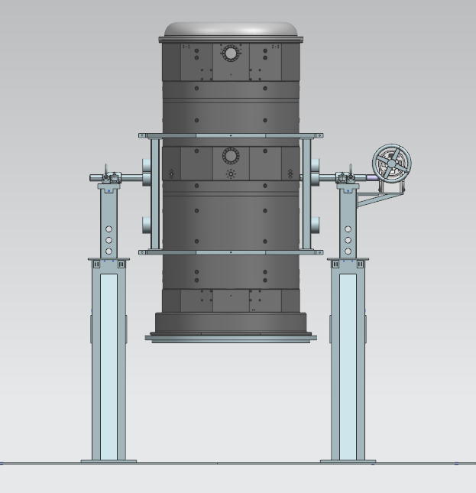
Horn C Assembly
Lower inner conductor and fasten to the outer conductor
22.1 ft

Slide 22
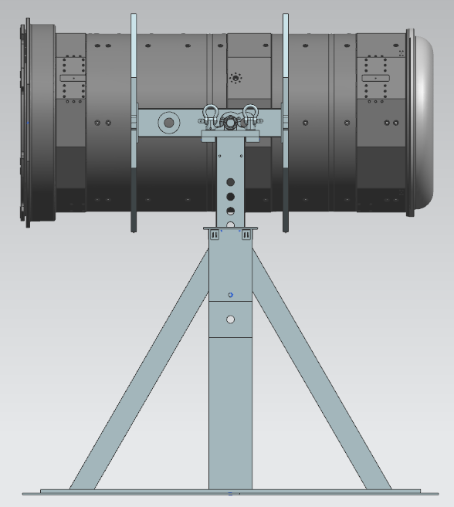
Horn C Assembly
Remove counterweight, using hydraulic cart to support
Place connecting flange and ceramic ring together on hydraulic cart and bolt to the horn
Rotate horn to horizontal position and remove from fixture

Slide 23
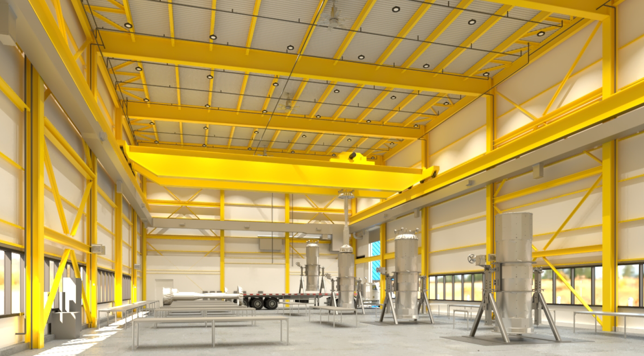
TSIB Layout and Lift Plan
Lowering of inner conductor into outer conductor confirmed to fit within hook height

Slide 24
Fabrication Procedures
All procedures and specifications shown at Horn A reviews apply to Horns B and C
Aluminum Welding Specification
Electrical Isolator Assembly
Electroless Nickel Plating Specification
Friction Stir Welding Requirements for Conductor Buswork
HI-POT Voltage Testing Procedure for LBNF Focusing Horns
Instrumentation Line Assembly Procedure
Horn A Spider Supports Installation Procedure
LBNF Horn Assembly in Flipping Fixture
LBNF Horn Inner Conductor Welding
LBNF Horns Traveler
Silver Brush-Plating Procedure for Focusing Horns
Vendor Specification for LBNF Silver Plating
All procedures available at DUNE-doc-21618

Slide 25
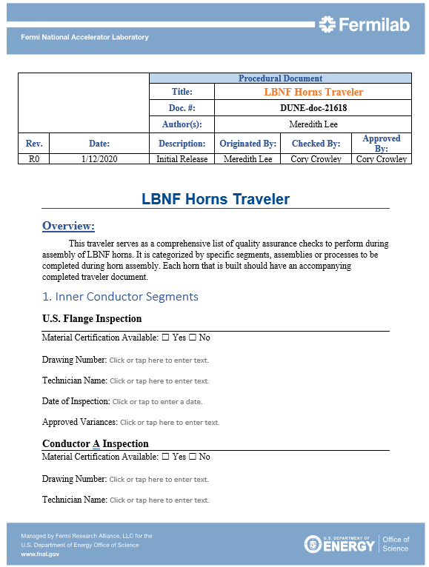
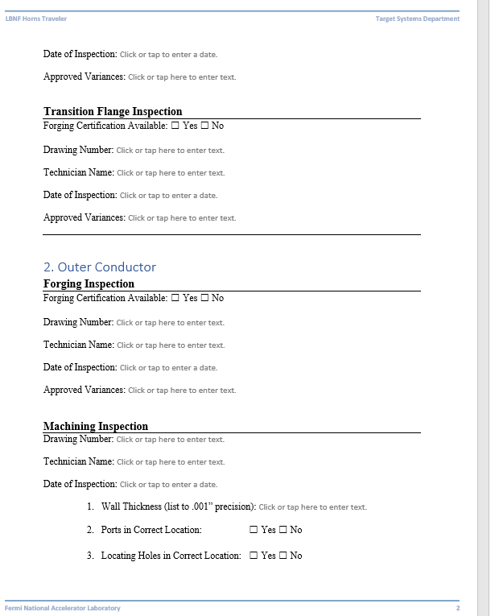
Fabrication Procedures - Traveler
Document containing all QA checks and signoffs for every assembly and fabrication step
Categorized by specific parts, assemblies and processes
References in-depth procedures
One traveler assigned and populated for each horn built

Slide 26
Summary
Fabrication planning occurred at same time as horn design to ensure feasibility
Welding plan will follow proven process to date
Greater dependence on multi-ring sample due to high cost of individual sample parts
Anodizing and nickel plating fixtures heavily influenced by NuMI design
Nickel plating fixture design requires slight differences in order to not exceed tank size
All stages of flipping fixture assembly confirmed to fit in TSIB
Fabrication procedures available for all critical assemblies and processes

Slide 27
Additional Slides

Slide 28
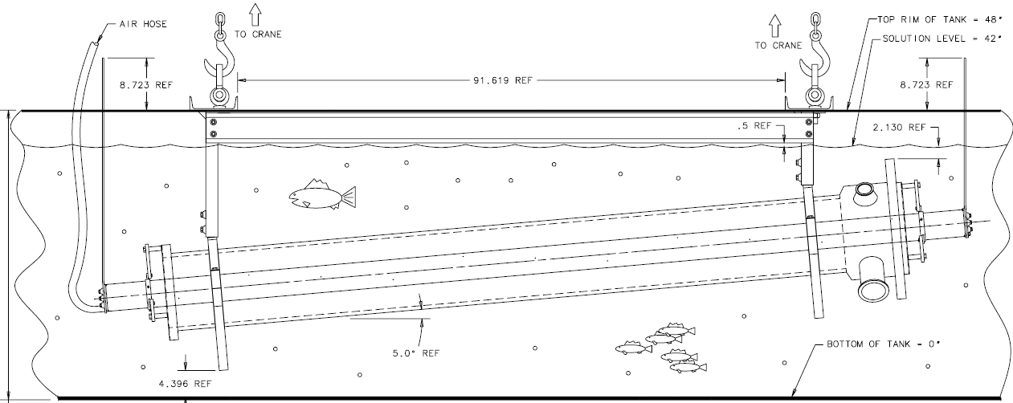
Anodizing Fixture in Tank

Slide 29
Horn B Assembly in Flipping Fixture
Four ground steel plates form 178”x115”x0.75” (14.8’x9.6’) base plate
Holes to anchor plate to the floor
Holes to anchor stands to plate
Left stand is fixed
Right stand has 1 position for Horn A and 1 position for B and C
A
A
B,C
B,C

