Slide 1
Neutrino Beamline
Horns B & C
Preliminary Design Review
Cost, Schedule, & Risks
Cory Crowley
3 December 2021

Slide 2
Outline
Horn B / C Cost Summary
  Major Quotes
  Cost Documentation
  CPI
Schedule Overview
  Production Horns
  Integration with Crosshairs
  SPI
Risks
Summary

Slide 3
Horn B & C + (A) Cost Summary
Horn B / C M&S is estimated to cost 5.63M in FY21 dollars at completion.
4.01M in labor for Design / Fabrication / Assembly / Testing.
1.6M M&S contingency + 981k in labor contingency. 2.58M advertised Contg.
B & C represent 12.2M, including some bulk-buy procurements for Horn A.
Totals are being driven by size of horns and beamline requirements.
  Large, precision conductors have non-linear cost curves. ~2X NuMI = ~5X cost.
  Horn A estimates have, on average, been within 10% of budget and substantiate all horn part costs outside of conductors due to shared / scaled designs.
  High NRE & setup costs for B & C is inherent. Spares will be cheaper by 100k - 250k.
Sum of Value
 | ETC |  | ETC Total | EAC |  | EAC Total | CONTG |  | CONTG Total
Row Labels | L Labor | M Material |  | L Labor | M Material |  | L Labor | M Material
131.01.03.03 Beamline | $ 3,322,861 | $ 5,554,214 | $ 8,877,075 | $ 4,010,425 | $ 5,628,272 | $ 9,638,698 | $ 981,130 | $ 1,598,506 | $ 2,579,636
131.01.03.03.03 Target Complex | $ 3,322,861 | $ 5,554,214 | $ 8,877,075 | $ 4,010,425 | $ 5,628,272 | $ 9,638,698 | $ 981,130 | $ 1,598,506 | $ 2,579,636
131.01.03.03.03.03 Horns | $ 3,322,861 | $ 5,554,214 | $ 8,877,075 | $ 4,010,425 | $ 5,628,272 | $ 9,638,698 | $ 981,130 | $ 1,598,506 | $ 2,579,636
131.01.03.03.03.03.04 Horn B | $ 2,095,869 | $ 5,067,873 | $ 7,163,742 | $ 2,609,815 | $ 5,120,550 | $ 7,730,365 | $ 607,425 | $ 1,464,205 | $ 2,071,629
131.01.03.03.03.03.06 Horn C | $ 1,226,991 | $ 486,341 | $ 1,713,332 | $ 1,400,610 | $ 507,722 | $ 1,908,332 | $ 373,705 | $ 134,301 | $ 508,006
Grand Total | $ 3,322,861 | $ 5,554,214 | $ 8,877,075 | $ 4,010,425 | $ 5,628,272 | $ 9,638,698 | $ 981,130 | $ 1,598,506 | $ 2,579,636

Slide 4
Horn B & C + (A) Cost Summary
Horn B / C are planned to take 22,789 hours to design, procure, & assemble. (Some of those hours are supporting Horn A procurements).
We have 5,447 hours of labor hour contingency.
Horn B Labor carries much of the design burden due to 95% of components (by piece part count) carrying over to Horn C.
Horn B also carries fabrication oversight burden since many procurements lumped together under that WBS element.
Sum of Value
 | ETC | ETC Total | EAC | EAC Total | CONTG | CONTG Total
Row Labels | L Labor |  | L Labor |  | L Labor
131.01.03.03 Beamline | 18,570 | 18,570 | 22,789 | 22,789 | 5,447 | 5,447
131.01.03.03.03 Target Complex | 18,570 | 18,570 | 22,789 | 22,789 | 5,447 | 5,447
131.01.03.03.03.03 Horns | 18,570 | 18,570 | 22,789 | 22,789 | 5,447 | 5,447
131.01.03.03.03.03.04 Horn B | 11,985 | 11,985 | 15,070 | 15,070 | 3,449 | 3,449
131.01.03.03.03.03.06 Horn C | 6,585 | 6,585 | 7,719 | 7,719 | 1,999 | 1,999
Grand Total | 18,570 | 18,570 | 22,789 | 22,789 | 5,447 | 5,447
Horn B / C Estimate at Completion (EAC): M&S + labor = 9.64M
EAC does not include contingency.

Slide 5
Major Quotes
Vendor quotes in hand for many major procurements.
Costs below reflect latest budgetary vendor correspondence and pricing escalations gathered during prototype Horn A fabrication.
Thorough BOE documentation exists and reflects fulfilled or in-process orders from FY21.
  Ceramics (O’Keefe, does not include ceramic ring): ~250K
  Outer Conductor Forgings (Scot Forge): ~320K
  Inner Conductor Forgings (Scot Forge): ~404K
  Machined Inner Conductors (TBD / Expert Opinion): ~722K
  Outer Conductor Machining (TBD / Expert Opinion): ~310K
  Nickel Plating (Dav-Tech / Techmetals): ~464K
  Anodizing (Dav-Tech / Techmetals): ~131K
  Stripline Fabrication (Multiple Vendors): ~364K

Slide 6
Cost Documentation
Costs are documented in Basis of Estimate for Horns.
  Captured entirely in DUNE-doc-8810
  Supporting data is embedded directly in activity tabs.
  Justification for Labor and Material requirements can be reasonably substantiated by ongoing prototype Horn A fabrication.
Horns continue to be one of the most extensively captured & documented cost drivers for beamline.
Ongoing production costs for Horn A are directly reflected in estimates for Horns B & C.
Last year has seen shift away from “Expert Opinion” to FY21 Purchase orders. Estimate uncertainties are dropping.
Machining costs for conductors remains largest internal cost risk due to inability to gather vendor interest in budgetary quotes.
Vendors burned out on budget work; need to build back our reputation.

Slide 7
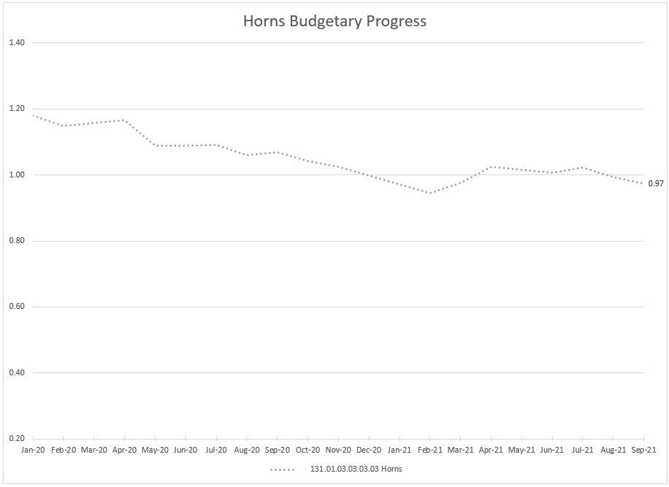
Horns Historical Cost Performance
CPI = Earned Value / Actual Cost
1 is Ideal; >1 shows cost savings, <1 shows higher expenditures.
Engineering + drafting time had efficiencies until ~12/20 due to design carry-over on B & C.
Major expenditures started 2/21, so larger cost basis.
Horn B & C engineering / drafting + all costs to date on prototype Horn A fabrication have been very close to budget.
Horn A costs are justifying expenses on B & C.

Slide 8
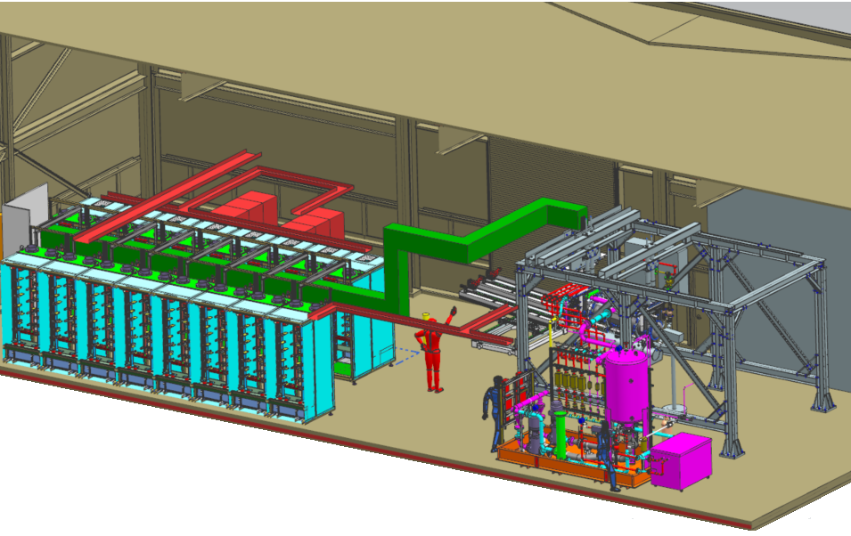
Horn B & C Schedule Overview
DOE funding profile has pushed production of horns B & C out roughly 2 years.
This was a direct result of the test stand being delayed due to bundled procurements for common fabrications with the production power supply and stripline in LBNF 20.
Those procurements are in process of being corrected, and production will then default to true funding limitations related to conductor fabrication.
  All production happens together for cost savings.
  Not clear LBNF project will be able to advance funding to handle the large procurements as currently bundled.
  Must make decision on if worth it to break apart, or can accommodate expenditures on technically limited schedule, or simply leave somewhat delayed.
  High level assessment of project risks drives decisions on priority.

Slide 9
Horn B / C / NBI / Crosshair Integration
Crosshairs are only independent WBS element that are directly integrated into horns. Line item exists in schedule and that is sufficient to track.
Horns likely responsible for fabrication of Horn crosshair bracketry + labor spent on NBI for procuring actual crosshairs.

Slide 10
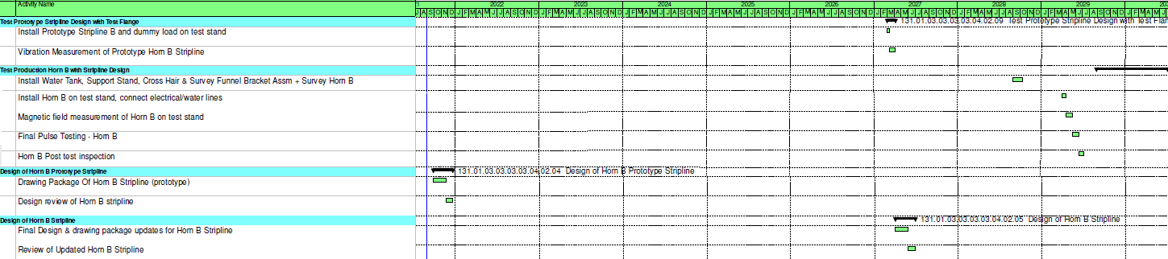
Horn B Testing Schedule Overview
Test schedule is comprehensive and allows dedicated activities for:
  Initial connection / outfitting with new test stand.
  Vibration measurement & characterization on full scale prototype stripline.
  Magnetic field measurement.
  Post test inspection & Q.A.
  Decoupling time, followed by more Q.A. & few hundred hours of any design updates before we start production stripline build.
  Retest of full Horn B with potentially updated stripline design.

Slide 11
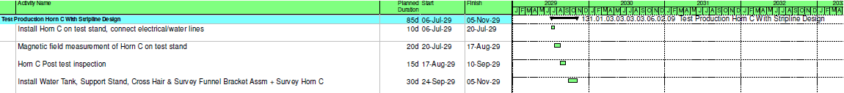
Horn C Testing Schedule Overview
Test schedule follows same steps as Horn B, though does not include prototype stripline effort + potential redesign.
Test stand activities for production horns must integrate with spare horns. This logic is present, but schedule is in flux due to funding.
Will firm up by mid-December in preparation for Director’s / IPT reviews.
Thought has been put into testing production and spare horns by the time of beamline commissioning.

Slide 12
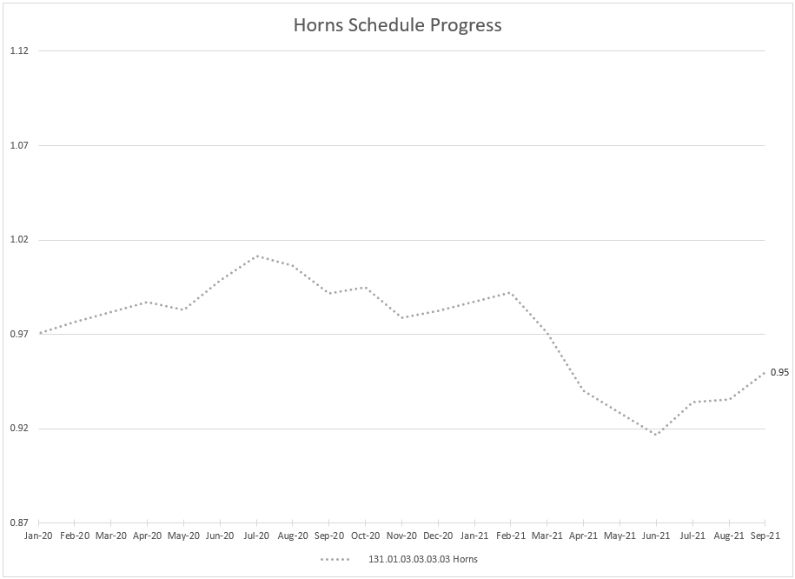
Horns Historical Schedule Performance
SPI = Earned Value / Planned Progress
1 is Ideal; >1 shows schedule advancement, <1 shows schedule delay.
Work occurring within 10% of scheduled duration.
Horn program is well supported by AD/TSD.
Short term difficulties with drafting & fabrication resources are being addressed.
Strong basis for continued success if planned resource needs are met.

Slide 13
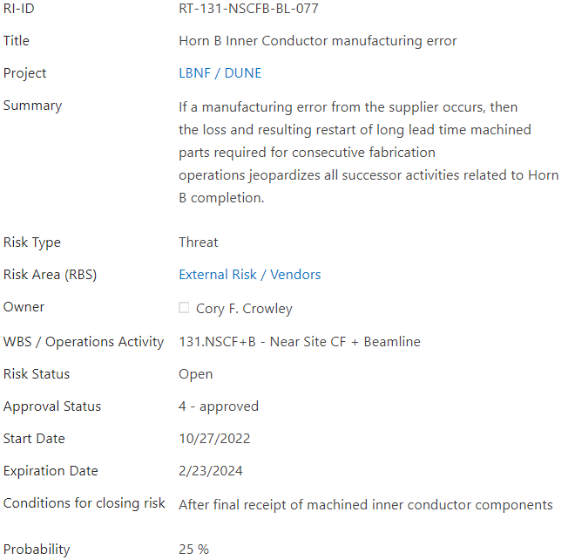
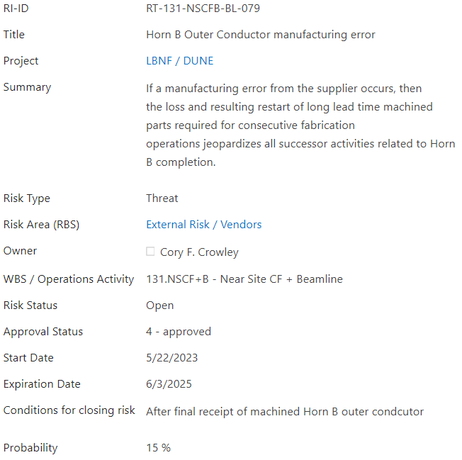
System Risks
All risks are captured in project risk register under beamline subgroup.
Details of impacted activities, mitigation costs, schedule delays, etc… are wrapped up into risk Monte Carlo analysis.
All horn risks are approved & tracked by project office.

Slide 14
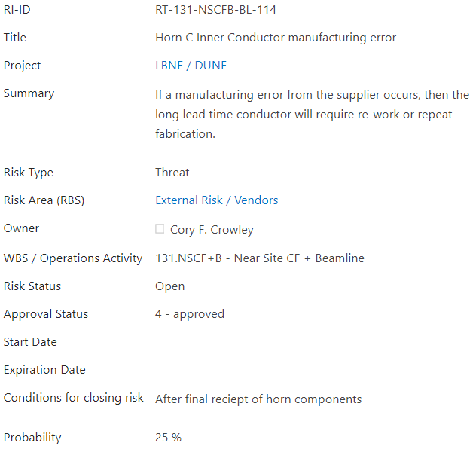
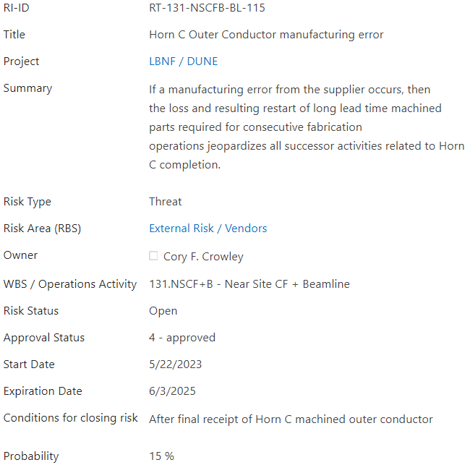
System Risks

Slide 15
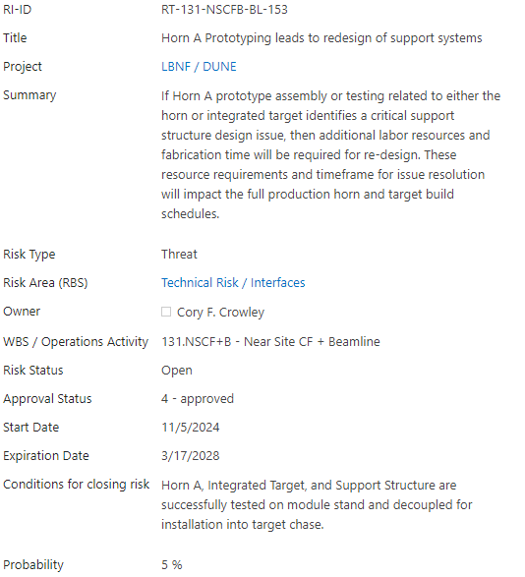
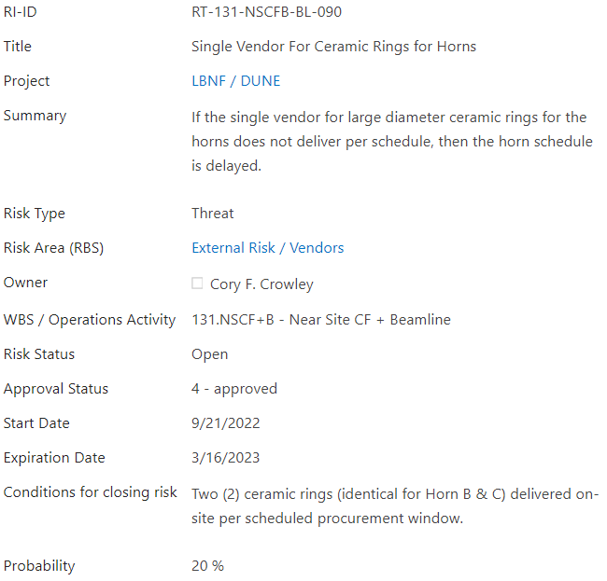
System Risks
Ceramic rings have one vendor and is critical supplier for fabrication success.
Horn A testing impacts everything.

Slide 16
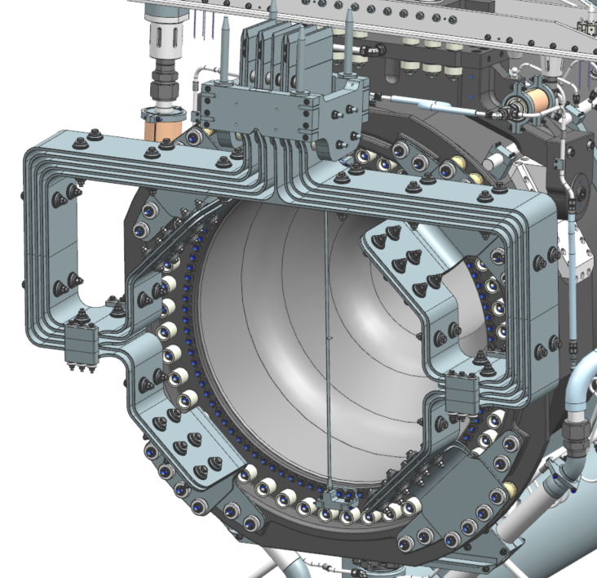
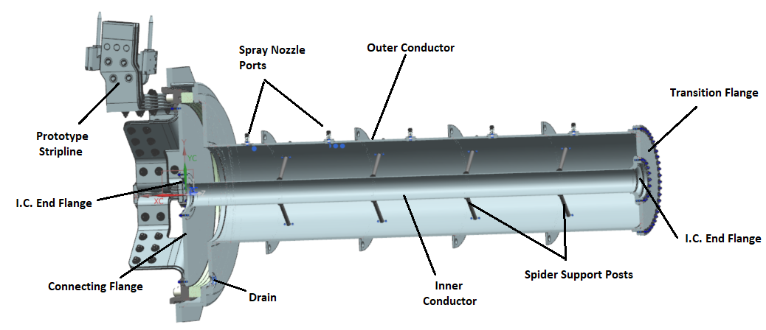
System Opportunities
One opportunity: Horn B prototype stripline serves as production horn stripline (or spare).
Dummy load testing will prove out design for both Horn B & C.
Must rigidly affix conductor to test frame, possibly add weighted ring to adapter flange for replicating mechanical impedance.
Detailed design awaits additional engineering support.

Slide 17
System Risks
Design risks are actively updated.
Most concerning ones have been retired:
  No vendor for inner conductor nickel plating.
  No vendor for outer conductor anodizing.
  Unacceptable magnetic field uniformity at horn drain ports.
  Stripline / ceramics redesign due to corona inception.
  No vendor for friction stir welded striplines.
Schedule, resource, & accident type risks remain:
  Production timelines.
  Component damage.
  Major interface issues during testing.
  COVID / Supply Chain.

Slide 18
Separate Advancements in Risk + Cost Reduction
No domestic vendor has been identified with the *existing* capabilities to nickel plate or anodize horn B or C.
  Limiting factor is horn diameter. Long tanks exist, but not ones 5’ x 5’
  Existing vendor offered quote for tank construction / facility reconfiguration.
  Project is taking this quote forward as cost of building horns.
Second known vendor is an option. Non-committal without serious buyer backing
  250K to setup processing line, open PO to handle work after that.
  Not “clean” for procurement.
Costs are driven by tank count required (7) + thousands of gallons of chemicals.
FNAL/DOE identified this vendor base issue, and we have a parallel effort to attempt to address it.

Slide 19
Nickel Plating SBIR (Phase I)
Small Business Innovation Research grant awarded (Phase I) for novel approach to electrolytically deposit nickel on an aluminum substrate.
Phase I successful in demonstrating electrochemistry & processing steps.

Slide 20
Nickel Plating SBIR (Phase II)
Phase II awarded to further refine process & demonstrate alpha-scale plating ability.
Radiation & corrosion tests have no discernable difference compared to EN. Hardness similar & wear resistance similar. Erosion is an issue.
Identified internal tensile stresses due to deposition rate.

Slide 21
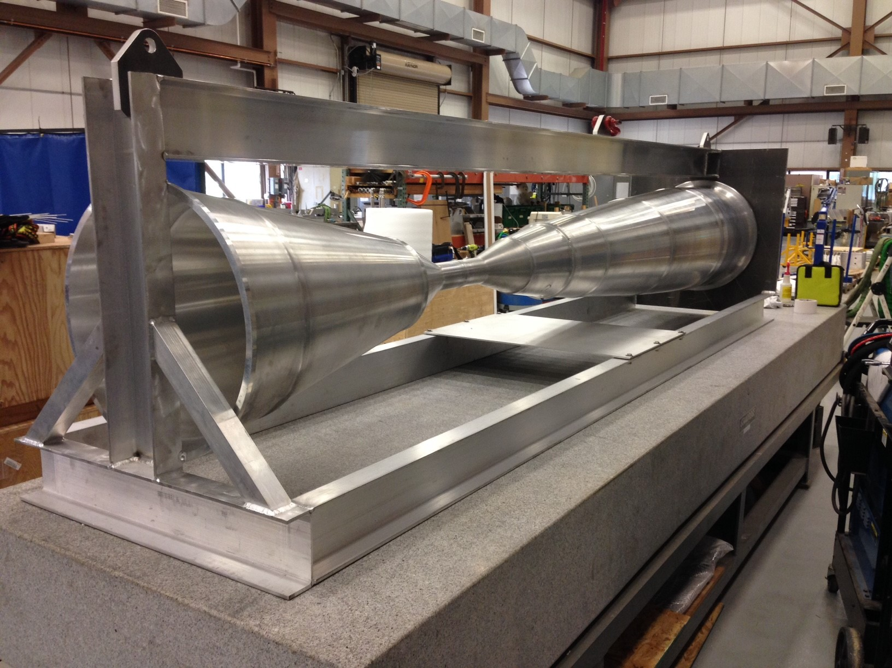
Nickel Plating SBIR (Phase IIB)
Phase IIB awarded 2021 cycle (rare for HEP).
  Get a full-scale horn conductor electrolytically plated and prove it’s equivalent to EN.
  Solve residual tensile stress issue.

Slide 22
Summary
Horn B & C costs are well understood to extent possible.
  Prototyping costs meeting expectations for Horn A.
  Labor chargebacks have historically met planned expenditures.
Existing NuMI horn vendor base has been fabricating nearly identical Horn A components with near 100% success.
Some NRE will carry over to B & C (fixturing, bulk buys, etc…).
LBNF Schedule is delayed, and efforts are ongoing to shorten duration.
Risks are captured & managed.
Horn B construction will be peak of assembly difficulties; Horn C benefits from lessons learned on A & B.
Off-project efforts captured in SBIR are ongoing in attempt to reduce cost + risk.
Questions?

