Slide 1
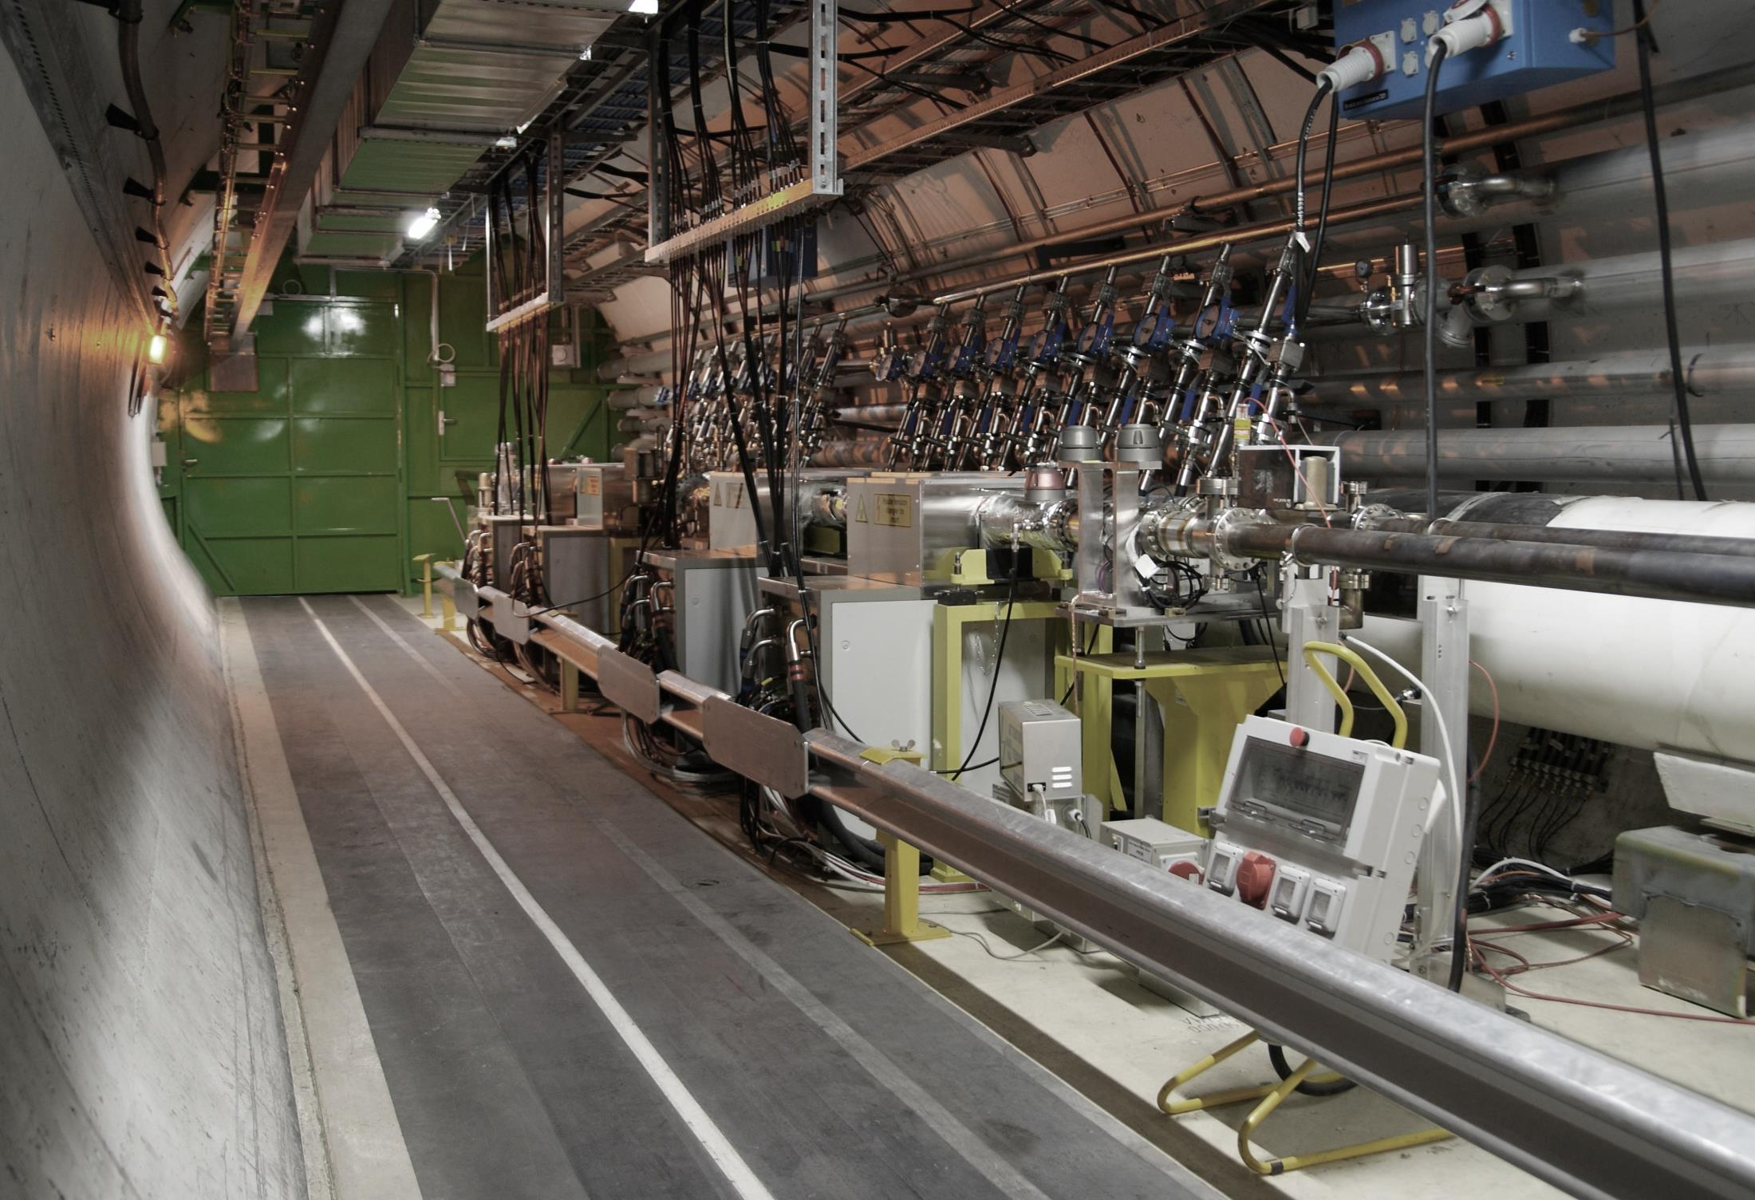
Transverse Feedback in LHC
Wolfgang Hofle, CERN SY-RF

Slide 2
LHC Transverse Feedback
– early days and there is always some
“unfished business”
Wolfgang Hofle
CERN
Systems Department
Acknowledgements: G. Kotzian, D. Valuch, M. Söderen, K. Li (CERN)
collaborating colleagues from the US and JINR, Russia

Slide 3
LHC Design
LHC design called for a transverse damper
  mitigation of resistive wall instability
  concern that such a system could not be used throughout the fill if the noise injected from the pick-up and kicker power system could not be kept sufficiently small enough
many teams from different labs continue to contribute to the understanding of the interaction of noise with a feedback system and the resulting emittance blow-up
All what was hoped for was that the LHC feedback would be able to mitigate the instability until beams in collision
In practice, the system built at CERN has been used throughout the production fills during run I and run II
  continues to be the baseline to have the feedback on all the time, including for High Lumi LHC
  increased gain needed for High-Lumi LHC
  High frequency intra-bunch feedbacks were studied with US-LARP and proposed
  Noise injected via the crab cavities for High Lumi remains a concern and is addressed also by introducing new feedback paths acting back on the crab cavities
Kickers and power system realized for the initial start-up remain the work horse
  in kind contribution of JINR, Russia to LHC (1997 agreement, I.N. Ivanov, V. Zhabitsky)
Valeri’s experience from the Tevatron and his push to improve our system has been an invaluable guidance
  I much enjoyed Valeri’s insight and rigorous approach in our discussions and the collaborative work during his visits to CERN

Slide 4
LHC Transverse Damper (ADT)
  Initially designed for
    Injection damping
    Feedback during ramp (coupled bunch instabilities)
  LHC Physics since Run 1 (2010-)
    providing stability at all times in the cycle
    (including with colliding beams !)
    diagnostics tool to record bunch-by-bunch oscillations
    abort gap and injection cleaning
    blow-up for loss maps and aperture studies
    tool to produce losses for quench tests
    tune measurement

Slide 5
Principle OF TraNsVerse Feedback

Slide 6
Principle of Transverse Feedbacks
  One or multiple pick-ups
  Turn by turn, bunch by bunch position with digitization and processing
  Widely used in high intensity
  lepton colliders (B factories) and light sources to provide beam stability
  High intensity hadron machines
  need feedback for stability as well
  Use in hadron colliders more challenging and restricted in past mostly to injection damping (low noise system needed)
  LHC collider uses TFB all the time including with stored, colliding beams, (protons and Pb ions) since 2010
  T_{signal} = T_{beam} + n T_{rev}

Slide 7
LHC Transverse Feedback
AKA Damper / ADT

Slide 8
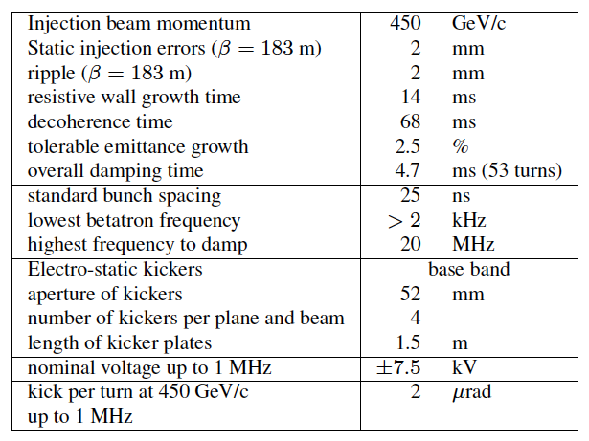
LHC Transverse Damper Specs

Slide 9
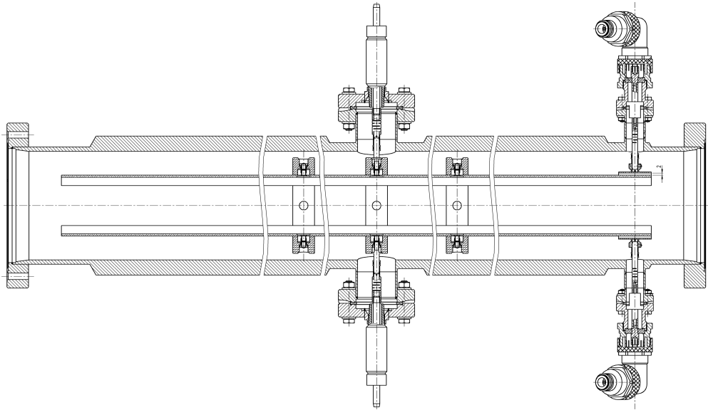
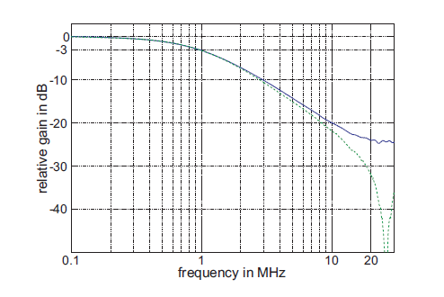

ADT Power and Kicker System
Kicker length: each kicker 1.5 m
Max voltage: 10.5 kV
2 μrad kick to 450 GeV beam
Gain up to beyond 20 MHz
16 kickers,
32x30 kW tetrode amplifiers
Bandwidth up to 20 MHz
Power
observation
beam
ADT kicker. The beam is kicked by electric field
Measured ADT frequency response. Green: bare power amplifier, blue: power amp + kicker.
Built in collaboration with JINR, Dubna, Russia; E. Gorbachev et al. LHC Proj. Rept.-1165 CERN (2008)
LHC transverse Feedback (ADT) kickers and amplifiers in tunnel point 4 of LHC, RB44 and RB46

Slide 10
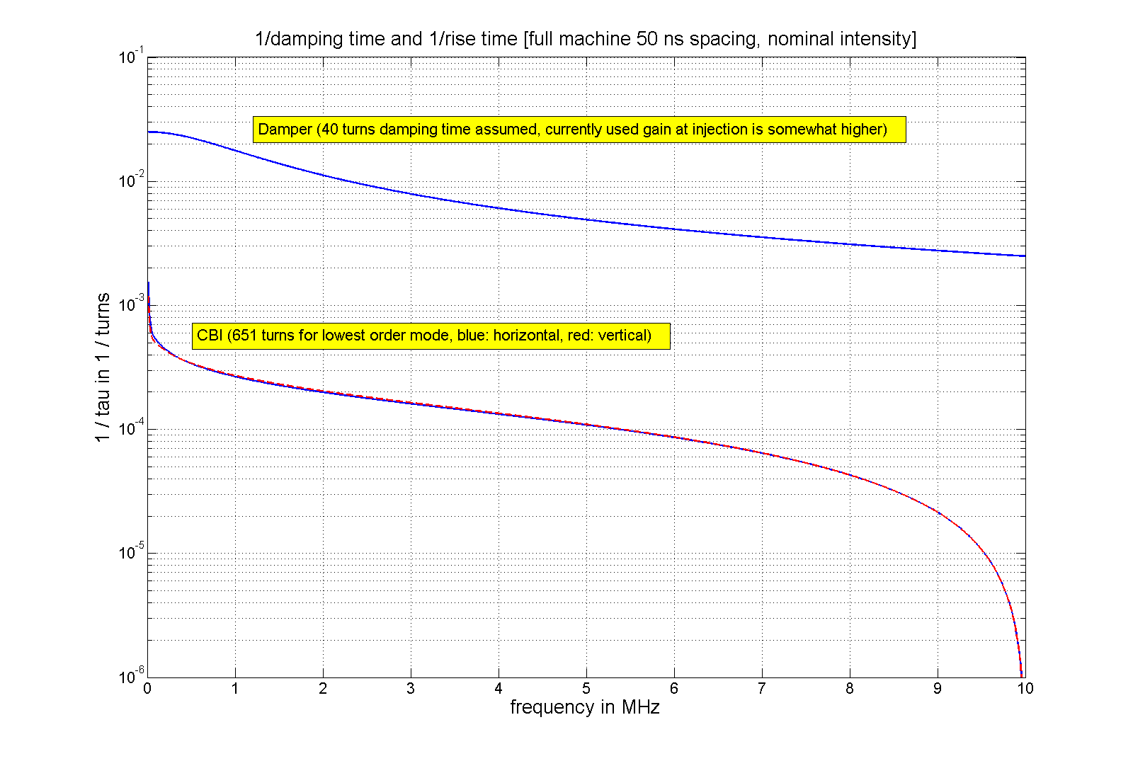
Instability Growth Rates versus Damping
50 ns bunch spacing
40 turns, 1/40 = 0.025
1.2x10¹¹ per bunch
50 ns spacing well
under control
with damper
Run 1: Instability calculation by
N. Mounet (CERN BE-ABP)
LHC

Slide 11
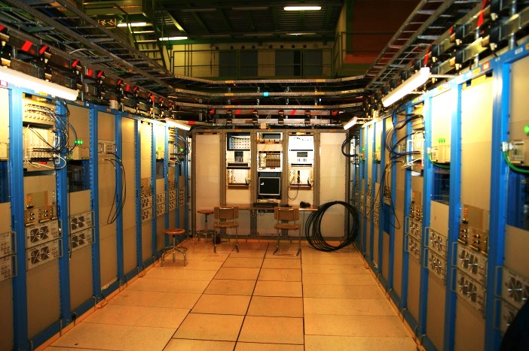
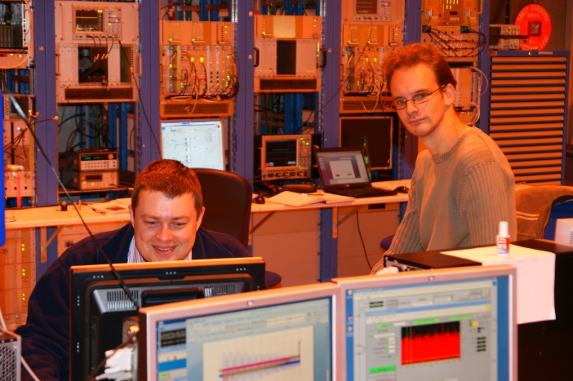
Drive Signal Generation
Under ground cavern
  200 W driver amplifiers (25 MHz BW)
  tetrode amplifier control
EMC
  carefully designed to minimize
perturbances by noise
  major EMC issue during commissioning:
  8 kHz switching frequency of UPS
Electronics in surface building SR4
for easy access during commissioning
A/D conversion
all signal processing and D/A
computer controls

Slide 12
Overview of ADT Signal Processing
Beam position VME module
Signal processing VME module
Analogue RF signals
Intensity nomalized bunch position digitized and synchronized (two pick-ups)
Run 1

Slide 13
Beam Position Module
Low noise amplifier for for good S/N ratio before
Adaptation of signal levels to beam intensity
Challenge for multi-bunch operation: keeping reflections under control

Slide 14
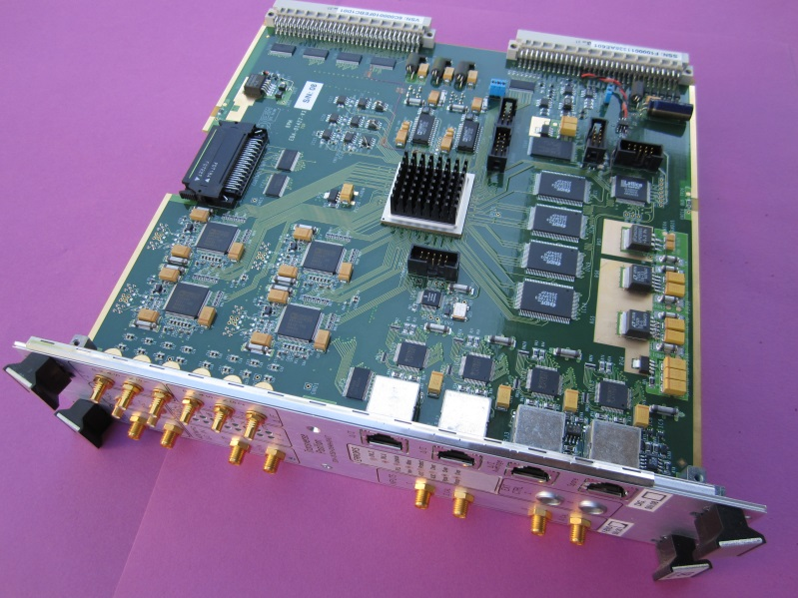
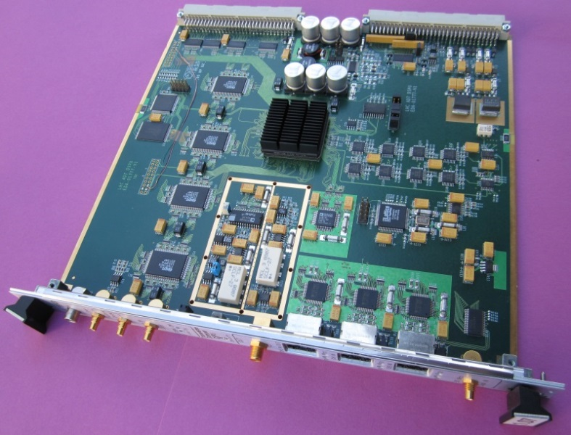
ADC / Signal Processing / DAC
Beam Position VME board
bunch spacing: 25 ns, 40 MS/s
bunch by bunch normalised position
16 bit ADCs
2 μm rms resolution
Gbit serial link to transmit data for
processing or storage
Processing VME board (Run 1)
  upgraded during run 2
    Combines now set of 4 PUs
80 MHz clock frequency
amplitude and phase correction by FIRs
adjustment of delay and feedback phase
generation of excitation signals
14 bit DAC

Slide 15
LHC Transverse Feedback - Post LS1
Major upgrade in LS1
And LS2 of electronics (2013-2021)
doubling # of pick-ups
complete re-cabling of PUs
new digital hardware
multiple ADCs and DACs
reduction of noise
flexibility for gain control
instability diagnostics (trigger !)
tune diagnostics (GPU)
D. Valuch, M. Söderen, G. Kotzian
CERN SY-RF

Slide 16
TRANSVERSE FEEDBACK KICKER
As an Exciter

Slide 17
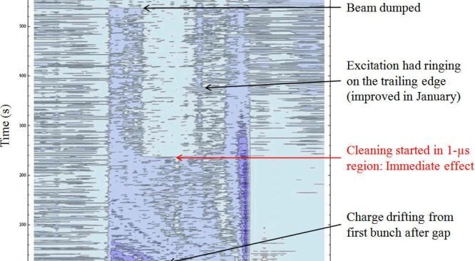
Abort Gap Cleaning
(Abort Gap Monitor (Synchrotron Light)
3 μs
Time (turns)
Time (within turn)
M. Meddahi et al. IPAC’10
B. Goddard et al. IPAC’11
E. Gianfelice-Wendt et al. IPAC’12
Abort gap viewed by abort gap monitor with RF switched off,
Cleaning by ADT (DDS) in V-plane stepping through a range of frequencies
Also used for injection gap cleaning prior to every injection (H-plane)

Slide 18
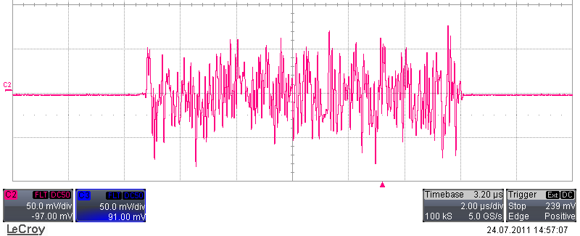
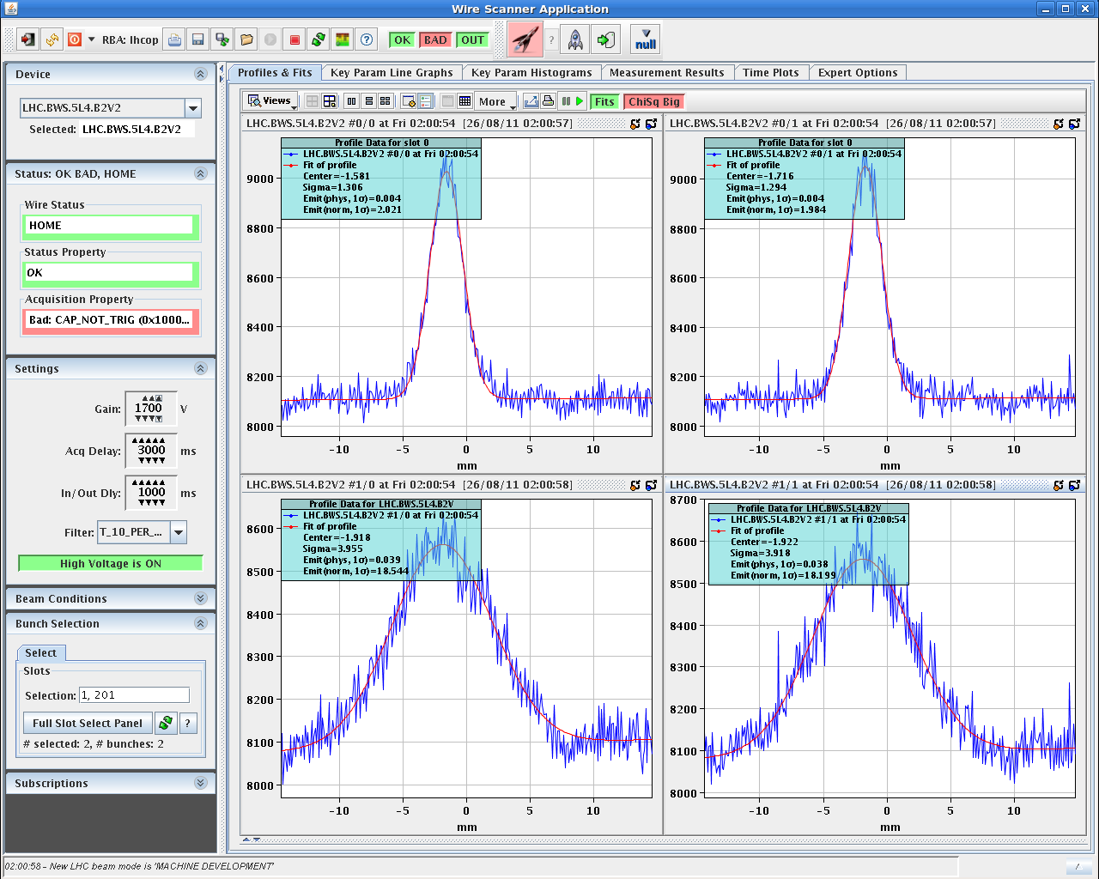
Selective Transverse Blow-up
gate, 11 μs (example)
“White noise” generated on FPGA
clocked at 40 MS/s
→ aperture measurements by blow-up
loss maps for collimation set-up
dynamic aperture
→ any kind of excitation can be gated
(also DDS produced narrow band)
Wire scanner measurements
(normalized transverse emittance)
2 μm
Blow-up functionality very important In a future
very large HC (to balance
emittance damping by
synchrotron radiation damping)
18 μm
stops at 18 μm
→ aperture
aperture measurement using blow-up
with transverse damper

Slide 19
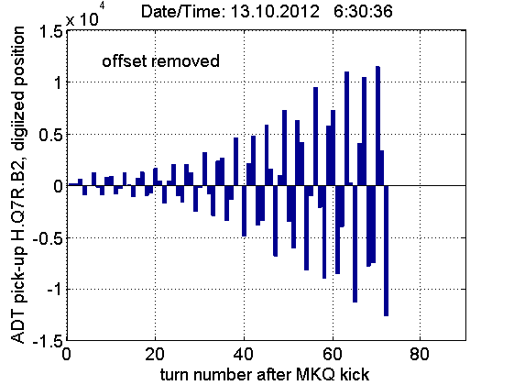
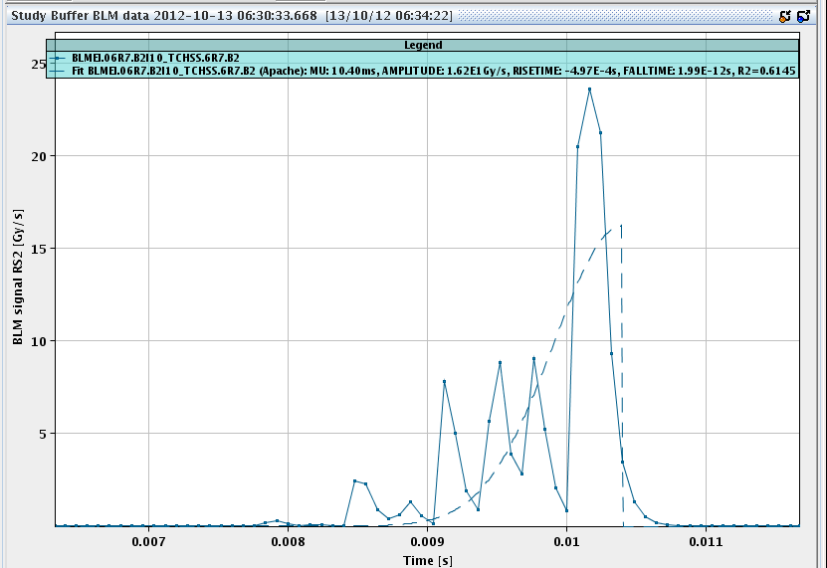
Fast Losses with ADT Simulating “UFO” Type Losses for Quench Test
evolution of beam oscillation amplitude
Fast losses (BLM signal)
1 ms
Transverse Feedback was used as exciter in three quench tests
carried out in February 2013

Slide 20
Operational Experience with TRANSVERSE dampER in LHC

Slide 21
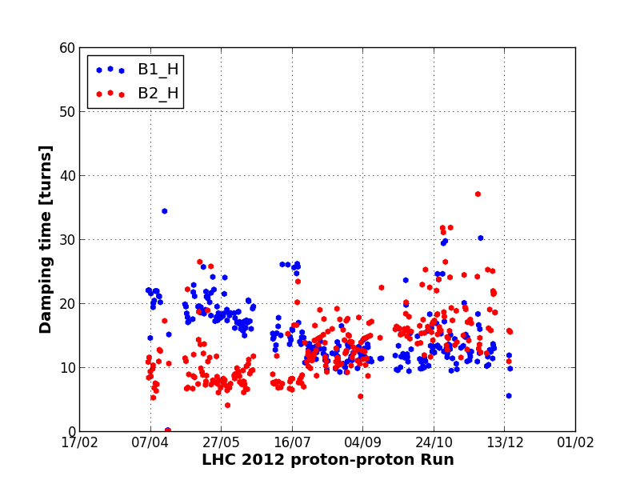
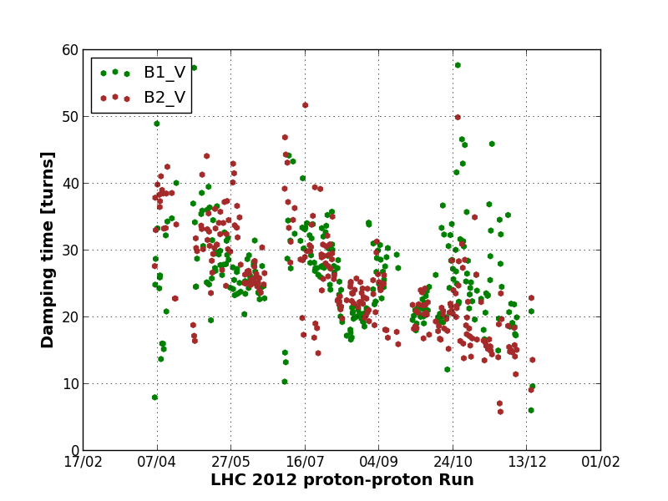
Automated Fill Analysis: Damping Time
2012 Proton Physics Run
Horizontal
Injection oscillations damping of first bunch in a train systematically logged
Fill analysis tool computes
damping time and tune
for every injected batch and fill
Data quality check challenging
Variations over time in part due to chromaticity settings (V-plane !)
Difference H/V: large V inj. error →
first bunch on edge of kicker pulse
2012 Proton Physics Run
Vertical
Macpherson
CERN BE-OP & BE-RF
LHC

Slide 22
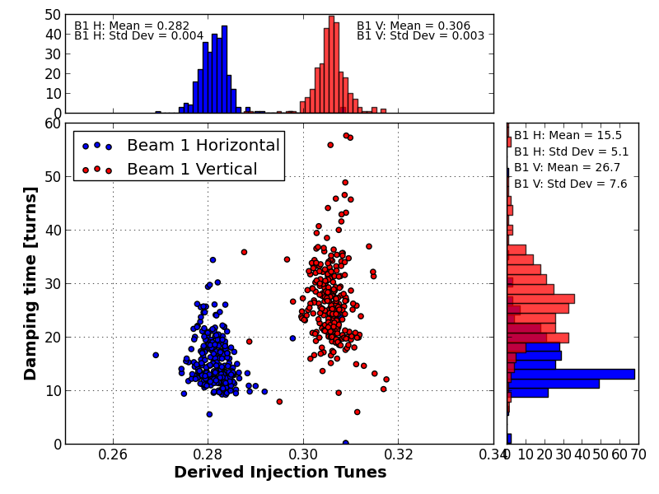
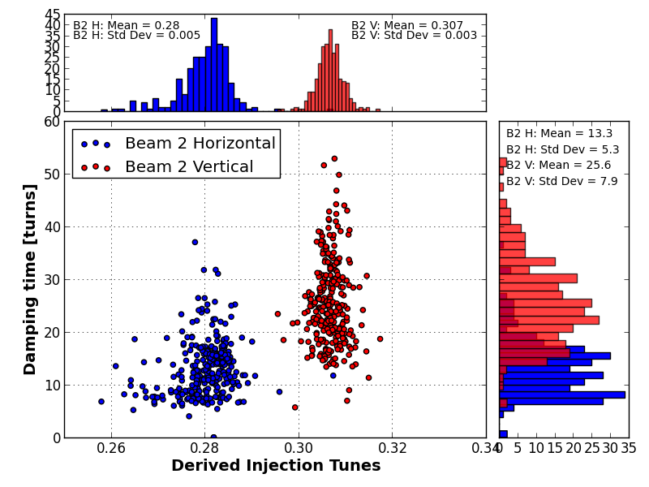
Automated Fill Analysis: Damping Time
Beam 2
H: 13 turns
V: 26 turns
V
H
V
H
Beam 1
H: 16 turns
V: 27 turns
Macpherson
CERN BE-OP & BE-RF

Slide 23
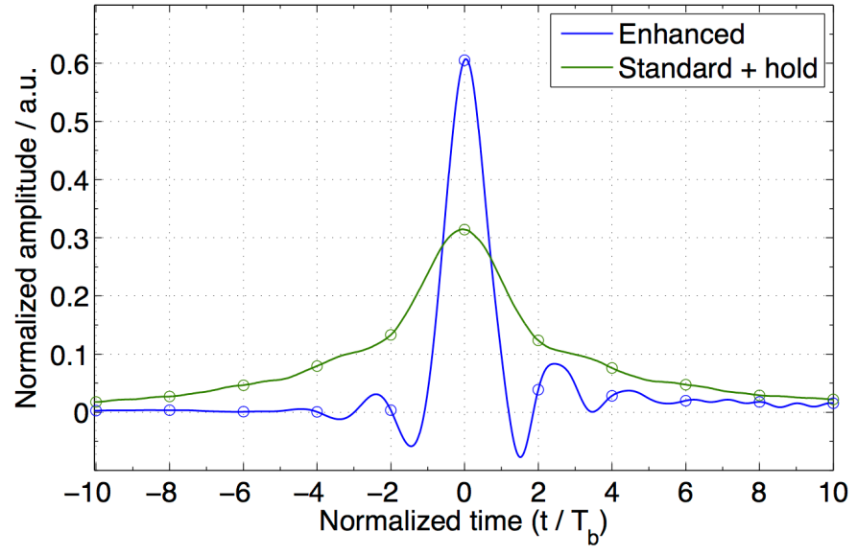
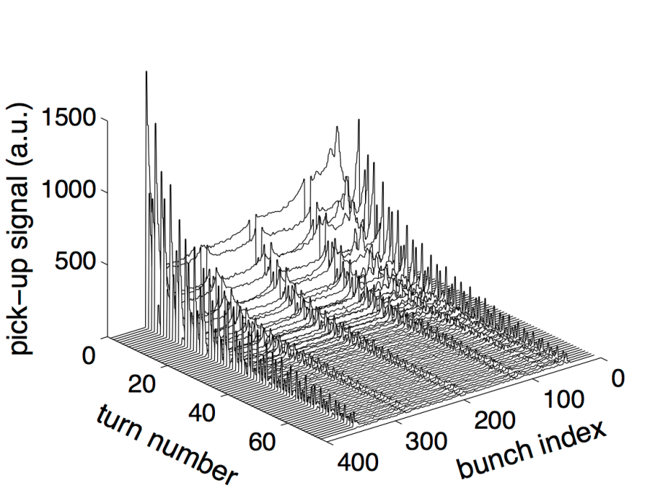
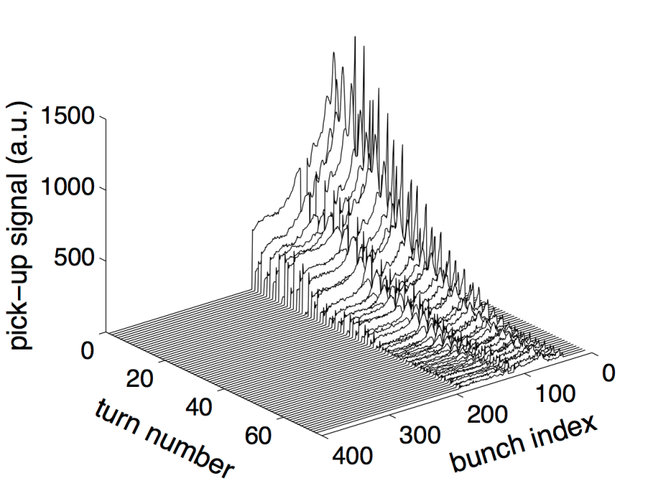
Performance with Bunch Trains in LHC 2012
50 ns bunch spacing
standard + hold
144 bunches (4x36)
25 ns bunch spacing
enhanced bandwidth
144 bunches (2x72)
Injection
oscillation
damping

Slide 24
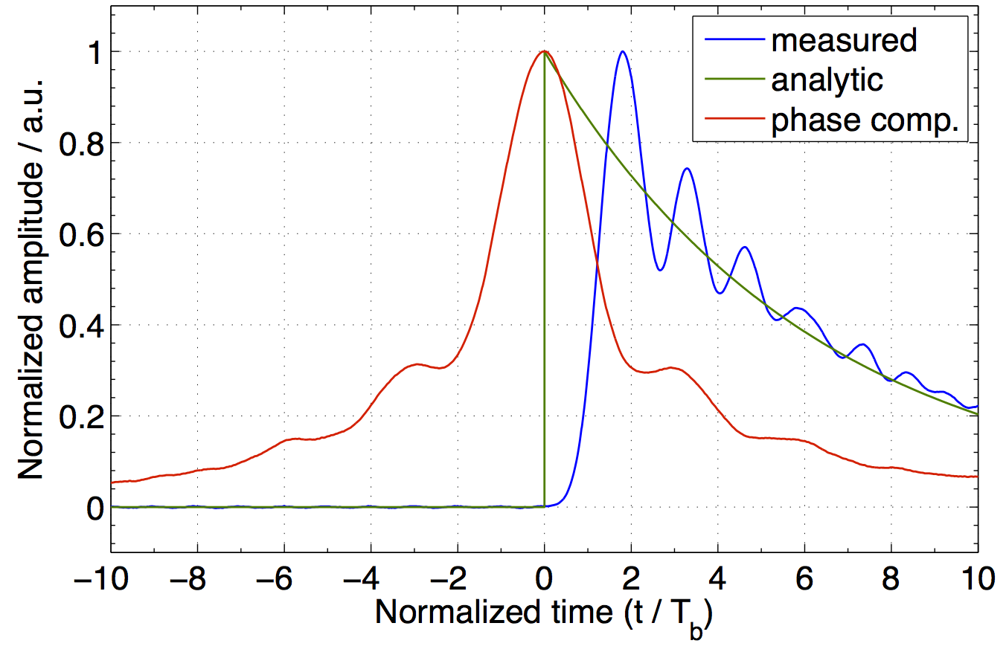
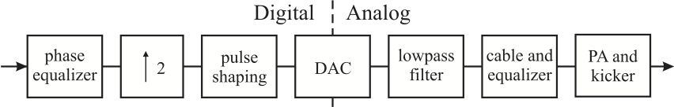
Impulse Response – Linearization of Phase
Courtesy: G. Kotzian
Linearization of phase makes system
usable as feedback up to 20 MHz
W. Hofle et al., WEPME43
IPAC’13
32 tap FIR
for phase equalization

Slide 25
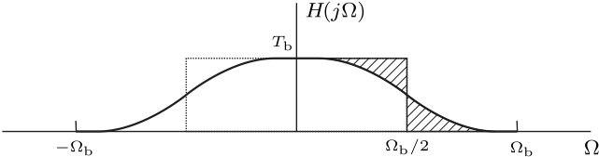
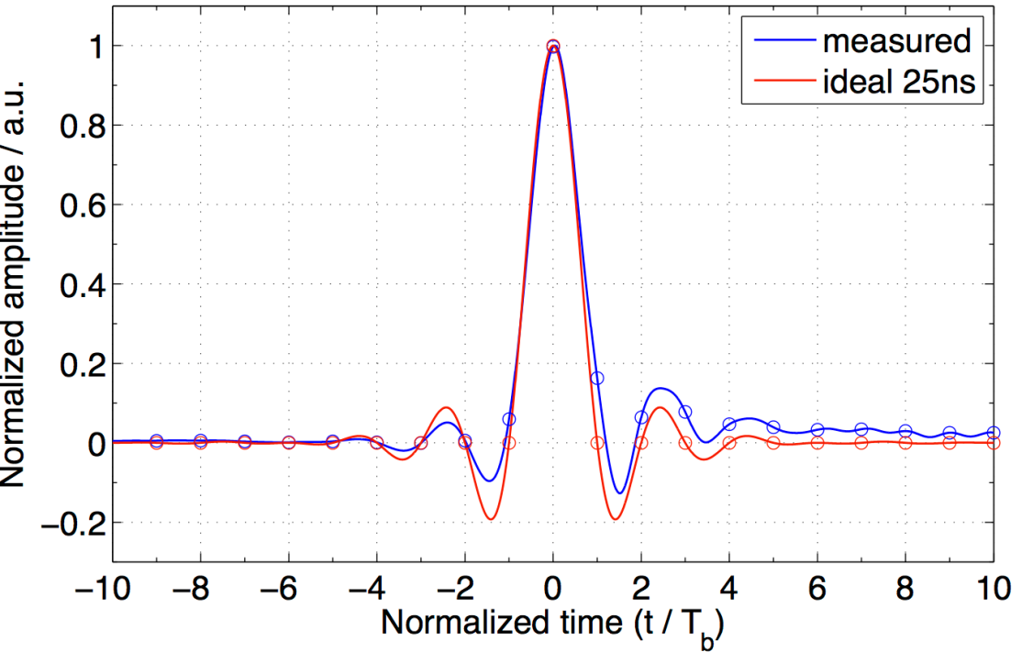
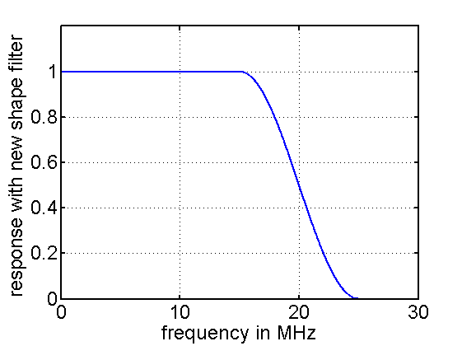
Shaping Time Domain Response
Condition for h(nT_{b}) = 0
→ symmetry of roll off
Motivated by appearance of single bunch instabilities
Used operationally for squeeze
and 25 ns spacing tests

Slide 26
Operation Through Cycle (run 1 →)
LHC

Slide 27
TRANSVERSE FEEDBACK and tune Diagnostics

Slide 28
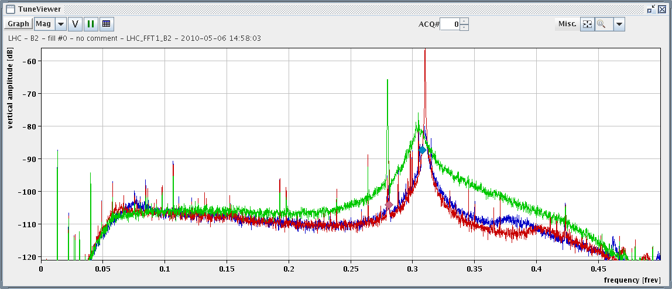
Impact on Tune Measurement System (LHC)
feedback gain
with damper, max gain used
R. Steinhagen
PAC’11, N.Y.
less broadening with lower gain
reduction of tune peak, i.e.
residual oscillations by more than 20 dB
solution deployed in 2012: ADT gain modulation within turn and gated BBQ
6 bunches are used for the Tune Measurement, these have low ADT gain
LHC

Slide 29
Closed Loop Transfer Function
beam
system input
system output
G(s)
perturbation
PU
F(s)
feedback
visible
to damper
open loop
output of closed loop
closed loop transfer function
See also formalism with z-transform treatment: C.-Y. Yao et al. WEPME56 IPAC’13 (Argonne NL)
Tune measurement from in-loop signal: C. H. Kuo, IPAC’11, pp. 514-516

Slide 30
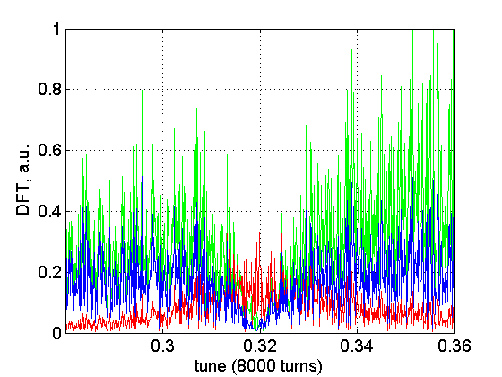
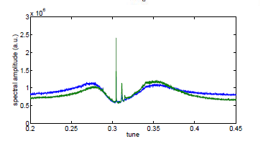
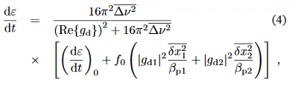
Spectra with feedback on (LHC)
Beam
(invisible to FB)
PU signal
Kicks by TFB
Beam oscillating due to
external excitation
(not instability !)
reduced by feedback
Simulation:
Single bunch 8000 turns
(tune is trench)
Measurement from a single bunch,
two pick-ups, spectra averaged over 45 minutes (2010 data, V plane)
W. Hofle, V. Lebedev et al. IPAC’11
extensively already studied in US for SSC design

Slide 31
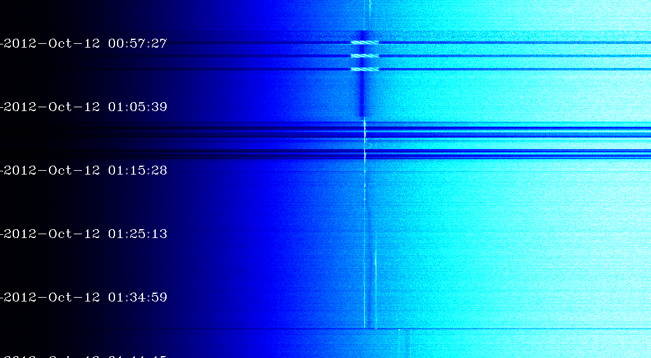
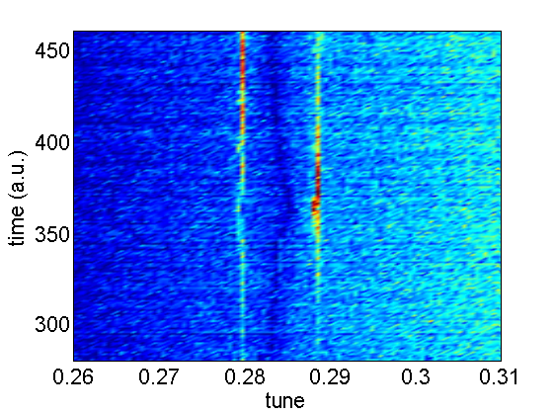
Tune Measurement with ADT (LHC)
cleaning
(injection)
time
high gain (@450 GeV)
(trench @tune)
lower gain
(average over 6 bunches)
parasitic lines ! (ramp)
tune change at start
of squeeze (0.28→0.31)
(4 TeV)
tune (H)
Based on recording of 6 bunches (horizontal plane)
(also considering and tested excitation by short burst gated on 6 bunches)
Courtesy: F. Dubouchet (CERN)

Slide 32
intra bunch motion feedback

Slide 33
Intra Bunch Transverse Feedback
BPM
Kicker
Beam
Active closed loop
Feedback
Analog
Front
End
ADC
Signal
Processing
DAC
Analog Back
End
Power Amp
transverse
position
pre-processed
sampled
position
“slices”
calculated
correction data
correction
signal
pre-distortion
drive signal
Collaboration within US-LARP, proof of principle in SPS successful
John Fox et al., multiple contributing labs

Slide 34


Normalized beam position
LHC ADT case (f scales 1/bunch length)
normalized
transverse position
as computed
center of gravity
oscillation amplitude
Phase rotation in digital part to align
Sum and Delta in I, Q; required
angle measured during set-up
The normalization scheme sees the symmetric (even) oscillation patterns (needed for the closed loop feedback)
Damper sensitivity to symmetric intra-bunch motion is a function of the longitudinal beam spectra
For the anti-symmetric case no oscillation amplitude is detected, odd modes not visible to the damper, provided bunch is symmetric in shape
LHC vs SPS feedback: 400 MHz → 200 MHz, bunchlength
G. Kotzian, IPAC 2017

Slide 35
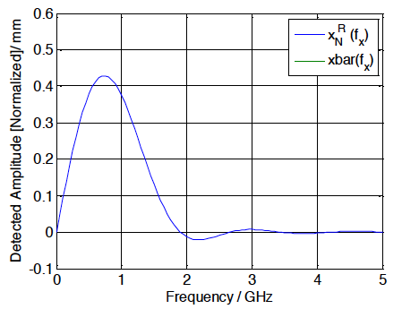

Headtail oscillation detection
LHC ADT case (f scales 1/bunch length)
different combination
of Sum and Delta I,Q components
indicates headtail motion
This algorithm can detect odd-mode oscillations
Algorithms cannot resolve the original oscillation frequency, and absolute oscillation amplitude accurately
However, can detect activity and distinguish between symmetric (even) and asymmetric (odd) modes of every bunch → valuable diagnostics !
LHC vs SPS feedback: 400 MHz → 200 MHz, bunchlength

Slide 36
Thank you
and best wishes for you, Valery
for your journey ahead

Slide 37
ADDITIONAL SLIDES

Slide 38
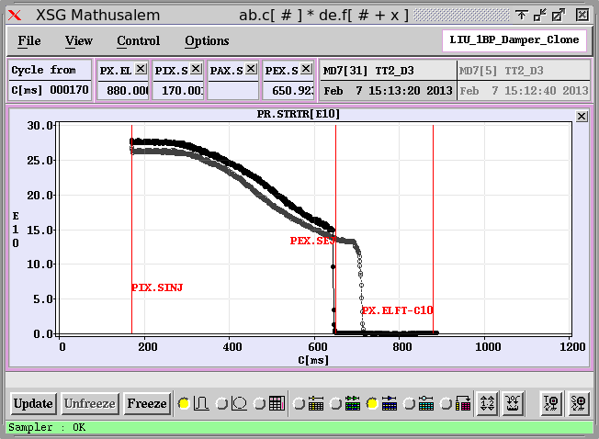
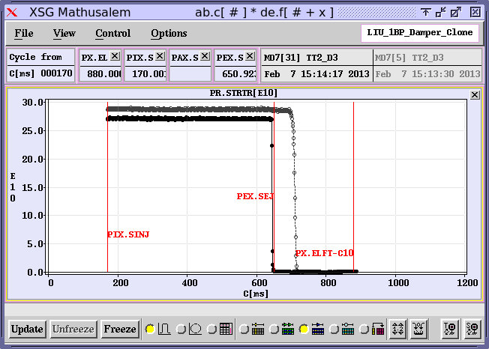
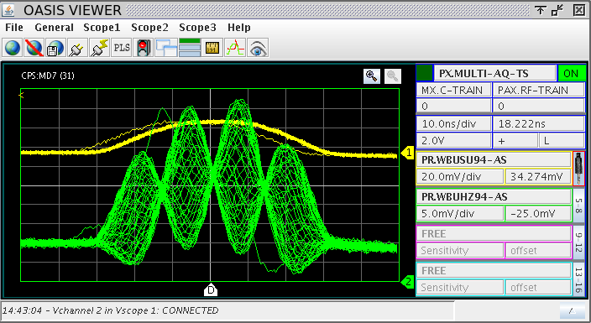
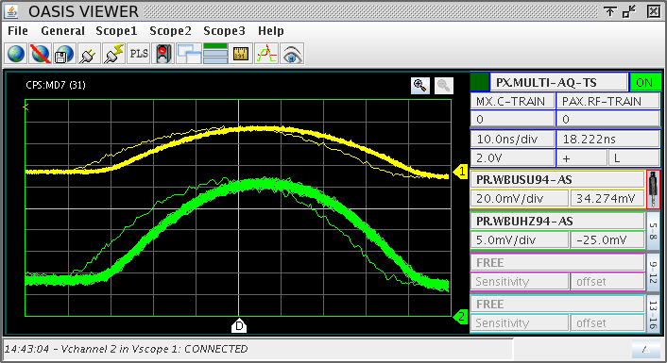
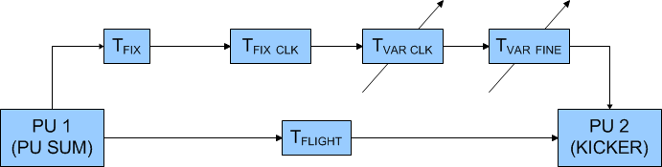
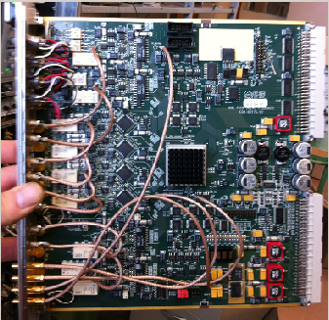
CERN PS Transverse Feedback
10 ns/div
10 ns/div
PS TFB OFF
PS TFB ON
1.4 GeV → 26 GeV
Challenge:
Time of Flight Compensation
Fully digital implementation
Blas et al. WEPME011
D. Perrelet (CERN BE-RF)
PS TFB ON
PS TFB ON
10 ns/div
10 ns/div

Slide 39
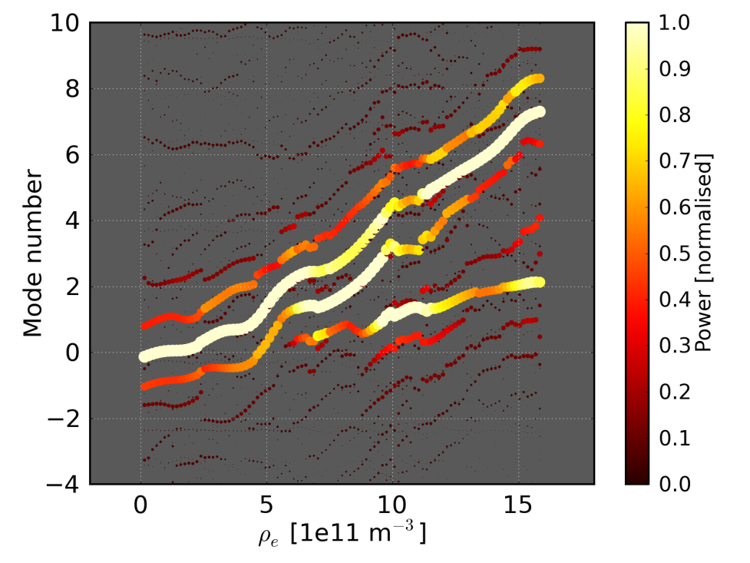
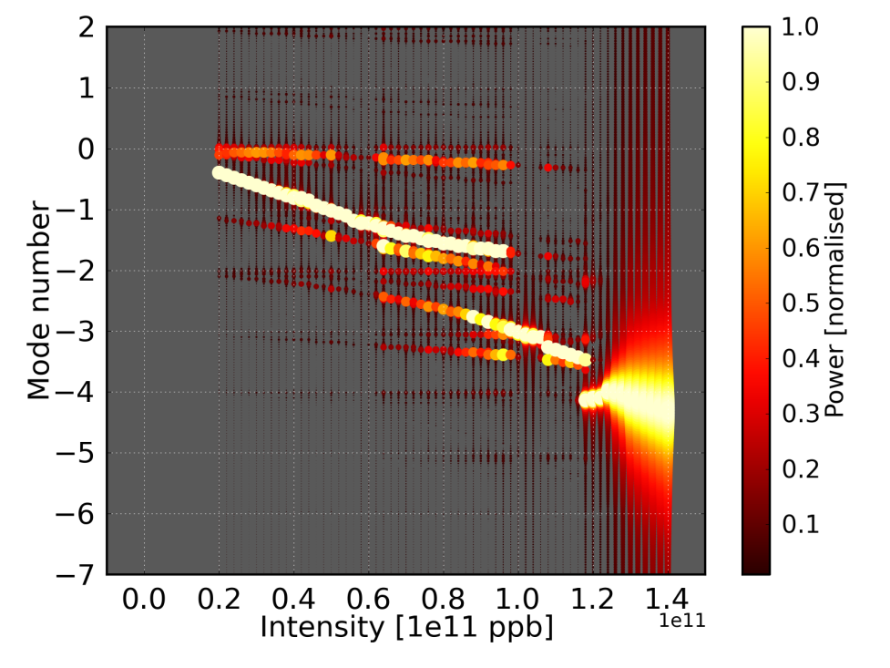
SPS High Bandwidth Damper Project
Feedback Project addresses limitation in the SPS in intensity due to E-Cloud Instability (ECI) and Transverse Mode Coupling Instability (TMCI)
Recent Simulations with Head Tail Code confirm feasibility
SPS is test bed for deployment of such a system in other accelerators (e.g. LHC)
Mode Spectra without feedback
ECI (limitation at 25 ns spacing)
TMCI (single bunch intensity limitation)
CERN SPS
Courtesy: K. Li, CERN

Slide 40
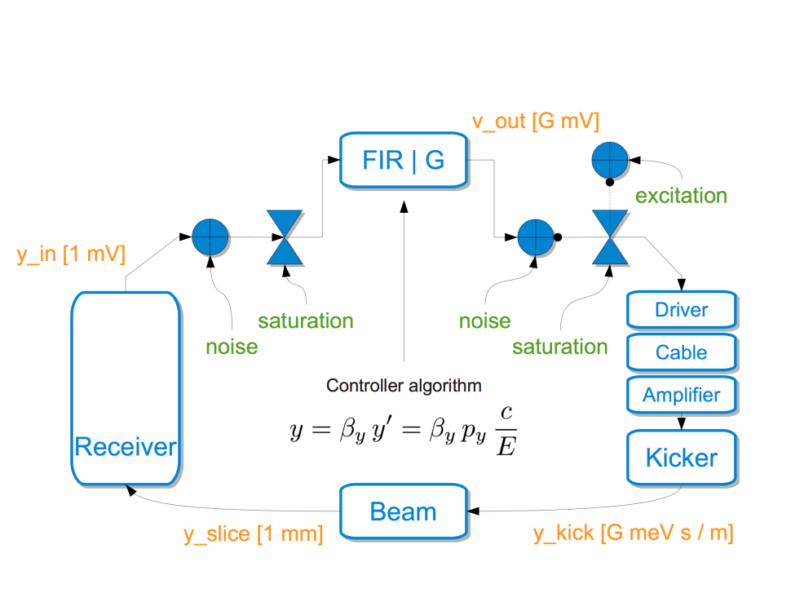
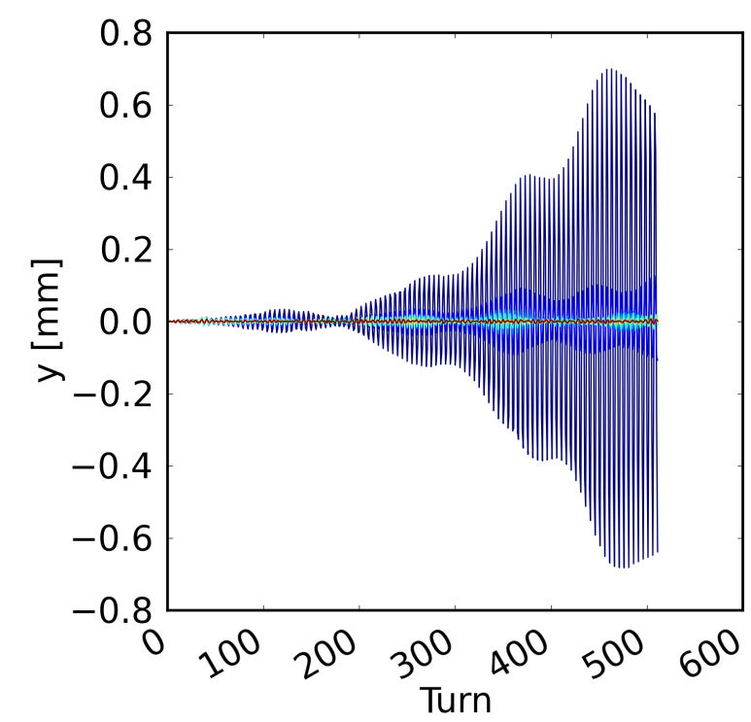
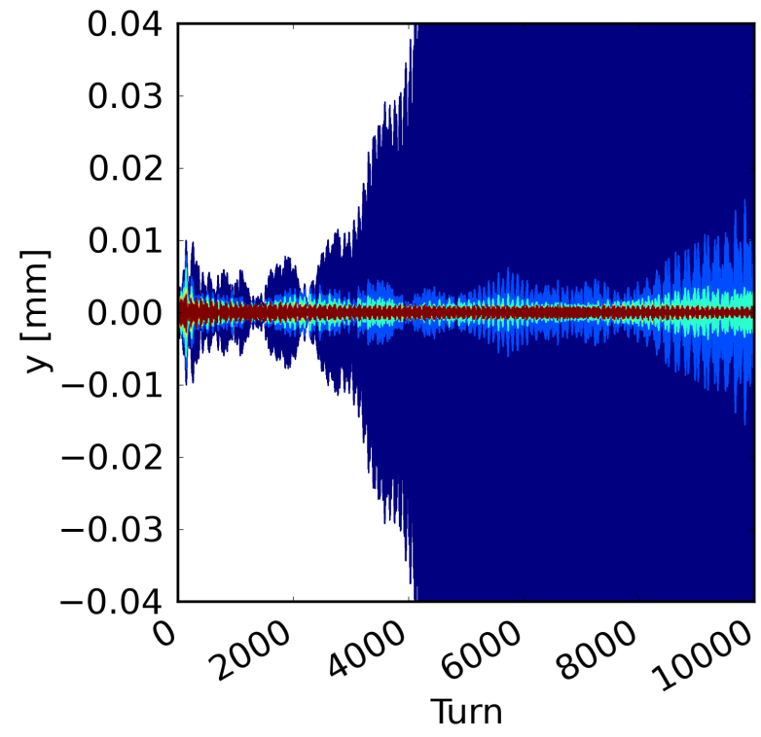
Simulations with Feedback
K. Li et al., WEPME042
Bandwidth need at SPS injection 450 GeV/c
from simulation (2.7 ns bunch length)
ECI: 500 MHz
TMCI: 200 MHz
CERN Headtail Code
ECI
TMCI
increasing FB gain
increasing FB gain
CERN SPS

Slide 41
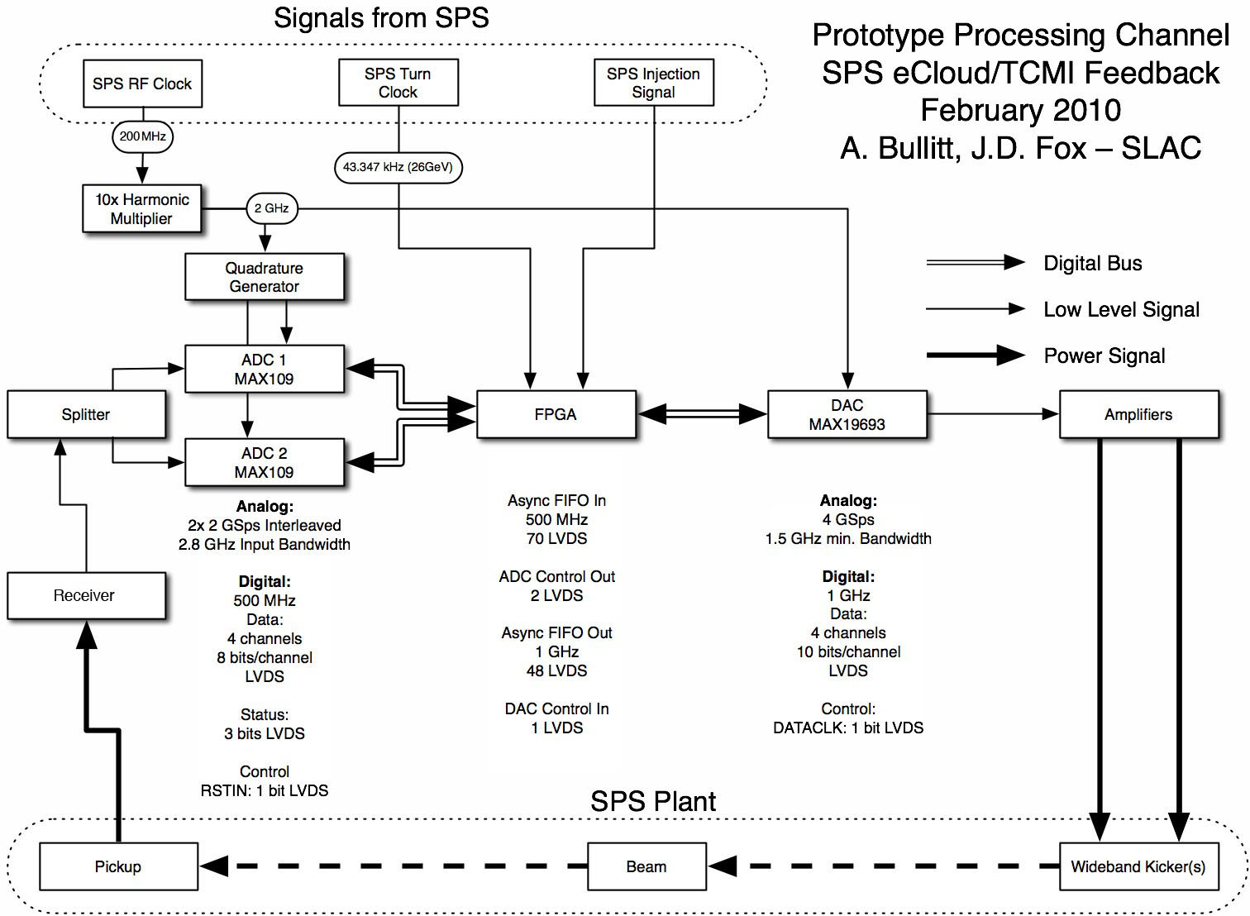
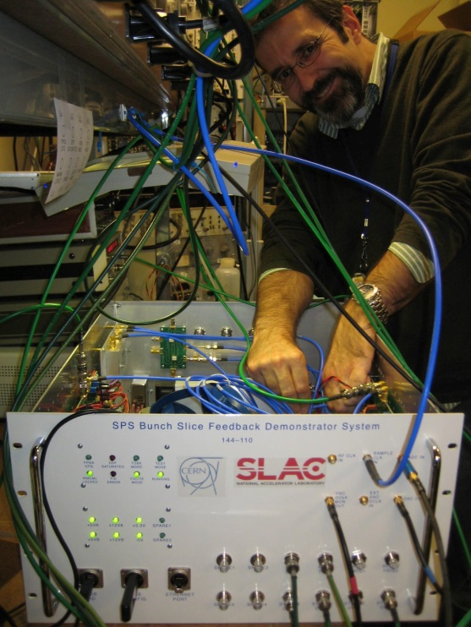
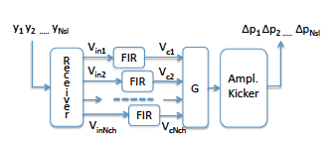
Hardware Development for the SPS feedback
4 GS/s sampling rate
16 5-tap FIR for single bunch control
J. Dusatko et al. (SLAC)
WEPME061, IPAC 2013
CERN SPS

Slide 42
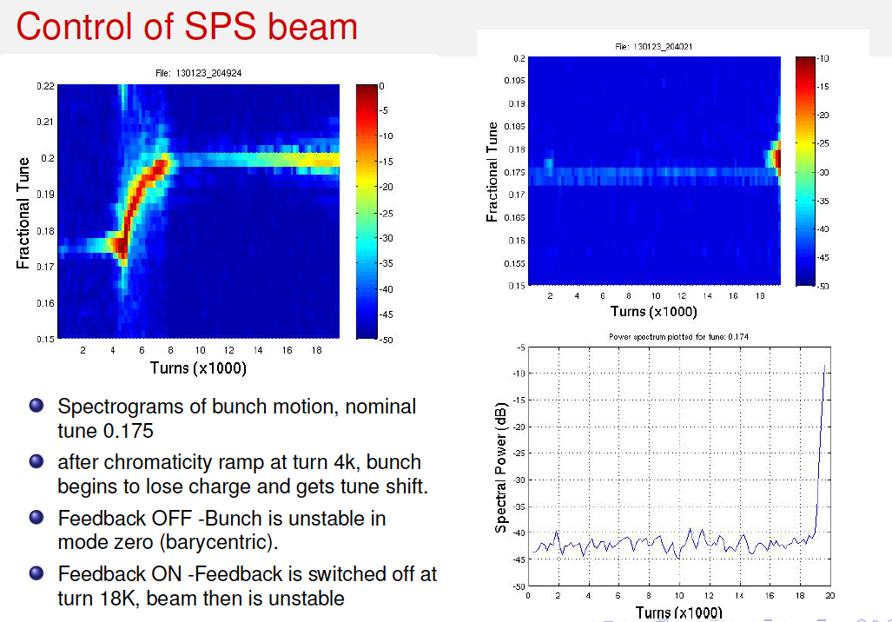
Single Bunch instability control with SPS HBTFB
FB switched off
no feedback
feedback
chromaticity
chromaticity
J. D. Fox et al. (SLAC)
WEPME060, IPAC 2013
CERN SPS

Slide 43
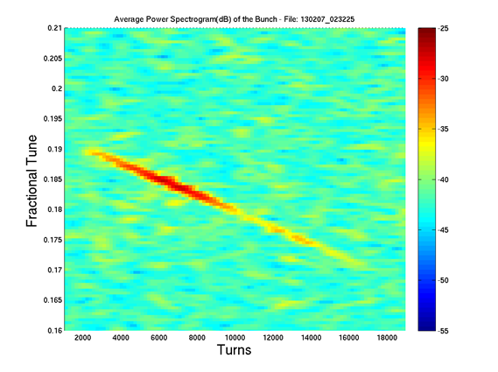
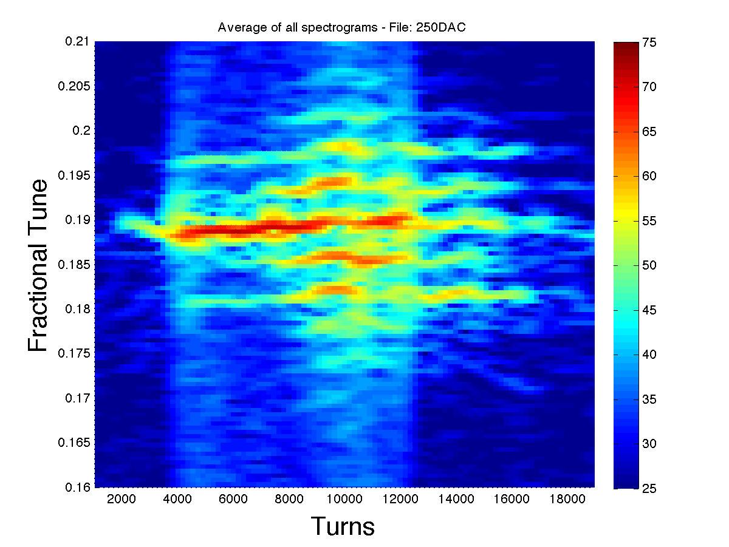
Beam Response in Closed Loop
gain = +64
gain = +16
Feedback “gain”
-16
-16
-16
-16
Frequency
Sweep
0.19 – 0.17
Frequency
Sweep
0.19 – 0.17
Turns
Turns
Note the different response of the beam for different positive feedback gains.
Many modes get excited with higher gain in positive feedback.
2012-2013 experimental results:
J. D. Fox et al. (SLAC), IPAC 2013
CERN SPS

Slide 44



Kicker Design for SPS Feedback
Need for high Bandwidth requires new kicker for the SPS:
Inspired by Stochastic Cooling
Systems → Faltin type kicker
considered (strip-line with
slotted shield to beam pipe)
L. Faltin, Nucl. Instrum. Methods 148 (1978) pp. 449.
J. Cesaratto et al. (SLAC)
WEPME061, IPAC 2013
CERN SPS

